Slide 1
期末论文答辩 THISIS ORAL DEFENSE
汇报人：韩昊辰

Slide 2
Parents should Avoid Excessive Intervention when Children are Playing
TOPIC

Slide 3
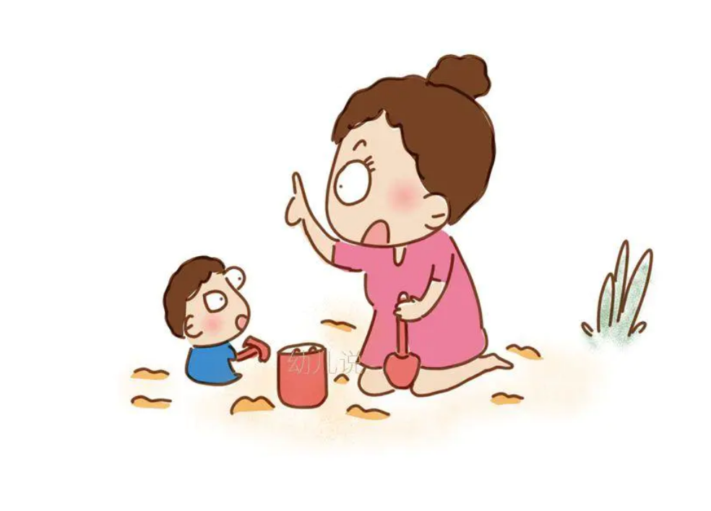
Background
Excessive Intervetion:
Reminding too frequently
Teaching too many
Regulating strictly on way of playing
Aim:
Analyze the draw back
Draw parents’ attention

Slide 4
Structure
Thesis Statement:
Excessive interventions bring about many drawbacks ranging from making children more fragile to frustration to limiting independent exploration as well as lowering the effect of learning in games.
Topic Sentences:
(1) As one of the main excessive interventions of parents, constantly reminding the children of risks and even cutting them off from injury and dangers makes children weaker, because children neither get the experience of fall nor have enough courage faced with frustration.
(2) Another kind of excessive intervention children encounter is being taught everything in playing, for lack of experience in life, by their parents. But it only results in limitation of independent exploration.
(3) Respecting children’s own way of playing and offering encouragement will spark significant learning.

Slide 5
Supporting Paragraph 1
Parents
constantly remind the children of risks and even cut them off from injury and dangers
A
1. cut off from risks——> no adaption to difficulties——>children be weaker to greater rain in future
2. remind too much——> spawn fear of risks (risks are everywhere)——> children have less courage to face the challenge
B
Drawbacks
Advise
stop over protection
C

Slide 6
Supporting Paragraph 2
Parents
teach everything in children’s playing
A
children will do less to explore other aspects of the item being taught——> children become less initiative and innovative when they become an adult
B
Drawbacks
Advise
leave more problems for children to solve by themselves.
C

Slide 7
Supporting Paragraph 3 (counter argument)
“if they don’t intervene, children will play in a single, repetitive and meaningless way”
Parents
A
1. any way of playing involves so many challenges and problems waiting for children to find, analyse and solve——> no meaningless way exists
2.children’s freedom to choose matters——> It inspires curiosity and passion for learning
B
Analyze
Advise
respect children’s own way of playing and offer enough encouragement
C

Slide 8
Excessive intervention makes children more fragile to frustration, limits their independent exploration and lowers their effect of learning in games
Ending
Dear parents, let’s avoid excessive intervention and allow children to fully enjoy the playing and then enjoy a happy life!

Slide 9
Thanks for listening!

