Slide 1





Data Cleaning
The essential steps before every possible analysis
Combining & Rearranging
Some of our data has the text separated into different columns. We have to combine and rearrange before anything else.
Selecting & Renaming
Not all of the columns of data are useful to our analysis. We have to select and rename them.
Correcting Spellings
Acronyms and misspellings are common in our text (which comes from teenagers). By building a dictionary for it, we can correct the spelling.
Stemming, Stopwords, etc.
After correcting spelling, we can do the old-fashioned data pre-processing skills to our data.

Slide 2
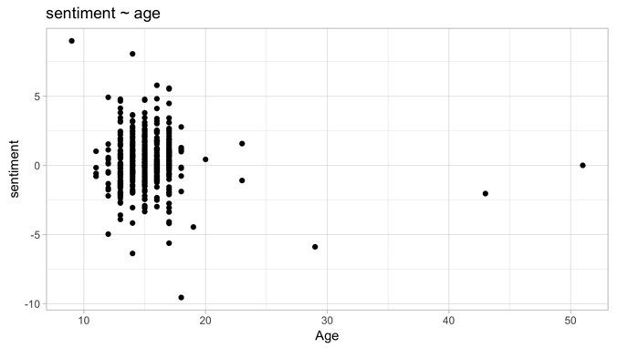
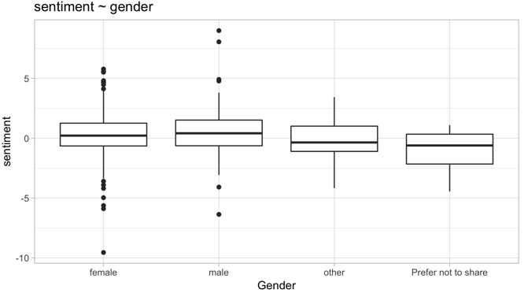
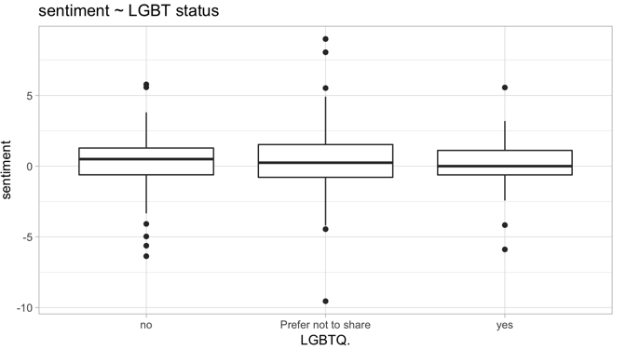
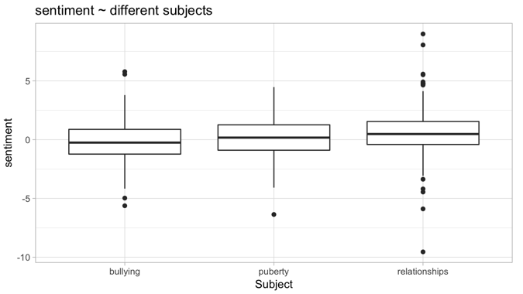
Basic Demographic Information
Average sentiment score on Age, Gender, LGBTQ status and Subjects

Slide 3
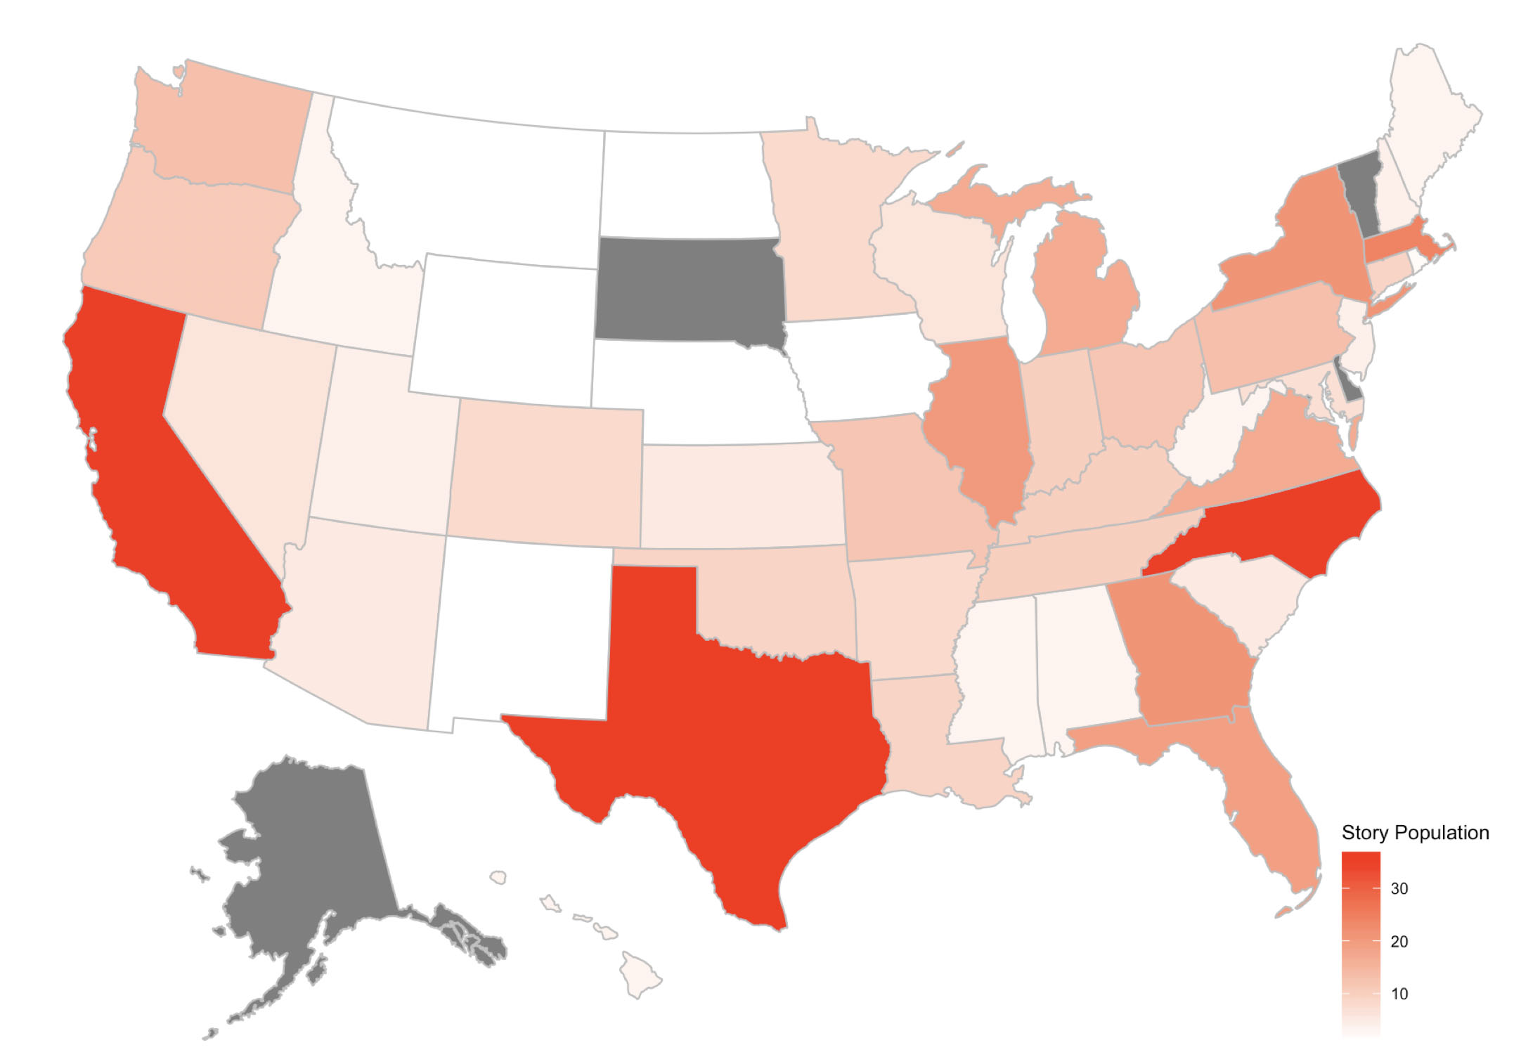
20.6%
Midwest
18.6%
West
16.9%
Northeast
11.1%
Southwest
32.8%
Southeast
Map on Sample Population
Basic view of sample
population on states.

