Slide 1
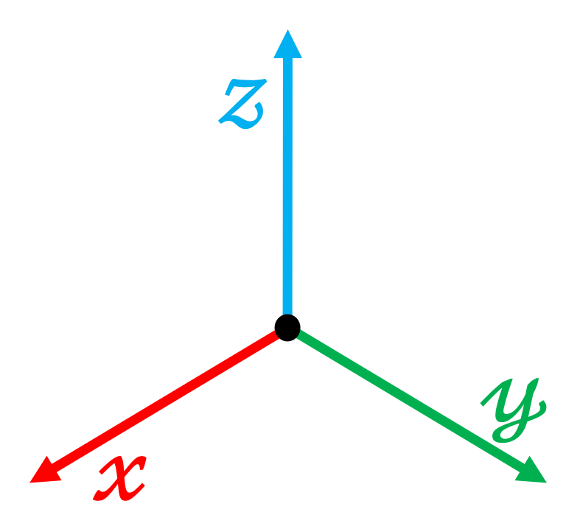
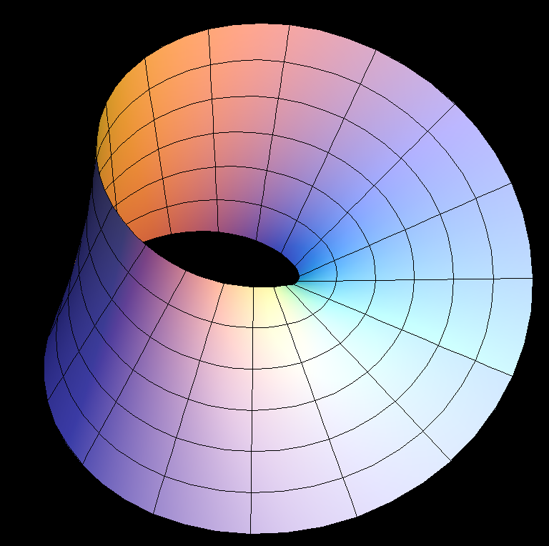
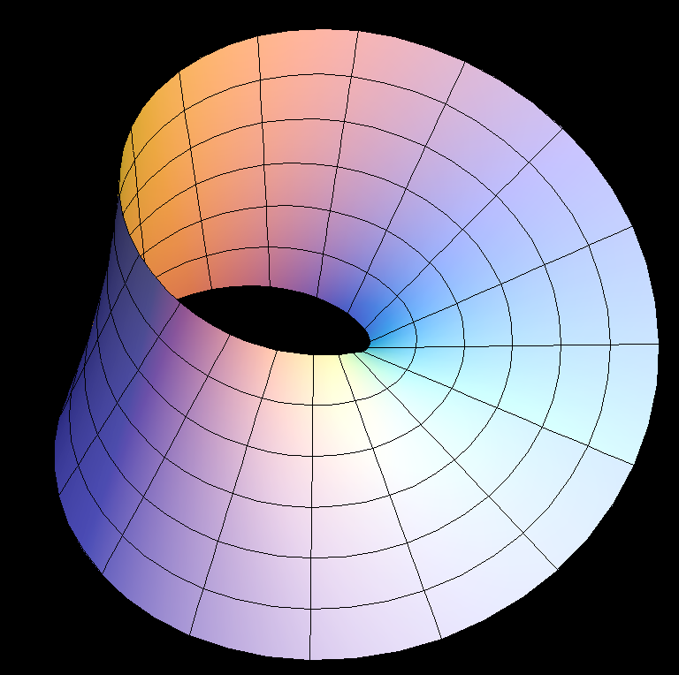
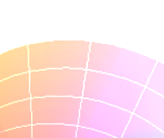
Character
Animation
Geometric
Computing
3D Content
Generation
Human Behavior
Analysis
Motion
Topology
Character
Animation
Geometry
3D content
Generation
Human Behavior
Analysis

