Slide 1
Robotic Navigation and Exploration
HW3-1: Path Tracking
Name：顏維廷
Student id：M11452023

Slide 2
Policy Network Architecture
The input state goes through two layers (64 units each) to produce the output.
The model outputs a probability distribution and samples an action from it.
self.main = nn.Sequential(
nn.Linear(s_dim, 64),
nn.ReLU(),
nn.Linear(64, 64),
nn.ReLU()
)
self.dist = DiagGaussian(64, a_dim, std)

Slide 3
Value Network
The input state goes through two layers (64 units each), and outputs a single value.
This value represents how good the current state is
self.main = nn.Sequential(
nn.Linear(s_dim, 64),
nn.ReLU(),
nn.Linear(64, 64),
nn.ReLU())

Slide 4
Data Collection
At each step, the model selects an action based on the current state and estimates its value.
Stores the state, action, probability, and value, and interacts with the environment to get the next state and reward
for step in range(self.n_step):
state_tensor = torch.from_numpy(self.states).float().to(self.device)
with torch.no_grad():
actions, a_logps = policy_net.forward(state_tensor, deterministic=False)
values = value_net.forward(state_tensor)
self.mb_states[step, :] = self.states.copy()
self.mb_dones[step, :] = self.dones.copy()
self.mb_actions[step, :] = actions.cpu().numpy()
self.mb_a_logps[step, :] = a_logps.cpu().numpy()
self.mb_values[step, :] = values.cpu().numpy().squeeze()
self.states, rewards, self.dones, info = self.env.step(self.mb_actions[step])
self.mb_rewards[step, :] = rewards

Slide 5
Policy Loss
The model compares the new action probability with the old one and computes a ratio.
To prevent large updates, clip this ratio within a certain range, and take the minimum value to compute the loss
ratio = torch.exp(sample_a_logps - sample_old_a_logps)
surr1 = ratio * sample_advs
surr2 = torch.clamp(ratio, 1.0 - self.clip_val, 1.0 + self.clip_val) * sample_advs
pg_loss = -torch.min(surr1, surr2).mean()

Slide 6
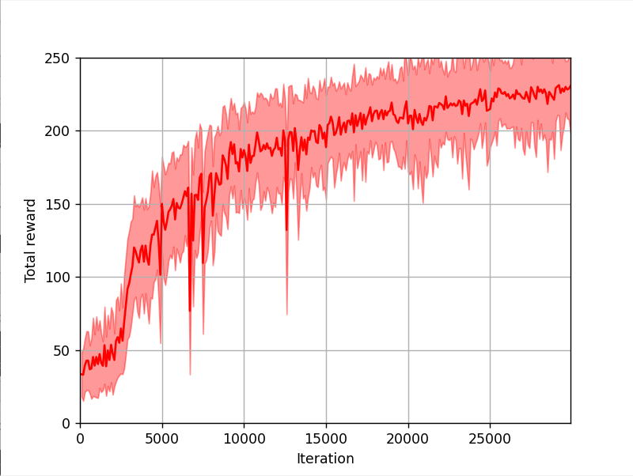
Training Plot

