Slide 1

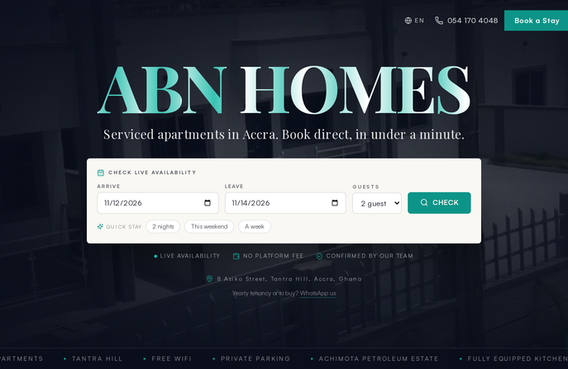

PRODUCT WALKTHROUGH
ABN Homes
How the platform works — from first visit to owner payout
abnhomes.vercel.app · live production · November 2026
Guest journey
Staff console
Owner & tenant portals
Notes:
• ABN Homes is live in production at abnhomes.vercel.app — this walkthrough covers the real system, not mockups.
• Three surfaces to cover: the guest journey, the staff console, and the owner and tenant portals.
• Narrative frame: follow one booking from first visit to owner payout.
• Palette and type mirror the product's own brand: navy, cream, teal, serif display headings.

Slide 2
ONE PLATFORM
Four audiences, one source of truth
ABN Homes runs short-stay apartments and long-let leases in Accra. The platform replaces spreadsheets and WhatsApp threads: inventory, bookings, money, operations and reporting live in one accountable system with a double-entry ledger the database itself protects.
▣
Guests
⛨
Staff
browse, book, pay, check in
22-page console for daily operations
◫
Owners
⌂
Tenants
statements, expenses, payouts
lease, rent account, requests
42
22
15
37
database tables
admin pages
screenshots flows verified
tests passing
Notes:
• One platform replaces spreadsheets and WhatsApp threads for a short-stay and long-let business in Accra.
• Four audiences share one database: guests, staff, owners, tenants — each with a scoped view.
• The money story is a double-entry ledger enforced by the database itself.
• Scale markers: 42 tables, 22 admin pages, 15 verified screenshot flows, 37 tests passing.

Slide 3
01 / 03
SECTION
The Guest Experience
Marketing site, marketplace, booking, payment — the public-facing loop, all server-validated.
01
Notes:
• Section break: we enter the guest-facing loop, section one of three.
• Four surfaces ahead: marketing site, marketplace, booking engine, payments.
• Key theme to repeat: everything is server-validated — the client is never trusted.

Slide 4
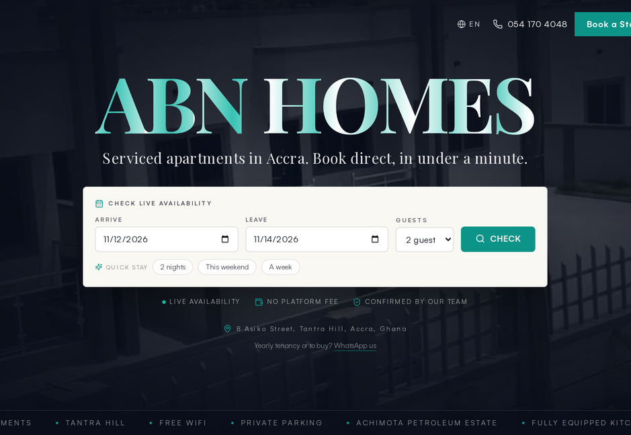
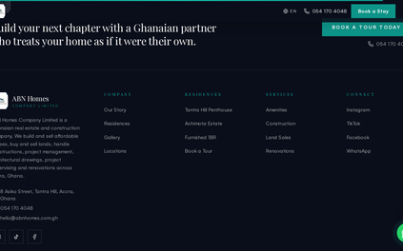
GUEST EXPERIENCE
The brochure is the booking funnel
Every page is server-rendered with per-page metadata, sitemap and robots — the site reads live inventory, so a unit published in the console appears immediately.
Bilingual-ready: English first with an i18n scaffold; amenities, locations, gallery, mortgage calculator and contact channels included.
Same design language as this deck: warm cream, deep navy, teal accents.
Live homepage and current-homes grid
Notes:
• Fully server-rendered: per-page metadata, sitemap and robots on every route.
• The site reads live inventory — a unit published in the console appears immediately.
• i18n scaffold in place, English first; amenities, gallery, mortgage calculator and contact channels included.
• The product's design language is deliberately the same as this deck: cream, navy, teal.

Slide 5

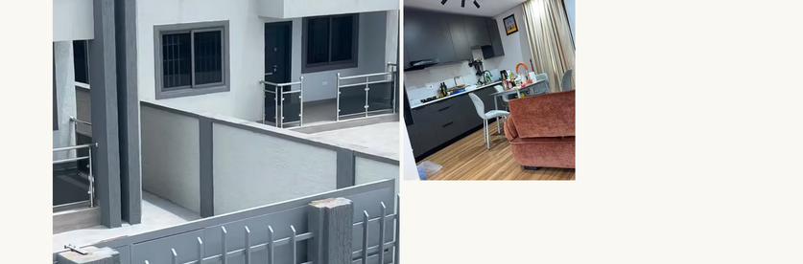
GUEST EXPERIENCE
Marketplace: honest listings, live quotes
⇄
Live pricing — nightly quotes from active rate plans, never stale
⌕
Search — dates, guests, bedrooms, amenities, price
Residences grid with filters
★
Reviews — moderated, with per-category sub-scores
♥
Wishlist — saved stays for signed-in users
⌘
Resilient URLs — slugs backfilled and lookup hardened (fixed 11 Nov)
Stay page: gallery, quote, availability, reviews
Notes:
• Nightly quotes come from active rate plans — the price a guest sees is never stale.
• Search covers dates, guests, bedrooms, amenities and price.
• Reviews are moderated and carry per-category sub-scores; signed-in users can save wishlists.
• Resilience fix: slugs backfilled and lookup hardened, shipped 11 Nov.

Slide 6
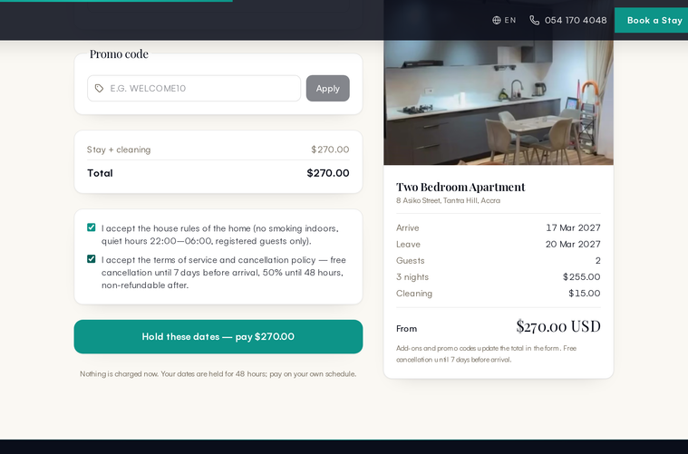
GUEST EXPERIENCE
Booking: the only public write, the most guarded
Nothing the browser sends is trusted — price is recomputed, availability re-checked, the unit must be published.
◔
48h hold
▦
Exclusion constraint
dates reserved, booking code issued
double bookings impossible at the database
✓
In-transaction validation
✦
Portal code
coupons and add-ons cannot double-apply
guest gets a trip page without an account
Ninety-second request form with all-inclusive quote
Notes:
• Booking is the only public write in the whole system — and the most guarded.
• Server-side: price recomputed, availability re-checked, unit must be published.
• A request becomes a 48h hold with a booking code; a Postgres exclusion constraint makes double bookings impossible.
• Coupons and add-ons are validated inside the transaction so they cannot double-apply.
• A portal code gives the guest a trip page without creating an account.

Slide 7
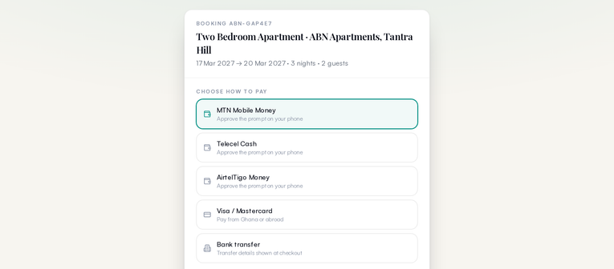
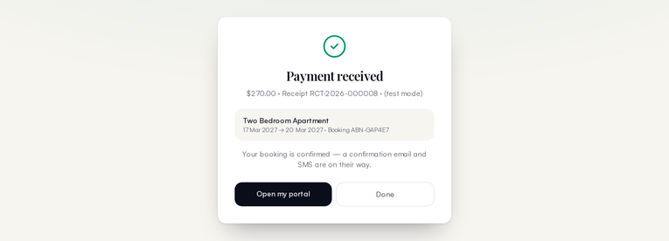
GUEST EXPERIENCE
Payments: one code path, two rails
A gateway abstraction hides Paystack behind an interface. Today the simulation rail runs — same ledger writes, same receipts — so go-live is an env-var change, not a code change.
CHANNELS
Checkout: channel, amount, promo code
MTN MoMo
Telecel Cash
AirtelTigo
Visa / Mastercard
Bank transfer
⛨
Webhook signature-verified — unsigned calls get 401
▤
Refunds post reversing entries, payment marked REVERSED
Settled: booking auto-confirmed
Notes:
• One code path, two rails: a gateway abstraction hides Paystack behind an interface.
• The simulation rail runs today — same ledger writes, same receipts — so go-live is an env-var change, not a code change.
• Five channels: MTN MoMo, Telecel Cash, AirtelTigo, Visa / Mastercard, bank transfer.
• Webhooks are signature-verified; unsigned calls get a 401.
• Refunds post reversing entries and the payment is marked REVERSED.

Slide 8
THE WHOLE LOOP
One booking, end to end
1
Discover
2
Hold
3
Pay
marketplace and stay pages with live quotes
48h reservation, booking code, outbox messages queued
simulated MoMo checkout settles into the ledger
4
Confirm
5
Stay
6
Review
auto-confirmed, receipts + staff alerts fire
trip page with access notes, Wi-Fi, house rules
moderated review lands back on the listing
✓
Verified on production 11 Nov: 13/13 assertions passed, including refund reversal.
Notes:
- Walk the six stages in order: discover, hold, pay, confirm, stay, review.
- Stress the 48-hour hold with a booking code issued before any money moves.
- Payment settles directly into the ledger; confirmation, receipts and staff alerts fire automatically.
- The stay stage is the guest trip page: access notes, Wi-Fi and house rules, no account needed.
- Close on the proof point: production verification on 11 Nov, 13/13 assertions including refund reversal.

Slide 9
CHAPTER 02 / 03
Running the Business
02
The admin console, the ledger, operations, communications and the portals staff and stakeholders live in.
Notes:
- Transition: we leave the public guest loop and go behind the login.
- Preview the section: admin console, double-entry ledger, daily operations, messaging, portals.
- Frame it as the system staff and stakeholders actually live in every day.

Slide 10
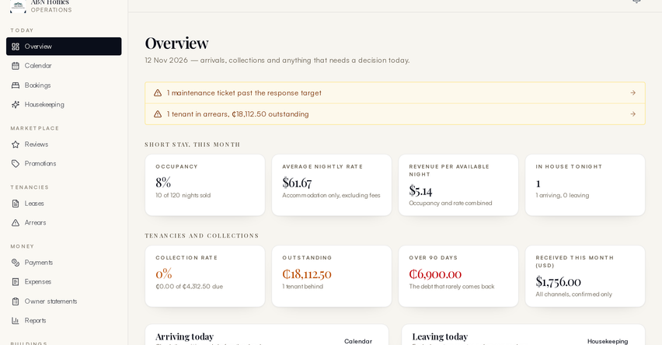
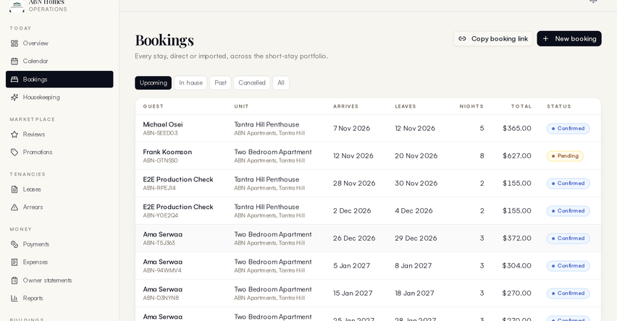
RUNNING THE BUSINESS
22 pages of operations, one login
Same console, different powers — the role decides the menu.
▦
22 pages
♟
6 roles from SUPER_ADMIN to VENDOR
✓
Every write audited
⛨
Role-gated middleware
Operational snapshot with alerts
Bookings with balances and status
A housekeeper signs in to housekeeping powers only; finance sees money; SUPER_ADMIN sees all — including user suspension and the audit trail.
Notes:
- One console, 22 pages — everything operational lives behind a single login.
- Six roles from SUPER_ADMIN down to VENDOR; middleware gates every route, every write is audited.
- Dashboard shows the live operational snapshot; bookings page shows balances and status at a glance.
- Use the housekeeper example: scoped powers, not shared passwords.

Slide 11
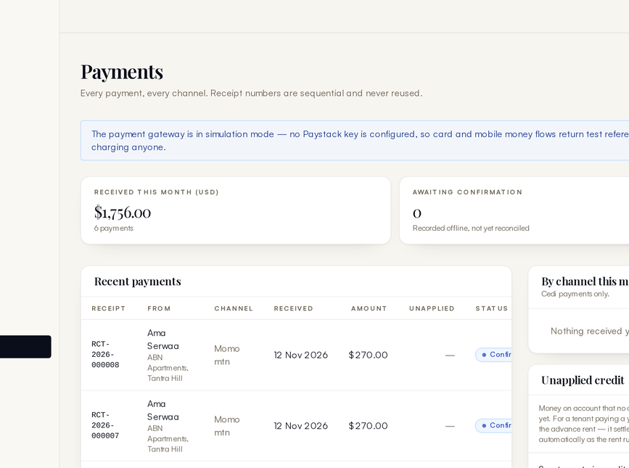
RUNNING THE BUSINESS
Every cedi moves through a double-entry ledger
A payment is a balanced ledger pair allocated across charges — not a status flag. Statements are queries, not reconstructions.
⚿
Append-only — ledger edits are blocked by database triggers
↶
Reversals — refunds post reversing entries, never edits
⇅
Allocations — payments settle charges oldest-first
▤
Statements & payouts — owner balances always live
Ledger, payments, expenses and payouts
Notes:
- Core idea: a payment is a balanced ledger pair allocated across charges, not a status flag.
- Statements are queries over live data, never rebuilt after the fact.
- The database itself enforces integrity: append-only triggers, refunds as reversing entries.
- Allocations settle charges oldest-first; owner statements and payouts always reflect live balances.

Slide 12
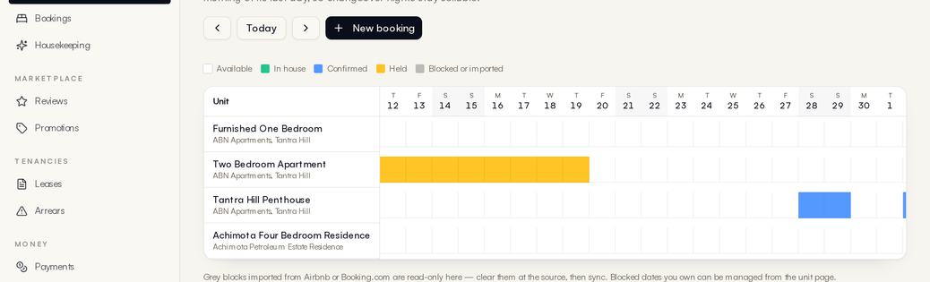
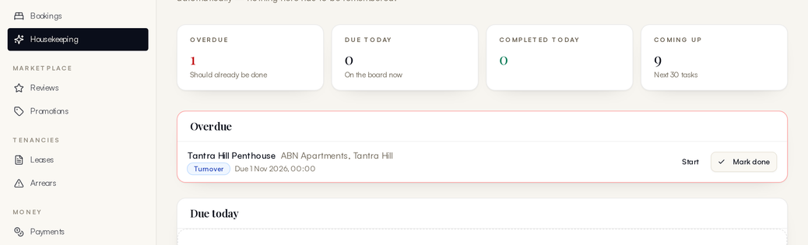
RUNNING THE BUSINESS
Turnover, maintenance, assets — the daily grind, systematised
From check-out to owner statement, nothing lives in a notebook.
✓
Check-out creates the turnover task automatically
◔
Preventive schedules — generators, AC servicing, pest control
Occupancy calendar
⚒
Asset registry ties equipment to units with service history
$
Costs captured as expenses flow into owner statements
Housekeeping board
Notes:
- Check-out is the trigger: the turnover task is created automatically, nothing is phoned in.
- Preventive schedules cover generators, AC servicing and pest control on a calendar.
- The asset registry links each piece of equipment to its unit with full service history.
- Maintenance costs are captured as expenses and flow straight into owner statements.
- Point at the two screenshots: the occupancy calendar and the housekeeping board in daily use.

Slide 13
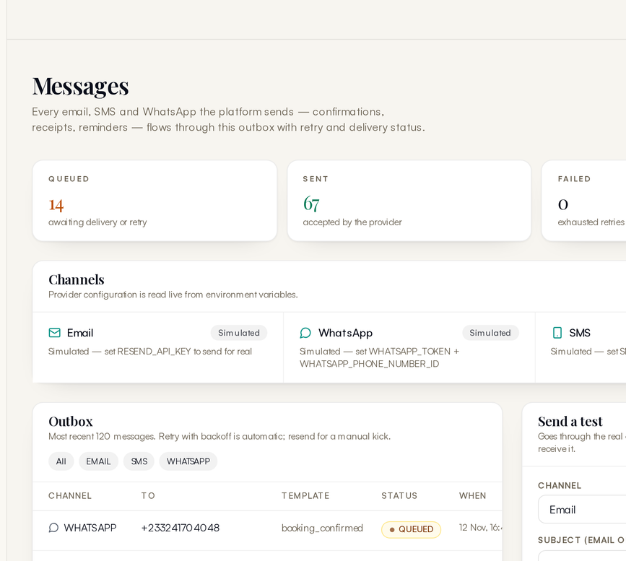
RUNNING THE BUSINESS
An outbox, not a prayer
Every outbound message is queued in the database with channel, status and attempt counter; a cron sweeper drains it. No provider configured yet? Simulation mode records full content and marks sent — the communication design is testable before any sender account exists.
✉
Email
◌
SMS
◌
WhatsApp
◔
Staff bell — in-app notifications with unread counts for booking requests, payments, task assignments, linked to records.
Message log with per-channel status
Notes:
- Every outbound message is queued in the database with channel, status and attempt counter.
- A cron sweeper drains the queue with retries — delivery is observable, not assumed.
- Simulation mode records full content and marks sent, so the design is testable before any sender account exists.
- Three channels planned: email, SMS, WhatsApp.
- The staff bell adds in-app notifications with unread counts, each linked to its record.

Slide 14
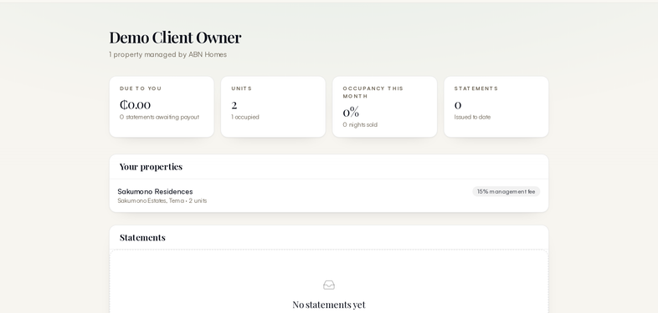
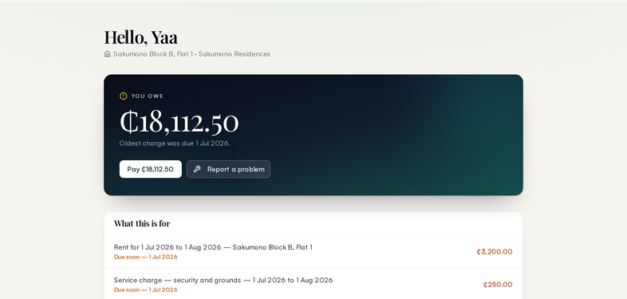
RUNNING THE BUSINESS
Owners and tenants serve themselves
Two self-service views over the same ledger — statements and requests without a middleman.
Owner portal: performance, statements, payouts
Tenant portal: lease, rent account, requests
✓
Occupancy and revenue per property
✓
Lease and rent account with arrears position
✓
Expenses charged against their units
✓
Maintenance request desk with replies
✓
Payout batches with approval states
✓
Payment history and documents
●
Same phone-OTP identity as guests — one system, role-scoped views.
Notes:
- Two self-service portals over the same ledger — no emailed spreadsheets.
- Owners see occupancy and revenue per property, expenses against their units, and payout batches with approval states.
- Tenants see their lease and rent account with the arrears position, a maintenance request desk, and payment history with documents.
- Same phone-OTP identity as guests: one system, role-scoped views.

Slide 15

CHAPTER 03 / 03
Platform & Roadmap
What it is built on, what runs unattended, and what stands between the prototype and commercial launch.
03
01
02
03
The Guest Experience
Running the Business
Platform & Roadmap
Notes:
- Third and final section: after the guest loop and business operations, we look at the platform itself.
- Three beats ahead: architecture and security, the automation that runs unattended, and the launch roadmap.
- Framing line: the prototype is built and tested — this section covers what stands between it and commercial launch.
- Chapter 03 of 03; keep it brief and move to the architecture slide.

Slide 16
PLATFORM
Boring technology, strict guarantees
✦
▦
⎙
Next.js 16 + TypeScript
PostgreSQL 17 on Supabase + Prisma 6
NextAuth v5
one app for site, console and portals
staff password + phone OTP, role matrix
42-table schema, pooled
⛨
▶
◔
Database guards
Idempotency
20s transactions
exclusion constraint (no double bookings), append-only ledger triggers
double-submitted payments and bookings are harmless
TX_OPTS raised from 5s after a real production timeout (fixed 11 Nov)
Notes:
- Stack is deliberately boring: one Next.js 16 + TypeScript app serves site, console and portals.
- Data layer: PostgreSQL 17 on Supabase with Prisma 6 — a 42-table schema behind a connection pool.
- Auth is NextAuth v5: staff passwords plus phone OTP, enforced through a role matrix.
- The strict guarantees live in the database: an exclusion constraint makes double bookings impossible and triggers keep the ledger append-only.
- Idempotency makes double-submitted payments harmless; the transaction timeout went from 5s to 20s after a real production timeout, fixed 11 Nov.

Slide 17
PLATFORM
Five jobs run the business overnight
Job | Schedule | What it does
❄ Sweeper | daily + 15-min | expires unpaid holds, drains the outbox
➤ Outbox drain | with sweeper | sends SMS, email, WhatsApp with retries
▤ Rent run | daily 06:00 UTC | invoices every active long-let lease
▦ iCal sync | daily 06:17 UTC | pulls OTA calendars, blocks booked dates
↻ Keep-alive | every 6h | stops Supabase free tier pausing
⚿
Cron routes are bearer-secret guarded — verified 401 on unauthenticated calls.
Notes:
- Five cron jobs do the overnight work — no human has to remember any of it.
- Sweeper expires unpaid holds every 15 minutes and drains the outbox; the drain sends SMS, email and WhatsApp with retries.
- Rent run invoices every active long-let lease at 06:00 UTC; iCal sync pulls OTA calendars 17 minutes later and blocks booked dates.
- Keep-alive exists purely to stop the Supabase free tier from pausing.
- Security: all cron routes are bearer-secret guarded — unauthenticated calls verified to get 401.

Slide 18
ROADMAP
Four switches to launch, then growth
⚡
Go-live switches (env vars, no code)
↗
Then, in order of value
1
Paystack live keys
— real MoMo and card settlement
→
WhatsApp Business API
for trip updates
2
SMS sender (Arkesel/Hubtel)
— real OTPs and guest messages
→
Outbound iCal
to Airbnb / Booking.com
3
Email sender
— receipts and confirmations
→
Referral rewards activation
4
Credential hygiene
→
Photo uploads on tasks
; trend dashboards; image pipeline
— rotate DB password, change seeded staff password, sync CRON_SECRET
Notes:
- Launch needs four environment-variable switches, not code changes: Paystack live keys, an SMS sender (Arkesel/Hubtel), an email sender, and credential hygiene.
- Credential hygiene detail: rotate the DB password, change the seeded staff password, sync CRON_SECRET.
- After launch, growth in order of value: WhatsApp Business API for trip updates, then outbound iCal to Airbnb / Booking.com.
- Then referral rewards activation, and finally photo uploads on tasks, trend dashboards and the image pipeline.

Slide 19


Built. Tested. Live.
✓
Full platform verification passed 11 Nov 2026 — every page, every flow
✓
Production E2E: hold, payment, confirmation, notifications, refund — 13/13
✓
Companion deliverables: build documentation (docx), this deck, narrated demo video
abnhomes.vercel.app · ABN Homes — Accra, Ghana
Notes:
- Close on evidence, not promises: full platform verification passed on 11 Nov 2026 — every page, every flow.
- Production E2E covered the whole loop — hold, payment, confirmation, notifications, refund — 13 of 13 assertions passed.
- Companion deliverables: build documentation (docx), this deck, and a narrated demo video.
- End on the live URL: abnhomes.vercel.app — ABN Homes, Accra, Ghana.

