Slide 1
Digital Design & Computer Arch. Lab 6 Supplement:
Testing the ALU
Prof. Onur Mutlu
ETH Zurich
Spring 2024
8 April 2024

Slide 2
What Will We Learn?
In Lab 6, you learn how to:
Verify the functionality of your designs using testbenches.
Find and resolve bugs in your design.
You will:
Write a testbench that verifies the correctness of your ALU from Lab 5.
Use the same testbench to find and fix bugs in a buggy ALU that we provide.

Slide 3
Preparation
You are expected to finish Lab 5 before continuing, because we will be testing the ALU from Lab 5.
Download the material for Lab 6, which includes:
A template testbench file;
A template for the test-vectors;
A Verilog description of an ALU, which contains some bugs.

Slide 4
Part 1: Expected Results
Before writing our testbench, we need to prepare a set of inputs for which the expected results are known.
You will be given a set of inputs for the ALU you designed in Lab 5.
Determine the correct result for each set. Then, specify them in the file testvectors_hex.txt that we provide.
For output ‘zero’: directly set its expected value within the testbench

Slide 5
Part 2: Preparing the Testbench
Create a project with your ALU from Lab 5 and the testbench template we provided you with.
Make the necessary modifications to the testbench.
After this, you will have a testbench that will
Apply the vectors in the testvectors_hex.txt file;
Check the actual outputs of our ALU against what we expect.

Slide 6
Part 2: Why use a Testbench?
In Lab 5 we have seen that exhaustive search is not a feasible option anymore.
Instead we test our ALU on a set of representative values using the testbench.
If the ALU can add 1 and 2 it can probably also add 1 and 3.
For each operation test if it works for some examples.

Slide 7
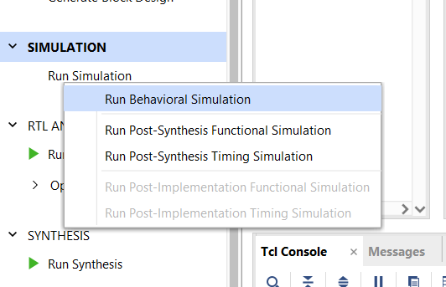
Part 3: Simulating the ALU
Run behavioral simulation using Vivado’s built-in simulator.

Slide 8
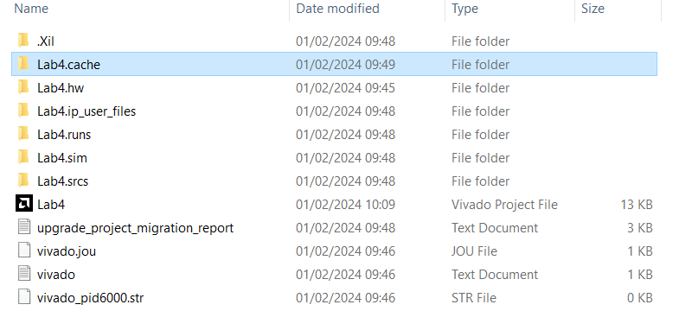
Part 3: Simulating the ALU: Caching
It can happen that Vivado fails to recognise file changes
It then uses cached (and outdated) information for the behavioral simulation.
This can be fixed by deleting all cached files and then doing the behavioral simulation again.
can be deleted
do not delete
can be deleted

Slide 9
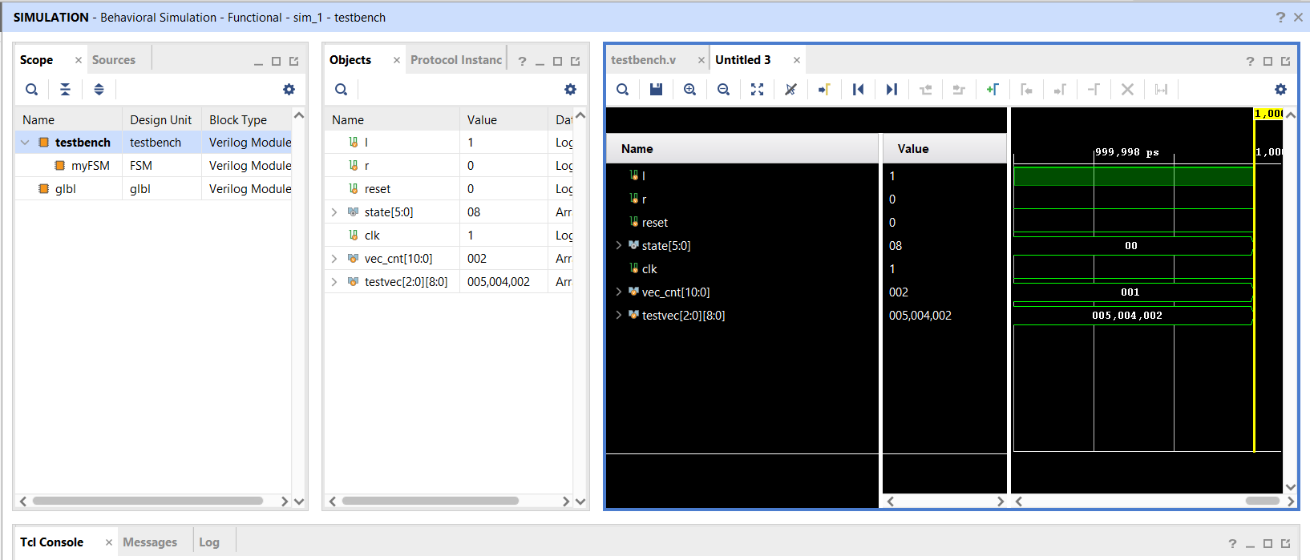
Part 4: Debugging the Problem
Using a simulator can help you locate the problems in your circuits.
You can not only observe the outputs but the state of all internal variables as well.

Slide 10
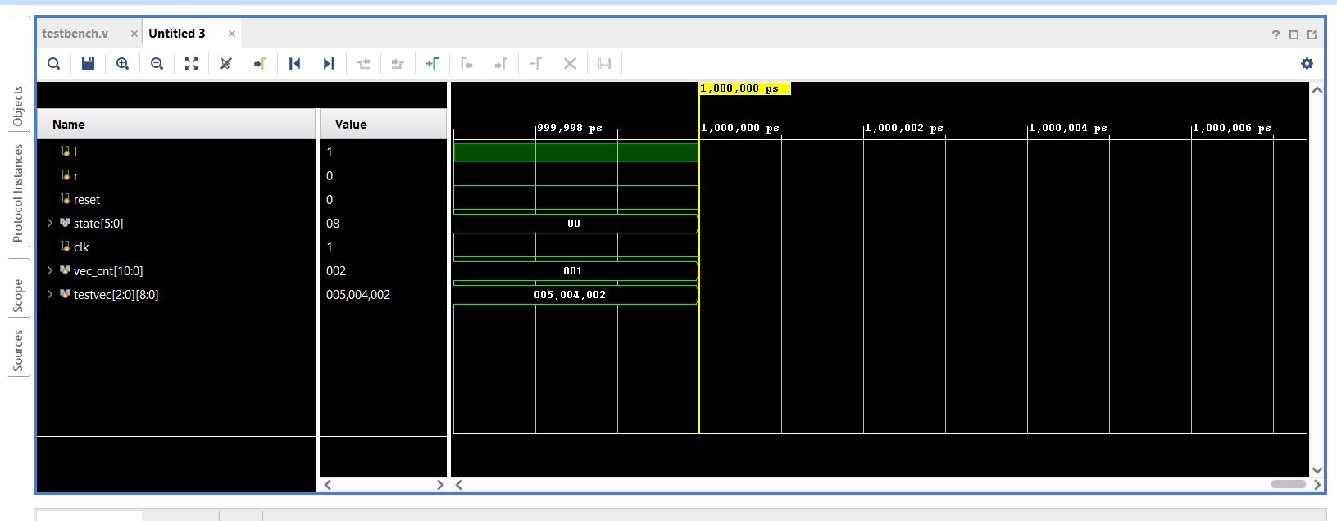
Part 4: Wave Diagrams Introduction
At first the wave diagrams are not very useful.
They are unformatted
Data is displayed in hexadecimal
Fit wave diagram to screen width

Slide 11
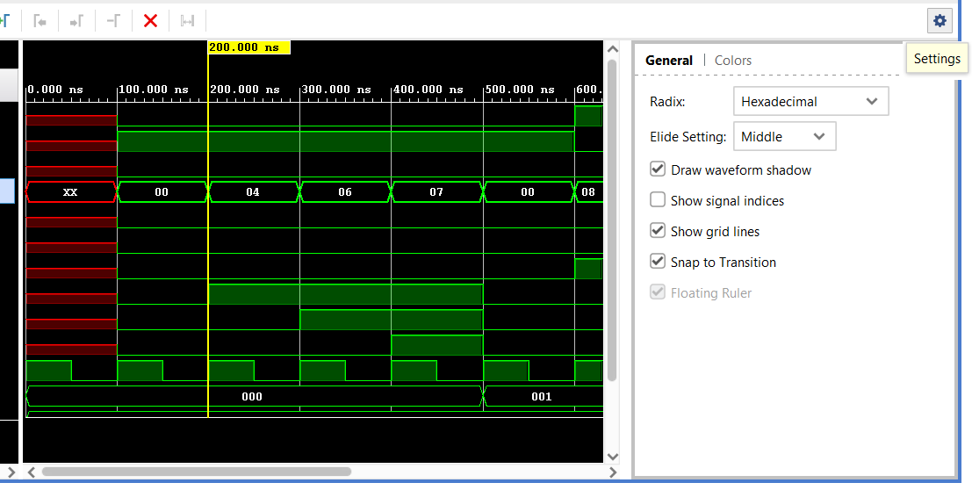
Part 4: Wave Diagrams Introduction
At first the wave diagrams are not very useful.
They are unformatted
Data is displayed in hexadecimal
Select decimal option

Slide 12
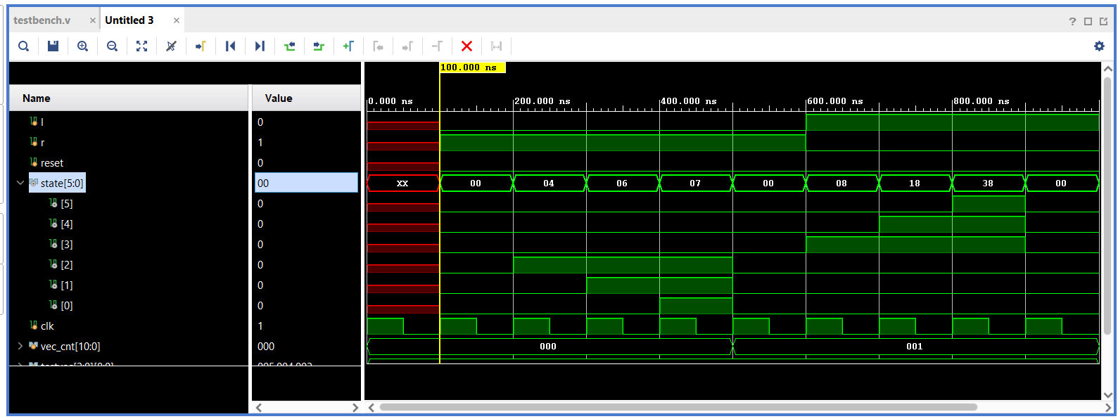
Part 4: Wave Diagrams Introduction
Selecting an Object in the wave diagram allows you to navigate the wave diagram using the < and > keys.
Allows you to jump between wave fronts.

Slide 13
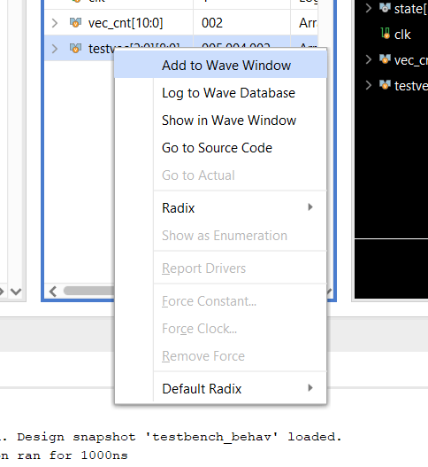
Part 4: Wave Diagrams Introduction
You can add other signals to the wave diagram.
This is useful for debugging the Unit-Under-Test (UUT).

Slide 14
Last Words
In Lab 6, you learn how to
write testbenches in Verilog to verify the functionality of the design.
Find and resolve bugs in your design
Write a testbench that verifies the correctness of your ALU from Lab 5.
Use the same testbench to find and solve bugs in a buggy ALU that we provide.
In the report, you will design a testbench for your FSM from Lab 4.

Slide 15
Report Deadline
[09 May 2025 23:59]

Slide 16
Digital Design & Computer Arch. Lab 6 Supplement:
Testing the ALU
Prof. Onur Mutlu
ETH Zurich
Spring 2024
8 April 2024

