Slide 1
Day 24
Game Time: Project Week
March 6th, 2017
Notes:
1

Slide 2
Project Week Overview
Notes:
2

Slide 3
Project Week! (This Week)
Today’s Class:
Organize by groups
Continue researching APIs
Refine project ideas
Submit Project Proposal
Initial Design work
Next Class:
Project Development
Instructor + TA Workshops
Saturday’s Class:
Project Development

Slide 4
Project Week (Next Week)
Next Week (Tuesday)
Interview Questions (Class Lecture)
Project Development
Next Week (Thursday)
Debug Work (Class Lecture)
Project Development
Presentation Prep
Saturday’s Class
Presentations!
Start Node.JS ☺

Slide 5
The Great Push
Be serious about project week!
Use this as an opportunity to push yourself and prove what you know.
Remember, this is a TEAM effort – you’ve got this!

Slide 6
Teams
Notes:
6

Slide 7
Groups (Project Manager Bold & Underlined)
Fridge Raiders
Paul
Josie
Andrew
Frank
Real Fake News
Melissa
Mark B.
Ahmed
Jeff
Kevin’s Excellent Adventure
Brendon
Christian
Kevin
Ben
Geo Contact Backup
Adam
Daniel
Sam
Phil
Sweet Tooth
Brian
Mark R.
Cale
Ashley
Martin
Riddle Me This
Blair
Jason
Taylor
Laura

Slide 8
Task

Slide 9
Coding Requirements
Use at least two APIs
Use AJAX to pull data
Use at least one new library or technology that we haven’t reviewed
Use a polished frontend / UI
Meet good quality coding standards (indentation, scoping, naming)
Do NOT use alerts, confirms, or prompts (look into modals!)
Use repeating element (table, columns, etc)
Use Bootstrap or Alternative CSS Framework
Be Deployed (Heroku or Firebase)
Have User Input Validation

Slide 10
Coding Requirements (Continued)
Utilize Firebase for Persistent Data Storage
Mobile Responsive
OPTIONAL
Use an alternative CSS framework like Materialize

Slide 11
Presentation Requirement
You will also be responsible for preparing a 10 - 15 minute presentation.
This will be a formal presentation.
One in which you explain in detail:
Your overall application’s concept
The motivation for its development
Your design process
The technologies you used (and briefly how they work)
A demonstration of its functionality
Directions for future development
Treat the presentation seriously!
Talking intelligently about tech is important

Slide 12
Be ready for the Camera
All presentations will be recorded…
So treat it seriously!
These can be great portfolio pieces if you invest the time.
HIGHLY Recommend having the `live view` of the project recorded and available should your computer quit, the Internet become unavailable, or your dog eat your hard drive.

Slide 13
Metrics

Slide 14
Metrics
Concept
Design
Functionality
Collaboration
Presentation

Slide 15
Awards Yay!
Most Awe-Inspiring
Most Useful
Most Creative
Best Use of Tech
Best UI/UX
Most Hilarious
Most Disruptive
Most Socially Conscious

Slide 16
API Suggestions

Slide 17
API Suggestions
Stick to APIs that do all of the following:
Allows CORS
Simple or no authentication
JSON response returned
Well documented

Slide 18
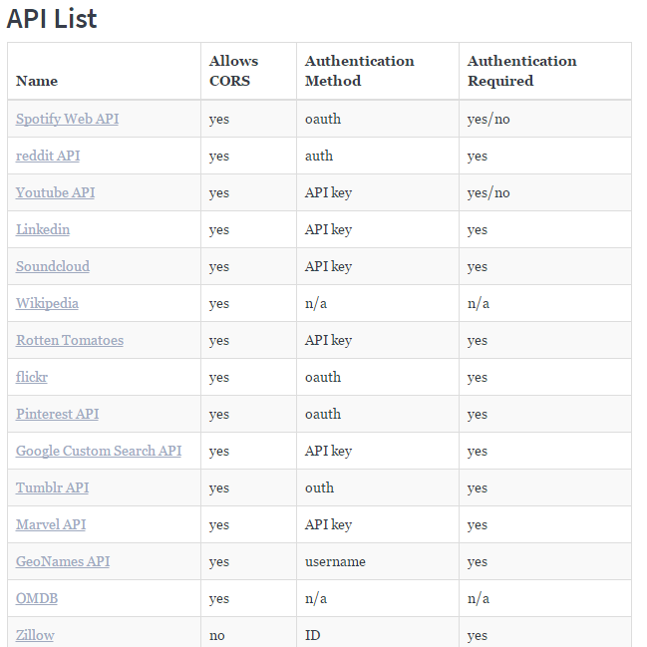
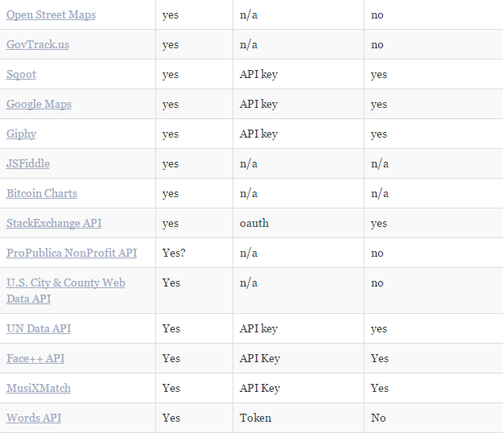
API Suggestions (This will be available in the class resources)

Slide 19
Tools

Slide 20
Collaboration is Critical!
Steering a project with remote developers like this one can be challenging.
Consider using the following tools…

Slide 21
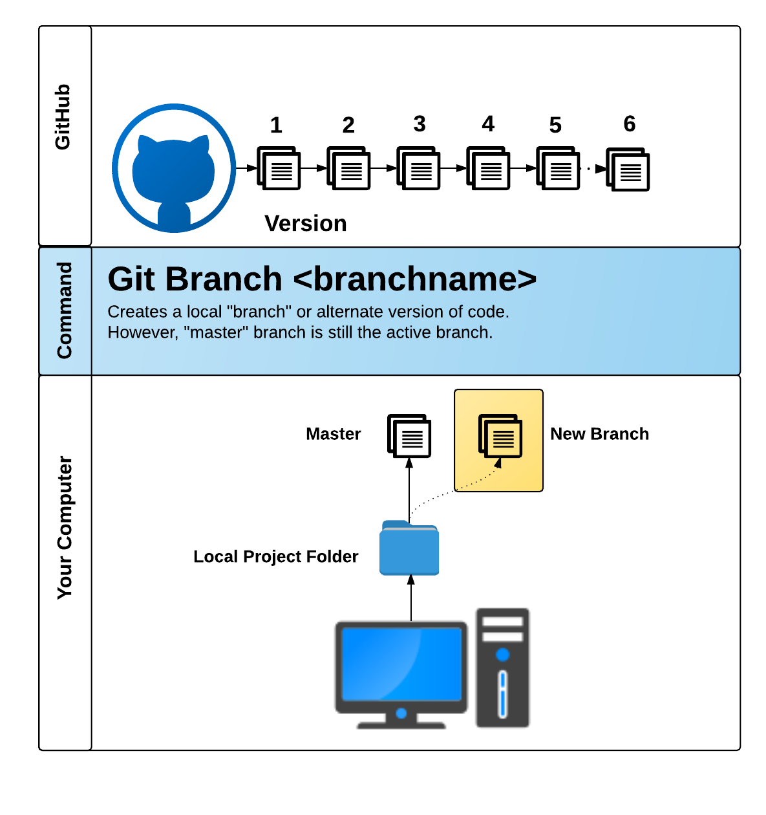
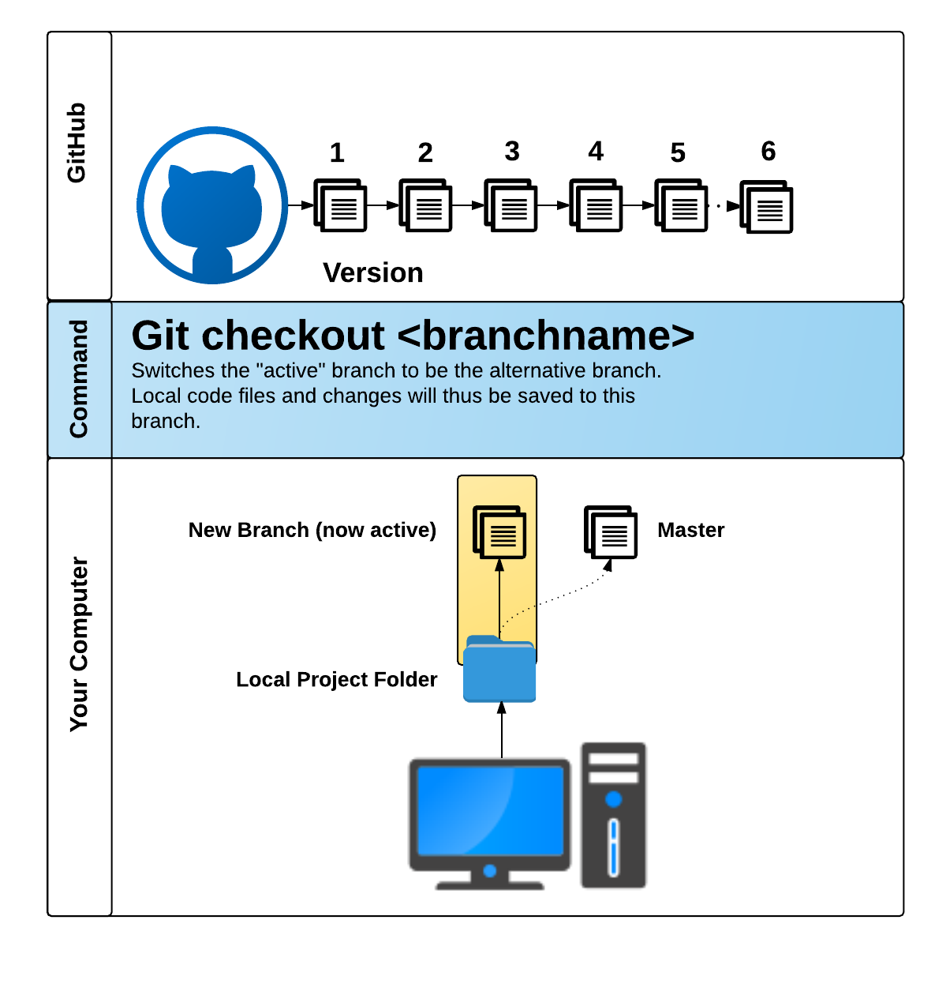
GitHub Pull Requests
GitHub Pull Requests are a great way to “combine” code when multiple users are working on the same files.
We’ll show you how to use this feature in the next class.

Slide 22
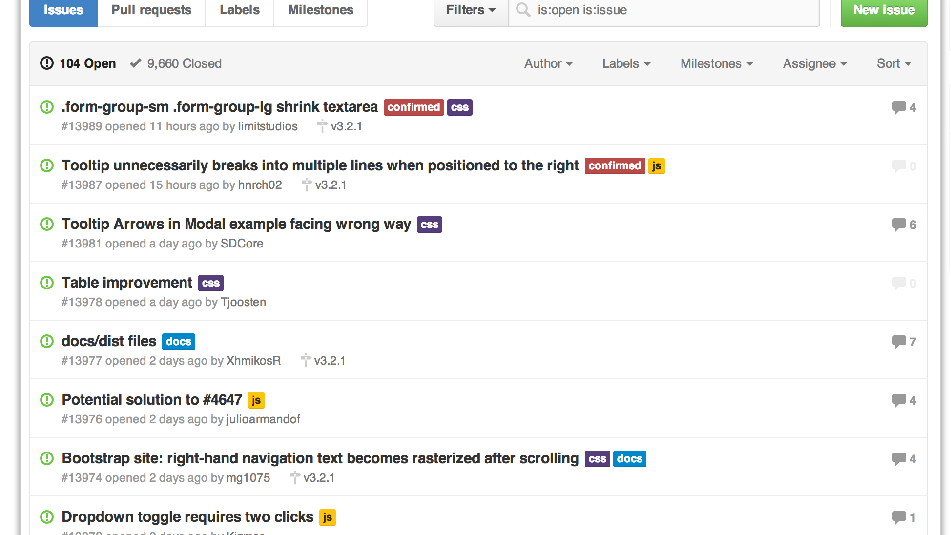
GitHub Issues
GitHub Issues are a great way to keep track of bugs, feature requests, etc.

Slide 23
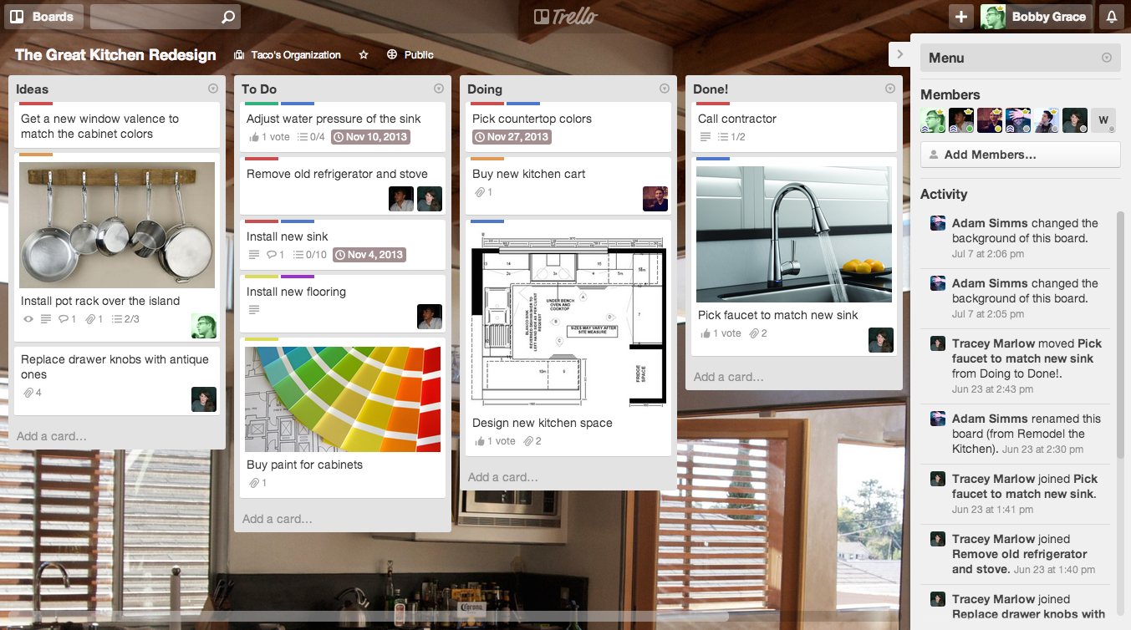
Trello
Trello is a great project management tool for creating to-do lists and communicating updates.

Slide 24
Today’s Focus

Slide 25
By End of Day - Today
Refine API Research
Create an initial draft / sketch of the final design
Create a short 1 page proposal listing out each of the following:
Project Title
Team Members
Project Description
Sketch of Final Product
APIs to be Used
Rough Breakdown of Tasks
Project managers will slack the github link containing this information to the open-forum channel with @kc135q in the message.

Slide 26
Questions

