Slide 1
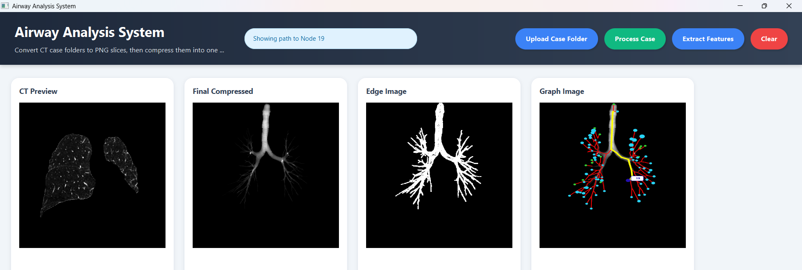
Computer Science 3A Mini Project
Airway Analysis
System
Graph-based CT airway structure review for education, research and decision-support.
Java desktop application
CT airway analysis
Pathfinding + graph overlay
Educational / research prototype • Not a clinical diagnosis tool

Slide 2
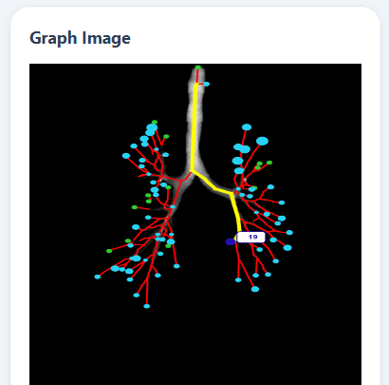
Introduction
01
Project overview and intended role
What the system is
An educational and research decision-support prototype for reviewing CT airway case data. It helps users understand airway structure through images, features, similarity results, suspicious nodes and pathfinding routes.
What the system is not
It is not a clinical diagnosis tool. The system highlights structural patterns that may need closer expert review, but it does not replace medical professionals or make final medical conclusions.
Graph-based airway review
Airway Analysis System

Slide 3
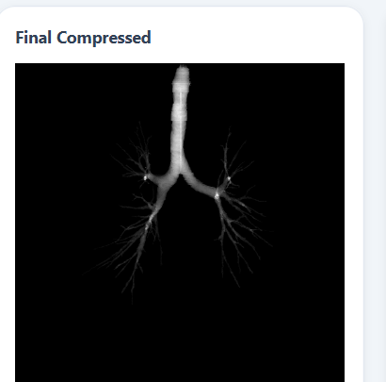
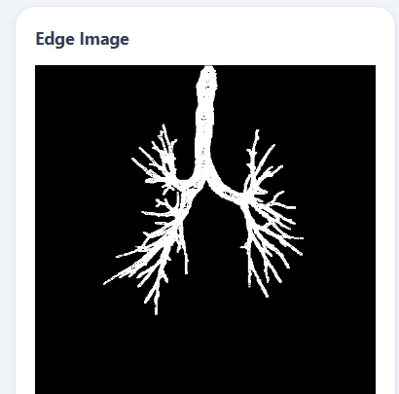
Background and Motivation
02
Why this matters in a South African medical education context
South Africa faces serious respiratory-health challenges, while CT medical imaging is complex and not always easy to interpret.
The motivation is to make airway scan information easier to inspect, explain and study. By transforming CT airway data into visual and structural summaries, the system can support students, researchers, lecturers and medical reviewers.
Education
Research
Expert review support
Airway Analysis System

Slide 4
Problem Statement
03
The core problem the system addresses
CT airway data is complex, difficult to interpret, and hard to simplify into useful structural information.
The challenge
Our response
The airway tree is three-dimensional, highly branched and spread across many image slices. This makes it difficult to locate regions that may require closer attention.
The system converts CT airway data into visual outputs, graph structures, feature categories, similarity results, suspicious regions and pathfinding routes.
Airway Analysis System

Slide 5
Project Objectives
04
What the system was built to achieve
To develop a Java desktop-based Airway Analysis System that converts complex CT airway case data into a simplified visual, numerical and graph-based representation.
01
02
03
04
Process CT data
Build graph structure
Extract features
Support review
Convert case files into PNG slices and one final airway image.
Represent branch points/endpoints as nodes and airway segments as edges.
Measure branch count, branch points, tapering, tortuosity and abrupt endings.
Show similarity results, suspicious regions and graph-based paths to areas needing attention.
Goal: improve understanding of airway structure without claiming diagnosis.
Airway Analysis System

Slide 6
System Overview
05
From CT case folder to graph-based review
The system aims to process CT airway data, build a graph, extract features, categorize results, compare cases and display everything in a clear Java desktop interface.
CT case folder
PNG slices
Compressed airway image
Preprocessing
Skeletonized airway
Graph nodes + edges
Feature categories
KNN similarity
Suspicious nodes
Pathfinding route
UI results
Visual + numerical + graph-based summary
Airway Analysis System

Slide 7
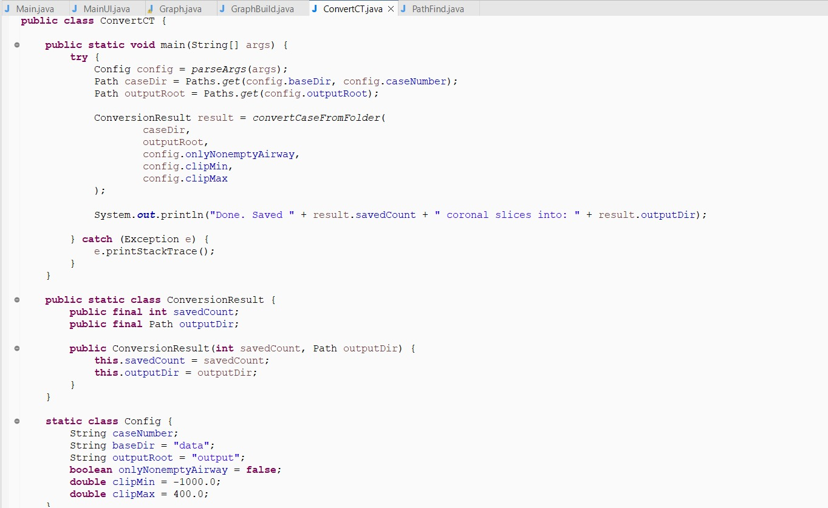
Technical Process Flow
06
Image preprocessing, feature extraction and algorithms used
CT Case Folder → ConvertCT → PNG Slices → PngCaseCompressor → Final Image → Grayscale → Sobel → Binary Mask → Zhang-Suen Thinning → Skeleton → Graph → Features → KNN → Suspicious Nodes → Dijkstra/A* → UI Overlay
Core idea
The CT case is first converted into image slices, then compressed and processed into a form that can be turned into a skeleton and graph.
Algorithms referenced
Sobel edge detection • binary masking • Zhang-Suen thinning • custom Graph ADT • KNN-style similarity • Dijkstra and A* pathfinding.
Airway Analysis System

Slide 8
Image Processing + Feature Extraction
07
Turning image data into measurable structure
Compressed
Edge Image
Graph Overlay
Structural features extracted
Branch Count
Branch Point Count
Average Tapering
Average Tortuosity
Abrupt-Ending Ratio
Airway Analysis System

Slide 9
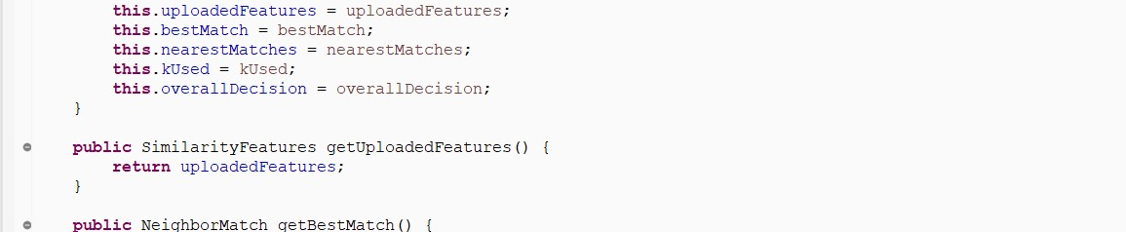
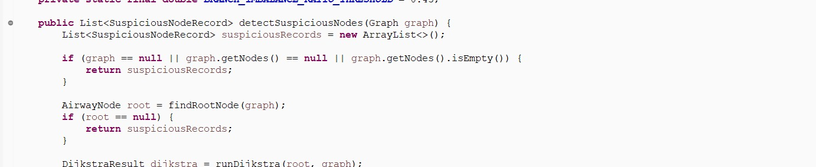
Graph, Similarity + Pathfinding
08
How the airway is reviewed computationally
Graph representation
Pathfinding
Nodes represent airway branch points or endpoints. Edges represent airway segments connecting those points.
Dijkstra/A* trace a route from the main airway to a selected suspicious node so the user can see where attention is needed.
Similarity detection
A KNN-style feature comparison finds saved cases that are structurally close to the selected case.
Airway Analysis System

Slide 10
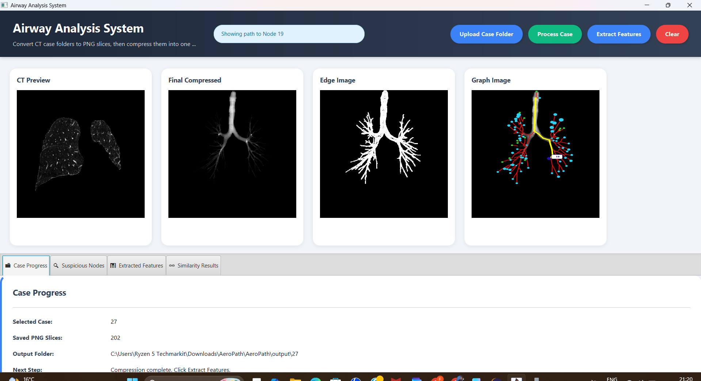
User Interface
09
How information is displayed to the user
Displayed outputs
CT preview
Final compressed airway image
Edge image
Graph image
Case progress
Suspicious nodes
Extracted features
Similarity results
Path to Node 19
The interface is designed to keep the workflow simple: upload case folder, process case, extract features and review results.
Airway Analysis System

Slide 11
Challenges Faced
10
Main development challenges
We faced several challenges during development, but two stood out as the most important.
Problem statement refinement
We shifted from disease detection to an educational/research decision-support system, because the project is not clinically validated and should not make medical diagnoses.
3D CT scan processing
CT cases had to be sliced into hundreds of PNG images and compressed into one final airway image. This caused heap-memory issues, so we increased the Java runtime memory arguments to complete larger cases.
Airway Analysis System

Slide 12
Conclusion
11
What the project demonstrates
The Airway Analysis System demonstrates how graph-based image processing can transform complex CT airway data into a clearer visual, numerical and structural summary.
Practical result
Project value
Image processing, custom graph structures, feature extraction, similarity comparison and pathfinding work together in one Java desktop application.
The value is not in replacing medical professionals, but in supporting students, researchers, lecturers and reviewers with clearer airway information.
Educational and research decision-support prototype for graph-based medical image analysis.
Airway Analysis System

Slide 13
References and Supporting Sources
12
Algorithms, dataset and feature category guidance
Project sources
Supporting references
Dataset
AeroPath CT airway dataset
Image Processing
Grayscale processing, Sobel edge detection, binary masking
Skeletonization
Zhang-Suen thinning algorithm
Graph Representation
Custom Graph ADT using nodes and edges
Similarity + Pathfinding
KNN-style feature comparison, Dijkstra and A* algorithms
Feature Category Guidance
CT airway morphology and segmentation literature, including Maetani et al., Kirby et al., Tawhai et al., and Lo et al.
Important note
Feature ranges are project-defined and not clinically validated diagnostic thresholds.
Airway Analysis System

