Slide 1
計 算 機 結 構
國立清華大學資訊工程系 黃婷婷教授

Slide 2

為什麼電腦不用十進位而用二進位？

Slide 3
Signal: Two States (二進制)
對、錯
本土化、非本土化
陰、陽
high、low
正、反
勝、負
真、偽
2

Slide 4
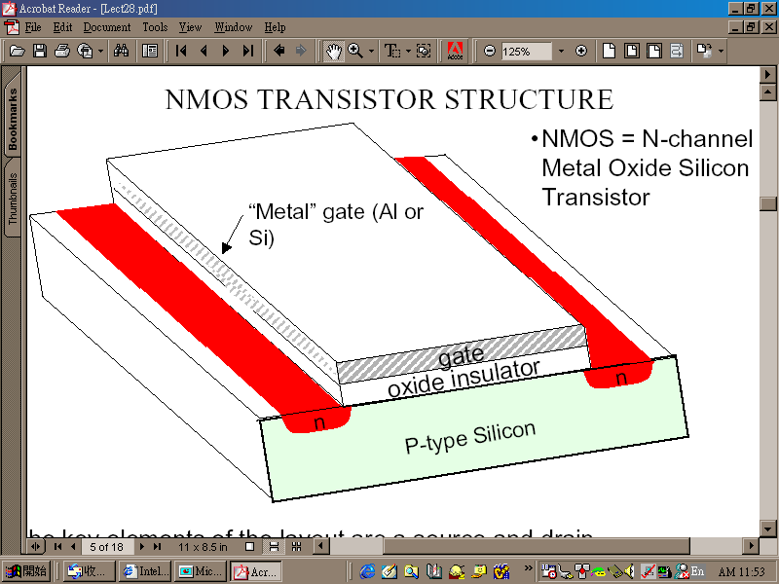
Switch (電子開關)
“gate” as the switch
3

Slide 5
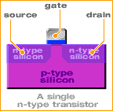
A Working Transistor (1/5)
Transistors consist of three terminals; the source, the gate, and the drain:
4

Slide 6
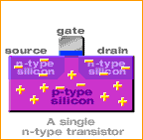
A Working Transistor (2/5)
In the n-type transistor, both the source and
the drain are negatively-charged and
sit on a positively-charged well of p-silicon.
5

Slide 7
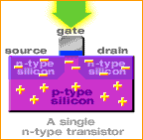
A Working Transistor (3/5)
When positive voltage is applied to the gate, electrons in the p-silicon are attracted to the area under the gate forming an electron channel between the source and the drain.
6

Slide 8
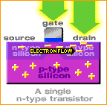
A Working Transistor (4/5)
When positive voltage is applied to the drain,
the electrons are pulled from the source to the drain.
In this state the transistor is on.
開
7

Slide 9
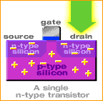
A Working Transistor (5/5)
If the voltage at the gate is removed, electrons are not attracted to the area between the source and drain. The pathway is broken and the transistor is turned off.
關
8

Slide 10
相關電壓電流特性 及電路分析等知識 我們是在＿＿＿課中介紹的
答：「電子電路學」「超大型積體電路設計」
9

Slide 11
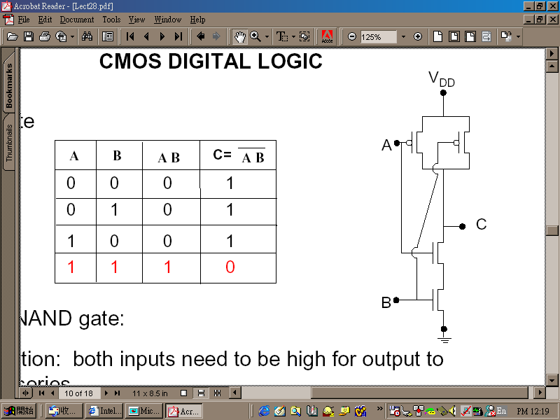
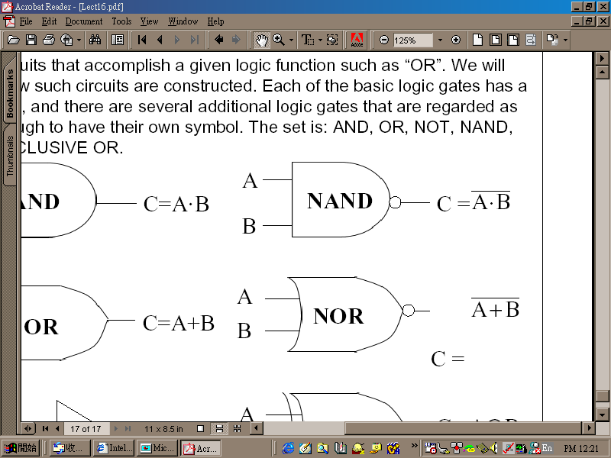
有了開關就可以做邏輯閘
CMOS NAND:
10

Slide 12
Switch (電子開關)
“gate” as the switch
3

Slide 13
有了邏輯閘就可做邏輯電路
加法器：
A
A
B
CO
B
Cl
S
A
Cl
B
11

Slide 14
也可以做記憶元件
可存一個bit的東西：
R'
R
Q
clock'
Q'
S'
S
12

Slide 15

這部份的學問叫＿＿＿＿
答：「數位邏輯設計」
13

Slide 16
最後，電腦的主要部份就都可以做了
暫存器
記憶體
控制器
控制信號
ALU
N
Z
clock
IR
PC
15

Slide 17
Basic Organization of Any Computer
Computer
Keyboard, Mouse
Processor
(active)
Memory
(passive)
(where
programs,
data
live when
running)
Devices
Disk (where
programs,
data
live when
not running)
Control
(“brain”)
Input
Datapath
(“brawn”)
Output
Display, Printer
16
Notes:
That is, any computer, no matter how primitive or advance, can be divided into five parts:
1. The input devices bring the data from the outside world into the computer.
2. These data are kept in the computer’s memory until ...
3. The datapath request and process them.
4. The operation of the datapath is controlled by the computer’s controller.
All the work done by the computer will NOT do us any good unless we can get the data back to the outside world.
5. Getting the data back to the outside world is the job of the output devices.
The most COMMON way to connect these 5 components together is to use a network of busses.

Slide 18
Computer Organization
Capabilities and performance characteristics of principal functional units, e.g., registers, ALU, shifters, ...
Ways in which these components are interconnected (structure)
Information flows between components (data, datapath)
Logic and means by which such information flow is controlled (control logic)
Register Transfer Level (RTL) description
17
Notes:
Deeper view. Design state of art organization in 1990. This is only the computer organization. What is computer architecture ?

Slide 19
What is Computer Architecture?
Computer Architecture = Instruction Set Architecture + Machine Organization
Application (IE)
Operating
Compiler
System
(MS Windows)
Software
Assembler
Hardware
Instruction Set
Architecture
Processor
Memory
I/O system
Datapath & Control
Digital Design
Circuit Design
Machine Organization
Transistors
18

Slide 20
Instruction Set as a Critical Interface
Coordination of many levels of abstraction
software
instruction set
hardware
Does it have to be hardware?
19

Slide 21
Another Perspective
High Level Language Program
temp = v[k];
v[k] = v[k+1];
v[k+1] = temp;
Compiler
Assembly Language Program
lw $15, 0($2)
lw $16, 4($2)
sw $16, 0($2)
sw $15, 4($2)
ISA
Assembler
Machine Language Program
0000 1001 1100 0110 1010 1111 0101 1000
1010 1111 0101 1000 0000 1001 1100 0110
1100 0110 1010 1111 0101 1000 0000 1001
0101 1000 0000 1001 1100 0110 1010 1111
Machine Interpretation
Control Signal Specification
ALUOP[0:3] <= InstReg[9:11] & MASK
°
°
20

Slide 22
Instruction Set Architecture (ISA)
“... the attributes of a [computing] system as seen by the programmer, i.e. the conceptual structure and functional behavior, as distinct from the organization of the data flows and controls, the logic design, and the physical implementation.” — Amdahl, Blaaw, and Brooks, 1964
Organization of Programmable Storage
Data Types and Data Structures: Encodings and Representations
Instruction Set
Instruction Formats
Modes of Addressing and Accessing Data Items and Instructions
Exceptional Conditions
SOFTWARE
21

Slide 23
MIPS R3000 ISA
Registers
Instruction categories:
Load/Store
Computational
Jump and Branch
Floating Point
coprocessor
Memory Management
Special
R0 - R31
PC
HI
LO
3 Instruction Formats: all 32 bits wide
OP
rs
rt
rd
sa
funct
OP
rs
rt
immediate
OP
jump target
22

Slide 24
Example ISA
Digital Alpha (v1, v3) 1992-97
HP PA-RISC (v1.1, v2.0) 1986-96
Sun Sparc (v8, v9) 1987-95
SGI MIPS (MIPS I, II, III, IV, V) 1986-96
Intel (8086,80286,80386, 1978- 80486,Pentium, MMX, SIMD, IA-64, ...)
ARM (v1,v2…v8) 1985-
23

Slide 25
Why Do Computer Architecture?
RAPID CHANGES
It is exciting!
It has never been more exciting!
It impacts every other aspect of electrical engineering and computer science
24

Slide 26
Flipped Classroom

Slide 27
Flipped Classroom
Before class:
Watch video and learn it by yourself (or group study)
Submit two question-and-answers to iLMS by each group before noon every Friday
In class:
First part:
Question and answer (for general question)
Second part:
Group study or individual student tutored by TAs and teacher
A set of questions discussed in each group
Third part:
Tournament
Submission of final answer sheet per group

Slide 28
Flipped Classroom
After class
Review the course and take a quiz online after each class
Complete three homework assignments
Take midterm and final exams
Submit one final project

Slide 29
Group Performance
Forming study groups. Each group has 5-6 students.
For members in the same group, their group performance will be the same
Advanced learner will help less advanced learner!
Group performance (in each class period)
First part: Student participation and interaction with teacher (teacher asks question or students raise question) – each group has at most 2 points
Second and third parts:
Group discussion : prepare your answers
Tournament – 2 points are given to the two groups (Q-group and A-group)
Submission of answer sheet – 1 point

Slide 30
In Class – Second & Third Parts
Group Discussion:
TA will select several questions from the questions uploaded by each group and give a question sheet at the beginning of part 2
Group discussion
Tournament: 2 points
TA selects some questions from question sheet (Q-group)
TA randomly select one member of groups whose question is not selected to answer the question (A-group)
If A-group can not answer the question, a member randomly selected from Q-group has to give the answer
The question is answered on the blackboard
2 points are given to these two groups based on their performance
Submission: 1 point
Your group answer-sheet at the end of class

Slide 31
In Class – Second & Third Parts
Second and third parts:
TA is the moderator
Each group prepares two question-and-answers and upload the questions to http://lms.nthu.edu.tw by Friday noon.
Moderator checks all questions and may ask some groups to reload questions if there is too much duplication among groups.
Good question is important. If it is selected by TA in tournament, it is worth 2 points!

Slide 32
After Class – Quiz
Quiz contains a set of single or multiple choice questions
Quiz is uploaded before 20:00 every Monday after class
Questions are all from the question sheet !!
Complete the quiz before Thursday noon each week
Grading: Total number of correct answers/total number of answers x 5%

Slide 33
Course Administration
授課老師: 黃婷婷
辦公室: 資電442 電話: 31310 email: tingting@cs.nthu.edu.tw
助教:
陳衍昊 yhchen@cs.nthu.edu.tw Online office hours: 星期二 19:00~21:00
孫勤昱 s102062801@m102.nthu.edu.tw Online office hours: 星期三 19:00~21:00
洪奕文 s106062802@m106.nthu.edu.tw Online office hours: 星期四 19:00~21:00
周猷翔 s108062591@m108.nthu.edu.tw Online office hours: 星期五 19:00~21:00
上課時間:
CS4100-00: 星期一 13:20-16:00
上課地點: DELTA 台達 109
課程網頁: http://www.cs.nthu.edu.tw/~tingting/cs4100.html
25

Slide 34
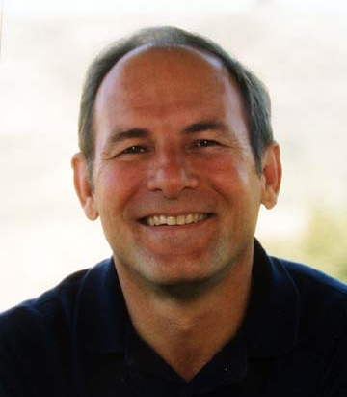
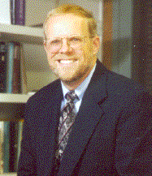
Text Book
Computer Organization and Design: The Hardware/Software Interface, 5th ed. David Patterson and John Hennessy, 2013
RISC, RAID
史丹福大學
校長
26

Slide 35
Topics Covered
Computer Organization and Design: The Hardware/Software Interface, D. Patterson and J. Hennessy
Topic
--------------------------------------------
Introduction
The Role of Performance
Instructions: Language of the Machine
Arithmetic for Computers
The Processor: Datapath and Control
Enhancing Performance with Pipelining
Exploiting Memory Hierarchy
27

Slide 36
Prerequisite
Prerequisite courses:
Logic design
28

Slide 37
Expected Course Workload
Learn MIPS instruction set
Learn processor emulators and benchmarking
1 final project
One mid-term and one final examination
Grade breakdown
In-class performance 25%
Quizzes 5%
Assignments & Final project 10%
Midterm Exam (Nov 4): 30%
Final Exam (Dec 30): 30%
29

Slide 38
Resource on Internet to Help Your Learning
Course Website
http://www.cs.nthu.edu.tw/~tingting/cs4100.html
ShareCourse (Please register)
http://www.sharecourse.net/sharecourse/course/view/courseInfo/1954
FB粉絲專頁 (TA online office)
https://www.facebook.com/NTHU-Arch-2019-Fall-2127926427528915/
Open Course Ware (OCW)
http://ocw.nthu.edu.tw/ocw/index.php?page=course&cid=76&
30

Slide 39
Course Problems
Cannot attend the class
One absence is allowed but no point of group performance will be given for that class
Two absents => you don’t have to come any more
Cannot be in the class on time
Late = absent
Cannot turn in homework on time
No late homework is accepted
What is cheating?
Study together in group is encouraged
Work must be your own. Copying is cheating!
31

