Slide 1
Pipelining
國立清華大學資訊工程學系
黃婷婷教授

Slide 2
Outline
An overview of pipelining
A pipelined datapath
Pipelined control
Hazards: types of hazard
Handling data hazards
  Inserting NOP（software）
  Forwarding, R-Type-use（hardware)
  Stalls, load-use (hardware)
Handling branch hazards
Exceptions
Superscalar and dynamic pipelining

Slide 3
Pipelining Is Natural!
Laundry example:
Ann (小安), Brian (小白),
Cathy (小新), Dave(小德)
each have one load of
clothes to wash, dry,
and fold
Washer takes 30 minutes
Dryer takes 40 minutes
“Folder” takes 20 minutes
A
B
C
D

Slide 4
Sequential Laundry
6 PM
7
8
9
10
11
Midnight
Time
30
40
20
30
40
20
30
40
20
30
40
20
T
a
s
k
O
r
d
e
r
A
B
C
D
Sequential laundry takes 6 hours for 4 loads
If they learned pipelining, how long would it take?

Slide 5
Pipelined Laundry: Start ASAP
6 PM
7
8
9
10
11
Midnight
Time
30
40
40
40
40
20
T
a
s
k
O
r
d
e
r
A
B
C
D
Pipelined laundry takes 3.5 hours for 4 loads

Slide 6
Pipelining Lessons
6 PM
7
8
9
Doesn’t help latency of single task, but throughput of entire
Pipeline rate limited by slowest stage
Multiple tasks working at same time using different resources
Potential speedup = Number pipe stages
Unbalanced stage length; time to “fill” & “drain” the pipeline reduce speedup
Stall for dependences
Time
30
40
40
40
40
20
T
a
s
k
O
r
d
e
r
A
B
C
D

Slide 7
Single cycle vs. Pipeline
Cycle 1
Cycle 2
Clk
Single Cycle Implementation:
Load
Store
Waste
Cycle 1
Cycle 2
Cycle 3
Cycle 4
Cycle 5
Cycle 6
Cycle 7
Cycle 8
Cycle 9
Cycle 10
Clk
Pipeline Implementation:
Load
Ifetch
Reg
Exec
Mem
Wr
Store
Ifetch
Reg
Exec
Mem
Wr
R-type
Ifetch
Reg
Exec
Mem
Wr
Notes:
Here are the timing diagrams showing the differences between the single cycle, multiple cycle, and pipeline implementations.
For example, in the pipeline implementation, we can finish executing the Load, Store, and R-type instruction sequence in seven cycles.
In the multiple clock cycle implementation, however, we cannot start executing the store until Cycle 6 because we must wait for the load instruction to complete.
Similarly, we cannot start the execution of the R-type instruction until the store instruction has completed its execution in Cycle 9.
In the Single Cycle implementation, the cycle time is set to accommodate the longest instruction, the Load instruction.
Consequently, the cycle time for the Single Cycle implementation can be five times longer than the multiple cycle implementation.
But may be more importantly, since the cycle time has to be long enough for the load instruction, it is too long for the store instruction so the last part of the cycle here is wasted.
+2 = 77 min. (X:57)

Slide 8
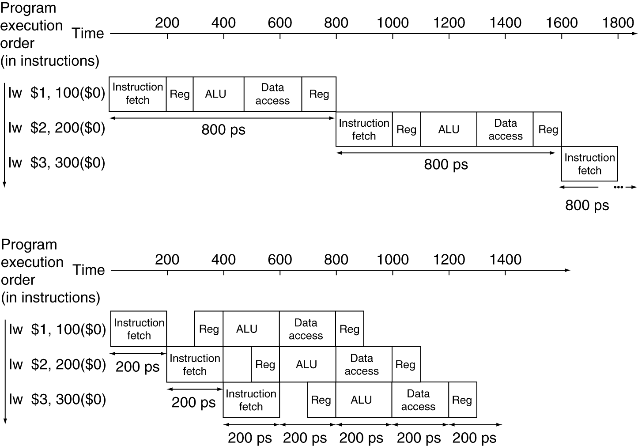
Pipeline Performance
Single-cycle (T_{c}= 800ps)
Pipelined (T_{c}= 200ps)

Slide 9
Why Pipeline? Because the Resources Are There!
Time (clock cycles)
Single-cycle Datapath
Inst 0
Im
Reg
ALU
Dm
Reg
I
n
s
t
r.
O
r
d
e
r
Inst 1
Im
Reg
ALU
Dm
Reg
Inst 2
Im
Reg
ALU
Dm
Reg
Inst 3
Im
Reg
ALU
Dm
Reg
Inst 4
Im
Reg
ALU
Dm
Reg

Slide 10
Outline
An overview of pipelining
A pipelined datapath
Pipelined control
Hazards: types of hazard
Handling data hazards
  Inserting NOP（software）
  Forwarding, R-Type-use（hardware)
  Stalls, load-use (hardware)
Handling branch hazards
Exceptions
Superscalar and dynamic pipelining

Slide 11
Designing a Pipelined Processor
Examine the datapath and control diagram
  Starting with single cycle datapath
  Single cycle control?
Partition datapath into stages:
  IF (instruction fetch), ID (instruction decode and register file read), EX (execution or address calculation), MEM (data memory access), WB (write back)
Associate resources with stages
Ensure that flows do not conflict, or figure out how to resolve
Assert control in appropriate stage

Slide 12
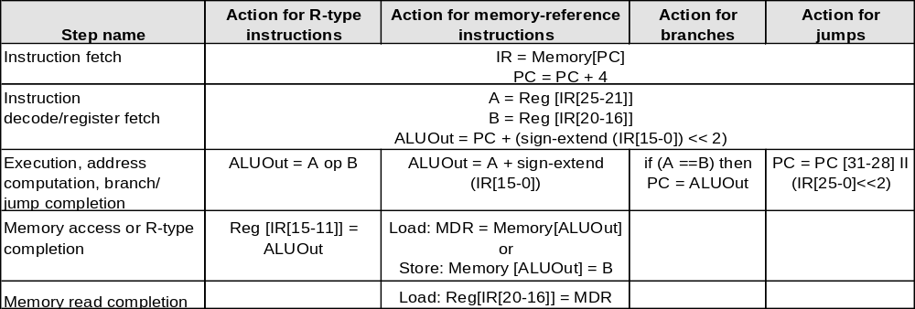
Multi-Execution Steps
But, use single-cycle datapath ...

Slide 13
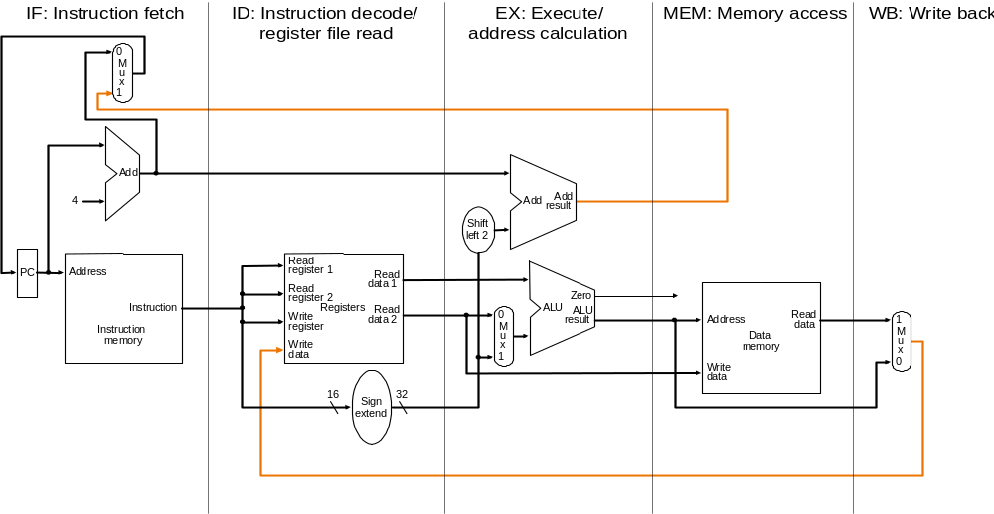
Split Single-cycle Datapath
What to add to split the datapath into stages?
Feedback
Path

Slide 14
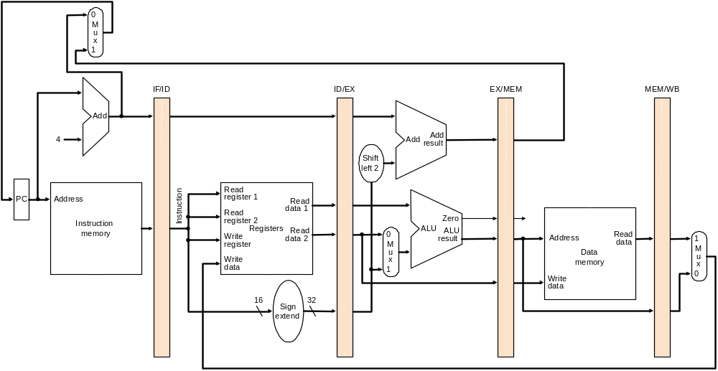
Add Pipeline Registers
Use registers between stages to carry data and control
Pipeline registers (latches)

Slide 15
Consider load
IF: Instruction Fetch
  Fetch the instruction from the Instruction Memory
ID: Instruction Decode
  Registers fetch and instruction decode
EX: Calculate the memory address
MEM: Read the data from the Data Memory
WB: Write the data back to the register file
Cycle 1
Cycle 2
Cycle 3
Cycle 4
Cycle 5
Load
Ifetch
Reg/Dec
Exec
Mem
Wr
Notes:
As shown here, each of these five steps will take one clock cycle to complete.
And in pipeline terminology, each step is referred to as one stage of the pipeline.
+1 = 8 min. (X:48)

Slide 16
Pipelining load
5 functional units in the pipeline datapath are:
  Instruction Memory for the Ifetch stage
  Register File’s Read ports (busA and busB) for the Reg/Dec stage
  ALU for the Exec stage
  Data Memory for the MEM stage
  Register File’s Write port (busW) for the WB stage
Cycle 1
Cycle 2
Cycle 3
Cycle 4
Cycle 5
Cycle 6
Cycle 7
Clock
1st lw
Ifetch
Reg/Dec
Exec
Mem
Wr
2nd lw
Ifetch
Reg/Dec
Exec
Mem
Wr
3rd lw
Ifetch
Reg/Dec
Exec
Mem
Wr
Notes:
For the load instructions, the five independent functional units in the pipeline datapath are:
(a) Instruction Memory for the Ifetch stage.
(b) Register File Read ports for the Reg/Decode stage.
(c) ALU for the Exec stage. (d) Data memory for the Mem stage.
(e) And finally Register File write port for the Write Back stage.
Notice that I have treat Register File read and write ports as separate functional units because the register file we have allows us to read and write at the same time.
Notice that as soon as the 1st load finishes its Ifetch stage, it no longer needs the Instruction Memory. Consequently, the 2nd load can start using the Instruction Memory (2nd Ifetch).
Furthermore, since each functional unit is only used ONCE per instruction, we will not have any conflict down the pipeline (Exec-Ifet, Mem-Exec, Wr-Mem) either.
I will show you the interaction between instructions in the pipelined datapath later. But for now, I want to point out the performance advantages of pipelining.
If these 3 load instructions are to be executed by the multiple cycle processor, it will take 15 cycles. But with pipelining, it only takes 7 cycles. This (7 cycles), however, is not the best way to look at the performance advantages of pipelining.
A better way to look at this is that we have one instruction enters the pipeline every cycle so we will have one instruction coming out of the pipeline (Wr stages) every cycle.
Consequently, the ffective?(or average) number of cycles per instruction is now ONE even though it takes a total of 5 cycles to complete each instruction.
+3 = 14 min. (X:54)

Slide 17
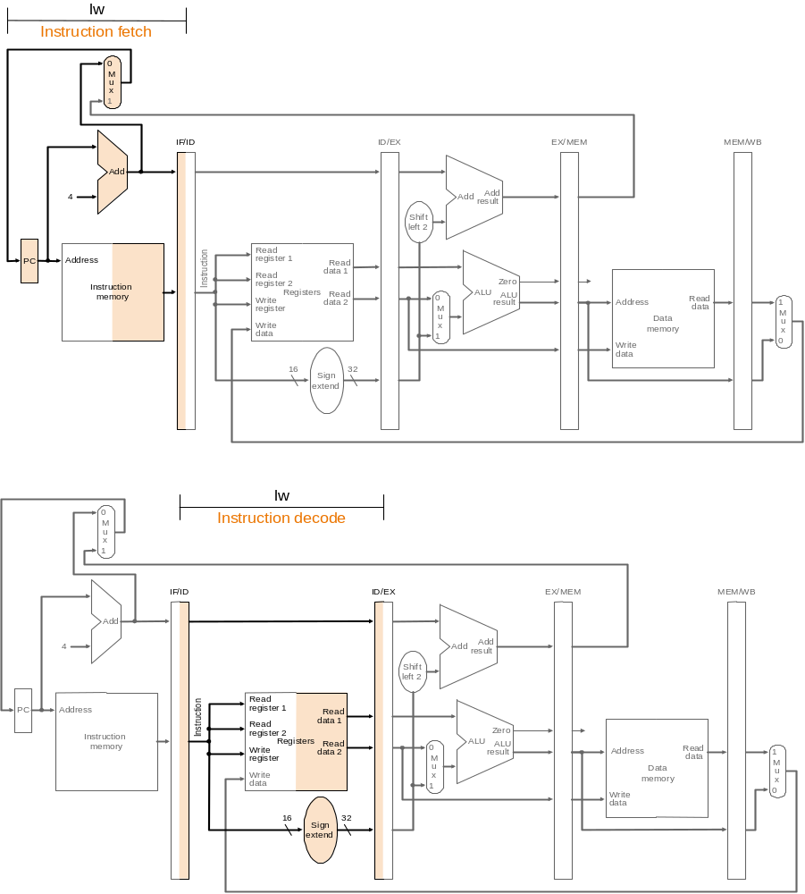
IF Stage of load
IR = mem[PC]; PC = PC + 4
IR, PC+4

Slide 18
ID Stage of load
A = Reg[IR[25-21]]; B = Reg[IR[20-16]];

Slide 19
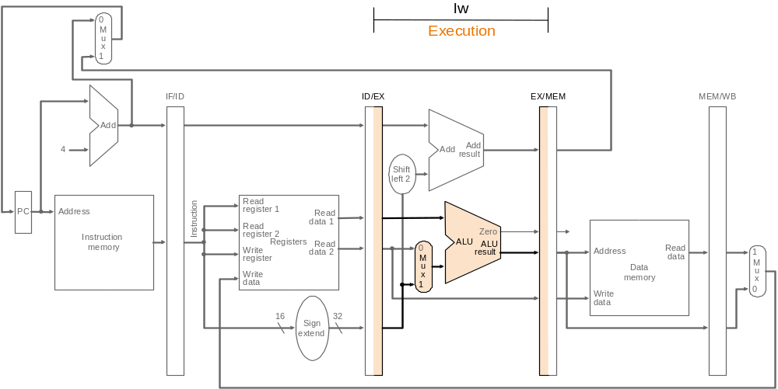
EX Stage of load
ALUout = A + sign-ext(IR[15-0])

Slide 20
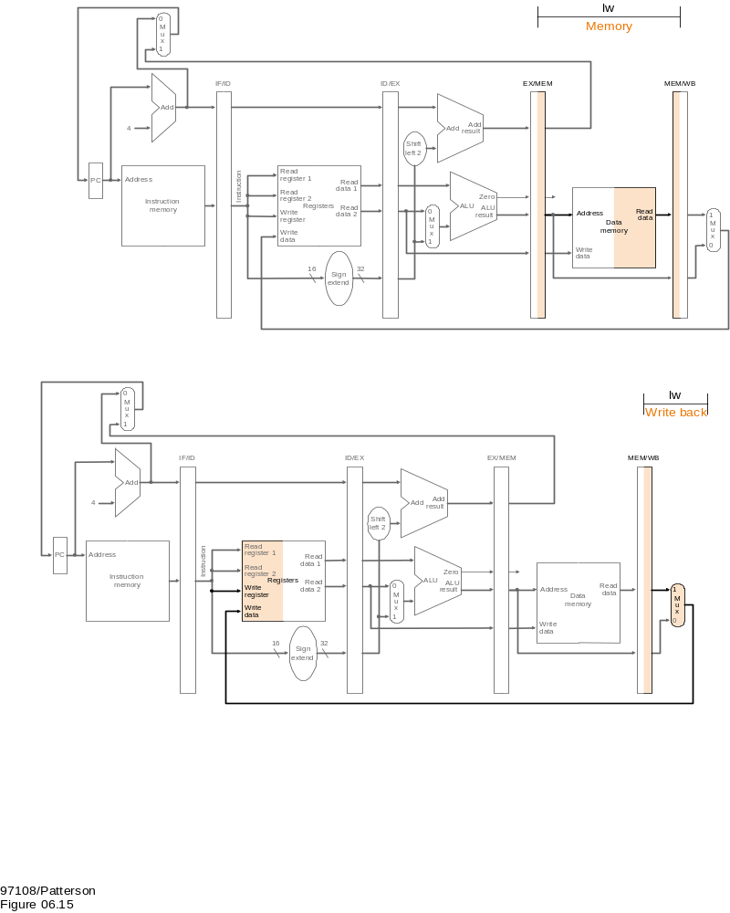
MEM State of load
MDR = mem[ALUout]

Slide 21
WB Stage of load
Reg[IR[20-16]] = MDR
Who will supply this address?

Slide 22
The Four Stages of R-type
IF: fetch the instruction from the Instruction Memory
ID: registers fetch and instruction decode
EX: ALU operates on the two register operands
WB: write ALU output back to the register file
Cycle 1
Cycle 2
Cycle 3
Cycle 4
R-type
Ifetch
Reg/Dec
Exec
Wr
Notes:
Well, so far so good. Let take a look at the R-type instructions.
The R-type instruction does NOT access data memory so it only takes four clock cycles, or in our new pipeline terminology, four stages to complete.
The Ifetch and Reg/Dec stages are identical to the Load instructions. Well they have to be because at this point, we do not know we have a R-type instruction yet.
Instead of calculating the effective address during the Exec stage, the R-type instruction will use the ALU to operate on the register operands.
The result of this ALU operation is written back to the register file during the Wr back stage.
+1 = 15 min. (55)

Slide 23
Pipelining R-type and load
We have a structural hazard:
  Two instructions try to write to the register file at the same time!
  Only one write port
Cycle 1
Cycle 2
Cycle 3
Cycle 4
Cycle 5
Cycle 6
Cycle 7
Cycle 8
Cycle 9
Clock
R-type
Ifetch
Reg/Dec
Exec
Wr
Ops! We have a problem!
R-type
Ifetch
Reg/Dec
Exec
Wr
Load
Ifetch
Reg/Dec
Exec
Mem
Wr
R-type
Ifetch
Reg/Dec
Exec
Wr
R-type
Ifetch
Reg/Dec
Exec
Wr
Notes:
What happened if we try to pipeline the R-type instructions with the Load instructions?
Well, we have a problem here!!!
We end up having two instructions trying to write to the register file at the same time!
Why do we have this problem (the write ubble??
Well, the reason for this problem is that there is something I have not yet told you.
+1 = 16 min. (X:56)

Slide 24
Important Observation
Each functional unit can only be used once per instruction
Each functional unit must be used at the same stage for all instructions:
  Load uses Register File’s write port during its 5th stage
  R-type uses Register File’s write port during its 4th stage
Several ways to solve: forwarding, adding pipeline bubble, making instructions same length
1
2
3
4
5
Load
Ifetch
Reg/Dec
Exec
Mem
Wr
1
2
3
4
R-type
Ifetch
Reg/Dec
Exec
Wr
Notes:
I already told you that in order for pipeline to work perfectly, each functional unit can ONLY be used once per instruction.
What I have not told you is that this (1st bullet) is a necessary but NOT sufficient condition for pipeline to work.
The other condition to prevent pipeline hiccup is that each functional unit must be used at the same stage for all instructions.
For example here, the load instruction uses the Register File Wr port during its 5th stage but the R-type instruction right now will use the Register File port during its 4th stage.
This (5 versus 4) is what caused our problem. How do we solve it? We have 2 solutions.
+1 = 17 min. (X:57)

Slide 25
Solution: Delay R-type’s Write
Delay R-type’s register write by one cycle:
  R-type also use Reg File’s write port at Stage 5
  MEM is a NOP stage: nothing is being done.
1
2
3
4
5
R-type
Ifetch
Reg/Dec
Exec
Mem
Wr
Cycle 1
Cycle 2
Cycle 3
Cycle 4
Cycle 5
Cycle 6
Cycle 7
Cycle 8
Cycle 9
Clock
R-type
Ifetch
Reg/Dec
Exec
Mem
Wr
R-type
Ifetch
Reg/Dec
Exec
Mem
Wr
Load
Ifetch
Reg/Dec
Exec
Mem
Wr
R-type also has 5 stages
R-type
Ifetch
Reg/Dec
Exec
Mem
Wr
R-type
Ifetch
Reg/Dec
Exec
Mem
Wr
Notes:
Well one thing we can do is to add a op?stage to the R-type instruction pipeline to delay its register file write by one cycle.
Now the R-type instruction ALSO uses the register file witer port at its 5th stage so we eliminate the write conflict with the load instruction.
This is a much simpler solution as far as the control logic is concerned. As far as performance is concerned, we also gets back to having one instruction completes per cycle.
This is kind of like promoting socialism: by making each individual R-type instruction takes 5 cycles instead of 4 cycles to finish, our overall performance is actually better off.
The reason for this higher performance is that we end up having a more efficient pipeline.
+1 = 20 min. (Y:00)

Slide 26
The Four Stages of store
IF: fetch the instruction from the Instruction Memory
ID: registers fetch and instruction decode
EX: calculate the memory address
MEM: write the data into the Data Memory
Add an extra stage:
WB: NOP
Cycle 1
Cycle 2
Cycle 3
Cycle 4
Store
Ifetch
Reg/Dec
Exec
Mem
Wr
Notes:
Let continue our lecture by looking at the store instruction.
Once again, the Ifetch and Reg/Decode stages are the same as all other instructions.
The Exec stage of the store instruction calculates the memory address.
Once the address is calculated, the store instruction will write the data it read from the register file back at the Reg/Decode stage into the data memory during the Mem stage.
Notice that unlike the load instruction which takes five cycles to accomplish its task, the Store instruction only takes four cycles or four pipe stages.
In order to keep our pipeline diagram looks more uniform, however, we will keep the Wr stage for the store instruction in the pipeline diagram.
But keep in mind that as far as the pipelined control and pipelined datapath are concerned, the store instruction requires NOTHING to be done once it finishes its Mem stage.
+2 = 27 min. (Y:07)

Slide 27
The Three Stages of beq
IF: fetch the instruction from the Instruction Memory
ID: registers fetch and instruction decode
EX:
  compares the two register operand
  select correct branch target address
  latch into PC
Add two extra stages:
MEM: NOP
WB: NOP
Cycle 1
Cycle 2
Cycle 3
Cycle 4
Beq
Ifetch
Reg/Dec
Exec
Mem
Wr
Notes:
Well similar to the store instruction, the branch instruction only consists of four pipe stages.
Ifetch and Reg/decode are the same as all other instructions because we do not know what instruction we have at this point. We have not finish decoding the instruction yet.
During the Execute stage of the pipeline, the BEQ instruction will use the ALU to compare the two register operands it fetched during the Reg/Dec stage.
At the same time, a separate adder is used to calculate the branch target address.
If the registers we compared during the Execute stage (point to the last bullet) have the same value, the branch is taken.
That is, the branch target address we calculated earlier (last bullet) will be written into the Program Counter.
Once again, similar to the Store instruction, the BEQ instruction will require NEITHER the pipelined control nor the pipelined datapath to do ANY thing once it finishes its Mem stage.
With all these talk about pipelined datapath and pipelined control, let take a look at how the pipelined datapath looks like.
+2 = 29 min. (Y:09)

Slide 28
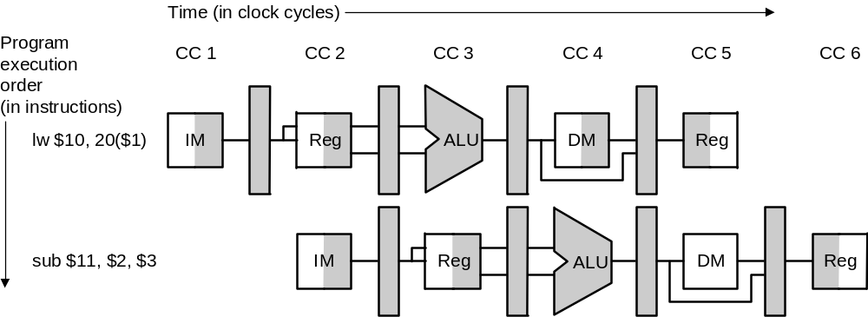
Graphically Representing Pipelines
Can help with answering questions like:
  How many cycles to execute this code?
  What is the ALU doing during cycle 4?
  Help understand datapaths

Slide 29
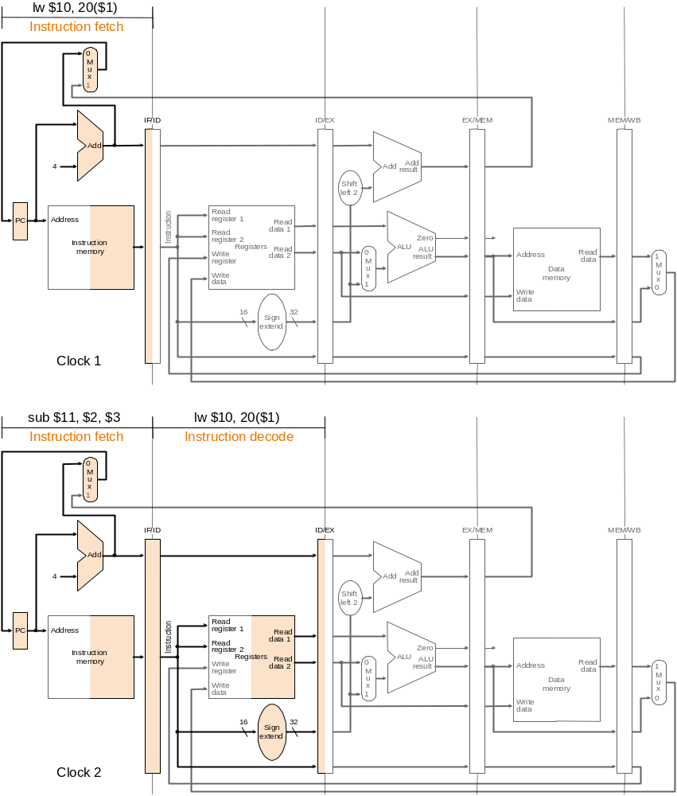
Example 1: Cycle 1

Slide 30
Example 1: Cycle 2

Slide 31
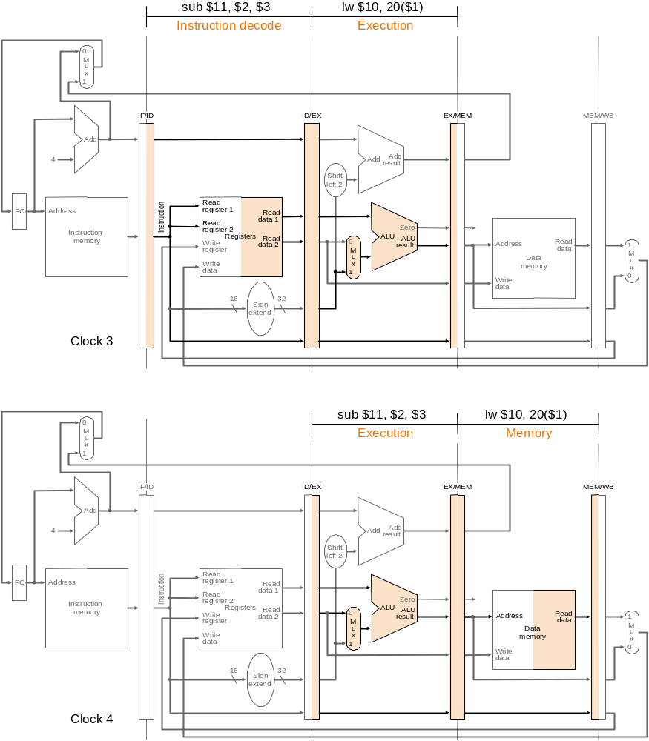
Example 1: Cycle 3

Slide 32
Example 1: Cycle 4

Slide 33
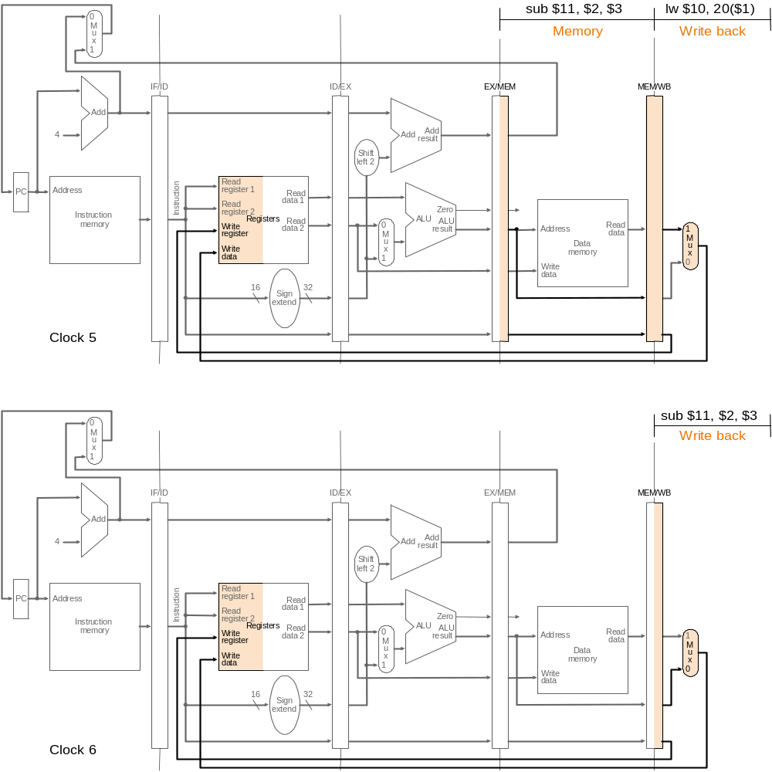
Example 1: Cycle 5

Slide 34
Example 1: Cycle 6

Slide 35
Outline
An overview of pipelining
A pipelined datapath
Pipelined control
Hazards: types of hazard
Handling data hazards
  Inserting NOP（software）
  Forwarding, R-Type-use（hardware)
  Stalls, load-use (hardware)
Handling branch hazards
Exceptions
Superscalar and dynamic pipelining

Slide 36
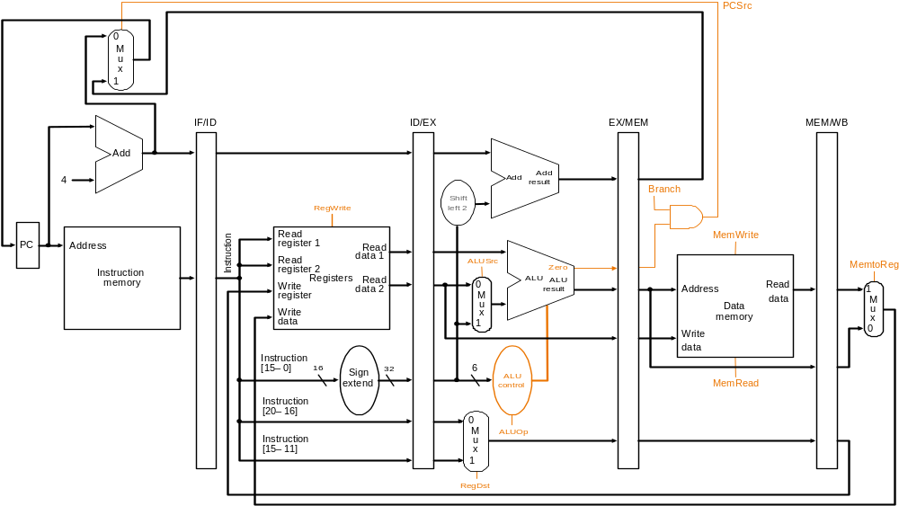
Pipeline Control: Control Signals

Slide 37
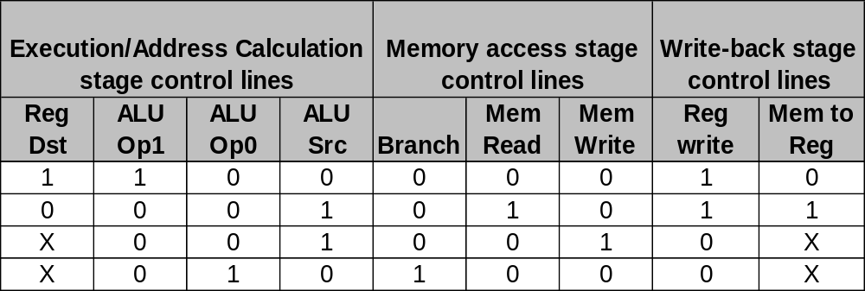
Group Signals According to Stages
Can use control signals of single-cycle CPU

Slide 38
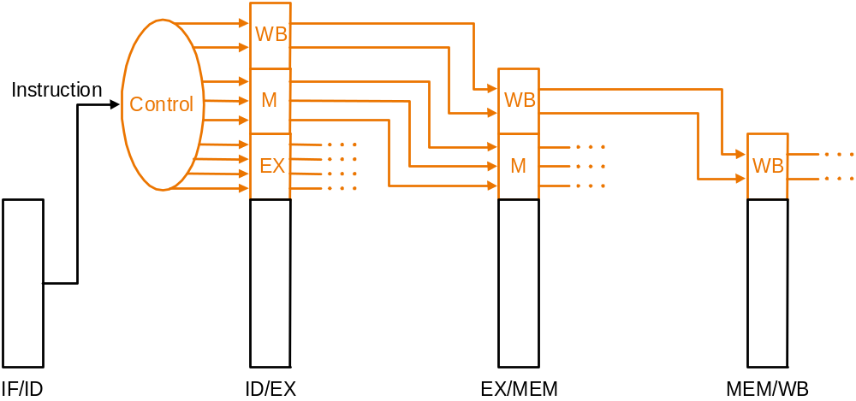
Data Stationary Control
Pass control signals along just like the data
  Main control generates control signals during ID

Slide 39
Data Stationary Control (cont.)
Signals for EX (ExtOp, ALUSrc, ...) are used 1 cycle later
Signals for MEM (MemWr, Branch) are used 2 cycles later
Signals for WB (MemtoReg, MemWr) are used 3 cycles later
ID
EX
MEM
WB
ExtOp
ExtOp
ALUSrc
ALUSrc
ALUOp
ALUOp
Main
Control
RegDst
RegDst
MemWr
ID/Ex Register
MemWr
Ex/MEM Register
MEM/WB Register
IF/ID Register
MemW
Branch
Branch
Branch
MemtoReg
MemtoReg
MemtoReg
MemtoReg
RegWr
RegWr
RegWr
RegWr
Notes:
The main control here is identical to the one in the single cycle processor. It generate all the control signals necessary for a given instruction during that instruction Reg/Decode stage.
All these control signals will be saved in the ID/Exec pipeline register at the end of the Reg/Decode cycle.
The control signals for the Exec stage (ALUSrc, ... etc.) come from the output of the ID/Exec register. That is they are delayed ONE cycle from the cycle they are generated.
The rest of the control signals that are not used during the Exec stage is passed down the pipeline and saved in the Exec/Mem register.
The control signals for the Mem stage (MemWr, Branch) come from the output of the Exec/Mem register. That is they are delayed two cycles from the cycle they are generated.
Finally, the control signals for the Wr stage (MemtoReg & RegWr) come from the output of the Exec/Wr register: they are delayed three cycles from the cycle they are generated.
+2 = 45 min. (Y:45)

Slide 40
WB Stage of load
Reg[IR[20-16]] = MDR
Who will supply this address?

Slide 41
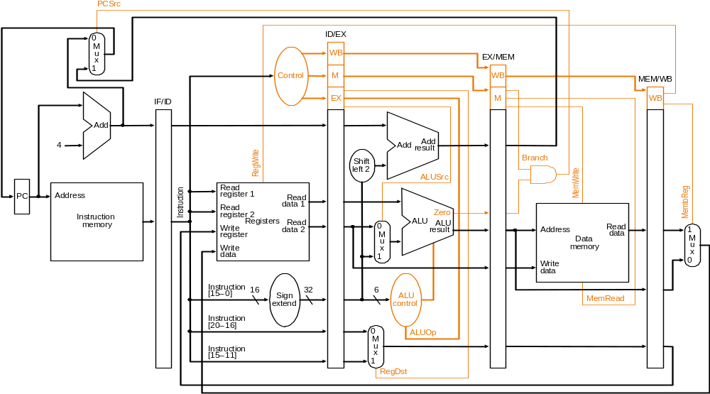
Datapath with Control

Slide 42
Let’s Try it Out
lw $10, 20($1)
sub $11, $2, $3
and $12, $4, $5
or $13, $6, $7
add $14, $8, $9

Slide 43
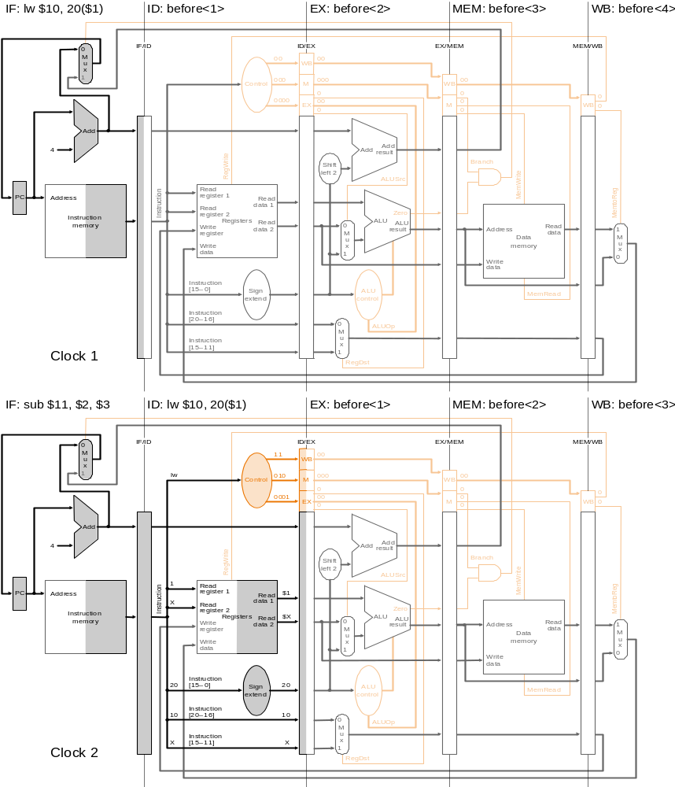
Example 2: Cycle 1

Slide 44
Example 2: Cycle 2

Slide 45
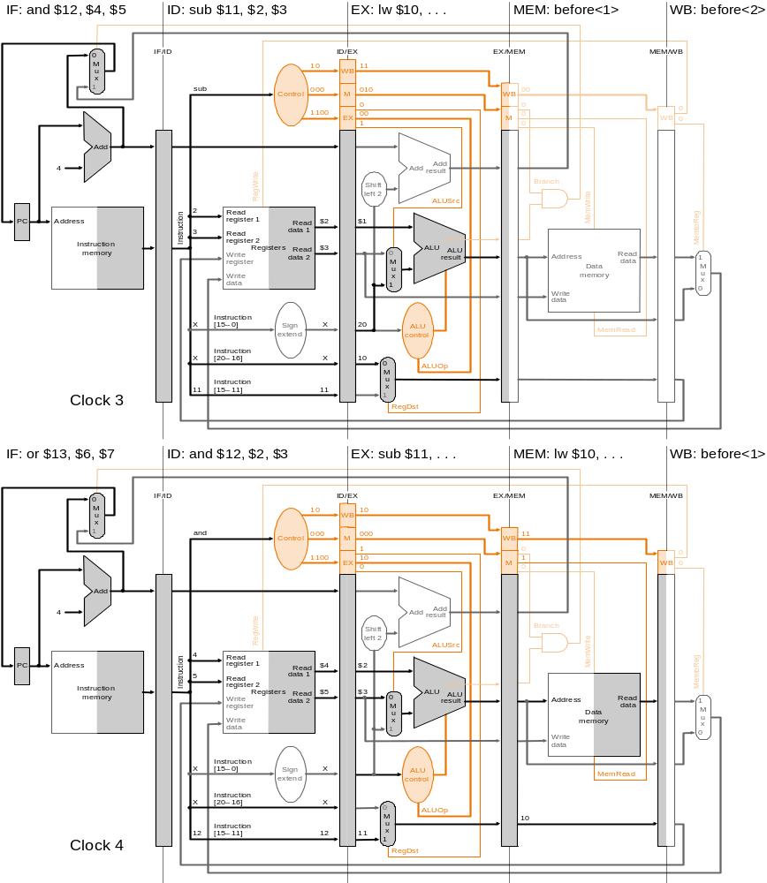
Example 2: Cycle 3

Slide 46
Example 2: Cycle 4

Slide 47
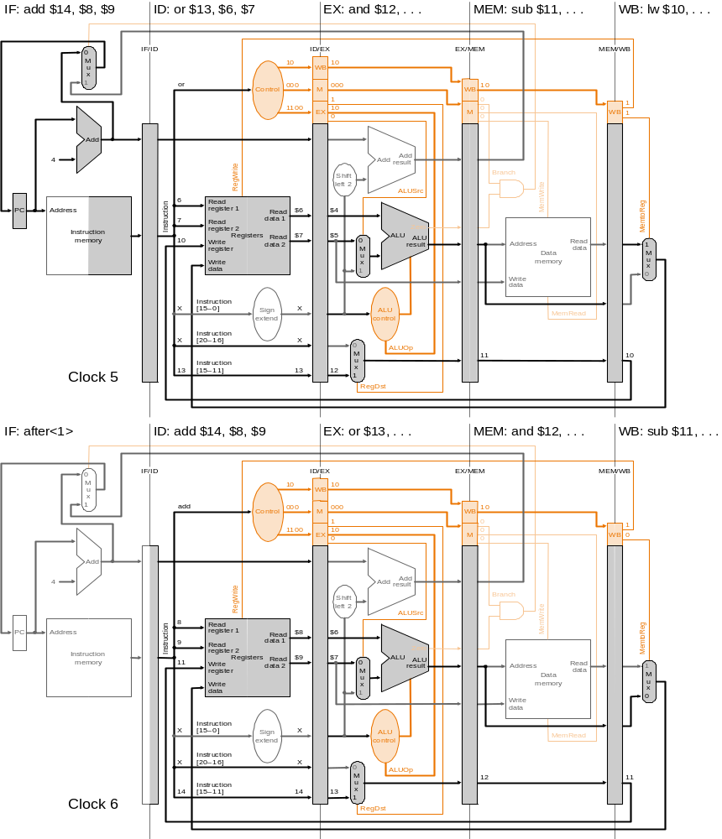
Example 2: Cycle 5

Slide 48
Example 2: Cycle 6

Slide 49
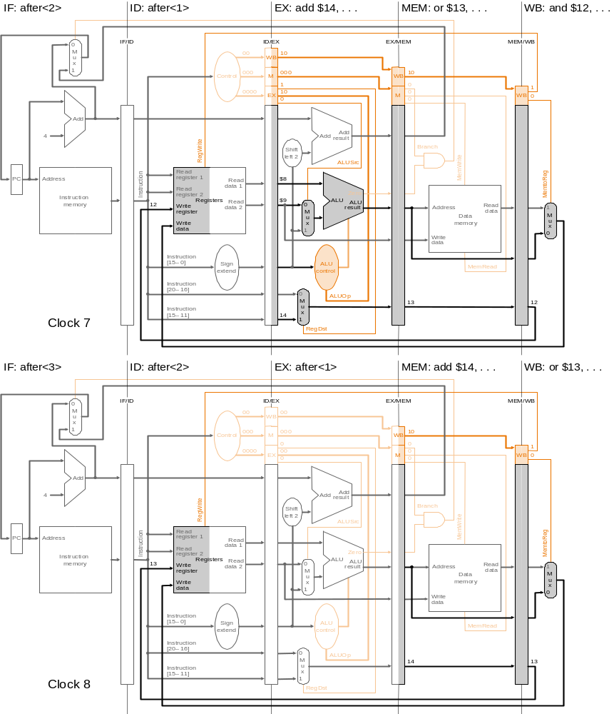
Example 2: Cycle 7
Fig. 6.34

Slide 50
Example 2: Cycle 8
Fig. 6.34

Slide 51
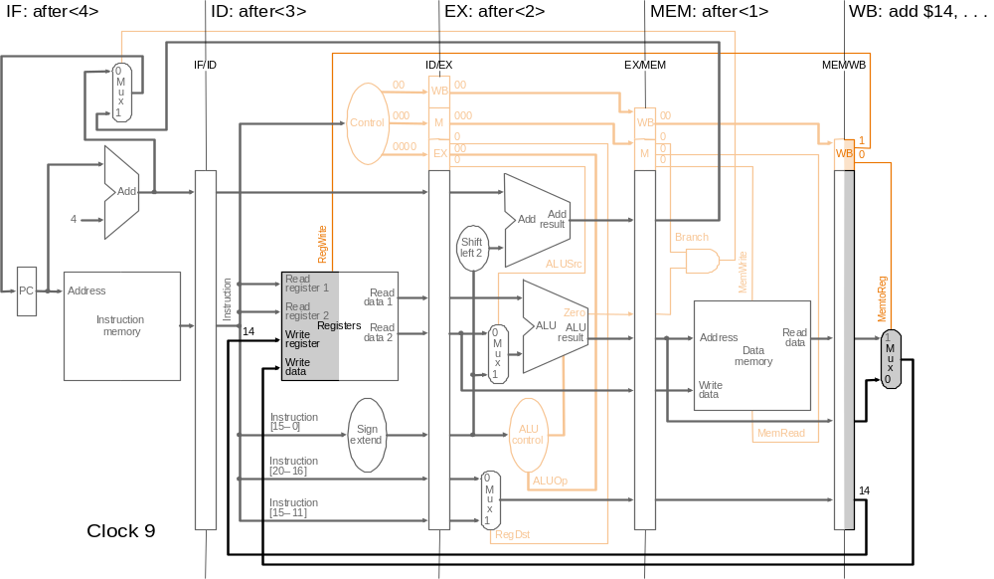
Example 2: Cycle 9

Slide 52
Summary of Pipeline Basics
Pipelining is a fundamental concept
  Multiple steps using distinct resources
  Utilize capabilities of datapath by pipelined instruction processing
    Start next instruction while working on the current one
    Limited by length of longest stage (plus fill/flush)
    Need to detect and resolve hazards
What makes it easy in MIPS?
  All instructions are of the same length
  Just a few instruction formats
  Memory operands only in loads and stores
What makes pipelining hard? hazards

Slide 53
Outline
An overview of pipelining
A pipelined datapath
Pipelined control
Hazards: types of hazard
Handling data hazards
  Inserting NOP（software）
  Forwarding, R-Type-use（hardware)
  Stalls, load-use (hardware)
Handling branch hazards
Exceptions
Superscalar and dynamic pipelining

Slide 54
Pipeline Hazards
Pipeline Hazards:
  Structural hazards: attempt to use the same resource in two different ways at the same time
    Ex.: combined washer/dryer or folder busy doing something else (watching TV)
  Data hazards: attempt to use item before ready
    Instruction depends on result of prior instruction still in the pipeline
  Control hazards: attempt to make decision before condition is evaluated
    Ex.: wash football uniforms and need to see result of previous load to get proper detergent level
    Branch instructions
Can always resolve hazards by waiting
  pipeline control must detect the hazard
  take action (or delay action) to resolve hazards

Slide 55
Structural Hazard: Single Memory
Time
Load
Mem
Reg
ALU
Mem
Reg
I
n
s
t
r.
O
r
d
e
r
Instr 1
Mem
Reg
ALU
Mem
Reg
Instr 2
Mem
Reg
ALU
Mem
Reg
Instr 3
Mem
Reg
ALU
Mem
Reg
Instr 4
Mem
Reg
ALU
Mem
Reg

Slide 56
Pipeline Hazards Illustrated
IF ID EX MEM WB
Structural
Hazard
IF ID ….
time

Slide 57
Structural Hazard: Single Memory
Time
Load
Mem
Reg
ALU
Mem
Reg
I
n
s
t
r.
O
r
d
e
r
Instr 1
Mem
Reg
ALU
Mem
Reg
Instr 2
Mem
Reg
ALU
Mem
Reg
Instr 3
Mem
Reg
ALU
Mem
Reg
Instr 4
Mem
Reg
ALU
Mem
Reg
Use 2 memory: data memory and instruction memory

Slide 58
Feedback Path: Data Hazard
0
M
u
x
1
I
F
/
I
D
I
D
/
E
X
E
X
/
M
E
M
M
E
M
/
W
B
A
d
d
4
A
d
d
r
e
A
d
d
s
u
l
t
l
S
h
i
f
t
e
f
t
2
n
R
e
a
d
o
r
e
g
i
s
t
e
r
1
P
C
A
d
d
r
e
s
s
i
t
R
e
a
d
c
u
d
a
t
a
1
r
t
R
e
a
d
s
Z
e
r
o
n
r
e
g
i
s
t
e
r
2
I
n
s
t
r
u
c
t
i
o
n
I
R
e
g
i
s
t
e
r
s
R
e
a
d
A
L
U
A
L
U
m
e
m
o
r
y
W
r
i
t
e
d
a
t
a
2
0
r
e
s
u
l
t
A
d
d
r
e
s
s
R
e
a
d
1
r
e
g
i
s
t
e
r
M
d
a
t
a
M
W
r
i
t
e
u
D
a
t
a
u
d
a
t
a
x
m
e
m
o
r
y
x
1
W
r
i
t
e
0
d
a
t
a
1
6
S
i
g
n
3
2
e
x
t
e
n
d

Slide 59
Data Hazards
T
i
m
e
(
i
n
c
l
o
c
k
c
y
c
l
e
s
)
V
a
l
u
e
o
f
C
C
1
C
C
2
C
C
3
C
C
4
C
C
5
C
C
6
C
C
7
C
C
8
C
C
9
r
e
g
i
s
t
e
r
$
2
:
1
0
1
0
1
0
1
0
1
0
/
-2
0
-20
-2
0
-2
0
-2
0
P
r
o
g
r
a
m
e
x
e
c
u
t
i
o
n
o
r
d
e
r
(
i
n
i
n
s
t
r
u
c
t
i
o
n
s
)
s
u
b
$
2
,
$
1
,
$
3
I
M
R
e
g
D
M
R
e
g
a
n
d
$
1
2
,
$
2
,
$
5
I
M
R
e
g
D
M
R
e
g
o
r
$
1
3
,
$
6
,
$
2
I
M
R
e
g
D
M
R
e
g
a
d
d
$
1
4
,
$
2
,
$
2
I
M
R
e
g
D
M
R
e
g
s
w
$
1
5
,
1
0
0
(
$
2
)
I
M
R
e
g
D
M
R
e
g

Slide 60
Types of Data Hazards
Three types: (inst. i1 followed by inst. i2)
RAW (read after write):
i2 tries to read operand before i1 writes it
WAR (write after read):
i2 tries to write operand before i1 reads it
  Gets wrong operand, e.g., autoincrement addr.
  Can’t happen in MIPS 5-stage pipeline because:
    All instructions take 5 stages, and reads are always in stage 2, and writes are always in stage 5
WAW (write after write):
i2 tries to write operand before i1 writes it
  Leaves wrong result ( i1’s not i2’s); occur only in pipelines that write in more than one stage
  Can’t happen in MIPS 5-stage pipeline because:
    All instructions take 5 stages, and writes are always in stage 5

Slide 61
Pipeline Hazards Illustrated
IF ID EX MEM WB
RAW (read after write) Data Hazard
IF ID EX MEM WB
WAW Data Hazard
(write after write)
IF ID EX MEM WB
IF ID EX Mem
IF ID EX MEM WB
WAR Data Hazard
(write after read)
time

Slide 62
Feedback Path: Control Hazard
0
M
u
x
1
I
F
/
I
D
I
D
/
E
X
E
X
/
M
E
M
M
E
M
/
W
B
A
d
d
4
A
d
d
r
e
A
d
d
s
u
l
t
l
S
h
i
f
t
e
f
t
2
n
R
e
a
d
o
r
e
g
i
s
t
e
r
1
P
C
A
d
d
r
e
s
s
i
t
R
e
a
d
c
u
d
a
t
a
1
r
t
R
e
a
d
s
Z
e
r
o
n
r
e
g
i
s
t
e
r
2
I
n
s
t
r
u
c
t
i
o
n
I
R
e
g
i
s
t
e
r
s
R
e
a
d
A
L
U
A
L
U
m
e
m
o
r
y
W
r
i
t
e
d
a
t
a
2
0
r
e
s
u
l
t
A
d
d
r
e
s
s
R
e
a
d
1
r
e
g
i
s
t
e
r
M
d
a
t
a
M
W
r
i
t
e
u
D
a
t
a
u
d
a
t
a
x
m
e
m
o
r
y
x
1
W
r
i
t
e
0
d
a
t
a
1
6
S
i
g
n
3
2
e
x
t
e
n
d

Slide 63
Outline
An overview of pipelining
A pipelined datapath
Pipelined control
Hazards: types of hazard
Handling data hazards
  Inserting NOP（software）
  Forwarding, R-Type-use (hardware)
  Stalls, load-use (hardware)
Handling branch hazards
Exceptions
Superscalar and dynamic pipelining

Slide 64
Handling Data Hazards
Use simple, fixed designs
  Eliminate WAR by always fetching operands early (ID) in pipeline
  Eliminate WAW by doing all write backs in order (last stage, static)
  These features have a lot to do with ISA design
Internal forwarding in register file:
  Write in first half of clock and read in second half
  Read delivers what is written, resolve hazard between sub and add
Detect and resolve remaining ones
  Compiler inserts NOP (software solution)
  Forward (hardware solution)
  Stall (hardware solution)

Slide 65
Software Solution
Have compiler guarantee no hazards
Where do we insert the NOPs?
sub $2, $1, $3
and $12, $2, $5
or $13, $6, $2
add $14, $2, $2
sw $15, 100($2)
Problem: this really slows us down!

Slide 66
Data Hazards
T
i
m
e
(
i
n
c
l
o
c
k
c
y
c
l
e
s
)
V
a
l
u
e
o
f
C
C
1
C
C
2
C
C
3
C
C
4
C
C
5
C
C
6
C
C
7
C
C
8
C
C
9
r
e
g
i
s
t
e
r
$
2
:
1
0
1
0
1
0
1
0
1
0
/
-2
0
-20
-2
0
-2
0
-2
0
P
r
o
g
r
a
m
e
x
e
c
u
t
i
o
n
o
r
d
e
r
(
i
n
i
n
s
t
r
u
c
t
i
o
n
s
)
s
u
b
$
2
,
$
1
,
$
3
I
M
R
e
g
D
M
R
e
g
Insert two nops
a
n
d
$
1
2
,
$
2
,
$
5
I
M
R
e
g
D
M
R
e
g
o
r
$
1
3
,
$
6
,
$
2
I
M
R
e
g
D
M
R
e
g
a
d
d
$
1
4
,
$
2
,
$
2
I
M
R
e
g
D
M
R
e
g
s
w
$
1
5
,
1
0
0
(
$
2
)
I
M
R
e
g
D
M
R
e
g

Slide 67
Outline
An overview of pipelining
A pipelined datapath
Pipelined control
Hazards: types of hazard
Handling data hazards
  Inserting NOP（software）
  Forwarding, R-Type-use（hardware)
  Stalls, load-use (hardware)
Handling branch hazards
Exceptions
Superscalar and dynamic pipelining

Slide 68
Data Hazards : Forwarding
T
i
m
e
(
i
n
c
l
o
c
k
c
y
c
l
e
s
)
V
a
l
u
e
o
f
C
C
1
C
C
2
C
C
3
C
C
4
C
C
5
C
C
6
C
C
7
C
C
8
C
C
9
r
e
g
i
s
t
e
r
$
2
:
1
0
1
0
1
0
1
0
1
0
/
-2
0
-20
-20
-20
-20
P
r
o
g
r
a
m
e
x
e
c
u
t
i
o
n
o
r
d
e
r
(
i
n
i
n
s
t
r
u
c
t
i
o
n
s
)
s
u
b
$
2
,
$
1
,
$
3
I
M
R
e
g
D
M
R
e
g
a
n
d
$
1
2
,
$
2
,
$
5
I
M
R
e
g
D
M
R
e
g
o
r
$
1
3
,
$
6
,
$
2
I
M
R
e
g
D
M
R
e
g
a
d
d
$
1
4
,
$
2
,
$
2
I
M
R
e
g
D
M
R
e
g
s
w
$
1
5
,
1
0
0
(
$
2
)
I
M
R
e
g
D
M
R
e
g

Slide 69
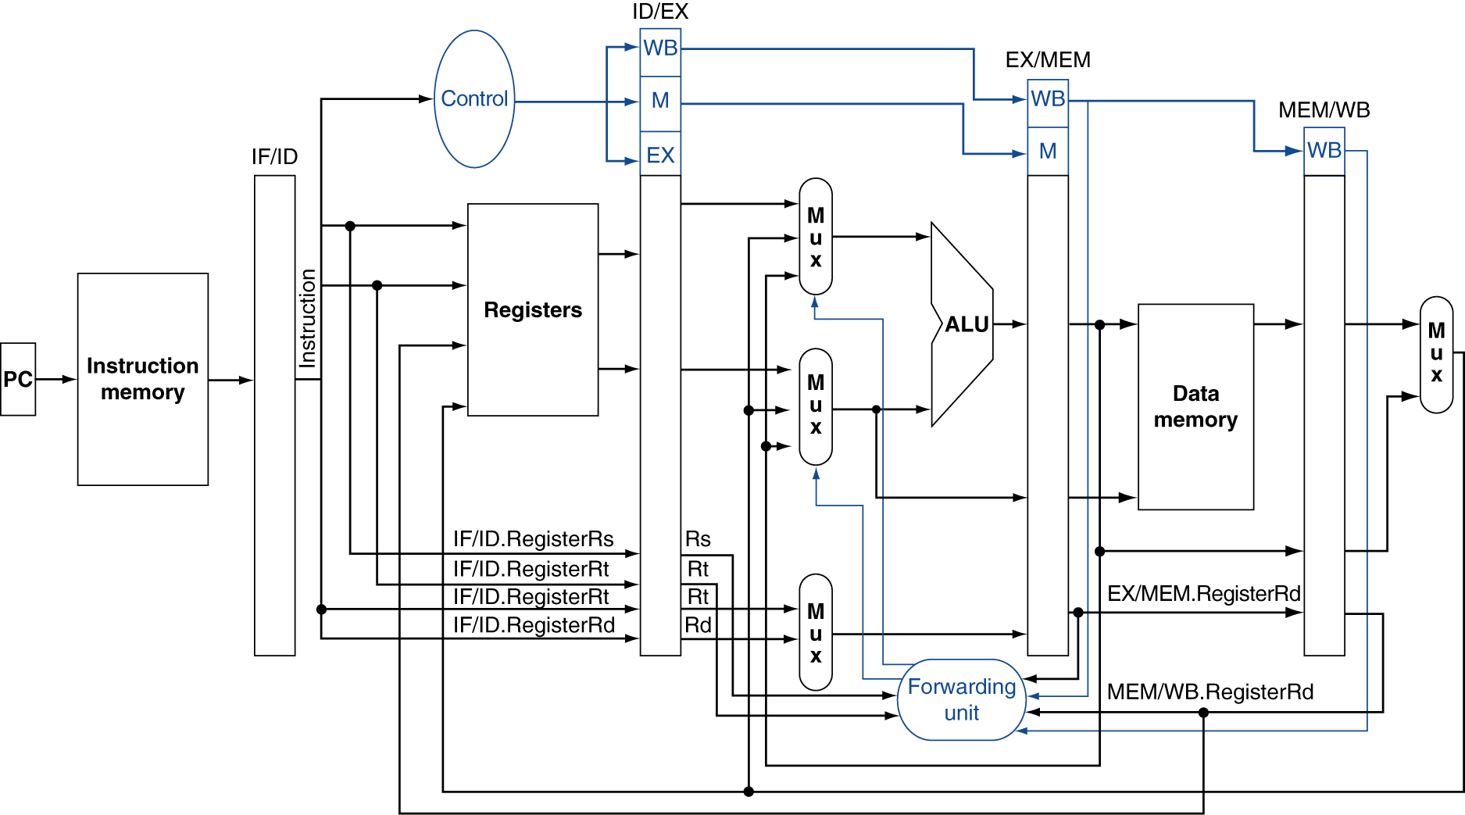
Datapath with Forwarding

Slide 70
Control: Detecting Data Hazards
Hazard conditions:
  1a. EX/MEM.RegisterRd = ID/EX.RegisterRs
  1b. EX/MEM.RegisterRd = ID/EX.RegisterRt
  2a. MEM/WB.RegisterRd = ID/EX.RegisterRs
  2b. MEM/WB.RegisterRd = ID/EX.RegisterRt
Two optimizations:
  Don’t forward if instruction does not write register
  => check if RegWrite is asserted
  Don’t forward if destination register is $0
  => check if RegisterRd = 0

Slide 71
Detecting Data Hazards (cont.)
Hazard conditions using control signals:
  At EX stage:
  EX/MEM.RegWrite and (EX/MEM.RegRd≠0)
  and (EX/MEM.RegRd=ID/EX.RegRs)
  At MEM stage:
  MEM/WB.RegWrite and (MEM/WB.RegRd≠0)
  and (MEM/WB.RegRd=ID/EX.RegRs)
  (replace ID/EX.RegRt for ID/EX.RegRs for the other two conditions)

Slide 72
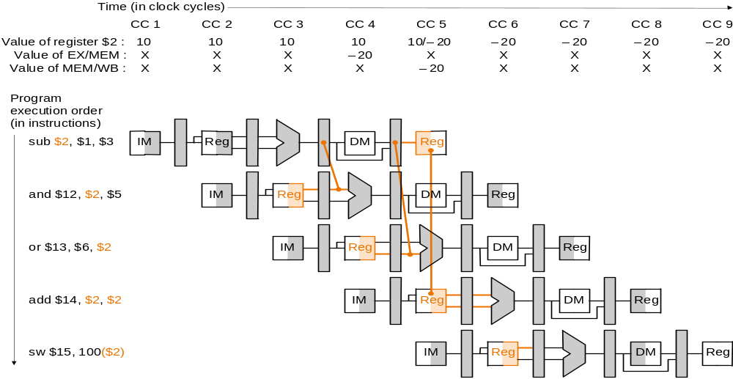
Resolving Hazards: Forwarding
Use temporary results, e.g., those in pipeline registers, don’t wait for them to be written

Slide 73
Datapath with Forwarding (Both MEM and WB Stages Forwards)

Slide 74
Forwarding Logic
Forwarding: input to ALU from any pipe reg.
  Add multiplexors to ALU input 
  Control forwarding in EX => carry Rs in ID/EX
Control signals for forwarding:
  If both WB and MEM forward, e.g., add $1,$1,$2; add $1,$1,$3; add $1,$1,$4; => let MEM forward
  EX hazard:
    if (EX/MEM.RegWrite and (EX/MEM.RegRd≠0)
    and (EX/MEM.RegRd=ID/EX.RegRs)) ForwardA=10
  MEM hazard:
    if (MEM/WB.RegWrite and (MEM/WB.RegRd≠0)
    and (EX/MEM.RegRd ≠ ID/EX.Reg.Rs)
    and (MEM/WB.RegRd=ID/EX.RegRs)) ForwardA=01
(ID/EX.RegRt<->ID/EX.RegRs, ForwardB<-> ForwardA)

Slide 75
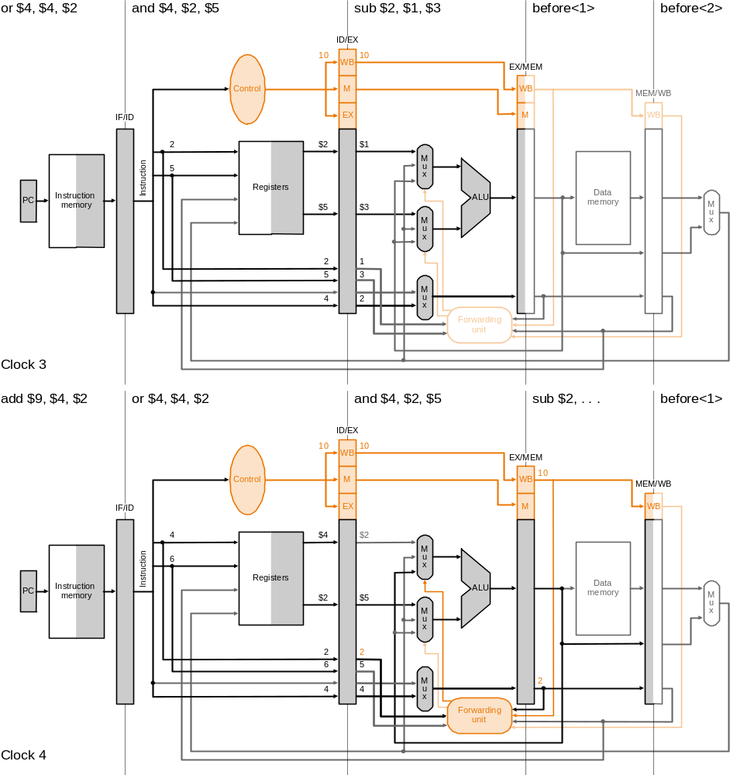
Example 3: Cycle 3

Slide 76
Example 3: Cycle 4

Slide 77
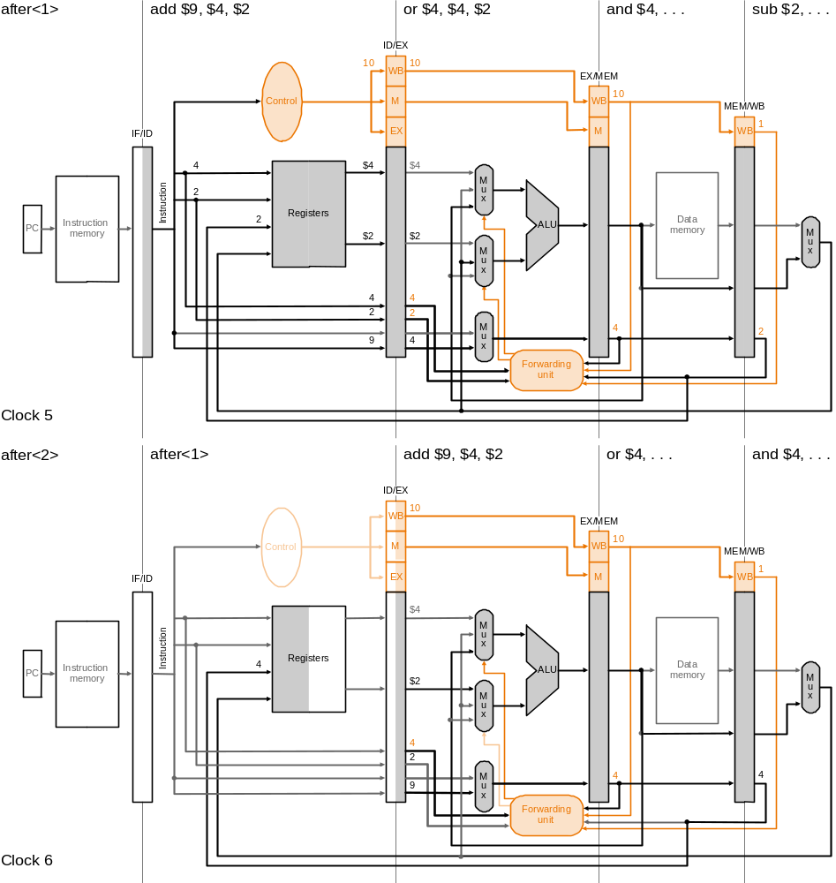
Example 3: Cycle 5

Slide 78
Example 3: Cycle 6
Fig. 6.42

Slide 79
Outline
An overview of pipelining
A pipelined datapath
Pipelined control
Hazards: types of hazard
Handling data hazards
  Inserting NOP（software）
  Forwarding, R-Type-use（hardware)
  Stalls, load-use (hardware)
Handling branch hazards
Exceptions
Superscalar and dynamic pipelining

Slide 80
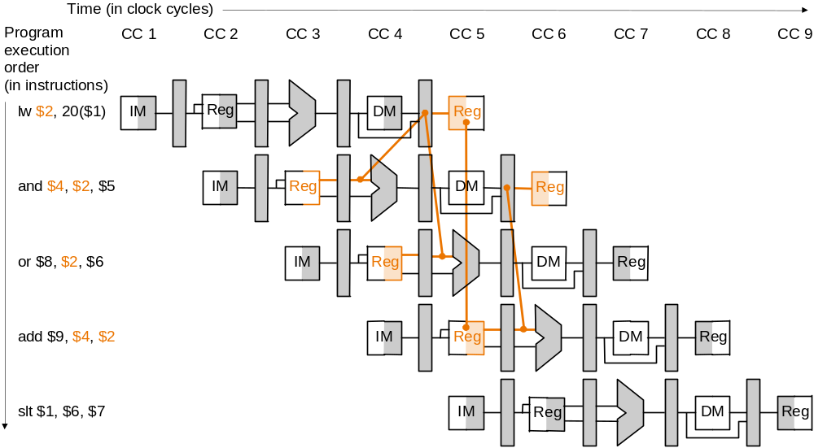
Can't Always Forward
lw can still cause a hazard:
  if is followed by an instruction to read the loaded reg.
Use stalling or compiler to resolve

Slide 81
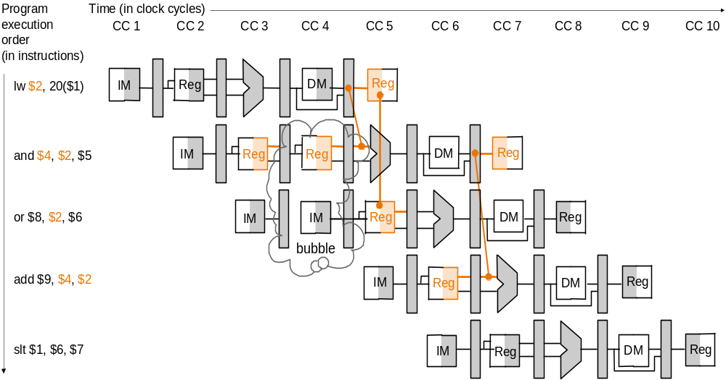
Stalling
Stall pipeline by keeping instructions in same stage and inserting an NOP instead

Slide 82
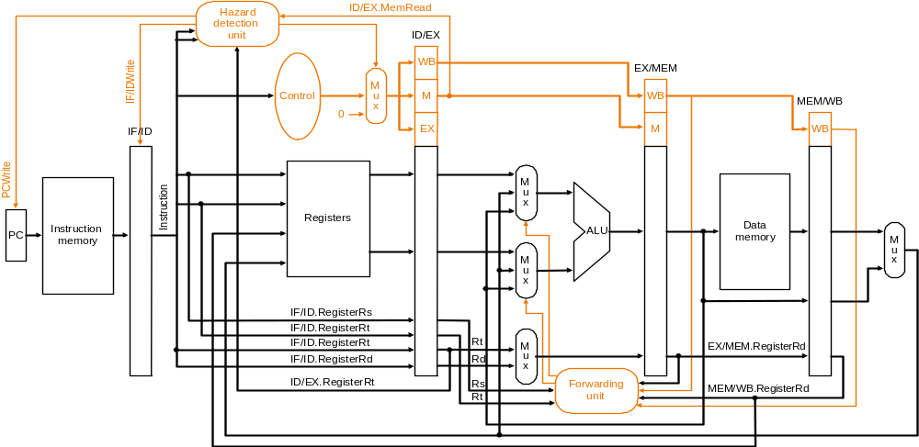
Datapath with Stalling Unit
Forwarding controls ALU inputs, hazard detection controls PC, IF/ID, control signals

Slide 83
Control: Handling Stalls
Hazard detection unit in ID to insert stall between a load instruction and its use:
if (ID/EX.MemRead and
((ID/EX.RegisterRt = IF/ID.RegisterRs) or
(ID/EX.RegisterRt = IF/ID.registerRt))
stall the pipeline for one cycle
(ID/EX.MemRead=1 indicates a load instruction)
How to stall?
  Stall instruction in IF and ID: not change PC and IF/ID
  => the stages re-execute the instructions
  What to move into EX: insert an NOP by changing EX, MEM, WB control fields of ID/EX pipeline register to 0
    as control signals propagate, all control signals to EX, MEM, WB are deasserted and no registers or memories are written

Slide 84
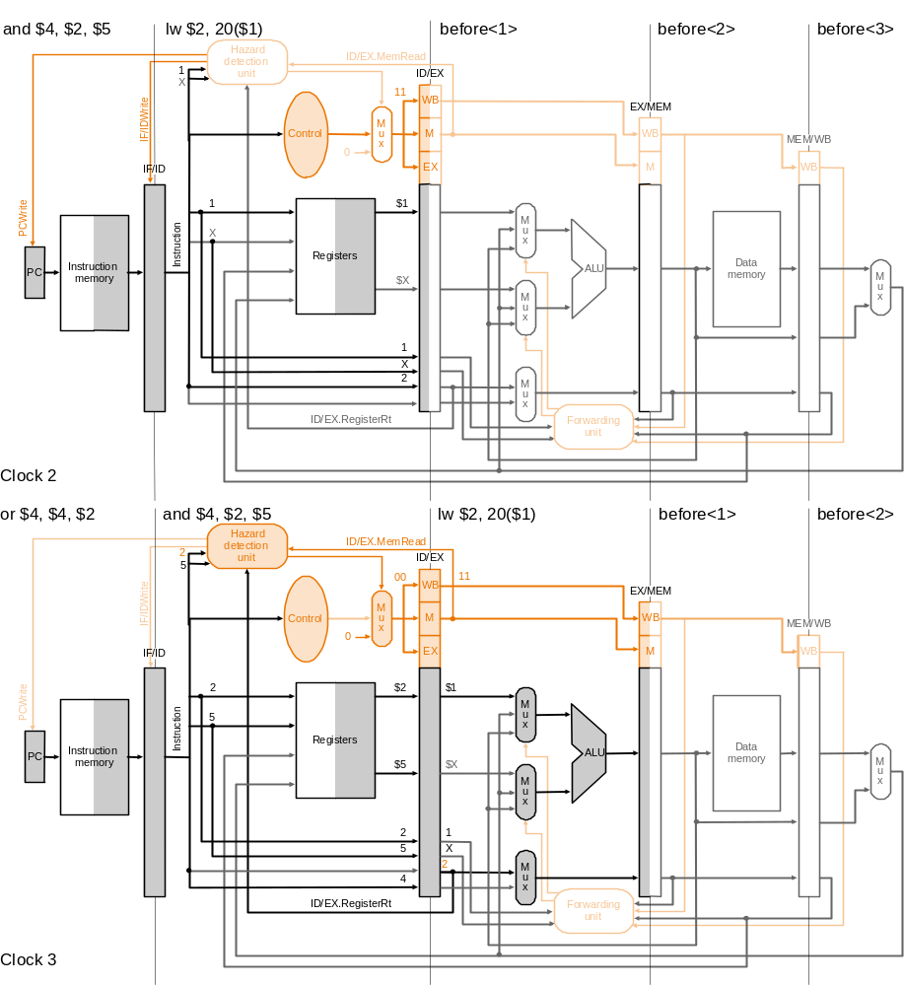
Example 4: Cycle 2

Slide 85
Example 4: Cycle 3

Slide 86
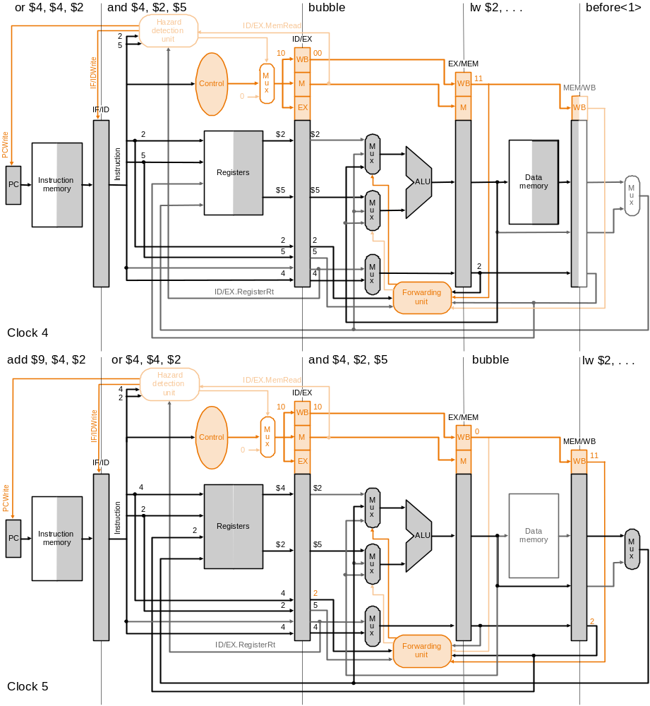
Example 4: Cycle 4

Slide 87
Example 4: Cycle 5

Slide 88
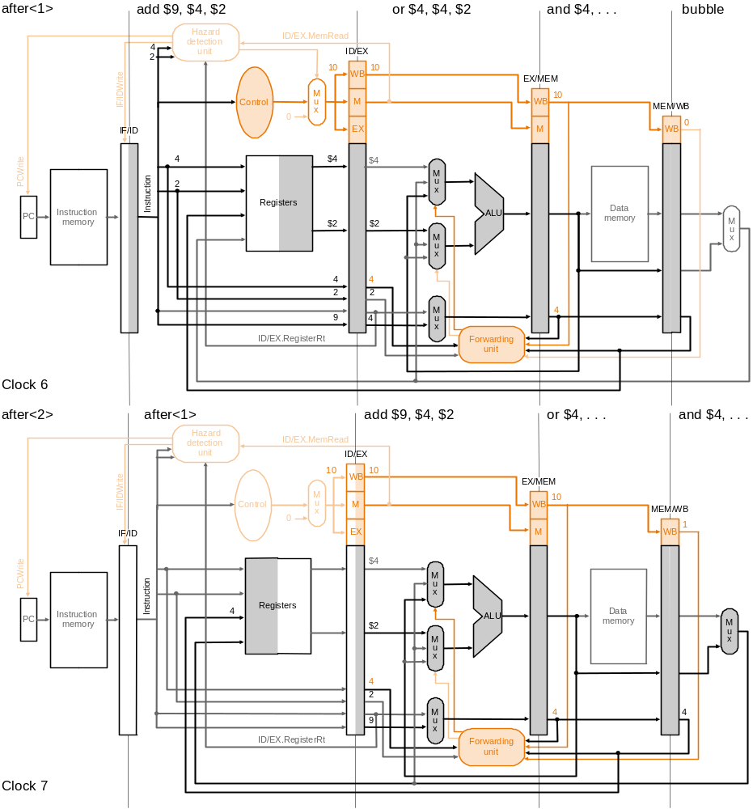
Example 4: Cycle 6
Fig. 6.49

Slide 89
Example 4: Cycle 7

Slide 90
Outline
An overview of pipelining
A pipelined datapath
Pipelined control
Hazards: types of hazard
Handling data hazards
  Inserting NOP（software）
  Forwarding, R-Type-use（hardware)
  Stalls, load-use (hardware)
Handling branch hazards
Exceptions
Superscalar and dynamic pipelining

Slide 91
Feedback Path
0
M
u
x
1
I
F
/
I
D
I
D
/
E
X
E
X
/
M
E
M
M
E
M
/
W
B
A
d
d
4
A
d
d
r
e
A
d
d
s
u
l
t
l
S
h
i
f
t
e
f
t
2
n
R
e
a
d
o
r
e
g
i
s
t
e
r
1
P
C
A
d
d
r
e
s
s
i
t
R
e
a
d
c
u
d
a
t
a
1
r
t
R
e
a
d
s
Z
e
r
o
n
r
e
g
i
s
t
e
r
2
I
n
s
t
r
u
c
t
i
o
n
I
R
e
g
i
s
t
e
r
s
R
e
a
d
A
L
U
A
L
U
m
e
m
o
r
y
W
r
i
t
e
d
a
t
a
2
0
r
e
s
u
l
t
A
d
d
r
e
s
s
R
e
a
d
1
r
e
g
i
s
t
e
r
M
d
a
t
a
M
W
r
i
t
e
u
D
a
t
a
u
d
a
t
a
x
m
e
m
o
r
y
x
1
W
r
i
t
e
0
d
a
t
a
1
6
S
i
g
n
3
2
e
x
t
e
n
d

Slide 92
Pipeline Datapath with Control Signals

Slide 93
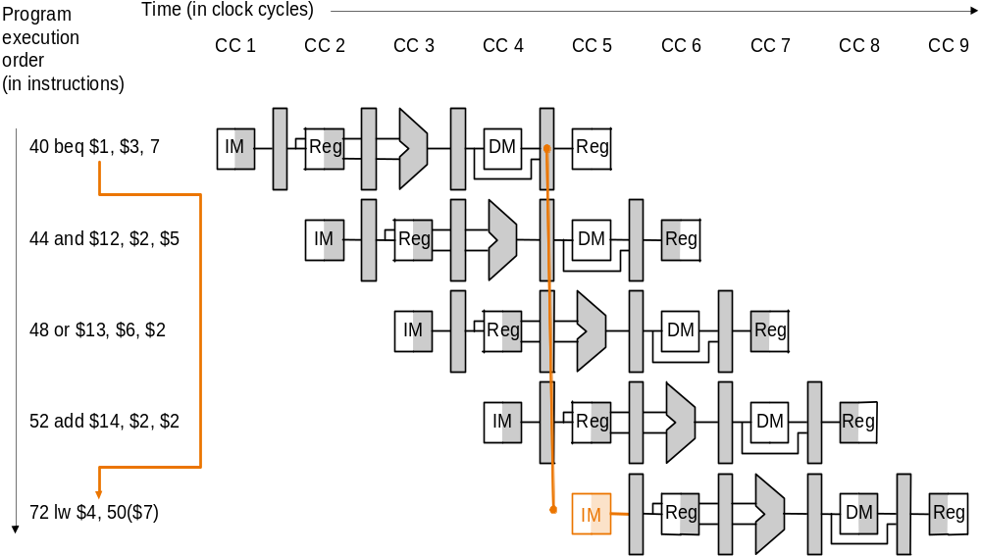
Branch Hazards
When decide to branch, other inst. are in pipeline!

Slide 94
Handling Branch Hazard
Predict branch always not taken
  Need to add hardware for flushing inst. if wrong
  Branch decision made at MEM => need to flush instruction in IF/ID, ID/EX by changing control values to 0
Reduce delay of taken branch by moving branch execution earlier in the pipeline
  Move up branch address calculation to ID
  Check branch equality at ID (using XOR) by comparing the two registers read during ID
  Branch decision made at ID => one instruction to flush
  Add a control signal, IF.Flush, to zero instruction field of IF/ID => making the instruction an NOP
Dynamic branch prediction
Compiler rescheduling, delay branch

Slide 95
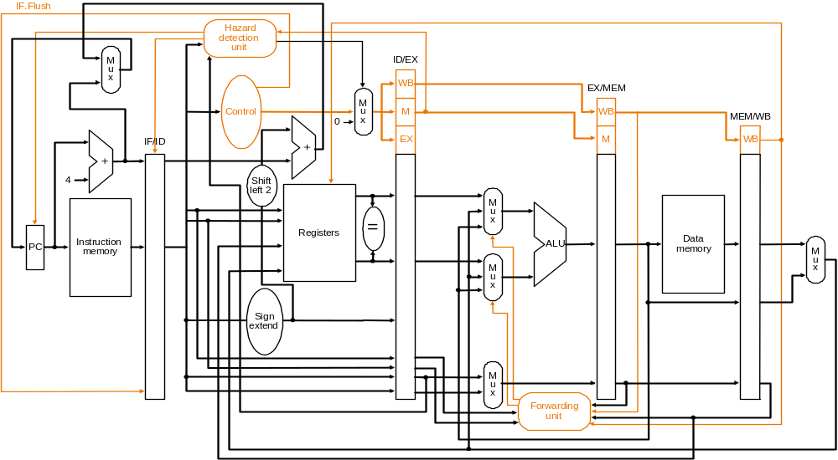
Pipeline with Flushing

Slide 96
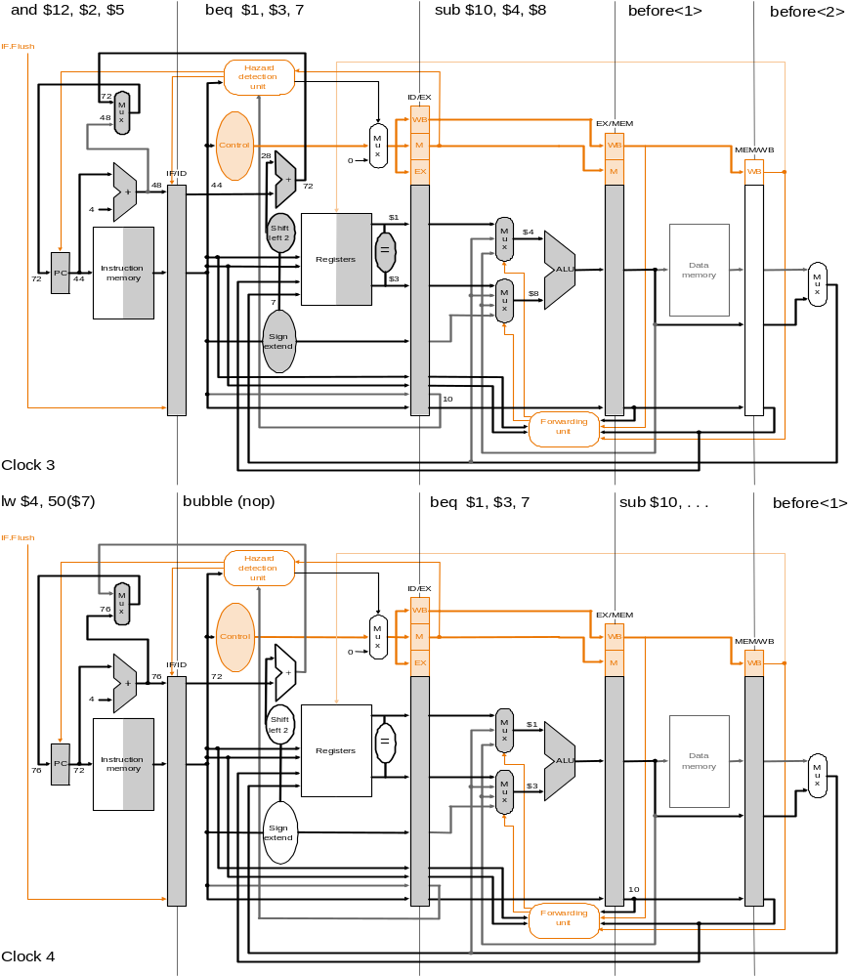
Example 5: Cycle 3

Slide 97
Example 5: Cycle 4

Slide 98
Dynamic Branch Prediction
In deeper and superscalar pipelines, branch penalty is more significant
Use dynamic prediction (e.g. loop)
  Branch prediction buffer (i.e., branch history table)
  Indexed by recent branch instruction addresses
  Stores outcome (taken/not taken)
  To execute a branch
    Check table, expect the same outcome
    Start fetching from fall-through or target
    If wrong, flush pipeline and flip prediction

Slide 99
Calculating the Branch Target
Even with predictor, still need to calculate the target address
  1-cycle penalty for a taken branch
Branch target buffer
  Cache of target addresses
  Indexed by PC when instruction fetched
    If hit and instruction is branch predicted taken, can fetch target immediately

Slide 100
Delayed Branch
Predict-not-taken + branch decision at ID
=> the following instruction is always executed
=> branches take effect 1 cycle later
  0 clock cycle penalty per branch instruction if can find instruction to put in slot (≅50% of time)
I
n
s
t
r.
O
r
d
e
r
Time (clock cycles)
add
Mem
Reg
ALU
Mem
Reg
beq
Mem
Reg
ALU
Mem
Reg
misc
Mem
Reg
ALU
Mem
Reg
lw
Mem
Reg
ALU
Mem
Reg

Slide 101
Outline
An overview of pipelining
A pipelined datapath
Pipelined control
Hazards: types of hazard
Handling data hazards
  Inserting NOP（software）
  Forwarding, R-Type-use（hardware)
  Stalls, load-use (hardware)
Handling branch hazards
Exceptions
Superscalar and dynamic pipelining

Slide 102
Exceptions and Interrupts
“Unexpected” events requiring change
in flow of control
  Different ISAs use the terms differently
Exception
  Arises within the CPU
  e.g., undefined opcode, overflow, syscall, …
Interrupt
  From an external I/O controller
In MIPS, exceptions managed by a System Control Coprocessor (CP0)
Dealing with them without sacrificing performance is hard

Slide 103
Handling Exceptions
Before jump to OS:
Save PC of offending (or interrupted) instruction
  In MIPS: Exception Program Counter (EPC)
Save indication of the problem
  In MIPS: Cause register
  We’ll assume 1-bit
    0 for undefined opcode, 1 for overflow
Jump to handler at 8000 00180

Slide 104
An Alternate Mechanism
Vectored Interrupts
  Handler address determined by the cause
Example:
  Undefined opcode: C000 0000
  Overflow: C000 0020
  …: C000 0040
Instructions either
  Deal with the interrupt, or
  Jump to real handler

Slide 105
Handler Actions
In OS:
Read cause, and transfer to relevant handler
Determine action required
If restartable
  Take corrective action
  use EPC to return to program
Otherwise
  Terminate program
  Report error using EPC, cause, …

Slide 106
Exceptions in a Pipeline
Another form of control hazard
Consider overflow on add in EX stage
  add $1, $2, $1
  Prevent $1 from being clobbered
  Complete previous instructions
  Flush add and subsequent instructions
  Set Cause and EPC register values
  Transfer control to handler
Similar to mispredicted branch
  Use much of the same hardware

Slide 107
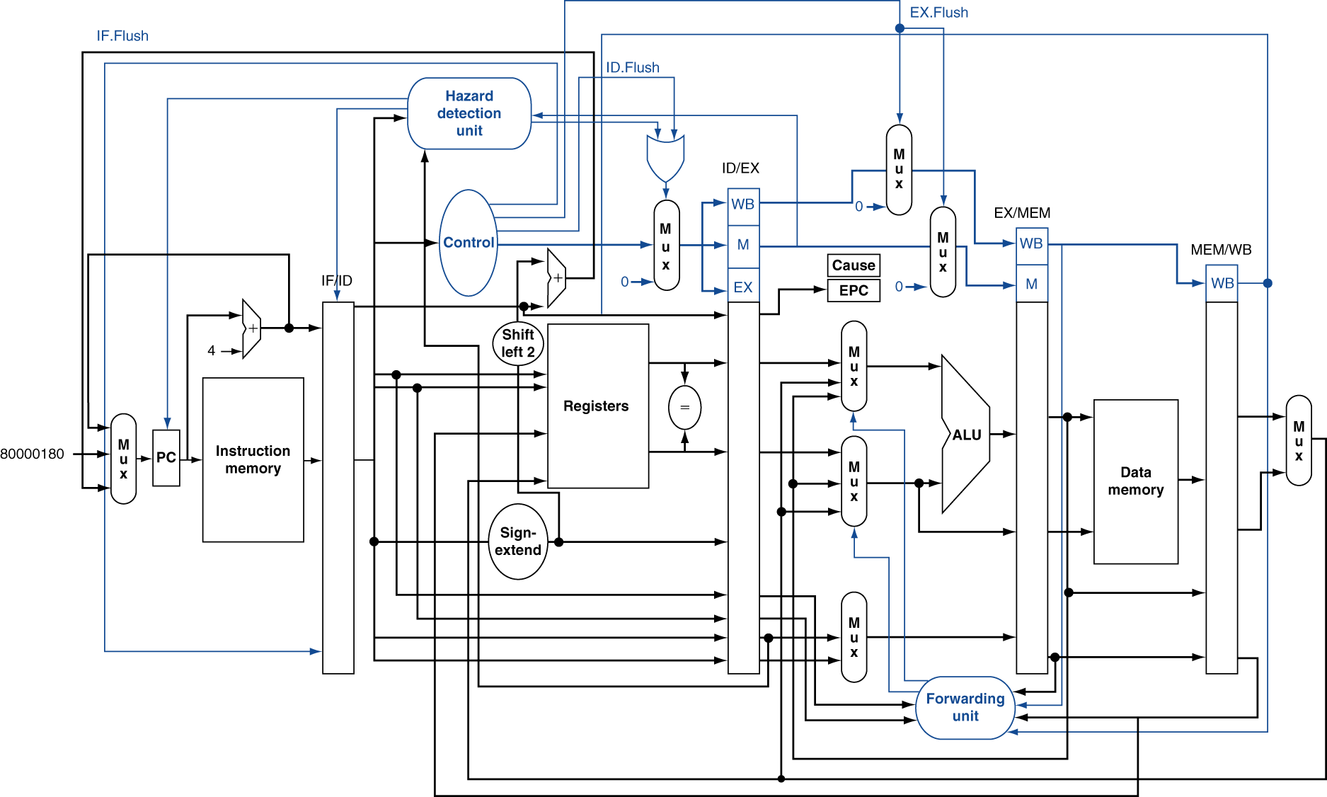
Pipeline with Exceptions

Slide 108
Exception Example
Exception on add in
  40 sub $11, $2, $4
  44 and $12, $2, $5
  48 or $13, $2, $6
  4C add $1, $2, $1
  50 slt $15, $6, $7
  54 lw $16, 50($7)
  …
Handler
  80000180 sw $25, 1000($0)
  80000184 sw $26, 1004($0)
  …

Slide 109
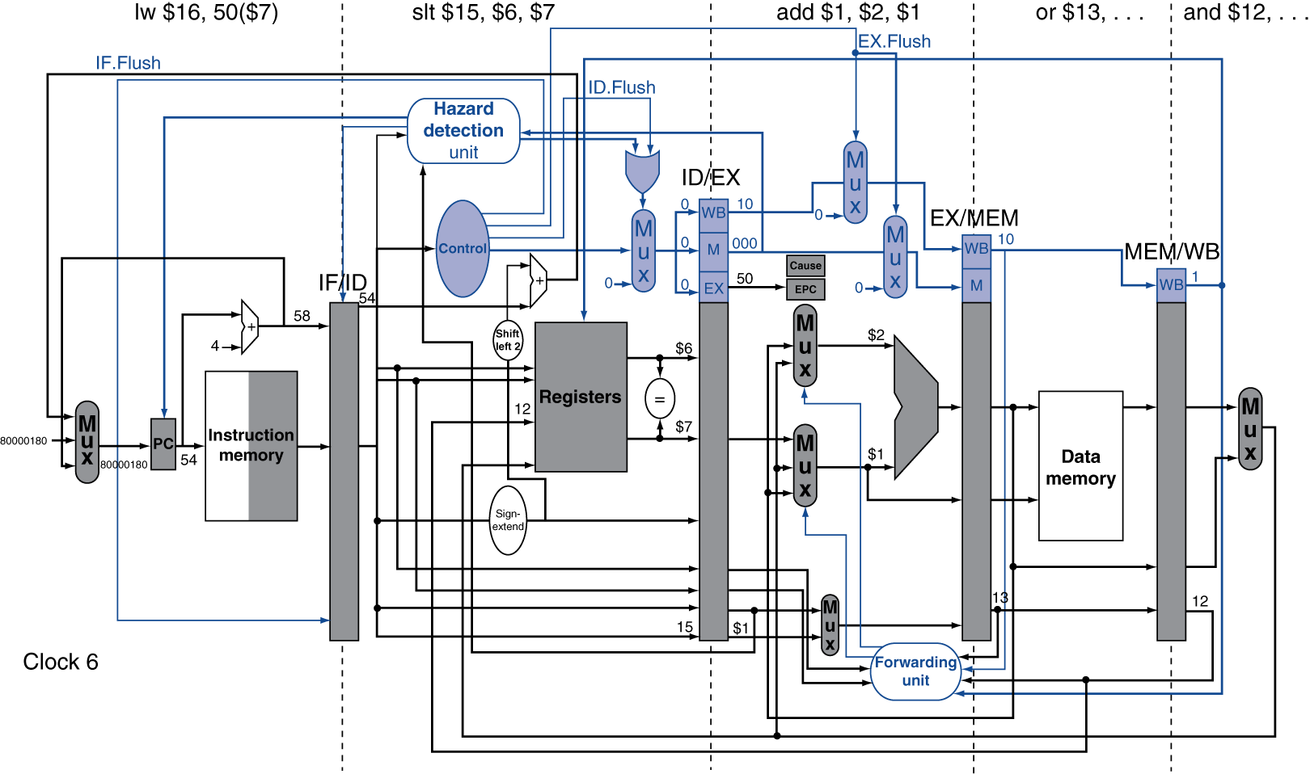
Exception Example

Slide 110
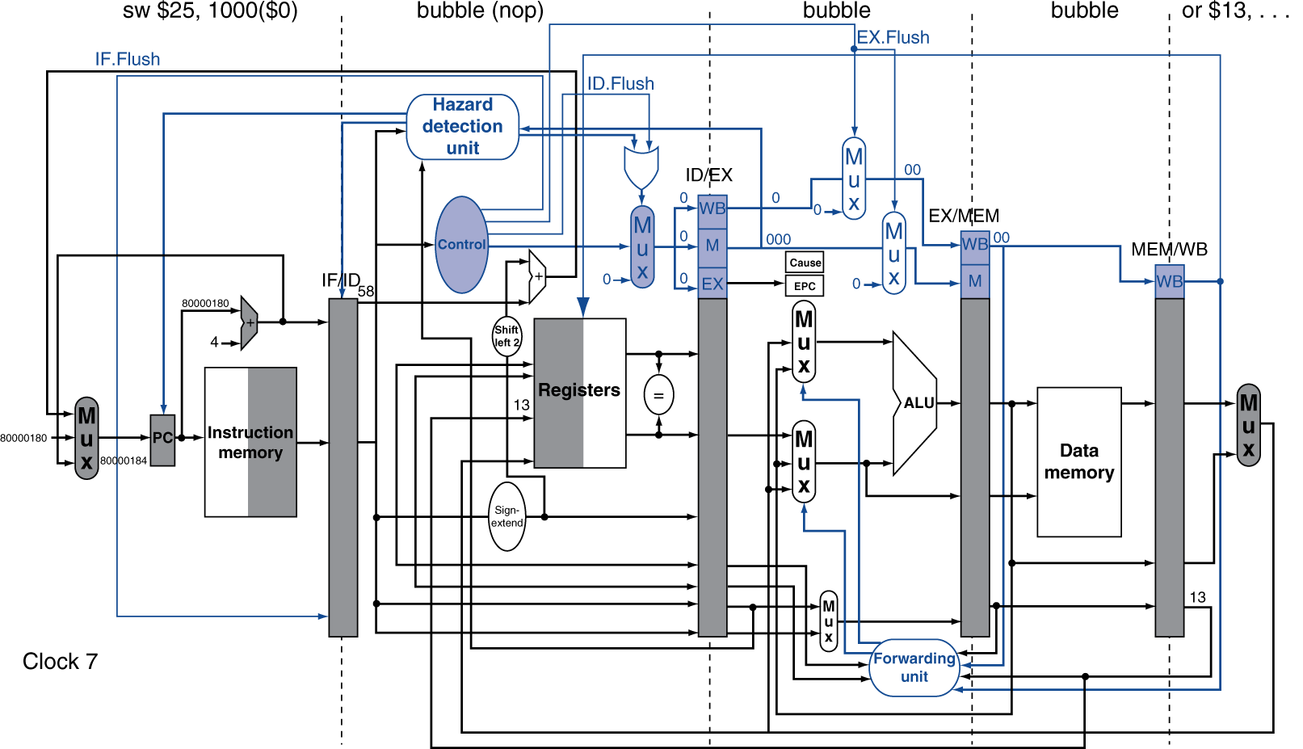
Exception Example

Slide 111
Multiple Exceptions
Pipelining overlaps multiple instructions
  Could have multiple exceptions at once
Simple approach: deal with exception from earliest instruction
  Flush subsequent instructions
  “Precise” exceptions
In complex pipelines
  Multiple instructions issued per cycle
  Out-of-order completion
  Maintaining precise exceptions is difficult!

Slide 112
Imprecise Exceptions
Just stop pipeline and save state
  Including exception cause(s)
Let the handler work out
  Which instruction(s) had exceptions
  Which to complete or flush
    May require “manual” completion
Simplifies hardware, but more complex handler software
Feasible for complex multiple-issue
out-of-order pipelines

Slide 113
Outline
An overview of pipelining
A pipelined datapath
Pipelined control
Hazards: types of hazard
Handling data hazards
  Inserting NOP（software）
  Forwarding, R-Type-use（hardware)
  Stalls, load-use (hardware)
Handling branch hazards
Exceptions
Superscalar and dynamic pipelining

Slide 114
Instruction-Level Parallelism (ILP)
Pipelining: executing multiple instructions in parallel
To increase ILP
  Deeper pipeline
    Less work per stage ⇒ shorter clock cycle
  Multiple issue
    Replicate pipeline stages ⇒ multiple pipelines
    Start multiple instructions per clock cycle
    CPI < 1, so use Instructions Per Cycle (IPC)
    E.g., 4GHz 4-way multiple-issue (Assume 1 instruction completed in 1 cycle)
      16 BIPS, peak CPI = 0.25, peak IPC = 4
      But dependencies reduce this in practice

Slide 115
Multiple Issue
Static multiple issue
  Compiler groups instructions to be issued together
  Packages them into “issue slots”
  Compiler detects and avoids hazards
Dynamic multiple issue
  CPU examines instruction stream and chooses instructions to issue each cycle
  Compiler can help by reordering instructions
  CPU resolves hazards using advanced techniques at runtime

Slide 116
Speculation
“Guess” what to do with an instruction
  Start operation as soon as possible
  Check whether guess was right
    If so, complete the operation
    If not, roll-back and do the right thing
Common to static and dynamic multiple issue
Examples
  Speculate on branch outcome
    Roll back if path taken is different
  Speculate on load
    A store that proceeds a load does not refer to the same address (load first)
    Roll back if location is updated

Slide 117
Compiler/Hardware Speculation
Compiler can reorder instructions
  e.g., move load before store
  Can include “fix-up” instructions to recover from incorrect guess
Hardware can look ahead for instructions to execute
  Buffer results until it determines they are actually needed
  Flush buffers on incorrect speculation

Slide 118
Multiple Issue
Static multiple issue (compiler approach)
Dynamic multiple issue (hardware approach)

Slide 119
Static Multiple Issue
Compiler groups instructions into “issue packets”
  Group of instructions that can be issued on a single cycle
  Determined by pipeline resources required
Think of an issue packet as a very long instruction
  Specifies multiple concurrent operations
  ⇒ Very Long Instruction Word (VLIW)

Slide 120
Scheduling Static Multiple Issue
Compiler must remove some/all hazards
  Reorder instructions into issue packets
  No dependencies with a packet
  Possibly some dependencies between packets
    Varies between ISAs; compiler must know!
  Pad with nop if necessary

Slide 121
MIPS with Static Dual Issue
Two-issue packets
  One ALU/branch instruction
  One load/store instruction
  64-bit aligned
    ALU/branch, then load/store
    Pad an unused instruction with nop
Address | Instruction type | Pipeline Stages
n | ALU/branch | IF | ID | EX | MEM | WB
n + 4 | Load/store | IF | ID | EX | MEM | WB
n + 8 | ALU/branch |  | IF | ID | EX | MEM | WB
n + 12 | Load/store |  | IF | ID | EX | MEM | WB
n + 16 | ALU/branch |  |  | IF | ID | EX | MEM | WB
n + 20 | Load/store |  |  | IF | ID | EX | MEM | WB

Slide 122
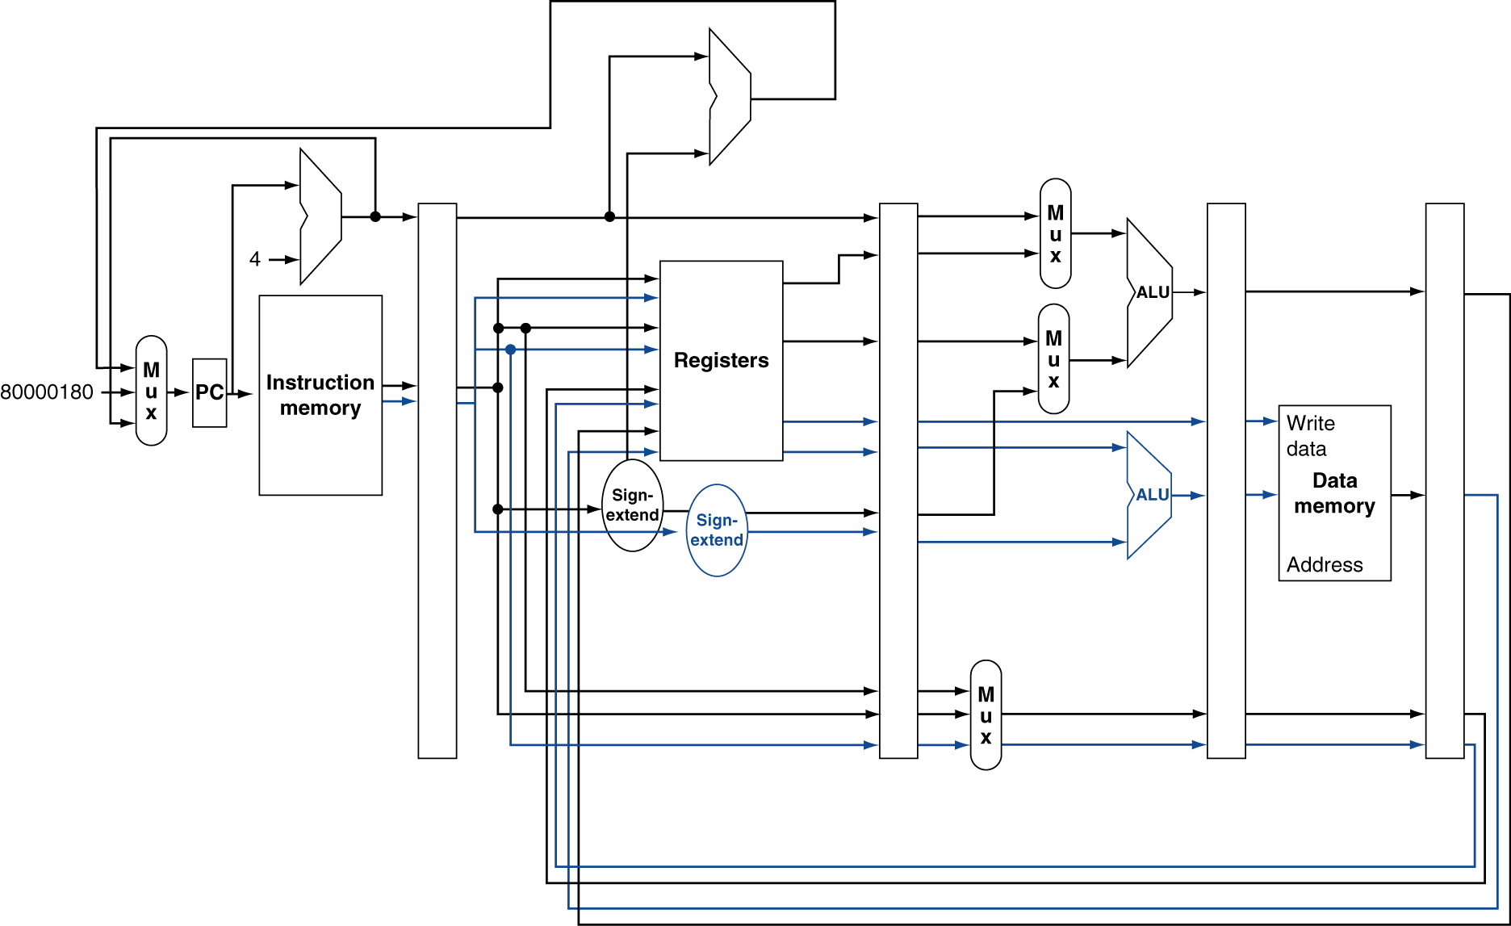
MIPS with Static Dual Issue
Notes:
Hardware required: (beyond hazard detection)
Register file with 4 read ports and two write ports (one r-type and one load instructions)
One more ALU to compute load/store address

Slide 123
Hazards in the Dual-Issue MIPS
More instructions executing in parallel
EX data hazard
  Forwarding avoided stalls with single-issue
  Now can’t use ALU result in load/store in same packet
    add $t0, $s0, $s1
    load $s2, 0($t0)
    Split into two packets, effectively a stall
Load-use hazard
  Still one cycle use latency, but now two instructions
More aggressive scheduling required

Slide 124
Scheduling Example
Schedule this for dual-issue MIPS
Loop: lw $t0, 0($s1) # $t0=array element
addu $t0, $t0, $s2 # add scalar in $s2
sw $t0, 4($s1) # store result
addi $s1, $s1,–4 # decrement pointer
bne $s1, $zero, Loop # branch $s1!=0
 | ALU/branch | Load/store | cycle
Loop: | nop | lw $t0, 0($s1) | 1
 | addi $s1, $s1,–4 | nop | 2
 | addu $t0, $t0, $s2 | nop | 3
 | bne $s1, $zero, Loop | sw $t0, 4($s1) | 4
  IPC = 5/4 = 1.25 (c.f. peak IPC = 2)

Slide 125
Loop Unrolling
Replicate loop body to expose more parallelism
  Reduces loop-control overhead
Use different registers per replication
  Called “register renaming”
  Avoid loop-carried “anti-dependencies”
    Store followed by a load of the same register (the value in the register is differrent)
    Aka “name dependence”
      Reuse of a register name

Slide 126
Scheduling Example
Schedule this for dual-issue MIPS
Loop: lw $t0, 0($s1) # $t0=array element
addu $t0, $t0, $s2 # add scalar in $s2
sw $t0, 4($s1) # store result
addi $s1, $s1,–4 # decrement pointer
bne $s1, $zero, Loop # branch $s1!=0
Replicate loop body 4 times to expose more parallelism

Slide 127
Unrolling Two Iterations
Schedule this for dual-issue MIPS
Loop: lw $t0, 0($s1) # $t0=array element
addu $t0, $t0, $s2 # add scalar in $s2
sw $t0, 4($s1) # store result
addi $s1, $s1,–4 # decrement pointer
bne $s1, $zero, Loop # branch $s1!=0
lw $t0, 0($s1) # $t0=array element
addu $t0, $t0, $s2 # add scalar in $s2
sw $t0, 4($s1) # store result
addi $s1, $s1,–4 # decrement pointer
bne $s1, $zero, Loop # branch $s1!=0

Slide 128
Loop Unrolling Example
 | ALU/branch | Load/store | cycle
Loop: | addi $s1, $s1,–16 | lw $t0, 0($s1) | 1
 | nop | lw $t1, 4($s1) | 2
 | addu $t0, $t0, $s2 | lw $t2, 8($s1) | 3
 | addu $t1, $t1, $s2 | lw $t3, 12($s1) | 4
 | addu $t2, $t2, $s2 | sw $t0, 4($s1) | 5
 | addu $t3, $t4, $s2 | sw $t1, 8($s1) | 6
 | nop | sw $t2, 12($s1) | 7
 | bne $s1, $zero, Loop | sw $t3, 16($s1) | 8
IPC = 14/8 = 1.75
  Closer to 2, but at cost of registers and code size

Slide 129
Multiple Issue
Static multiple issue (compiler approach)
Dynamic multiple issue (hardware approach)

Slide 130
Dynamic Multiple Issue
Simplest version of“Superscalar” processors
CPU decides whether to issue 0, 1, 2, … each cycle
  Avoiding structural and data hazards
Avoids the need for compiler scheduling
  Though it may still help
  Code semantics ensured by the CPU

Slide 131
Dynamic Pipeline Scheduling
Allow the CPU to execute instructions out of order to avoid stalls
  But commit result to registers in order
Example
  lw $t0, 20($s2)
  addu $t1, $t0, $t2
  sub $s4, $s4, $t3
  slti $t5, $s4, 20
  Can start sub while addu is waiting for lw

Slide 132
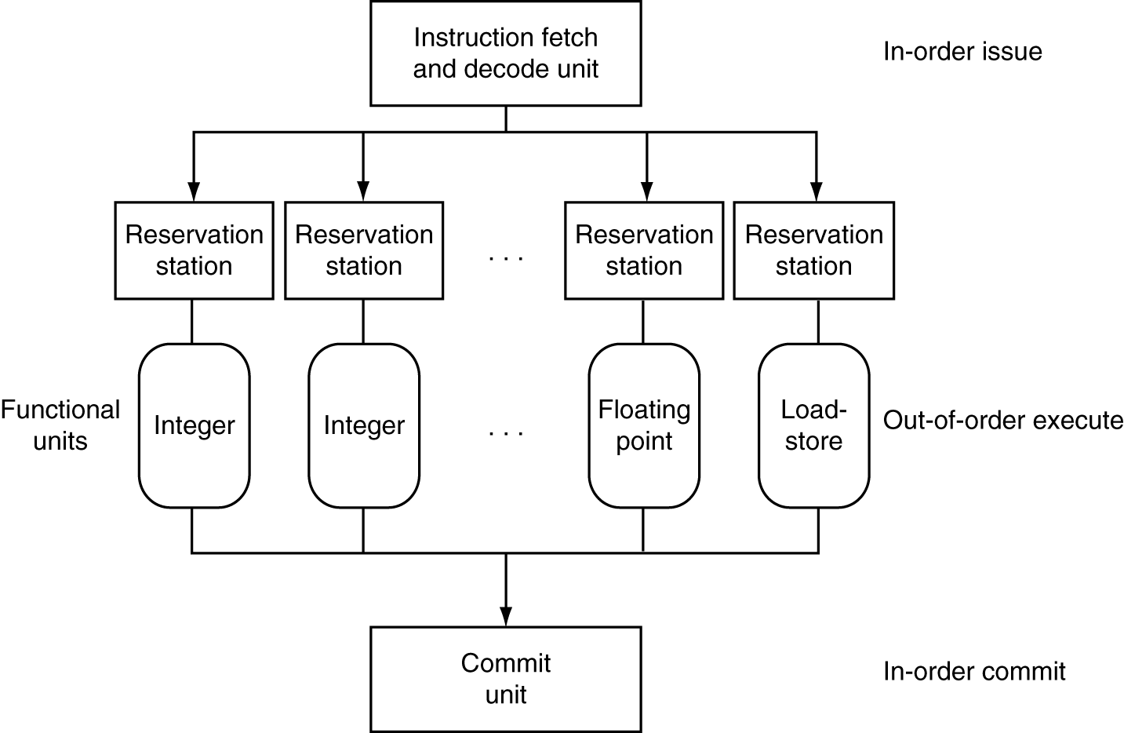
Dynamically Scheduled CPU
Preserves dependencies
Hold pending operands
Results also sent to any waiting reservation stations
Reorders buffer for register writes
Can supply operands for issued instructions

Slide 133
Speculation
Predict branch and continue issuing
  Don’t commit until branch outcome determined
Load speculation
  Avoid load and cache miss delay
    Predict the effective address
    Predict loaded value
    Load before completing outstanding stores
    Bypass stored values to load unit
  Don’t commit load until speculation cleared

Slide 134
Why Do Dynamic Scheduling?
Why not just let the compiler schedule code?
Not all stalls are predicable
  e.g., cache misses
Can’t always schedule around branches
  Branch outcome is dynamically determined
Different implementations of an ISA have different latencies and hazards (re-compile ?)

Slide 135
Does Multiple Issue Work?
The BIG Picture
Yes, but not as much as we’d like
Programs have real dependencies that limit ILP
Some dependencies are hard to eliminate
  e.g., pointer aliasing
Some parallelism is hard to expose
  Limited window size during instruction issue
Memory delays and limited bandwidth
  Hard to keep pipelines full
Speculation can help if done well

Slide 136
Power Efficiency
Complexity of dynamic scheduling and speculations requires power
Multiple simpler cores may be better
Microprocessor | Year | Clock Rate | Pipeline Stages | Issue width | Out-of-order/ Speculation | Cores | Power
i486 | 1989 | 25MHz | 5 | 1 | No | 1 | 5W
Pentium | 1993 | 66MHz | 5 | 2 | No | 1 | 10W
Pentium Pro | 1997 | 200MHz | 10 | 3 | Yes | 1 | 29W
P4 Willamette | 2001 | 2000MHz | 22 | 3 | Yes | 1 | 75W
P4 Prescott | 2004 | 3600MHz | 31 | 3 | Yes | 1 | 103W
Core | 2006 | 2930MHz | 14 | 4 | Yes | 2 | 75W
UltraSparc III | 2003 | 1950MHz | 14 | 4 | No | 1 | 90W
UltraSparc T1 | 2005 | 1200MHz | 6 | 1 | No | 8 | 70W

Slide 137
Fallacies
Pipelining is easy (!)
  The basic idea is easy
  The devil is in the details
    e.g., detecting data hazards
Pipelining is independent of technology
  So why haven’t we always done pipelining?
  More transistors make more advanced techniques feasible
  Pipeline-related ISA design needs to take account of technology trends
    e.g., predicted instructions

Slide 138
Pitfalls
Poor ISA design can make pipelining harder
  e.g., complex instruction sets (VAX, IA-32)
    Significant overhead to make pipelining work
    IA-32 micro-op approach
  e.g., complex addressing modes
    Register update side effects, memory indirection
  e.g., delayed branches
    Advanced pipelines have long delay slots

Slide 139
Concluding Remarks
ISA influences design of datapath and control
Datapath and control influence design of ISA
Pipelining improves instruction throughput
using parallelism
  More instructions completed per second
  Latency for each instruction not reduced
Hazards: structural, data, control
Multiple issue and dynamic scheduling (ILP)
  Dependencies limit achievable parallelism
  Complexity leads to the power wall

