Slide 1
CS4100: 計算機結構
Computer Abstractions and Technology
國立清華大學資訊工程學系

Slide 2
Outline
Computer
Abstractions
Technology
  Performance
    Definition
    CPU performance
  Power trends: multi-processing
  Measuring and evaluating performance
  Cost

Slide 3
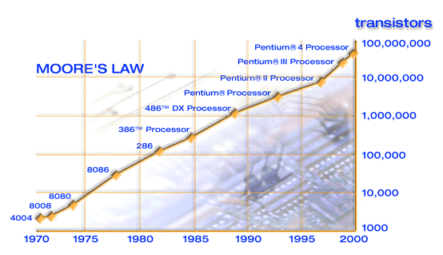
Technology Trends:
Microprocessor Capacity
2X transistors/chip
every 1.5 years
called

Slide 4
Classes of Computers
Desktop computers (PC)
  General purpose, variety of software
  Subject to cost/performance tradeoff
Server computers
  Network based
  High capacity, performance, reliability
  Range from small servers to building sized
Embedded computers
  Hidden as components of systems
  Stringent power/performance/cost constraints

Slide 5
Computer Usage:
General Purpose (PC and Server)
Uses: commercial (int.), scientific (FP, graphics), home (int., audio, video, graphics)
  Software compatibility is the most important factor
  Short product life; higher price and profit margin
Future:
  Use increased transistors for performance, human interface (multimedia), bandwidth, monitoring

Slide 6
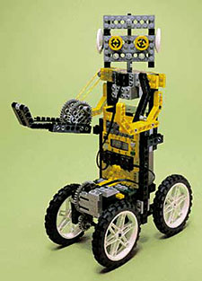
Computer Usage: Embedded
A computer inside another device used for running one predetermined application
Uses: control (traffic, printer, disk); consumer electronics (video game, CD player, PDA); cell phone
Lego Mindstorms
Robotic command explorer:
A “Programmable Brick”,
Hitachi H8 CPU (8-bit), 32KB RAM,
LCD, batteries,
infrared transmitter/receiver,
4 control buttons, 6 connectors

Slide 7
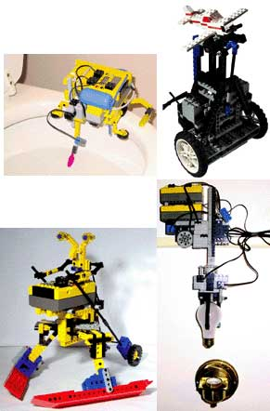
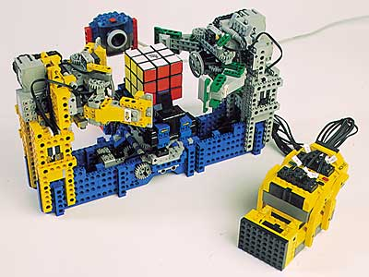
它可以做什麼?

Slide 8

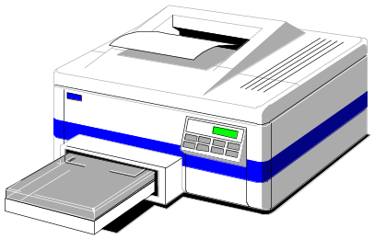
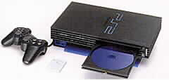

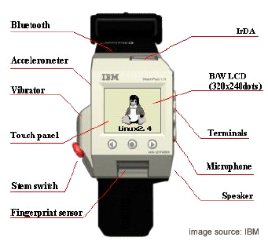

生活裡的應用比比皆是

Slide 9
Embedded Computers
Typically w/o FP or MMU, but integrating various peripheral functions, e.g., DSP
  Large variety in ISA, performance, on-chip peripherals
  Compatibility is non-issue, new ISA easy to enter, low power become important
More architecture and survive longer:
4- or 8-bit microprocessor still in use
(8-bit for cost-sensitive, 32-bit for performance)
Large volume sale (billions) at low price ($40-$5)
Trend: lower cost, more functionality
  system-on-chip, μP core on ASIC

Slide 10
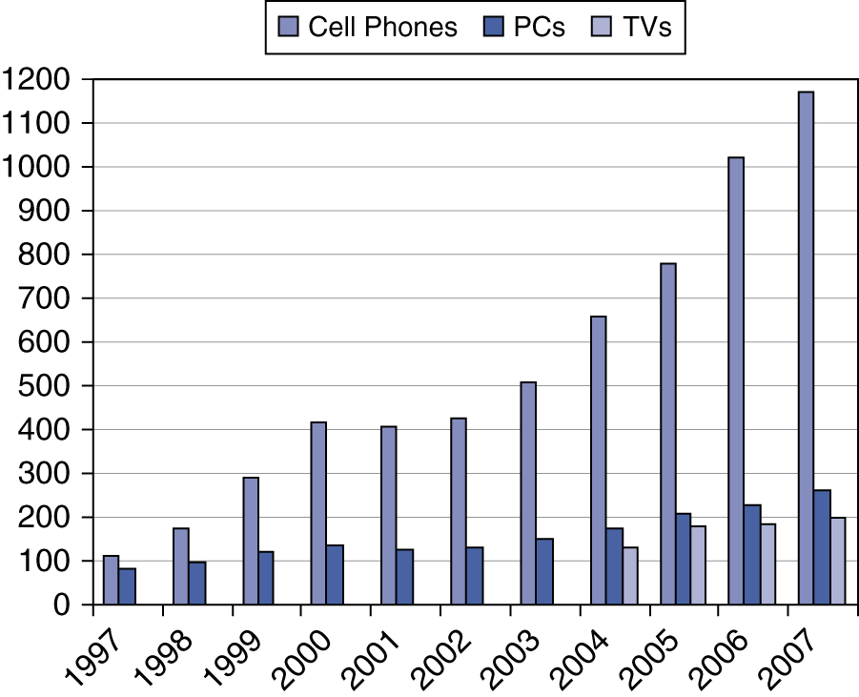
The Processor Market

Slide 11
Outline
Computer
Abstractions
Technology
  Performance
    Definition
    CPU performance
  Power trends: multi-processing
  Measuring and evaluating performance
  Cost

Slide 12

Below Your Program
§1.2 Below Your Program
Application software
  Written in high-level language
System software
  Compiler: translates HLL code to machine code
  Operating System: service code
    Handling input/output
    Managing memory and storage
    Scheduling tasks & sharing resources
Hardware
  Processor, memory, I/O controllers

Slide 13

Levels of Program Code
High-level language
  Level of abstraction closer to problem domain
  Provides for productivity and portability
Assembly language
  Textual representation of instructions
Hardware representation
  Binary digits (bits)
  Encoded instructions and data

Slide 14
Outline
Computer
Abstractions
Technology
  Performance
    Definition
    CPU performance
  Power trends: multi-processing
  Measuring and evaluating performance
  Cost

Slide 15
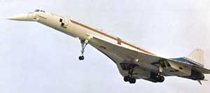
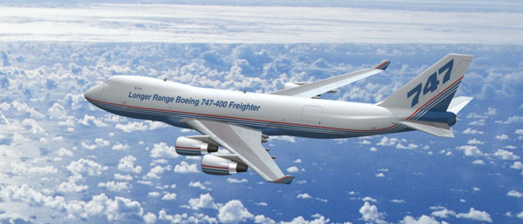
那一架飛機的效能比較好？
Concorde:
Capacity: 132 persons
Range: 4000 miles
Cruising speed: 1350 mph
747-400:
Capacity: 470 persons
Range: 4150 miles
Cruising speed: 610 mph
Notes:
Boeing 747:
First flight: February 9, 1969
Commercial flight in 1970
747-400:
Capacity: 400
Range: 11,485 km
Cruising speed: 929 kph at 10,664 m (35,000 ft)
Length: 70.7 m
Wingspan: 64.8 m
Concorde:
First flight: Concorde 001, F-WTSS, on March 2nd 1969
Commercial service: 1976
Capacity: 100
Range: 6667 km
Cruising speed: 2160 kph (Mach 2) at 18,288 m (60,000 ft)
Length: 62.1 m
Wingspan: 25.2 m

Slide 16
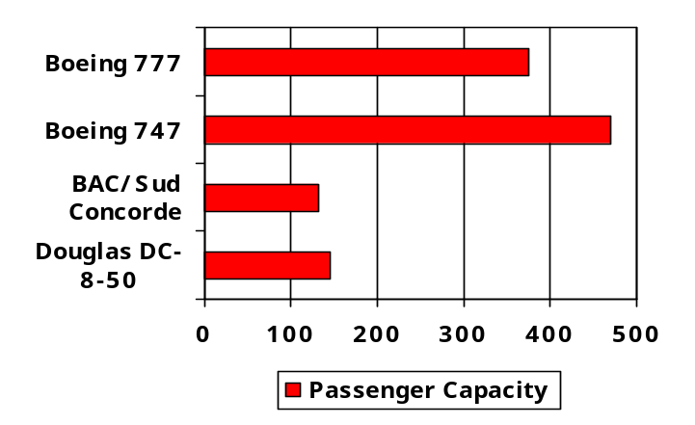
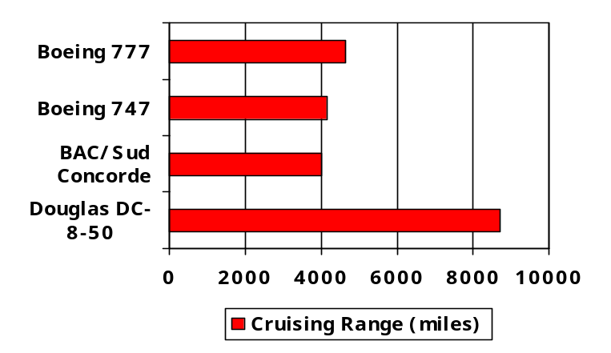
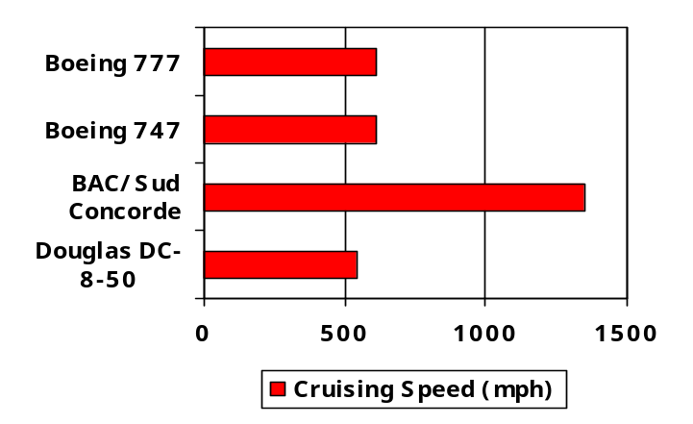
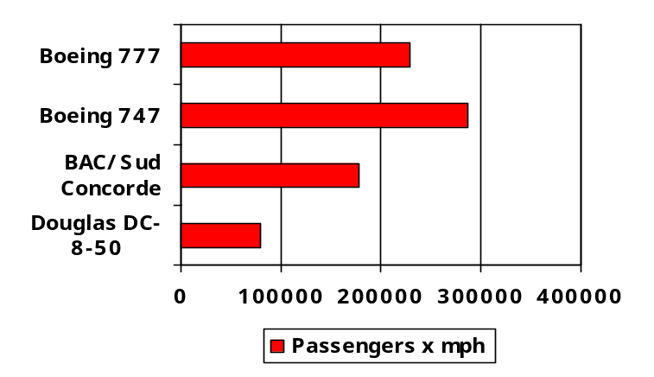
Defining Performance
§1.4 Performance
Which airplane has the best performance?

Slide 17
Response Time and Throughput
Response time
  How long it takes to do a task
Throughput
  Total work done per unit time
    e.g., tasks/transactions/… per hour
How are response time and throughput affected by
  Replacing the processor with a faster version?
  Adding more processors?
We’ll focus on response time for now…

Slide 18
Measuring Execution Time
Elapsed time
  Total response time, including all aspects
    Processing, I/O, OS overhead, idle time
  Determines system performance
CPU time
  Time spent processing a given job
    Discounts I/O time, other jobs’ shares
  Comprises user CPU time and system CPU time
Different programs are affected differently by CPU and system performance

Slide 19
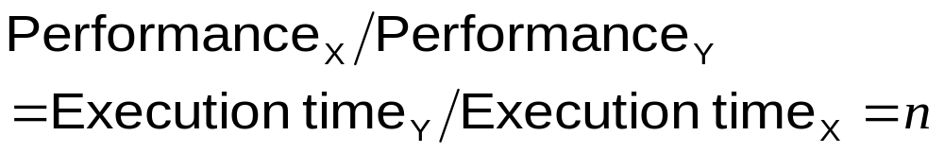
Relative Performance
Define Performance = 1/Execution Time
“X is n time faster than Y”
Example: time taken to run a program
  10s on A, 15s on B
  Execution Time_{B} / Execution Time_{A}
  = 15s / 10s = 1.5
  So A is 1.5 times faster than B

Slide 20
CPU Clocking
Operation of digital hardware governed by a constant-rate clock
Clock period
Clock (cycles)
Data transfer
and computation
Update state
Clock period: duration of a clock cycle
  e.g., 250ps = 0.25ns = 250×10^{–12}s
Clock frequency (rate): cycles per second
  e.g., 4.0GHz = 4000MHz = 4.0×10⁹Hz

Slide 21
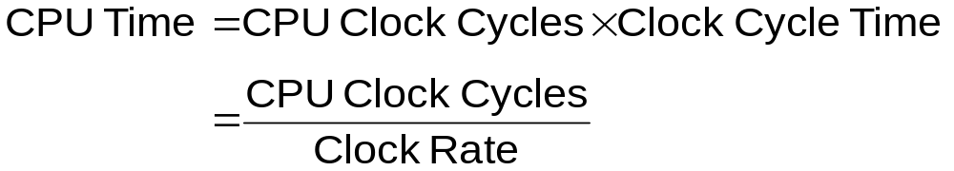
CPU Time
Performance improved by
  Reducing number of clock cycles
  Increasing clock rate
  Hardware designer must often trade off clock rate against cycle count

Slide 22
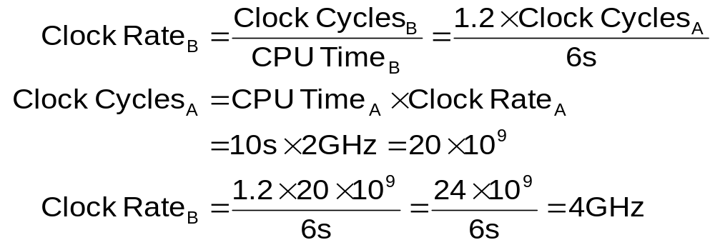
CPU Time Example
Computer A: 2GHz clock, 10s CPU time
Designing Computer B
  Aim for 6s CPU time
  Can do faster clock, but causes 1.2 × clock cycles
How fast must Computer B clock be?

Slide 23
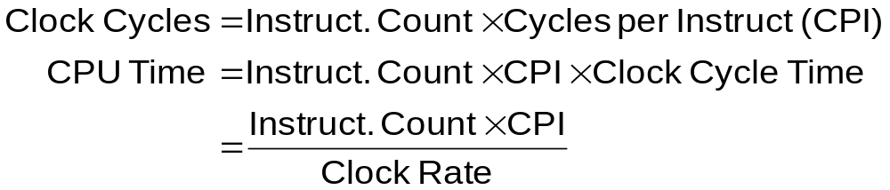
Instruction Count and CPI
CPI : Clock Per Instruction
Instruction Count for a program
  Determined by program, ISA and compiler
Average cycles per instruction
  Determined by CPU hardware
  If different instructions have different CPI
    Average CPI affected by instruction mix

Slide 24
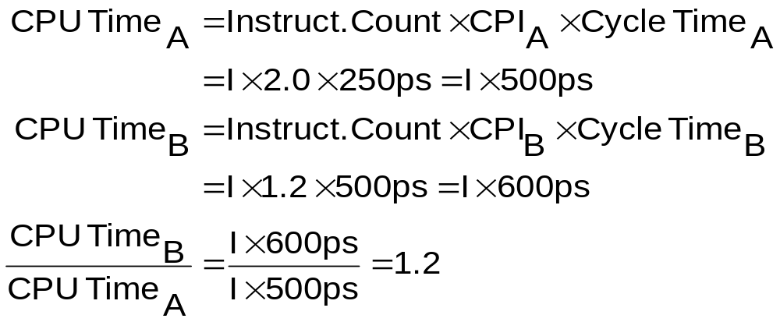
CPI Example
Computer A: Cycle Time = 250ps, CPI = 2.0
Computer B: Cycle Time = 500ps, CPI = 1.2
Same ISA
Which is faster, and by how much?
A is faster…
…by this much

Slide 25
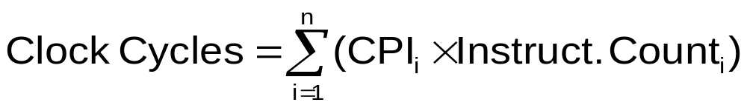
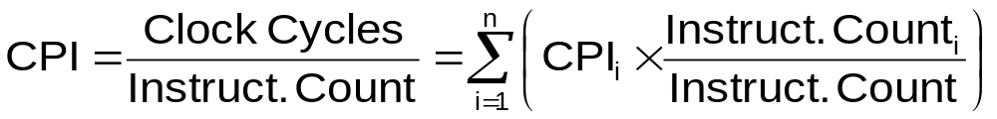
CPI in More Detail
If different instruction classes take different numbers of cycles
Weighted average CPI
Relative frequency

Slide 26
CPI Example
Alternative compiled code sequences using instructions in classes A, B, C
Class | A | B | C
CPI for class | 1 | 2 | 3
IC in sequence 1 | 2 | 1 | 2
IC in sequence 2 | 4 | 1 | 1
Sequence 1: IC = 5
  Clock Cycles
  = 2×1 + 1×2 + 2×3
  = 10
  Avg. CPI = 10/5 = 2.0
Sequence 2: IC = 6
  Clock Cycles
  = 4×1 + 1×2 + 1×3
  = 9
  Avg. CPI = 9/6 = 1.5

Slide 27
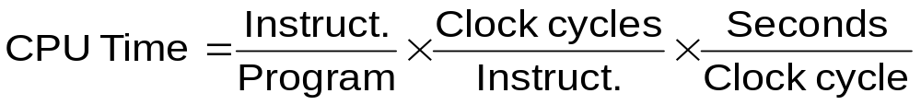
Performance Summary
The BIG Picture
Performance depends on
 | Instruction Count | CPI | Clock Rate
Program
Compiler
Instruction Set
Organization
Technology

Slide 28
Performance Summary
The BIG Picture
Performance depends on
 | Instruction Count | CPI | Clock Rate
Program | X | X
Compiler
Instruction Set
Organization
Technology

Slide 29
Performance Summary
The BIG Picture
Performance depends on
 | Instruction Count | CPI | Clock Rate
Program | X | X
Compiler | X | X
Instruction Set
Organization
Technology

Slide 30
Performance Summary
The BIG Picture
Performance depends on
 | Instruction Count | CPI | Clock Rate
Program | X | X
Compiler | X | X
Instruction Set | X | X
Organization
Technology

Slide 31
Performance Summary
The BIG Picture
Performance depends on
 | Instruction Count | CPI | Clock Rate
Program | X | X
Compiler | X | X
Instruction Set | X | X
Organization |  | X | X
Technology

Slide 32
Performance Summary
The BIG Picture
Performance depends on
 | Instruction Count | CPI | Clock Rate
Program | X | X
Compiler | X | X
Instruction Set | X | X
Organization |  | X | X
Technology |  |  | X

Slide 33
Outline
Computer
Abstractions
Technology
  Performance
    Definition
    CPU performance
  Power trends: multi-processing
  Measuring and evaluating performance
  Cost

Slide 34
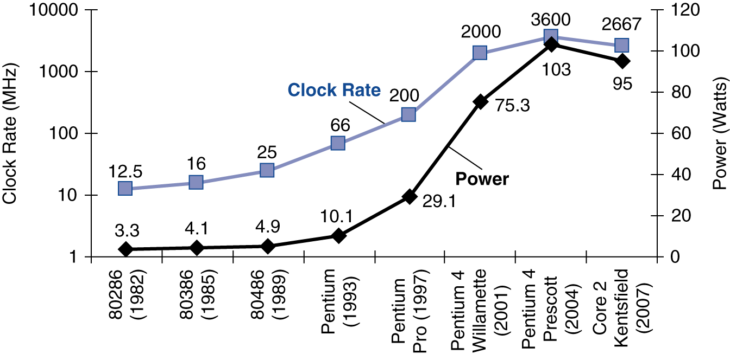
Power Trends
§1.5 The Power Wall
In CMOS IC technology
×30
5V → 1V
×1000

Slide 35
Reducing Power
The power wall
  We can’t reduce voltage further
  We can’t remove more heat
How else can we improve performance?

Slide 36
Multiprocessors
Multicore microprocessors
  More than one processor per chip
Requires explicitly parallel programming
  Compare with instruction level parallelism
    Hardware executes multiple instructions at once
    Hidden from the programmer
  Hard to do
    Programming for performance
    Load balancing
    Optimizing communication and synchronization

Slide 37
Outline
Computer
Abstractions
Technology
  Performance
    Definition
    CPU performance
  Power trends: multi-processing
  Measuring and evaluating performance
  Cost

Slide 38
What Programs for Comparison?
What’s wrong with this program as a workload?
integer A[][], B[][], C[][];
for (I=0; I<100; I++)
for (J=0; J<100; J++)
for (K=0; K<100; K++)
C[I][J] = C[I][J] + A[I][K]*B[K][J];
What measured? Not measured? What is it good for?
Ideally run typical programs with typical input before purchase, or before even build machine
  Called a “workload”; For example:
  Engineer uses compiler, spreadsheet
  Author uses word processor, drawing program, compression software

Slide 39
Benchmarks
Obviously, apparent speed of processor depends on code used to test it
Need industry standards so that different processors can be fairly compared => benchmark programs
Companies exist that create these benchmarks: “typical” code used to evaluate systems
Notes:
In 1989, a company was found for making benchmarking program.

Slide 40
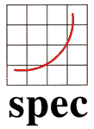
Example Standardized Workload Benchmarks
Standard Performance Evaluation Corporation (SPEC) : supported by a number of computer vendors to create standard set of benchmarks
Began in 1989 focusing on benchmarking workstation and servers using CPU-intensive benchmarks
The latest release: SPEC2006 benchmarks
  CPU performance (CINT 2006, CFP 2006)
  High-performance computing
  Client-sever models
  Mail systems
  File systems
  Web-servers …

Slide 41
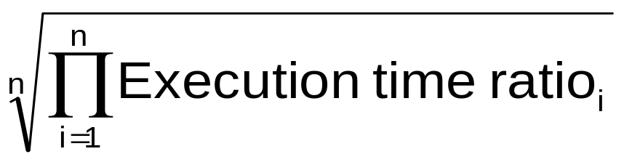
SPEC CPU Benchmark
SPEC CPU2006
  Elapsed time to execute a selection of programs
    Negligible I/O, so focuses on CPU performance
  Normalize relative to reference machine
  Summarize as geometric mean of performance ratios
    CINT2006 (integer)

Slide 42
CINT2006 for Opteron X4 2356
Name | Description | IC×10⁹ | CPI | Tc (ns) | Exec time | Ref time | SPECratio
perl | Interpreted string processing | 2,118 | 0.75 | 0.40 | 637 | 9,777 | 15.3
bzip2 | Block-sorting compression | 2,389 | 0.85 | 0.40 | 817 | 9,650 | 11.8
gcc | GNU C Compiler | 1,050 | 1.72 | 0.47 | 24 | 8,050 | 11.1
mcf | Combinatorial optimization | 336 | 10.00 | 0.40 | 1,345 | 9,120 | 6.8
go | Go game (AI) | 1,658 | 1.09 | 0.40 | 721 | 10,490 | 14.6
hmmer | Search gene sequence | 2,783 | 0.80 | 0.40 | 890 | 9,330 | 10.5
sjeng | Chess game (AI) | 2,176 | 0.96 | 0.48 | 37 | 12,100 | 14.5
libquantum | Quantum computer simulation | 1,623 | 1.61 | 0.40 | 1,047 | 20,720 | 19.8
h264avc | Video compression | 3,102 | 0.80 | 0.40 | 993 | 22,130 | 22.3
omnetpp | Discrete event simulation | 587 | 2.94 | 0.40 | 690 | 6,250 | 9.1
astar | Games/path finding | 1,082 | 1.79 | 0.40 | 773 | 7,020 | 9.1
xalancbmk | XML parsing | 1,058 | 2.70 | 0.40 | 1,143 | 6,900 | 6.0
Geometric mean |  |  |  |  |  |  | 11.7
High cache miss rates

Slide 43
Outline
Computer
Abstractions
Technology
  Performance
    Definition
    CPU performance
  Power trends: multi-processing
  Measuring and evaluating performance
  Cost

Slide 44

Manufacturing ICs
§1.7 Real Stuff: The AMD Opteron X4
Yield: proportion of working dies per wafer

Slide 45
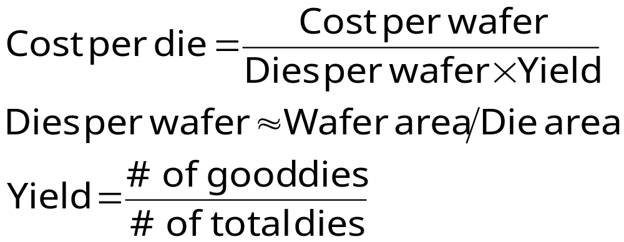
Integrated Circuit Cost
Nonlinear relation to area and yield
  Wafer cost and area are fixed
  Die area determined by architecture and circuit design
  Yield determined by manufacturing process

Slide 46
Cost of a Chip Includes ...
Die cost: affected by wafer cost, number of dies per wafer, and die yield (#good dies/#total dies)
Testing cost
Packaging cost: depends on pins, heat dissipation, ...

Slide 47
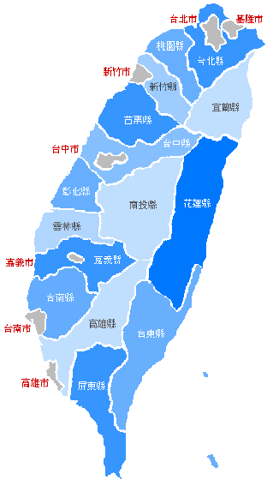
有關效能的另一個公式
0.5小時
從台北到高雄要多久？
4小時
如果改坐飛機，
台北到高雄只要1小時
全程可以加快多少？
0.5小時
如何導公式？

Slide 48
由台北到高雄
不能enhance的部份為在市區的時間: 0.5 + 0.5 = 1小時
可以enhance的部份為在高速公路上的4小時
現在改用飛機， 可以enhance的部份縮短為1小時
走高速公路所需時間 4 + 1
speedup = ----------------------- = ---------- = 2.5
坐飛機所需時間 1 + 1

Slide 49
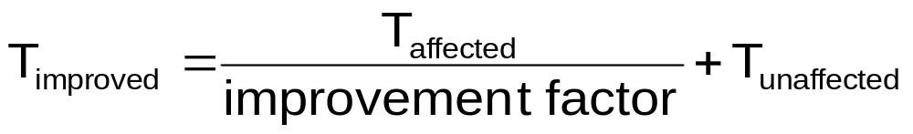
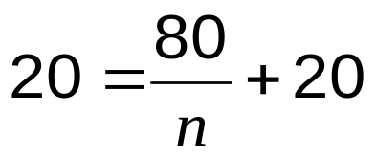
Pitfall: Amdahl’s Law
Improving an aspect of a computer and expecting a proportional improvement in overall performance
§1.8 Fallacies and Pitfalls
Example: multiply accounts for 80s/100s
  How much improvement in multiply performance to get 5× overall?
  Can’t be done!
Corollary: make the common case fast

Slide 50
Concluding Remarks
Cost/performance is improving
  Due to underlying technology development
Hierarchical layers of abstraction
  In both hardware and software
Execution time: the best performance measure
Power is a limiting factor
  Use parallelism to improve performance
§1.9 Concluding Remarks

