Slide 1
Computer Arithmetic
國立清華大學資訊工程學系
黃婷婷教授

Slide 2
Outline
Addition and subtraction (Sec. 3.2)
Constructing an arithmetic logic unit (Appendix C)
  Building ALU
    Add, sub, and, or, nor
    Set-on-less-than, overflow detection, zero detection
  Fast adders
    Cascaded carry look-ahead adder
    Multiple level carry look-ahead adder
Multiplication (Sec. 3.3, Appendix C)
  Unsigned multiply
  Signed multiply
Division (Sec. 3.4)
Floating point (Sec. 3.5)
  Representations
  Addition and multiplication

Slide 3
Problem: Designing MIPS ALU
Requirements: must support the following arithmetic and logic operations
  add, sub: two’s complement adder/subtractor with overflow detection
  and, or, nor : logical AND, logical OR, logical NOR
  slt (set on less than): two’s complement adder with inverter, check sign bit of result

Slide 4
Functional Specification
ALUop
4
A
32
Zero
ALU
Result
32
Overflow
B
32
CarryOut
ALU Control (ALUop) Function
  0000 and
  0001 or
  0010 add
  0110 subtract
  0111 set-on-less-than
  1100 nor
Notes:
Now you remember what binary numbers are, let design an Arithmetic Logic Unit that can perform bitwise AND, bitwise OR, binary add, binary subtract, and et-on-less-than.
The type of operation the ALU perform will be selected by the ALUop bits.
The ALU I am going to show you in class is 4 bits wide (N = 4). The ALU you need to design for the next homework assignment will be 32 bits wide.
I will show you how to implement all these operations except the last one, which is left as your homework assignment.
+1 = 25 min. (Y:05)

Slide 5
Functional Specification
ALUop
4
A
32
Zero
ALU
Result
32
Overflow
B
32
CarryOut
ALU Control (ALUop) Function
  0000 and
  0001 or
  0010 add
  0110 subtract
  0111 set-on-less-than
  1100 nor
Notes:
Now you remember what binary numbers are, let design an Arithmetic Logic Unit that can perform bitwise AND, bitwise OR, binary add, binary subtract, and et-on-less-than.
The type of operation the ALU perform will be selected by the ALUop bits.
The ALU I am going to show you in class is 4 bits wide (N = 4). The ALU you need to design for the next homework assignment will be 32 bits wide.
I will show you how to implement all these operations except the last one, which is left as your homework assignment.
+1 = 25 min. (Y:05)

Slide 6
A Bit-slice ALU
Design trick 1: divide and conquer
  Break the problem into simpler problems, solve them and glue together the solution
Design trick 2: solve part of the problem and extend
A
32
B
32
a31
b31
a0
b0
4
m
ALU₀
m
ALU₃₁
c31
cin
co
cin
ALUop
s31
s0
Overflow
Zero
32
Result

Slide 7
A 1-bit ALU
Design trick 3: take pieces you know (or can imagine) and try to put them together
CarryIn
Operation
and
A
0
or
Result
1
Mux
1-bit
Full
Adder
add
2
B
CarryOut
Notes:
Now that I have shown you how to build a 1-bit full adder, we have all the major components needed for this 1-bit ALU.
In order to build a 4-bit ALU, we simply connect four 1-bit ALUs in series to feed the CarryOut of one ALU to the CarryIn of the next ALU.
Even though I called this an ALU, I actually lied a little. There is something missing about this ALU. This ALU can NOT perform the subtract operation.
Let see how can we fix this problem.
2 min = 35 min. (Y:15)

Slide 8
Functional Specification
ALUop
4
A
32
Zero
ALU
Result
32
Overflow
B
32
CarryOut
ALU Control (ALUop) Function
  0000 and
  0001 or
  0010 add
  0110 subtract
  0111 set-on-less-than
  1100 nor
Notes:
Now you remember what binary numbers are, let design an Arithmetic Logic Unit that can perform bitwise AND, bitwise OR, binary add, binary subtract, and et-on-less-than.
The type of operation the ALU perform will be selected by the ALUop bits.
The ALU I am going to show you in class is 4 bits wide (N = 4). The ALU you need to design for the next homework assignment will be 32 bits wide.
I will show you how to implement all these operations except the last one, which is left as your homework assignment.
+1 = 25 min. (Y:05)

Slide 9
A 4-bit ALU
1-bit ALU 4-bit ALU
CarryIn0
Operation
Operation
CarryIn
A0
1-bit
ALU
A
Result0
B0
CarryIn1
CarryOut0
A1
1-bit
ALU
Result1
Result
B1
Mux
CarryIn2
CarryOut1
A2
1-bit
ALU
Result2
B2
1-bit
Full
Adder
CarryIn3
CarryOut2
A3
1-bit
ALU
B
Result3
B3
CarryOut
CarryOut3
Notes:
Now that I have shown you how to build a 1-bit full adder, we have all the major components needed for this 1-bit ALU.
In order to build a 4-bit ALU, we simply connect four 1-bit ALUs in series to feed the CarryOut of one ALU to the CarryIn of the next ALU.
Even though I called this an ALU, I actually lied a little. There is something missing about this ALU. This ALU can NOT perform the subtract operation.
Let see how can we fix this problem.
2 min = 35 min. (Y:15)

Slide 10
How about Subtraction?
2’s complement: take inverse of every bit and add 1 (at c_{in} of first stage)
  A + B’ + 1 = A + (B’ + 1) = A + (-B) = A - B
  Bit-wise inverse of B is B’
Subtract
(Bnegate)
CarryIn
Operation
A
ALU
Result
Sel
B
0
Mux
1
B’
CarryOut
Notes:
Recalled something you learned from grade school that: A - B is the same as A plus (-B).
Also recall from earlier slides that in order to calculate the 2 complement representation of negative B, we simply take the inverse of very bit and add 1.
The bitwise inverse of B is easy to compute. Just pass them through the inverter.
In order to do the add 1 operation, we simply set the CarryIn to 1.
So for the subtract operation, we simply select the output of the inverter and set CarryIn to 1.
Then we will be adding A to the negative of B and whola, we have the A minus B operation.
+2 = 37 min. (Y:17)

Slide 11
Revised Diagram
LSB and MSB need to do a little extra
A
32
B
32
a31
b31
a0
b0
4
ALU31
ALU0
?
co
cin
ALUop
c31
cin
s0
s31
Supply a 1 on subtraction
32
Overflow
Zero
Combining the CarryIn and Bnegate
Result

Slide 12
Functional Specification
ALUop
4
A
32
Zero
ALU
Result
32
Overflow
B
32
CarryOut
ALU Control (ALUop) Function
  0000 and
  0001 or
  0010 add
  0110 subtract
  0111 set-on-less-than
  1100 nor
Notes:
Now you remember what binary numbers are, let design an Arithmetic Logic Unit that can perform bitwise AND, bitwise OR, binary add, binary subtract, and et-on-less-than.
The type of operation the ALU perform will be selected by the ALUop bits.
The ALU I am going to show you in class is 4 bits wide (N = 4). The ALU you need to design for the next homework assignment will be 32 bits wide.
I will show you how to implement all these operations except the last one, which is left as your homework assignment.
+1 = 25 min. (Y:05)

Slide 13
R-Format Instructions (1/2)
Define the following “fields”:
  opcode: partially specifies what instruction it is (Note: 0 for all R-Format instructions)
  funct: combined with opcode to specify the instruction
  Question: Why aren’t opcode and funct a single 12-bit field?
  rs (Source Register): generally used to specify register containing first operand
  rt (Target Register): generally used to specify register containing second operand
  rd (Destination Register): generally used to specify register which will receive result of computation
6
5
5
5
5
6
opcode
rs
rt
rd
shamt
funct

Slide 14
Nor Operation
A nor B = (not A) and (not B)
ALUop
2
Ainvert
CarryIn
Operation
a
0
0
1
Bnegate
1
Result
b
0
2
1
CarryOut

Slide 15
Functional Specification
ALUop
4
A
32
Zero
ALU
Result
32
Overflow
B
32
CarryOut
ALU Control (ALUop) Function
  0000 and
  0001 or
  0010 add
  0110 subtract
  0111 set-on-less-than
  1100 nor
Notes:
Now you remember what binary numbers are, let design an Arithmetic Logic Unit that can perform bitwise AND, bitwise OR, binary add, binary subtract, and et-on-less-than.
The type of operation the ALU perform will be selected by the ALUop bits.
The ALU I am going to show you in class is 4 bits wide (N = 4). The ALU you need to design for the next homework assignment will be 32 bits wide.
I will show you how to implement all these operations except the last one, which is left as your homework assignment.
+1 = 25 min. (Y:05)

Slide 16
Outline
Addition and subtraction (Sec. 3.2)
Constructing an arithmetic logic unit (Appendix C)
  Building ALU
    Add, sub, and, or, nor
    Set-on-less-than, overflow detection, zero detection
  Fast adders
    Cascaded carry look-ahead adder
    Multiple level carry look-ahead adder
Multiplication (Sec. 3.3, Appendix C)
  Unsigned multiply
  Signed multiply
Division (Sec. 3.4)
Floating point (Sec. 3.5)
  Representations
  Addition and multiplication

Slide 17
Functional Specification
ALUop
4
A
32
Zero
ALU
Result
32
Overflow
B
32
CarryOut
ALU Control (ALUop) Function
  0000 and
  0001 or
  0010 add
  0110 subtract
  0111 set-on-less-than
  1100 nor
Notes:
Now you remember what binary numbers are, let design an Arithmetic Logic Unit that can perform bitwise AND, bitwise OR, binary add, binary subtract, and et-on-less-than.
The type of operation the ALU perform will be selected by the ALUop bits.
The ALU I am going to show you in class is 4 bits wide (N = 4). The ALU you need to design for the next homework assignment will be 32 bits wide.
I will show you how to implement all these operations except the last one, which is left as your homework assignment.
+1 = 25 min. (Y:05)

Slide 18
Set on Less Than (I)
1-bit in ALU
(for bits 1-30)
ALUop
Ainvert
CarryIn
Operation
a
0
0
1
Bnegate
1
Result
b
0
2
1
Less
(0:bits 1-30)
3
CarryOut

Slide 19
Set on Less Than (II)
Sign bit in ALU
Ainvert
CarryIn
Operation
a
0
0
1
Bnegate
1
Result
b
0
2
1
Less
3
Set
Overflow
detection
Overflow

Slide 20
Set on Less Than (III)
Bit 0 in ALU
ALUop
Ainvert
CarryIn
Operation
a
0
0
1
Bnegate
1
Result
b
0
2
1
Set
3
CarryOut

Slide 21
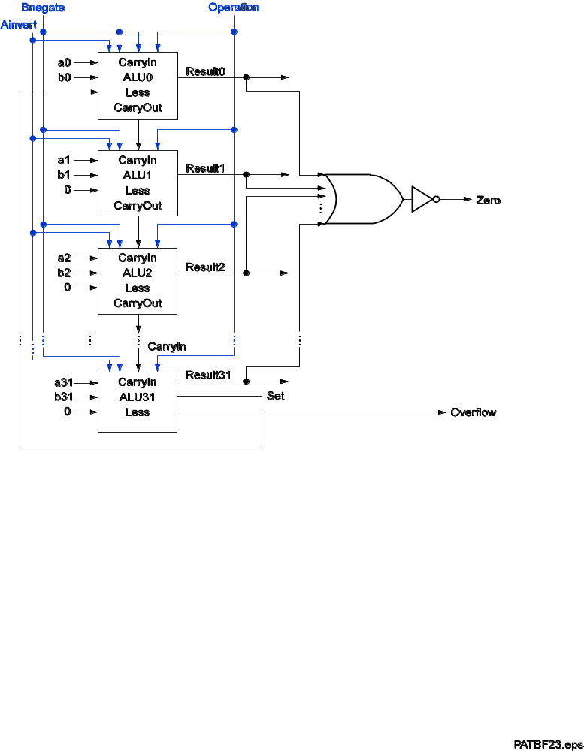
A Ripple Carry Adder and Set on Less Than
ALUop Function
  0000 and
  0001 or
  0010 add
  0110 subtract
  0111 set-less-than
  1100 nor

Slide 22
Functional Specification
ALUop
4
A
32
Zero
ALU
Result
32
Overflow
B
32
CarryOut
ALU Control (ALUop) Function
  0000 and
  0001 or
  0010 add
  0110 subtract
  0111 set-on-less-than
  1100 nor
Notes:
Now you remember what binary numbers are, let design an Arithmetic Logic Unit that can perform bitwise AND, bitwise OR, binary add, binary subtract, and et-on-less-than.
The type of operation the ALU perform will be selected by the ALUop bits.
The ALU I am going to show you in class is 4 bits wide (N = 4). The ALU you need to design for the next homework assignment will be 32 bits wide.
I will show you how to implement all these operations except the last one, which is left as your homework assignment.
+1 = 25 min. (Y:05)

Slide 23
Overflow
Decimal Binary Decimal 2’s complement
0 0000 0 0000
1 0001 -1 1111
2 0010 -2 1110
3 0011 -3 1101
4 0100 -4 1100
5 0101 -5 1011
6 0110 -6 1010
7 0111 -7 1001
-8 1000
Ex: 7 + 3 = 10 but ... - 4 - 5 = - 9 but …
0 1 1 1 1 0 0 0
0 1 1 1 7 1 1 0 0 -4
+ 0 0 1 1 3 + 1 0 1 1 -5
1 0 1 0 -6 0 1 1 1 7

Slide 24
Overflow Detection
Overflow: result too big/small to represent
  -8 ≤ 4-bit binary number ≤ 7
  When adding operands with different signs, overflow cannot occur!
  Overflow occurs when adding:
    2 positive numbers and the sum is negative
    2 negative numbers and the sum is positive
    => sign bit is set with the value of the result
  Overflow if: Carry into MSB ≠ Carry out of MSB
0 1 1 1 1 0 0 0
0 1 1 1 7 1 1 0 0 -4
+ 0 0 1 1 3 + 1 0 1 1 -5
1 0 1 0 -6 0 1 1 1 7
Notes:
Recalled from some earlier slides that the biggest positive number you can represent using 4-bit is 7 and the smallest negative you can represent is negative 8.
So any time your addition results in a number bigger than 7 or less than negative 8, you have an overflow.
Keep in mind is that whenever you try to add two numbers together that have different signs, that is adding a negative number to a positive number, overflow can NOT occur.
Overflow occurs when you to add two positive numbers together and the sum has a negative sign. Or, when you try to add negative numbers together and the sum has a positive sign.
If you spend some time, you can convince yourself that If the Carry into the most significant bit is NOT the same as the Carry coming out of the MSB, you have a overflow.
+2 = 41 min. (Y:21)

Slide 25
Overflow Detection Logic
Overflow = CarryIn[N-1] XOR CarryOut[N-1]
CarryIn0
A0
1-bit
ALU
Result0
X
Y
X XOR Y
B0
CarryOut0
0
0
0
CarryIn1
A1
0
1
1
1-bit
ALU
Result1
1
0
1
B1
CarryOut1
1
1
0
CarryIn2
A2
1-bit
ALU
Result2
B2
CarryIn3
Overflow
A3
1-bit
ALU
Result3
B3
CarryOut3
Notes:
Recall the XOR gate implements the not equal function: that is, its output is 1 only if the inputs have different values.
Therefore all we need to do is connect the carry into the most significant bit and the carry out of the most significant bit to the XOR gate.
Then the output of the XOR gate will give us the Overflow signal.
+1 = 42 min. (Y:22)

Slide 26
Dealing with Overflow
Some languages (e.g., C) ignore overflow
  Use MIPS addu, addui, subu instructions
Other languages (e.g., Ada, Fortran) require raising an exception
  Use MIPS add, addi, sub instructions
  On overflow, invoke exception handler
    Save PC in exception program counter (EPC) register
    Jump to predefined handler address
    mfc0 (move from coprocessor reg) instruction can retrieve (copy) EPC value (to a general purpose register), to return after corrective action (by jump register instruction)

Slide 27
Zero Detection Logic
Zero Detection Logic is a one BIG NOR gate (support conditional jump)
CarryIn0
A0
1-bit
ALU
Result0
B0
CarryIn1
CarryOut0
A1
1-bit
ALU
Result1
B1
Zero
CarryIn2
CarryOut1
A2
1-bit
ALU
Result2
B2
CarryIn3
CarryOut2
A3
1-bit
ALU
Result3
B3
CarryOut3
Notes:
Besides detecting overflow, our ALU also needs to indicate if the result is zero.
This is easy to do. All we need is a BIG NOR gate.
Then if any of the Result bit is not zero, then the output of the NOR gate will be low.
The only time the output of the NOR gate is high is when all the result bits are zeroes.
+1 = 43 min. (Y:23)

Slide 28
Problems with Ripple Carry Adder
Carry bit may have to propagate from LSB to MSB => worst case delay: N-stage delay
CarryIn0
A0
CarryIn
1-bit
ALU
Result0
B0
A
CarryIn1
CarryOut0
A1
1-bit
ALU
Result1
B1
CarryIn2
CarryOut1
A2
1-bit
ALU
Result2
B
B2
CarryIn3
CarryOut2
CarryOut
A3
Design Trick: look for parallelism and throw hardware at it
1-bit
ALU
Result3
B3
CarryOut3
Notes:
The Adder we just built is called a Ripple Carry Adder because: Carry may have to propagate from the least significant bit to the most significant bit.
In other words, the combination of A0, B0, and CarryIn0 may cause CarryOut0 to become 1.
As a result of CarryOut0 going 1, CarryOut1 may become 1 and etc., etc., .... etc and propagate down the carry chain.
Recall the Carry Logic: CarryIn to CarryOut has a 2-gate delay.
So in the worst case, a N-bit ripple carry will have a 2N gate delay.
For a 32-bit adder, this means the worst case delay is 64 gates. This can be a problem.
So after the break, I will show you some faster way of designing an ALU.
+2 = 45 min. (Y:25)

Slide 29
Outline
Addition and subtraction (Sec. 3.2)
Constructing an arithmetic logic unit (Appendix C)
  Building ALU
    Add, sub, and, or, nor
    Set-on-less-than, overflow detection, zero detection
  Fast adders
    Cascaded carry look-ahead adder
    Multiple level carry look-ahead adder
Multiplication (Sec. 3.3, Appendix C)
  Unsigned multiply
  Signed multiply
Division (Sec. 3.4)
Floating point (Sec. 3.5)
  Representations
  Addition and multiplication

Slide 30
Carry Look-ahead: Theory (I)
(Appendix C)
CarryOut=(B*CarryIn)+(A*CarryIn)+(A*B)
  Cin1=Cout0= (B0 * Cin0)+(A0 * Cin0)+ (A0 * B0)
  Cin2=Cout1= (B1 * Cin1)+(A1 * Cin1)+ (A1 * B1)
Substituting Cin1 into Cin2:
  Cin2=(A1*A0*B0)+(A1*A0*Cin0)+(A1*B0*Cin0)
  +(B1*A0*B0)+(B1*A0*Cin0)+(B1*B0*Cin0)
  +(A1*B1)
B1
A1
B0
A0
Cin1
Cin0
Cin2
1-bit
ALU
1-bit
ALU
Cout1
Cout0
Notes:
Carry lookahead is another way to speed up an adder and here is the theory behind it.
Remember the logic equation for CarryOut so the carry coming out of bit 1 and into bit 2 (Cin2) looks like this.
Notice that, this carry will depends on the carry coming out of bit 0 (Cin1).
By substituting the equation of Cin1 into the equation Cin2, we can rewrite the equation of Cin2 so it depends on Cin0, A0, B0, A1, and B1.
The beauty of this equation is that it does NOT depend of the carry coming out of bit 0 (Cout0) so it does not have to wait for the carry to propagate through the lower bits.
This equation can be simplified if we redefine two terms: carry generate and propagate.
+2 = 55 min. (Y:35)

Slide 31
Carry Look-ahead: Theory (II)
Now define two new terms:
  Generate Carry at Bit i: gi = Ai * Bi
  Propagate Carry via Bit i: pi = Ai xor Bi
We can rewrite:
  Cin1=g0+(p0*Cin0)
  Cin2=g1+(p1*g0)+(p1*p0*Cin0)
  Cin3=g2+(p2*g1)+(p2*p1*g0)+(p2*p1*p0*Cin0)
Carry going into bit 3 is 1 if
  We generate a carry at bit 2 (g2)
  Or we generate a carry at bit 1 (g1) and
  bit 2 allows it to propagate (p2 * g1)
  Or we generate a carry at bit 0 (g0) and
  bit 1 as well as bit 2 allows it to propagate …..
Notes:
Using the carry generate and carry propagate terms, we can rewrite the carry lookahead equations like these.
For example, the Carry going into bit 3 (Cin 3) is 1 if:
(a) We generate a carry at bit 2.
(b) Or we generate a carry at bit 1 and bit 2 allows it to propagate ... and so on.
+1 = 56 min. (Y:36)

Slide 32
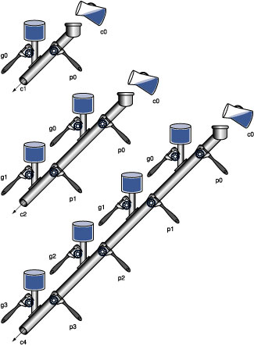
A Plumbing Analogy for Carry Loo-kahead
(1, 2, 4 bits)
Notes:
Using the carry generate and carry propagate terms, we can rewrite the carry lookahead equations like these.
For example, the Carry going into bit 3 (Cin 3) is 1 if:
(a) We generate a carry at bit 2.
(b) Or we generate a carry at bit 1 and bit 2 allows it to propagate ... and so on.
+1 = 56 min. (Y:36)

Slide 33
Common Carry Look-ahead Adder
Expensive to build a “full” carry look-ahead adder
  Ex: Cin3=g2+(p2*g1)+(p2*p1*g0)+(p2*p1*p0*Cin0)
  Just imagine length of the equation for Cin31
Common practices:
  Cascaded carry look-ahead adder
  Multiple level carry look-ahead adder
Notes:
As you can imagine from looking at the carry lookahead equations, it is very expensive if you want to build a full 32-bit carry lookahead adder: the equation for Cin31 will be very long.
A common practice is to build smaller N-bit carry lookahead adders and then connect them together to form a bigger adder.
For example, here we connect four 8-bit carry lookahead adders to form a 32-bit adder.
+1 = 57 min. (Y:37)

Slide 34
Cascaded Carry Look-ahead
Connects several N-bit look-ahead adders to form a big one
A[31:24]
B[31:24]
A[23:16]
B[23:16]
A[15:8]
B[15:8]
A[7:0]
B[7:0]
8
8
8
8
8
8
8
8
8-bit Carry
Lookahead
Adder
C24
8-bit Carry
Lookahead
Adder
C16
8-bit Carry
Lookahead
Adder
C8
8-bit Carry
Lookahead
Adder
C0
8
8
8
8
Result[31:24]
Result[23:16]
Result[15:8]
Result[7:0]
Notes:
As you can imagine from looking at the carry lookahead equations, it is very expensive if you want to build a full 32-bit carry lookahead adder: the equation for Cin31 will be very long.
A common practice is to build smaller N-bit carry lookahead adders and then connect them together to form a bigger adder.
For example, here we connect four 8-bit carry lookahead adders to form a 32-bit adder.
+1 = 57 min. (Y:37)

Slide 35
Example: Carry Look-ahead Unit
Carry Look-ahead Unit
c_{out}
c_{in}
4
4
4
g_{i}
p_{i}

Slide 36
Example: Cascaded Carry Look-ahead
Connects several N-bit look-ahead adders to form a big one
4-bit Carry
Lookahead
Unit
c12
4-bit Carry
Lookahead
Unit
c8
4-bit Carry
Lookahead
Unit
c4
4-bit Carry
Lookahead
Unit
c0
p[15:12]
g[15:12]
p[11:8]
g[11:8]
p[7:4]
g[7:4]
p[3:0]
g[3:0]
c[16:13]
c[12:9]
c[8:5]
c[4:1]
+
+
+
+
+
+
+
+
+
+
+
+
+
+
+
+
Notes:
As you can imagine from looking at the carry lookahead equations, it is very expensive if you want to build a full 32-bit carry lookahead adder: the equation for Cin31 will be very long.
A common practice is to build smaller N-bit carry lookahead adders and then connect them together to form a bigger adder.
For example, here we connect four 8-bit carry lookahead adders to form a 32-bit adder.
+1 = 57 min. (Y:37)

Slide 37
Outline
Addition and subtraction (Sec. 3.2)
Constructing an arithmetic logic unit (Appendix C)
  Building ALU
    Add, sub, and, or, nor
    Set-on-less-than, overflow detection, zero detection
  Fast adders
    Cascaded carry look-ahead adder
    Multiple level carry look-ahead adder
Multiplication (Sec. 3.3, Appendix C)
  Unsigned multiply
  Signed multiply
Division (Sec. 3.4)
Floating point (Sec. 3.5)
  Representations
  Addition and multiplication

Slide 38
Multiple Level Carry Look-ahead Adder
View an N-bit look-ahead adder as a block
Where to get Cin of the block ?
A[31:24]
B[31:24]
A[23:16]
B[23:16]
A[15:8]
B[15:8]
A[7:0]
B[7:0]
8
8
8
8
8
8
8
8
C24
C16
C8
8-bit Carry
Lookahead
Adder
8-bit Carry
Lookahead
Adder
8-bit Carry
Lookahead
Adder
8-bit Carry
Lookahead
Adder
C0
8
8
8
8
Result[31:24]
Result[23:16]
Result[15:8]
Result[7:0]
  Generate “super” Pi and Gi of the block
  Use next level carry look-ahead structure to generate block Cin
Notes:
As you can imagine from looking at the carry lookahead equations, it is very expensive if you want to build a full 32-bit carry lookahead adder: the equation for Cin31 will be very long.
A common practice is to build smaller N-bit carry lookahead adders and then connect them together to form a bigger adder.
For example, here we connect four 8-bit carry lookahead adders to form a 32-bit adder.
+1 = 57 min. (Y:37)

Slide 39
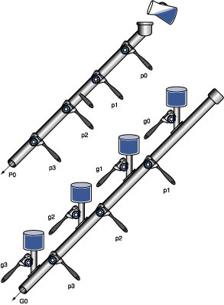
A Plumbing Analogy for Carry Look-ahead (Next Level P0 and G0)
Notes:
Using the carry generate and carry propagate terms, we can rewrite the carry lookahead equations like these.
For example, the Carry going into bit 3 (Cin 3) is 1 if:
(a) We generate a carry at bit 2.
(b) Or we generate a carry at bit 1 and bit 2 allows it to propagate ... and so on.
+1 = 56 min. (Y:36)

Slide 40
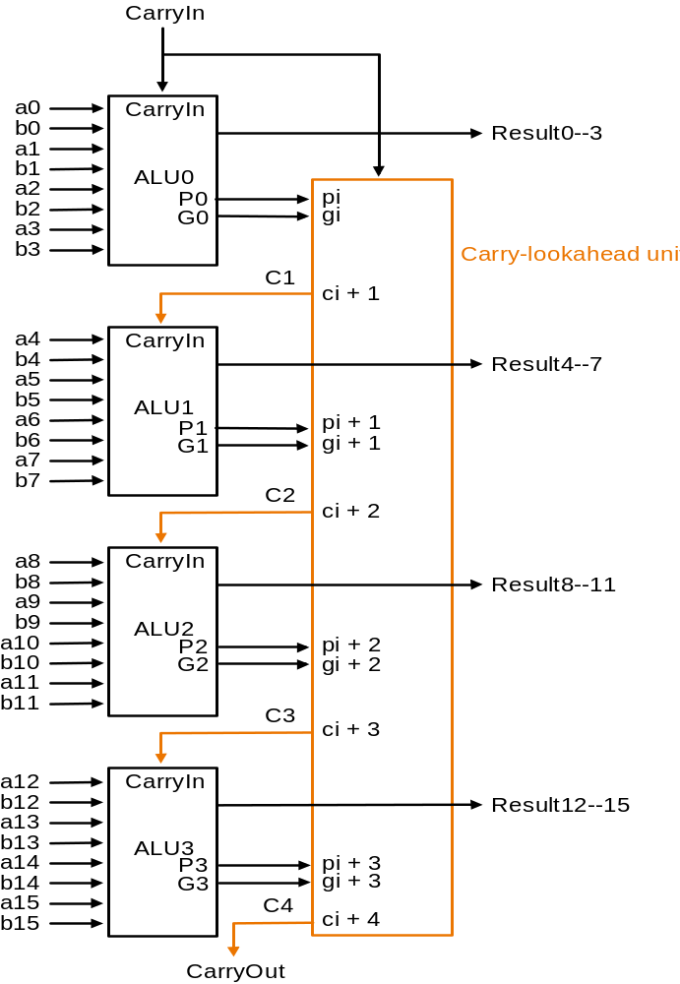
A Carry Look-ahead Adder
A B Cout
0 0 0 kill
0 1 Cin propagate
1 0 Cin propagate
1 1 1 generate
G = A * B
P = A + B
Notes:
Names: suppose G0 is 1 => carry no matter what else => generates a carry
suppose G0 =0 and P0=1 => carry IFF C0 is a 1 => propagates a carry
Like dominoes
What about more than 4 bits?

Slide 41
Example: Carry Look-ahead Unit
P
G
Carry Look-ahead Unit
c_{out}
c_{in}
4
4
4
g_{i}
p_{i}

Slide 42
Example: Multiple Level Carry Look-ahead
C[4:0]
4-bit Carry
Lookahead
Unit
P3, G3
P2, G2
P1, G1
P0, G0
4-bit Carry
Lookahead
Unit
c12
4-bit Carry
Lookahead
Unit
c8
4-bit Carry
Lookahead
Unit
c4
4-bit Carry
Lookahead
Unit
c0
p[15:12]
g[15:12]
p[11:8]
g[11:8]
p[7:4]
g[7:4]
p[3:0]
g[3:0]
c[16:13]
c[12:9]
c[8:5]
c[4:1]
+
+
+
+
+
+
+
+
+
+
+
+
+
+
+
+
+

Slide 43
Carry-select Adder
CP(2n) = 2*CP(n)
n-bit adder
n-bit adder
CP(2n) = CP(n) + CP(mux)
n-bit adder
1
n-bit adder
0
n-bit adder
Cout
Design trick: guess
Notes:
Use multiplexor to save time: guess both ways and then select
(assumes mux is faster than adder)

Slide 44
Arithmetic for Multimedia
Graphics and media processing operates on vectors of 8-bit and 16-bit data
  Use 64-bit adder, with partitioned carry chain
    Operate on 8×8-bit, 4×16-bit, or 2×32-bit vectors
  SIMD (single-instruction, multiple-data)
Saturating operations
  On overflow, result is largest representable value
    c.f. 2s-complement modulo arithmetic
  E.g., clipping in audio, saturation in video

Slide 45
Outline
Addition and subtraction (Sec. 3.2)
Constructing an arithmetic logic unit (Appendix C)
  Building ALU
    Add, sub, and, or, nor
    Set-on-less-than, overflow detection, zero detection
  Fast adders
    Cascaded carry look-ahead adder
    Multiple level carry look-ahead adder
Multiplication (Sec. 3.3, Appendix C)
  Unsigned multiply
  Signed multiply
Division (Sec. 3.4)
Floating point (Sec. 3.5)
  Representations
  Addition and multiplication

Slide 46
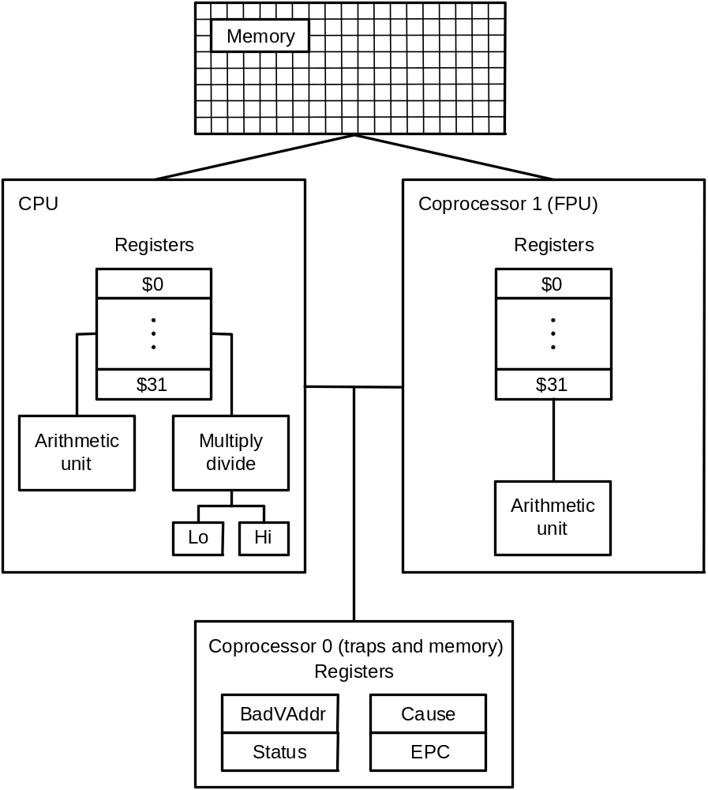
MIPS R2000 Organization

Slide 47
Multiplication in MIPS
mult $t1, $t2 # t1 * t2
No destination register: product could be ~2⁶⁴; need two special registers to hold it
3-step process:
$t1
01111111111111111111111111111111
X $t2
01000000000000000000000000000000
00011111111111111111111111111111 11000000000000000000000000000000
Hi Lo
mfhi $t3
$t3
00011111111111111111111111111111
mflo $t4
$t4
11000000000000000000000000000000
Notes:
Don’t have to understand the multiplication process YET. MUST UNDERSTAND that HI ORDER BITS in HI, LOW ORDER BITS in LO, (noise) MUST USE MFHI, MFLO to access.

Slide 48
MIPS Multiplication
Two 32-bit registers for product
  HI: most-significant 32 bits
  LO: least-significant 32-bits
Instructions
  mult rs, rt / multu rs, rt
    64-bit product in HI/LO
  mfhi rd / mflo rd
    Move from HI/LO to rd
    Can test HI value to see if product overflows 32 bits
  mul rd, rs, rt
    Least-significant 32 bits of product –> rd

Slide 49
Unsigned Multiply
Paper and pencil example (unsigned):
Multiplicand 1000_{ten}
Multiplier X 1001_{ten}
1000
0000
0000
1000
Product 01001000_{ten}
m bits x n bits = m+n bit product
Binary makes it easy:
  0 => place 0 ( 0 x multiplicand)
  1 => place a copy ( 1 x multiplicand)
2 versions of multiply hardware and algorithm

Slide 50
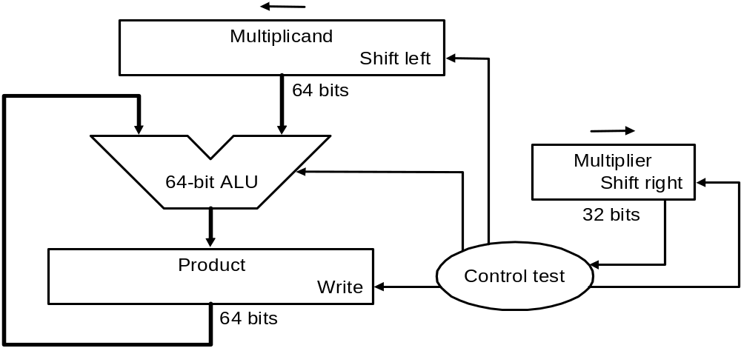
Unsigned Multiplier (Ver. 1)
64-bit multiplicand register (with 32-bit multiplicand at right half), 64-bit ALU, 64-bit product register, 32-bit multiplier register

Slide 51
Multiply Algorithm (Ver. 1)
Start
Multiplier0 = 1
1. Test
Multiplier0
Multiplier0 = 0
1a. Add multiplicand to product and
place the result in Product register
0010 x 0011
Product Multiplier Multiplicand
0000 0000 0011 0000 0010
0000 0010 0001 0000 0100
0000 0110 0000 0000 1000
0000 0110 0000 0001 0000
0000 0110 0000 0010 0000
2. Shift Multiplicand register left 1 bit
3. Shift Multiplier register right 1 bit
32nd
repetition?
No: < 32 repetitions
Yes: 32 repetitions
Done
Notes:
Mer: 0011 Mnd: 0000 0010 P: 0000 0000
1a. 1=>P=P+Mcand Mer: 0011 Mcand: 0000 0010 P: 0000 0010
2. Shl Mcand Mer: 0011 Mcand: 0000 0100 P: 0000 0010
3. Shr Mer Mer: 0001 Mcand: 0000 0100 P: 0000 0010
1a. 1=>P=P+Mcand Mer: 0001 Mcand: 0000 0100 P: 0000 0110
2. Shl Mcand Mer: 0001 Mcand: 0000 1000 P: 0000 0110
3. Shr Mer Mer: 0000 Mcand: 0000 1000 P: 0000 0110
1. 0=>nop Mer: 0000 Mcand: 0000 1000 P: 0000 0110
2. Shl Mcand Mer: 0000 Mcand: 0001 0000 P: 0000 0110
3. Shr Mer Mer: 0000 Mcand: 0001 0000 P: 0000 0110
1. 0=>nop Mer: 0000 Mcand: 0001 0000 P: 0000 0110
2. Shl Mcand Mer: 0000 Mcand: 0010 0000 P: 0000 0110
3. Shr Mer Mer: 0000 Mcand: 0010 0000 P: 0000 0110

Slide 52
Observations: Multiply Ver. 1
Delay ratio of multiply to add 5:1 to 100:1
Half of the bits in multiplicand always 0
=> 64-bit adder is wasted
0’s inserted in right of multiplicand as shifted
=> least significant bits of product never changed once formed
Instead of shifting multiplicand to left, shift product to right?
Product register wastes space => combine Multiplier and Product register

Slide 53
Unsigned Multiply
Paper and pencil example (unsigned):
Multiplicand 1000_{ten}
Multiplier X 1001_{ten}
1000
0000
0000
1000
Product 01001000_{ten}
m bits x n bits = m+n bit product
Binary makes it easy:
  0 => place 0 ( 0 x multiplicand)
  1 => place a copy ( 1 x multiplicand)
2 versions of multiply hardware and algorithm

Slide 54
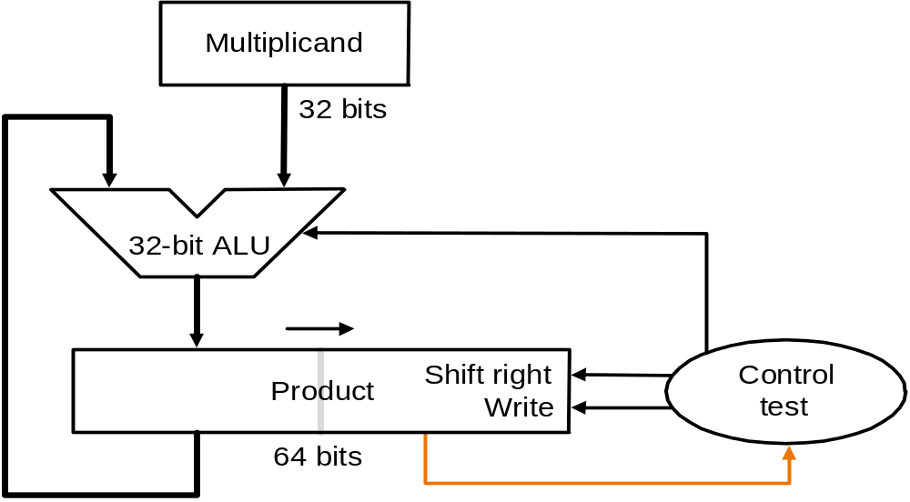
Unisigned Multiplier (Ver. 2)
32-bit Multiplicand register, 32 -bit ALU, 64-bit Product register (HI & LO in MIPS), (0-bit Multiplier register)

Slide 55
Multiply Algorithm (Ver. 2)
Start
Product0 = 1
1. Test
Product0
Product0 = 0
1a. Add multiplicand to left half of product and
place the result in left half of Product register
0010 x 0011
Multiplicand Product
0010 0000 0011
0010 0011
0010 0001 0001
0011 0001
0010 0001 1000
0010 0000 1100
0010 0000 0110
2. Shift Product register right 1 bit
32nd
repetition?
No: < 32 repetitions
Yes: 32 repetitions
Done
Notes:
Mcand: 0010 P: 0000 0011
1a. 1=>P=P+Mcand Mcand: 0010 P: 0010 0011
2. Shr P Mcand: 0010 P: 0001 0001
1a. 1=>P=P+Mcand Mcand: 0010 P: 0011 0001
2. Shr P Mcand: 0010 P: 0001 1000
1. 0=>nop Mcand: 0010 P: 0001 1000
2. Shr P Mcand: 0010 P: 0000 1100
1. 0=>nop Mcand: 0010 P: 0000 1100
2. Shr P Mcand: 0010 P: 0000 0110

Slide 56
Outline
Addition and subtraction (Sec. 3.2)
Constructing an arithmetic logic unit (Appendix C)
  Building ALU
    Add, sub, and, or, nor
    Set-on-less-than, overflow detection, zero detection
  Fast adders
    Cascaded carry look-ahead adder
    Multiple level carry look-ahead adder
Multiplication (Sec. 3.3, Appendix C)
  Unsigned multiply
  Signed multiply
Division (Sec. 3.4)
Floating point (Sec. 3.5)
  Representations
  Addition and multiplication

Slide 57
Signed Multiply
What about signed multiplication?
  The easiest solution is to make both positive and remember whether to complement product when done (leave out sign bit, run for 31 steps)
  Apply definition of 2’s complement
    sign-extend partial products and subtract at end

Slide 58
Using Definition of 2’s Complement
Paper and pencil example (signed):
Multiplicand 1001 (-7)
Multiplier X 1001 (-7)
11111001
+ 0000000
+ 000000
- 11001
Product 00110001 (49)
Rule 1: Multiplicand sign extended
Rule 2: Sign bit (s) of Multiplier
  0 => 0 x multiplicand
  1 => -1 x multiplicand
Why rule 2 ?
  X = s x_{n-2} x_{n-3….} x₁ x₀ (2’s complement)
  Value(X) = - 1 x s x 2^{n-1} + x_{n-2} x 2^{n-2} +… + x₁ x 2¹+ x₀ x 2⁰

Slide 59
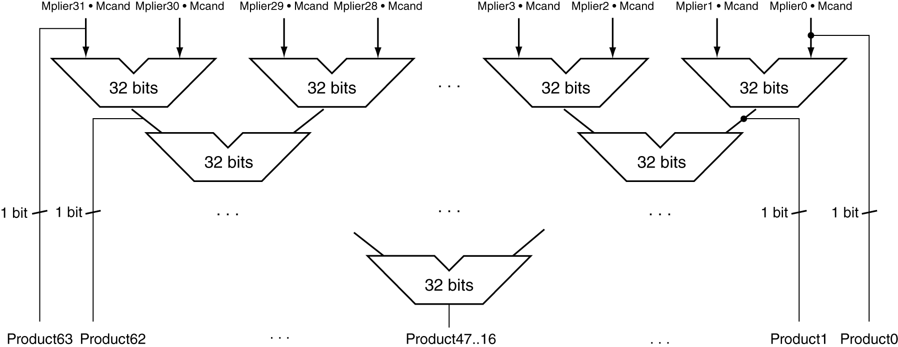
Faster Multiplier
A combinational multiplier
Use multiple adders
  Cost/performance tradeoff
Can be pipelined
  Several multiplication performed in parallel

Slide 60
Wallace Tree Multiplier
Use carry save adders: three inputs and two outputs
1 0 1 0 1 1 1 0
0 0 1 0 0 0 1 1
1 0 0 0 0 1 1 1
----------------
0 0 0 0 1 0 1 0 (sum)
1 0 1 0 0 1 1 1 (carry)
8 full adders
One full adder delay (no carry propagation)
The last stage is performed by regular adder
What is the minimum delay for 16 x 16 multiplier ?

Slide 61
8-bit Wallace Tree Multiplier
M0
M1
M2
M3
M4
M5
M6
M7
CSA
CSA
CSA
CSA
CSA
CSA
Regular adder

Slide 62
Outline
Addition and subtraction (Sec. 3.2)
Constructing an arithmetic logic unit (Appendix C)
  Building ALU
    Add, sub, and, or, nor
    Set-on-less-than, overflow detection, zero detection
  Fast adders
    Cascaded carry look-ahead adder
    Multiple level carry look-ahead adder
Multiplication (Sec. 3.3, Appendix C)
  Unsigned multiply
  Signed multiply
Division (Sec. 3.4)
Floating point (Sec. 3.5)
  Representations
  Addition and multiplication

Slide 63
MIPS R2000 Organization

Slide 64
Division in MIPS
div $t1, $t2 # t1 / t2
Quotient stored in Lo, remainder in Hi
mflo $t3 #copy quotient to t3
mfhi $t4 #copy remainder to t4
3-step process
Unsigned division:
divu $t1, $t2 # t1 / t2
  Just like div, except now interpret t1, t2 as unsigned integers instead of signed
  Answers are also unsigned, use mfhi, mflo to access
No overflow or divide-by-0 checking
  Software must perform checks if required

Slide 65
Divide: Paper & Pencil
1001_{ten} Quotient
Divisor 1000_{ten} 1001010_{ten} Dividend
-1000
0010
0101
1010
-1000
10_{ten} Remainder
See how big a number can be subtracted, creating quotient bit on each step
  Binary => 1 * divisor or 0 * divisor
Two versions of divide, successive refinement
Both dividend and divisor are 32-bit positive integers

Slide 66
Divide Hardware (Version 1)
64-bit Divisor register (initialized with 32-bit divisor in left half), 64-bit ALU, 64-bit Remainder register (initialized with 64-bit dividend), 32-bit Quotient register
Shift Right
Divisor
64 bits
Quotient
Shift Left
64-bit ALU
32 bits
Remainder
Write
Control
64 bits

Slide 67


Divide Algorithm (Version 1)
Start: Place Dividend in Remainder
1. Subtract Divisor register from
Remainder register, and place the
result in Remainder register
0111 / 0010
Quot. Divisor Rem.
0000 00100000 00000111
11100111
00000111
0000 00010000 00000111
11110111
00000111
0000 00001000 00000111
11111111
00000111
0000 00000100 00000111
00000011
0001 00000011
0001 00000010 00000011
00000001
0011 00000001
0011 00000001 00000001
Remainder ≥ 0
Test
Remainder
Remainder < 0
2a. Shift Quotient register to left, setting new rightmost bit to 1
2b. Restore original value by adding Divisor to Remainder, place sum in Remainder, shift Quotient to the left, setting new least significant bit to 0
33rd
repetition?
No: < 33 repetitions
Yes: 33 repetitions
Notes:
Q: 0000 D: 0010 0000 R: 0000 0111  = 1110 0000
1: R = R Q: 0000 D: 0010 0000 R: 1110 0111
2b: +D, sl Q, 0 Q: 0000 D: 0010 0000 R: 0000 0111
3: Shr D Q: 0000 D: 0001 0000 R: 0000 0111  = 1111 0000
1: R = R Q: 0000 D: 0001 0000 R: 1111 0111
2b: +D, sl Q, 0 Q: 0000 D: 0001 0000 R: 0000 0111
3: Shr D Q: 0000 D: 0000 1000 R: 0000 0111  = 1111 1000
1: R = R Q: 0000 D: 0000 1000 R: 1111 1111
2b: +D, sl Q, 0 Q: 0000 D: 0000 1000 R: 0000 0111
3: Shr D Q: 0000 D: 0000 0100 R: 0000 0111  = 1111 1100
1: R = R Q: 0000 D: 0000 0100 R: 0000 0011
2a: sl Q, 1 Q: 0001 D: 0000 0100 R: 0000 0011
3: Shr D Q: 0000 D: 0000 0010 R: 0000 0011  = 1111 1110
1: R = R Q: 0000 D: 0000 0010 R: 0000 0001
2a: sl Q, 1 Q: 0011 D: 0000 0010 R: 0000 0001
3: Shr D Q: 0011 D: 0000 0001 R: 0000 0001
Recommend show 2 comp of divisor, show lines for subtract divisor and restore remainder

Slide 68
Observations: Divide Version 1
Half of the bits in divisor register always 0
=> 1/2 of 64-bit adder is wasted
=> 1/2 of divisor is wasted
Instead of shifting divisor to right,
shift remainder to left?
1st step cannot produce a 1 in quotient bit
=> switch order to shift first and then subtract
=> save 1 iteration
Eliminate Quotient register by combining with Remainder register as shifted left

Slide 69
Divide Hardware (Version 2)
32-bit Divisor register, 32 -bit ALU, 64-bit Remainder register, (0-bit Quotient register)
Divisor
32 bits
32-bit ALU
Remainder
(Quotient)
Shift Left
Control
64 bits
Write

Slide 70
Divide Algorithm (Version 2)
Start: Place Dividend in Remainder
Divide Algorithm (Version 2)
1. Shift Remainder register left 1 bit
0111 / 0010
Step Remainder Div.
0 0000 0111 0010
1.1 0000 1110
1.2 1110 1110
1.3b 0001 1100
2.2 1111 1100
2.3b 0011 1000
3.2 0001 1000
3.3a 0011 0001
4.2 0001 0001
4.3a 0010 0011
0001 0011
2. Subtract Divisor register from the
left half of Remainder register, and place the
result in the left half of Remainder register
Remainder ≥ 0
Test
Remainder
Remainder < 0
3a. Shift Remainder to left, setting new rightmost bit to 1
3b. Restore original value by adding Divisor to left half of Remainder, and place sum in left half of Remainder. Also shift Remainder to left, setting the new least significant bit to 0
32nd
repetition?
No: < 32 repetitions
Yes: 32 repetitions
Done. Shift left half of Remainder right 1 bit
Notes:
D: 0010 R: 0000 0111
0: Shl R D: 0010 R: 0000 1110
1: R = R D: 0010 R: 1110 1110
2b: +D, sl R, 0 D: 0010 R: 0001 1100
1: R = R D: 0010 R: 1111 1100
2b: +D, sl R, 0 D: 0010 R: 0011 1000
1: R = R D: 0010 R: 0001 1000
2a: sl R, 1 D: 0010 R: 0011 0001
1: R = R D: 0010 R: 0001 0001
2a: sl R, 1 D: 0010 R: 0010 0011
Shr R(rh) D: 0010 R: 0001 0011

Slide 71
Divide
Signed Divides:
  Remember signs, make positive, complement quotient and remainder if necessary
  Let Dividend and Remainder have same sign and negate Quotient if Divisor sign & Dividend sign disagree,
  e.g., -7÷ 2 = -3, remainder = -1
  -7÷- 2 = 3, remainder = -1
  Satisfy Dividend =Quotient x Divisor + Remainder

Slide 72
Observations: Multiply and Divide
Same hardware as multiply: just need ALU to add or subtract, and 64-bit register to shift left (multiply: shift right)
Hi and Lo registers in MIPS combine to act as 64-bit register for multiply and divide

Slide 73
Multiply/Divide Hardware
32-bit Multiplicand/Divisor register, 32 -bit ALU, 64-bit Product/Remainder register, (0-bit Multiplier/Quotient register)
Multiplicand/
Divisor
32 bits
32-bit ALU
Shift Right
Product/
Remainder
(Multiplier/
Quotient)
Shift Left
Control
64 bits
Write

Slide 74
Outline
Addition and subtraction (Sec. 3.2)
Constructing an arithmetic logic unit (Appendix C)
  Building ALU
    Add, sub, and, or, nor
    Set-on-less-than, overflow detection, zero detection
  Fast adders
    Cascaded carry lookahead adder
    Multiple level carry lookahead adder
Multiplication (Sec. 3.3, Appendix C)
  Unsigned multiply
  Signed multiply
Division (Sec. 3.4)
Floating point (Sec. 3.5)
  Representations
  Addition and multiplication

Slide 75
Floating-Point: Motivation
What can be represented in N bits?
Unsigned 0 to 2^{n} - 1
2’s Complement -2^{n-1} to 2^{n-1}- 1
1’s Complement -2^{n-1}+1 to 2^{n-1}
Excess M -M to 2^{n} - M - 1
But, what about ...
  very large numbers? 9,349,398,989,787,762,244,859,087,678
  very small number? 0.0000000000000000000000045691
  rationals 2/3
  irrationals √2
  transcendentals e, π

Slide 76
Scientific Notation: Binary
Computer arithmetic that supports it is called floating point, because the binary point is not fixed, as it is for integers
Normalized form: no leading 0s
(exactly one digit to left of decimal point)
Alternatives to represent 1/1,000,000,000
  Normalized: 1.0 x 10⁻⁹
  Not normalized: 0.1 x 10⁻⁸, 10.0 x 10⁻¹⁰
Significand (Mantissa)
exponent
1.0_{two} x 2⁻¹
“binary point”
radix (base)

Slide 77
FP Representation
Normal format: 1.xxxxxxxxxx_{two} × 2^{yyyy}two
Want to put it into multiple words: 32 bits for single-precision and 64 bits for double-precision
A simple single-precision representation:
S represents sign
Exponent represents y’s
Significand represents x’s
31
30
23
22
0
S
Exponent
Significand
1 bit
8 bits
23 bits

Slide 78
Double Precision Representation
Next multiple of word size (64 bits)
Double precision (vs. single precision)
  But primary advantage is greater accuracy
  due to larger significand
31
30
20
19
0
S
Exponent
Significand
1 bit
11 bits
20 bits
Significand (cont’d)
32 bits

Slide 79
IEEE 754 Standard (1/4)
Regarding single precision, DP similar
Sign bit:
1 means negative
0 means positive
Significand:
  To pack more bits, leading 1 implicit for normalized numbers
  1 + 23 bits single, 1 + 52 bits double
  always true: 0 < Significand < 1
  (for normalized numbers)
Note: 0 has no leading 1, so reserve exponent value 0 just for number 0

Slide 80
IEEE 754 Standard (2/4)
Exponent:
  Need to represent positive and negative exponents
  Also want to compare FP numbers as if they were integers, to help in value comparisons
  If use 2’s complement to represent?
  e.g., 1.0 x 2⁻¹ versus 1.0 x2⁺¹ (1/2 versus 2)
1/2
0
1111 1111
000 0000 0000 0000 0000 0000
2
0
0000 0001
000 0000 0000 0000 0000 0000
  If we use integer comparison for these two words, we will conclude that 1/2 > 2!!!

Slide 81
Biased (Excess) Notation
Biased 7
0000 -7
0001 -6
0010 -5
0011 -4
0100 -3
0101 -2
0110 -1
0111 0
1000 1
1001 2
1010 3
1011 4
1100 5
1101 6
1110 7
1111 8

Slide 82
IEEE 754 Standard (3/4)
Instead, let notation 0000 0000 be most negative, and 1111 1111 most positive
Called biased notation, where bias is the number subtracted to get the real number
  IEEE 754 uses bias of 127 for single precision:
  Subtract 127 from Exponent field to get actual value for exponent
  1023 is bias for double precision
1/2
0
0111 1110
000 0000 0000 0000 0000 0000
2
0
1000 0000
000 0000 0000 0000 0000 0000

Slide 83
IEEE 754 Standard (4/4)
Summary (single precision):
(-1)^{S} x (1.Significand) x 2^{(Exponent-127)}
Double precision identical, except with exponent bias of 1023
31
30
23
22
0
S
Exponent
Significand
1 bit
8 bits
23 bits

Slide 84
Example: FP to Decimal
Sign: 0 => positive
Exponent:
  0110 1000_{two} = 104_{ten}
  Bias adjustment: 104 - 127 = -23
Significand:
  1+2⁻¹+2⁻³ +2⁻⁵ +2⁻⁷ +2⁻⁹ +2⁻¹⁴ +2⁻¹⁵ +2⁻¹⁷ +2⁻²²
  = 1.0 + 0.666115
Represents: 1.666115_{ten}×2⁻²³ ≈ 1.986 × 10⁻⁷
0
0110 1000
101 0101 0100 0011 0100 0010

Slide 85
Example 1: Decimal to FP
Number = - 0.75
= - 0.11_{two} × 2⁰ (base 2 scientific notation)
= - 1.1_{two} × 2⁻¹ (normalized scientific notation)
Sign: negative => 1
Exponent:
  Bias adjustment: -1 +127 = 126
  126_{ten} = 0111 1110_{two}
1
0111 1110
100 0000 0000 0000 0000 0000

Slide 86
Example 2: Decimal to FP
A more difficult case: representing 1/3?
  = 0.33333…₁₀ = 0.0101010101… ₂ × 2⁰ (base 2)
  = 1.0101010101… ₂ × 2⁻² (normalization)
  Sign: 0
  Exponent = -2 + 127 = 125₁₀=01111101₂
  Significand = 0101010101…
0
0111 1101
0101 0101 0101 0101 0101 010

Slide 87
Single-Precision Range
Exponents 00000000 and 11111111 reserved
Smallest value
  Exponent: 00000001
  ⇒ actual exponent = 1 – 127 = –126
  Fraction: 000…00 ⇒ significand = 1.0
  ±1.0 × 2^{–126} ≈ ±1.2 × 10^{–38}
Largest value
  exponent: 11111110
  ⇒ actual exponent = 254 – 127 = +127
  Fraction: 111…11 ⇒ significand ≈ 10. ₂ = 2.0
  ±2.0 × 2⁺¹²⁷ ≈ ±3.4 × 10⁺³⁸

Slide 88
Double-Precision Range
Exponents 0000…00 and 1111…11 reserved
Smallest value
  Exponent: 00000000001
  ⇒ actual exponent = 1 – 1023 = –1022
  Fraction: 000…00 ⇒ significand = 1.0
  ±1.0 × 2^{–1022} ≈ ±2.2 × 10^{–308}
Largest value
  Exponent: 11111111110
  ⇒ actual exponent = 2046 – 1023 = +1023
  Fraction: 111…11 ⇒ significand ≈ 10. ₂ = 2.0
  ±2.0 × 2⁺¹⁰²³ ≈ ±1.8 × 10⁺³⁰⁸

Slide 89
Floating-Point Precision
Relative precision
  all fraction bits are significant
  Single: approx 2^{–23}
    Equivalent to 23 × log₁₀2 ≈ 23 × 0.3 ≈ 6 decimal digits of precision
  Double: approx 2^{–52}
    Equivalent to 52 × log₁₀2 ≈ 52 × 0.3 ≈ 16 decimal digits of precision

Slide 90
Zero and Special Numbers
What have we defined so far? (single precision)
  Exponent Significand Object
  0 0 ???
  0 nonzero ???
  1-254 anything +/- floating-point
  255 0 ???
  255 nonzero ???

Slide 91
Zero and Special Numbers
What have we defined so far? (single precision)
  Exponent Significand Object
  0 0 ???
  0 nonzero ???
  1-254 anything +/- floating-point
  255 0 ???
  255 nonzero ???

Slide 92
Representation for 0
Represent 0?
  exponent all zeroes
  significand all zeroes too
  What about sign?
  +0: 0 00000000 00000000000000000000000
  -0: 1 00000000 00000000000000000000000

Slide 93
Special Numbers
What have we defined so far? (single precision)
  Exponent Significand Object
  0 0 0
  0 nonzero ???
  1-254 anything +/- floating-point
  255 0 ???
  255 nonzero ???
Range:
  1.0 × 2⁻¹²⁶ ≈ 1.8 × 10⁻³⁸
  What if result too small? (>0, < 1.8x10⁻³⁸ => Underflow!)
  (2 – 2⁻²³) × 2¹²⁷ ≈ 3.4 × 10³⁸
  What if result too large? (> 3.4x10³⁸ => Overflow!)

Slide 94
Gradual Underflow
Represent denormalized numbers (denorms)
  Exponent : all zeroes
  Significand : non-zeroes
  Allow a number to degrade in significance until it become 0 (gradual underflow)
0
0000 0000
0100 0000 0000 0000 0000 000
= 0.01₂ × 2⁻¹²⁶

Slide 95
Smallest Number
  The smallest normalized number
    1.0000 0000 0000 0000 0000 0000 × 2⁻¹²⁶
  The smallest de-normalized number
    0.0000 0000 0000 0000 0000 0001 × 2⁻¹²⁶

Slide 96
Special Numbers
What have we defined so far? (single precision)
  Exponent Significand Object
  0 0 0
  0 nonzero denorm
  1-254 anything +/- floating-point
  255 0 ???
  255 nonzero ???

Slide 97
Representation for +/- Infinity
In FP, divide by zero should produce +/- infinity, not overflow
Why?
  OK to do further computations with infinity, e.g., X/0 > Y may be a valid comparison
IEEE 754 represents +/- infinity
  Most positive exponent reserved for infinity
  Significands all zeroes
S
1111 1111
0000 0000 0000 0000 0000 000

Slide 98
Special Numbers (cont’d)
What have we defined so far? (single-precision)
Exponent Significand Object
0 0 0
0 nonzero denom
1-254 anything +/- fl. pt. #
255 0 +/- infinity
255 nonzero ???

Slide 99
Representation for Not a Number
What do I get if I calculate sqrt(-4.0) or 0/0?
  If infinity is not an error, these should not be either
  They are called Not a Number (NaN)
  Exponent = 255, Significand nonzero
Why is this useful?
  Hope NaNs help with debugging?
  They contaminate: op(NaN,X) = NaN
  OK if calculate but don’t use it

Slide 100
Special Numbers (cont’d)
What have we defined so far? (single-precision)
Exponent Significand Object
0 0 0
0 nonzero denom
1-254 anything +/- fl. pt. #
255 0 +/- infinity
255 nonzero NaN

Slide 101
Outline
Addition and subtraction (Sec. 3.2)
Constructing an arithmetic logic unit (Appendix C)
  Building ALU
    Add, sub, and, or, nor
    Set-on-less-than, overflow detection, zero detection
  Fast adders
    Cascaded carry lookahead adder
    Multiple level carry lookahead adder
Multiplication (Sec. 3.3, Appendix C)
  Unsigned multiply
  Signed multiply
Division (Sec. 3.4)
Floating point (Sec. 3.5)
  Representations
  Addition and multiplication

Slide 102
Floating-Point Addition
Basic addition algorithm:
(1) Align binary point :compute Ye – Xe
  right shift the smaller number, say Xm, that many positions to form Xm × 2^{Xe-Ye}
(2) Add mantissa: compute Xm × 2^{Xe-Ye} + Ym
(3) Normalization & check for over/underflow if necessary:
  left shift result, decrement result exponent
  right shift result, increment result exponent
  check overflow or underflow during the shift
(4) Round the mantissa and renormalize if necessary

Slide 103
Floating-Point Addition Example
Now consider a 4-digit binary example
  1.000₂ × 2^{–1} + –1.110₂ × 2^{–2} (0.5 + –0.4375)
1. Align binary points
  Shift number with smaller exponent
  1.000₂ × 2^{–1} + –0.111₂ × 2^{–1}
2. Add mantissa
  1.000₂ × 2^{–1} + –0.111₂ × 2–1 = 0.001₂ × 2^{–1}
3. Normalize result & check for over/underflow
  1.000₂ × 2^{–4}, with no over/underflow
4. Round and renormalize if necessary
  1.000₂ × 2^{–4} (no change) = 0.0625

Slide 104
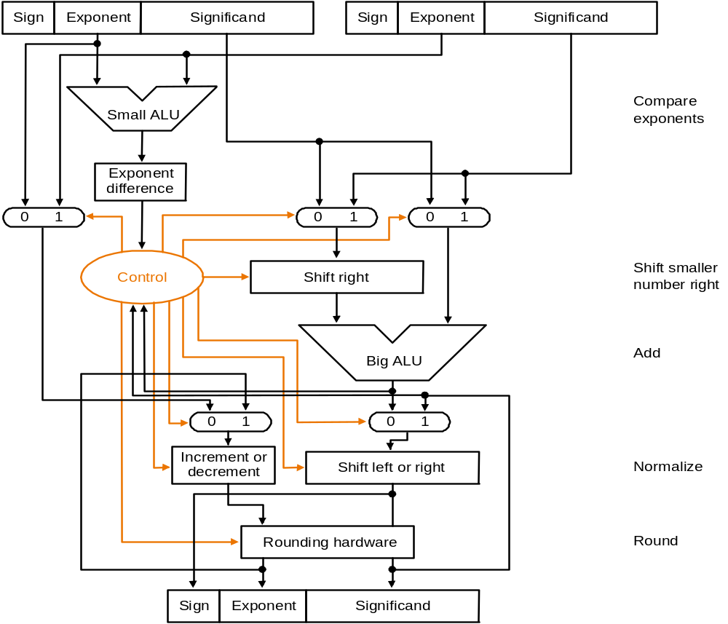
Step 1
Step 2
Step 3
Step 4

Slide 105
FP Adder Hardware
Much more complex than integer adder
Doing it in one clock cycle would take too long
  Much longer than integer operations
  Slower clock would penalize all instructions
FP adder usually takes several cycles
  Can be pipelined

Slide 106
Floating-Point Multiplication
Basic multiplication algorithm
(1) Add exponents of operands to get exponent of product
doubly biased exponent must be corrected:
Xe = 7
Ye = -3
Excess 8
=4+8 = 12 = 01100
need extra subtraction step of the bias amount
(2) Multiplication of operand mantissa
(3) Normalize the product & check overflow or underflow during the shift
(4) Round the mantissa and renormalize if necessary
(5) Set the sign of product
Xe = 1111
Ye = 0101
10100
= 15
= 5
= 20
= 7 + 8
= -3 + 8
= 4 + 8 + 8
Arithmetic-<number>

Slide 107
Floating-Point Multiplication Example
Now consider a 4-digit binary example
  1.000₂ × 2^{–1} × –1.110₂ × 2^{–2} (0.5 × –0.4375)
1. Add exponents
  Unbiased: –1 + –2 = –3
  Biased: (–1 + 127) + (–2 + 127) = –3 + 254 – 127 = –3 + 127
2. Multiply operand mantissa
  1.000₂ × 1.110₂ = 1.1102 ⇒ 1.110₂ × 2^{–3}
3. Normalize result & check for over/underflow
  1.110₂ × 2^{–3} (no change) with no over/underflow
4. Round and renormalize if necessary
  1.110₂ × 2^{–3} (no change)
5. Determine sign:
  –1.110₂ × 2^{–3} = –0.21875

Slide 108
MIPS R2000 Organization

Slide 109
MIPS Floating Point
Separate floating point instructions:
  Single precision: add.s,sub.s,mul.s,div.s
  Double precision: add.d,sub.d,mul.d,div.d
FP part of the processor:
  contains 32 32-bit registers: $f0, $f1, …
  most registers specified in .s and .d instruction refer to this set
  Double precision: by convention, even/odd pair contain one DP FP number: $f0/$f1, $f2/$f3
  separate load and store: lwc1 and swc1
  Instructions to move data between main processor and coprocessors:
    mfc0, mtc0, mfc1, mtc1, etc.
Notes:
lwcz: lw means load word, c co-processor ( z= 0 traps processor, z=1 floating point unit)
Lwc1 : lw to floating point co-processor

Slide 110
Interpretation of Data
The BIG Picture
Bits have no inherent meaning
  Interpretation depends on the instructions applied
Computer representations of numbers
  Finite range and precision
  Need to account for this in programs

Slide 111

Associativity
Floating Point add, subtract associative ?
§3.6 Parallelism and Computer Arithmetic: Associativity
Therefore, Floating Point add, subtract are not associative!
  Why? FP result approximates real result!
  This example: 1.5 x 10³⁸ is so much larger than 1.0 that 1.5 x 10³⁸ + 1.0 in floating point representation is still 1.5 x 10³⁸

Slide 112
Concluding Remarks
ISAs support arithmetic
  Signed and unsigned integers
  Floating-point approximation to reals
Bounded range and precision
  Operations can overflow and underflow
MIPS ISA
  Core instructions: 54 most frequently used
    100% of SPECINT, 97% of SPECFP
  Other instructions: less frequent
§3.9 Concluding Remarks

