Slide 1




Master of DBMS cluster
Collect system / transaction features, eg: locking dependency
Slaves of DBMS cluster
Receive transaction requests
Process raw features with ML / stats
OPTIMIZE transaction routing destination
Controller

Slide 2



NTK Kernel Machine
Generated Image
Fake / Real probability as Loss function
Update Generated Image
Real Image

Slide 3

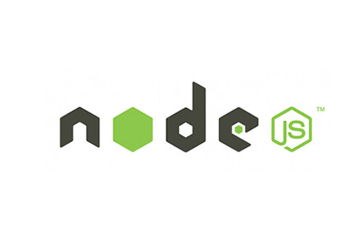




Front-end Framework
Back-end
& DBMS
Deployment
Deploy &
Load Balancing
RESTful API
Blockchain
(Under construction)

