Slide 1
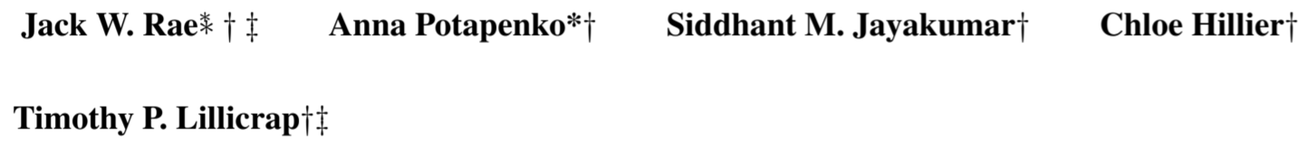
Compressive Transformers For Long-Range Sequence Modelling
ICLR 2020
Citation count: 8
Notes:
It comes from DeepMind

Slide 2
Motivation
Transformers need large memory to store previous experience and compute the longer attention.
Hard to approach long and sparse attention
How about we compress the old memory and only retain the most important information?
Notes:
目前SOTA 的transformer MODEL是transformer XL，但如果以XL的架構要再繼續延長模型的attention size不外乎就是一個辦法，增加segment memory的長度，但是這樣會需要消耗更多memory和computaiotn，同時在長距離文本依賴時，attention 也許會很sparse，存了大量的資料在segment level memory但很多資料可能都沒有被attention使用到，那有沒有有效的方式去儲存呢？而這篇paper提出的就是將segment memory壓縮保留重點，在相同的memory空間保留更多資訊

Slide 3
Background
Transformer XL (Transformer-XL: Attentive Language Models Beyond a Fixed-Length Context )
Segment-Level Recurrence
Relative Positional Encodings

Slide 4
Background
Segment-Level Recurrence
Every hidden layer caches the previous state of itself and concatenate to the previous segment.

Slide 5

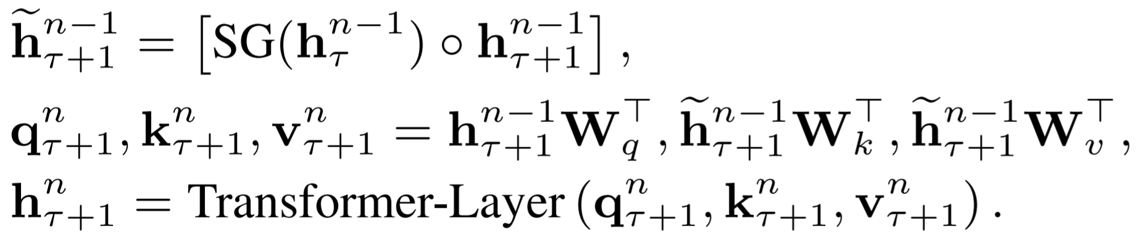



Background
Segment-Level Recurrence
: Consecutive segments of length L
: n-th Hidden layer for τ –th segment, d is the hidden dimension
SG() : Function for Stop Gradient
: The operator denotes the concatenation of two hidden segments

Slide 6
Background

Slide 7
Problem formulation
Is there a cheaper way to increase the attention size?

Slide 8
Outline
Main Idea
Experiments & Evaluation
Conclusion

Slide 9
Main Idea
Compressive Memory
Based on transformer XL, Compress old memories, and store them in an additional compressed memory. In this example compression ratio C = 3

Slide 10
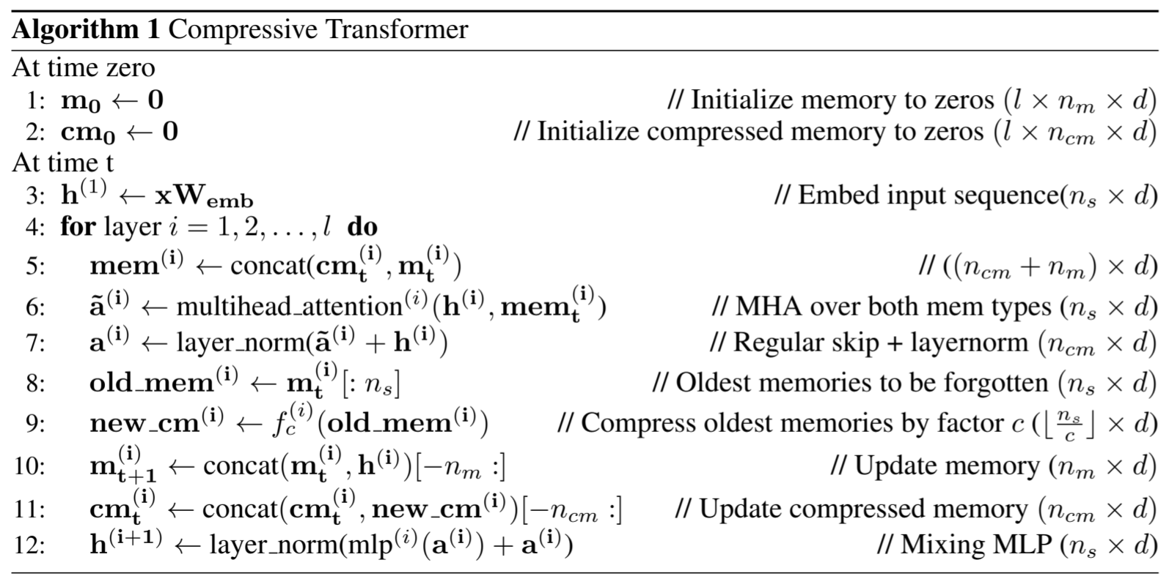
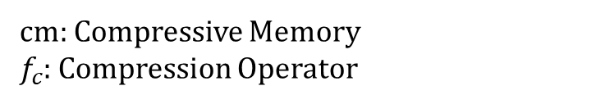
Main Idea
cm: Compressive Memory
$f_{c}$: Compression Operator

Slide 11
Main Idea
For choices of Compression Functions fc
Max/Mean Pooling: where the kernel and stride is set to the compression rate c
1D convolution: With kernel & stride set to c, need to be optimized
Dilated Convolutions: need to be optimized
Most-Used: where the memories are sorted by their average attention (usage) and the most-used are preserved.

Slide 12
Main Idea
For choices of Compression Loss
BPTT: Backpropagating through time over unroll, but cost time
Auto-Encoding Loss: Reconstruct old memory from compressed memory, attempt to retain all information
Attention Reconstruction: Next Page

Slide 13
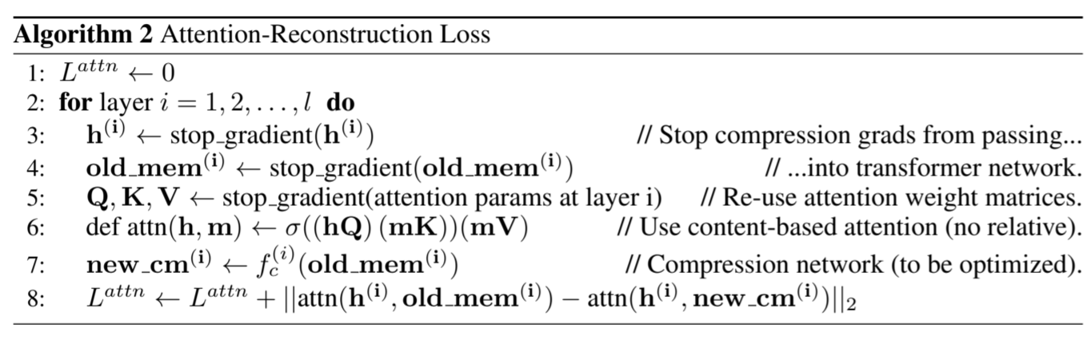
Main Idea
Attention Reconstruction
And we found that Attention Reconstruction works Best through 3 choice.

Slide 14
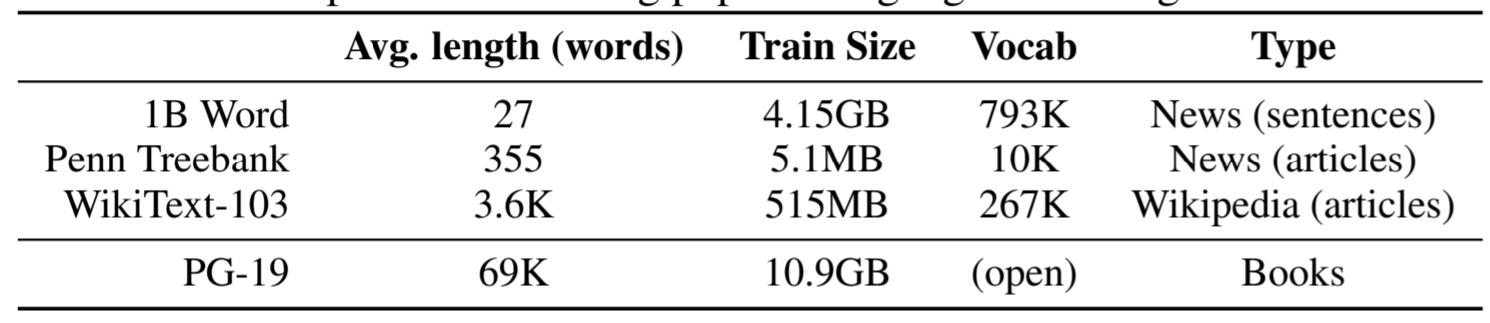
Main Idea
Book-Level language modelling benchmark: PG-19
Release a new dataset: PG-19
Using text from books published over 100 years
Contains 28752 books, 11GB

Slide 15
Experiments & Evaluation
ENWIK8
PG-19
WIKITEXT-103
Compressibility Of Layers
Attention
Optimization Schedule
Speech
Reinforcement Learning

Slide 16
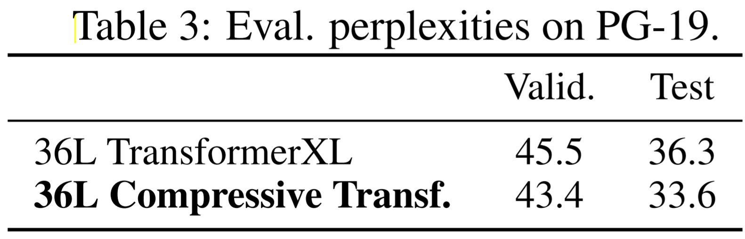
Experiment: PG-19
During Training:
Transformer XL: 36 layers, window size 512, attention window 1024,
Compressive Transformer: 36 layers, window size 512, memory size 512, compressive memory 512, C = 2
About improve 7.4%

Slide 17
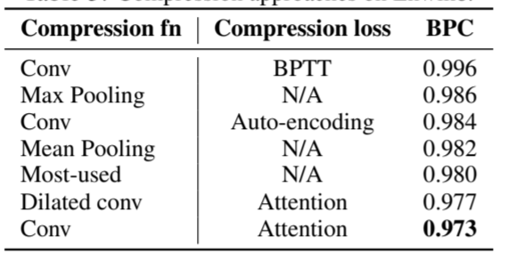
Experiment: Compression approaches on Enwik8
Sweep over compression rate of 2, 3, 4
Attention Reconstruction works best

Slide 18
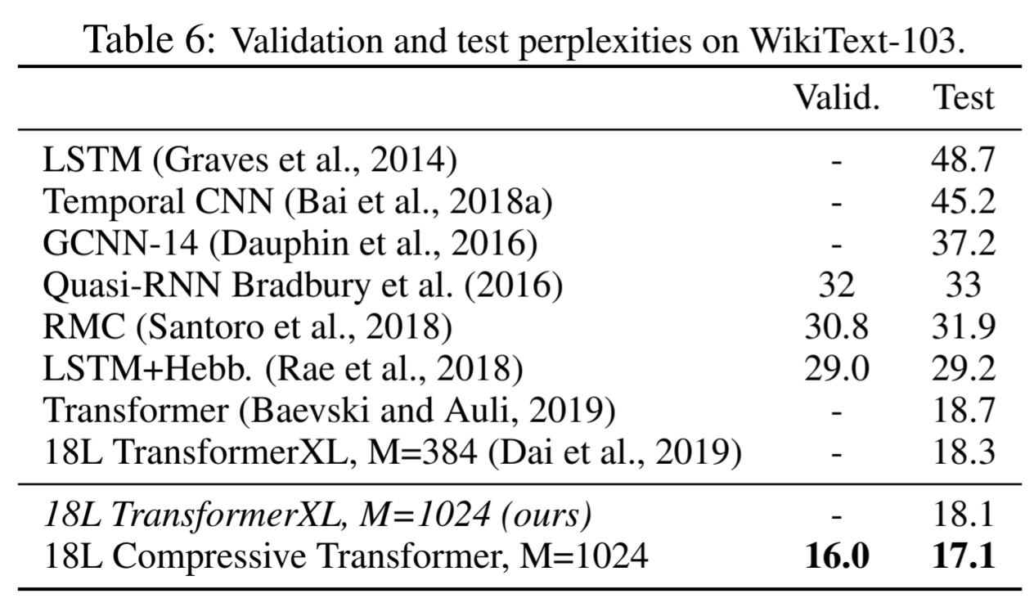
Experiment: WIKITEXT-103
During Training:
Compressive Transformer: memory size 500, compressive memory 1500, C = 4
5% higher probability on correct word than the prior SotA Transformer XL.
Notes:
Unit: perplexity
WIKITEXT-103: SOTA

Slide 19
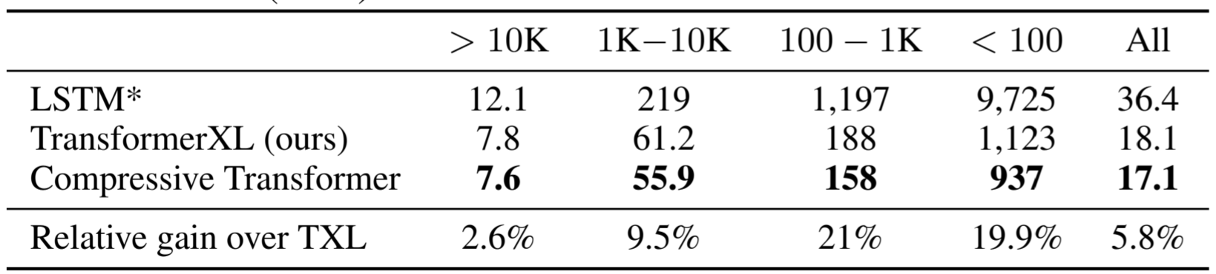
Experiment: WIKITEXT-103
During Training:
Compressive Transformer: memory size 500, compressive memory 1500, C = 4
Obtains a much larger improvement of ≈ 20% for infrequent words

Slide 20
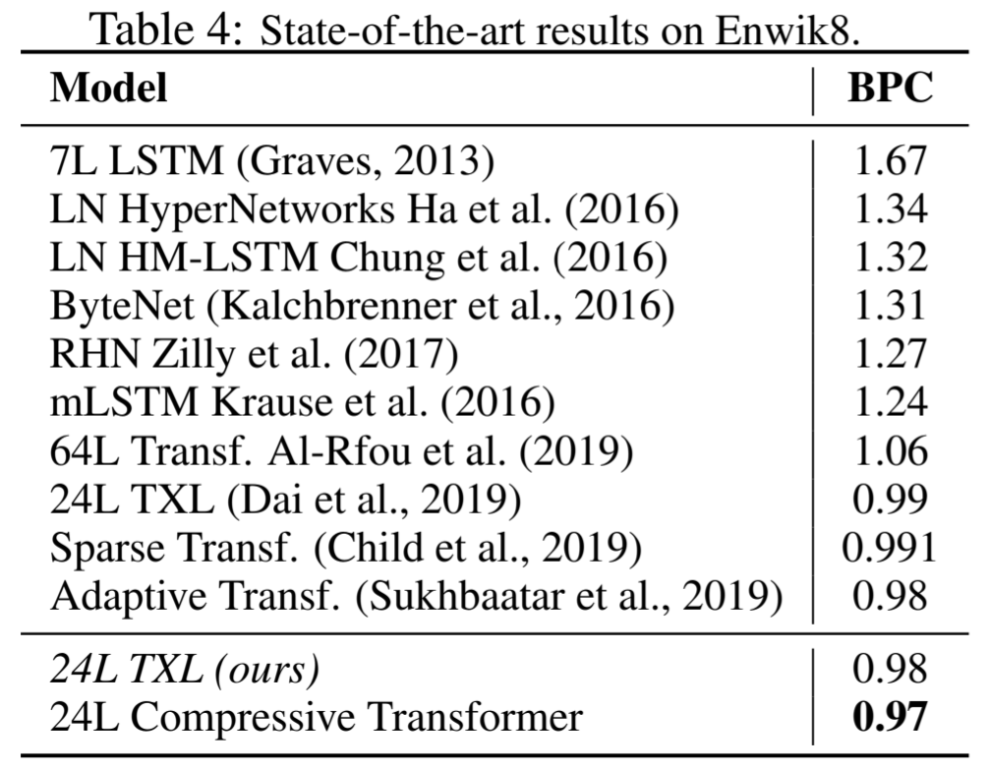
Experiment: ENWIK8
During Training:
Transformer XL: 24 layers, window size 768, memory size 2304,
Compressive Transformer: 24 layers, window size 768, memory size 768, compressive memory 1152, C = 3
During Evaluation:
Transformer XL: memory size 4096
Compressive Transformer: memory size , compressive memory size 3072
Notes:
ENWIK8: SOTA

Slide 21
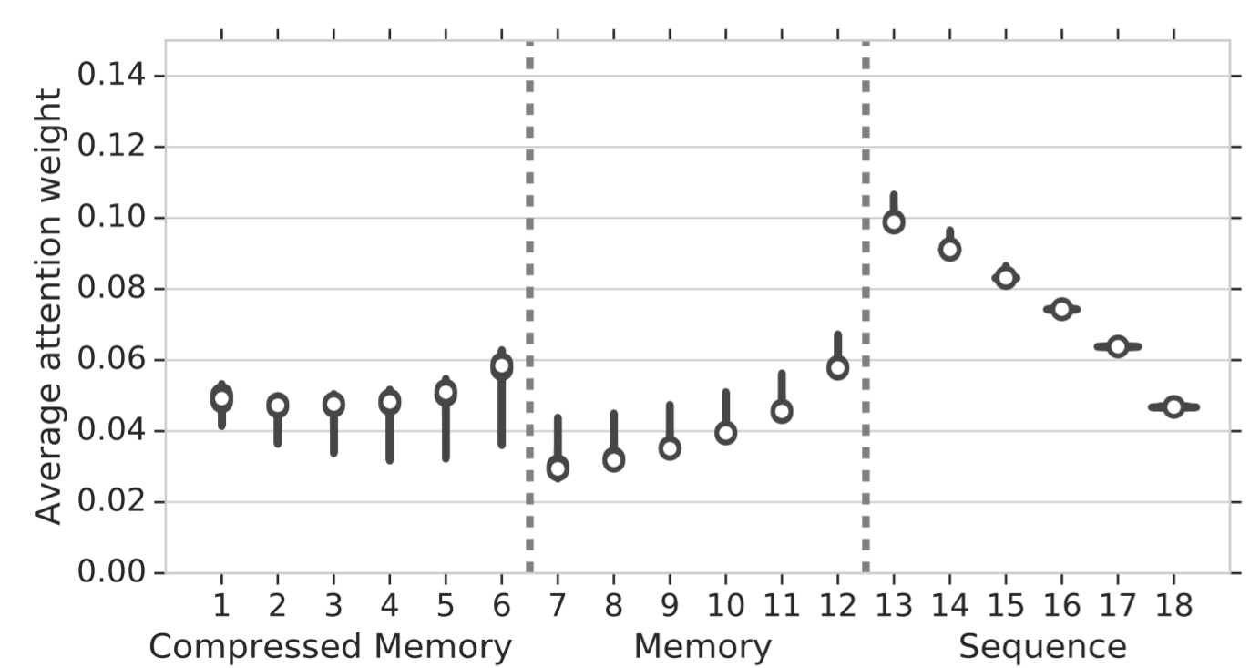
Experiment: Attention
It average the attention weight over a sample of 20, 000 sequences from a trained model on Enwik8 and separate the attention into eighteen buckets
It shows an increase in the activations stored in compressed memory.
Notes:
compress function有挑出重點資訊保留在memory內
有解Sparse attention

Slide 22
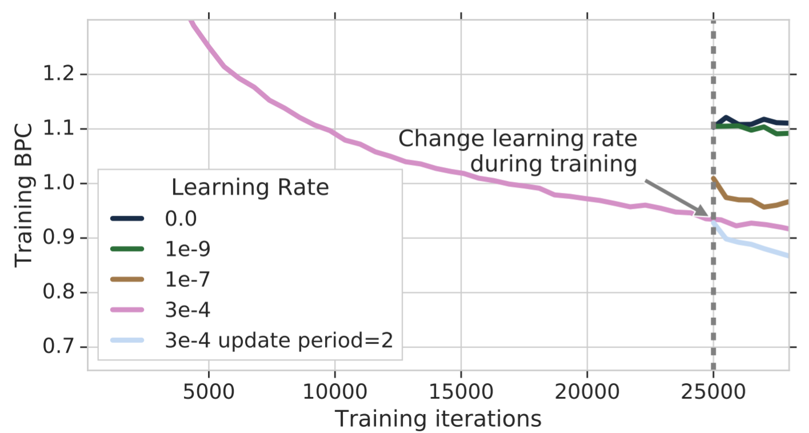
Experiment: Optimization Schedule
An observation that when the learning rate is tuned to be much smaller, performance degrades drastically
propose reducing the frequency of optimization updates during training(increases the effective batch size)

Slide 23
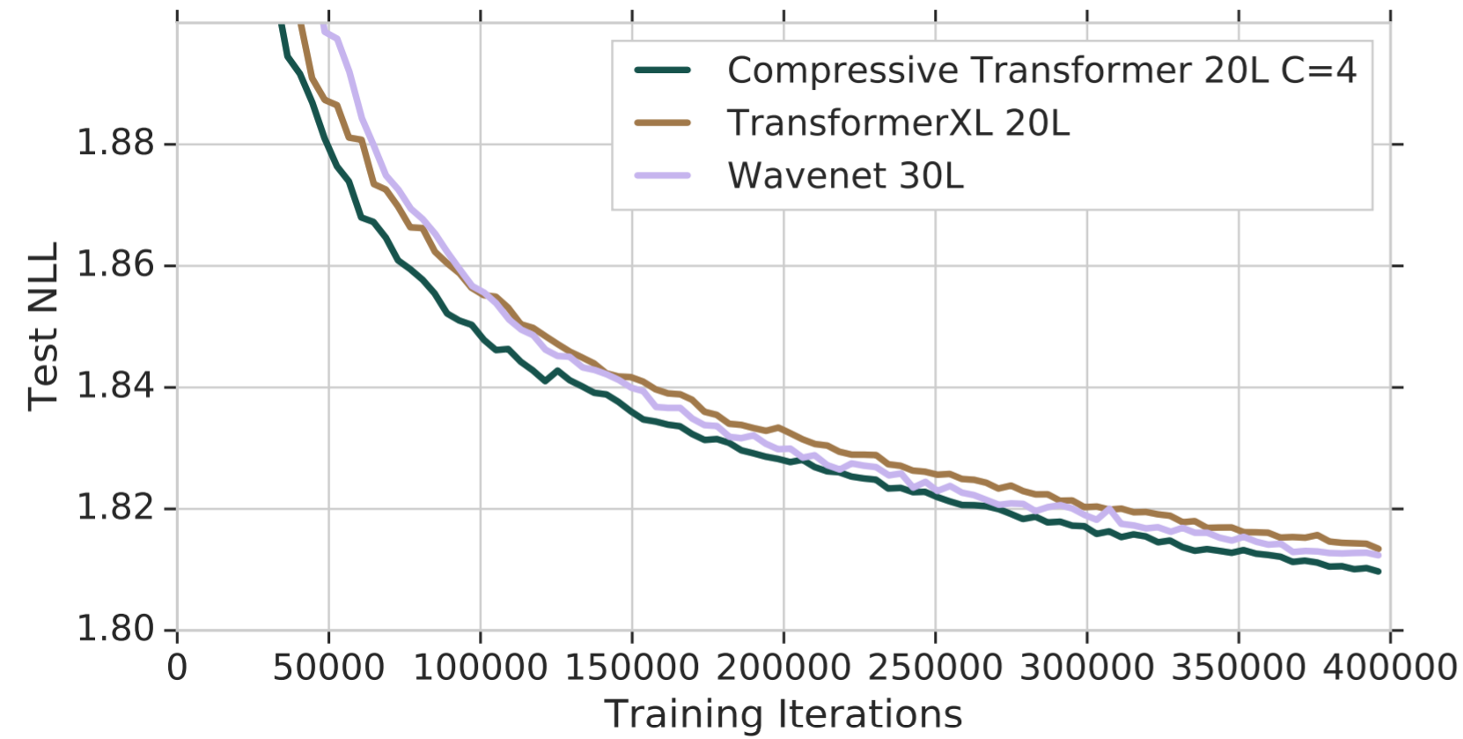
Experiment: Speech
Train the model on 24.6 hours of 24kHz North American speech data.
Chunk the sequences into windows of size 3840, roughly 80ms of audio
During Training:
Transformer XL: 20 layers, window size 768, memory size 1568
Compressive Transformer: 20 layers, window size 768, memory size 768, compressive memory 768, C = 4
(But not full convergence, should be better)
WaveNet: 30 layers
Compressive transformer is Better than WaveNet.

Slide 24
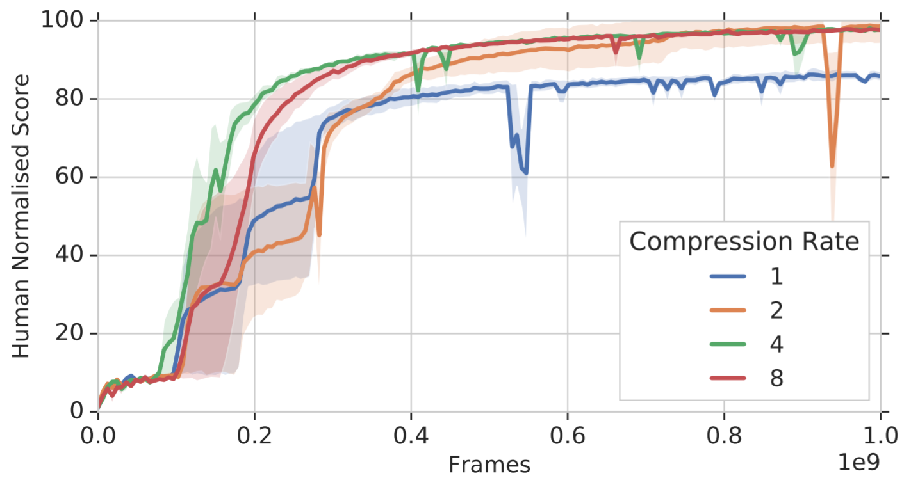
Experiment: Reinforcement Learning
Replace an LSTM to Compressive Transformer in the IMPALA.
Task: DMLab-30 rooms select nonmatching object
Compressive transformer is able to solve the task to Human-Level but the model with compression rate 1 is unable

Slide 25
Conclusion
Compression is a simpler approach to dynamic or sparse attention — which often requires custom kernels to make efficient.

