Slide 1
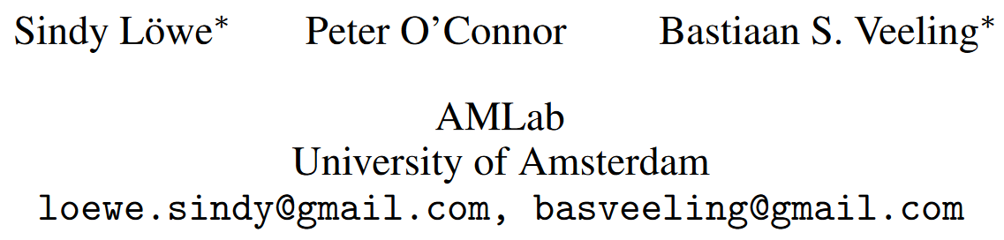
Putting An End to End-to-End:Gradient-Isolated Learning of Representations
NIPS’19
Citation count: 2

Slide 2
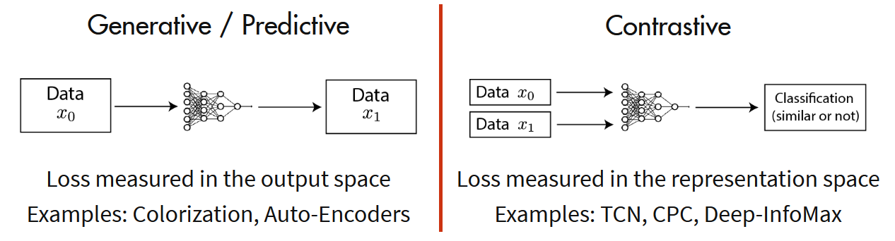
Background
Contrastive learning
Notes:
Self-Supervised Learning
Predictive: auto-encoder
Contrastive: an encoder too, predict similarity

Slide 3
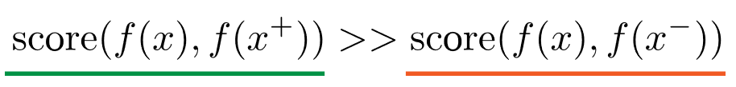

Background
Contrastive learning
For any data point $x,$contrastive methods aim to learn an encoder $f$ such that:
Notes:
here x+ is data point similar to x, referred to as a positive sample. x- is a data point dissimilar to x, referred to as a negative sample.
the score function is a metric that measures the similarity between two features.

Slide 4
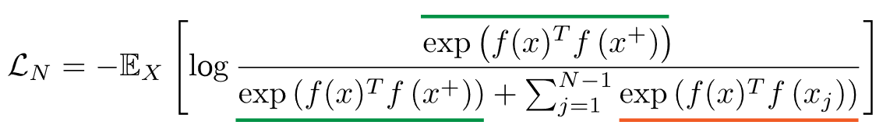

Background
Contrastive learning
To optimize for this property, we can construct a softmax classifier.
with
Notes:
This is the familiar cross-entropy loss for an N-way softmax classifier, and commonly called the InfoNCE loss in the contrastive learning literature.

Slide 5
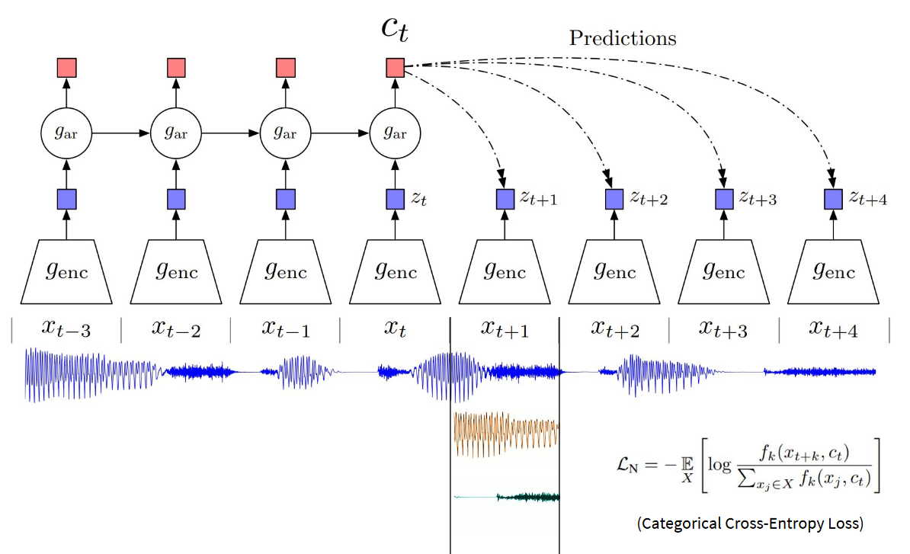
Background
Contrastive Predictive Coding (CPC)
Notes:
CPC learns representations by encoding information that's shared across data points multiple time steps apart, discarding local information.

Slide 6
Motivation
End-to-end backpropagation creates a substantial memory overhead.
End-to-end training does not allow to asynchronously optimize individual layers.

Slide 7
Problem formulation
Common tasks (such as image classification, speaker classification)
But without backpropagation.

Slide 8
Challenges
Without backpropagation?

Slide 9
Outline
Main idea
Evaluation
Conclusion

Slide 10
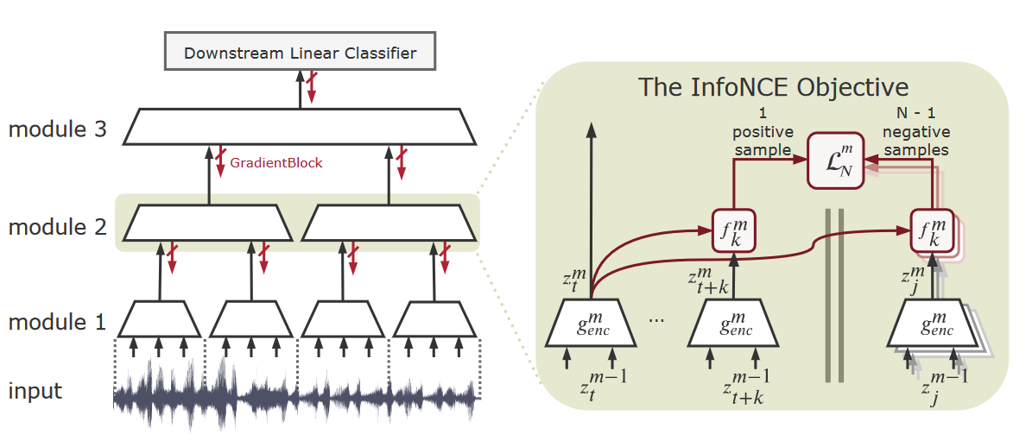
Main idea
Base on architecture of CPC, divide it by depth into a stack of some modules.

Slide 11

Main idea(cont.)
Train each module $g_{enc}^{m}$ using the module-local NCE loss. (without backpropagation)

Slide 12
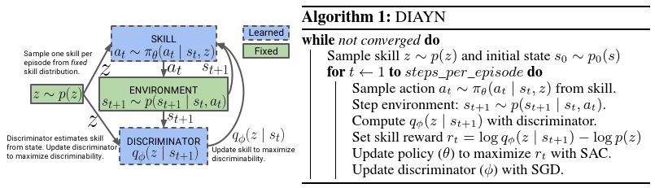
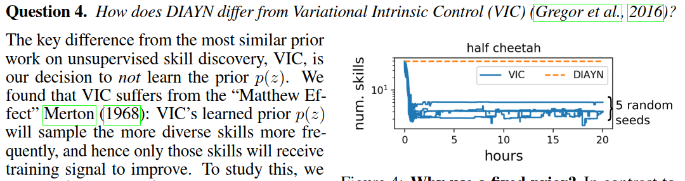



Algorithm
VIC

Slide 13
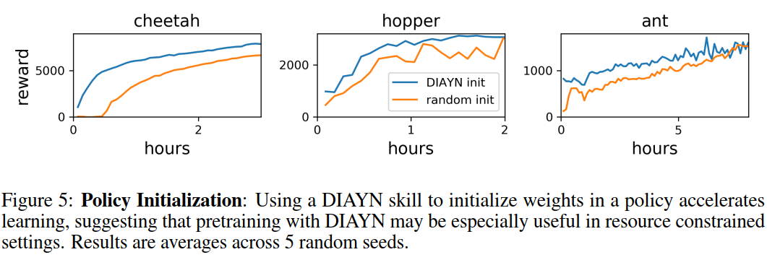
Experiment1
Accelerating learning with policy initialization

Slide 14
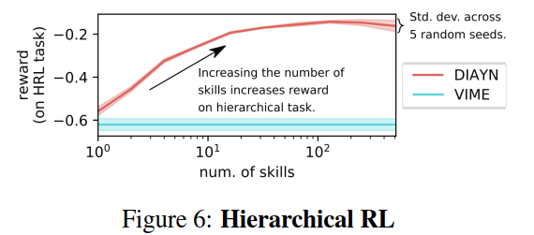
Experiment2
Are skills discovered by DIAYN useful for hierarchical RL?
Learn a meta-controller using learned skills compared to hierarchical RL

Slide 15
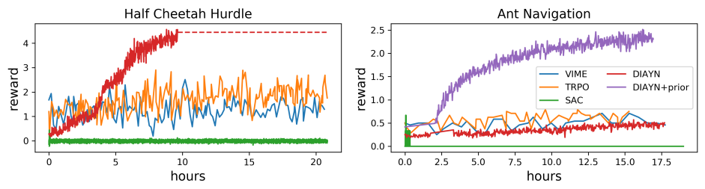
Experiment3
How can DIAYN leverage prior knowledge about what skills will be useful?
Condition the discriminator on certain function of the observations
Notes:
如果對環境有一些prior knowleage，可以對discriminator的input state apply一個function，比方說如果今天有一個環境state是x,y,z的座標，我知道task只需要在意x,y的座標，我就可以用一個function f把z的資訊蓋掉，那discriminator只能從x,y來分辨skill的話，agent在學skill的時候就不會在意z軸的資訊，因為z軸的資訊不會幫助他們和其他skill有差別。

Slide 16
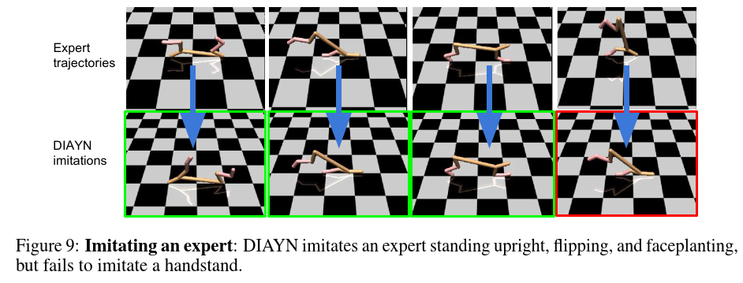

Experiment4
Can we use learned skills to imitate an expert?

Slide 17
Experiment5
What skills does DIAYN learn?
https://sites.google.com/view/diayn/
Notes:
人工去看

Slide 18
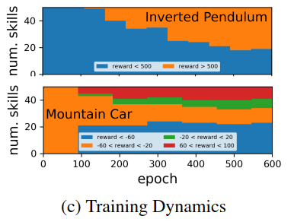
Experiment6
How does the distribution of skills change during training?

Slide 19
Conclusion
Pro
A novel approach, without end-to-end backpropagation
Decrease memory requirement dramatically
Con
Lack of theory
Performance overhead

