Slide 1


Slide 2
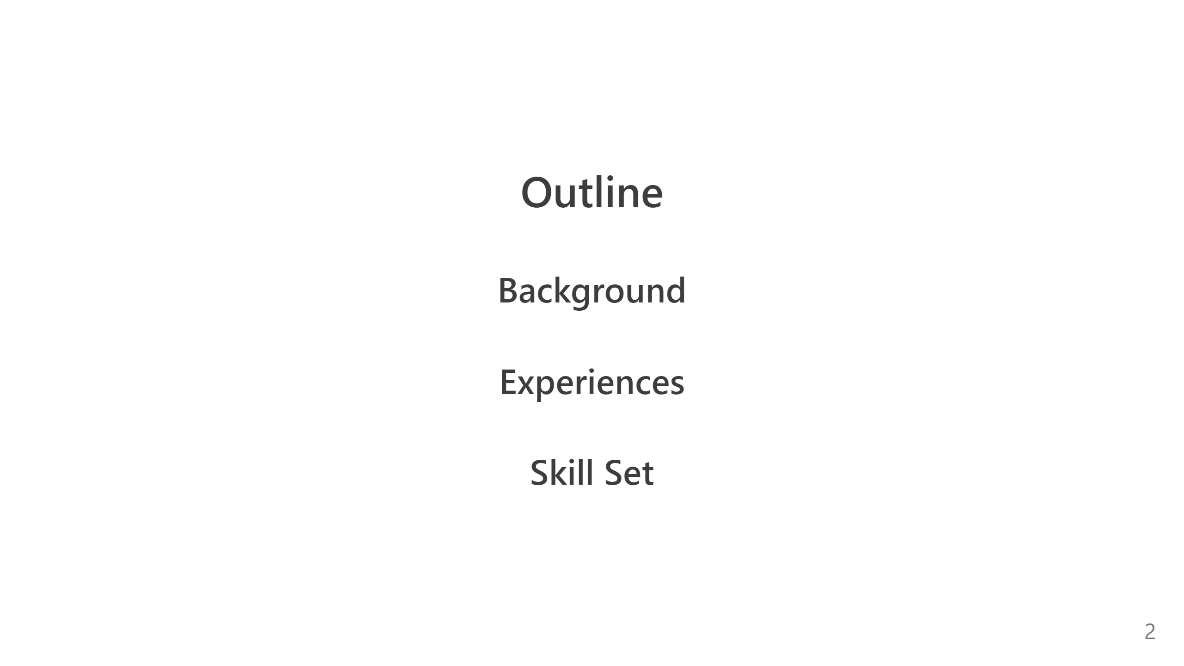

Slide 3
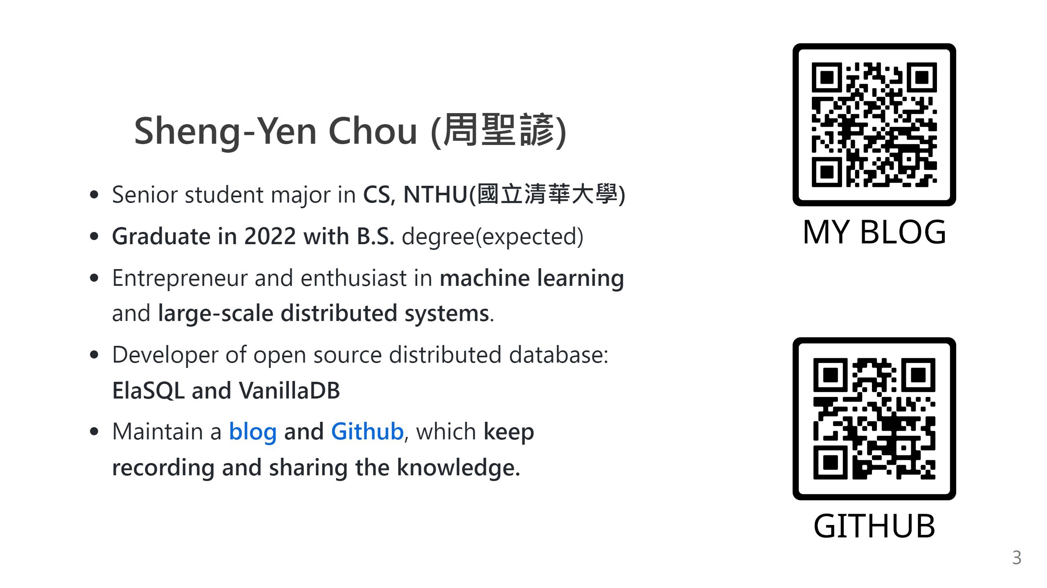

Slide 4
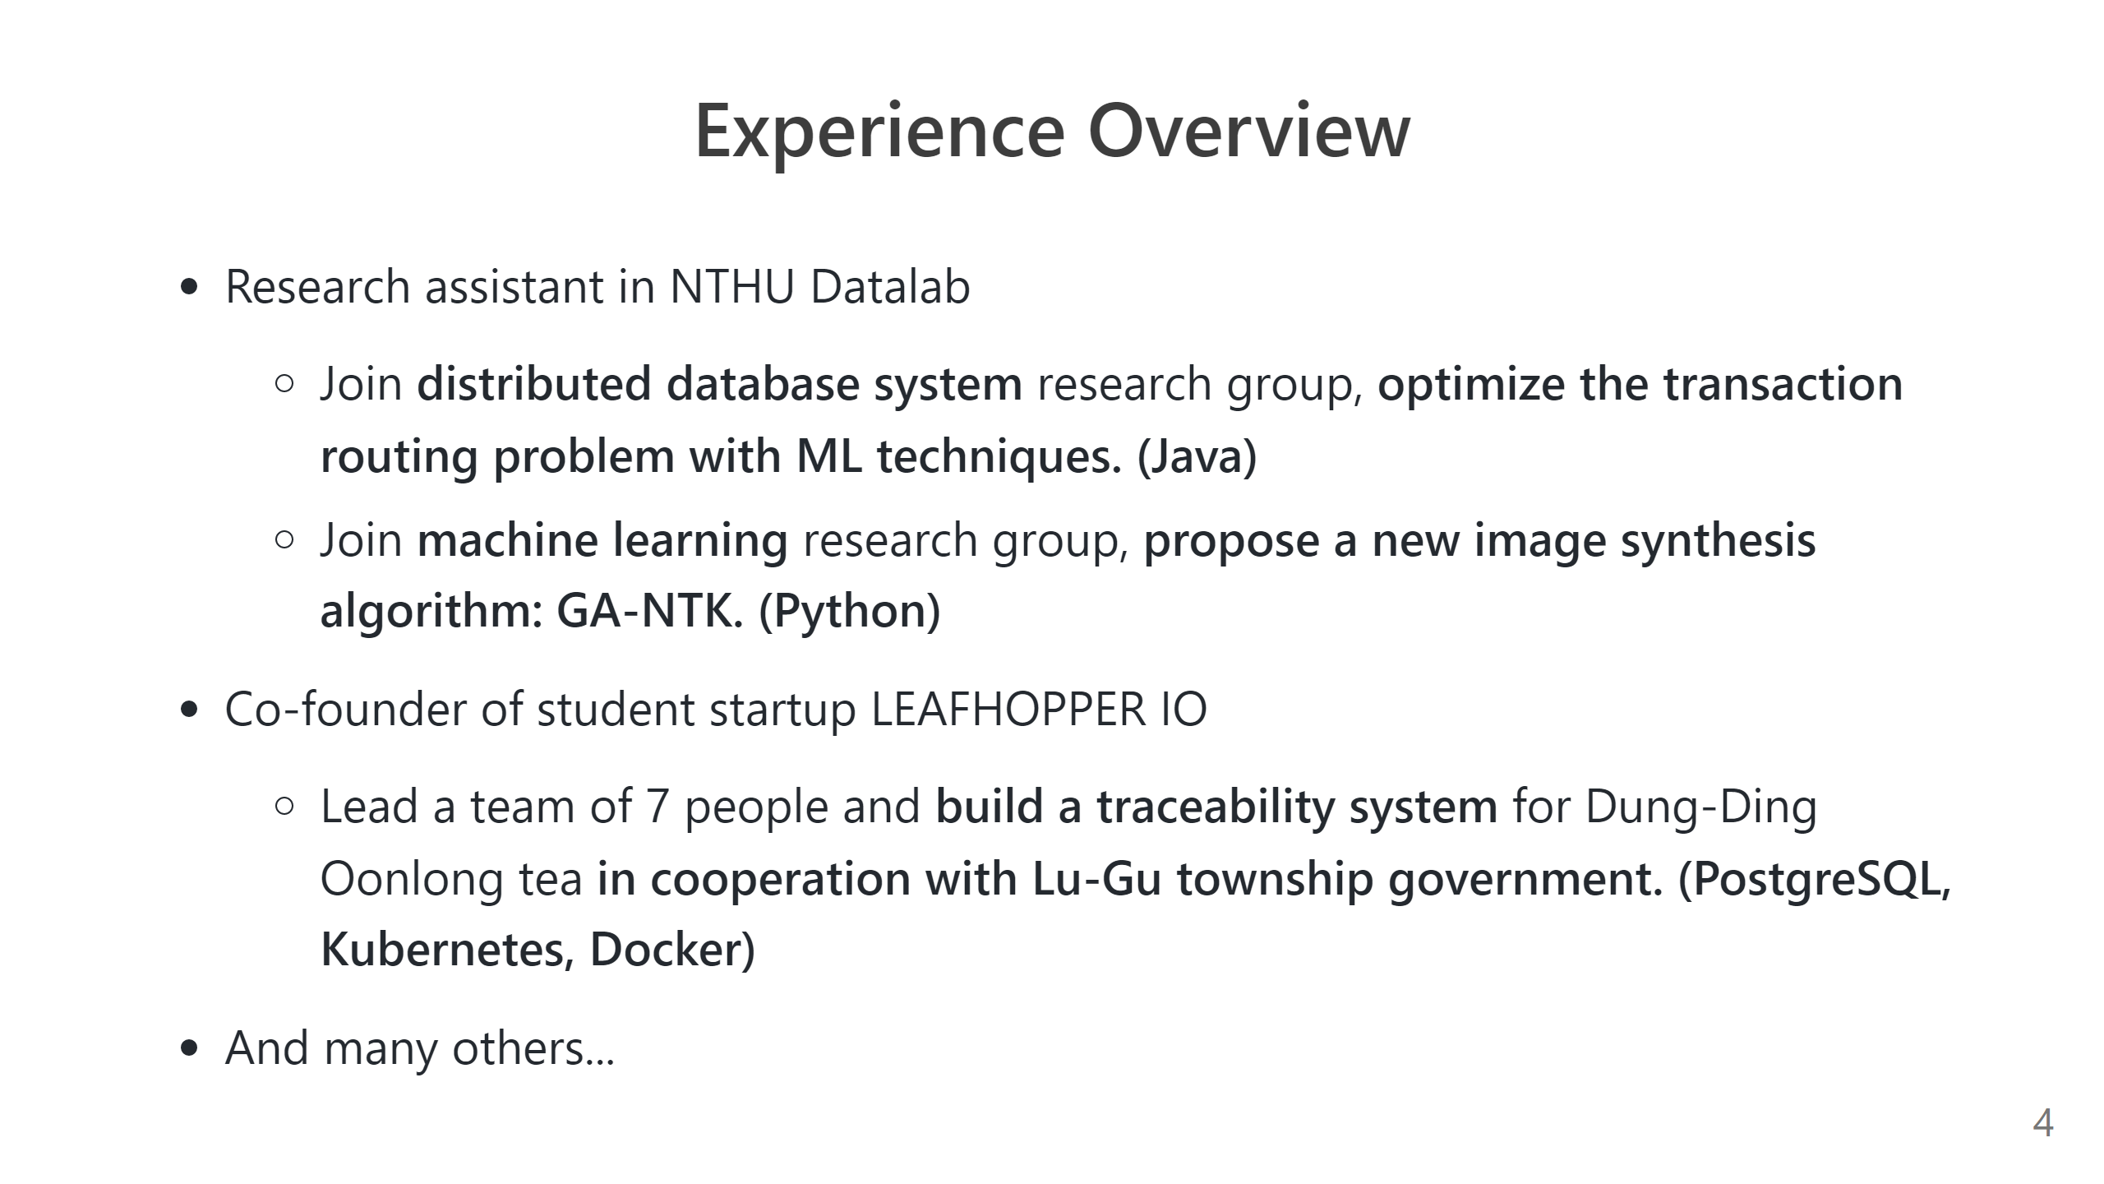

Slide 5
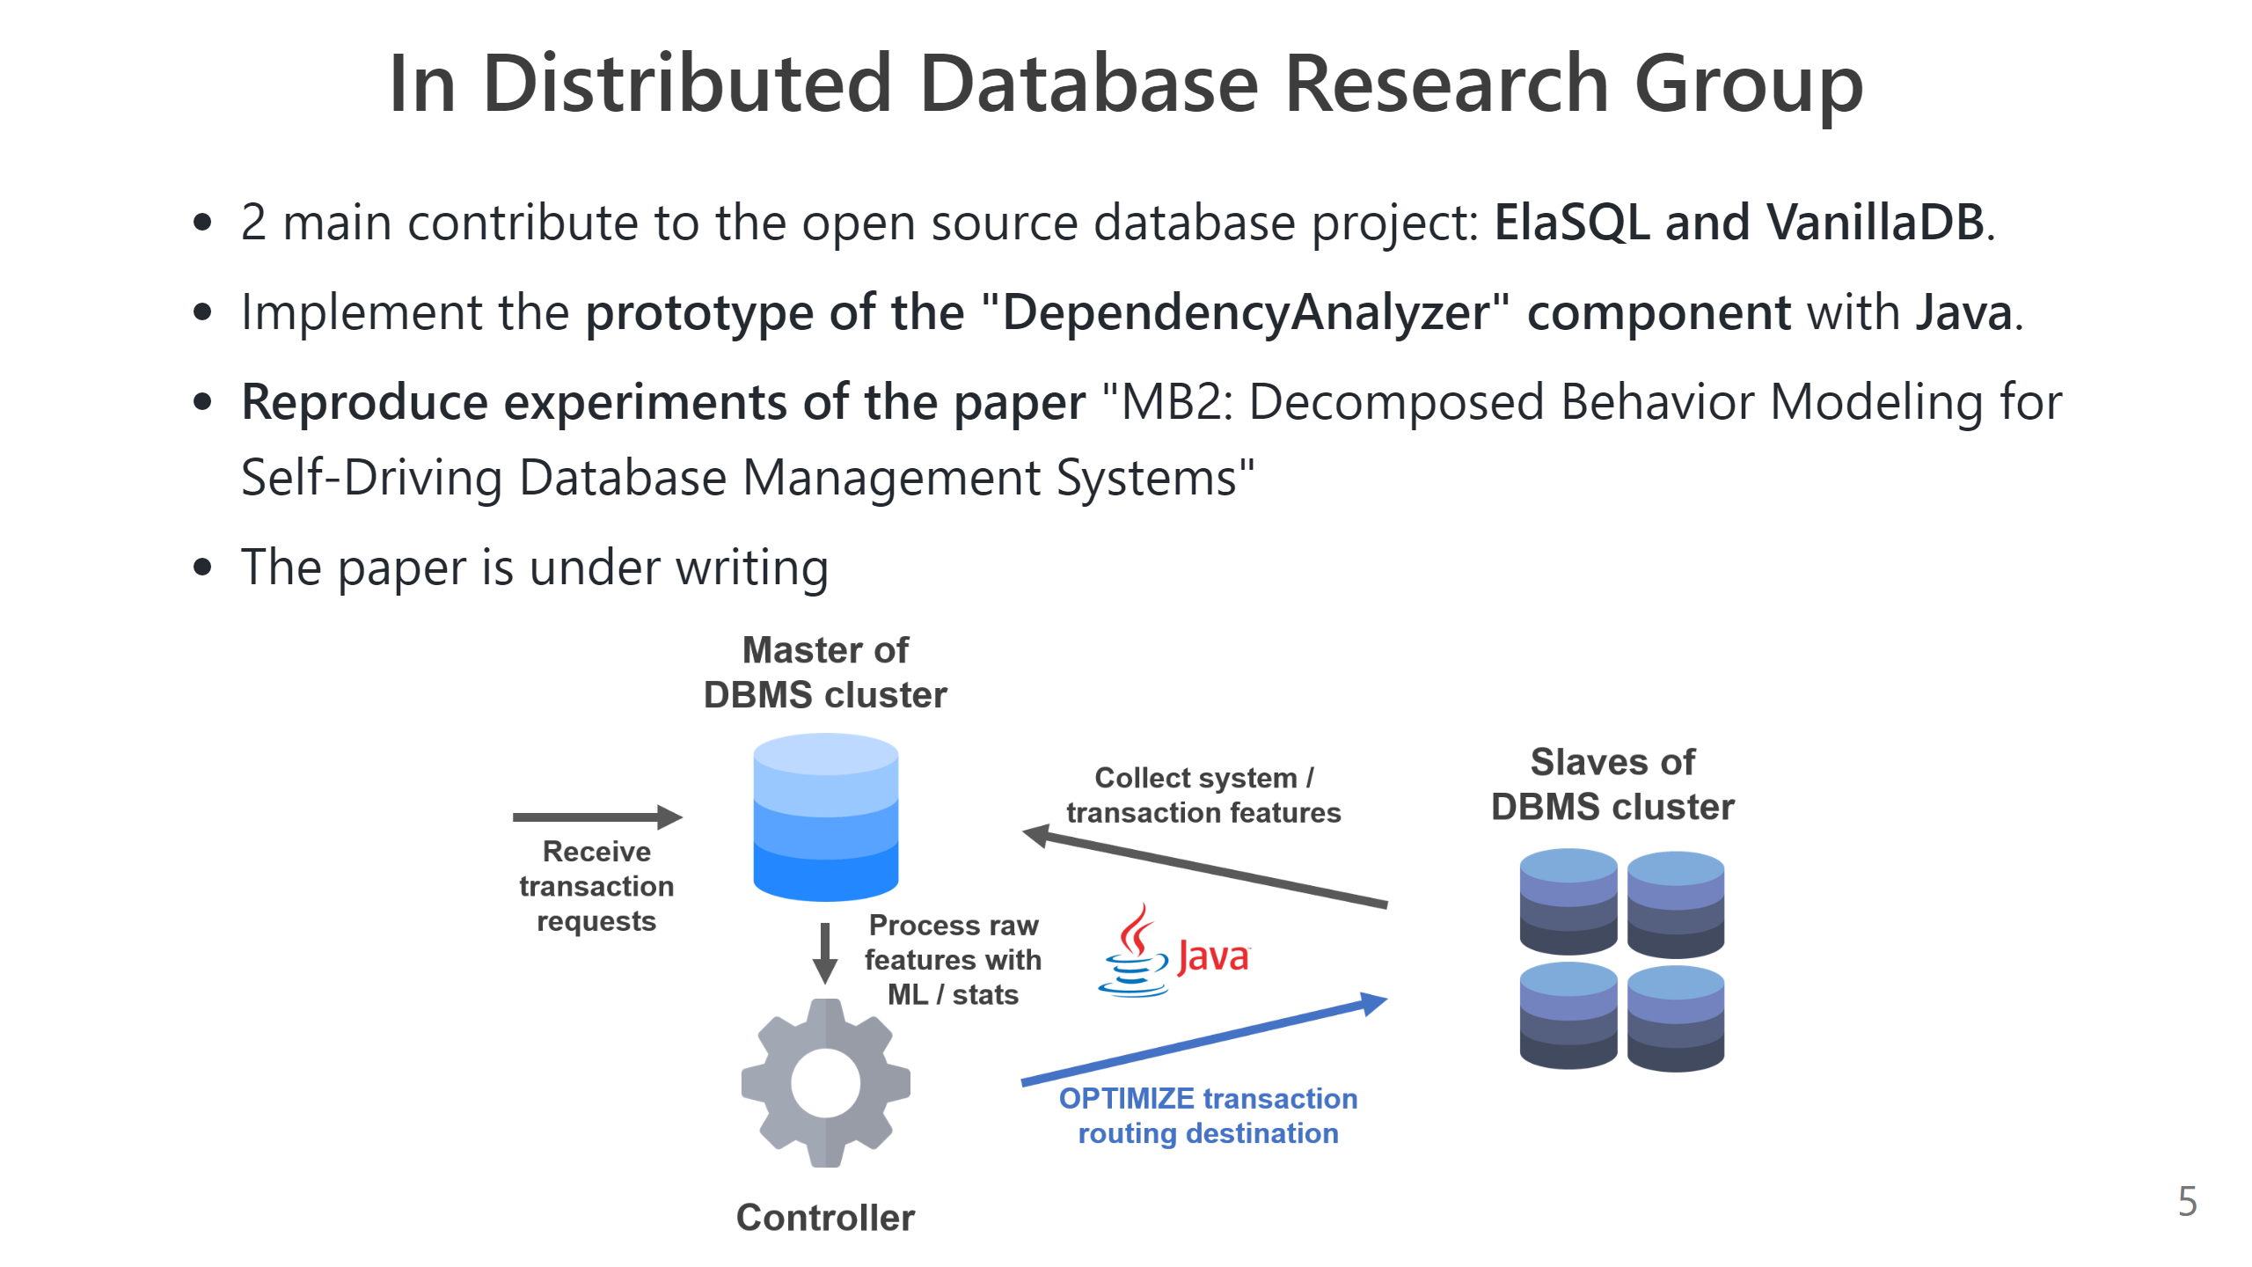
Notes:
- Design a **data pipeline** to collect features of distributed DBMS in **open source database project: ElaSQL and VanillaDB with Java**. Optimize / estimate transaction routing destination with ML model and PID control

Slide 6
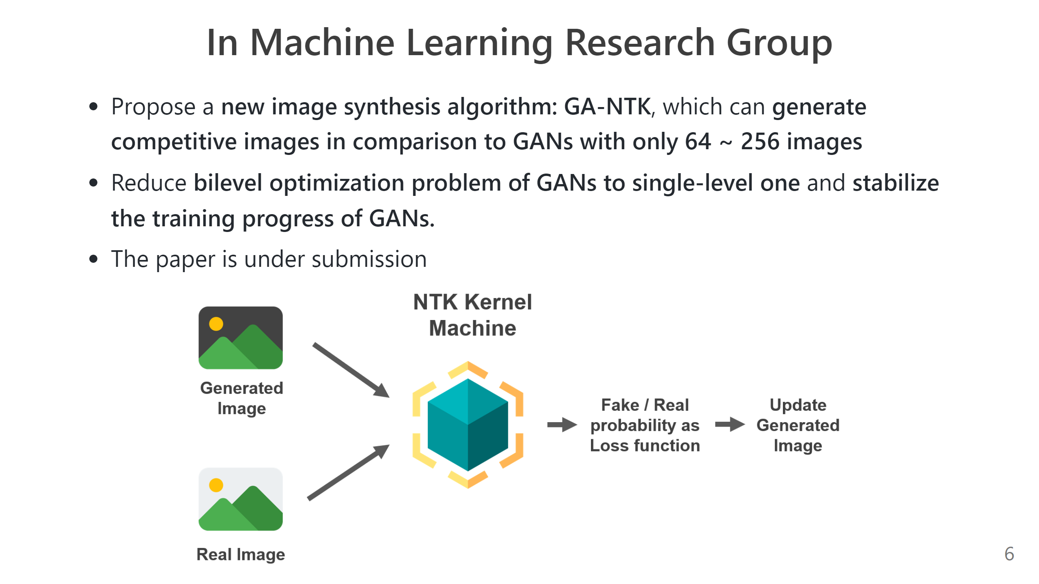

Slide 7
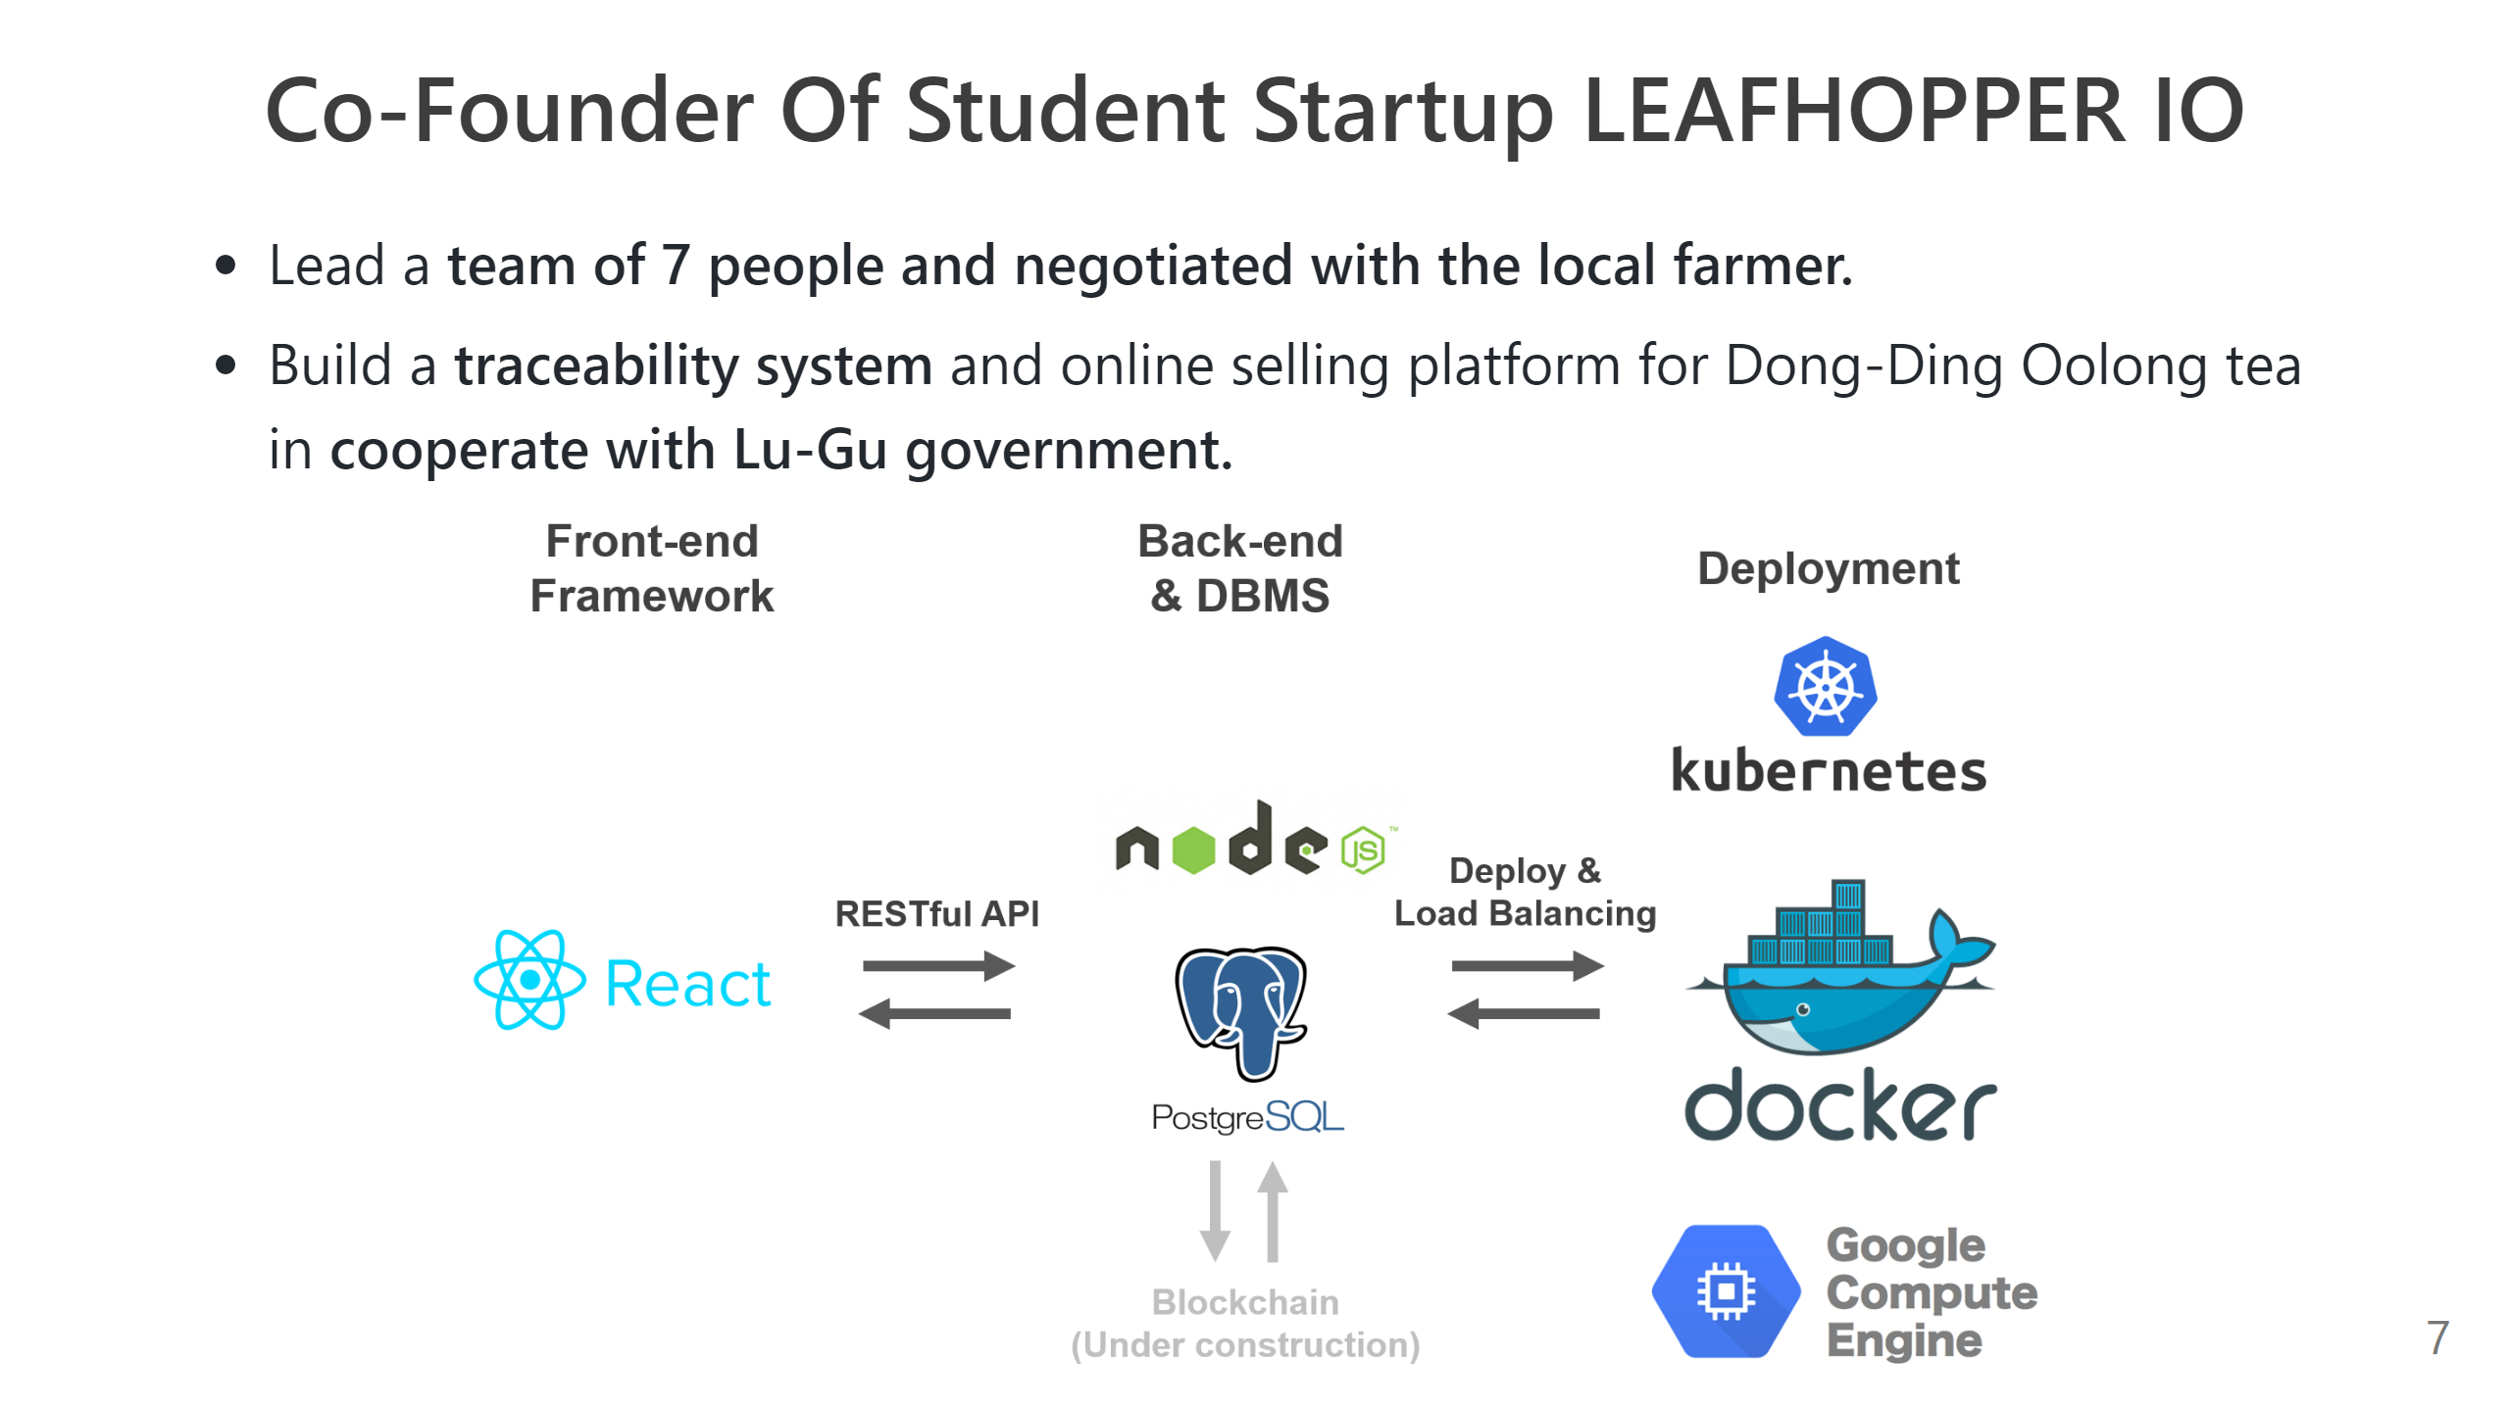

Slide 8
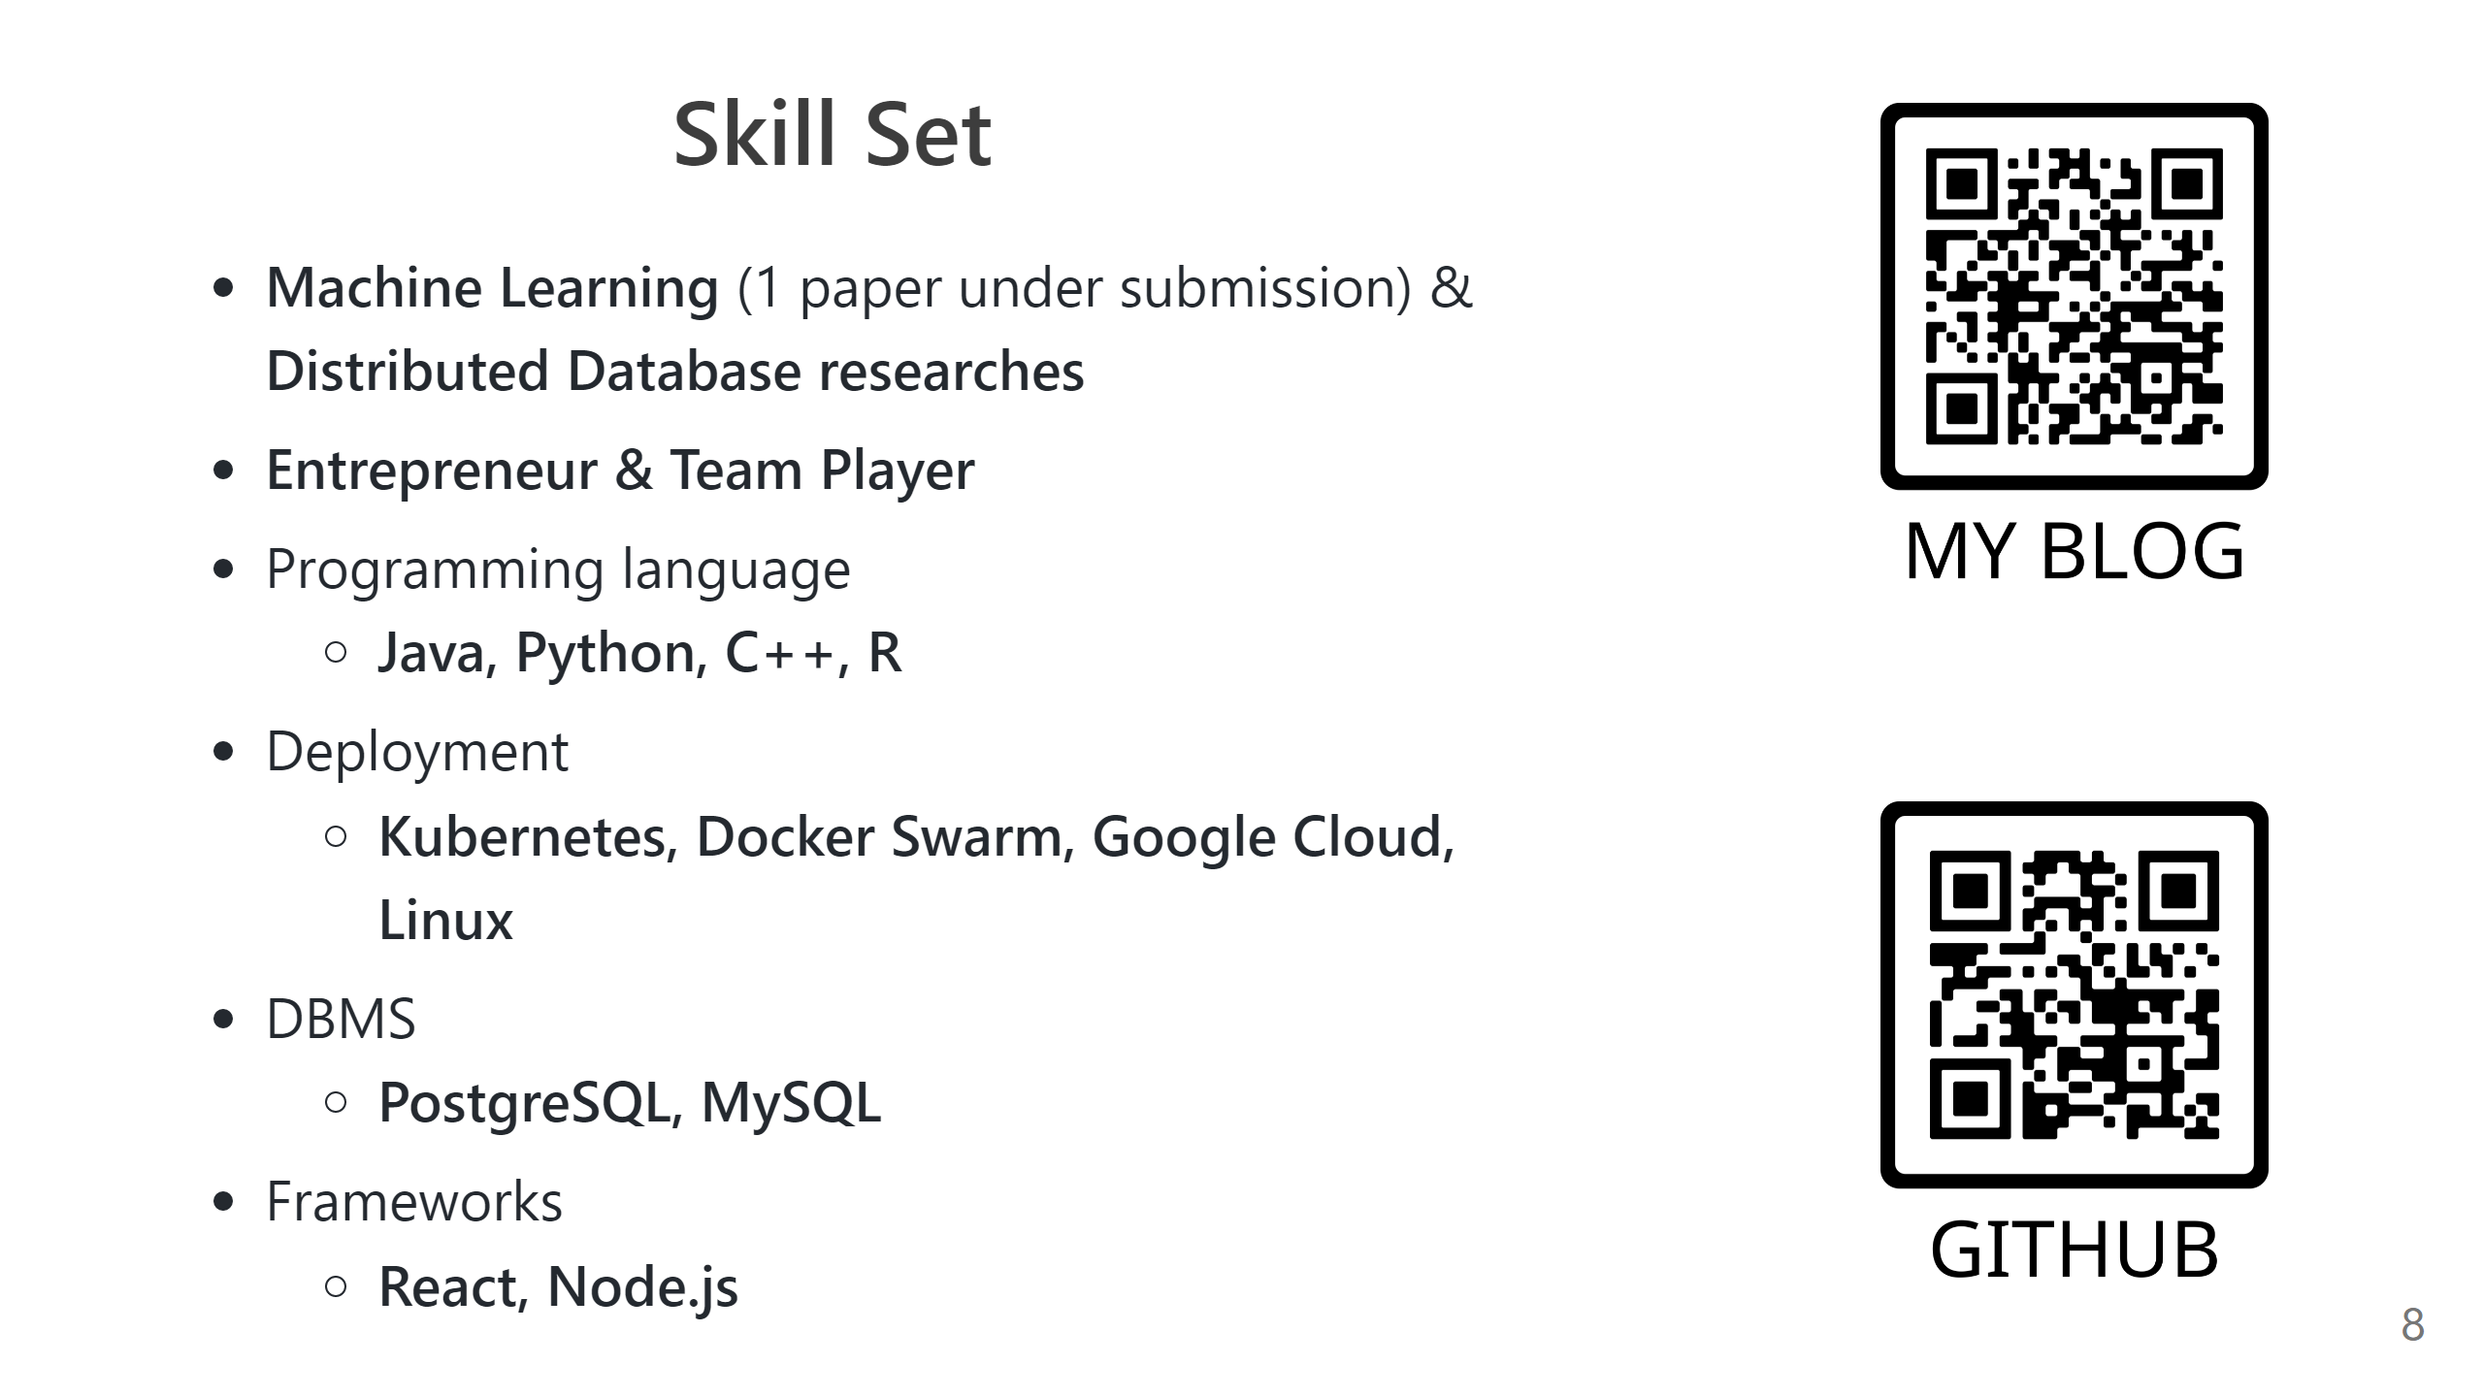

Slide 9


