Slide 1


Slide 2
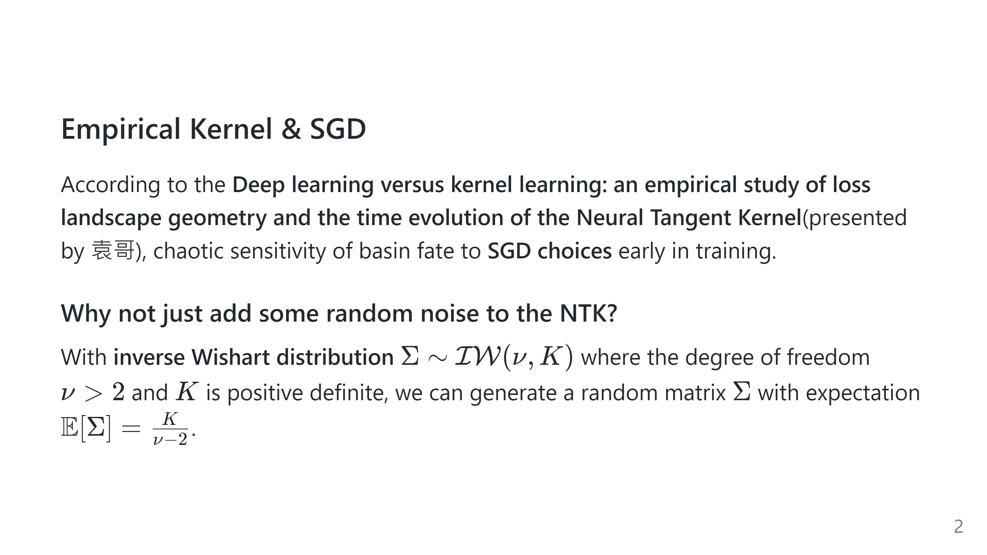

Slide 3
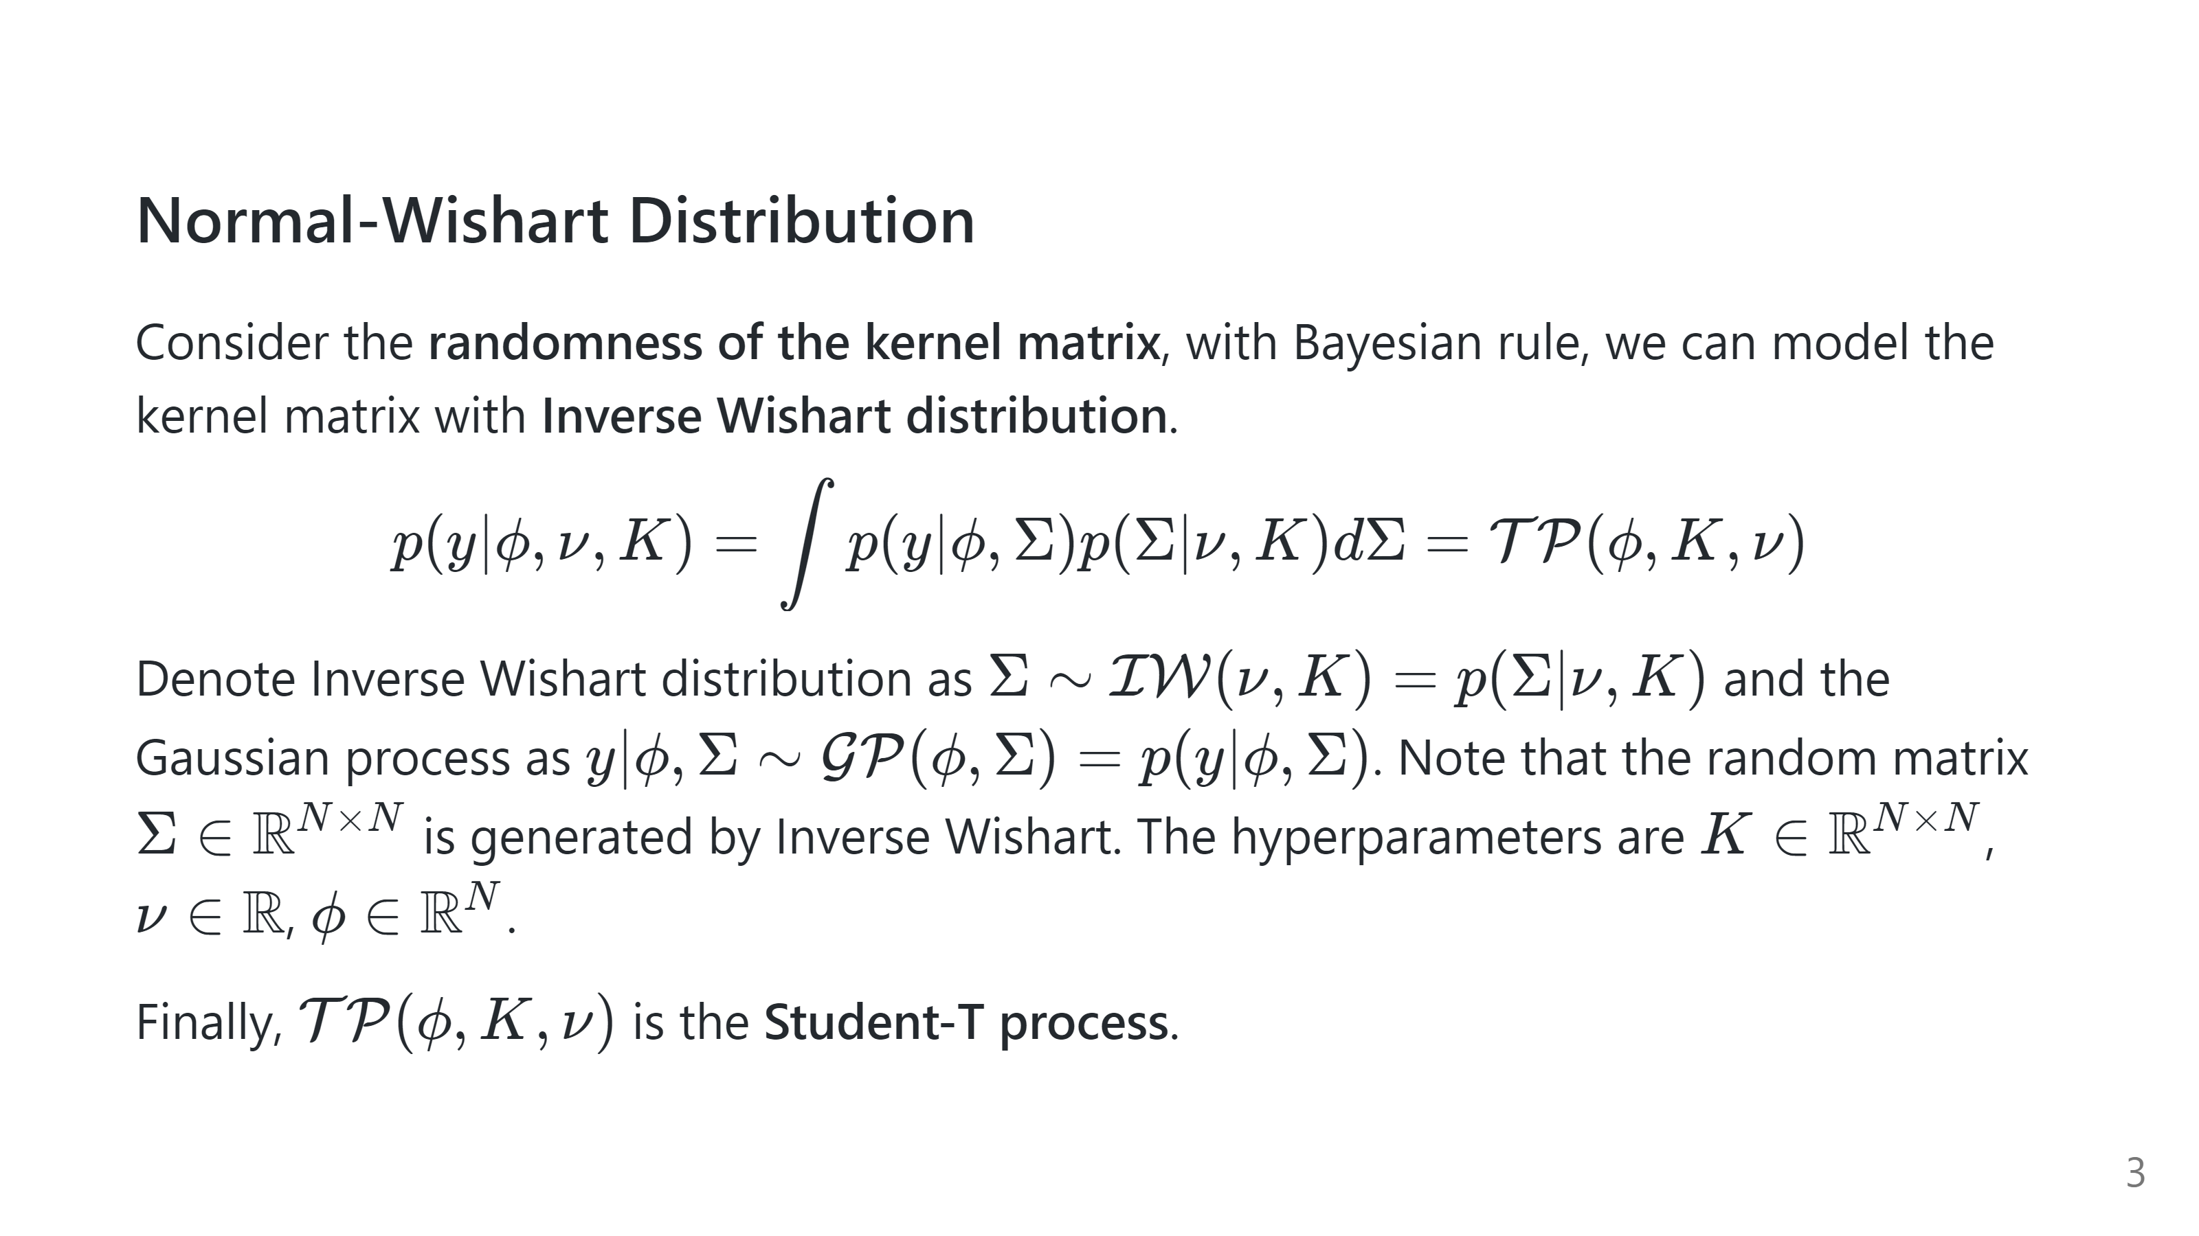

Slide 4
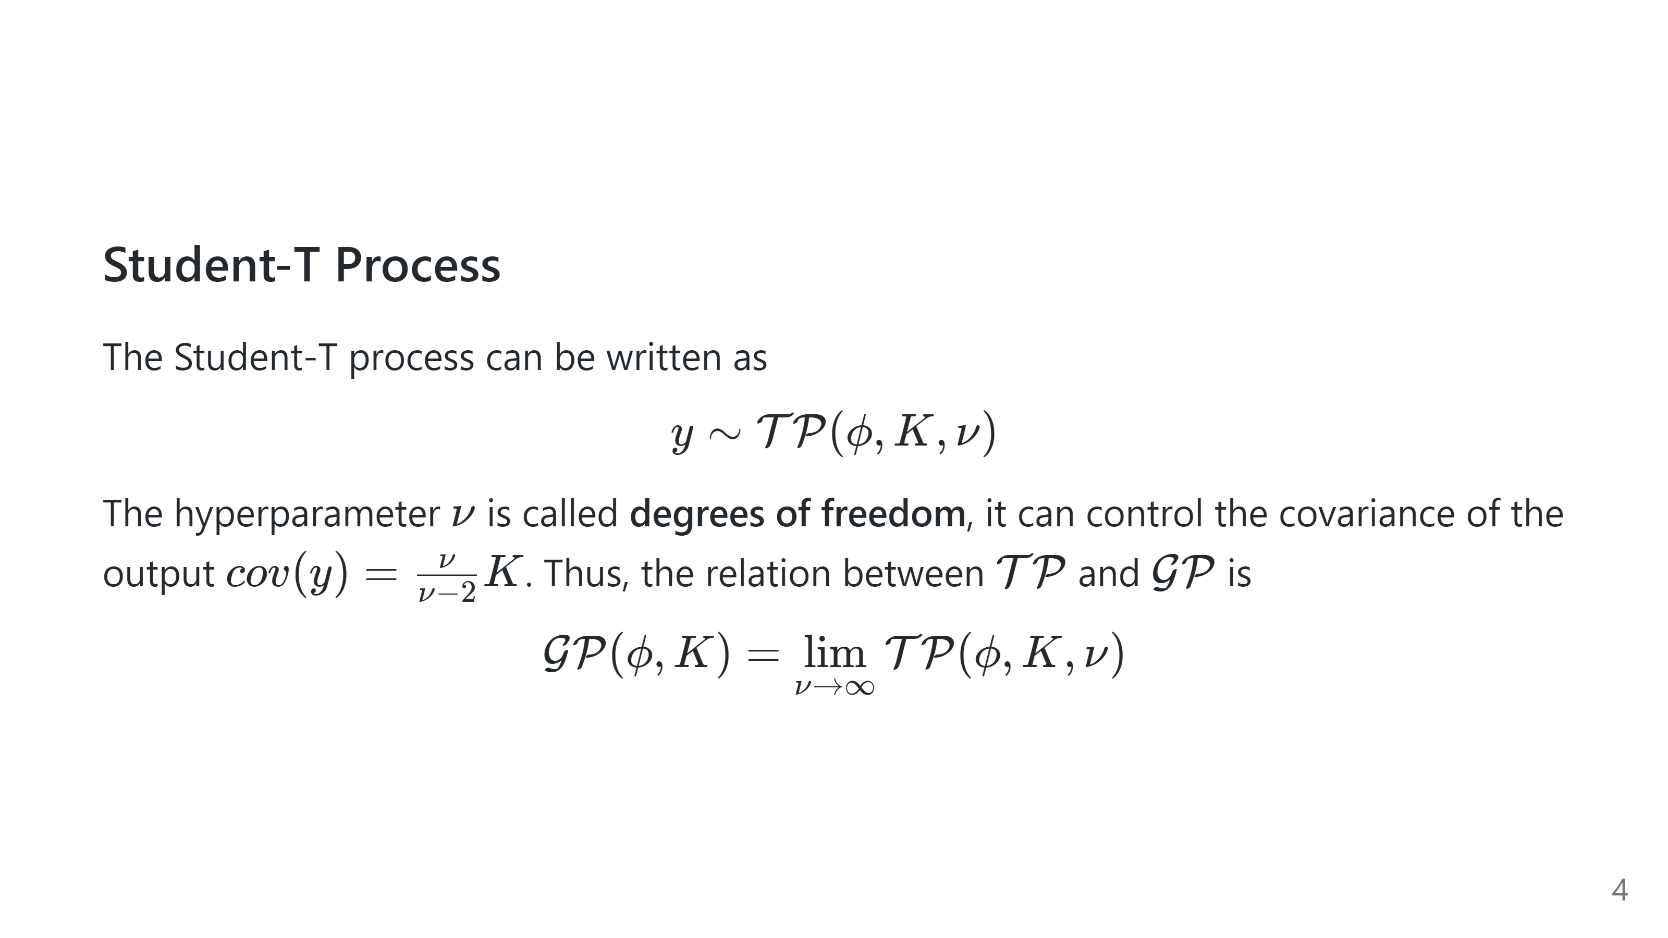
Notes:
$$ \mathbin{E}[y] = \phi $$ $$ \mathbin{COV}[y] = \frac{\nu}{\nu - 2} K $$

Slide 5
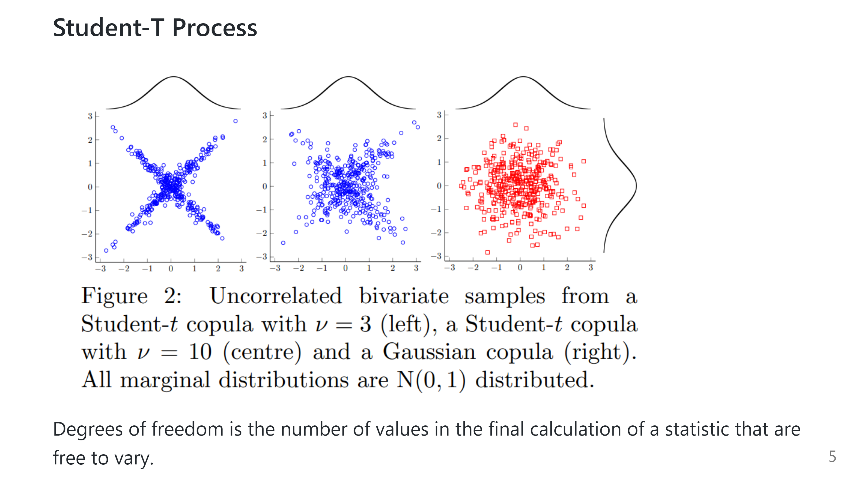

Slide 6
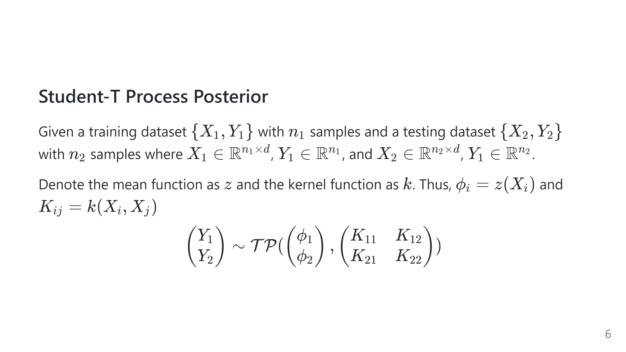

Slide 7
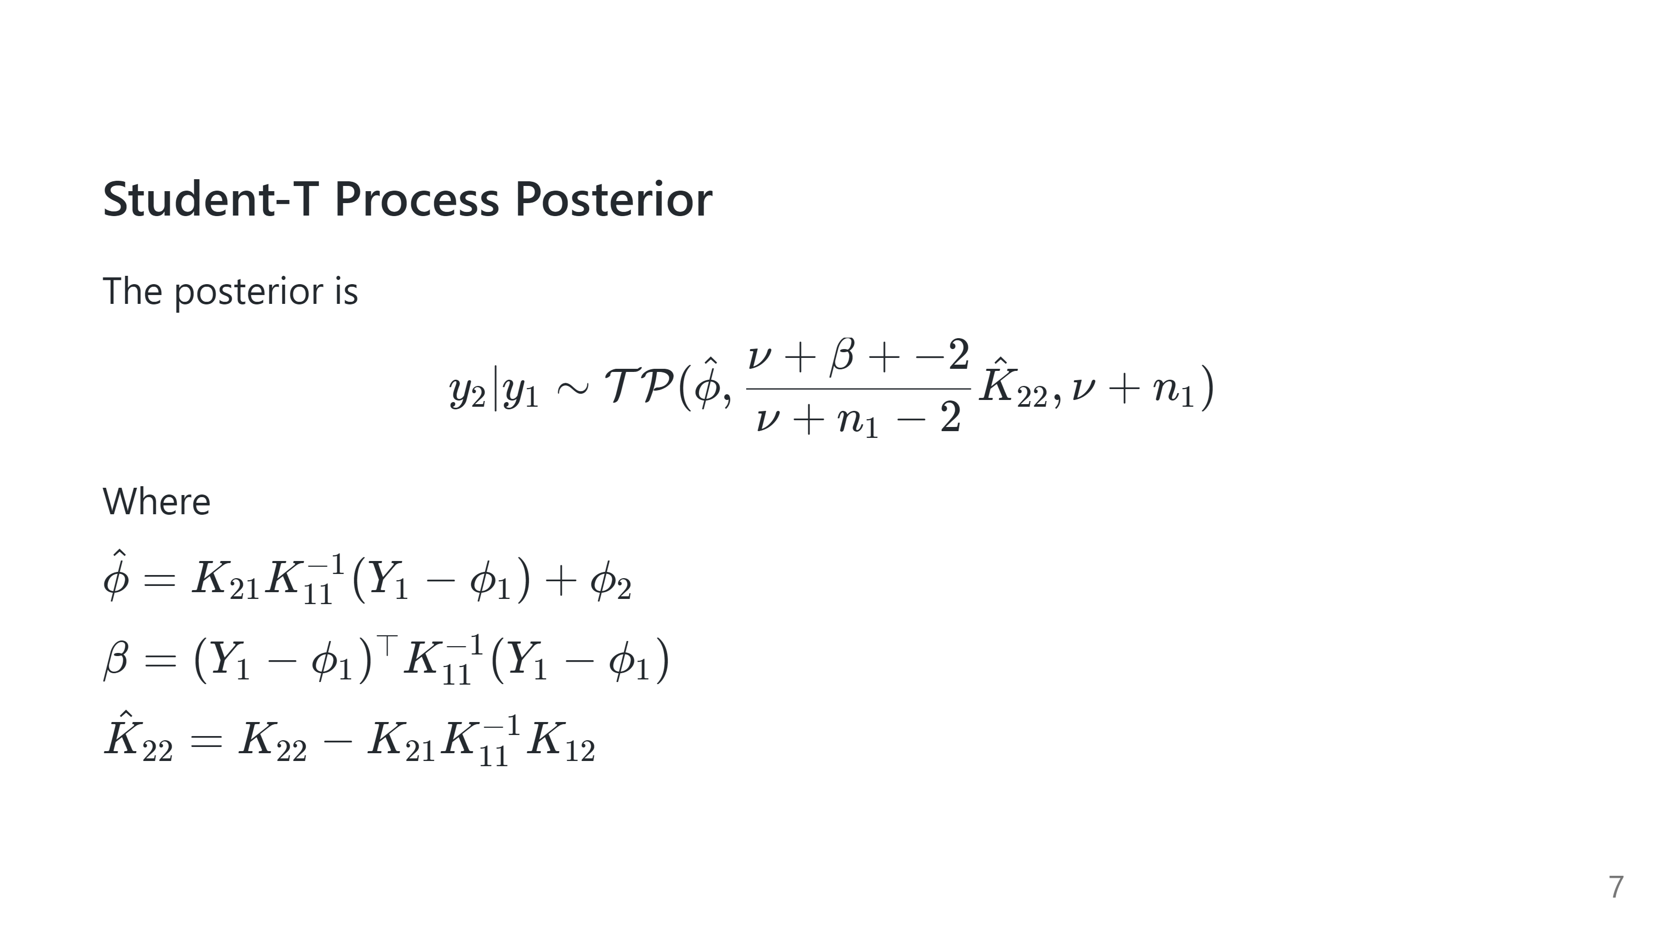

Slide 8
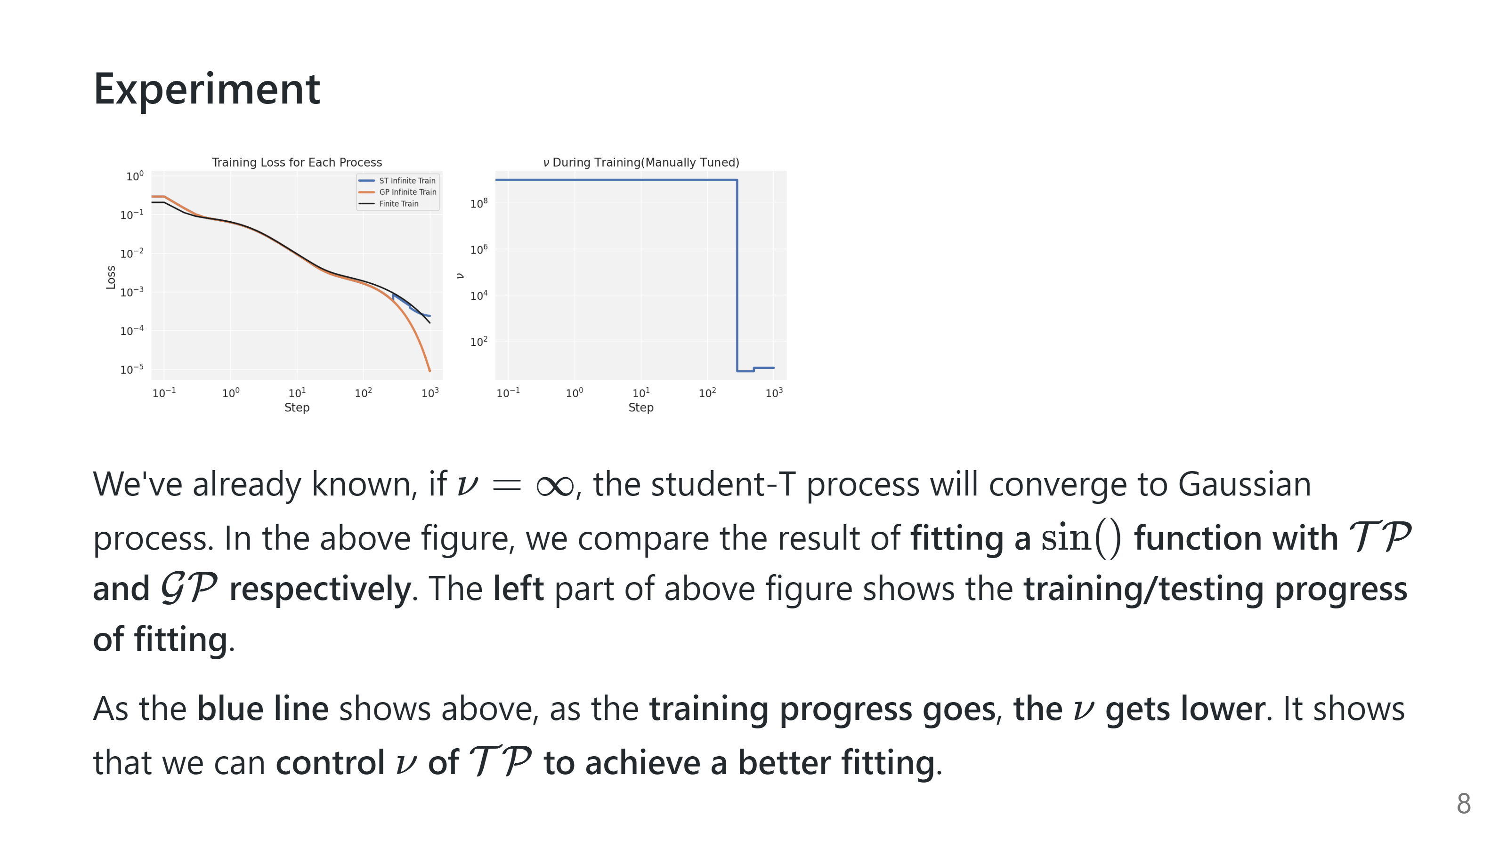

Slide 9
