Slide 1
CS4101 嵌入式系統概論 Timers and Clocks
Prof. Chung-Ta King
Department of Computer Science
National Tsing Hua University, Taiwan
Materials from MSP430 Microcontroller Basics, John H. Davies, Newnes, 2008

Slide 2
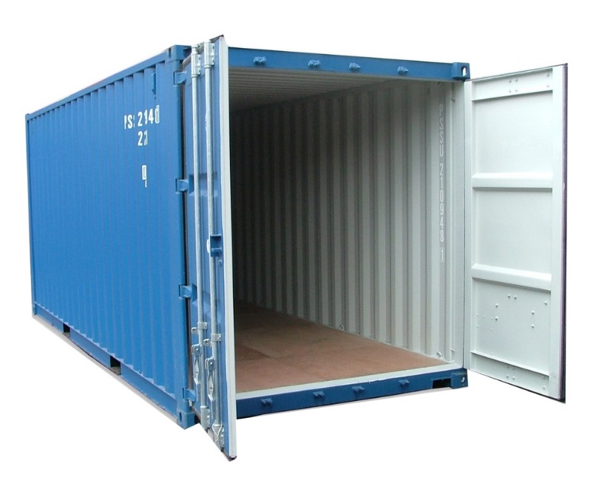
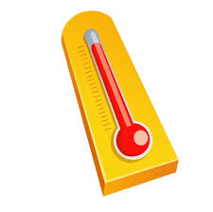
Consider Container Thermometer
Container thermometer: monitor the temperature of the interior of a container
Monitor the temperature every 5 minutes
Flash LED alarm at 1 Hz
If the temperature rises above a threshold, flash the LED alarm at 3 Hz and notify backend server
If the temperature drops below a threshold, return the LED alarm to normal and notify the server
Need to know exact time!

Slide 3
Time-based Control
Many embedded systems are used to control things based on time or that have time constraints
Traffic light controller
Power meter
Pacemaker (心跳節律器)
Subway collision avoidance system
Airbag
...
How to track real (wall clock) time?

Slide 4
Recall First MSP430 Program
#include <msp430.h> void main(void) { WDTCTL = WDTPW + WDTHOLD; // Stop watchdog timer P1DIR |= 0x41; // set P1.0 & 6 to outputs //(red & green LEDs) for(;;) { volatile unsigned int i; P1OUT ^= 0x41; // Toggle P1.0 & 6 using XOR i = 50000; // Delay do (i--); while (i != 0); } }
How much time?
How to flash at 1Hz?
Notes:
3
3

Slide 5
Problems Regarding Time
Using software delay loops
Waste of processor because it is not available for other operations
Difficult to translate into actual time
Given a time for the delay, difficult to translate into number of iterations
The delays are unpredictable, e.g., compiler optimization, interrupts
We need an independent reference of time!

Slide 6
Reference of Time
Simplest form of reference of time is a counter
Why can a counter provide real time?
Such a counter is called a timer
Accuracy and stability of the clock is critical
Where to put the timers?
1254
Counter
Clock
1254
1254 sec passed since counter was 0
1.254 sec passed since counter was 0
1 Hz
1000 Hz
Counter
Notes:
A timer is really no more than a counter and has no direct concept of time. It is the programmer’s job to establish a relation
between the value in the counter and real time. This depends essentially on the frequency of the clock for the timer.

Slide 7
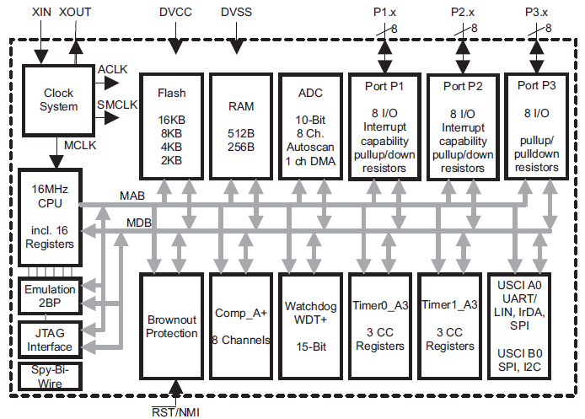
Make Timer an IO Device!
Clock system
Counters
Notes:
MSP430G2553 has two instances of Timer_A (i.e. Timer_A is not actually a single timer, but two timers – 0 and 1): Timer0_A3 andTimer1_A3. Why the “3” on the end? That refers to the number of interrupts that each timer can trigger (these are called capture/compare registers).

Slide 8
Timers Being IO Devices
Have internal registers with addresses in the memory space for the CPU to access

Slide 9
Typical Registers in a Timer
The counter itself
Target for counting
Control settings
Others: clock source selection, flags
Counter
Comparator
Control
Target Time
Target Time
(鬧鐘)
Target Time

Slide 10
Outline
Basic concepts of timers
MSP430 timers
An example of using MSP430 Timer_A
Clocks in MSP430

Slide 11
MSP430 Timers
Contain several timers, including:
Timer_A/Timer_B:
A 16-bit counter, TAR, with 3 capture/compare registers
Clock frequency of 12kHz ➔ count up to 5.46 seconds (65,535 divided by 12,000)
MSP430G2553 has two instances of Timer_A : Timer0_A3 and Timer1_A3
Notes:
10
The Timers are 16-bit timers. We can count up to 16 bits – i.e. 2^16, or 65,535 (in hex, this is 0xFFFF). If we run using a clock frequency of 12kHz (the default for the ACLK), it means the counter can count up to 5.46 seconds (65,535 divided by 12,000). If we were to run the timer off the SMCLK at a 1MHz frequency, we can only count up to 0.05 seconds (or 50 ms) – not that useful.
10

Slide 12
MSP430 Timers
Watchdog timer:
Count up and reset MSP430 when it reaches its limit
The code must keep clearing the counter before the limit is reached to prevent a reset
Protect system against failure of software, such as unintended, infinite loops
Notes:
11
11

Slide 13
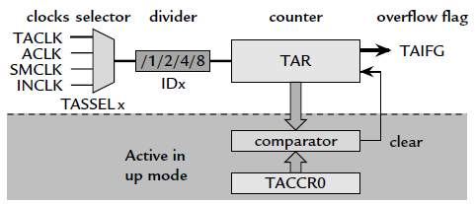
Registers in Timer0_A3
TA0R (0170h): the counter itself
TA0CCR0 (0172h): target for counting
Three target registers: TA0CCR0, TA0CCR1, TA0CCR2
TA0CTL (0160h): control settings
Others: clock source selection, flags
TA0R
TA0CCR0
Notes:
TA0R (0170h) /TA1R (0190h), TA0CCR0 (0172h) /TA1CCR0 (0192h), TA0CTL (0160h) /TA1CTL (0180h)
3 capture/compare registers: TA0CCR0 (0172h), TA0CCR1 (0174h), TA0CCR2 (0176h)

Slide 14
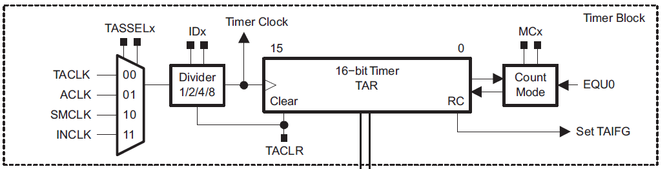
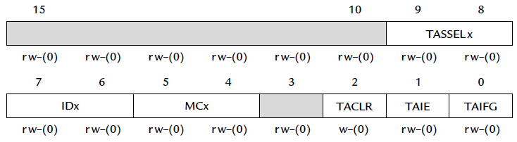
Inside Timer0_A3
Timer0_A3 Control Register: TA0CTL (0160h)
TA0R

Slide 15
Typical Operations of Timer0_A3
TA0R
Continuously count up/down
Is time up yet?
Yes
TA0CTL
TAIFG has to be explicitly cleared by the CPU
TA0CCRx
If TAIE=1, setting of TAIFG causes an interrupt to the CPU
(x may be 0, 1, or 2)

Slide 16
Timer0_A3 Control Register (TA0CTL)
TASSELx: Timer0_A3 clock source select (x is 0, 1, 2, or 3)
IDx: input divider
MCx: mode control
TACLR: Timer0_A3 clear
TAIE: Timer0_A3 interrupt enable
TAIFG: Timer0_A3 interrupt flag

Slide 17
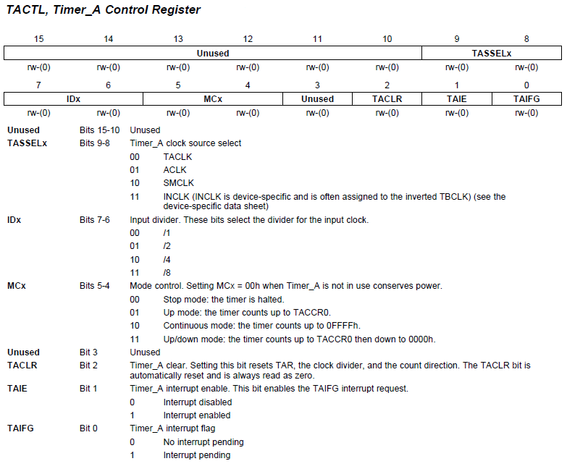
TA0CTL
TA0CTL = TASSEL_2 + MC_1; // src from SMCLK, up mode

Slide 18
Timer Mode
MCx=00: Stop mode
The timer is halted
MCx=01: Up mode
The timer repeatedly counts from 0 to TA0CCR0
MCx=10: Continuous mode
The timer repeatedly counts from 0 to 0FFFFh
MCx=11: Up/down mode
The timer repeatedly counts from 0 to TA0CCR0 and back down to 0

Slide 19
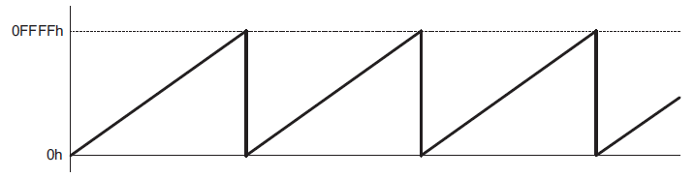
Continuous Mode (MCx=10)
In the continuous mode, the timer repeatedly counts up to 0FFFFh and restarts from zero
The TAIFG interrupt flag is set when the timer resets from 0FFFFh to zero
TAIFG is set, and Timer0_A3 interrupts CPU

Slide 20
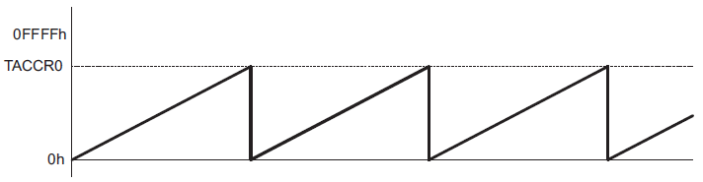
Up Mode (MCx=01)
The up mode is used if the timer period is different from 0FFFFh counts.
Timer period 100 → store 99 to TA0CCR0
When TA0CCR0 == 99, set TA0CCR0 CCIFG flag (discussed later)
Reset timer to 0 and set TAIFG interrupt flag
TAIFG is set, and Timer0_A3 interrupts CPU

Slide 21
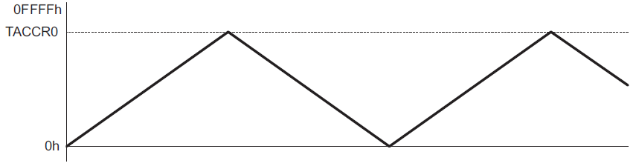
Up/Down Mode (MCx=11)
The up/down mode is used if the timer period is different from 0FFFFh counts, and if a symmetrical pulse generation is needed.
→ The period is twice the value in TA0CCR0
Timer interrupts!
(TAIFG is set)

Slide 22

Event Timing
So far, we have learned how to know when a specified time interval has passed, e.g. alarm clock
How do I know when an “event” of interest occurs?
Ex.: when a button is down, temperature exceeds 40 °C, …
Clock
11:54:20
Current time (TA0R)
60 Hz
12:00:00
Alarm time (TA0CCR0)
7:30:00
Alarm time (TA0CCR1)
23:00:00
Alarm time (TA0CCR2)
Clock
11:54:20
Current time (TA0R)
60 Hz
11:54:20
23:00:00
7:11:20

Slide 23
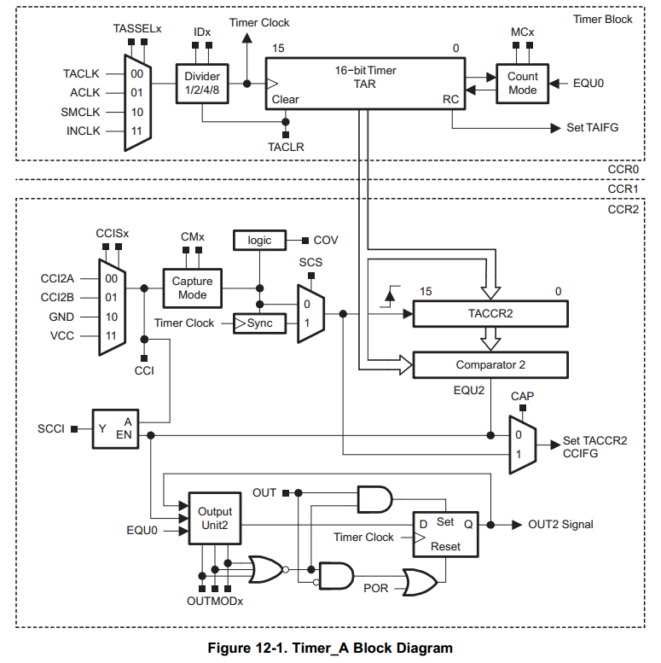
Timer0_A3 Capture/Compare Block
Timer Block
May contain several Capture/Compare Blocks (MSP430G2553 has 3 blocks for each of the 2 timers)
Each C/C block is controlled by a control register, TA0CCTLx
Inside each C/C block, the Capture/Compare Register, TA0CCRx, holds the count to configure timer
But, all C/C blocks within Timer0_A3 share the same timer block: TA0R
TA0CTL
TA0R
Capture/Compare Block
TA0CCR2
TA0CCTL2
Notes:
Two or three identical capture/compare blocks, TACCRx, are present in Timer_A
Capture/compare channel 0 is special in two ways. Its register TA0CCR0 is taken over for the modulus value in Up and Up/Down
modes, so that it is no longer available for its usual functions. It also has its own interrupt vector with a higher priority than the other interrupts from Timer_A, which all share a common vector. Therefore channel 0 should be chosen for the most urgent tasks if it
is free.

Slide 24
Modes of Capture/Compare Block
Compare mode: (CAP = 0)
Compare the value of TA0R with the value stored in TA0CCRx and update an output when they match
Capture mode: (CAP = 1)
Used to record time events → records the “time” (value in TA0R) at which the input changes in TA0CCRx
The input, usually CCIxA and CCIxB, can be either external or internal from another peripheral or software, depending on board connections
TA0CCR0 = 24000; // represent 2 sec with 12kHz clk src
(12 kHz = 12,000 counts/sec → 24,000 counts = 2 sec.)
Notes:
The capture mode is selected when CAP = 1.
If a capture occurs:
• The timer value is copied into the TA0CCRx register
• The interrupt flag CCIFG is set
The compare mode is selected when CAP = 0.
The compare mode is used to generate PWM output signals or interrupts at specific time intervals. When TAR counts to the value in a TACCRx:
• Interrupt flag CCIFG is set
• Internal signal EQUx = 1
• EQUx affects the output according to the output mode
• The input signal CCI is latched into SCCI

Slide 25
Compare Basics
15 |  |  |  |  |  |  |  |  |  |  |  |  |  |  | 0
TA0R
Counter
Register (TA0R)
Counter overflow action
Interrupt (TAIFG)
Clock input
Clock
GPIO Pin (TA0CLK)
When Counter = Compare,
Compare actions can occur
Compare actions
Interrupt (CCIFGx)
Signal peripheral
Modify pin (TAx.n)
Capture/Compare Register (TA0CCR_{x})

Slide 26
Capture Basics
15 |  |  |  |  |  |  |  |  |  |  |  |  |  |  | 0
TA0R
Counter
Register (TA0R)
Counter overflow action
Interrupt (TAIFG)
Clock input
Clock
GPIO Pin (TA0CLK)
Capture input signal triggers transfer: Counter → Capture
Capture actions
Interrupt (CCIFGx)
Signal peripheral
Modify pin (TAx.n)
Capture input
CCInA
CCInB
Software
Capture/Compare Register (TA0CCR_{x})
Capture time (i.e. count value) when capture input signal occurs
When capture is triggered, count value is placed in TA0CCRx and an interrupt is generated

Slide 27
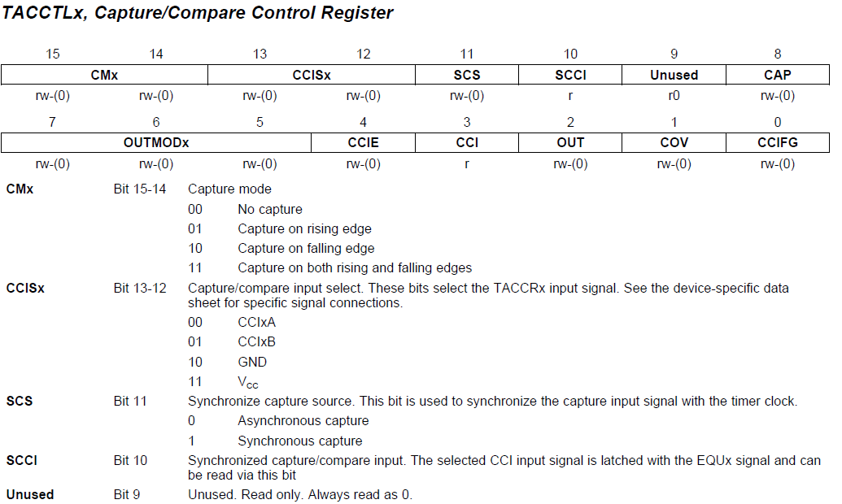
TA0CCTL (Capture/Compare Control Reg.)
CMx: capture mode
CCISx: C/C input select
SCS: synchronize capture source
SCCI: synchronized C/C input
CAP: capture mode
OUTMODx: output mode
CCIE: C/C interrupt enable
CCI: C/C input
OUT: output
COV: capture overflow
CCIFG: C/C interrupt flag

Slide 28
TA0CCTL (Capture/Compare Control Reg.)

Slide 29
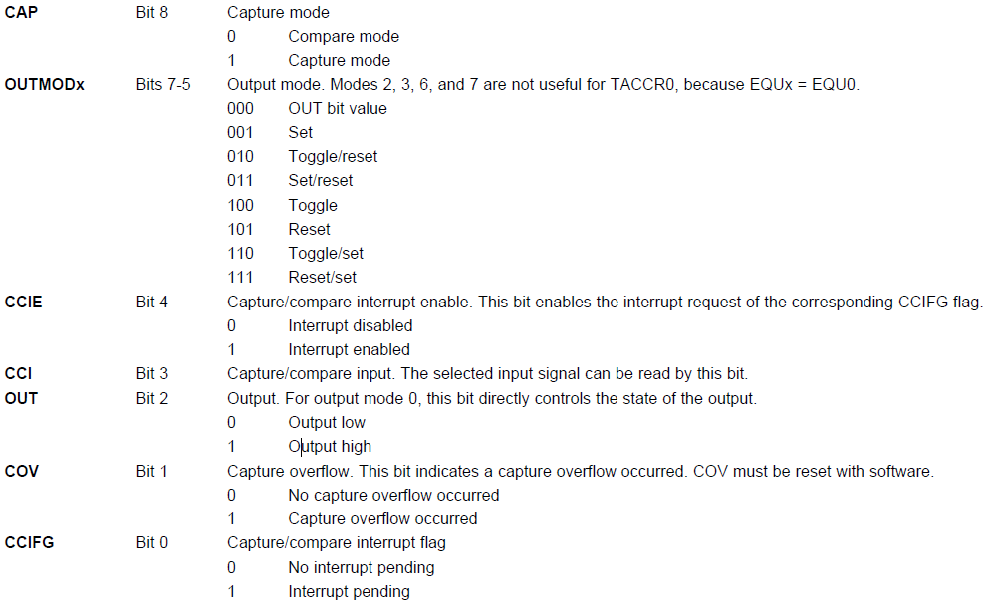
TA0CCTL cont’d

Slide 30
Sample Code 1 for Timer0_A3
Goal: flash an LED at 1 Hz (on 0.5 sec, off 0.5 sec)
Need an event to trigger the flashing → counter (TA0R) overflow
Need a way to detect the event → CPU polling
How to make TA0R overflow at 1 Hz?
Use SMCLK clock (discussed later) at 800 KHz
When TA0R (16 bits) overflows, it has counted 2¹⁶, equivalent to a period of 2¹⁶/800KHz ≈ 0.08 sec
Divide the frequency of the clock by 8 to give a period of about 0.66 sec → close enough to 0.5 sec!
Continuously count up; on overflow return to 0

Slide 31
Sample Code 1 for Timer0_A3
#define LED1 BIT0 void main(void) { WDTCTL = WDTPW|WDTHOLD; // Stop watchdog timer P1OUT |= ~LED1; P1DIR |= LED1; TA0CTL |= MC_2|ID_3|TASSEL_2|TACLR; //Setup Timer_A for (;;) { // Loop forever while (TA0CTL_bit.TAIFG == 0) { // Wait overflow } // CPU polling and doing nothing TA0CTL_bit.TAIFG = 0; // Clear overflow flag P1OUT ˆ= LED1; // Toggle LEDs } // Back around infinite loop }
Notes:
30
30

Slide 32
Sample Code Settings Explained
The following symbols are defined in header file:
MC_2: set MC of TA0CTL to 10₂ (continuous mode)
ID_3: set ID of TA0CTL to 11₂ (divide freq. by 8)
TASSEL_2: set TASSEL to 10 (use SMCLK)
TACLR: clear the counter, the divider, and the direction of the count
TA0R

Slide 33
Sample Code 2 for Timer0_A3
Can have more accurate time if we can control the amount to count
With SMCLK (800KHz) divided down to 100 KHz, we need 50,000 counts for a delay of 0.5 sec → put 50,000 in TA0CCR0 ?
Since TA0R starts from 0 and counts up to the value in TA0CCR0, after which it returns to 0 and sets TAIFG → the period is TA0CCR0+1 counts!
So we actually store 49,999 in TA0CCR0 to get a delay of 0.5 sec using SMCLK

Slide 34
Sample Code 2 for Timer0_A3
Flash red LED at 1 Hz using SMCLK at 800 KHz
#include <msp430.h> #define LED1 BIT0 void main (void) { WDTCTL = WDTPW|WDTHOLD; // Stop watchdog timer P1OUT |= ~LED1; P1DIR = LED1; TA0CCR0 |= 49999; TA0CTL |= MC_1|ID_3|TASSEL_2|TACLR; //Setup Timer0_A //up mode, divide clk by 8, use SMCLK, clr timer for (;;) { // Loop forever while (!(TA0CTL & TAIFG)) {) // Wait for time up TA0CTL &= ~TAIFG; // Clear overflow flag P1OUT ^= LED1; // Toggle LEDs } // Back around infinite loop }

Slide 35
Summary
Basic concepts of timers
A counter driven by a clock
MSP430 timers
Timer block: TA0R and TA0CTL, up/continueous mode
Capture/compare block: TA0CCR0 and TA0CCTL0

Slide 36
Outline
Basic concepts of timers
MSP430 timers
An example of using MSP430 Timer_A
Clocks in MSP430

Slide 37
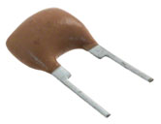
Theoretically, One Clock Is Enough
A clock is a series of square wave signals whose edges trigger hardware
A clock source, e.g. crystal or RC circuit, to generate the clock to drive CPU, memory, and I/O peripherals
May be divided down by a factor of 2, 4, 8, or 16 for the main bus and rest of circuit board
But, systems have conflicting requirements
Low power, fast start/stop, accuracy, ...

Slide 38
Different Requirements for Clocks
Devices often in a low-power mode until some event occurs; then must wake up and handle event rapidly
Clock must get to be stabilized quickly
Devices also need to track real time: (1) can wake up periodically, or (2) time-stamp external events
Therefore, two kinds of clocks often needed:
A fast clock to drive CPU, which can be started and stopped rapidly but need not be particularly accurate
A slow clock that runs continuously to monitor real time, which must use little power and be accurate
Notes:
37

Slide 39
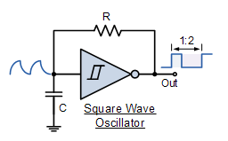
Different Requirements for Clocks
Different clock sources also have different characteristics
Crystal: accurate and stable (w.r.t. temperature or time); expensive, delicate, drawing large current, external component, longer time to start up/stabilize
Resistor and capacitor (RC): cheap, quick to start, integrated within microcontroller and sleep with CPU; poor accuracy and stability
Ceramic resonator and MEMS clocks in between
Need multiple clocks

Slide 40
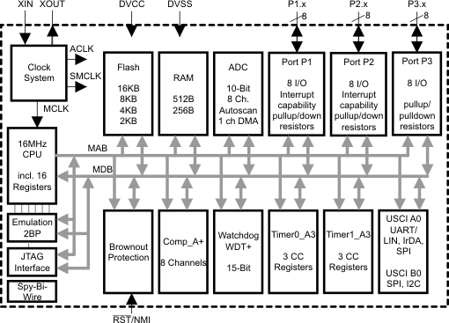
MSP430 Clock System
Clock system

Slide 41
Clocks in MSP430
Master clock (MCLK): for CPU and some peripherals, normally driven by digitally controlled oscillator (DCO)
Subsystem master clock (SMCLK): distributed to peripherals, normally driven by DCO
Auxiliary clock (ACLK): distributed to peripherals, normally for real-time clocking and driven by a low-frequency crystal oscillator, typically at 32 KHz
Name | Description | Used-by | Typical Speed
MCLK | Master Clock | CPU | Fast
SMCLK | Sub-Master Clock | Peripherals | Fast
ACLK | Auxiliary Clock | Peripherals | Slow
Notes:
Typically SMCLK runs at the same frequency as MCLK, both in the megahertz range.
ACLK is often derived from a watch crystal and therefore runs at a much lower frequency.
Most peripherals can select their clock from either SMCLK or ACLK

Slide 42
Clock Sources
Digitally controlled oscillator, DCO:
Internal; a highly controllable RC oscillator that starts fast (< 1μs)
Very low-power, low-frequency oscillator, VLO:
Internal at 12 KHz; alternative to LFXT1 when accuracy of a crystal is not needed; may not available in all devices
Low- or high-frequency crystal oscillator, LFXT1:
External; used with a low- or high-frequency crystal; an external clock signal can also be used; connected to MSP430 through XIN and XOUT pins
High-frequency crystal oscillator, XT2:
External; similar to LFXT1 but at high frequencies
Notes:
41
To support the lowest power consumption and performance on-demand, the enhanced basic clock system (BCS+) on the MSP430F2xx (like all other MSP430 clock systems) typically provides two clocks. A low frequency auxiliary clock (ACLK) is typically sourced directly from a common 32 kHz watch crystal and is used for always-on low power peripherals. A high-speed clock is generated on-chip from an instant-on digitally controlled oscillator (DCO) used by the CPU and other peripherals. To save power, an application’s interrupt events steer the usage of the DCO only when required. The majority of the application’s life is spent in standby mode with high-performance available on-demand and only when required.
Reduced standby power consumption also known as real-time clock (RTC) or LPM3 mode current has been reduced to less than 1 micro amp. This power consumption can be achieved using an external 32kHz crystal or the VLO.
The F20xx introduces a new very-low power oscillator (VLO) as an alternative to the typical 32kHz ACLK. The VLO provide a 12kHz on-chip oscillator with no external components that is perfect for ultra-low power applications that need a wake-up function, but the precision of a 32kHz crystal.
The F2xx crystal oscillator is improved providing programmable integrated crystal load capacitors allows the use of a wider range of crystals and elimination of external components used typically to stabilize oscillation. Failsafe crystal oscillator can trigger a non-maskable interrupt and start the on-chip oscillator for failsafe operation. This feature is always available with no additional power consumption in both high-frequency and low frequency modes. Crystal min-pulse input de-glitch filters reduce the possibility of externally introduced high frequency system noise and improves reliability.
Improved on-chip digitally controlled oscillator (DCO) offers a sub 1 micro second start with +2.5% accuracies and 16MHz operation over temperature and voltage.

Slide 43
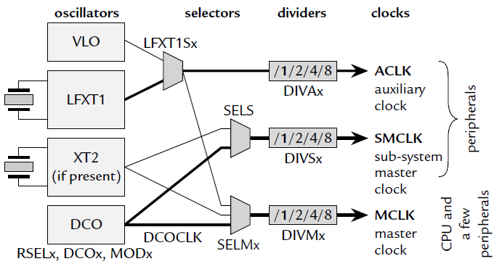
From Sources to Clocks
Typical sources of clocks:
MCLK, SMCLK: DCO (typically at 1.1 MHz)
ACLK: LFXT 1 (typically at 32 KHz) or VLO
Note: Interconnections may vary with different MCUs

Slide 44
Controlling Clocks
In MSP430, Basic Clock Module is also an IO module
Being an IO peripheral, it can be controlled by registers, DCOCTL and BCSCTL1–3
DCOCTL (056h): configure DCO
BCSCTL1 (basic clock system control 1, 057h): configure ACLK and DCO
BCSCTL2 (basic clock system control 2, 058h): configure MCLK, SMCLK
BCSCTL3 (basic clock system control 3, 053h): control LFXT1/VLO
Tedious to set!
Use tag-length-value instead

Slide 45
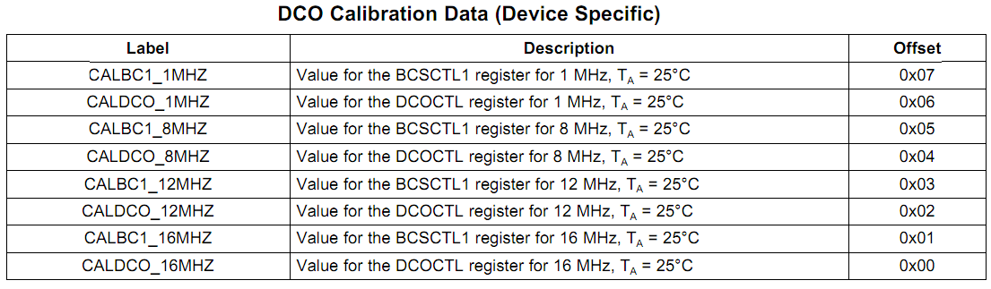
Tag-Length-Value
Tag-Length-Value (TLV) stores device-specific information in the flash memory to set DCOCTL and BCSCTL1 for DCO frequency
BCSCTL1 = CALBC1_1MHZ; // Set range DCOCTL = CALDCO_1MHZ;
Notes:
The Tag-Length-Value (TLV) structure is used in selected MSP430x2xx devices to provide device-specific information in the device’s flash memory SegmentA, such as calibration data. For the device-dependent Implementation, see the device-specific data sheet. (@ chapter 24, userguide, page 587)
For DCO calibration, the BCS+ registers (BCSCTL1 and DCOCTL) are used. The values stored in the flash information memory SegmentA are written to the BCS+ registers
44

Slide 46
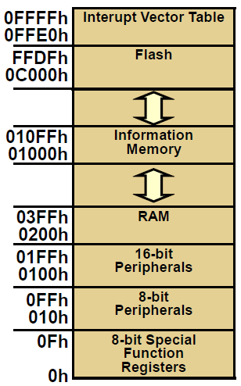
MSP430G2553 Memory Map
Flash/ROM
(16 KB)
Information memory: A 256B block of flash memory that stores nonvolatile data, including serial numbers to identify the equipment
Flash/ROM
(256 bytes)
RAM
(512 bytes)
Notes:
45
Refer back to page 6 to see the blocks; Ask where the peripherals go?

Slide 47
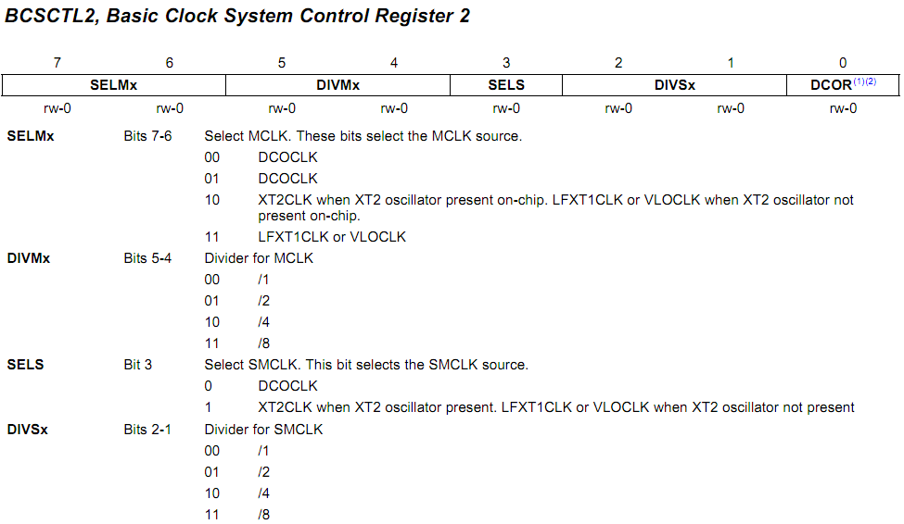
BCSCTL2
MCLK
SMCLK
Set MCLK driven by VLO
BCSCTL2 |= SELM_3 + DIVM_3; // MCLK = VLO/8
Notes:
範例程式碼需要與下一頁一起看
(1) Does not apply to MSP430x20xx or MSP430x21xx devices.
(2) This bit is reserved in the MSP430AFE2xx devices
46

Slide 48
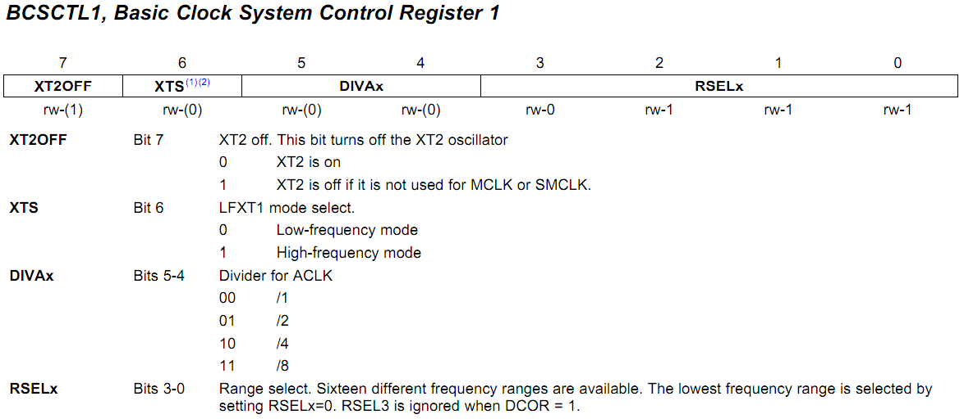
BCSCTL1
Set MCLK driven by VLO
BCSCTL1 = CALBC1_1MHZ; // Set range
Notes:
(1) XTS = 1 is not supported in MSP430x20xx devices.
(2) This bit is reserved in the MSP430AFE2xx devices
47

Slide 49
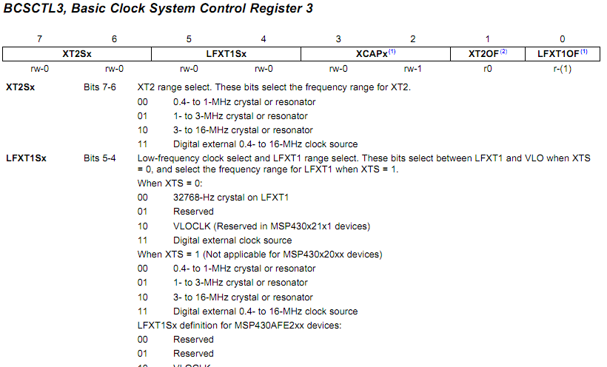
BCSCTL3
Set MCLK driven by VLO
BCSCTL3 |= LFXT1S_2; // Enable VLO as MCLK/ACLK src
Notes:
範例程式碼需要與上一頁一起看
MSP430x22xx, MSP430x23x0: XT2 is not present
(1) This bit is reserved in the MSP430AFE2xx devices.
(2) Does not apply to MSP430x2xx, MSP430x21xx, or MSP430x22xx devices.
48

Slide 50
Summary
Timer is a counter driven by a clock
The count multiplied by the clock frequency gives real time
Timers in MSP430 can
Compare with a target count to produce an alarm clock
Capture the time when a special event occurs
MSP430 clock module takes several different clock sources (DCO, VLO) and generate three different clock trains (MCLK, SMCLK, ACLK) to drive CPU and various peripherals
Timers and clocks in MSP430 are all IO devices and can be controlled by setting appropriate registers

