Slide 1
CS4101 嵌入式系統概論 Analog-to-Digital Converter
Prof. Chung-Ta King
Department of Computer Science
National Tsing Hua University, Taiwan
Materials from MSP430 Microcontroller Basics, John H. Davies, Newnes, 2008

Slide 2
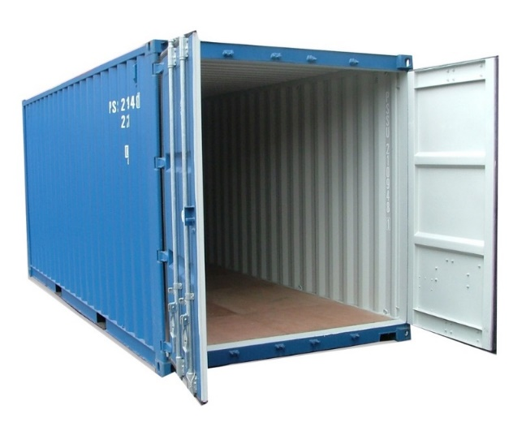
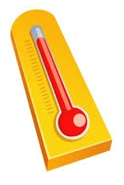
Recall the Container Thermometer
Container thermometer: monitor the temperature of the interior of a container
Monitor the temperature every minute
Flash LED alarm at 1 Hz
If the temperature rises above 45°C, flash the LED alarm at 3 Hz and send a message “Danger!” to the control server
If the temperature drops below 45°C, return the LED alarm to normal and send a message “Safe!” to the control server
…
Need to measure the temperature!

Slide 3
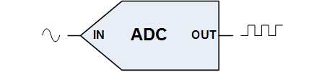
Digitizing Temperature
Temperature is a nature phenomena, whose value varies continuously
To make it feasible for computer to handle, we need to convert it into a digital number
To transform an analog signal into a series of digital numbers, the analog-to-digital converter (ADC) samples the signal at a fixed interval and converts the sampled values into digital numbers
00101
10100
01010
11001
Analog signal
Digital numbers
Notes:
2

Slide 4
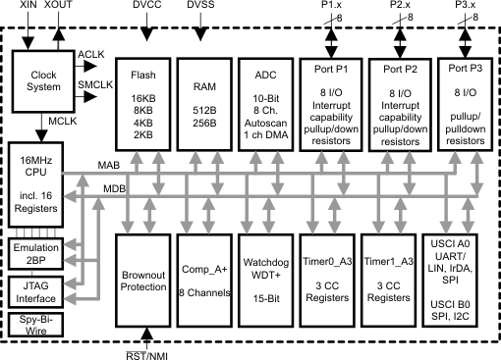
So Far, We Have Learned …
ADC
Clock System
IO
Timer System

Slide 5
Outline
Introduction to analog-to-digital conversion
ADC of MSP430
Sample code of using ADC10 in MSP430

Slide 6
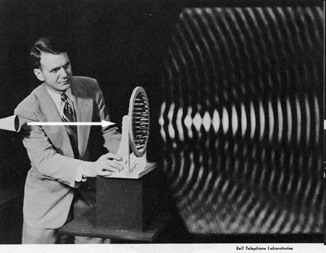
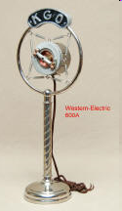
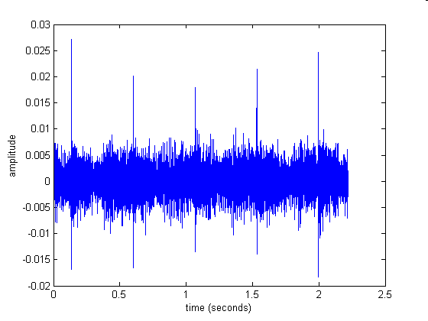
Analog Signals
A signal representing continuous things, e.g.
Fluctuations in air pressure (i.e. sound) strike the diaphragm of a microphone, which causes corresponding fluctuations in the voltage or current in an electric circuit
The voltage or current signal is an "analog" of the sound
strength
voltage
time
time
Notes:
Analog signals normally imply continuous signals (in time and value)

Slide 7
Analog-to-Digital Conversion (ADC)
ADC: convert an analog signal, e.g., a voltage V, into a binary value that the processor can handle
Input V(t): a continuous function, i.e., V can take any value within a range and can change in any way along time t
Output V[n]: a sequence of binary values, each has a fixed number of bits and can represent a finite number of values
Typically input is sampled regularly at intervals of T, so the continuous nature of time has also been lost
We also have DAC (digital-to-analog converter)!
00101
10100
01010
11001
Analog signal
Digital numbers
V(t)
V(n)

Slide 8
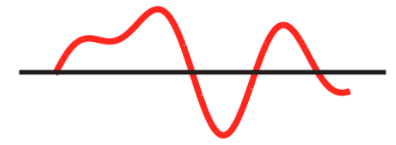
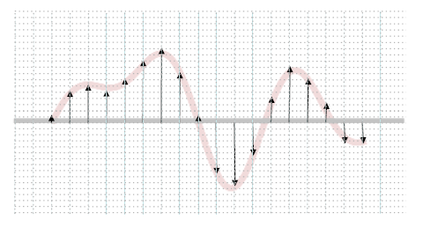
Analog-to-Digital Conversion
Convert an analog signal to its digital representation
Continuous time
Continuous values
Discrete time
Discrete values

Slide 9
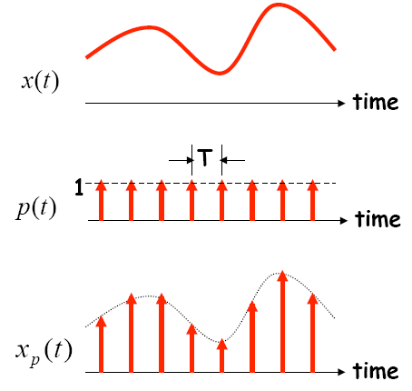
Sampling in Time
The value of the analog signal is measured at certain intervals in time. Each measurement is referred to as a sample
A series of “snapshots”

Slide 10
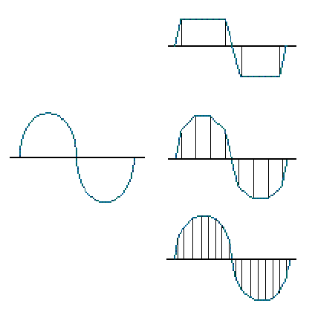
Terminologies in Sampling
Sampling rate:
How often analog signal is measured (samples per second, Hz), e.g. 44,100 Hz?
Sampling resolution:
Number of bits to represent each sample (“sample word length,” “bit depth”), e.g. 16 bit
Analog Input
4 samples/cycle
8 samples/cycle
16 samples/cycle

Slide 11
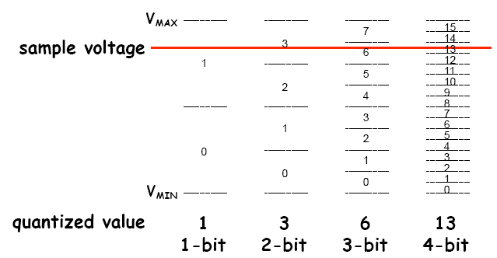
Encoding of Discrete Signals
If we use N bits to encode the magnitude of one of the discrete-time samples, we can capture 2^{N} possible values

Slide 12
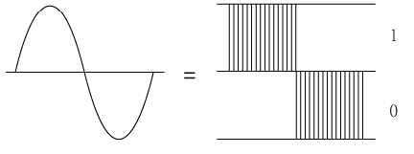
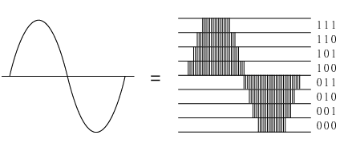
Sampling Rate and Encoding Bits
1-bit
Low sampling rate
3-bit
High sampling rate

Slide 13
Outline
Introduction to analog-to-digital conversion
ADC of MSP430
Sample code of using ADC10 in MSP430

Slide 14
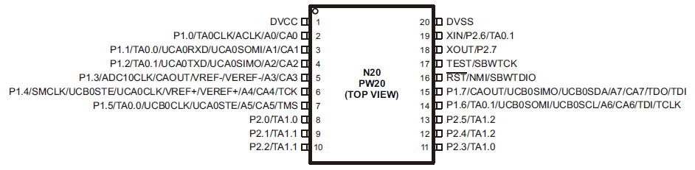
Requirements of MSP430 for ADC
Provide continuous sampling of multiple analog inputs (channels) and store sampled data
Input pins can take analog signals
ADC10CTL

Slide 15
Requirements of MSP430 for ADC
Provide continuous sampling of multiple analog inputs and store sampled data
Option 1:
Your code is interrupted by a timer to trigger ADC to read and convert a sample. Your code is interrupted again when ADC converts one.
2 interrupts: Timer, ADC
ADC10CTL

Slide 16
Requirements of MSP430 for ADC
Provide continuous sampling of multiple analog inputs and store sampled data
Option 2:
ADC is triggered by a timer to read and convert a sample. Your code is interrupted when ADC converts one.
1 interrupt: ADC
ADC10CTL

Slide 17
Requirements of MSP430 for ADC
Provide continuous sampling of multiple analog inputs and store sampled data
Option 1:
On an ADC interrupt, your code moves the converted data from ADC to a CPU register and then to memory.
ADC10CTL

Slide 18
Requirements of MSP430 for ADC
Provide continuous sampling of multiple analog inputs and store sampled data
Option 2:
Use hardware (Data Transfer Controller, DTC) to move data from ADC to memory → DMA
Interrupt CPU when block transfer is done
ADC10CTL

Slide 19
ADC in MSP430
MSP430 may contain one or more ADC converters:
Comparator:
Compare the voltages on its two input terminals and return 0 or 1, e.g., Comparator_A+
Successive-approximation ADC:
Use binary search to determine the closest digital representation of the input signal, e.g., ADC10 and ADC12 to give 10 and 12 bits of output
Sigma-delta ADC:
A more complicated ADC that gives higher resolution (more bits) but at a slower speed, e.g., SD16 and SD16_A, both of which give a 16-bit output

Slide 20
Simplified Block Diagram of ADC10
Voltage reference
Clock sources
Trigger a conversion
Conversion trigger
Convert one sample to 10-bit number
Notes:
Why do we need a clock? (drive SAR conversion, …) → do 10-bit conversion in 10 cycles
Conversion trigger can also be driven by a clock (OUTx) → trigger conversion periodically

Slide 21
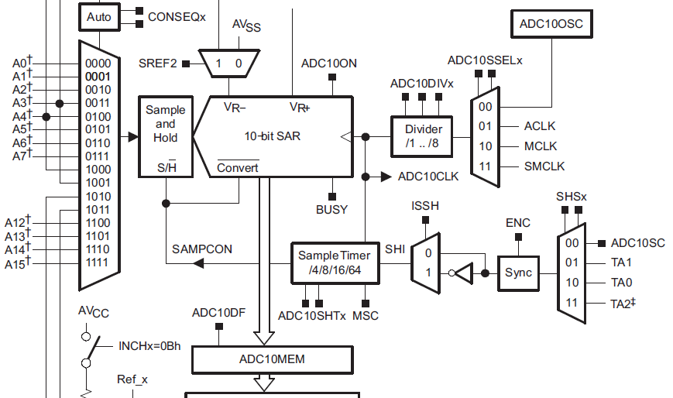
Main Components of ADC10
Analog inputs:
Some are from internal, e.g. temperature, and some are from external, e.g. A0, A1, …, A7
A pin can take digital or analog signals

Slide 22
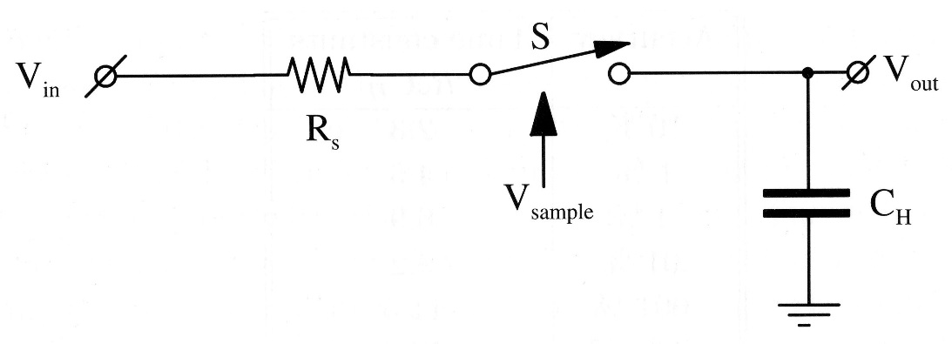
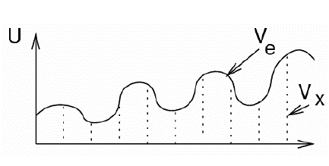
Main Components of ADC10
Sample-and-Hold circuit:
V_{out} = V_{in} when V_{sample} = 1
SAR (Successive-Approximation Register):
10-bit → at least 10 cycles for one conversion (need to be driven by a clock)
Result written to ADC10MEM and raising ADC10IFG
V_{in}
V_{out}

Slide 23
Successive-Approximation ADC
Generate internal analog signal V_{D/A} by DAC
Compare V_{D/A} with input signal V_{in}
Modify V_{D/A} by D₀D₁D₂…D_{N-1} until closest possible value to V_{in} is reached
Dr.-Ing. Frank Sill, Department of Electrical Engineering, Federal University of Minas Gerais, Brazil

Slide 24
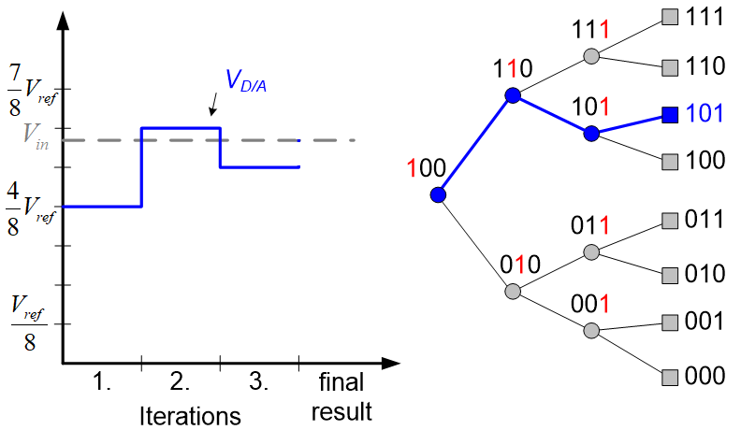
Successive-Approximation ADC
3 cycles for one conversion, driven by a clock
P. Fischer, VLSI-Design - ADC und DAC, Uni Mannheim, 2005

Slide 25
Main Components of ADC10
Built-in voltage reference:
Setting REFON in ADC10CTL0 register to 1 enables the internal reference
Two selectable voltage levels: 2.5 V and 1.5 V
Setting REF2_5V in ADC10CTL0 to 1 selects 2.5 V as the internal reference, otherwise 1.5 V
After voltage reference is turned on, must wait about 30µs for it to settle
Notes:
The input signal is between 0 V to 1.5 (2.5) V. If input signal is 1.5 V, then ADC10MEM will contain 0x3FF (10-bit output).

Slide 26
Main Components of ADC10
Reference voltage: 0V ~ 1.5V or 2.5V
ADC10MEM: 10-bit output of ADC conversion
0x3FF for 1.5V or 2.5V

Slide 27
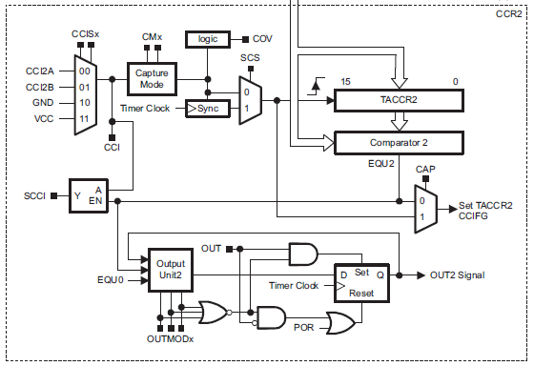
Main Components of ADC10
Triggering of sample-and-hold circuit:
By ADC10SC bit in ADC10CTL0 register, which can be set (and is thus triggered) by software, or
OUTx from Timer0_A3: for periodic sampling
Capture/Compare Block 2
of Timer0_A3

Slide 28
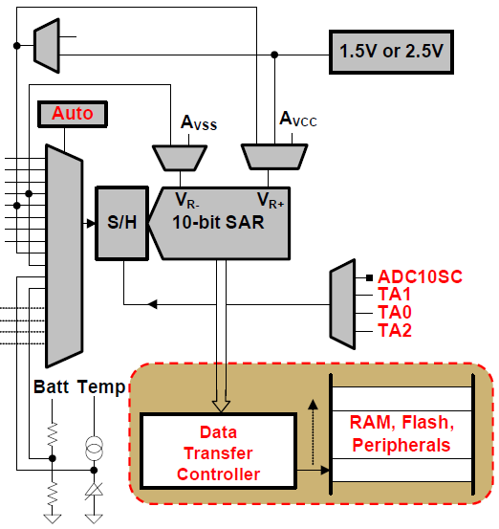
Data Transfer Controller (DTC)
Transfer conversion results from ADC10MEM to other on-chip memory locations
Each load of ADC10MEM triggers a data transfer until a set amount
During each DTC transfer, CPU is halted
1.5V or 2.5V or Reference
Input channel
ADC10MEM
Notes:
@ userguide 22.2.1 10-Bit ADC Core ,Page 542
The eight external and four internal analog signals are selected as the channel for conversion by the analog input multiplexer.
The ADC core converts an analog input to its 10-bit digital representation and stores the result in the ADC10MEM register. The core uses two programmable/selectable voltage levels (VR+ and VR-) to define the upper and lower limits of the conversion. The digital output (NADC) is full scale (03FFh) when the input signal is equal to or higher than VR+, and zero when the input signal is equal to or lower than VR-. The input channel and the reference voltage levels (VR+ and VR-) are defined in the conversion-control memory. Conversion results may be in straight binary format or 2s-complement format.
The ADC10 core is configured by two control registers, ADC10CTL0 and ADC10CTL1. The core is enabled with the ADC10ON bit. With few exceptions the ADC10 control bits can only be modified when ENC = 0. ENC must be set to 1 before any conversion can take place.
SAR: successive approximation register
27

Slide 29
ADC10 Interrupts
One interrupt and one interrupt vector (ADC10_VECTOR)
If both ADC10IE and GIE bits are set, then ADC10IFG generates an interrupt request
ADC10IFG is automatically reset when interrupt request is serviced, or it may be reset by software
When DTC is not used (ADC10DTC1 = 0), ADC10IFG is set when conversion results are loaded into ADC10MEM
When DTC is used (ADC10DTC1 > 0), ADC10IFG is set when a block transfer completes

Slide 30
Enabling Sampling and Conversion

Slide 31
ADC10 Registers
Register | Short Form | Register Type | Addr.
ADC10 input enable register 0 | ADC10AE0 | Read/write | 04Ah
ADC10 control register 0 | ADC10CTL0 | Read/write | 01B0h
ADC10 control register 1 | ADC10CTL1 | Read/write | 01B2h
ADC10 memory | ADC10MEM | Read | 01B4h
ADC10 data transfer control register 0 | ADC10DTC0 | Read/write | 048h
ADC10 data transfer control register 1 | ADC10DTC1 | Read/write | 049h
ADC10 data transfer start address | ADC10SA | Read/write | 01BCh
Where the converted 10-bit digital value is saved
Notes:
power-on reset (PoR)
30

Slide 32
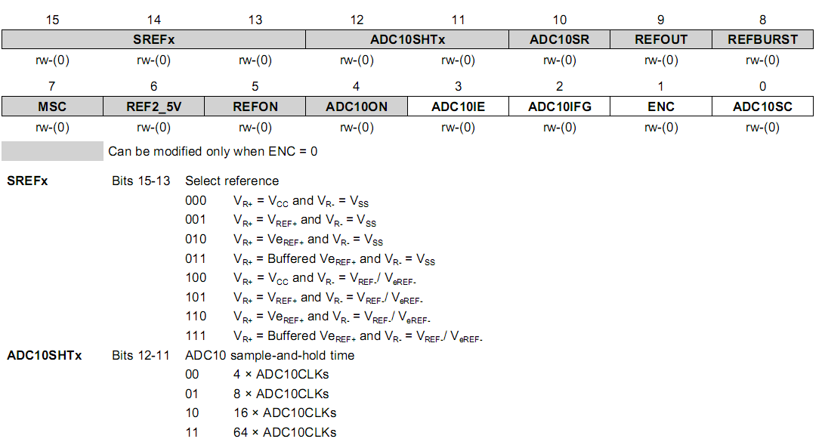
ADC10CTL0
ideal for the temperature sensor
ideal for the temperature sensor
Notes:
31

Slide 33
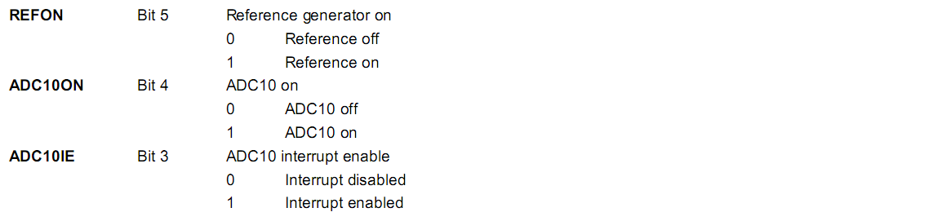
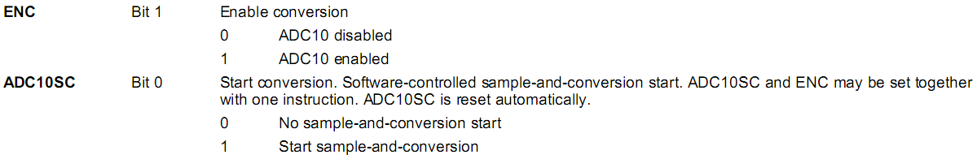
ADC10CTL0 cont’d
ADC10CTL0 = SREF_2 + ADC10SHT_1; // Reference range & SH time
Notes:
32

Slide 34
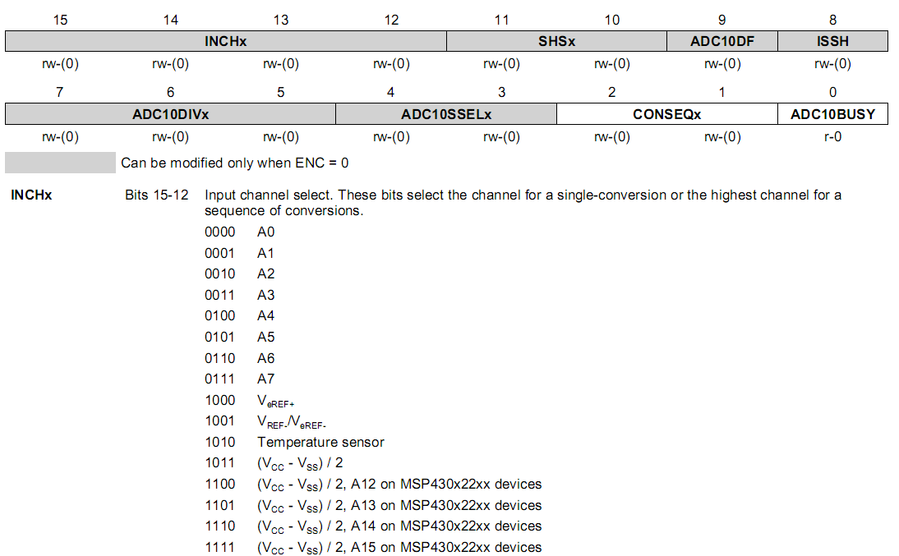
ADC10CTL1
Notes:
33

Slide 35
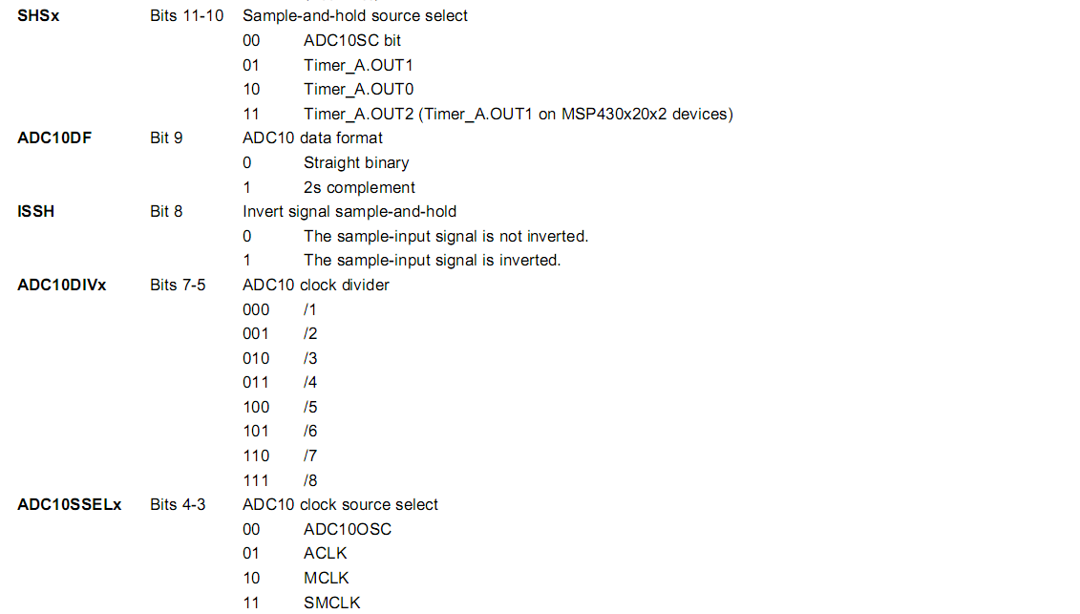
ADC10CTL1 cont’d
ADC10CTL1 = INCH_10 + ADC10DIV_0; // Temp Sensor ADC10CLK
Notes:
Single-channel single conversion means that after a conversion, the trigger bit is reset and needs to be set again for the next conversion, even if the MSC and SHP bits are set. In repeated single conversion mode, with set MSC and SHP bits, the ADC will convert the same channel over and over again as fast as possible (based on the SHT_x setting).
Sequence mode samples all channels from x down to 0. When using a timer trigger instead of ADC12SC, the two modes are the same if MSC is clear or if MSC is set and SHP is clear.
34

Slide 36
Outline
Introduction to analog-to-digital conversion
ADC of MSP430
Sample code of using ADC10 in MSP430

Slide 37
Sample Code 1 for ADC10
Repetitive single-channel-single-conversion:
Software repetitively perform single samples on A1 (pin P1.1, external input) with reference to Vcc
If A1 > 0.5*Vcc, P1.0 set, else reset.
Set ADC10SC to start sample and conversion
But ADC10SC is automatically cleared at end of conversion
Enable the next conversion in ISR of ADC10 and iterate
Notes:
Multiple single-channel-single-conversion, repeating by software triggering in ISR

Slide 38
Timing in Sample Code 1
Provide continuous sampling of multiple analog inputs and store sampled data
Option 1’:
Code continuously triggers ADC to read and convert a sample. The code is interrupted when ADC converts one.
Sample interval is the time to do a ADC conversion
ADC10CTL
X

Slide 39
Sample Code 1 for ADC10
void main(void) { WDTCTL = WDTPW + WDTHOLD; // Stop WDT // H&S time 16x, interrupt enabled ADC10CTL0 = ADC10SHT_2 + ADC10ON + ADC10IE; ADC10CTL1 = INCH_1; // Input from A1 ADC10AE0 |= 0x02; // Enable pin A1 for analog in P1DIR |= 0x01; // Set P1.0 to output ADC10CTL0 |= ENC + ADC10SC; // Start sampling for (;;) { } } #pragma vector=ADC10_VECTOR __interrupt void ADC10_ISR(void) { if (ADC10MEM < 0x1FF) P1OUT &= ~0x01; else P1OUT |= 0x01; ADC10CTL0 |= ENC + ADC10SC; // enable sampling }
Just read the converted value, no need to store
Notes:
38
Why not read ADC10MEM right after setting ADC10CTL0? While wait for interrupt? What is the time to go through one iteration?
Any one of the pins of Port 1 can be set to be an analog input. Thus up to 8 channels are available for separate ADC inputs.
Analog Enable control register ADC10AE0 will be use for enabling the corresponding input channels.
38

Slide 40
Signals Involved in Sample Code 1

Slide 41
Sample Code 2 for ADC10
Continuous sampling (repeat-single-channel) driven by Timer0_A3
ADC samples A1 16/second driven by Timer0_A3, and interrupts CPU after each sampling
Timer0_A3 uses ACLK running at 32 KHz driven by an external crystal (2048 ACLK cycles give 1/16 second (ACLK/2048))
Timer0_A3 runs in up mode with CCR0 defining the sampling period (2048 cycles) and CCR1 triggering ADC10 to do conversion
CPU in ISR checks each sample and if A1 > 0.5Vcc, P1.0 is set, else reset
Notes:
Repeat-single-channel

Slide 42
Timing in Sample Code 2
Provide continuous sampling of multiple analog inputs and store sampled data
Option 2:
ADC is triggered by a timer to read and convert a sample. Your code is interrupted when ADC converts one.
1 interrupt: ADC
ADC10CTL

Slide 43
Sample Code 2 for ADC10
#include “msp430.h” void main(void) { WDTCTL = WDTPW + WDTHOLD; // Stop WDT // TA1 trigger sample start ADC10CTL1 = SHS_1 + CONSEQ_2 + INCH_1; ADC10CTL0 = SREF_1 + ADC10SHT_2 + REFON + ADC10ON + ADC10IE; ADC10CTL0 |= ENC; // ADC10 Enable ADC10AE0 |= 0x02; // P1.1 ADC10 option select P1DIR |= 0x01; // Set P1.0 output TA0CCR0 = 2048-1; // Sampling period TA0CCTL1 = OUTMOD_3; // TA0CCR1 set/reset TA0CCR1 = 2046; // TA0CCR1 OUT1 on time TA0CTL = TASSEL_1 + MC_1; // ACLK, up mode while(1); }
Timer0_A CCR1 out mode 3: The output (OUT1) is set when the timer counts to the TA0CCR1 value and is reset when the timer counts to the TA0CCR0 value.
Notes:
42
SHS_1: S&H triggering source → OUT1
CONSEQ_2: Conversion sequence mode select (Repeat-single-channel)
SREF_1: Select reference (VR+ = VREF+ and VR- = VSS)
ADC10SHT_2: Sample-and-hold time (6 × ADC10CLKs)
REFON: internal reference generator on
The settling time for the internal reference is < 30µs. If DCOCLK is 1 MHz, then 1 cycle takes 6µs and 30 cycles gives long enough delay for the internal reference voltage to settle down.
42

Slide 44
Sample Code 2 for ADC10
// ADC10 interrupt service routine #pragma vector=ADC10_VECTOR __interrupt void ADC10_ISR(void){ if (ADC10MEM < 0x155) // ADC10MEM = A1 > 0.5V? P1OUT &= ~0x01; // Clear P1.0 LED off else P1OUT |= 0x01; // Set P1.0 LED on }
Notes:
43
Where do these two ISRs return to?
0x155 is 1/3 of 0x3FFF, which gives 0.5 V out of 1.5 V
43

Slide 45
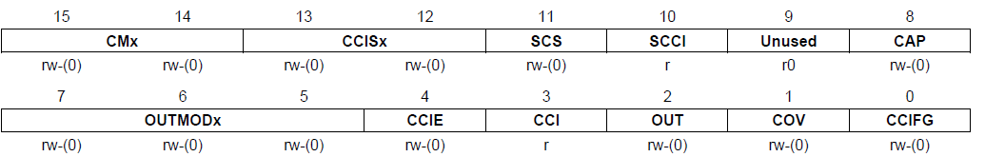
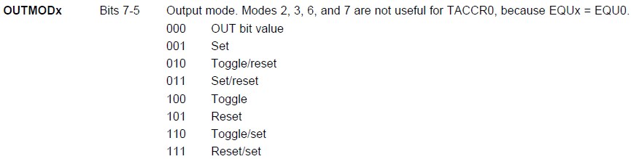
TA0CCTLx (Capture/Compare Control Reg.)

Slide 46
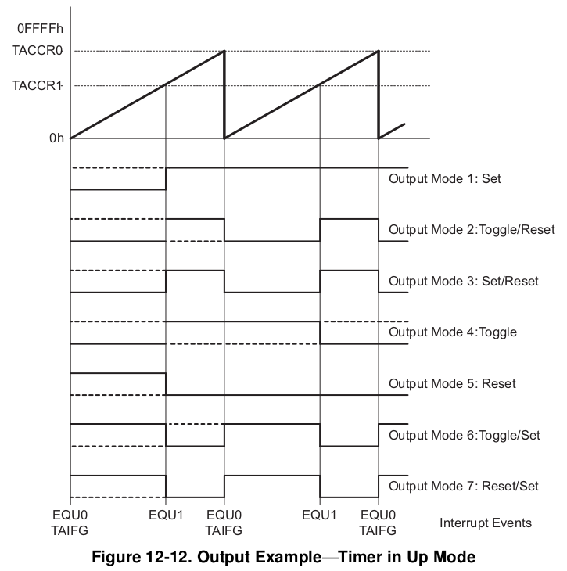
Timer in Up Mode
2047
2046

Slide 47
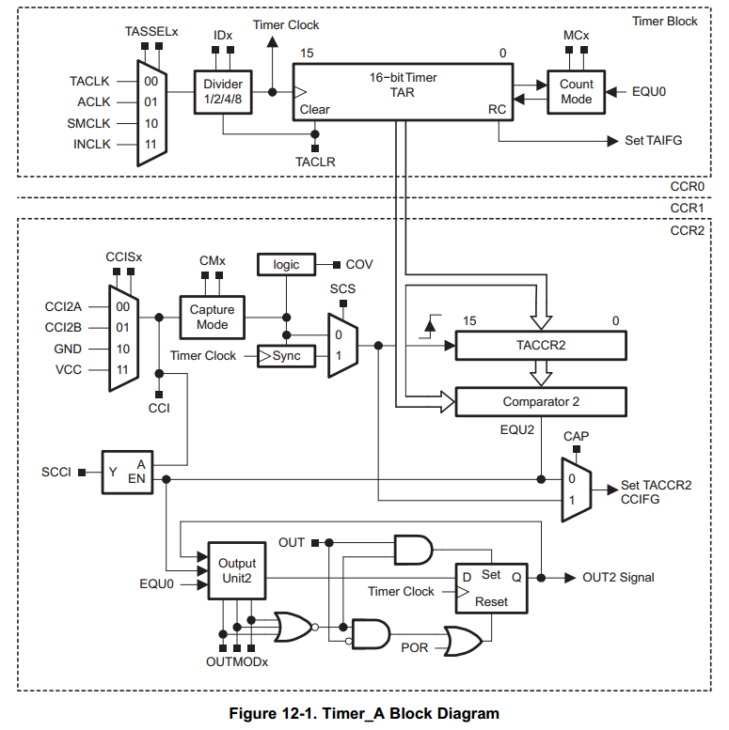
Timer in Set/Reset Mode
2047
2046
0
CCR0
CCR1
2047
2046
3

Slide 48
Timer0_A3 to Activate ADC
OUT1

Slide 49
OUT1 to Trigger ADC Conversion

Slide 50
Summary
ADC: analog-to-digital conversion DAC: digital-to-analog conversion
Conversions will necessarily introduce errors. Important to understand constraints and limitations
ADC10 in MSP430
Convert an analog signal into 10-bit digitals
Registers associated with ADC10
Sample programs of ADC10
Single conversion
Continuous conversion driven by Timer_A

