Slide 1
CS4101 嵌入式系統概論 Embedded Real-Time OS
Prof. Chung-Ta King
Department of Computer Science
National Tsing Hua University, Taiwan
(Materials from Prof. P. Marwedel of Univ. Dortmund, Richard Barry, and
http://www.eecs.umich.edu/eecs/courses/eecs373/Lec/RTOS2.pptx)

Slide 2
Outline
Embedded and real-time operating systems
Embedded operating systems
Overview of real-time systems
Real-time operating systems (RTOS)
FreeRTOS
Tasks
Link to FreeRTOS on Arduino
Tasks in FreeRTOS
Task states
Task creation and deletion

Slide 3
Operating Systems
The collection of software that manages a system’s hardware resources
Often include a file system module, a GUI and other components
Often times, a “kernel” is understood to be a subset of such a collection
Characteristics
Resource management
Interface between application and hardware
Library of functions for the application
Applications are compiled separately from the OS
Notes:
Resource management - e.g. memory, processor, hard disk, cd-rom, printer
Interface between application and hardware
Creation of an operating system-API for hardware - leads to a simple handling of the hardware for the programmer (minor knowledge of hardware)
Library of functions for application
Use:
The operating system has a big influence at software reliability, productivity, maintenance and service.
Allocation of resources (cpu, memory, etc) for the application
Deletion of conflict situations

Slide 4
Embedded Operating System (EOS)
Application is compiled and linked together with the embedded OS
On system start, application usually gets executed first, and it then starts the EOS
Typically only part of the OS (services or functions) that are needed to support the embedded system are configured and linked in
Characteristics:
Resource management
Less overhead
Code of OS and application mostly reside in ROM
(Dr. Jimmy To, EIE, POLYU)
Notes:
Resources management
Optimising to less memory requirement
Processor
Mostly no management of the ports and periphery (limitation to operating system kernel)
Less Overhead
Run time
Memory requirement (RAM, ROM)
Interface: Relation to the outside world (input.- and output signals)
Kind of operating system:
Single-/multi-user system
Timesharing (multi-access)
Multitasking
Batch

Slide 5
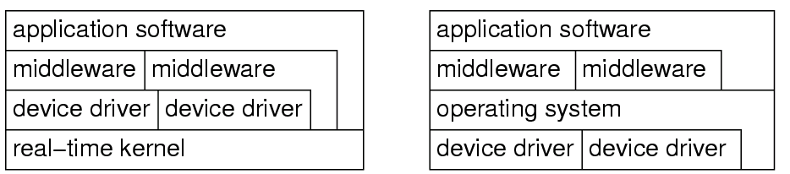
Characteristics of Embedded OS
Embedded OS need to be configurable:
No single OS fits all needs → install only those needed
e.g., conditional compilation using #if and #ifdef
Device drivers often not integrated into kernel
Embedded systems often application-specific → specific devices → move devices out of OS to tasks
Embedded OS
Standard OS
kernel

Slide 6
Characteristics of Embedded OS
Protection is often optional
Embedded systems are typically designed for a single purpose, untested programs rarely loaded, and thus software is considered reliable
Privileged I/O instructions not necessary and tasks can do their own I/O, e.g., adc10 is address of some ADC register: Simply use
load register, adc10 instead of OS call
Real-time capability
Many embedded systems are real-time (RT) systems and, hence, the OS used in these systems must be real-time operating systems (RTOSs)

Slide 7
What is a Real-Time System?
Real-time systems are: "those systems in which the correctness of the system depends not only on the logical result of the computation, but also on the time at which the results are produced"
J. Stankovic, "Misconceptions about Real-Time Computing," IEEE Computer, 21(10), October 1988.

Slide 8
Real-Time Characteristics
Pretty much typical embedded systems
Sensors and actuators all controlled by a processor
The big difference is timing constraints (deadlines)
Tasks can be broken into two categories¹
Periodic Tasks: time-driven, recurring at regular intervals
An air monitoring system taking a sample every 10 seconds
Flash LEDs in 1 Hz
Aperiodic: event-driven
The airbag of a car having to react to an impact
Press a button
¹Sporadic tasks are sometimes considered as a third category. They are tasks similar to aperiodic tasks but activated with some known bounded rate, which is characterized by a minimum interval of time between two successive activations.

Slide 9
Soft, Firm and Hard deadlines
The instant at which a result is needed is called a deadline
If the result has utility even after the deadline has passed, the deadline is classified as soft, otherwise it is firm
If a catastrophe could result if a firm deadline is missed, the deadline is hard

Slide 10
Goals of an RTOS
Manage to meet RT deadlines
Also like
Deadlines met
Ability to specify scheduling algorithm
Interrupts are fast
Interrupt prioritization easy to set
Tasks stay out of each others’ way
Normally through page protection
Device drivers already written (and tested!) for us
Portable—runs on a huge variety of systems
Nearly no overhead so we can use a small device!
That is a small memory and CPU footprint
Notes:
Tasks stay out of each others’ way: One task running awry shouldn’t take the rest of the system down.
This generally requires a lot of overhead.
Need some sense of process number/switching
Need some kind of MMU in hardware
Device drivers already written (and tested!) for us:
-- Ideally the RTOS has drivers for all the on-board peripherals.
-- It’s a lot easier to call a “configure_I2C()” function than to read the details of the device specification and do the memory-mapped work yourself

Slide 11
Requirements for RTOS
Predictability of timing behavior of the OS
Upper bound on execution time for all OS services
Scheduling policy must be deterministic
Period in which interrupts are disabled must be short (to avoid unpredictable delays in processing critical events)
OS should manage timing and scheduling
OS has to be aware of task deadlines (unless scheduling is done off-line)
OS should provide precise time services with high resolution
Important if internal processing of the embedded system is linked to an absolute time in the physical environment

Slide 12
Functionality of RTOS Kernel
Processor management
Memory management
Timer management
Task management (resume, wait, etc.)
Inter-task communication
Task synchronization
resource management

Slide 13
Outline
Embedded and real-time operating systems
Embedded operating systems
Overview of real-time systems
Real-time operating systems (RTOS)
FreeRTOS
Tasks
Link to FreeRTOS on Arduino
Tasks in FreeRTOS
Task states
Task creation and deletion

Slide 14
FreeRTOS
FreeRTOS is nothing but software that provides multitasking facilities
Allows to run multiple tasks and has a simple scheduler to switch between tasks (priority-based multitasking)
Fully preemptive
Always runs the highest priority task that is ready to run
Context switch occurs if a task blocks or a task yields the CPU
Queues to communicate between multiple tasks
Semaphores for resource sharing between multiple tasks
Utilities to view CPU utilization, stack utilization etc.
(http://www.socialledge.com/sjsu/index.php?title=FreeRTOS_Tutorial)

Slide 15
Ticks
System runs on “ticks”
Every tick the kernel runs and figures out what to do next.
Interrupts have a different mechanism
Basically a hardware timer is set to generate regular interrupts for ticks and calls the scheduler
This means the OS occupies one of the timers—you can’t easily share

Slide 16
Three Main Areas in FreeRTOS
Tasks
Almost half of FreeRTOS's core code deals with tasks (in task.c and task.h)
Creating, scheduling, and maintaining tasks
Communication
40% of FreeRTOS's core code deals with communication (in queue.c and queue.h)
Tasks and interrupts use queues to send data to each other and to signal the use of critical resources
Hardware interface
Most FreeRTOS code is hardware-independent. About 6% of code to interface to hardware-dependent code
(http://www.aosabook.org/en/freertos.html)

Slide 17
Tasks in FreeRTOS
In FreeRTOS, computations are organized around tasks, which are the most basic unit of scheduling
A task is a thread
A task is a function that must return void and take a void pointer parameter:
void ATaskFunction(void *pvParameters);
A task normally runs in an infinite loop and must not return
You inform the scheduler of
The task’s resource needs (stack space, priority)
Any arguments the task needs

Slide 18
Example: Creating a Task
void setup() {
// Now set up two tasks to run independently
xTaskCreate(
vTask1, // Pointer to function for the task
(const portCHAR *) "Task1", // Name for the task
128, // Stack size
NULL, // NULL task parameter
1, // This task will run at priority 1
NULL ); // Do not use the task handle
xTaskCreate(vTask2, "Task2", 1000, NULL, 1, NULL);
/* Now the task scheduler, which takes over control of scheduling individual tasks, is automatically started */
}
void loop() {
// Empty! Things are done in Tasks.
}

Slide 19
Example: Creating a Task
void vTask1(void *pvParameters) {
(void) pvParameters;
for( ;; ) // A Task shall never return or exit.
{
// do whatever the task is to do
}
}
void vTask2(void *pvParameters) {
(void) pvParameters;
for( ;; ) // A Task shall never return or exit.
{
// do whatever the task is to do
}
}

Slide 20
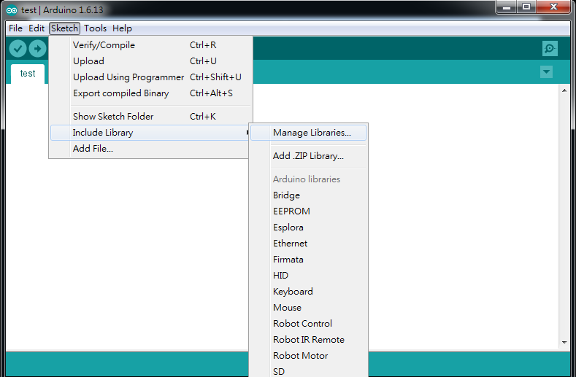
Link to FreeRTOS on Arduino
There is a FreeRTOS implementation in Arduino IDE
Go to “Sketch” → “Include Library” → “Manage Libraries…” to open Arduino IDE Library manager

Slide 21
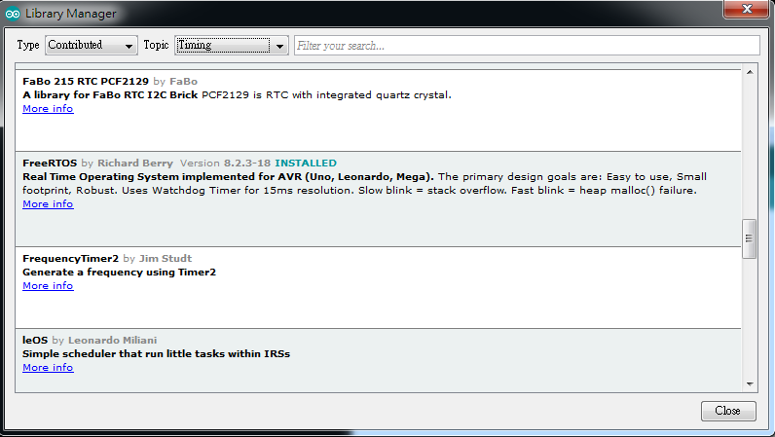
Link to FreeRTOS on Arduino
In the Arduino IDE Library manager (from Arduino Version 1.8.4) look for the FreeRTOS Library
Type: “Contributed” and Topic: “Timing”

Slide 22
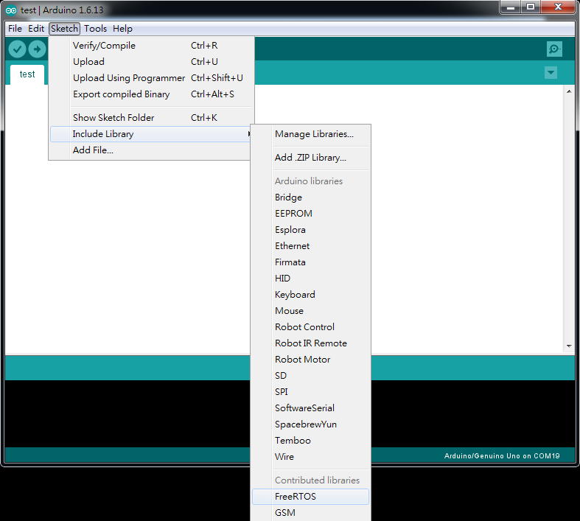
Link to FreeRTOS on Arduino
Under the “Sketch” → “Include Library”, ensure that the FreeRTOS library is included in your sketch

Slide 23
Example: Blink_AnalogRead
#include <Arduino_FreeRTOS.h>
/* define two tasks for Blink & AnalogRead */
void TaskBlink(void *pvParameters);
void TaskAnalogRead(void *pvParameters);
void setup() {
Serial.begin(9600);
while (!Serial) {
; // wait for serial port to connect.
}
/* Now set up two tasks to run independently */
xTaskCreate(TaskBlink, (const portCHAR *)"Blink", 128,
NULL, 2, NULL);
xTaskCreate(TaskAnalogRead,
(const portCHAR *) "AnalogRead", 128, NULL, 1,
NULL);
}

Slide 24
Example: Blink_AnalogRead
void loop() {
// Empty. Things are done in Tasks.
}
void TaskBlink(void *pvParameters) {
(void) pvParameters;
pinMode(LED_BUILTIN, OUTPUT);
for (;;) { // A Task shall never return or exit.
digitalWrite(LED_BUILTIN, HIGH); // turn on the LED
vTaskDelay(1000); // wait for 1000 ticks
digitalWrite(LED_BUILTIN, LOW); // turn off the LED
vTaskDelay(1000); // wait for 1000 ticks
}
}

Slide 25
Example: Blink_AnalogRead
void TaskAnalogRead(void *pvParameters) {
(void) pvParameters;
for (;;) {
/* read the input on analog pin 0 */
int sensorValue = analogRead(A0);
/* print out the value you read */
Serial.println(sensorValue);
/* one tick delay in between reads for stability */
vTaskDelay(1);
}
}

Slide 26
Outline
Embedded and real-time operating systems
Embedded operating systems
Overview of real-time systems
Real-time operating systems (RTOS)
FreeRTOS
Tasks
Link to FreeRTOS on Arduino
Tasks in FreeRTOS
Task states
Task creation and deletion

Slide 27
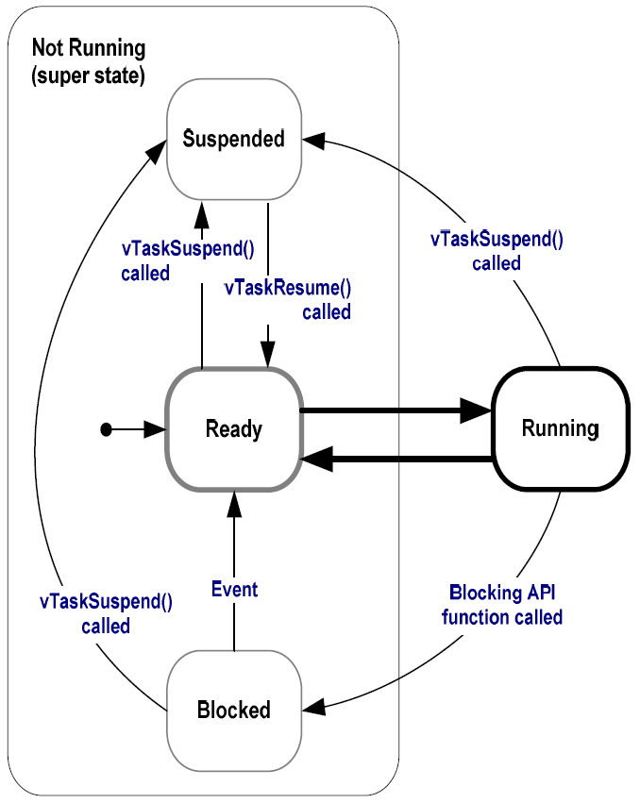
Task States in FreeRTOS
Running:
Task is actually executing
Only one task can exist in Running state at any one time (assuming 1-core system)
Ready:
Task is ready to execute but a task of equal or higher priority is Running

Slide 28
Task States in FreeRTOS
Blocked:
Task is waiting for some event
Time: if a task calls vTaskDelay() it will be blocked until the delay period has expired
Resource: tasks can also block waiting for queue and semaphore events
Suspended:
Much like blocked, but not waiting for anything
Tasks will only enter or exit the suspended state when explicitly commanded to do so through the vTaskSuspend() and vTaskResume() API calls respectively

Slide 29
Task Creation
xTaskCreate(pvTaskCode, pcName, usStackDepth, pvParameters, uxPriority, pxCreatedTask)
pvTaskCode: pointer to task entry function, implemented to never return
pcName: a descriptive name for the task to facilitate debugging
usStackDepth: size of task stack, specified as the number of variables that the stack can hold
pvParameters: pointer to parameters for the task
uxPriority: priority at which the task should run; low numeric priority values denote low priority
pvCreatedTask: pass back a handle to reference the task

Slide 30
Task Deletion
A created task commonly runs in an infinite loop, but it may be deleted by
void vTaskDelete(TaskHandle_t xTask);
xTask: handle of the task to be deleted; NULL to cause the calling task to be deleted
Remove a task from the RTOS kernels management
void vOtherFunction(void) {
TaskHandle_t xHandle = NULL;
// Create the task, storing the handle.
xTaskCreate(vTaskCode, "NAME", STACK_SIZE, NULL,
tskIDLE_PRIORITY, &xHandle);
// Use the handle to delete the task.
if(xHandle != NULL) vTaskDelete(xHandle);
}
Notes:
Memory allocated by the task code is not automatically freed, and should be freed before the task is deleted.

