Slide 1
CS4101 Introduction to Embedded Systems Inter-Task Communication
Prof. Chung-Ta King
Department of Computer Science
National Tsing Hua University, Taiwan
(Materials from Prof. Insup Lee, Prof. Frank Drews, Richard Barry, MQX User Guide,
Using the FreeRTOS Real Time Kernel, Study of an Operating System: FreeRTOS)

Slide 2
Consider This FreeRTOS Example
int Light, xAxis, yAxis; void setup() { xTaskCreate(photoresistor,”Task1”,128,NULL,3,NULL); xTaskCreate(joystick,”Task2”,128,NULL,3,NULL); xTaskCreate(RGB_LED,”Task3”,128,NULL,3,NULL); vTaskStartScheduler(); } void photoresistor(void) { Light = ...; // writer } void joystick(void) { xAxis = ...; yAxis = ...; // writer } void RGB_LED(void) { ... = ...Light ... xAxis ... yAxis; // reader }
Tasks communicate through shared variables
What’s wrong with this?
Notes:
1
1

Slide 3
Consider Another Example
int Shared = 0; void setup() { xTaskCreate(Task1,”Task1”,128,NULL,3,NULL); xTaskCreate(Task2,”Task2”,128,NULL,3,NULL); xTaskCreate(Task3,”Task3”,128,NULL,1,NULL); vTaskStartScheduler(); } void Task1(void) { ... Shared = Shared + 1; ... } void Task2(void) { ... Shared = Shared + 1; ... } Void Task3(void) { ... Ans = Shared; ... }
Two writers
One reader
What will you get in Ans?
Notes:
2
2

Slide 4
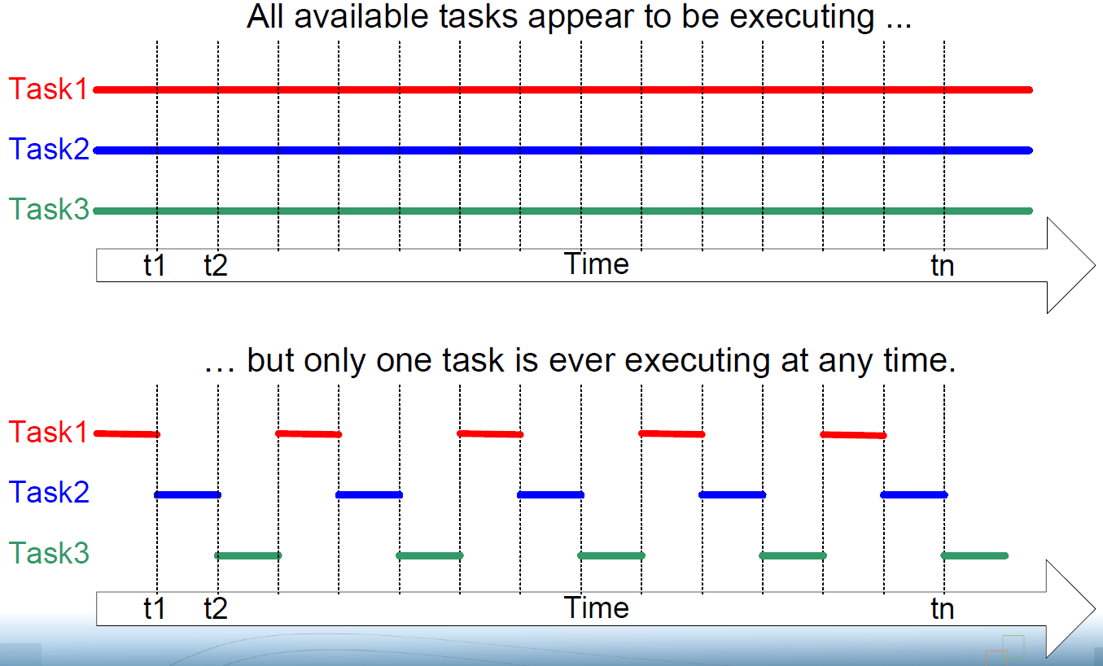
Multi-Tasking (Multiprogramming)
Assume
1 CPU

Slide 5
Let’s Examine the Assembly Code
Task1 Task2
... ...
ld r1,M[Shared] ld r1,M[Shared]
add r2,r1,#1 add r2,r1,#1
st r2,M[Shared] st r2,M[Shared]
... ...

Slide 6
When Tasks Are Scheduled to CPU
Time Task1 Task2
...
ld r1,M[Shared]
ld r1,M[Shared]
add r2,r1,#1
st r2,M[Shared]
add r2,r1,#1
st r2,M[Shared]
Tick interrupt
CPU runs scheduler, which chooses Task2
CPU saves Task1’s state in its stack
CPU restores Task2’s state from its stack and runs it
Task1’s state is restored and run
What will you get in Shared?
Race condition

Slide 7
Problem with Shared Variables
Writer-reader relationship
Using shared variables to communicate between tasks may be “unsafe”, especially when two or more tasks want to update the variables at the same time
Such shared variables must be “protected” from tampering from other tasks
Updates to such variables are “critical” and must be made atomic
How to do?
Disable interrupts when executing such critical sections
Use “protected” data structure, e.g., queue in FreeRTOS
Provide special synchronization primitives, e.g., mutex
…

Slide 8
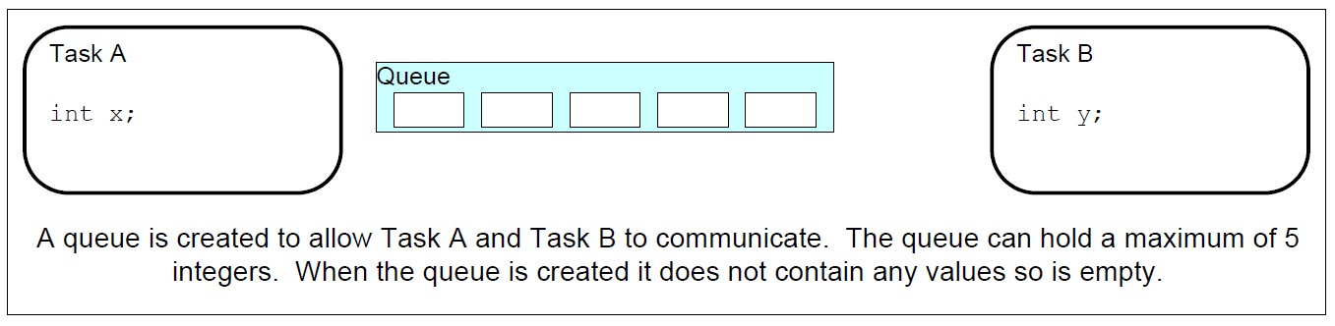
FreeRTOS Queues
Queues:
A queue can hold a finite number of fixed size data items
In most cases, used as thread safe FIFO (First In First Out) buffers with new data being written to the back of the queue, and removed from the front
Can be used to send messages between tasks, and between interrupts and tasks

Slide 9
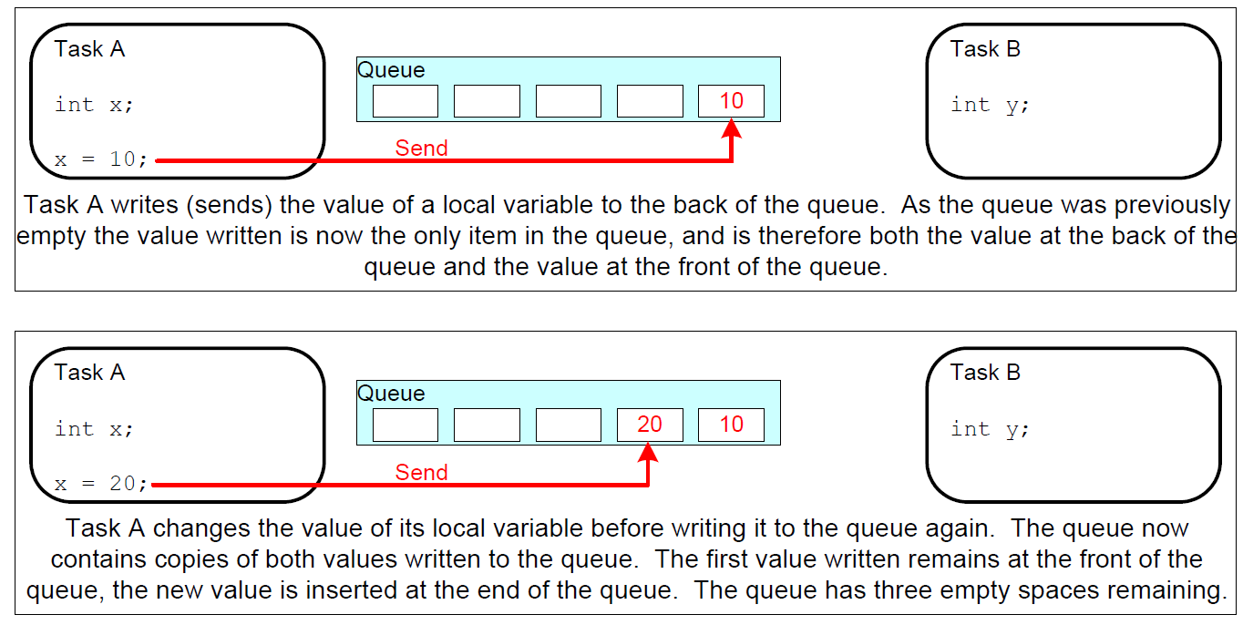
FreeRTOS Queues

Slide 10
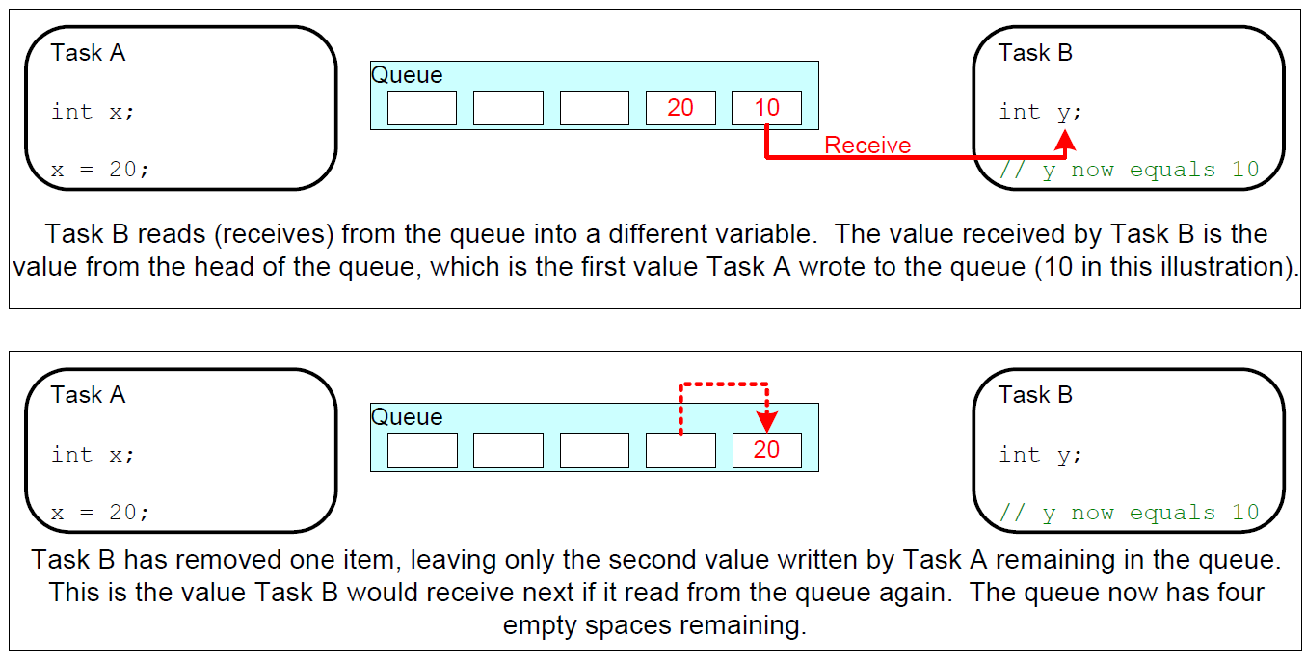
FreeRTOS Queues

Slide 11
FreeRTOS Queues
Queues are objects in their own right
Not owned by or assigned to any particular task
Any number of tasks can write to the same queue and any number of tasks can read from the same queue
Very common to have multiple writers, but very rare to have multiple readers
# of items and item size determined at queue create time
Sending/receiving items are by copy not reference
What happen when more than one task write into or read from a queue?
What is guaranteed by “thread-safe”/”no race condition”?

Slide 12
FreeRTOS Queues
Queue functions
Create queues: xQueueCreate(), vQueueDelete()
Send/receive data to/from queues: xQueueSend(), xQueueSendToBack(), xQueueReceive(), xQueueReceiveFromISR()
Queue management: number of items in a queue, …
Blocking on a queue: effect of priority, …

Slide 13
Queue Creation
A queue must be explicitly created before it can be used
FreeRTOS allocates RAM from the heap when a queue is created
RAM holds both the queue data structure and the items that are contained in the queue
xQueueCreate():
Used to create a queue and returns an xQueueHandle to reference the queue it creates

Slide 14
Queue Creation
QueueHandle_t xQueueCreate(
UBaseType_t uxQueueLength,
UBaseType_t uxItemSize);
Creates a new queue instance
Allocates queue storage and returns a handle
uxQueueLength: max. # of items the queue can contain
uxItemSize: # of bytes that each item in queue requires
Items are queued by copy, not by reference, so this is the number of bytes that will be copied for each posted item
Each item on the queue must be the same size
Returns a queue handle by which the queue can be referenced

Slide 15
Send Data through Queues
BaseType_t xQueueSend(QueueHandle_t xQueue,
const void * pvItemToQueue,
TickType_t xTicksToWait);
Post an item on a queue
The item is queued by copy, not by reference
Must not be called from an interrupt service routine
xQueue: queue handle to which the item is to be posted
pvItemToQueue: pointer to item to be placed on queue
xTicksToWait: max. time (in ticks) that task should block waiting for space to become available, should it is full
If INCLUDE_vTaskSuspend is set to '1‘, then specifying the block time as portMAX_DELAY will block task indefinitely

Slide 16
Blocking on Queues
Queue APIs permit a block time to be specified
When read from an empty queue,
Task will be placed into the Blocked state
Until data is available on the queue or block time expires → then moved to the Ready state
When write to a full queue,
Task will be placed into the Blocked state
Until space is available in the queue, or block time expires
If more than one task blocked on same queue, then task with the highest priority will be unblocked first
If the blocked tasks have equal priority, the task that has been waiting for data the longest will be unblocked
How about a queue with length 1?

Slide 17
Receive Data through Queues
BaseType_t xQueueReceive(
QueueHandle_t xQueue, void *pvBuffer,
TickType_t xTicksToWait);
Receive an item from a queue
The item is received by copy so a buffer of adequate size must be provided
Must not be used in an interrupt service routine
xQueue: queue handle from which to receive item
pvBuffer: pointer to the buffer into which the received item will be copied
xTicksToWait: max. amount of time (in ticks) the task should block waiting for an item, if the queue is empty

Slide 18
Example of Queues (1/2)
QueueHandle_t Global_Queue_Handle = 0; //Global Handler void setup() { Serial.begin(9600); // Create a queue of 3 int Global_Queue_Handle = xQueueCreate(3, sizeof(int)); // Create tasks with priority 1 // xTaskCreate(sender_task,"sx", 128, NULL, 1, NULL); xTaskCreate(receiver_task,"rx", 128, NULL, 1, NULL); vTaskStartScheduler(); }
Notes:
17
17

Slide 19
Example of Queues (2/2)
void sender_task(void *p){ int i=0; while(1){ Serial.println("sent value:"); Serial.println(i); if(!xQueueSend(Global_Queue_Handle, &i++, 1000)) Serial.println("Failed to send to queue"); vTaskDelay(3000/portTICK_PERIOD_MS); //delay 3 sec } } void receiver_task(void *p){ int rx_int = 0; while(1){ if(xQueueReceive(Global_Queue_Handle,&rx_int,1000)){ Serial.println("receive value:"); Serial.println(rx_int); } else Serial.println("Failed to receive from queue"); } }
Notes:
18
18

Slide 20
Using Queues within an ISR
BaseType_t xQueueSendFromISR(
QueueHandle_t xQueue,
const void *pvItemToQueue,
BaseType_t *pxHigherPriorityTaskWoken);
Post an item into the back of a queue
Safe to use from within an interrupt service routine
Don't block if there is no room in the queue
Don't directly wake a task that was blocked on a queue read
pxHigherPriorityTaskWoken: get set to pdTRUE if sending to the queue causes a task to unblock, and the unblocked task has a priority higher than the currently running task
Notes:
Similar to xQueueGenericSend, except we don't block if there is no room in the queue. Also we don't directly wake a task that was blocked on a queue read, instead we return a flag to say whether a context switch is required or not (i.e. has a task with a higher priority than us been woken by this post).

Slide 21
Using Queues within an ISR
BaseType_t xQueueReceiveFromISR(
QueueHandle_t xQueue, void *pvBuffer,
BaseType_t *pxHigherPriorityTaskWoken);
Receive an item from a queue
Safe to use from within an interrupt service routine
Don‘t block if the queue is empty
pxHigherPriorityTaskWoken: A task may be blocked waiting for space to become available on the queue. If xQueueReceiveFromISR() causes such a task to unblock, *pxHigherPriorityTaskWoken will get set to pdTRUE, otherwise *pxHigherPriorityTaskWoken will remain unchanged

Slide 22
Other Functions for Queues
BaseType_t xQueueSendToFront(
QueueHandle_t xQueue,
const void * pvItemToQueue,
TickType_t xTicksToWait );
Send data to the front (head) of a queue
unsigned portBASE_TYPE uxQueueMEssagesWaiting(
xQueueHandle xQueue);
Query the number of items currently in a queue

Slide 23
Other Functions for Queues
portBASE_TYPE xQueuePeek(
xQueueHandle xQueue,
const void * pvBuffer,
portTickType xTicksToWait);
Receive an item from the head of the queue without removing the item from the queue

Slide 24
Using Queues to Transfer Compound Types
It is common for a task to receive data from multiple sources on a single queue
Receiver needs to know the data source to allow it to determine how to process the data
Use the queue to transfer structures which contain both data value and data source, like
typedef struct {
int iValue; // a data value
int iMeaning; // data source
} xData;

Slide 25
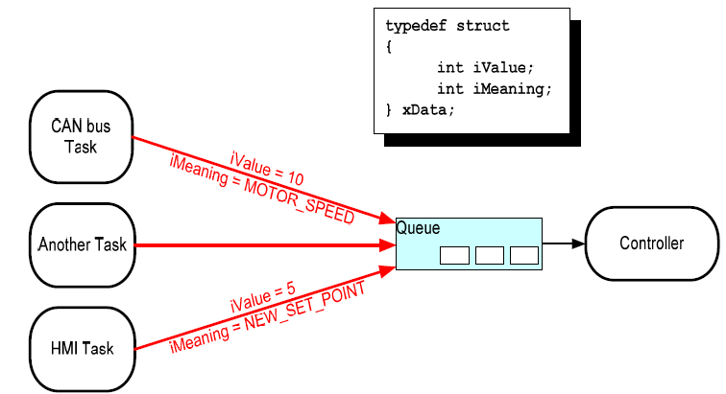
Example of Using Compound Data
Controller task:
performs system function by reacting to external inputs and changes of system state
CAN bus task:
Inputs motor speed value

Slide 26
Working with Large Data
When data items in the queue is large, inefficient to copy data into and out of the queue byte by byte
Preferable to use the queue to transfer points to the data
More efficient in processing time and RAM space
Queuing pointers requires extra cares
The multiple tasks sharing the RAM via the pointer must not modify its contents simultaneously
Only sending task can access the RAM until its pointer has been queued, and only receiving task can access the RAM after the pointer has been removed from the queue
The RAM being pointed to should remain valid, e.g., dynamically allocated or allocated on a task stack
Notes:
If the memory being pointed to was allocated dynamically, exactly one task be responsible for freeing the memory.
No task should attempt to access the memory after it has been freed.
A pointer should never be used to access data that has been allocated on a task stack. The data will not be valid after the stack frame has changed.

