Slide 1
CS4101 Introduction to Embedded Systems Course Overview
Prof. Chung-Ta King
Department of Computer Science
National Tsing Hua University, Taiwan

Slide 2
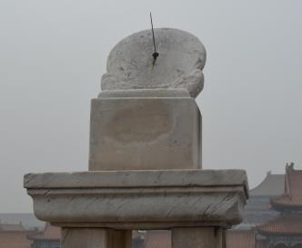
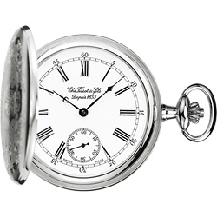
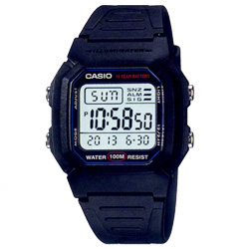
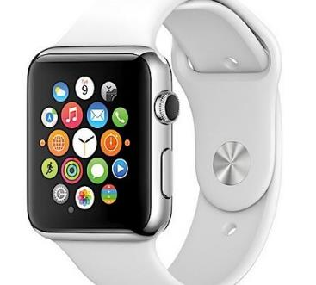
Consider the Evolution of Watches
Notes:
Implementation technology, accuracy in timing, more functionalities, mass manufacturing and low cost/affordable, changeable UI, update after market, is it a watch?
Which discipline specializes in each generation?

Slide 3
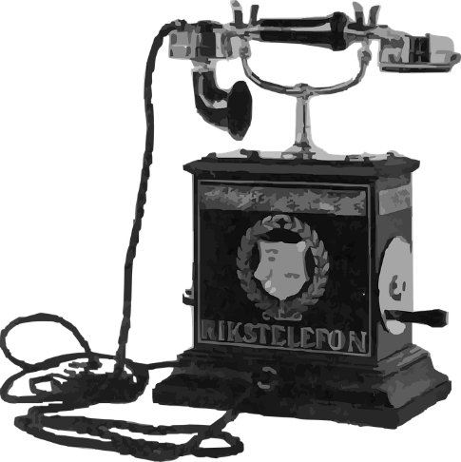
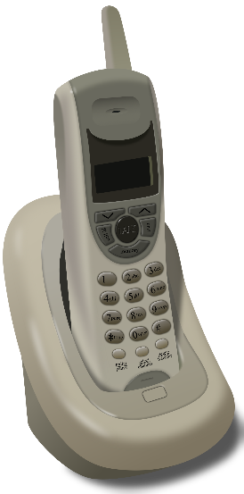
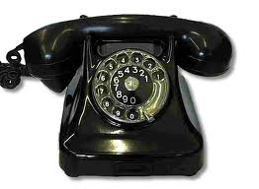
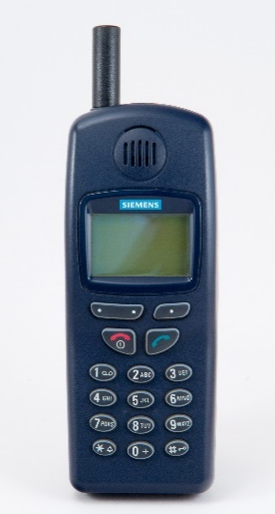
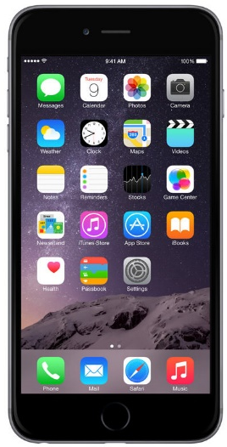
Telephones
Notes:
Fixed function, movable, a supplementary function

Slide 4
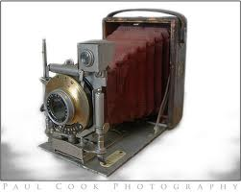
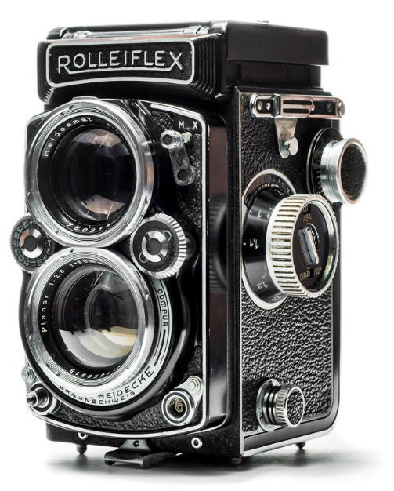
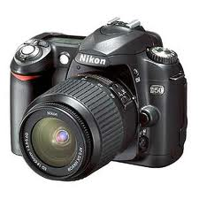
Cameras
Notes:
Pure manual, mechanical and manual, electronic operation and recording, can get GPS and wifi

Slide 5
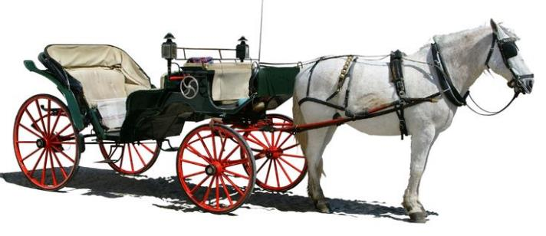
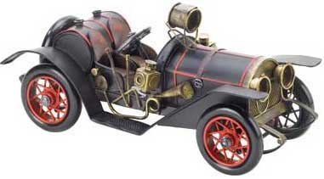
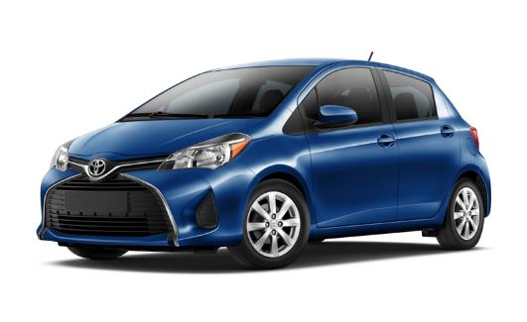
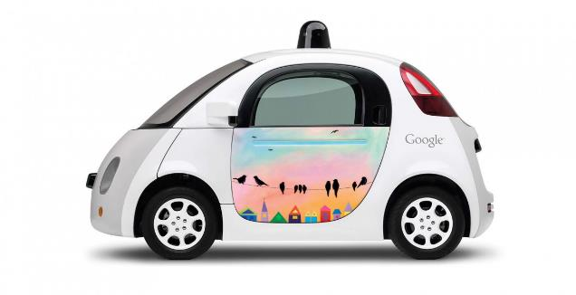
Cars
Notes:
Horse power, engine power, more electronic control and entertainment, electric powered, autonomous driving

Slide 6
What is the trend?
Notes:
Physical things are augmented with computing/communication capabilities, and become part of the cyber space
Virtual → real; real → virtual

Slide 7
Physical Things Augmented with Computing/Communication
OR
Computing/Communication “Embedded” into Physical Things
Notes:
Physical things are augmented with computing/communication capabilities, and become part of the cyber space
Virtual → real; real → virtual

Slide 8
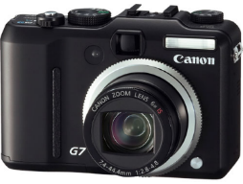
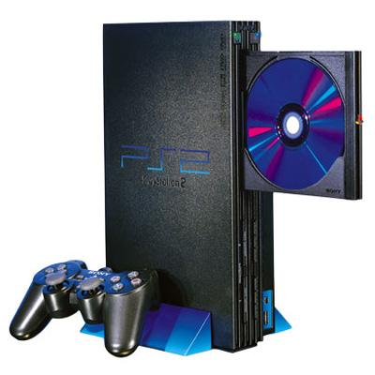
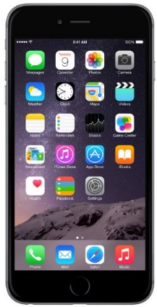
So, What Is Embedded System?
A computer, pretending not to be a computer
Computers disguised as a .
(Stephen A. Edwards)

Slide 9
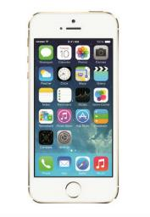

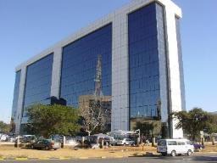
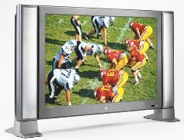
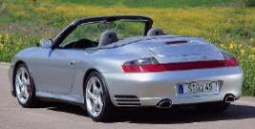
What Is Embedded System?
“An embedded system is an application that contains at least one programmable computer ... and which is used by individuals who are unaware that the system is computer-based.” -- Michael J. Pont, Embedded C
Programmable computers require programs → embedded software (嵌入式軟體)

Slide 10
What Is Embedded System?
Information processing systems embedded into a larger product [Peter Marwedel]
Main reason for buying is not information processing
Any device that includes a programmable processor but is not itself a general-purpose computer
➔Application-specific: take advantage of application characteristics to optimize the design:
Do not need all general-purpose bells and whistles

Slide 11
Same Basics Inside, However
I/O and control are most important
output
analog
CPU
input
analog
mem
embedded
computer

Slide 12
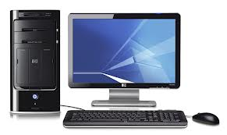
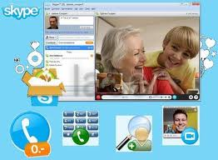
Why Embedded Systems?
After all, we can still make phone calls with
Why embed a computer into a phone? a watch? a camera? or anything?
or

Slide 13

Embedded vs Pure Hardware
Many electronic products are implemented in pure hardware (ASICs, boards)
Lack of flexibility (changing standards, system revisions, bug fixes, extra functionalities)
Costly for specialized application-specific integrated circuits (ASICs) (M$ range, technology-dependent)
Trend towards implementation in software running on embedded processors (or possibly FPGAs)
Use commodity microprocessors
Software-defined X
(Peter Marwedel)
Notes:
X = radio, networks, factories, cars, grids
Software-defined car: letting the car’s function be defined by software components that stitch together the environmental sensors, safety systems, mechanical linkages, and visual interfaces to build a vehicle where the function can be redefined after it has shipped.

Slide 14
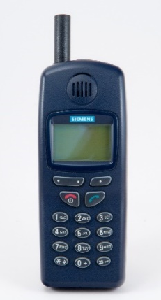

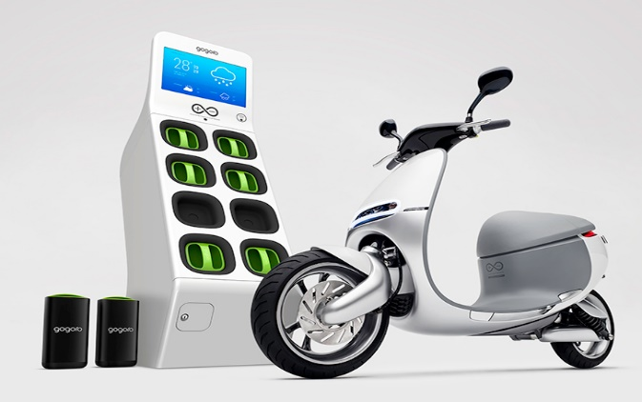
Embedded vs Pure Hardware
Hardware- vs software-oriented design thinking:
Is it a car or a computer with an appearance of a car?
Notes:
X = radio, networks, factories, cars, grids
Software-defined car: letting the car’s function be defined by software components that stitch together the environmental sensors, safety systems, mechanical linkages, and visual interfaces to build a vehicle where the function can be redefined after it has shipped.

Slide 15
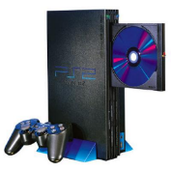
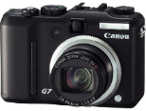
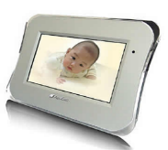
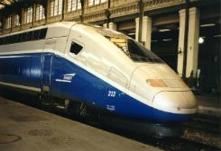
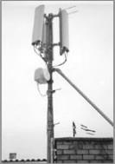

Some Concepts to Clarify
Embedded systems refer to not only small devices or gadgets
But also large, complex systems requiring strict reliability and real-time responses

Slide 16
Some Concepts to Clarify
A product, e.g., video decoder, may be implemented using pure hardware or microprocessor + embedded software
A chip may be implemented using pure logic gates or a microprocessor + peripheral logic + software (SoC)
An embedded system may or may not have OS
Simple systems may be implemented by a single program that runs continuously
Systems that need to control and respond to many activities may require an OS for resource management

Slide 17
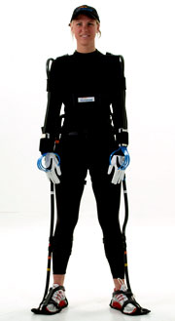
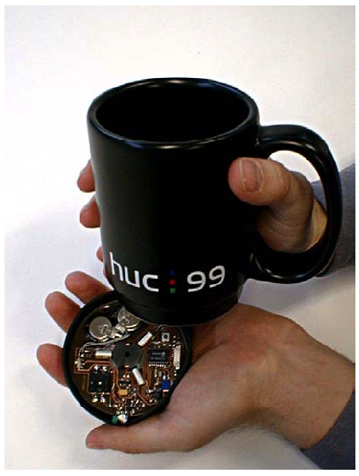
Embedded = Smart
Computers embedded into objects
Augment objects with programmatic control, communication, sensing, and actuation
Internet of things (IoT)
Let the world know you:
Make physical objects/phenomena accessible to digital world
Let you know the world:
Give intelligence/life to physical objects so that they can sense/react
Put a “robot” inside everything!

Slide 18
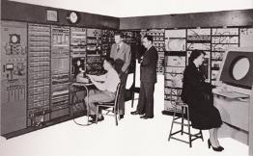
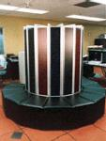
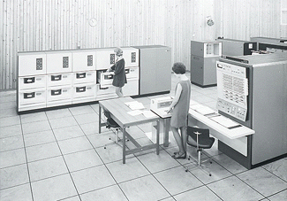
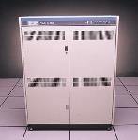
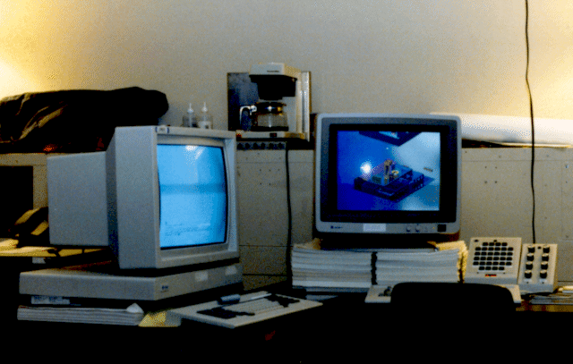


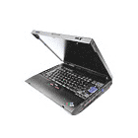


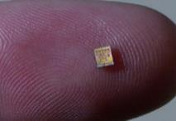
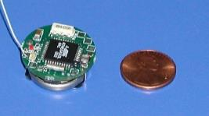
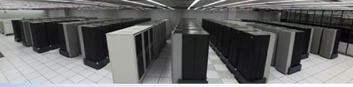
A New Paradigm of Computing
Number Crunching
Data Storage
Mainframe
log (people per computer)
Minicomputer
Productivity
Interactive
Workstation
PC
Streaming
information
to/from physical
world
Laptop
PDA
year
Notes:
So if we look at the computing spectrum today, each of the classes exist simultaneously. In a room we can put 100s of teraflops and many petabytes of computing.
Our productivity, document preparation, and personal information management fits in our pocket and a new class is emerging that will provide a means of streaming information to and from the physical world like we have never seen before.

Slide 19
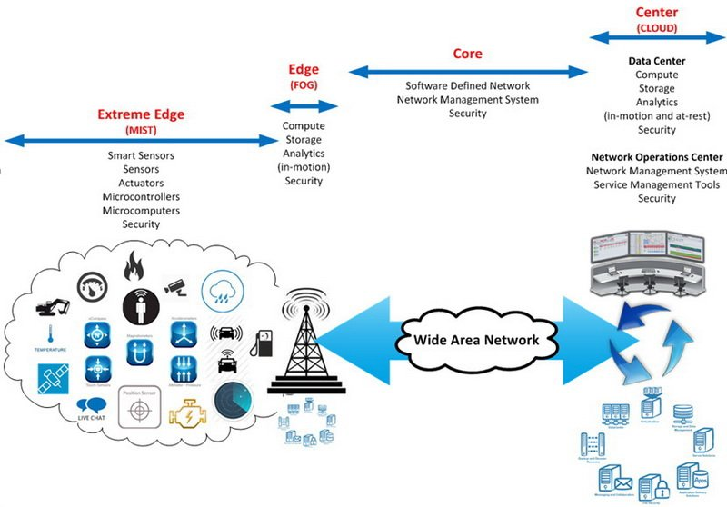
Computing System – a Bigger Picture
Device
Service
(https://www.linkedin.com/pulse/edge-computing-where-data-comes-alive-michael-j-)

Slide 20
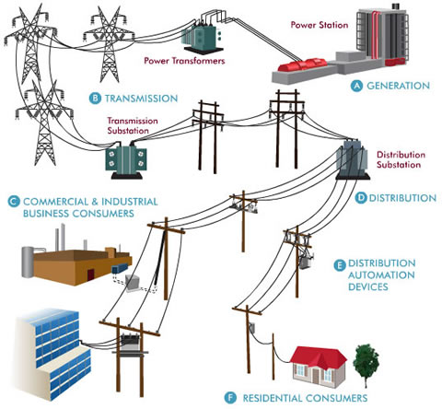
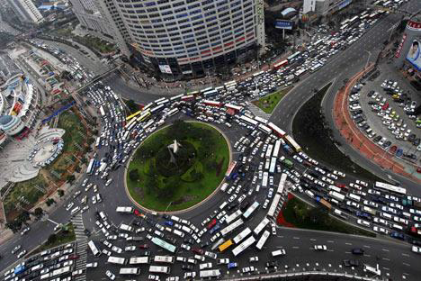
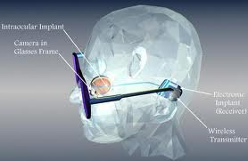
Future Embedded Systems
Smart Grid
Smart City
Retinal Implant
(Source: oncor.com, Prof. L.G. Chen)

Slide 21
Implications
Infinite opportunities, innovations, execution
Integration: must know application domain, packaging, A/D, sensor/actuator, power, …
System view:
Cloud
IoT
Big Data
AI

Slide 22
About This Course
Principles behind the design of the course:
Build the course around labs: Use labs to carry out the course contents. Labs are to develop a simple embedded system, from I/O device to system
Cover basic concepts in embedded system development: interrupt, clocking, I/O, real-time system, OS service, development tools
Term project development: innovation, development process, learning-by-doing

Slide 23
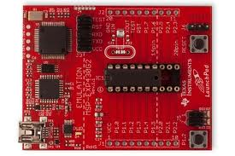
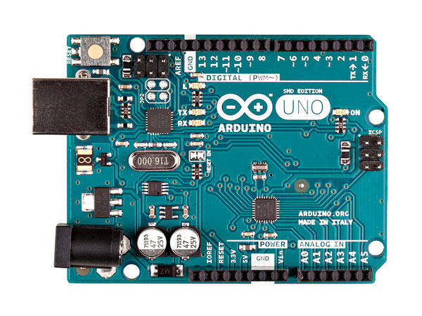
Lab Platforms
TI MSP430 LaunchPad
Arduino UNO

Slide 24
Labs
LaunchPad:
Registers/addressing mode/IO
Timer and clock
ADC (analog-to-digital conversion)
Power management
Serial communication interface, UART
Arduino UNO :
DAC (digital-to-analog conv.)
Sensors
FreeRTOS
Synchronization
Device drivers
In EECS 326, 328
Tuesday classes
Expect to complete labs in class

Slide 25
Lectures
Discuss general concepts related to the labs
May lack of a systematic discussion of embedded systems and a comprehensive coverage of all important concepts
Introduce usages specific to the lab boards
May be used in Tuesday classes
In Delta 103
Thursday classes

Slide 26
What Will and Will Not Learn?
Will learn:
Basic concepts of embedded systems
Hands-on development of a system and know what’s behind
Innovation development, presentation
Will not learn (but important):
Software engineering for embedded systems
System evaluation, optimization
Real-time system and scheduling
Reliability, security

Slide 27
Course Information
Instructor: Prof. Chung-Ta King (金仲達教授)
Office: Delta 640 Phone: x42804
email: king@cs.nthu.edu.tw
Teaching assistants:
詹禮維、湯景皓、粘鈞泰、陳令臻、廖敏君、姚瀚程、蘇維哲、黃瑞連
Office: CSEE 734 Phone: x33553
Class time and place:
Tuesday 10:10 - 12:00 (EECS 326, 328)
Thursday 10:10 - 11:00 (Delta 103)
Courseware: eLearn (https://elearn.nthu.edu.tw/)
http://www.cs.nthu.edu.tw/~king/courses/cs4101.html

Slide 28
Expected Workload
Labs:
Run on Tuesday in EECS 326, 328
Basic assignments to be completed in class plus advanced assignments for bonus
Term project:
Final demonstration and project report
Grade breakdown
Assignments and Labs 75%
Term project 25%

