Slide 1
CS4101 嵌入式系統概論 Interrupts
Prof. Chung-Ta King
Department of Computer Science
National Tsing Hua University, Taiwan
Materials from MSP430 Microcontroller Basics, John H. Davies, Newnes, 2008

Slide 2
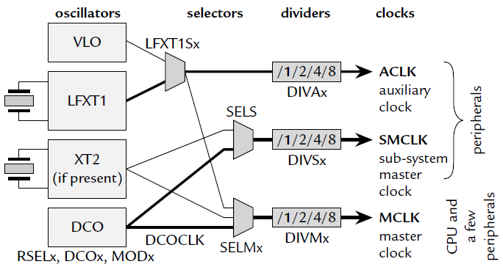
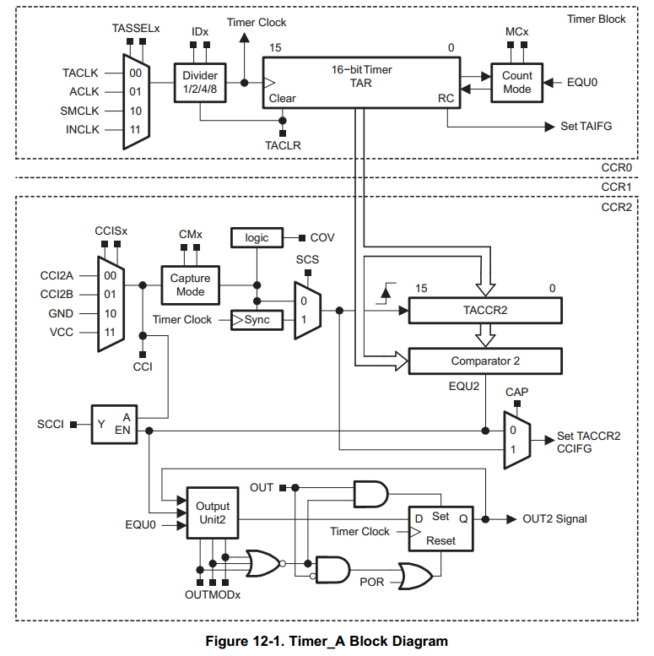
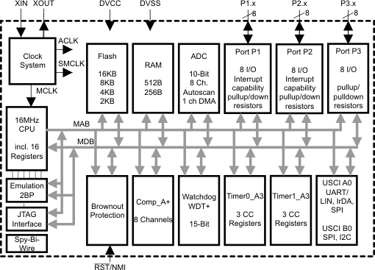
From Clock to Timer to CPU

Slide 3
How Does CPU Know Timer Is Up?
#define LED1 BIT0 void main(void) { WDTCTL = WDTPW|WDTHOLD; // Stop watchdog timer P1OUT = ~LED1; P1DIR = LED1; TA0CCR0 = 49999; TA0CTL = MC_1|ID_3|TASSEL_2|TACLR; //Setup Timer_A for (;;) { // Loop forever while(!(TA0CTL & TAIFG)) { } // Wait overflow TA0CTL &= ~TAIFG; // Clear overflow flag P1OUT ˆ= LED1; // Toggle LEDs } }
0x0001
Polling
Similar in detecting button down event
Notes:
Polling is like checking whether soup is boiling or whether someone is at the door.

Slide 4
Problem with Polling
CPU is in the loop forever
Waste power; cannot do other useful things
Question: How can it do other useful things, e.g. handling some events? or go into low-power modes?
Solution: Let CPU be notified when the timer is up!
Before that, CPU can do other useful things or go to sleep
Notification forces CPU to start handling events such as “timer up” or “button down”
The notification is an interrupt!
Notes:
3
3
Interrupt, because you stop whatever you are doing and turn to attend that event
3

Slide 5
Outline
Introduction to interrupt
Interrupts of MSP430
Handling interrupts of Timer0_A3 in MSP430
Handling interrupts of port P1 in MSP430

Slide 6
Interrupts
Cause a break to CPU in the continuity of executing a program/flow to run something else → normally expect to resume the program/flow later
Requirements for computers:
Must let CPU know when the event occurs
Must let CPU know where to jump to execute the handling code
Must not allow your program know it is “interrupted”!!
→ you program must execute as if nothing happens
→ must store and restore your “program state”
Notes:
Use examples such as someone at the door: (1) the door bell rings, (2) check who is at the door and react accordingly, (3) must resume whatever is interrupted. Resume, like computer screen remains where we left it or book at the right page.

Slide 7
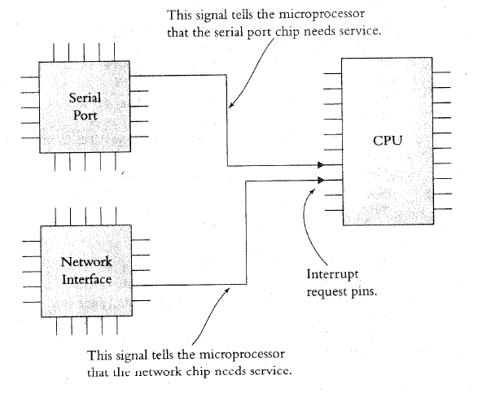
Interrupt: Processor’s Perspective
How does CPU know when there is an interrupt?
Usually when it receives a signal from one of the IRQ (interrupt request) pins

Slide 8
Interrupt: Processor’s Perspective
What does CPU do in handling an interrupt?
When receiving an interrupt signal, the processor (1) stops at the next instruction, (2) saves the address of the next instruction on the stack or a register, (3) jumps to a specific interrupt service routine (ISR), (4) afterwards, resumes from the interrupted instruction
ISR is basically a subroutine to perform operations to handle the interrupt with a RETURN at the end
How to be transparent to the running program?
CPU has to save the “state” of the program, e.g. contents of registers, onto the stack/registers and restoring them at the end of ISR

Slide 9
Interrupt Service Routine
The following shows an example of an ISR
Task Code ISR
...
MOVE R1, R7
MUL R1, 5 PUSH R1
ADD R1, R2 PUSH R2
DIV R1, 2 ...
JCOND ZERO, END ;ISR code uses R1, R2
SUBTRACT R1, R3 ...
... POP R2
... POP R1
END: MOVE R7, R1 RETURN
... ...
Save & restore (partial)
program state
PUSH PC
PC←ISR
POP PC, …

Slide 10
Disabling Interrupts
Programs may disable interrupts
In most cases the program can select which interrupts to disable during critical operations and which to keep enabled by writing corresponding values into special registers
Nonmaskable interrupts cannot be disabled and are used to indicate critical events, e.g. power failures
Certain processors assign priorities to interrupts, allowing programs to specify a threshold priority so that only interrupts having higher priorities than the threshold are enabled

Slide 11
Where to Put ISR Code?
Challenges:
Locations of ISRs should be fixed so that the processor can easily find them
But, different ISRs may have different lengths → hard to track their starting addresses
Worse yet, application programs may supply their own ISRs; thus ISR codes may change dynamically
Possible solutions:
Fix ISR starting addresses, e.g., in 8051, the first interrupt pin always causes 8051 to jump to address 0x0003
Those fixed memory locations store actual locations of ISRs → we thus have a table of addresses, interrupt vector table

Slide 12
How to Know Who Interrupts?
Simple answer: according to interrupt signal
One interrupt signal corresponds to one device and ISR
Difficult problem: not enough interrupt signals → same signal shared by several devices/events
Option 1: inside corresponding ISR, poll and check devices in turn → slow, devices are passive ➔ polled interrupt
Option 2: devices/events provide the address of ISRs → fast, devices are proactive ➔ vectored interrupt
CPU
IRQ
Data Bus
Ack
code
I/O Device

Slide 13
Some Common Questions
Can CPU be interrupted in middle of an instruction?
Usually not, except critical hardware failure, long-running instructions (e.g. moving data in memory), etc.
If two interrupts occur at the same time, which ISR does the process do first?
Prioritize the interrupt signals
Can an interrupt signal interrupt another ISR?
Interrupt nesting is usually allowed according to priority
What happens when an interrupt is signaled while the interrupt is disabled?
Processors usually remember the interrupt signals and jump to the ISR when the interrupt is enabled

Slide 14
Interrupt Latency
Interrupt latency is the amount of time taken to respond to an interrupt. It depends on:
Longest period during which the interrupt is disabled
Time to execute ISRs of higher priority interrupts
Time for processor to stop current execution, do the necessary ‘bookkeeping’ and start executing the ISR
Time taken for the ISR to save state/context and start executing instructions that service the interrupt
Very important to make ISRs short!
Factors 4 and 2 are controlled by writing efficient code that are not too long
Factor 3 depends on HW, not under software control

Slide 15
Outline
Introduction to interrupt
Interrupts of MSP430
Handling interrupts of Timer0_A3 in MSP430
Handling interrupts of port P1 in MSP430

Slide 16
Three Types of Interrupts in MSP430
System reset:
Power-up, external reset, Watchdog Timer, flash key violation, PC out-of-range, etc.
Always take
(Non)-maskable interrupt (NMI):
RST/NMI pin, oscillator fault, flash access violation
Cannot be masked; but still need bits to be set in special peripheral registers
Maskable interrupt
Enable the interrupt
Prepare the interrupt service routine (ISR) and link it to the interrupt

Slide 17
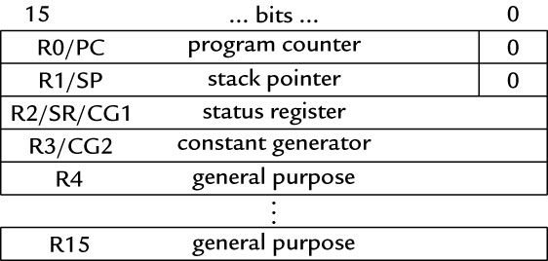
Enabling an Interrupt
On MSP430, an interrupt will be detected and serviced if
The global interrupt-enable (GIE) bit in Status Register (SR) in CPU is set
A peripheral device enables interrupt → For Timer0_A3: TAIE bit in TA0CTL register, CCIE bit in TA0CCTLx register
The peripheral signals an interrupt → For Timer0_A3: TAIFG, CCIFG

Slide 18
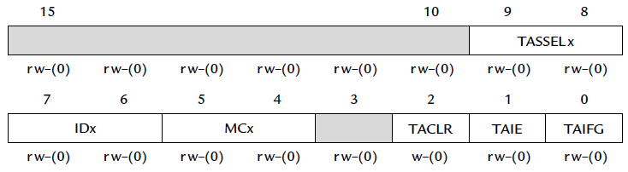
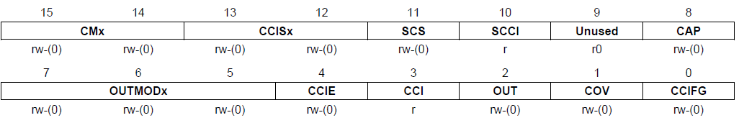
Ex: Timer0_A3 Interrupt Enabling
TA0CTL
TA0CCTLx

Slide 19
When an Interrupt Is Requested
Any currently executing instruction is completed. MCLK is started if the CPU was off.
The PC, which points to the next instruction, is pushed onto the stack or a register.
The SR is pushed onto the stack.
The interrupt with the highest priority is selected.
The interrupt request flag is cleared automatically for interrupts that have a single source.
The “starting address” of ISR is loaded into the PC and the CPU starts to execute the ISR at that address.
These operations take about 6 cycles
Save state
Vectored interrupt

Slide 20
After an Interrupt Is Serviced
An interrupt service routine must always finish with the return from interrupt instruction reti:
The SR pops from the stack. All previous settings of GIE and the mode control bits are now in effect. → restores the previous low-power mode if there was one.
The PC pops from the stack/register and execution resumes at the point where it was interrupted. Alternatively, the CPU stops and the device reverts to its low-power mode before the interrupt.
The original program runs as if there were no interrupt.

Slide 21
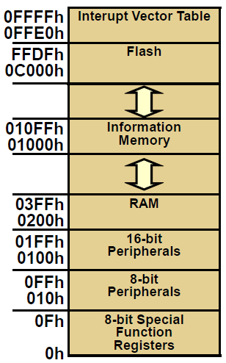
Where to Find ISRs?
MSP430 uses vectored interrupts
Each ISR has its own vector (starting address), which is stored at a predefined address in a vector table at the end of the memory space (addresses 0xFFE0 ~ 0xFFFF).
The vector table is at a fixed location, but the ISRs themselves can be located anywhere in memory.

Slide 22
Interrupt Source | Interrupt Flag | System Interrupt | Word Address | Priority
Power-up/external reset/Watchdog Timer+/flash key viol./PC out-of-range | PORIFG RSTIFG WDTIFG KEYV | Reset | 0FFFEh | 31 (highest)
NMI/Oscillator Fault/ Flash access viol. | NMIIFG/OFIFG/ ACCVIFG | Non-maskable | 0FFFCh | 30
Timer1_A3 | TA1CCR0 CCFIG | maskable | 0FFFAh | 29
Timer1_A3 | TA1CCR1/2 CCFIG, TAIFG | maskable | 0FFF8h | 28
Comparator_A+ | CAIFG | maskable | 0FFF6h | 27
Watchdog Timer+ | WDTIFG | maskable | 0FFF4h | 26
Timer0_A3 | TA0CCR0 CCIFG | maskable | 0FFF2h | 25
Timer0_A3 | TA0CCR1/2 CCIFG, TAIFG | maskable | 0FFF0h | 24
 |  |  | 0FFEEh | 23
 |  |  | 0FFECh | 22
ADC10 | ADC10IFG | maskable | 0FFEAh | 21
 |  |  | 0FFE8h | 20
I/O Port P2 (8) | P2IFG.0 to P2IFG.7 | maskable | 0FFE6h | 19
I/O Port P1 (8) | P1IFG.0 to P1IFG.7 | maskable | 0FFE4h | 18
 |  |  | 0FFE2h | 17
 |  |  | 0FFE0h | 16
Unused |  |  | 0FFDEh 0FFCDh | 15 - 0
Notes:
The MSP430 uses vectored interrupts, which means that the address of each ISR—its vector—is stored in a vector table at a deﬁned address in memory. In most cases each vector is associated with a unique interrupt but some sources share a vector. The ISR itself must locate the source of interrupts that share vectors. For example, TAIFG shares a vector with the capture/compare interrupts for all channels of Timer_A other than 0. Channel 0 has its own interrupt ﬂag TACCR0 CCIFG and separate vector. (MSP430g2553 Datasheet)
21

Slide 23
Outline
Introduction to interrupt
Interrupts of MSP430
Handling interrupts of Timer0_A3 in MSP430
Handling interrupts of port P1 in MSP430

Slide 24
Interrupts from Timer0_A3
Interrupts can be generated by the timer itself (flag TAIFG in TA0CTK) and each capture/compare block (flag CCIFG in TA0CCTLx)
TAIFG
CCIFG
TA0CTL
TA0CCTLx

Slide 25
Two Interrupt Vectors for Timer0_A3
For TA0CCR0 CCIFG (high priority):
CCIFG0 flag is cleared automatically when serviced
For all other CCIFG flags and TAIFG
In compare mode, any CCIFG flag is set if TA0R counts to the associated TA0CCRx value
Flags are not cleared automatically, because need to determine who made the interrupt request
Can use software (ISR) to poll the flags in each of the three control registers in Timer0_A3 → slow
Check only one hardware register in Timer0_A3: interrupt vector register (TA0IV)

Slide 26
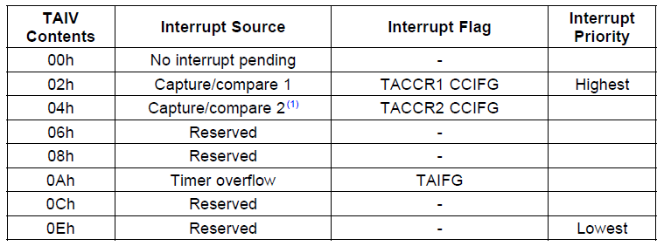
TA0IV
On an interrupt, TA0IV (at 0x012E) contains a number indicating highest priority enabled interrupt
Any access of TA0IV resets the highest pending interrupt flag. If another interrupt flag is set, another interrupt is immediately generated
Notes:
#pragma vector=TIMER0_A1_VECTOR
__interrupt void Timer_A(void) {
switch( TAIV ) {
case 2: break; // CCR1 not used
case 4: break; // CCR2 not used
case 10: P1OUT ^= 0x01; // overflow break;
}
}

Slide 27
Toggle LED on Interrupts from Timer0_A3
#include <msp430.h> // Specific device #include <intrinsics.h> // Intrinsic functions #define LED1 BIT0 void main(void) { WDTCTL = WDTPW|WDTHOLD; // Stop watchdog timer P1OUT = ˜LED1; P1DIR = LED1; TA0CCR0 = 49999; // Upper limit of count for TA0R TA0CCTL0 = CCIE; // Enable interrupts TA0CTL = MC_1|ID_3|TASSEL_2|TACLR; // Up mode, divide clock by 8, clock from SMCLK, clear __enable_interrupt(); // Enable interrupts (intrinsic) for (;;) { } // Loop forever doing nothing } // Interrupt service routine for CCR0 of Timer0_A3 #pragma vector = TIMER0_A0_VECTOR __interrupt void TA0_ISR (void){ P1OUT ˆ= LED1; // Toggle LED }
Interrupt

Slide 28
Sample Code Explained
#pragma line associates the function with a particular interrupt vector
TIMER0_A0_VECTOR for TA0CCR0 interrupt (check <msp430g2553.h> for definitions of interrupt vectors)
__interrupt keyword names the function
Compiler will generate code to store address of the function in the interrupt vector table and to use reti rather than ret at the end of the function
An intrinsic function, __enable_interrupt() sets the GIE bit and turn on interrupts
It is declared in intrinsics.h

Slide 29
A Note on Interrupts in Timer0_A3
The interrupt vector for TA0CCR1, TA0CCR2, and TA0R is TIMER0_A1_VECTOR.
Check <msp430g2553.h> for definitions of interrupt vectors
All three interrupts will cause the CPU to run the same ISR at TIMER0_A1_VECTOR.
Check TA0IV to detect which one causes the interrupt
Note: TA0IV will be reset automatically when read → better to read TA0IV into a local variable first before checking the bits
#pragma vector=TIMER0_A1_VECTOR __interrupt void Timer_A(void) { switch( TAIV ) { case 2: break; // CCR1 not used case 4: break; // CCR2 not used case 10: P1OUT ^= 0x01; break; } }

Slide 30
Outline
Introduction to interrupt
Interrupts of MSP430
Handling interrupts of Timer0_A3 in MSP430
Handling interrupts of port P1 in MSP430

Slide 31
Interrupts on Port 1
Ports P1 and P2 can request an interrupt when the value on an input pin changes
Registers of P1 for interrupt:
Port P1 interrupt enable, P1IE: enables interrupts when the value on an input pin changes, by setting appropriate bits of P1IE to 1; off (0) by default
Port P1 interrupt edge select, P1IES: can generate interrupts either on a positive edge (0), when the input goes from low to high, or on a negative edge (1)
Port P1 interrupt flag, P1IFG: a bit is set when the selected transition has been detected on the input, and an interrupt is requested if it has been enabled.

Slide 32
Interrupts on Port 1
A single interrupt vector for the whole port
An interrupt will be generated whenever one or more interrupt-enabled pins on the port detect the signal transitions
The ISR must check P1IFG to determine the bit that caused the interrupt
This bit must be cleared explicitly

Slide 33
Sample Code for P1
A hi/low transition on P1.4 triggers P1_ISR to toggles P1.0
void main(void) { WDTCTL = WDTPW + WDTHOLD; // Stop watchdog timer P1DIR = 0x01; // P1.0 output, else input P1OUT = 0x10; // P1.4 set, else reset P1REN |= 0x10; // P1.4 pullup P1IE |= 0x10; // P1.4 interrupt enabled P1IES |= 0x10; // P1.4 Hi/lo edge P1IFG &= ~0x10; // P1.4 IFG cleared _BIS_SR(GIE); // Enter interrupt while(1); // Loop forever } #pragma vector=PORT1_VECTOR __interrupt void Port_1(void) { P1OUT ^= 0x01; // P1.0 = toggle P1IFG &= ~0x10; // P1.4 IFG cleared }

Slide 34
Summary
Interrupts: a subroutine generated by the hardware at an unpredictable time
Issues to consider:
How to set up and know there is an interrupt?
How to know where is the interrupt service routine?
Must not interfere the original program
The shared-data problem
MSP430 interrupt
Handling interrupts of Timer0_A3 and Port 1 in MSP430

