Slide 1
CS4101 Introduction to Embedded Systems Synchronization
Prof. Chung-Ta King
Department of Computer Science
National Tsing Hua University, Taiwan
(Materials from Prof. Insup Lee, Prof. Frank Drews, MQX User Guide,
Using the FreeRTOS Real Time Kernel, Study of an Operating System: FreeRTOS)

Slide 2
Why Synchronization?
Synchronization may be used to solve:
Mutual exclusion
Control flow
Data flow
Synchronization mechanisms include:
Message queues
Semaphores
Mutexs
Locks
Correct synchronization mechanism depends on the synchronization issue being addressed

Slide 3
Mutual Exclusion
Problem: multiple tasks may “simultaneously” need to access the same resource
Resource may be code, data, peripheral, etc.
Need to allow the shared resource exclusively accessible to only one task at a time, e.g. for atomic operations
Normally by restricting code execution, e.g. critical section
All tasks are equal and play the same role
How to do?
Allowing only one task to lock the resource and the rest have to wait for the resource to be unlocked
Common mechanisms: lock/unlock, mutex, semaphore, disabling interrupts, FreeRTOS queue
Notes:
e.g. 更衣室

Slide 4
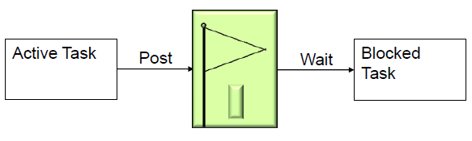
Control Flow Synchronization
Problem: a task or ISR may need to resume the execution of one or more other tasks, so that tasks execute in an application-controlled order
Mutual exclusion is used to prevent another task from running, while control flow is used to allow another task to run, often specific tasks
Tasks play different roles, e.g. caller/callees
How to do?
Common mechanisms: post/wait, signal, FreeRTOS queue, task suspend/resume
Notes:
e.g. night shift wakeup

Slide 5
Data Flow Synchronization
Problem: a task or ISR may need to pass some data to one or more other specific tasks, so that data may be processed in an application-controlled order
Tasks play different roles, e.g. producer/consumer
How to do?
Common mechanisms: FreeRTOS queue, signal, post/wait
Can data synch be done by control synch?
Can control synch be done by data synch?
Can data synch be done by mutual exclusion?
Can mutual exclusion be done by data synch?
Notes:
e.g. deliver ordered dishes

Slide 6
Outline
Introduction to task synchronization
Semaphores and mutexs of FreeRTOS
Mutex
Counting semaphores
Binary semaphores

Slide 7
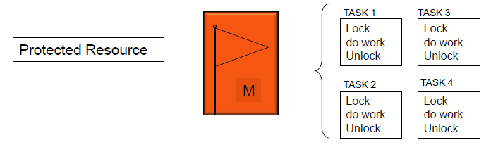
Mutex
Mutexes are used for mutual exclusion, so that only one task at a time uses a shared resource, e.g., file, data, device, ...
To access the shared resource, a task locks the mutex associated with the resource
The task owns the mutex until it unlocks the mutex

Slide 8
Mutex
Mutex acts like a binary semaphore using a single token to guard a resource
When a task wishes to access the resource, it must first obtain ('take') the token
When the task has finished with the resource, it must 'give' the token back - allowing other tasks the opportunity to access the same resource
Mutex may cause a high priority task to be waiting on a lower priority one
Even worse, a medium priority task might be running and cause the high priority task to miss its deadline!
Priority inversion problem

Slide 9
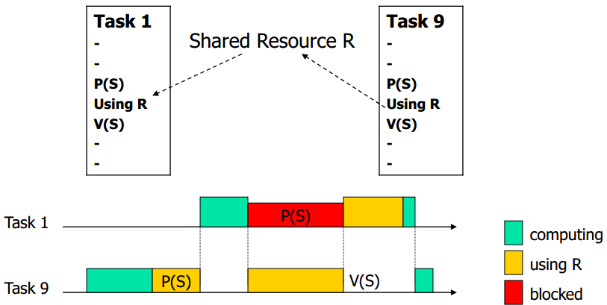
Priority Inversion: Case 1
Assume priority of T₁ > priority of T₉
If T₉ has exclusive access, T₁ has to wait until T₉ releases resource → inverting priority
T₁ has higher priority and preempts T₉
Critical section
(critical section)

Slide 10
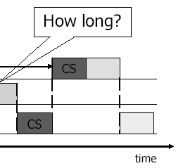
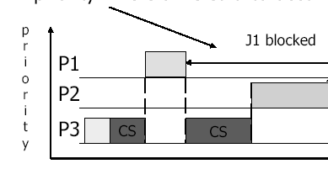
Priority Inversion: Case 2
A medium-priority task preempts a lower-priority task which is using a shared resource, but a higher priority task is blocked waiting for that resource
If the higher-priority task would be otherwise ready to run, but a medium-priority task is currently running instead, a priority inversion is occurred

Slide 11
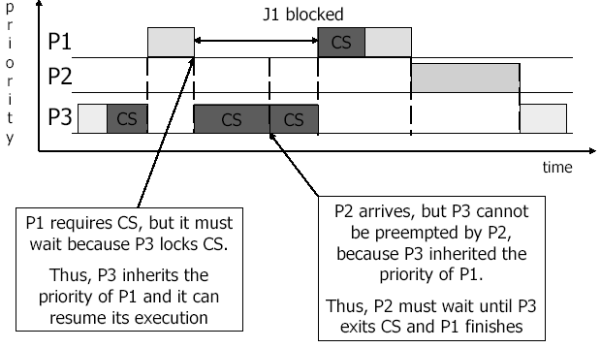
Solving Priority Inversion
Priority inheritance
If a high priority task blocks while attempting to obtain a mutex (token) that is currently held by a lower priority task, then the priority of the task holding the token is temporarily raised to that of the blocking task
FreeRTOS mutex implements priority inheritance

Slide 12
Create a Mutex
SemaphoreHandle_t xSemaphoreCreateMutex(void);
Creates a mutex and returns a handle, of type SemaphoreHandle_t, that the mutex can be referenced
Mutexes cannot be used in interrupt service routines
FreeRTOS Mutex implements priority inheritance
Priority of a task that ‘takes’ a mutex is temporarily raised if another task of higher priority attempts to obtain the mutex
The task that owns the mutex ‘inherits’ the priority of the task attempting to ‘take’ the same mutex
So, the mutex must always be ‘given’ back – otherwise the higher priority task will never be able to obtain the mutex, and the lower priority task will never ‘disinherit’ the priority
Notes:
A task only needs to take the binary semaphore without giving it back. So the binary semaphore may be in the ‘empty’ state for a long time.
On the other hand, a mutex must be given back as soon as possible, otherwise the higher priority task will never be able to obtain the mutex, and the lower priority task will never 'disinherit' the priority.

Slide 13
Take a Mutex
xSemaphoreTake(xSemaphoreHandle xSemaphore,
TickType_t xTicksToWait)
xSemaphore: handle to the mutex being taken
xTicksToWait: time in ticks to wait for the mutex to become available
A block time of zero can be used to poll the mutex
Cannot be called from an interrupt service routine
xSemaphoreTakeFromISR(
xSemaphoreHandle xSemaphore,
signed BaseType_t *pxHigherPriorityTaskWoken)
Can be called from an interrupt service routine

Slide 14
Give a Mutex
xSemaphoreGive(SemaphoreHandle_t xSemaphore)
xSemaphore: handle to the mutex being released
xSemaphoreGiveFromISR(
SemaphoreHandle_t xSemaphore,
signed BaseType_t *pxHigherPriorityTaskWoken)
pxHigherPriorityTaskWoken: set to pdTRUE if giving the mutex caused a higher priority task to unblock, causing a context switch before the interrupt is exited
Can be called from an interrupt service routine

Slide 15
Example of Mutex (1/3)
#include <semphr.h> SemaphoreHandle_t gatekeeper = 0; /* global handler */ void setup(){ Serial.begin(9600); gatekeeper = xSemaphoreCreateMutex(); /* create tasks with priority 1 for both users */ xTaskCreate(user_1, (const portCHAR*)"t1", 128, NULL, 1, NULL); xTaskCreate(user_2, (const portCHAR*)"t2", 128, NULL, 2, NULL); Serial.println("test"); vTaskStartScheduler(); } void loop(){ ... }
Notes:
14
14

Slide 16
Example of Mutex (2/3)
void user_1(void *p){ while(1){ if(xSemaphoreTake(gatekeeper, 100)){ Serial.println("User 1 got access"); /* critical section */ vTaskDelay(200); /* stay in C.S. for 200 ticks */ xSemaphoreGive(gatekeeper); /* release semaphore, exit critical section */ } else{ Serial.println(“User 1 cannot access in 1000 ms"); } vTaskDelay(100); // or do other works /* without delay, user 1 will get key immediately */ } }
Take & give back
Notes:
15
15

Slide 17
Example of Mutex (3/3)
void user_2(void *p){ while(1){ if(xSemaphoreTake(gatekeeper, 100)){ Serial.println("User 2 got access"); /* critical section */ xSemaphoreGive(gatekeeper); /* release semaphore, exit critical section */ } else{ /* fail to get the semaphore */ Serial.println("User 2 cannot access in 1000 ms"); } vTaskDelay(100); /* or do other works */ /* without delay, user 2 will get key immediately after releasing the key */ } }
Take & give back
Notes:
16
16

Slide 18

Semaphores
Semaphores are used to:
Control access to a shared resource (mutual exclusion)
Signal the occurrence of an event
Allow two tasks to synchronize their activities
Basic idea
A semaphore contains a number of tokens. The code needs to acquire one in order to continue execution
If all the tokens of the semaphore are used, the requesting task is suspended until some tokens are released by their current owners
vs lock/unlock, mutex

Slide 19
How Semaphores Work?
A semaphore has:
Counter: maximum number of concurrent accesses
Queue: for tasks that wait for access
If a task requests (waits for) a semaphore
If counter > 0, then (1) the counter is decremented by 1, and (2) task gets the semaphore and proceeds to do work
Else task is blocked and put in the queue
If a task releases (posts) a semaphore
If there are tasks in the semaphore queue, then an appropriate task is readied, according to queuing policy
Else counter is incremented by 1
Notes:
18
Mutex is special case where the count =1 so only one task can hold it at a time

Slide 20
Counting Semaphores
Typically used for two things:
Counting events:
An event handler will 'give' a semaphore each time an event occurs, and a handler task will 'take' a semaphore each time it processes an event
Resource management:
The count value indicates number of available resources
To get a resource, a task must obtain (take) a semaphore
When a task finishes with the resource, it 'gives' the semaphore back
SemaphoreHandle_t xSemaphoreCreateCounting( UBaseType_t uxMaxCount, UBaseType_t uxInitialCount)

Slide 21
Example of Counting Semaphore (1/2)
#include <semphr.h> xSemaphoreHandle count_sem; //Global Handler int main(void){ /* Parameter for uxMaxCount, uxInitialCount */ count_sem = xSemaphoreCreateCounting(2, 2); /* Create tasks with priority 1 for both users */ xTaskCreate(task1, (signed char*)) “t1", 1024, NULL, 1, NULL); xTaskCreate(task2, (signed char*)) “t2", 1024, NULL, 1, NULL); vTaskStartScheduler(); return 0; }

Slide 22
Example of Counting Semaphore (2/2)
void task1(void *p){ while(1){ if(xSemaphoreTake(count_sem, portMAX_DELAY)){ xSemaphoreGive(count_sem); } vTaskDelay(3000); } } void task2(void *p){ while(1){ if(xSemaphoreTake(count_sem), portMAX_DELAY){ xSemaphoreGive(count_sem); } vTaskDelay(3000); } }

Slide 23
Binary Semaphores
Semaphores with counter = 1, used for mutual exclusion (mutex) and synchronization
For synchronization purpose, a binary semaphore can be thought of as a queue that only holds one item
The queue can only be empty or full (hence binary)
Tasks using the queue don't care what the queue holds, only want to know if the queue is empty or full
If more than one task are blocked on the queue, then the task with the highest priority will be the task that is unblocked the next time the semaphore becomes available
Similar to mutexes, but mutexes handles priority inheritance and more suitable for mutual exclusion
Notes:
Mutexes include a priority inheritance mechanism, binary semaphores do not. This makes binary semaphores the better choice for implementing synchronization (between tasks or between tasks and an interrupt), and mutexes the better choice for implementing simple mutual exclusion.

Slide 24
Binary Semaphores and Interrupts
The best way to handle complex events triggered by interrupts is not to do the code in the ISR
Otherwise, you might not be able to handle other interrupts in time
Create a task to do the complex works associated with the event and make it to block on a binary semaphore
When the interrupt happens, the ISR just sets (gives) the semaphore and exits → control flow synchronization
Task can now be scheduled like any other to do the remaining works
No need to worry about nesting interrupts and interrupt priority
This is called Deferred Interrupt Processing

Slide 25
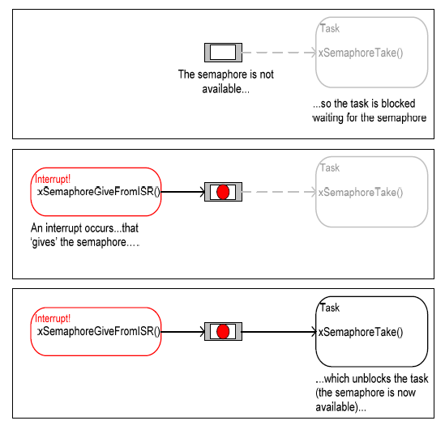
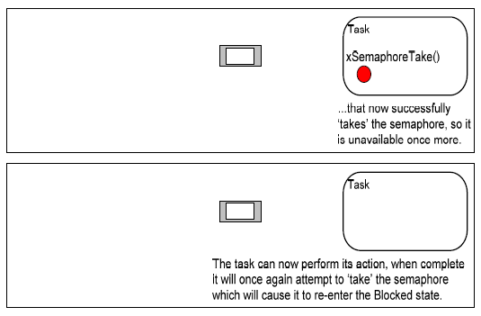
Binary Semaphores and Interrupts
Figure from Using the FreeRTOS Real Time Kernel (a pdf book), fair use claimed.

Slide 26
Create a Binary Semaphore
SemaphoreHandle_t xSemaphoreCreateBinary(void);
Function to create a binary semaphore
The semaphore is created in the 'empty' state
A binary semaphore need not be given back once obtained, and can be left in ‘empty’ for an indefinite time
Task control flow synchronization can be implemented by one task/interrupt continuously 'giving' the semaphore while another continuously 'takes' the semaphore
Binary semaphores are assigned to variables of type SemaphoreHandle_t and can be used in any API function that takes a parameter of this type
Notes:
A task only needs to take the binary semaphore without giving it back. So the binary semaphore may be in the ‘empty’ state for a long time.
On the other hand, a mutex must be given back as soon as possible, otherwise the higher priority task will never be able to obtain the mutex, and the lower priority task will never 'disinherit' the priority.

Slide 27
Example of Binary Semaphores
#include <semphr.h> vSemaphoreHandle binary_sem; //Global handler void one_sec_isr(void){ // an ISR xSemaphoreGiveFromISR(binary_sem, NULL); } void sem_task(void *p){ while(1) if(xSemaphoreTake(binary_sem,999999)) puts("Tick!"); } int main(void){ vSemaphoreCreateBinary(binary_sem); xTaskCreate(sem_task, (signed char*)) "t1", 2048, NULL, 1, NULL); vTaskStartScheduler(); return 0; }
Control flow
Notes:
26
26

