Slide 1
CS4101 嵌入式系統概論 Serial Communication
Prof. Chung-Ta King
Department of Computer Science
National Tsing Hua University, Taiwan
(Materials from MSP430 Microcontroller Basics, John H. Davies, Newnes, 2008)

Slide 2
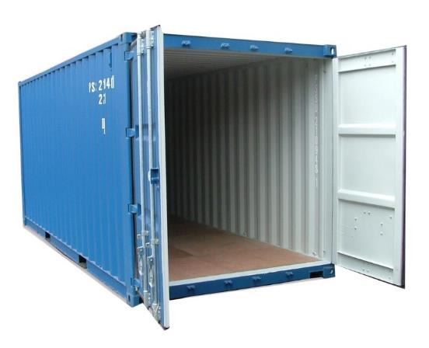

Recall the Container Thermometer
Container thermometer: monitor the temperature of the interior of a container
Monitor the temperature every minute
Flash LED alarm at 1 Hz
If the temperature rises above 45°C, flash the LED alarm at 3 Hz and send a message “Danger!” to the control server
If the temperature drops below 45°C, return the LED alarm to normal and send a message “Safe!” to the control server
…
Need to communicate with the server!

Slide 3
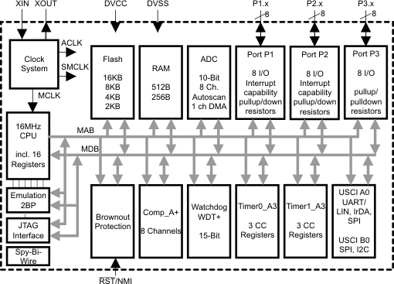
We Have Learned …
ADC
Clock System
IO
Comm
Timer System

Slide 4
Outline
Asynchronous serial communication
Asynchronous serial communication in MSP430 using software and Timer_A

Slide 5
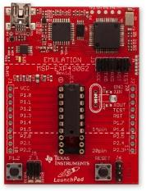
Communication Interfaces
Communication interfaces:
For exchanging information with external devices, e.g., USB, RS-232, Ethernet, IrDA, SPI, I2C, ...
Serial communication:
A single bit is transferred at a time
Synchronous: a clock signal is sent along with data; the device that generates the clock is called the master and other devices are slaves
Asynchronous: no clock transmitted, fewer wires
Parallel communication:
Multiple bits are transferred at a time

Slide 6
Asynchronous Serial Communication
Serial communication without carrying clock signal
Can be managed in hardware by a peripheral called a universal asynchronous receiver/transmitter (UART), which is built into many microcontrollers

Slide 7

Asynchronous Serial Communication
Serial communication without carrying clock signal
Can be managed in hardware by a peripheral called a universal asynchronous receiver/transmitter (UART), which is built into many microcontrollers
Even if UART is not available, it can be emulated easily with a timer using software
Features:
Usually require only a single wire for each transmission direction plus a common ground wire → 3 wires
Most general-purpose connections are full duplex, i.e. data can be sent simultaneously in both directions
Often connect two end devices (not a shared bus)

Slide 8
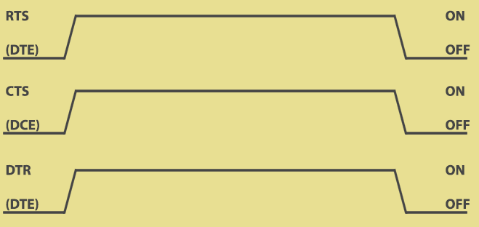
Asynchronous Serial Communication
How to synchronize the transmissions of the two ends which run on independent clocks?
Use handshaking signals, or
Transmit short data (e.g. one byte) at a time, assuming the two clocks run at same rate during that period of time → two ends must agree on a common data rate
DTE
DCE
https://www.codrey.com/embedded-systems/rs232-serial-communication/

Slide 9
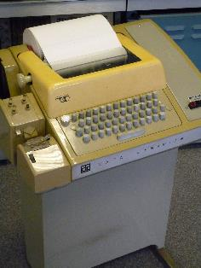
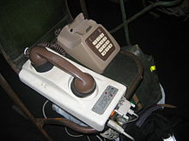
RS-232
A standard for asynchronous serial communication
Originally for connecting equipment such as teletype (data terminal equipment, DTE) to modem (data communication equipment, DCE)
Old version, RS-232-C, in 1969
Current version, ANSI/TIA/EIA-232-F, maintained by EIA
Main features:
Connection must be less than 50 feet
Voltage level: 1 (-3~-15V), 0 (+3~+15V)
Region between ±3 V does not correspond to valid data
MSP430’s voltage is less than 3V → use transceiver
Falling edge means 0 → 1

Slide 10
RS-232
Data are sent in short frames, each of which contains a single data byte and some control bits
Baud rate: # of signal changes per second, e.g., 9600 baud
In RS-232, each signal change represents one bit, so baud rate and data rate (bits per second) are equal
Example: the line idles high and each frame contains
one low start bit (ST)
eight data bits, LSB first
one high stop bit (SP)
8-N-1 format: 8-bit data, no parity bit, 1 stop bit

Slide 11
Serial Transmission Using UARTs
UART: Universal Asynchronous Receiver Transmitter
Takes parallel data and transmits serially
Receives serial data and converts to parallel
embedded device
1
0
1
0
1
0
1
1
1
0
0
1
1
0
1
1
1
0
0
1
1
0
1
1
Sending UART
Receiving UART
start bit
end bit
data

Slide 12
Outline
Asynchronous serial communication
Asynchronous serial communication in MSP430 using software and Timer_A
Example to use capture mode in Timer0_A3

Slide 13
Communication Peripherals in MSP430
Universal Serial Communication Interface (USCI):
Handle almost all aspects of the communication
Asynchronous channel, USCI_A: act as a universal asynchronous receiver/transmitter (UART) to support the usual RS-232 communication
Synchronous channel, USCI_B: handle both SPI and I²C as either master or slave
Included in MSP430G2553

Slide 14
Software UART Using Timer0_A3
Software UART on MSP430 using Timer0_A3 without relying on special UART hardware
In LaunchPad, data are received and transmitted through two GPIO pins, e.g. P1.1 (TXD) and P1.2 (RXD)
Use software to control Timer0_A3 to handle serial IO directly by sampling the input (capture) or setting up the next bit for output in an ISR
ADC
Clock System
IO
Comm
Timer System

Slide 15
How to Do?
General procedure for receive (RX)
Timer CCRx detects falling edge on RXD pin (e.g., P1.2), which indicates a start bit; start timer for 0.5 bit period
On timer interrupt, sample the serial input to see whether a valid start bit is received; if so, set timer for 1 bit period
On timer interrupt, sample the input to read the first bit (LSB); set timer for another bit period
Repeat this until all 8 bits have been received
Wait a further bit period and check that the input is high for the stop bit. A framing error occurs if this bit is low.
Capture
Transmission (TX) similar!

Slide 16
How to Leverage Timer0_A3?
For receive:
Use capture mode of a capture/compare block: When an event occurs on an input to CCRx block, register TA0CCRx will store the “time”, i.e., the value in TA0R, of that event
The input value will be latched in SCCI bit
RXD pin
(e.g., P1.2)

Slide 17
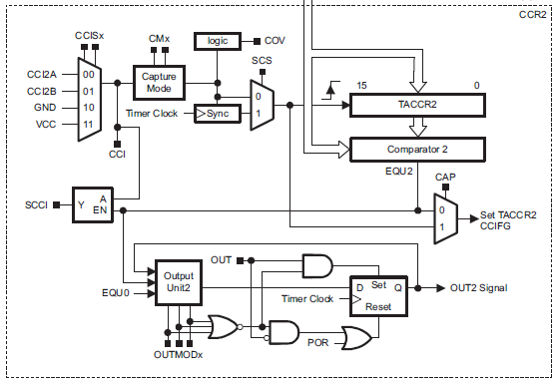
How to Leverage Timer0_A3?
For transmission:
Use output circuit of Timer0_A3
e.g. if OUTMODx=0, output of the block (OUTx) is controlled directly by OUT bit in TA0CCTLx, as if the pin is used for normal, digital output but operated via Timer0_A3
TXD pin
(e.g., P1.1)

Slide 18
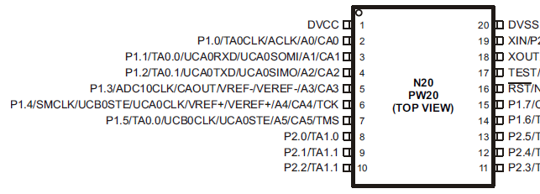
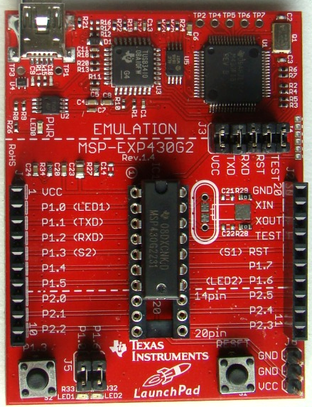
Pin Connections

Slide 19
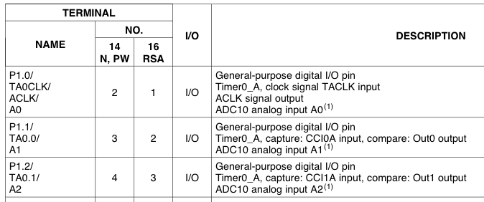
Pin Connections
Use TA0CCR0
TXD
Use TA0CCR1
RXD
#define TXD 0x02 // TXD on P1.1 (Timer0_A.OUT0) #define RXD 0x04 // RXD on P1.2 (Timer0_A.CCI1A) P1SEL |= TXD + RXD; // Enable TXD/RXD pins P1DIR = 0xFF & ~RXD; // Set pins to output P1OUT = 0x00; // Initialize all GPIO

Slide 20
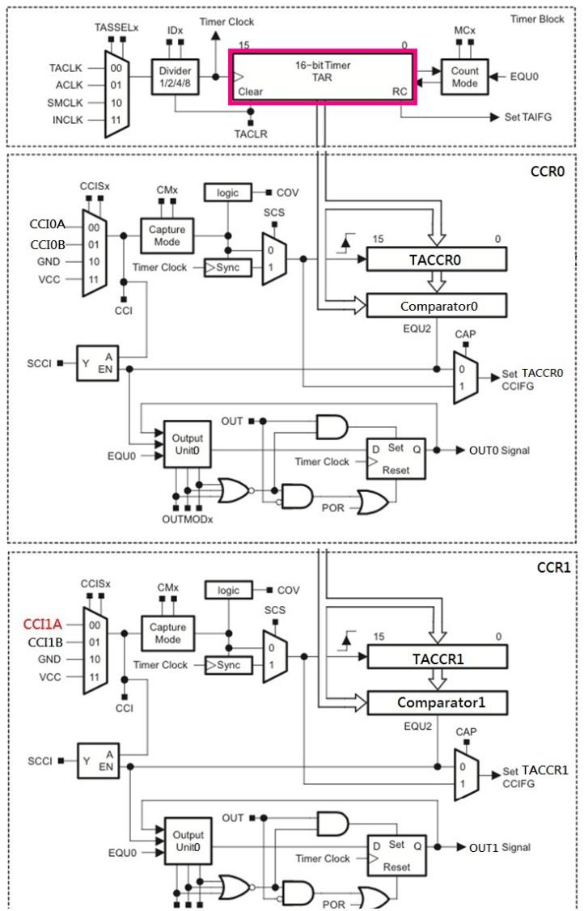
For
Transmission
TXD pin
For
Receive
Latch allows sampling at precise time, regardless of ISR latency
RXD pin

Slide 21
For LaunchPad
LaunchPad thinks that it has physical RS232 links with PC, while PC also thinks it has physical COM port (RS232) to LaunchPad

Slide 22
Receive Procedure by Timer0_A3
Between transmissions, CCR1 waits in Capture mode for a falling edge on its input.
When a falling edge is detected, TA0CCR1 captures the count in TA0R and raises an interrupt. CCR1 is switched to Compare mode and TA0CCR1 is set to fire an interrupt after 1.5 of the bit period from now.
At next interrupt, ISR saves the value of LSB latched in SCCI. Set for next compare event after one bit period.
The above procedure is repeated until all 8 bits of data have been received.

Slide 23
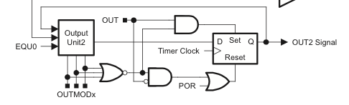
Transmission of Software UART
Use Capture/Compare Block 0 (TA0CCR0)
OUTMOD_0: OUT0 signal is defined by OUT bit
OUTMOD_2: OUT0 signal is reset when the timer counts to TA0CCR0
→ Use OUTMOD_0 to send a 1, OUTMOD_2 for 0
OUT0
Notes:
The OUTMODx determines how the signal changes when a CCR0 event happens.

Slide 24
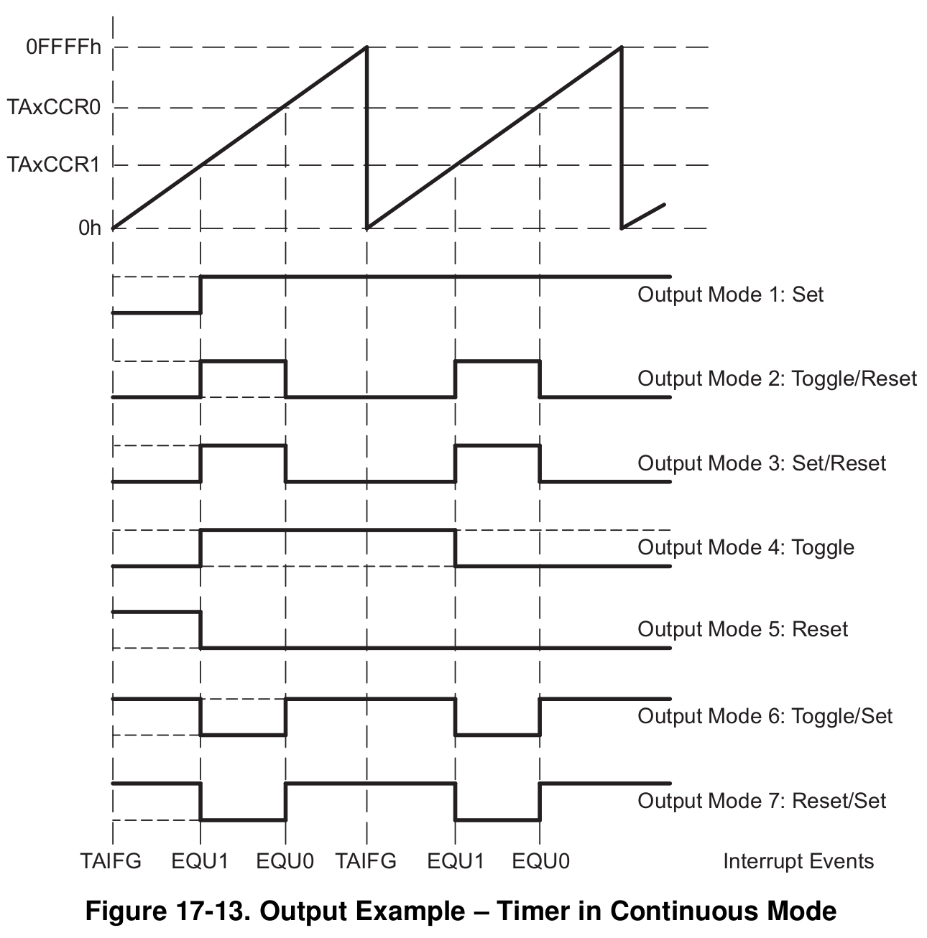
Example of OUT1 signal when the timer (TA0R) reaches TA0CCR1 and TA0CCR0 values, depending on the output mode, where the timer is in the continuous mode
Notes:
Timer in continuous mode to generate independent time intervals

Slide 25
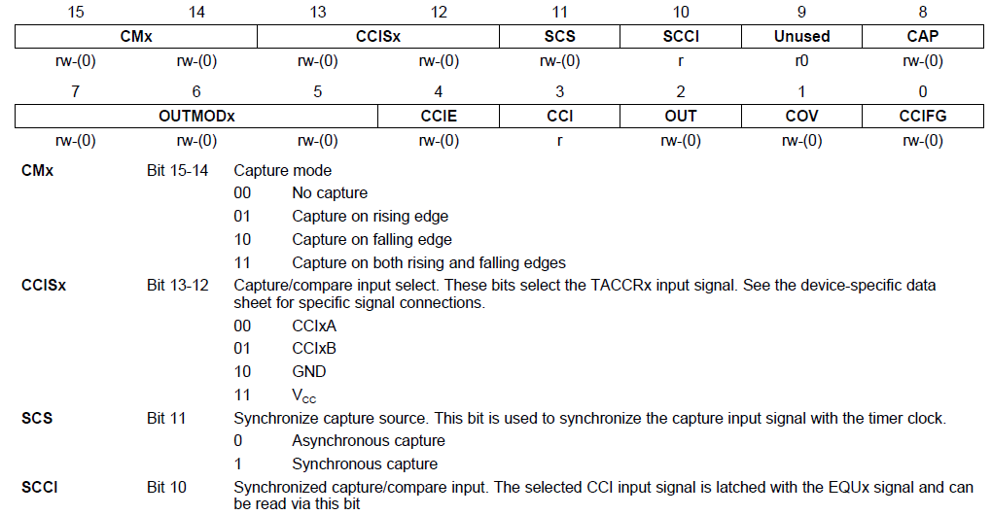
TA0CCTLx

Slide 26
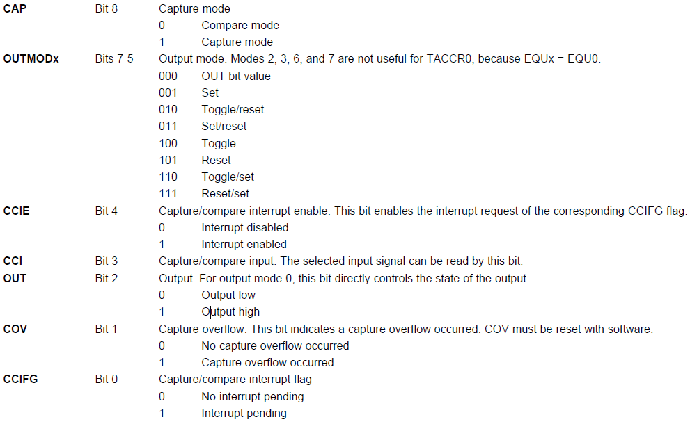
TA0CCTLx (cont’d)

Slide 27
Sample Code for Software UART
echo: send back the characters received
Use Timer0_A3, 9600 baud, full duplex, SMCLK at 1MHz
TA0CCR0 (TXD) and TA0CCR1 (RXD) may interrupt at any time and in an interleaved way
TA0R keeps an independent time reference, while CCR0 and CCR1 handle time intervals in TXD and RXD
hello
main()
wake up
capture
compare
TimerA_UART_print()
Timer_A1_ISR()
h
e
TimerA_UART_tx()
start Timer0
Timer_A0_ISR()
CCIE
0
1

Slide 28
Sample Code
#include “msp430.h” #define UART_TXD 0x02 // TXD on P1.1 (Timer0_A.OUT0) #define UART_RXD 0x04 // RXD on P1.2 (Timer0_A.CCI1A) #define UART_TBIT_DIV_2 (1000000 / (9600 * 2)) #define UART_TBIT (1000000 / 9600) unsigned int txData; // UART internal TX variable unsigned char rxBuffer; // Received UART character void TimerA_UART_init(void); void TimerA_UART_tx(unsigned char byte); void TimerA_UART_print(char *string);

Slide 29
Sample Code
void main(void) { WDTCTL = WDTPW + WDTHOLD; // Stop watchdog timer DCOCTL = 0x00; // Set DCOCLK to 1MHz BCSCTL1 = CALBC1_1MHZ; DCOCTL = CALDCO_1MHZ; P1OUT = 0x00; // Initialize all GPIO P1SEL = UART_TXD + UART_RXD; // Use TXD/RXD pins P1DIR = 0xFF & ~UART_RXD; // Set pins to output __enable_interrupt();

Slide 30
Sample Code
TimerA_UART_init(); // Start Timer_A UART TimerA_UART_print("G2xx3 TimerA UART\r\n"); TimerA_UART_print("READY.\r\n"); for (;;) { // Wait for incoming character __bis_SR_register(LPM0_bits); // Echo received character TimerA_UART_tx(rxBuffer); } } void TimerA_UART_print(char *string) { while (*string) TimerA_UART_tx(*string++); }
Waken up by Timer_A1_ISR
Notes:
TimerA_UART_tx() sends one byte at a time
TimerA_UART_print(char *string) sends the whole string

Slide 31
Sample Code
void TimerA_UART_init(void) { TA0CCTL0 = OUT; // Set TXD idle as '1' TA0CCTL1 = SCS + CM1 + CAP + CCIE; // CCIS1 = 0 // Set RXD: sync, neg edge, capture, interrupt TA0CTL = TASSEL_2 + MC_2; // SMCLK, continuous mode } void TimerA_UART_tx(unsigned char byte) { while (TA0CCTL0 & CCIE); // Ensure last char TX'd TA0CCR0 = TA0R; // Current count of TA counter TA0CCR0 += UART_TBIT; // One bit time till 1st bit TA0CCTL0 = OUTMOD0 + CCIE; // Set TXD on EQU0, Int txData = byte; // Load char to be TXD txData |= 0x100; // Add stop bit to TXData txData <<= 1; // Add start bit }
Notes:
TA0CCTL0 = OUT → set OUT bit always to 1 (gives TXD an idle state and all later bits with a 1)
TACCTL1 = SCS + CM1 + CAP + CCIE;
// Sync, capture on rising edge (1 → 0), Capture mode, CCIS1 = 0 (default) → CCI1A, interrupt
SCS: Synchronize capture source. This bit is used to synchronize the capture input signal with the timer clock.
0 → Asynchronous capture; 1 → Synchronous capture
CMx: Capture mode
00 → No capture; 01 → Capture on rising edge; 10 → Capture on falling edge; 11 → Capture on both rising and falling edges
CCISx: Capture/compare input select. These bits select the TACCRx input signal.
00 → CCIxA; 01 → CCIxB; 10 → GND; 11 → VCC
Transmission starts from LSB
What happens if TA0CCR0 overflow? Synch with TA0R’s overflow!

Slide 32
Sample Code
#pragma vector = TIMER0_A0_VECTOR // TXD interrupt __interrupt void Timer_A0_ISR(void) { static unsigned char txBitCnt = 10; TA0CCR0 += UART_TBIT; // Set TA0CCR0 for next intrp if (txBitCnt == 0) { // All bits TXed? TA0CCTL0 &= ~CCIE; // Yes, disable intrpt txBitCnt = 10; // Re-load bit counter } else { if (txData & 0x01) {// Check next bit to TX TA0CCTL0 &= ~OUTMOD2; // TX '1’ by OUTMODE0/OUT } else { TA0CCTL0 |= OUTMOD2;} // TX '0‘ txData >>= 1; txBitCnt--; } }

Slide 33
For
Transmission
TXD pin
For
Receive
Latch allows sampling at precise time, regardless of ISR latency
RXD pin

Slide 34
Sample Code
#pragma vector = TIMER0_A1_VECTOR // RXD interrupt __interrupt void Timer_A1_ISR(void) { static unsigned char rxBitCnt = 8; static unsigned char rxData = 0; switch (__even_in_range(TA0IV, TA0IV_TAIFG)) { case TA0IV_TACCR1: // TACCR1 - UART RXD TA0CCR1 += UART_TBIT;// Set TACCR1 for next int if (TA0CCTL1 & CAP) { // On start bit edge TA0CCTL1 &= ~CAP; // Switch to compare mode TA0CCR1 += UART_TBIT_DIV_2;// To middle of D0 } else { // Get next data bit rxData >>= 1;
Notes:
Entered here when RXD gets a rising edge (1 → 0) from idle to start bit
Timer_A interrupt vector register (TAIV): on an interrupt, TAIV contains a number indicating highest priority enabled interrupt for Timer_A0
TA0IV = 02h for TACCR1; = 04h for TACCR2; = 0ah for TAIFG
The __even_in_range(x,n) intrinsic tells the compiler that the expected argument is 1) always an even number and 2) in the range of x..n. It allows the compiler to use a way more efficient method to branch to the different cases.
Instead of chained comparisons, the compiler just adds the argument to the program counter. And follows this instruction with a table of jump instructions (which take 2 bytes each). As a result of this add, the program counter directly lands on the jump instruction that jumps to the case code. This intrinsic works best in conjunction with the IV registers, as these registers always return an even value in a known range. And, the highest priority interrupt has the largest value in the IV registers, so it is executed fastest.

Slide 35
Sample Code
if (TA0CCTL1 & SCCI) { // Get bit from latch rxData |= 0x80; } rxBitCnt--; if (rxBitCnt == 0) { // All bits RXed? rxBuffer = rxData; // Store in global rxBitCnt = 8; // Re-load bit counter TA0CCTL1 |= CAP; // Switch to capture __bic_SR_register_on_exit(LPM0_bits); // Clear LPM0 bits SR } } break; } }
Wake up
main loop

Slide 36
Interrupt Source | Interrupt Flag | System Interrupt | Word Address | Priority
Power-up/external reset/Watchdog Timer+/flash key viol./PC out-of-range | PORIFG RSTIFG WDTIFG KEYV | Reset | 0FFFEh | 31 (highest)
NMI/Oscillator Fault/ Flash access viol. | NMIIFG/OFIFG/ ACCVIFG | Non-maskable | 0FFFCh | 30
Timer1_A3 | TA1CCR0 CCFIG | maskable | 0FFFAh | 29
Timer1_A3 | TA1CCR1/2 CCFIG, TAIFG | maskable | 0FFF8h | 28
Comparator_A+ | CAIFG | maskable | 0FFF6h | 27
Watchdog Timer+ | WDTIFG | maskable | 0FFF4h | 26
Timer0_A3 | TA0CCR0 CCIFG | maskable | 0FFF2h | 25
Timer0_A3 | TA0CCR1/2 CCIFG, TAIFG | maskable | 0FFF0h | 24
 |  |  | 0FFEEh | 23
 |  |  | 0FFECh | 22
ADC10 | ADC10IFG | maskable | 0FFEAh | 21
 |  |  | 0FFE8h | 20
I/O Port P2 (8) | P2IFG.0 to P2IFG.7 | maskable | 0FFE6h | 19
I/O Port P1 (8) | P1IFG.0 to P1IFG.7 | maskable | 0FFE4h | 18
 |  |  | 0FFE2h | 17
 |  |  | 0FFE0h | 16
Unused |  |  | 0FFDEh 0FFCDh | 15 - 0
Three sources of interrupts cause the same interrupt vector. Which one(s) cause the interrupt? → check TA0IV register
Notes:
The MSP430 uses vectored interrupts, which means that the address of each ISR—its vector—is stored in a vector table at a deﬁned address in memory. In most cases each vector is associated with a unique interrupt but some sources share a vector. The ISR itself must locate the source of interrupts that share vectors. For example, TAIFG shares a vector with the capture/compare interrupts for all channels of Timer_A other than 0. Channel 0 has its own interrupt ﬂag TACCR0 CCIFG and separate vector.
35

Slide 37
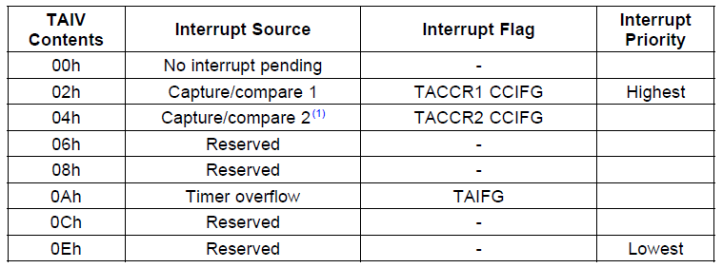
TA0IV (Timer0_A3 Interrupt Vector)
On an interrupt, TA0IV contains a number indicating the highest priority enabled interrupt: TA0CCR1_CCIFG, TA0CCR2_CCIFG, TA0IFG
Any access of TA0IV resets the highest pending interrupt flag. If another interrupt flag is set, another interrupt is immediately generated

Slide 38
Summary
Asynchronous serial communication
RS232
UART
Asynchronous serial communication in MSP430 using software and Timer0_A3
Software implementation of RS232 using Timer0_A3
An example to show capture mode of Timer0_A3

