Slide 1
CS4101 Introduction to Embedded Systems On-Board Communication
Prof. Chung-Ta King
Department of Computer Science
National Tsing Hua University, Taiwan

Slide 2
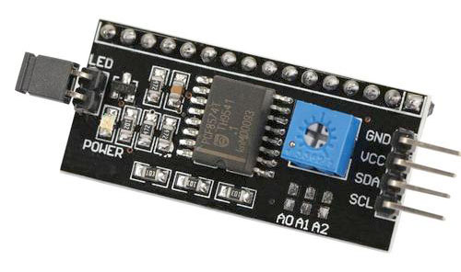
Recall the LCD 1602 16×2 Module
What is I2C?
GND (ground)
VCC (power supply 5V)
SDA (I2C data line)
SCL (I2C clock)
#include <Wire.h>
#include <LiquidCrystal_I2C.h>
LiquidCrystal_I2C lcd(0x27,16,2);
void setup() {
lcd.init(); // initialize LCD
lcd.backlight(); // open LCD backlight
lcd.setCursor(0, 0); // setting cursor
lcd.print("Hello, world!");
...

Slide 3
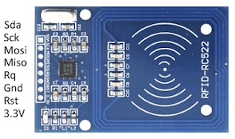
Regarding RFID-RC522
What is SPI?
#include <SPI.h>
#include <MFRC522.h>
#define RST_PIN A1 // reset pin
#define SS_PIN 10 // select pin for the chip
MFRC522 mfrc522(SS_PIN, RST_PIN); // create MFRC522
void setup() {
SPI.begin();
mfrc522.PCD_Init(); // init MFRC522
...

Slide 4
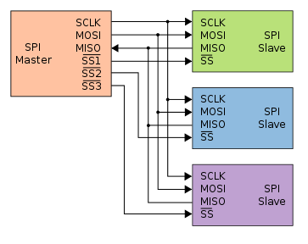
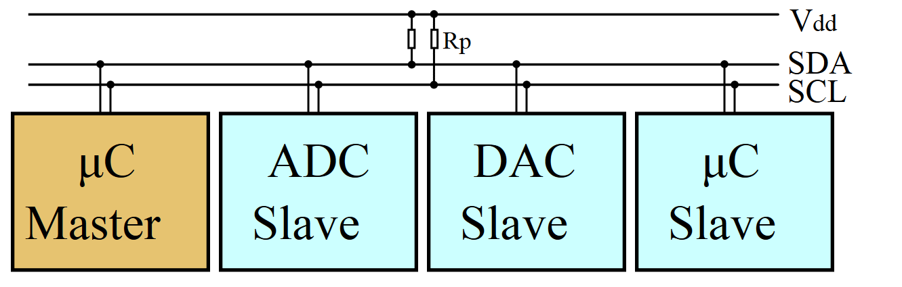
I2C and SPI
Both are synchronous serial communication interface
I2C (I²C, IIC): Inter-Integrated Circuit
Multi-master, multi-slave, packet switched, serial bus
Devices have an address (0x00 to 0x7F)
SPI: Serial Peripheral Interface
Devices communicate in full duplex using a master-slave architecture with a single master
Slave devices selected with individual slave select (SS) lines
I2C
SPI

Slide 5
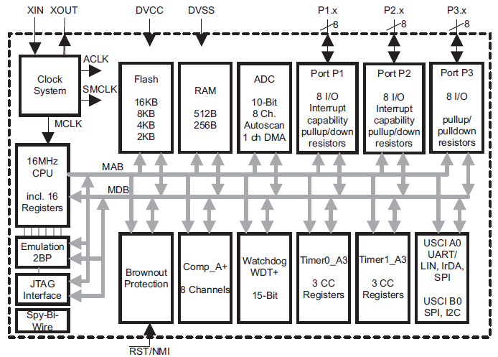
MSP430 Has I2C and SPI

Slide 6
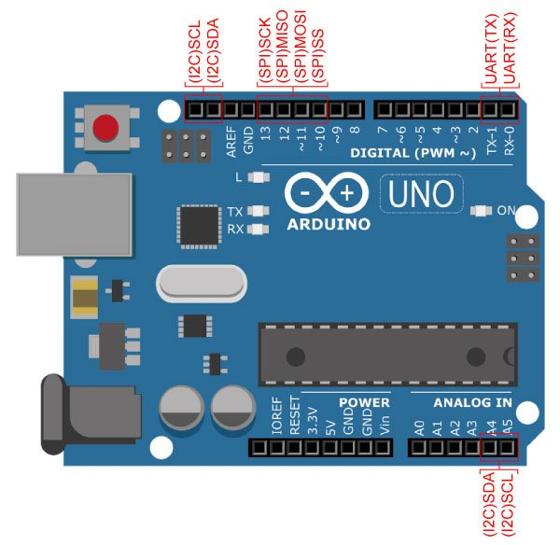
Arduino Also Has I2C and SPI
How do they differ?
I2C, SPI, and UART

Slide 7
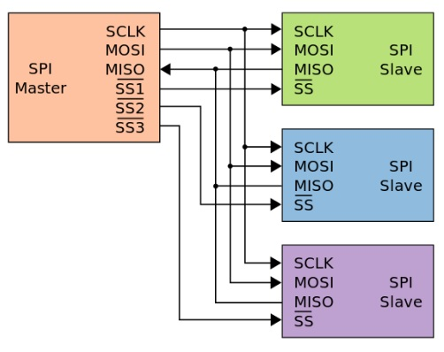
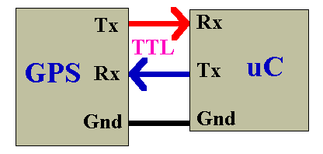
UART vs SPI vs I2C
UART | SPI | I2C
Universal Asynchronous Receiver/Transmitter | Serial Peripheral Interface | Inter-Integrated Circuit
Distance up to 50 feet | On board | On board
Asynchronous | Synchronous | Synchronous
One-to-one, no address | One master/n slaves | Multiple masters & slaves
3 wires | n + 3 wires | 3 wire bus
Full duplex | Full duplex | Half duplex

Slide 8
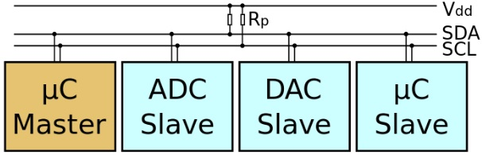
I2C
A two-wire, bi-directional synchronous serial bus supporting multiple masters and slaves with collision detection and arbitration
2 signal lines: SCL (serial clock), SDA (serial data)
Every device on I2C bus has a unique address (7 or 10 bits) and can act as a receiver or a transmitter
Data transfer rate: 100K bits/s (standard mode), 400K bits/s (fast mode), 3.4M bits/s (high speed mode)

Slide 9
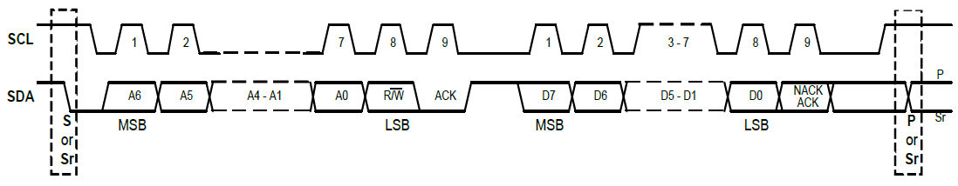
I2C Protocol
Four parts in a standard communication:
START or Repeated START signal generation
Slave address transfer
Data transfer
STOP signal generation
Clock is controlled by the master
Notes:
When the bus is free/idle, meaning no master device is engaging the bus (both SCL and SDA lines are high), a master can initiate a transfer by sending a START signal. A START signal, usually referred as the S-bit, is defined as a HIGH to LOW transition on the SDA line while SCL is HIGH. The START signal denotes the beginning of a new data transfer.

Slide 10
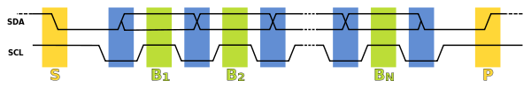
Bit Sampling
Each bit is sampled during the high period of SCL
SDA may be changed only during low period of SCL and must be held stable during the high period of SCL
SDA transitioning while SCL is low (blue), and data being read while SCL is high (green)
A transition on the SDA line while SCL is high is interpreted as a command (START or STOP)

Slide 11
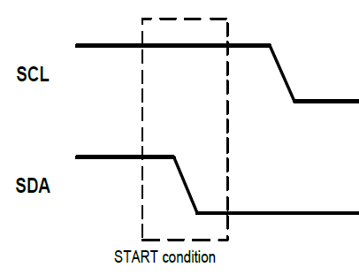
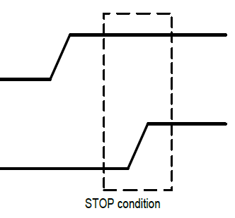
I²C Protocol: Start and Stop
Bus is free/idle when both SCL and SDA are high
A master initiates a transfer by sending START signal
A HIGH to LOW transition on SDA while SCL is HIGH
A STOP signal to terminate the communication
A LOW to HIGH transition on SDA while SCL is HIGH
Notes:
When the bus is free/idle, meaning no master device is engaging the bus (both SCL and SDA
lines are high), a master can initiate a transfer by sending a START signal. A START signal,
usually referred as the S-bit, is defined as a HIGH to LOW transition on the SDA line while SCL
is HIGH. The START signal denotes the beginning of a new data transfer.

Slide 12
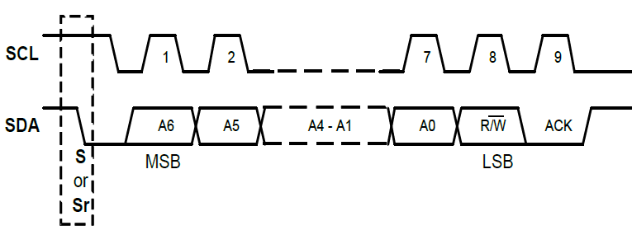
I²C Protocol: Slave Address Transfer
The 1st byte transferred by Master after START signal
A 7-bits calling address followed by the R/W bit to indicate the data transfer direction (0: write to slave, 1: read)
The matching slave responds by returning an acknowledge bit by pulling SDA low at the 9th SCL clock cycle

Slide 13
I²C Protocol: Data Transfer
Each transferred byte is followed by an acknowledge bit (SDA low) on the 9th SCL clock cycle
If the slave signals a NACK, the master can generate a STOP signal to abort the data transfer or generate a Repeated START signal and start a new transfer cycle
If the master, as the receiving device, send NACK to the slave, the slave releases the SDA line for the master to generate a STOP or Repeated START signal

Slide 14
I²C Transaction
Transmitter/receiver differs from master/slave
Master initiates transactions while slave responds
Transmitter sets data on SDA line, receiver acks
For a read, slave is transmitter and master acks
For a write, master is transmitter, and slave acks

Slide 15
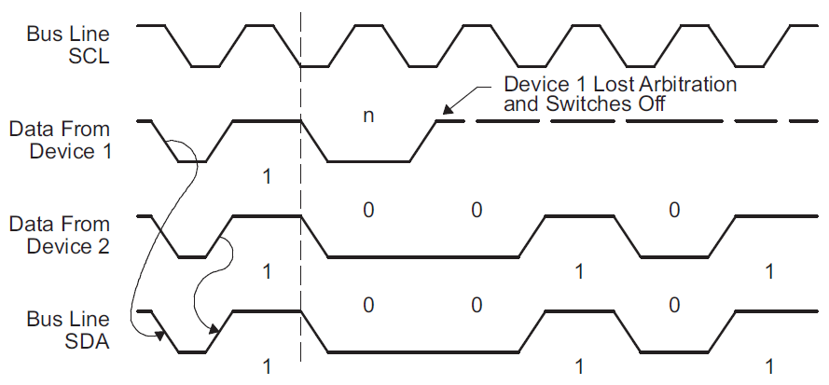
I²C Arbitration
Two masters may start transmission at about the same time → need arbitration (by the first transmitted bit that is different)
Devices that sent a 1 lose, because line is pulled to ground
Notes:
If two or more master transmitters simultaneously start a transmission on the bus, an arbitration procedure is invoked. The first master transmitter that generates a logic high is overruled by the opposing master generating a logic low. (If one transmitter sets SDA to 1 (not driving a signal) and a second transmitter sets it to 0 (pull to ground), the result is that the line is low. )
The first transmitter observes that the level of the line is different from that expected. It concludes that another node is transmitting and it loses arbitration
In the meantime, the other node has not noticed any difference between the expected and actual levels on SDA, and therefore continues transmission
The arbitration procedure gives priority to the device that transmits the serial data stream with the lowest binary value. The master transmitter that lost arbitration switches to the slave receiver mode, and sets the arbitration lost flag UCALIFG. If two or more devices send identical first bytes, arbitration continues on the subsequent bytes.

Slide 16
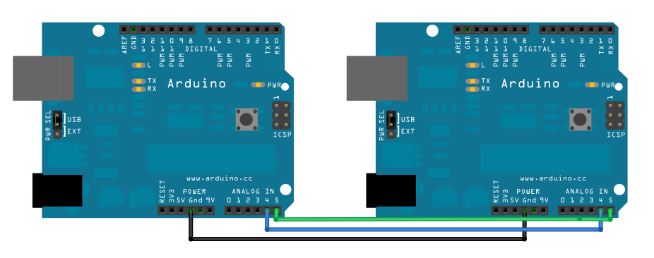
Connecting Two Arduino with I²C
https://www.arduino.cc/en/Tutorial/MasterWriter

Slide 17
Master Writer Code
#include <Wire.h> void setup() { Wire.begin(); // join i2c bus as master } byte x = 0; void loop() { Wire.beginTransmission(8); // transmit to device #8 Wire.write("x is "); // sends five bytes Wire.write(x); // sends one byte Wire.endTransmission(); // stop transmitting x++; delay(500); }
Notes:
Wire.begin() Wire.begin(address)
Initiate the Wire library and join the I2C bus as a master or slave.
address: the 7-bit slave address (optional); if not specified, join the bus as a master.
Wire.beginTransmission(address)
Begin a transmission to the I2C slave device with the given address. Subsequently, queue bytes for transmission with the write() function and transmit them by calling endTransmission().

Slide 18
Slave Receiver Code
#include <Wire.h> void setup() { Wire.begin(8); // join i2c bus with address #8 Wire.onReceive(receiveEvent); // register event Serial.begin(9600); // start serial for output } void loop() { delay(100); } void receiveEvent(int howMany) { while (Wire.available()) { char c = Wire.read(); // receive byte Serial.print(c); // print the byte } }
Notes:
Wire.onReceive(handler)
Registers a function to be called when a slave device receives a transmission from a master.
Wire.available()
Returns the number of bytes available for retrieval with read(). This should be called on a master device after a call to requestFrom() or on a slave inside the onReceive() handler.

Slide 19
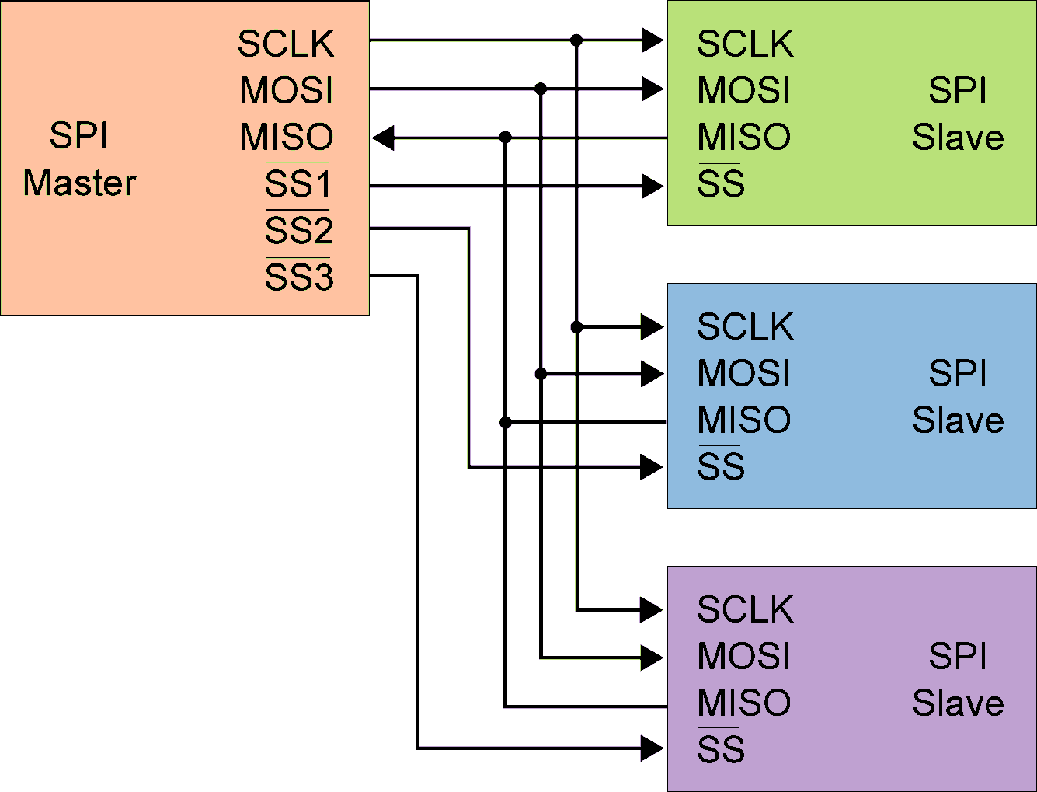
SPI
Serial Peripheral Interface (SPI):
A bus-type synchronous serial communication interface
Devices communicate in full duplex using a master-slave architecture with a single master
Slaves can send data to master at the same time when master is sending data to them
Slave is selected individually with dedicated wire, slave select (SS)
Requires 2 or 3 wires for the communication +1 wire for each device on the bus

Slide 20
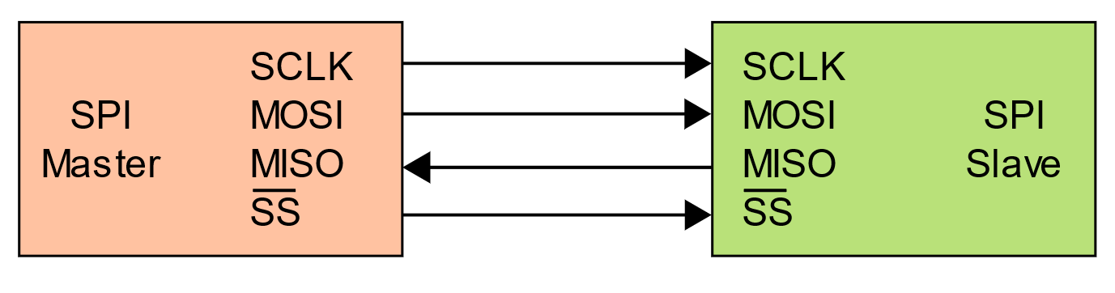
SPI Bus Wiring
Bus wires
MOSI (Master-Out, Slave-In): data from master to slave
MISO (Master-In, Slave-Out): data from slave to master
Both MOSI and MISO are active during every transmission
SCLK (System Clock): from master to synchronize transfers
SS (Slave Select): unique line to select each slave chip
Master asserts slave/chip select line
When a device's Slave Select pin is low, it communicates with the master. When it's high, it ignores the master

Slide 21
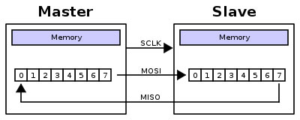
SPI Data Transfer
Full duplex, synchronous serial data transfer
Data shifted out of master's MOSI pin and into slave’s MISO
Data transfer is initiated by simply writing data to the SPI data register
All data movement is coordinated by SCLK
Master shifts out data to Slave, and shifts in data from Slave
http://upload.wikimedia.org/wikipedia/commons/thumb/b/bb/SPI_8-bit_circular_transfer.svg/400px-SPI_8-bit_circular_transfer.svg.png

Slide 22
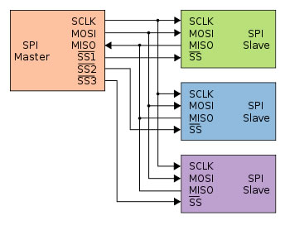
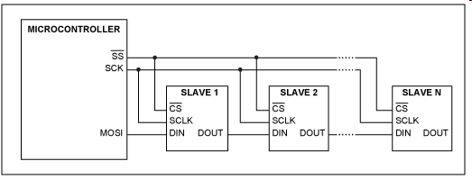
Two Possible Bus Configurations
Some wires have been renamed
Master and multiple independent slaves
http://upload.wikimedia.org/wikipedia/commons/thumb/f/fc/SPI_three_slaves.svg/350px-SPI_three_slaves.svg.png
Master and multiple daisy-chained slaves
http://www.maxim-ic.com/appnotes.cfm/an_pk/3947

Slide 23
SPI Sample Code
#include <SPI.h> const int chipSelectPin = 4; byte dataByte; void setup() { SPI.begin(); //Initializes the SPI pinMode(chipSelectPin, OUTPUT); //Pin for the slave digitalWrite(chipSelectPin, HIGH); //Deselects the slave } void loop() { digitalWrite(chipSelectPin, LOW); //Selects the slave SPI.beginTransaction(SPISettings(2000000, MSBFIRST, SPI_MODE0)); //SPI clock speed, bit order, SPI mode dataByte = SPI.transfer(0b00); //Receive data SPI.endTransaction(); //Ends communication digitalWrite(chipSelectPin, HIGH); //Deselects the slave }

