Slide 1
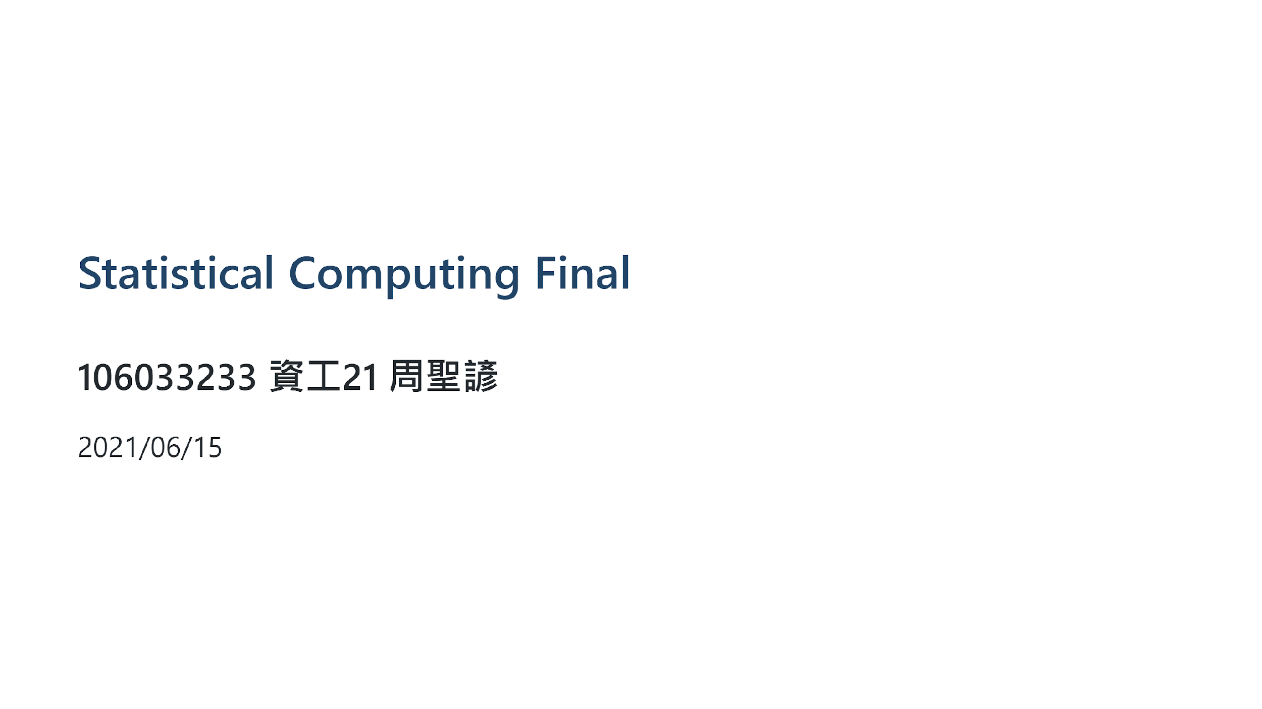

Slide 2
Outline
Dataset & EDA
SMO
Fourier Kernel Approximation(Skip, please refer to the report)
Evaluation

Slide 3
Dataset & EDA

Slide 4
Women’s Clothing E-Commerce Review Dataset
The dataset contains reviews written by customers for a online clothing shop.
Including 9 features, some important features are following
Age: The reviewers’ age
Title: The title of the review
Review: The review body
Rating: The product score granted by the customer from 1 Worst, to 5 Best.
Class Name: Categorical name of the product class name.

Slide 5
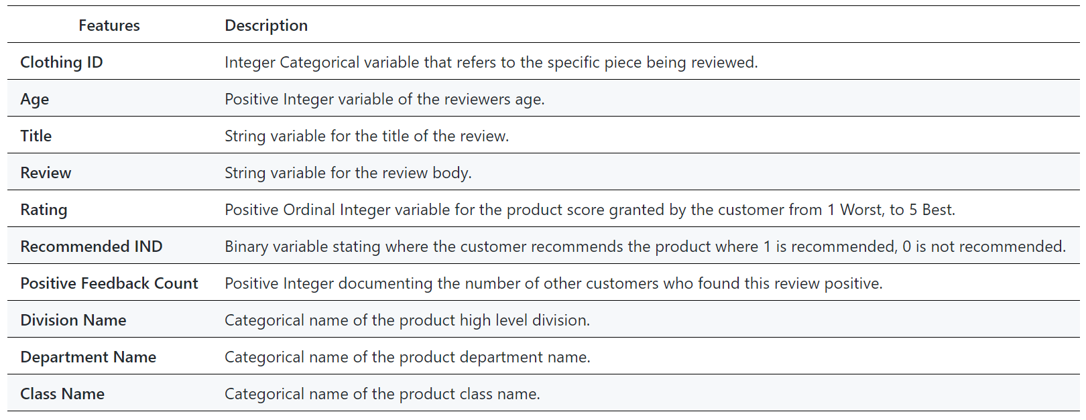

Slide 6
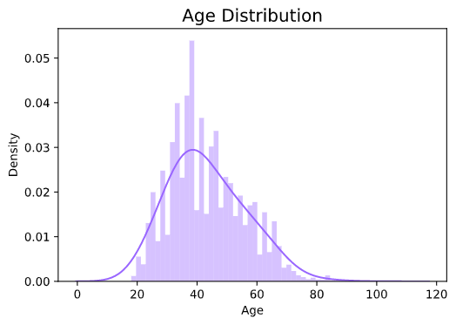
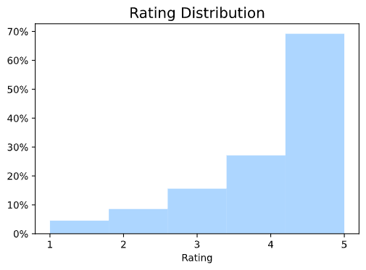
Age & Rating Distribution
Notes:
Mean age: about 40
Almost 70% are rating 5

Slide 7
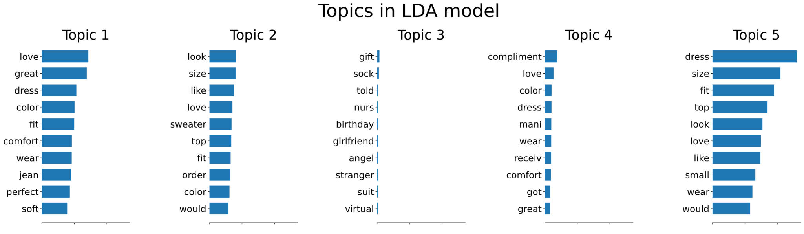
Topics
The topic 3 contains girlfriend, gift, birthday - related to boys and their girlfriend.

Slide 8
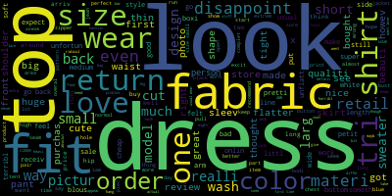
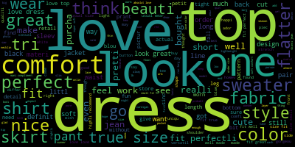
Rating 1 V.S. Rating 5
Rating 1
Rating 5
“Cute” seems to be a neutral word.

Slide 9
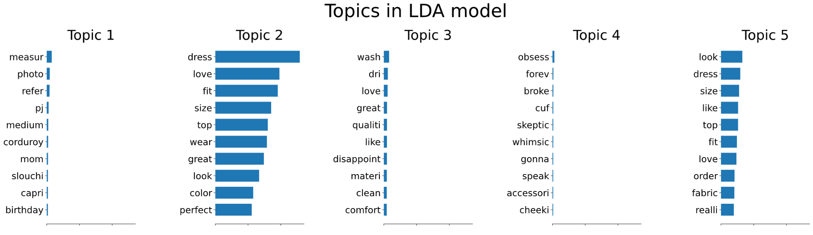
Ages < 30
The topic 4 contains broke, cheeky, obsess, forever - about the relationship.

Slide 10
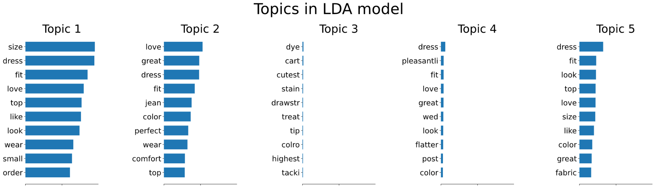
Ages 30 ~ 40
The topic 4 perhaps is about wedding.

Slide 11
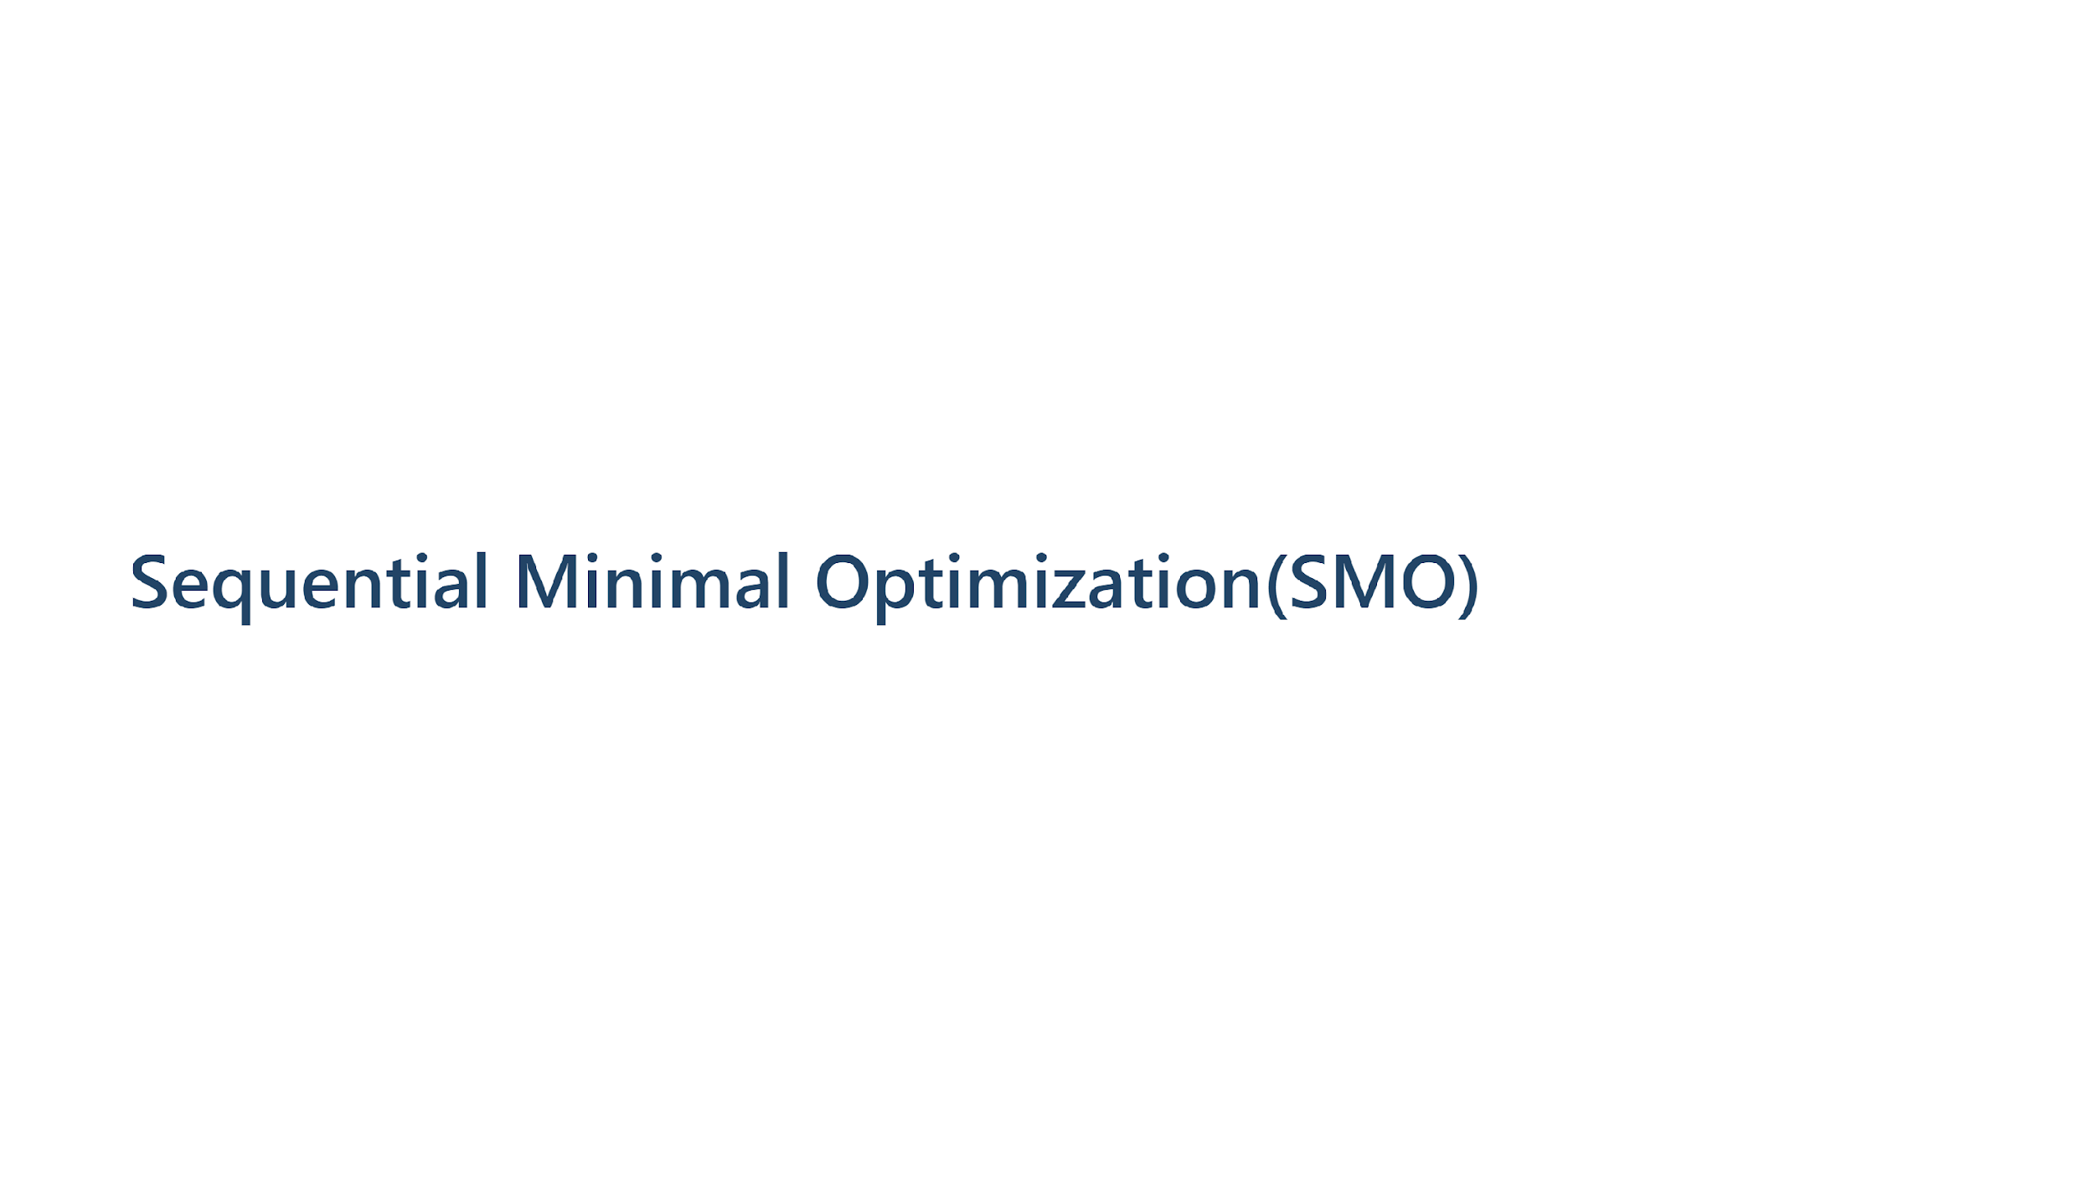

Slide 12
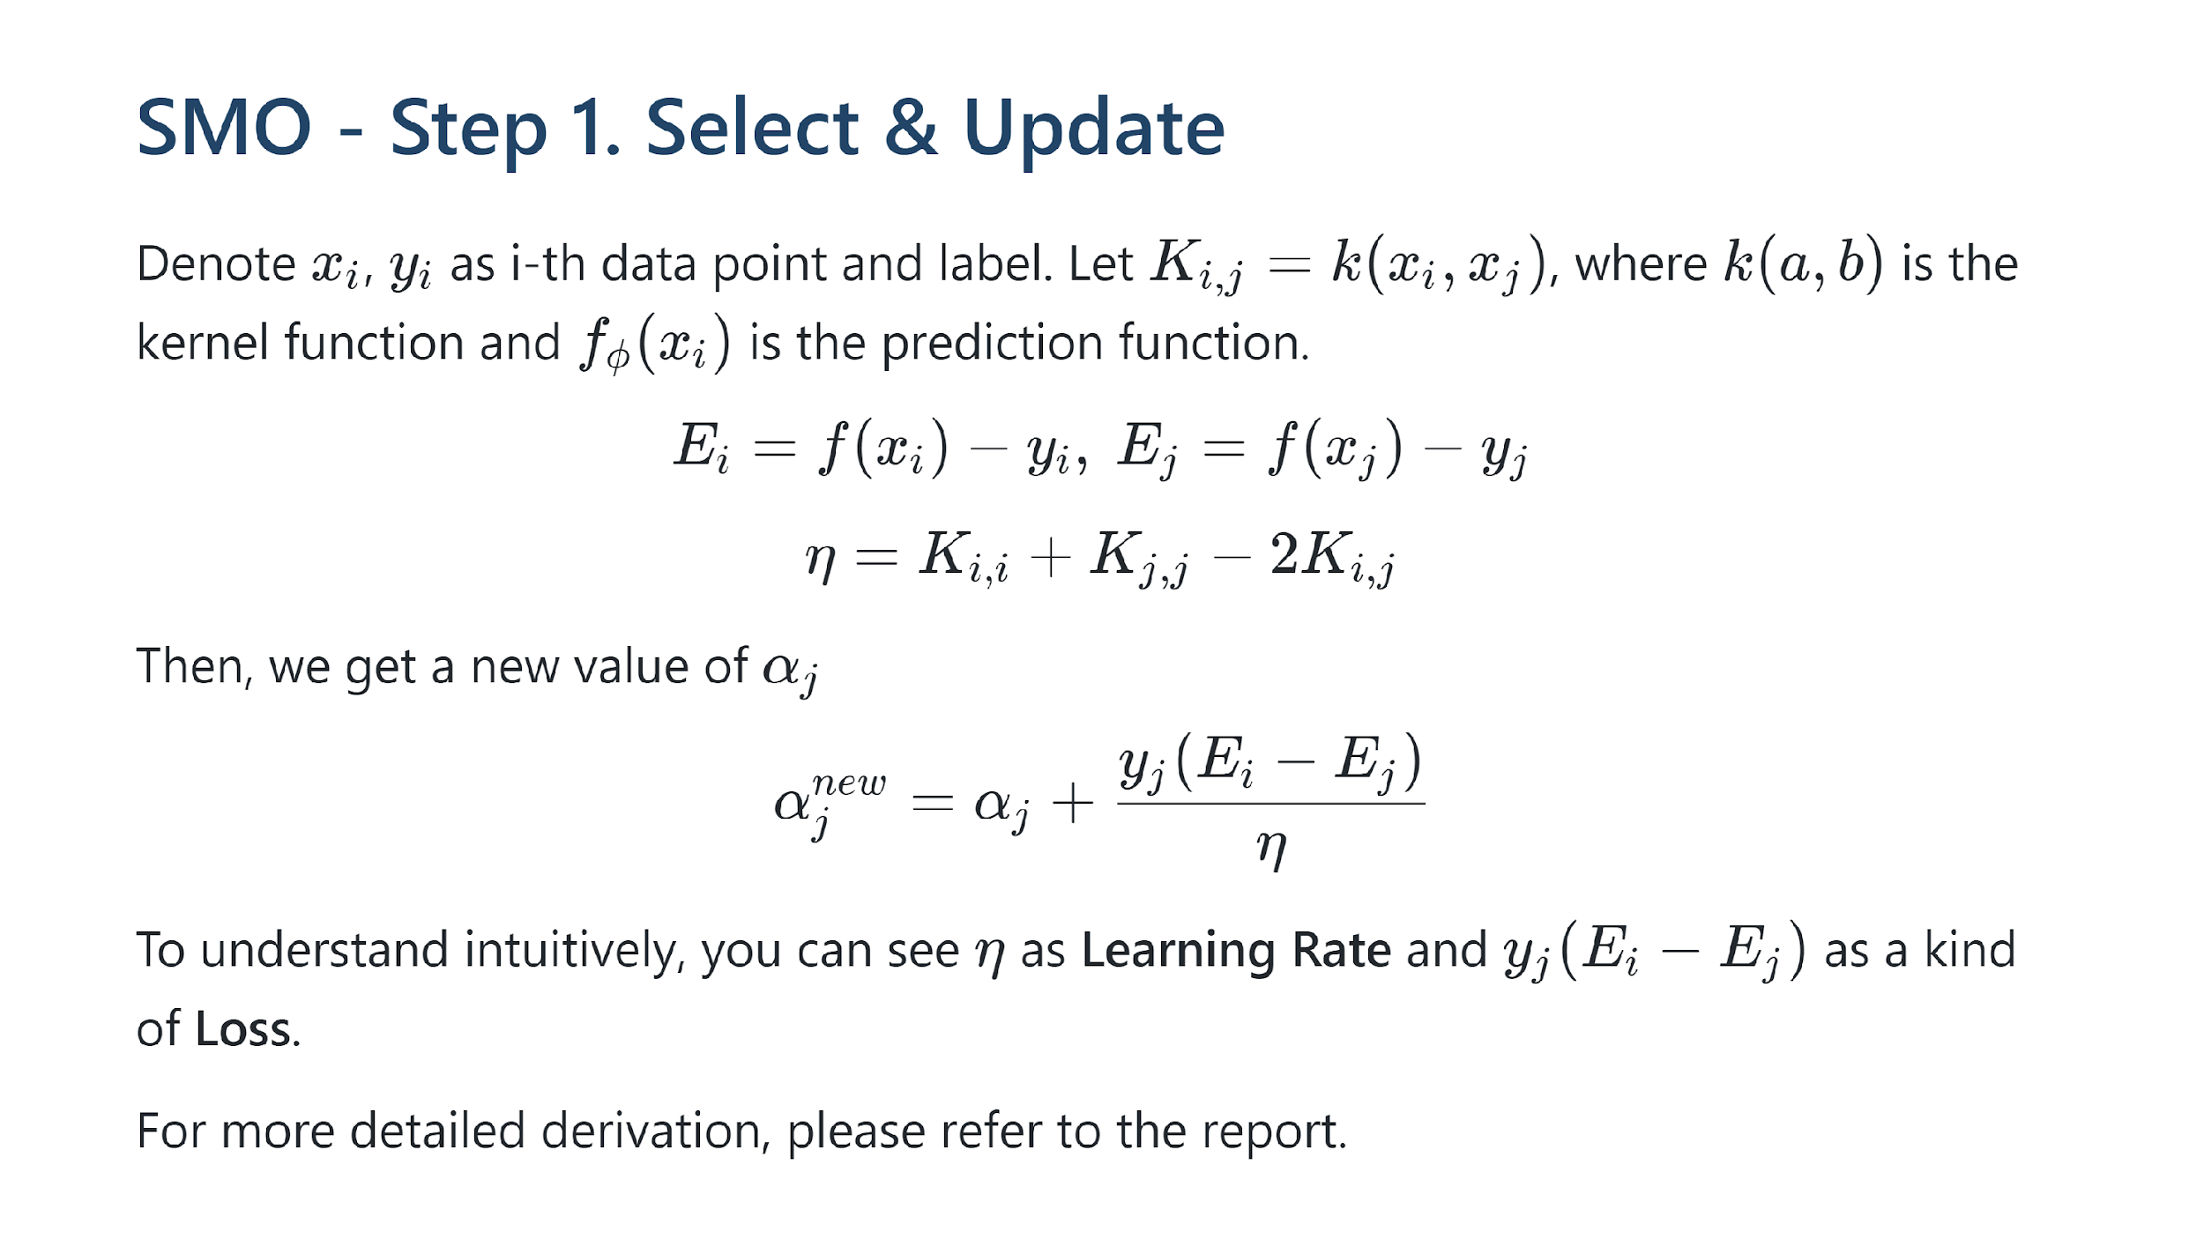

Slide 13
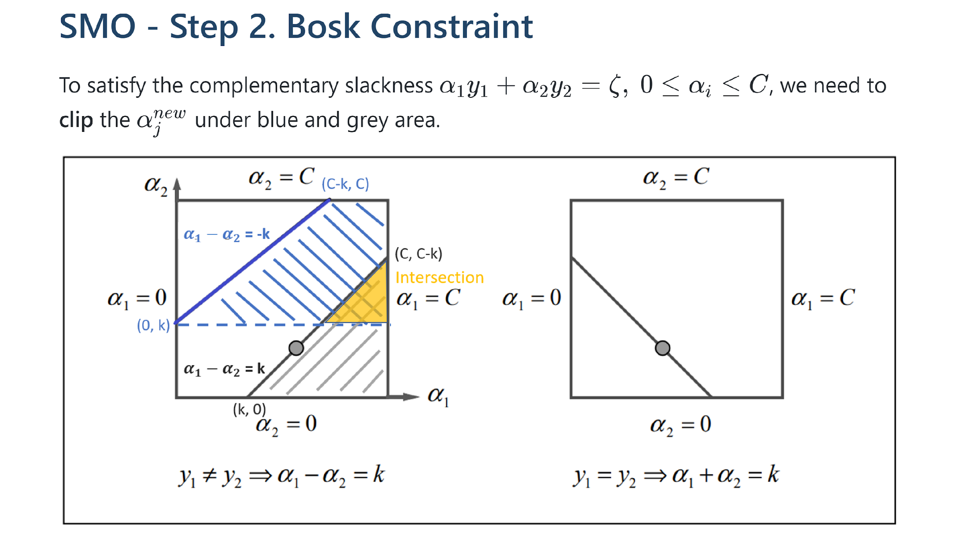

Slide 14
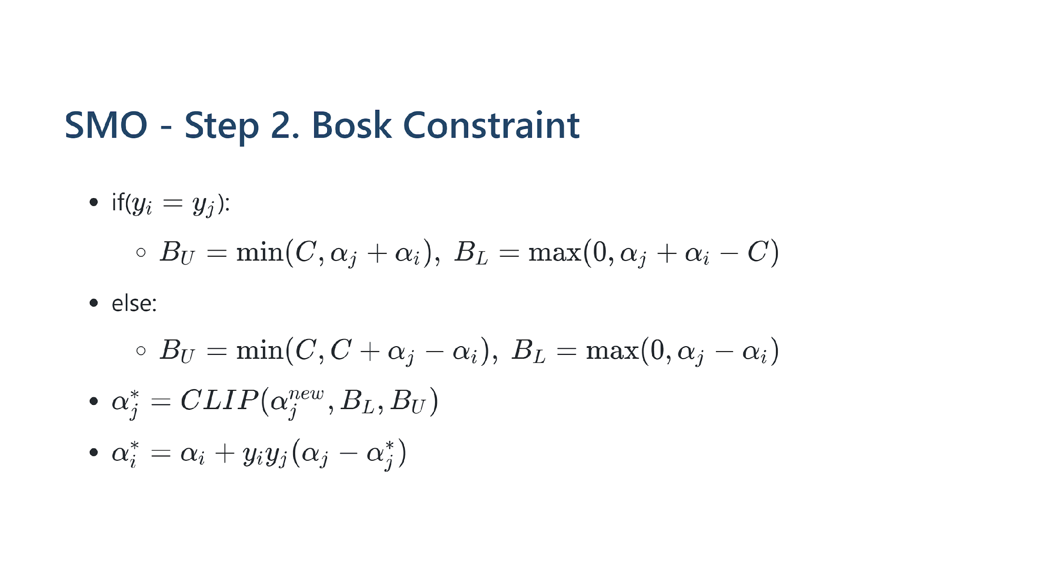

Slide 15
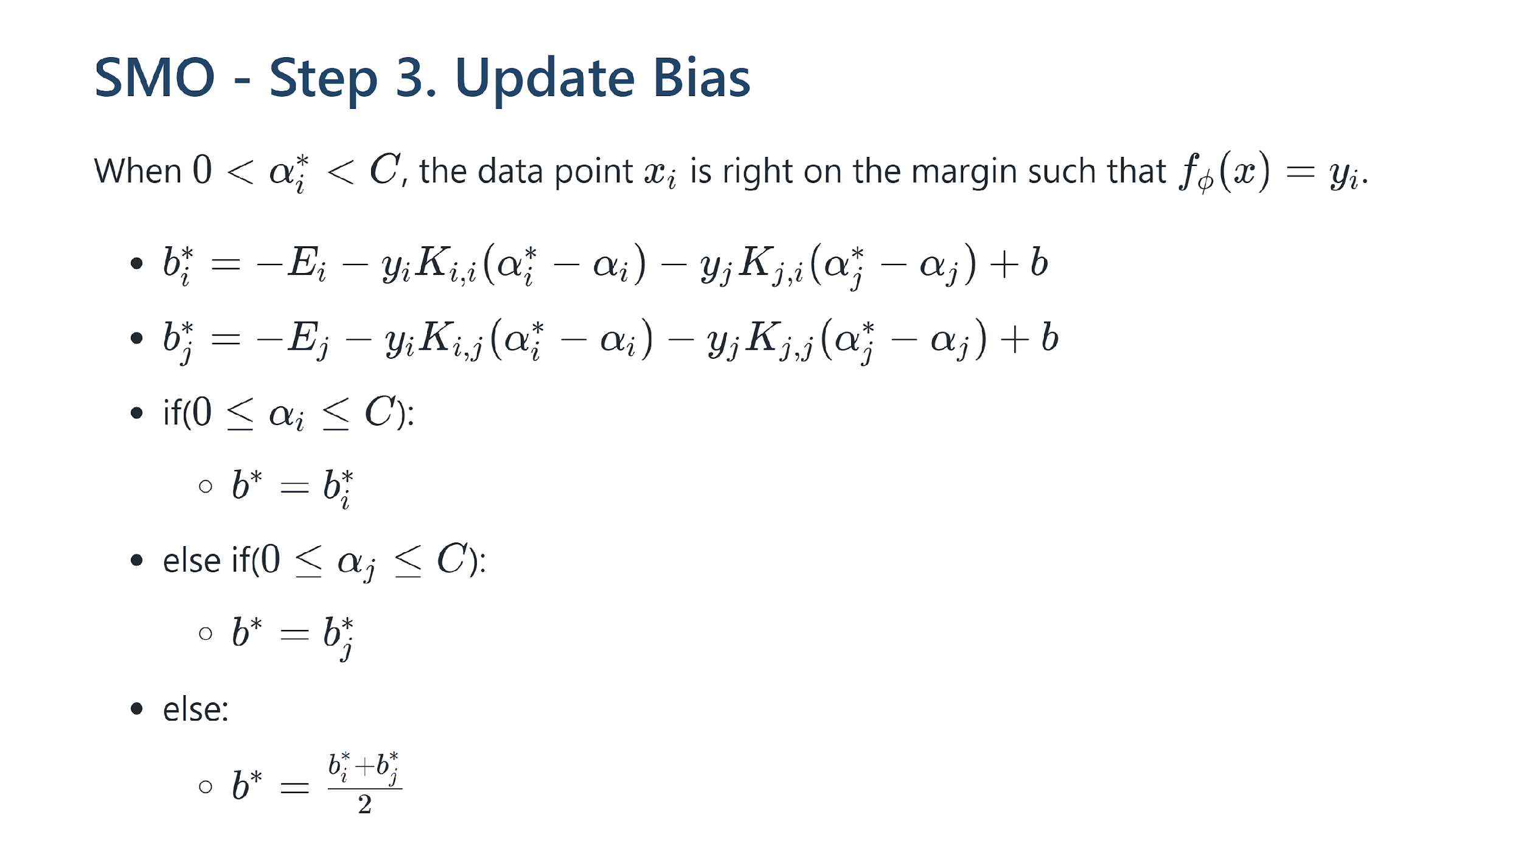

Slide 16


Slide 17
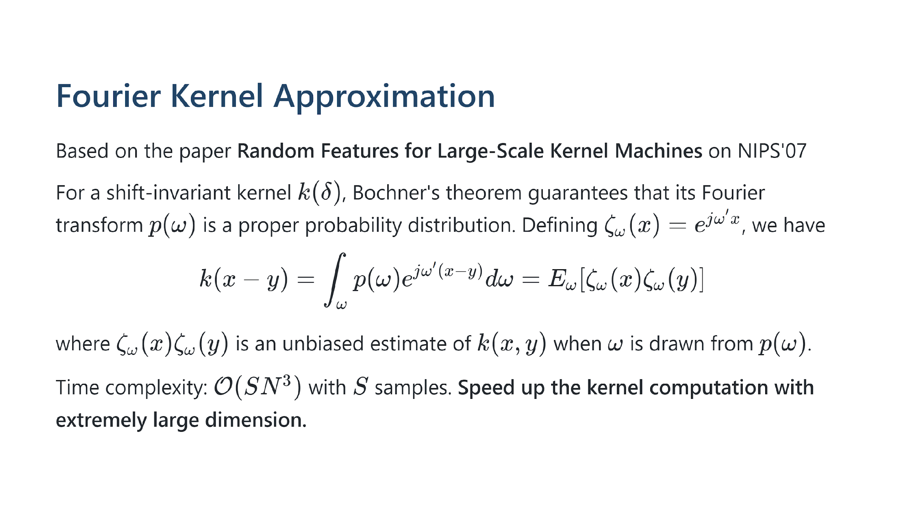

Slide 18
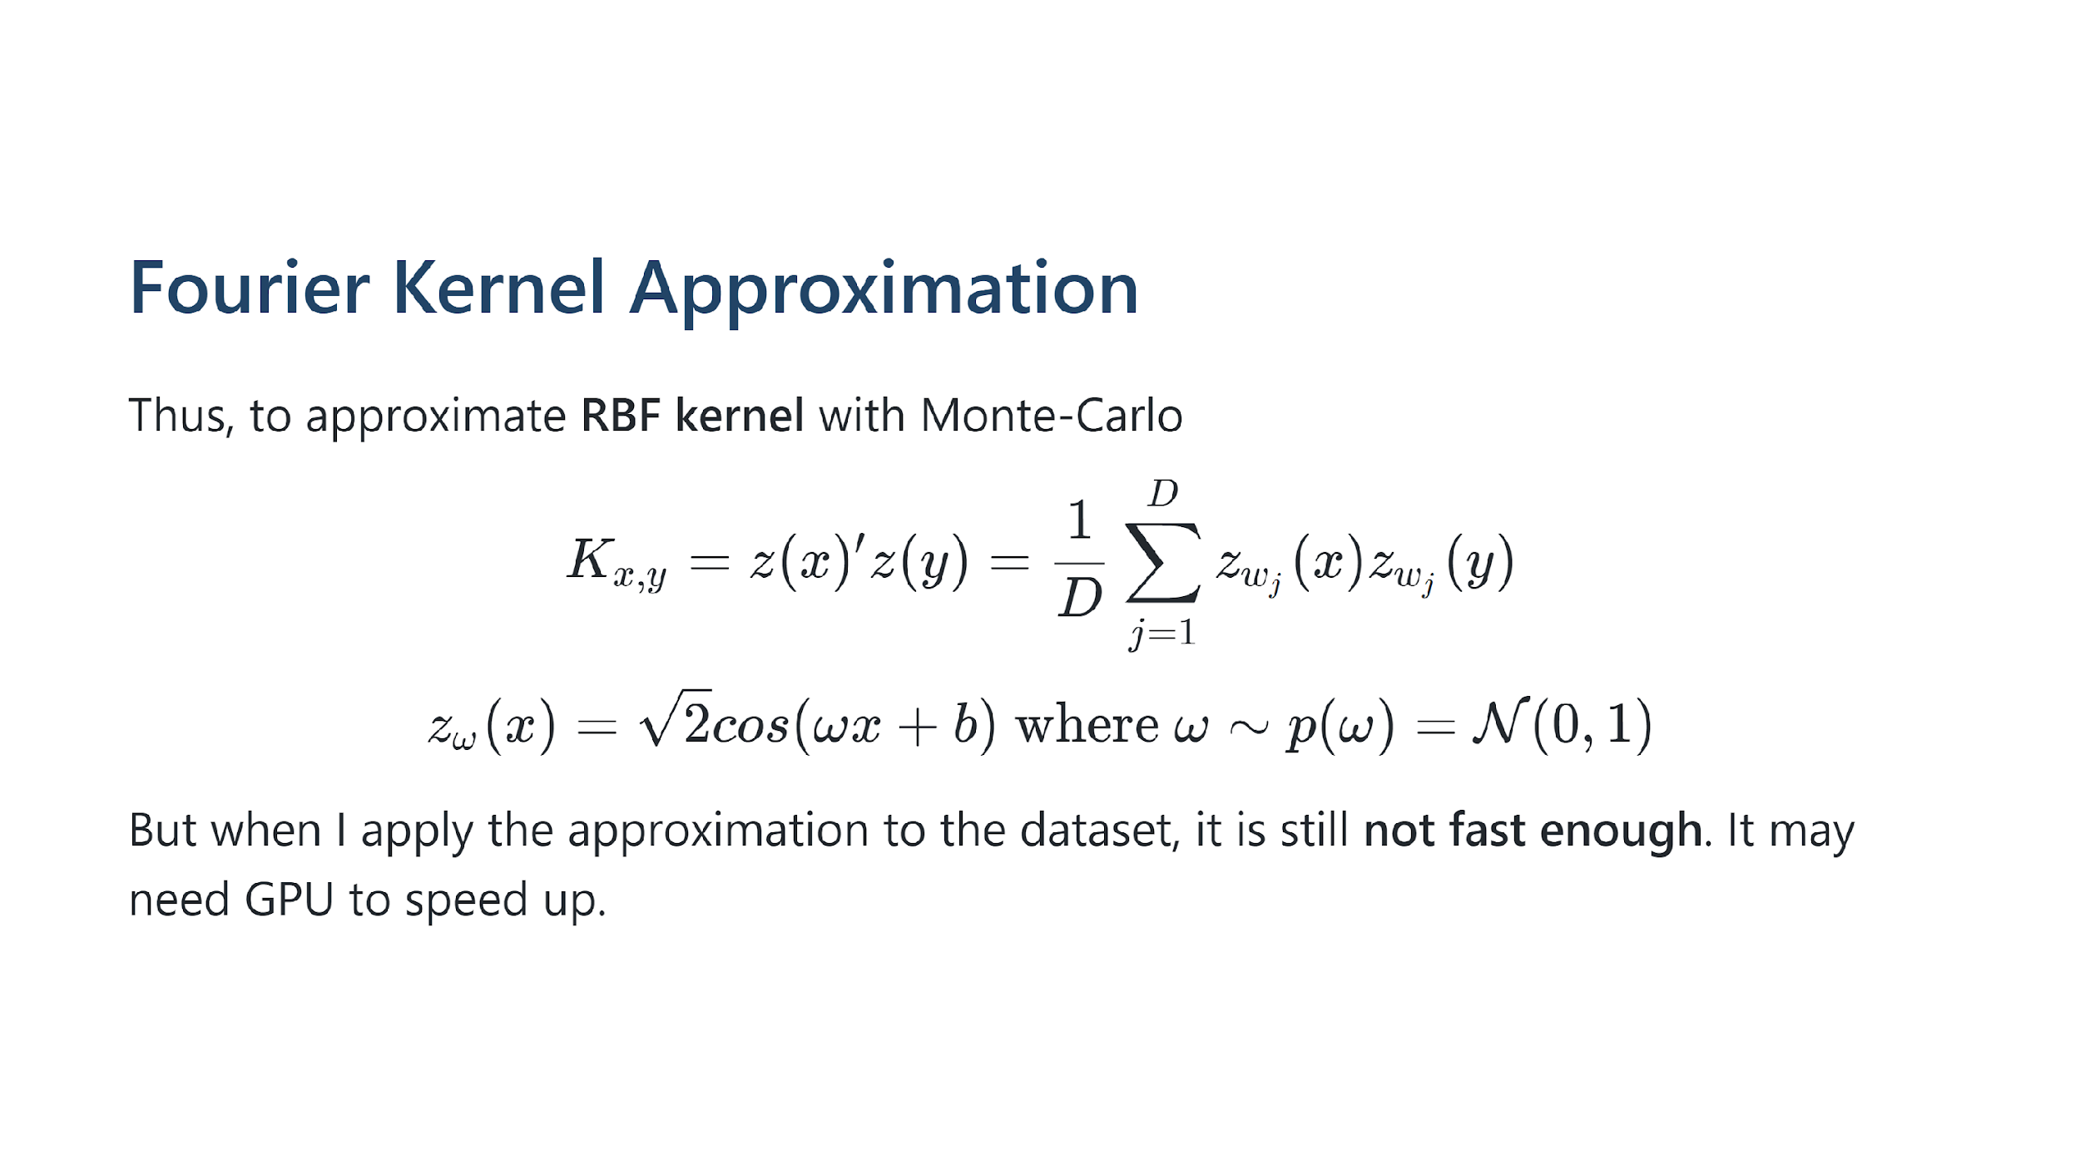

Slide 19
Evaluation

Slide 20
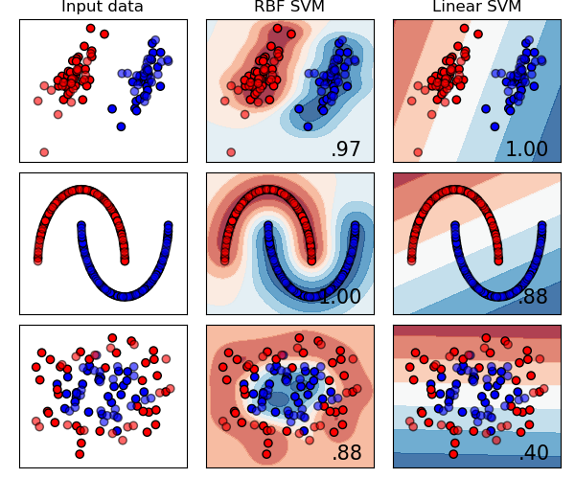
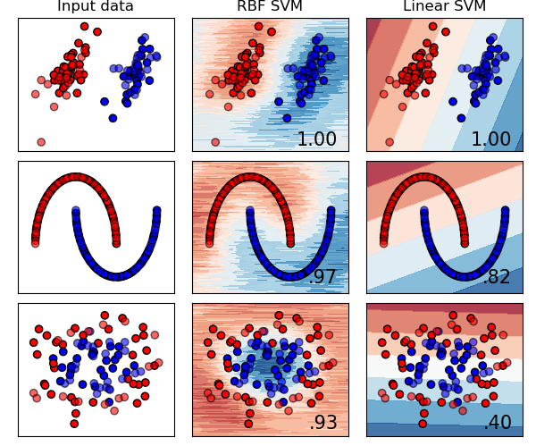
Evaluation - Simulation Data
Fourier Approximation Kernel
with 200 smples
Exact Kernel

Slide 21
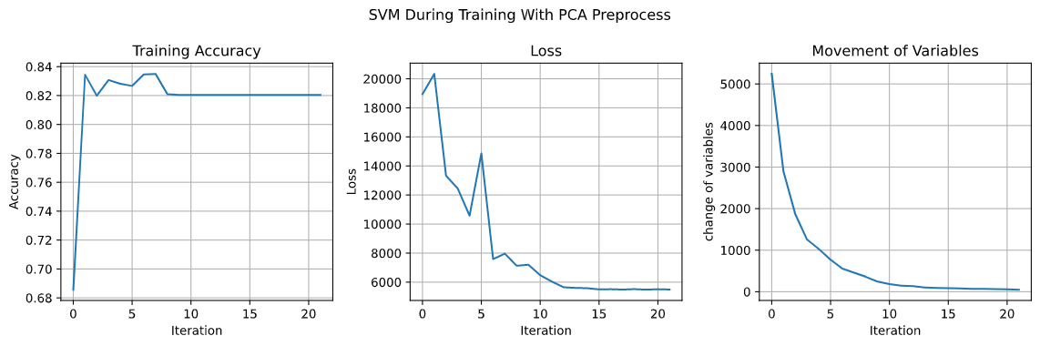
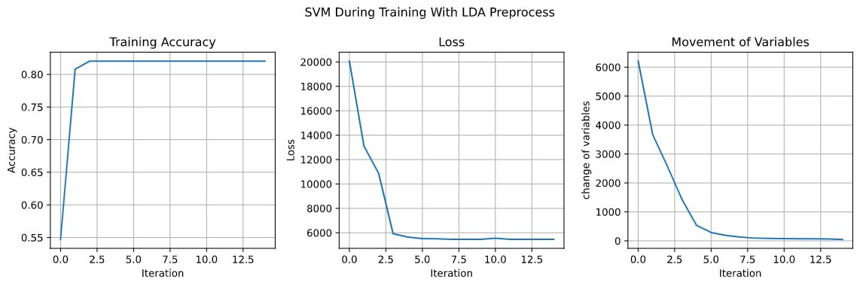
Evaluation - Women’s Clothing E-Commerce Dataset
PCA Preprocess
Training Acc: 82.03%
Testing Acc: 81.54%
LDA Preprocess
Training Acc: 82.03%
Testing Acc: 81.54%
SMOOTHER

Slide 22
Thanks For Listening

