Slide 1
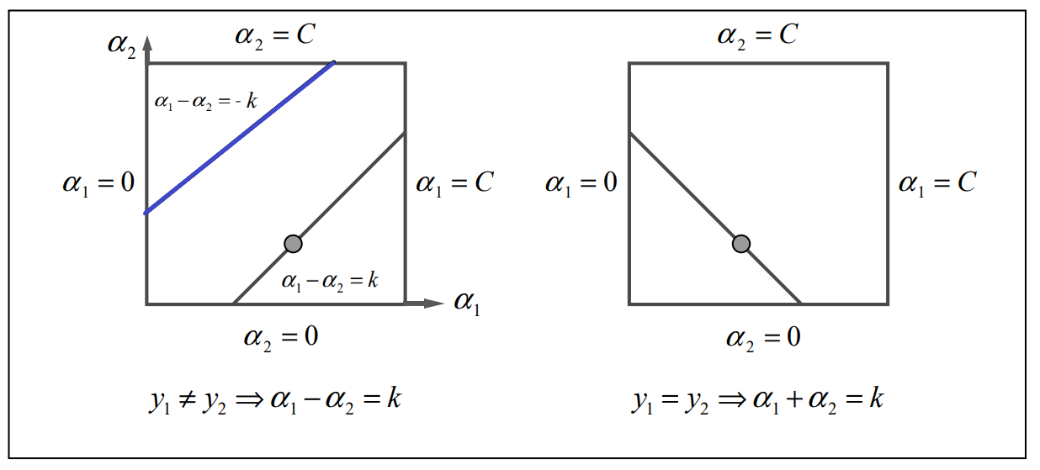


(C-k, C)
$α_{1}−α_{2}$= -k
(C, C-k)
Intersection
(0, k)
$α_{1}−α_{2}$ = k
(k, 0)

