Slide 1

Bay-yuan Hsu

Slide 2
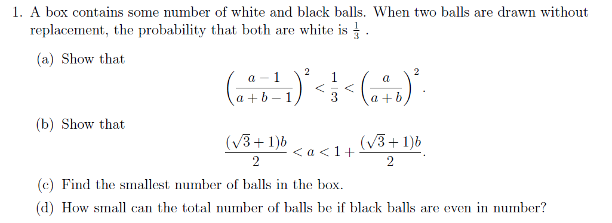

Slide 3
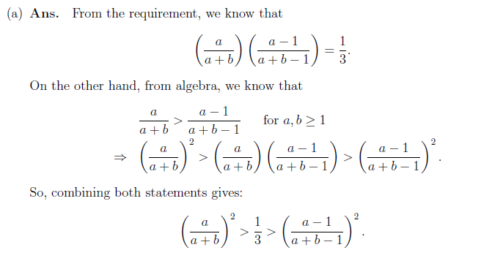

Slide 4
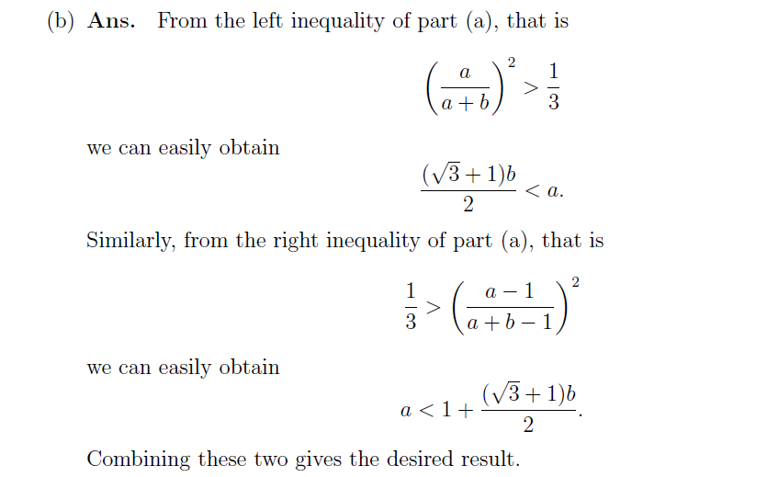

Slide 5
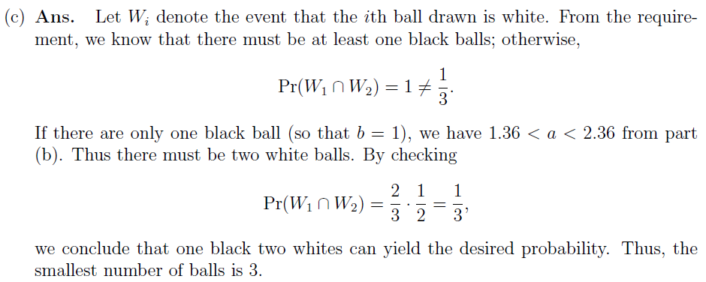

Slide 6
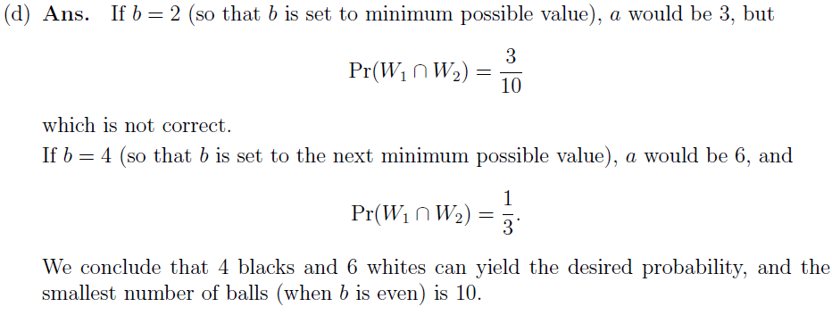

Slide 7
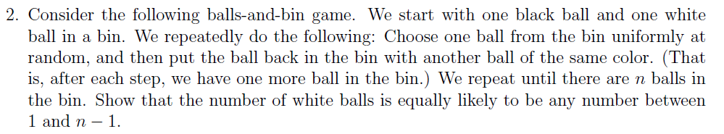

Slide 8
A_{i,j} is the bin contains i balls and j white balls
W_{i,j} is the bin contains i balls and j white balls and the next draw we get white ball
B_{i,j} is the bin contains i balls and j white balls and the next draw we get black e ball
1.
i = 3
Pr(A_{3,1}) = Pr(A_{2,1}) + Pr(B_{2,1}) = 1/2
Pr(A_{3,2}) Pr(A_{3,2})+ Pr(W_{2,1}) = 1/2
2.
Assume i = k is correct
Pr(A_{k,1}) = Pr(A_{k,2}) = …….. = Pr(A_{k,k-1}) = 1/k-1
3.
i = k+1
Pr(A_{k+1,1}) = Pr(A_{k,1})* Pr(B_{k,1}) = (1/k-1) * (k-1/k) = 1/k
Pr(A_{k+1,2}) = Pr(A_{k,1})* Pr(W_{k,1})+ Pr(A_{k,2})* Pr(B_{k,2}) = 1/k
.
.
.
Pr(A_{k+1,k}) = Pr(A_{k,k-1})* Pr(W_{k,k-1}) = 1/k

Slide 9
n*(1/2)^logn * (1/2)^k <= (1/2)^k

Slide 10
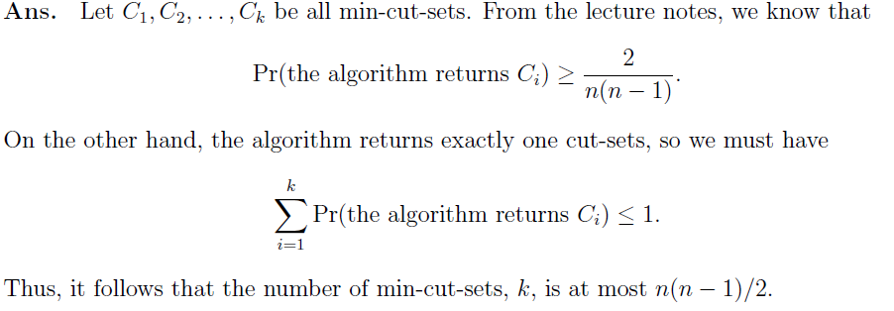

Slide 11
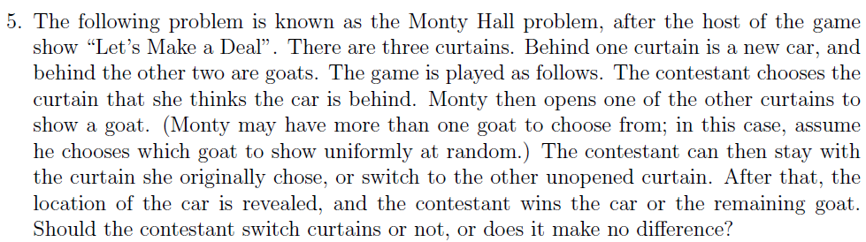
1-1/3 = 2/3
Because we have 2/3 chance to choose the door with goat at the first time. And if we switch the door in the second chance we will have the 100% to get a car.

Slide 12
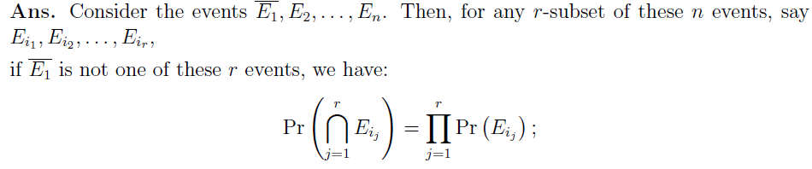

Slide 13
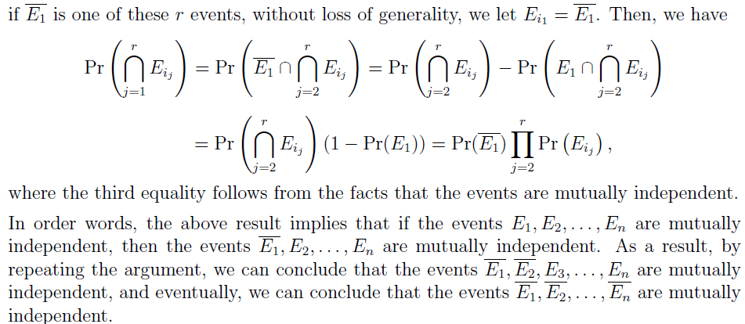

Slide 14
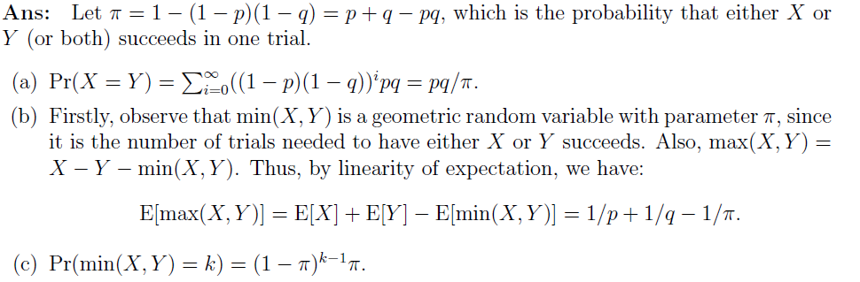

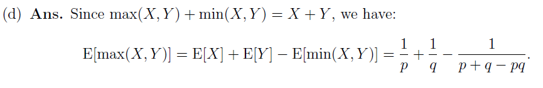

Slide 15

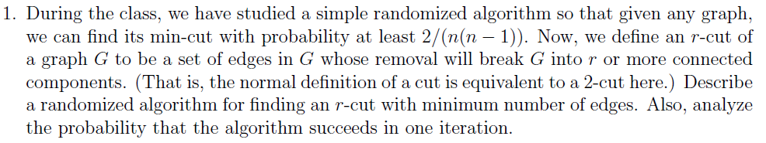

Slide 17


Slide 18

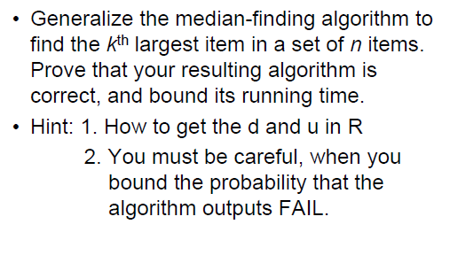

Slide 19
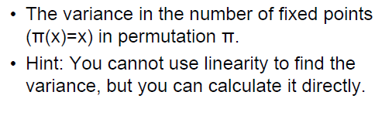
Assignment 2 –problem2

Slide 20
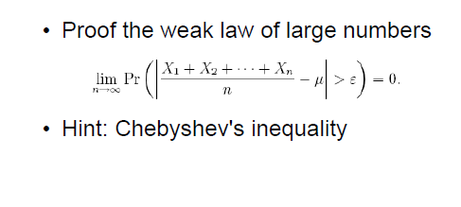
Assignment 2 –problem3

Slide 21
Assignment 2 –problem4
If X is a binomial random variable Bin(n, 1/2) with n >= 1,
show that the probability that X is even is 1/2.

Slide 22
Assignment 2 –problem5
Hint : Induction

