Slide 1



1. Sign In Page
Background
Image
① Passenger model (Button)
Sign in by scanning the bar code on ticket.
Seat number will be recorded.
② Staff model (Button)
Sign in with staff account.
PASSENGER
STAFF ACCOUNT

Slide 2

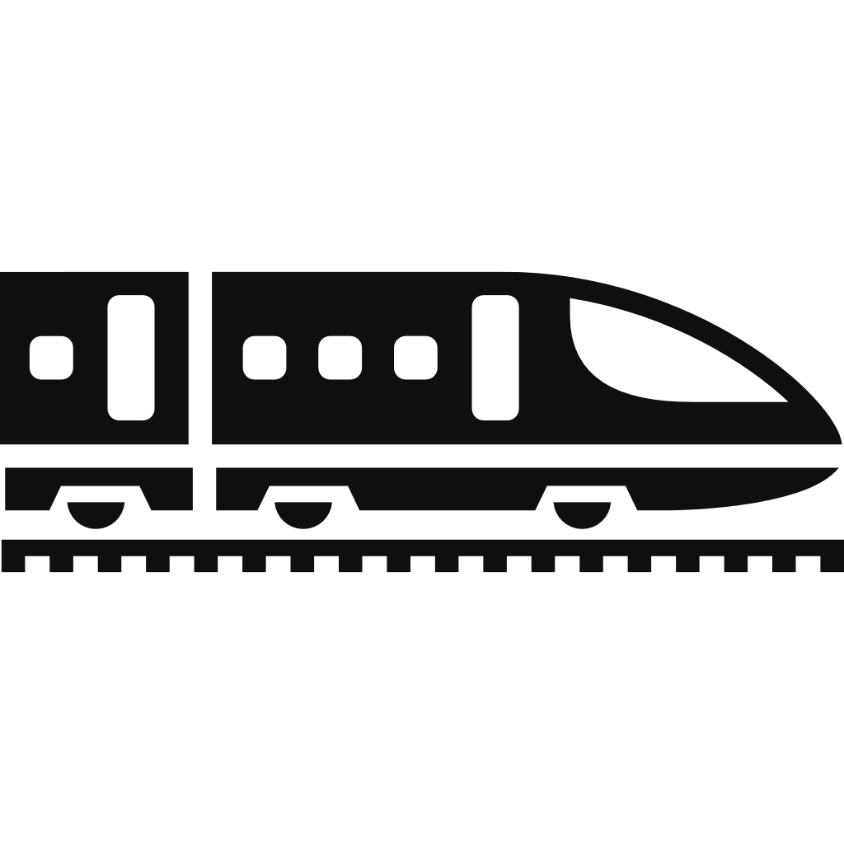


2. Passenger Model
① Rolling bar - next station
Connecting with destination board
next station: Aberdeen
speed: 180km/h, arrive
② Rolling bar - train speed and estimated time to next station
Example: [speed: 180km/h, arrive in 25 mins.]
O
C
④ Toilet: Occupied/Vacant
Switch automatically.
③ Doors: OPEN/CLOSE (Button)
Passengers are able to switch the state of door between open and close when it is safe.
Safe: When the train is standing on a station, and a same door is not allowed to operate too frequently.
V
O
⑤ Report (Button)
Allows passengers to send train staff (conductors) message when they need help. (eg facility trouble, ordering goods)
⑥ Emergency (Button)
Allows passengers to call train staff (conductors and even driver) immidiately when there is an emergency.
Even allows passengers to stop the train when it is necessary in the emergency.
REPORT
EMERGENCY

Slide 3

2. Passenger Model
① Rolling bar - next station
Connecting with destination board
next station: Aberdeen
speed: 180km/h, arrive
② Rolling bar - train speed and estimated time to next station
Example: [speed: 180km/h, arrive in 25 mins.]
O
C
④ Toilet: Occupied/Vacant
Switch automatically.
③ Doors: OPEN/CLOSE (Button)
Passengers are able to switch the state of door between open and close when it is safe.
Safe: When the train is standing on a station, and a same door is not allowed to operate too frequently.
V
O
⑤ Report (Button)
Allows passengers to send train staff (conductors) message when they need help. (eg facility trouble, ordering goods)
⑥ Emergency (Button)
Allows passengers to call train staff (conductors and even driver) immidiately when there is an emergency.
REPORT
EMERGENCY

Slide 4
2. Passenger Model
① Rolling bar - next station
Connecting with destination board
next station: Aberdeen
speed: 180km/h, arrive
② Rolling bar - train speed and estimated time to next station
Example: [speed: 180km/h, arrive in 25 mins.]
O
C
④ Toilet: Occupied/Vacant
Switch automatically.
Door
Animation
③ Doors: OPEN/CLOSE (Button)
Passengers are able to switch the state of door between open and close when it is safe.
Safe: When the train is standing on a station, and a same door is not allowed to operate too frequently.
OPEN
CLOSE
V
O
⑤ Report (Button)
Allows passengers to send train staff (conductors) message when they need help. (eg facility trouble, ordering goods)
⑥ Emergency (Button)
Allows passengers to call train staff (conductors and even driver) immidiately when there is an emergency.
REPORT
EMERGENCY

Slide 5

2. Passenger Model
① Rolling bar - next station
Connecting with destination board
next station: Aberdeen
speed: 180km/h, arrive
② Rolling bar - train speed and estimated time to next station
Example: [speed: 180km/h, arrive in 25 mins.]
O
C
④ Toilet: Occupied/Vacant
Switch automatically.
③ Doors: OPEN/CLOSE (Button)
Passengers are able to switch the state of door between open and close when it is safe.
Safe: When the train is standing on a station, and a same door is not allowed to operate too frequently.
V
O
WHILE IN AN EMERGENCY!
⑤ Report (Button)
Allows passengers to send train staff (conductors) message when they need help. (eg facility trouble, ordering goods)
⑥ Emergency (Button)
Allows passengers to call train staff (conductors and even driver) immidiately when there is an emergency.
CALL FOR HELP!
STOP THE TRAIN!
REPORT
EMERGENCY

Slide 6





3. Staff Model
① Rolling bar - next station (Button)
Staff could change the content of rolling bar (destination board)
next station: Aberdeen
speed: 180km/h, arrive
COACH 1
C
COACH 2
COACH 3
② Lights: OPEN/CLOSE (Button)
Staff could control every light in every coach, as well as control them together.
③ Doors: OPEN/CLOSE (Button)
Staff could monitor each door, and could switch each door’s state respective or totally.
Generally, after the train arrives at a station and stops down, driver could open all doors together.
COACH 4
COACH 5
COACH 6
O
④ Message (Button)
When passengers need help, they will send a report, and staff could receive the message. As well as locating the sender’s seat.
⑤ Emergency (Button)
When passengers are in emergency, staff could receive alarm, which is a phone call in fact.
MESSAGE
EMERGENCY

Slide 7
3. Staff Model
① Rolling bar - next station (Button)
Staff could change the content of rolling bar (destination board)
next station: Aberdeen
speed: 180km/h, arrive
next station:
COACH 1
C
CONFIRM
COACH 2
COACH 3
② Lights: OPEN/CLOSE (Button)
Staff could control every light in every coach, as well as control them together.
③ Doors: OPEN/CLOSE (Button)
Staff could monitor each door, and could switch each door’s state respective or totally.
Generally, after the train arrives at a station and stops down, driver could open all doors together.
COACH 4
COACH 5
COACH 6
O
④ Message (Button)
When passengers need help, they will send a report, and staff could receive the message. As well as locating the sender’s seat.
⑤ Emergency (Button)
When passengers are in emergency, staff could receive alarm, which is a phone call in fact.
Message
EMERGENCY

Slide 8
3. Staff Model
① Rolling bar - next station (Button)
Staff could change the content of rolling bar (destination board)
next station: Aberdeen
speed: 180km/h, arrive
COACH 1
C
COACH 2
Light
Image
COACH 3
② Lights: OPEN/CLOSE (Button)
Staff could control every light in every coach, as well as control them together.
③ Doors: OPEN/CLOSE (Button)
Staff could monitor each door, and could switch each door’s state respective or totally.
Generally, after the train arrives at a station and stops down, driver could open all doors together.
COACH 4
OPEN
COACH 5
CLOSE
OPEN ALL
CLOSE ALL
COACH 6
O
④ Message (Button)
When passengers need help, they will send a report, and staff could receive the message. As well as locating the sender’s seat.
⑤ Emergency (Button)
When passengers are in emergency, staff could receive alarm, which is a phone call in fact.
Message
EMERGENCY

Slide 9
3. Staff Model
① Rolling bar - next station (Button)
Staff could change the content of rolling bar (destination board)
next station: Aberdeen
speed: 180km/h, arrive
COACH 1
C
COACH 2
Door
Animation
COACH 3
② Lights: OPEN/CLOSE (Button)
Staff could control every light in every coach, as well as control them together.
③ Doors: OPEN/CLOSE (Button)
Staff could monitor each door, and could switch each door’s state respective or totally.
Generally, after the train arrives at a station and stops down, driver could open all doors together.
COACH 4
OPEN
COACH 5
CLOSE
OPEN ALL
CLOSE ALL
COACH 6
O
④ Message (Button)
When passengers need help, they will send a report, and staff could receive the message. As well as locating the sender’s seat.
⑤ Emergency (Button)
When passengers are in emergency, staff could receive alarm, which is a phone call in fact.
Message
EMERGENCY

