Slide 1



Finsight Orchestrator
Frank Xiao

Slide 2

Motivation: The Complexity of Financial Data
analytics
error
High Dimensionality Challenges
Financial datasets often aggregate hundreds of diverse indicators, including production data, consumption rates, and demographic context.
The sheer volume of variables creates a "noise" floor that obscures critical market signals and emerging trends during manual review.
Limitations of Manual Analysis
Manual interpretation is prone to bias and struggles with statistical significance—confusing simple correlation with causality.
As data accuracy diminishes at granular levels (e.g., city vs. national), manual analysts find it difficult to maintain robust comparisons across time and geography.

Slide 3



Finsight Orchestrator Architecture
public
Web Search Agent
(DuckDuckGo)
settings_input_component
Orchestrator
person
User Question
task_alt
Final Answer
analytics
Analytics Agent
(Reasoning
Code Generation Execution)
fact_check
Validator

Slide 4

Analytic Loop
search
Inspect
psychology
Reason
terminal
Execute
visibility
Observe
replay
Retry
fact_check
Validate

Slide 5
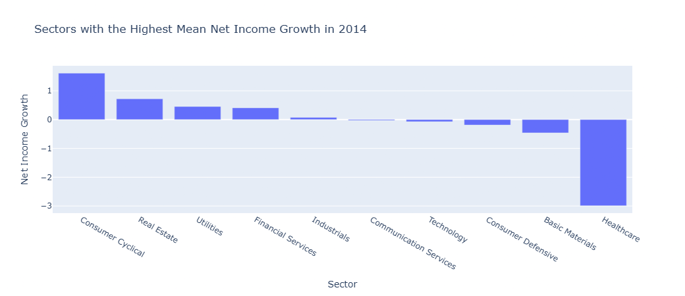
Example 1: Net Income Growth (2014–2018)
Question: Which sectors have the highest net income growth from 2014 to 2018?
Visualization:

Slide 6
Example 1: Net Income Growth (2014–2018)
Findings:
Consumer Cyclical showed the strongest growth (+161%).
Real Estate and Utilities also improved significantly.
Basic Materials and Healthcare experienced declines.
Conclusion: Some sectors experienced substantial profitability improvements over the five-year period.

Slide 7
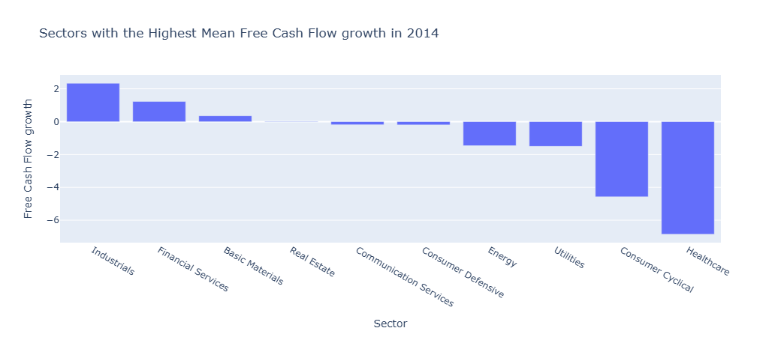
Example 2: Free Cash Flow Growth (2014–2018)
Question: Which sectors have the highest free cash flow growth from 2014 to 2018?
Visualization:

Slide 8
Example 2: Free Cash Flow Growth (2014–2018)
Findings:
Industrials showed the largest improvement (+234%).
Financial Services and Basic Materials also improved.
Consumer Cyclical and Healthcare declined.
Conclusion: Cash flow growth patterns differed from net income growth, showing the importance of analyzing multiple financial metrics.

Slide 9
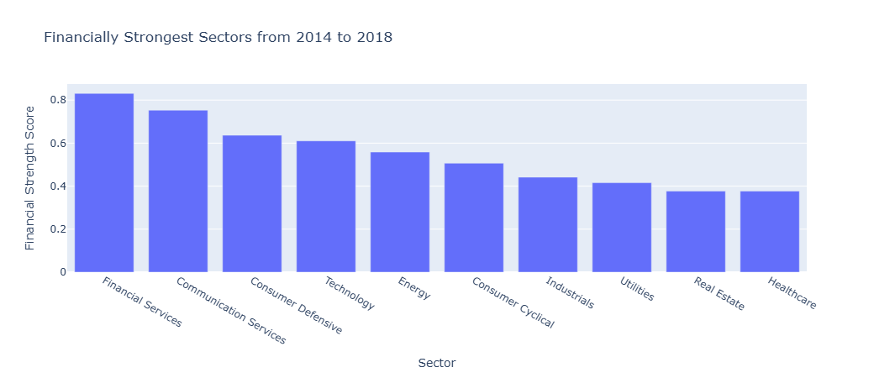
Example 3: Financial Strength Analysis
Question: Which sectors have the greatest financial strength?
Visualization:

Slide 10
Example 3: Financial Strength Analysis
Findings:
Financial Services ranked highest.
Communication Services and Consumer Defensive also scored highly.
Healthcare ranked among the weakest sectors.
Conclusion: Multi-factor evaluation provides a more comprehensive assessment than using a single metric.

Slide 11
Validator Agent
The Validator Agent acts as an independent reasoning and checking component that evaluates the outputs generated by the Analytics Agent.
Examples of Detected Issues:
Wrong dataset/year selected
Wrong ranking direction
Missing financial metrics
Question partially answered
Wrong variables analyzed

Slide 12
Validator Agent Finding Example
Question: Which sectors have the greatest financial strength?
Agent analysis result:
The financially strongest sectors from 2014 to 2018 were ranked using a composite score. The score rewards stronger revenue, net income, free cash flow, ROE, ROIC, and liquidity, and penalizes higher debt-to-equity.
Validator:
Validation: The validator did not fully approve this analysis. Main concern(s): The execution trace has fewer than 3 steps, so the iterative reasoning/execution process is not well demonstrated. Recommended correction(s): Include inspect, execute, observe, plot, and finalize steps in the trace.
Retry Note: The validator requested a retry because the first analysis was incomplete or suspicious. The system reran the analytics agent using the same structured plan.
Conclusion: Validation helps examine the analytic agent’s reasoning, execution, and result to improve reliability and reduces analytical errors.

Slide 13
Lesson Learned
Successful Outcomes:
Natural-language financial analytics
Automatic visualizations
Cross-year comparisons
Independent validation
Challenges:
Planner misinterpretation
Multi-part questions
Semantic understanding
Retry effectiveness

Slide 14
Future Improvements
Potential Enhancements:
Stronger LLM planning
Better semantic validation
True corrective retries
Multi-table joins
Advanced statistical analysis
Improved handling of complex questions
Expected Result: More robust and trustworthy analytics system

Slide 15
Conclusion
Summary:
Developed an orchestrated multi-agent analytics system.
Successfully performed financial analysis across 2014–2018 datasets.
Generated rankings, correlations, growth analyses, and visualizations.
Validator Agent improved reliability by detecting incomplete or incorrect analyses.
Key Takeaway:
Separating planning, execution, and validation creates a more trustworthy AI analytics workflow than a single-agent approach.

Slide 16
Thank You
For your time and attention

