Slide 1
PowerPoint 模板
黄湘云

Slide 2
Table of Contents
In the morning
Getting up
Breakfast
In the evening
Dinner
Going to sleep
壮士！我要模板
Python 块
matplotlib 绘图
软件信息

Slide 3
In the morning

Slide 4
Getting up
Turn off alarm
Get out of bed

Slide 5
Breakfast
Eat eggs
Drink coffee

Slide 6
In the evening

Slide 7
Dinner
Eat spaghetti
Drink wine

Slide 8
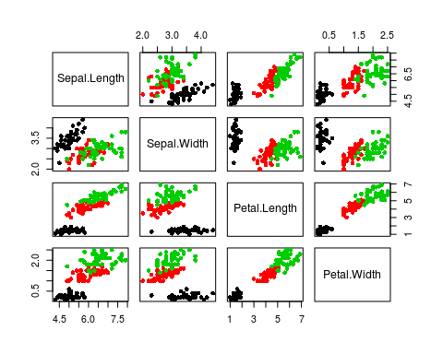
散点图

Slide 9
Going to sleep
Get in bed
Count sheep

Slide 10
壮士！我要模板
--- title: "Habits" output: powerpoint_presentation: reference_doc: my-styles.pptx ---

Slide 11
Python 块
import numpy as np import matplotlib.pyplot as plt plt.switch_backend('agg') # Very Important in R Markdown t = np.arange(0.0, 2.0, 0.01) s = np.sin(2*np.pi*t) plt.plot(t,s) plt.title(r'$\alpha_i > \beta_i$', fontsize=20) plt.text(1, -0.6, r'$\sum_{i=0}^\infty x_i$', fontsize=20) plt.text(0.6, 0.6, r'$\mathcal{A}\mathrm{sin}(2 \omega t)$', fontsize=20) plt.xlabel('time (s)') plt.ylabel('volts (mV)') plt.show() # plt.savefig('math-in-plot.png', bbox_inches='tight', dpi = 300) # plt.savefig('math-in-plot.pdf', bbox_inches='tight')

Slide 12
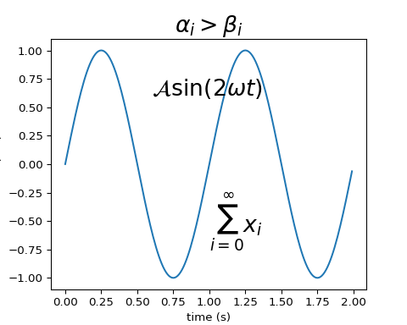
matplotlib 绘图
数学公式

Slide 13
软件信息
xfun::session_info("rmarkdown")
## R version 3.5.0 (2017-01-27) ## Platform: x86_64-pc-linux-gnu (64-bit) ## Running under: Ubuntu 14.04.5 LTS ## ## Locale: ## LC_CTYPE=en_US.UTF-8 LC_NUMERIC=C ## LC_TIME=en_US.UTF-8 LC_COLLATE=en_US.UTF-8 ## LC_MONETARY=en_US.UTF-8 LC_MESSAGES=en_US.UTF-8 ## LC_PAPER=en_US.UTF-8 LC_NAME=C ## LC_ADDRESS=C LC_TELEPHONE=C ## LC_MEASUREMENT=en_US.UTF-8 LC_IDENTIFICATION=C ## ## Package version: ## base64enc_0.1.3 digest_0.6.18 evaluate_0.13 glue_1.3.1 ## graphics_3.5.0 grDevices_3.5.0 highr_0.8 htmltools_0.3.6 ## jsonlite_1.6 knitr_1.22 magrittr_1.5 markdown_0.9 ## methods_3.5.0 mime_0.6 Rcpp_1.0.1 rmarkdown_1.12 ## stats_3.5.0 stringi_1.4.3 stringr_1.4.0 tinytex_0.13 ## tools_3.5.0 utils_3.5.0 xfun_0.7 yaml_2.2.0 ## ## Pandoc version: 2.1.3

