Slide 1
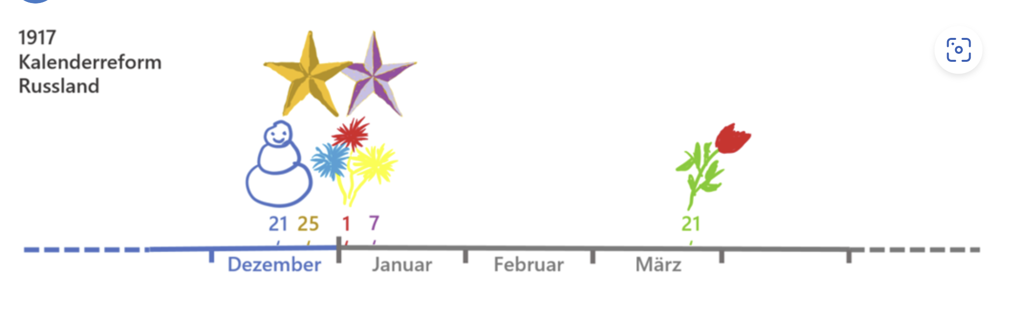

Slide 2

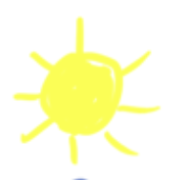




100 BCE
Old Roman Calendar
Winter Solstice
December January February March
21
25
7
1
21

Slide 3
Ancient Rome
Republican calendar
Spring Equinox
Start of the year
1
December January February March
21
25
7
1
21

Slide 4
Ancient Rome
Republican calendar,
which begins on January 1
Spring Equinox
1
1
December January February March
21
25
7
21

Slide 5
45 BC
Julian calendar
Winter Solstice
Spring Equinox
25
1
25
December January February March
25
7
21

Slide 6

274 AD Birthday of sun god
Birthday of sun god
Winter Solstice
25
1
25
December January February March
25
7
21

Slide 7
4th century AD Christmas
Christmas
25
1
25
December January February March
25
7
21

Slide 8
1581 Julian calendar
11
25
1
11
December January February March
25
7
21

Slide 9
1582 Gregorian calendar
21
25
1
21
December January February March
25
7
21

Slide 10
Later New Year‘s Day
21
25
1
21
December January February March
25
7
21

Slide 11
1917 Gregorian calendar
21
25
1
7
21
December January February March
1917
Julian calendar, Russia
25
1
December January February March
25
7
21

Slide 12
Since 1918
Christmas
Christmas
21
25
1
7
21
December January February March
25
7
21

Slide 13
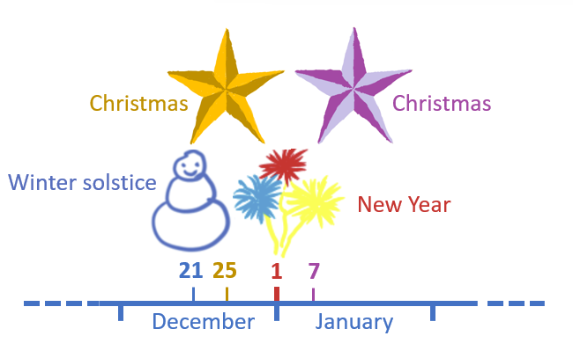
Christmas
Christmas
Winter solstice
New Year
21
25
1
7
21
December January
25
7
21

