Slide 1
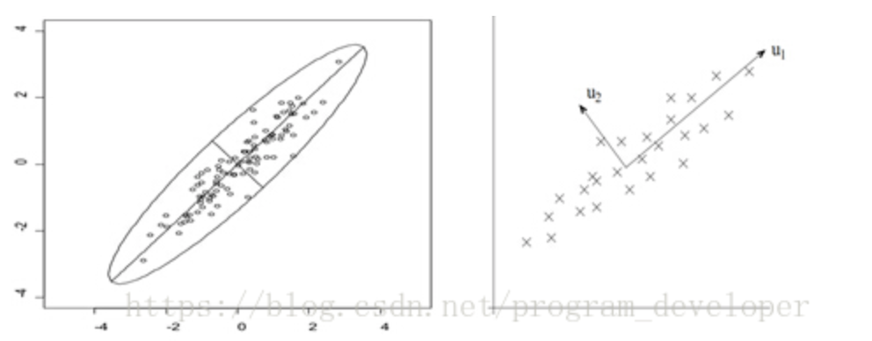
Principal Components Analysis
Peihao Fang
16269402

Slide 2
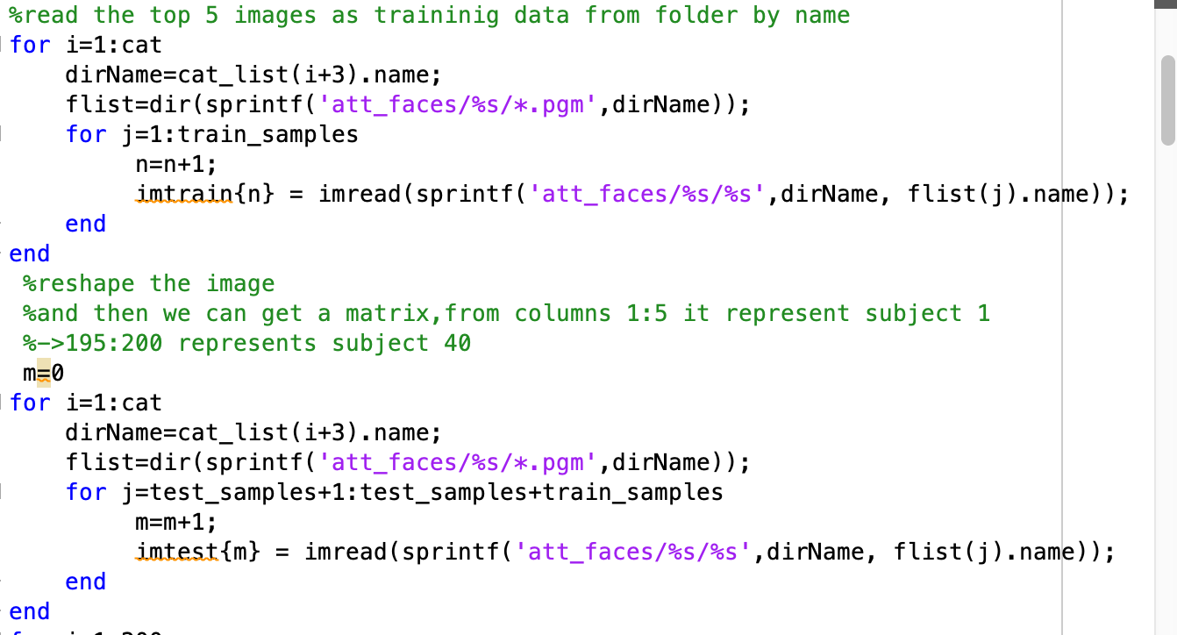
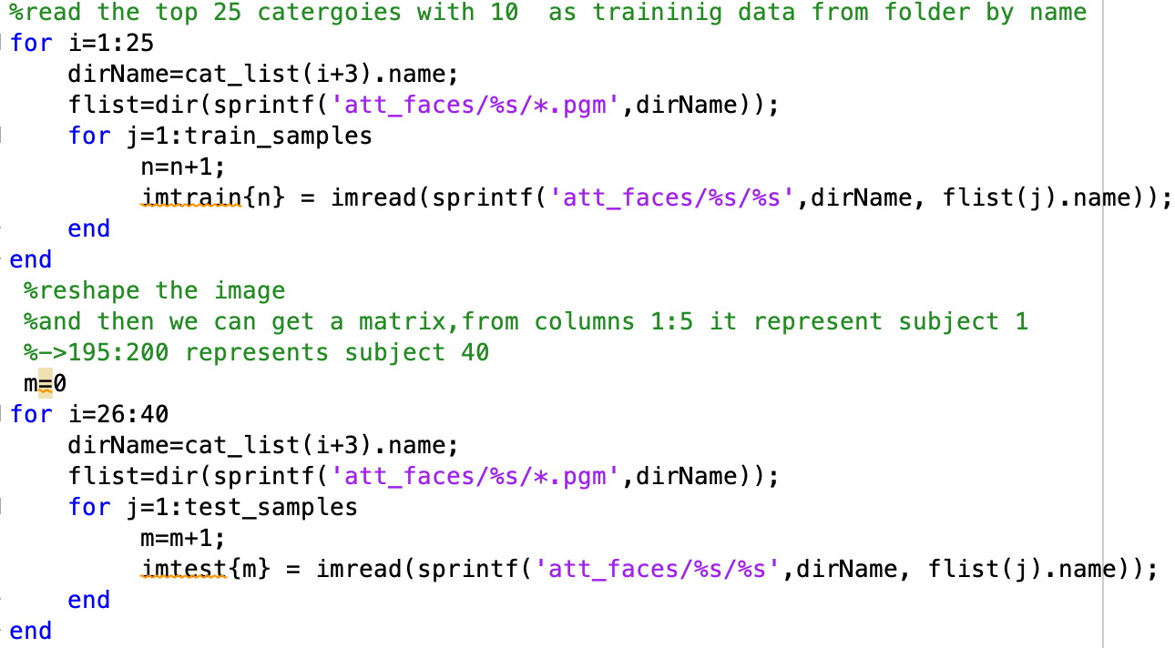
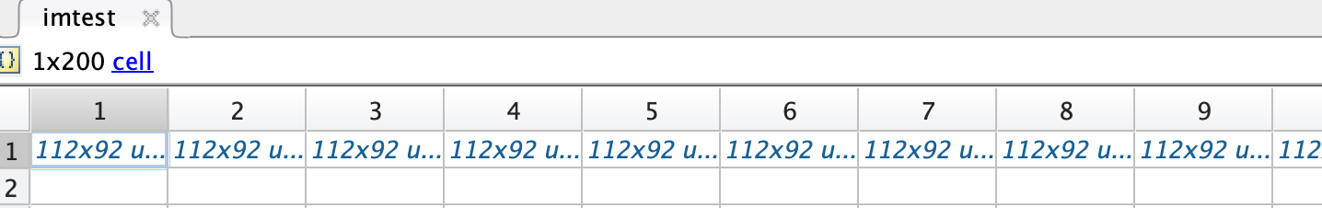
Model1:
First step, we need to load the image from folder.
Model1:For each subject, use the first five images (1.pgm to 5.pgm) for training the subspace. Use the files 6.pgm to 10.pgm for the performance evaluation.
Model2:Use the first twenty five subjects (1.pgm to 10.pgm) for training the subspace. Use the rest 15 subjects for the performance evaluation.
Model2:
After that we can get a cell struct

Slide 3
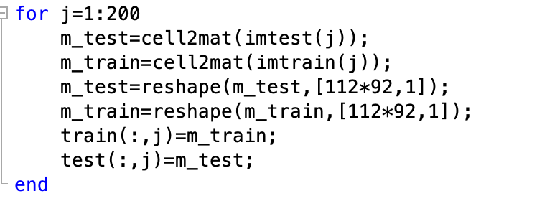
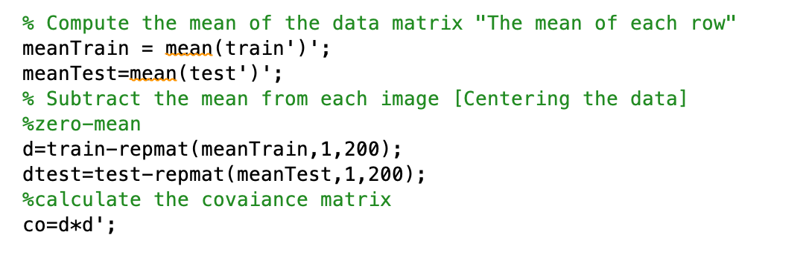
We need to change cell into matrix
Then we need to zero-mean the datasets . (unify)
The left image sets are model1 , moel2 has same operations.
Then we need to calculate covariance matrix.

Slide 4
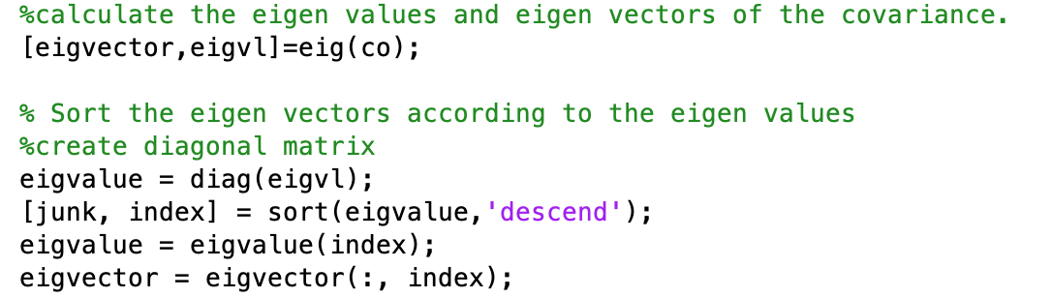
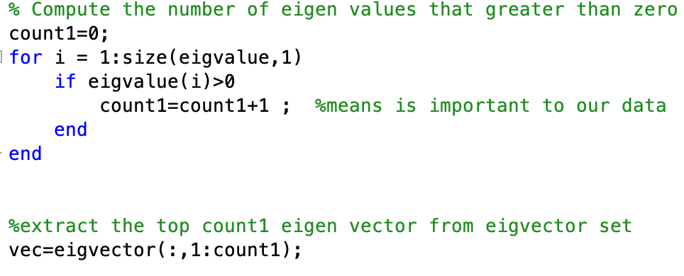
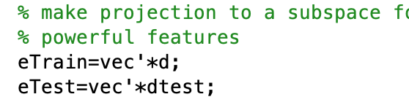
We can get eigen value and eigen features by use eig() with covariance .
Then we descend our data sequentially and then we set a threshold to select our top n eigen values. We assumes that these n features are important or useful for our model.
And we can get our sequential eigen vector matrix.
Finally, we project our original dataset into eigen subspace.

Slide 5
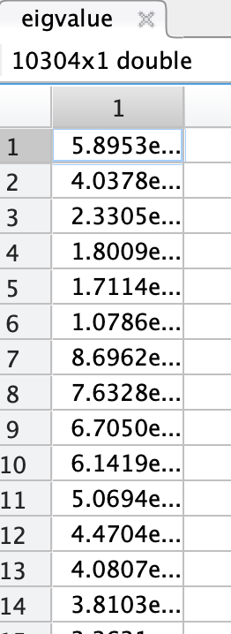
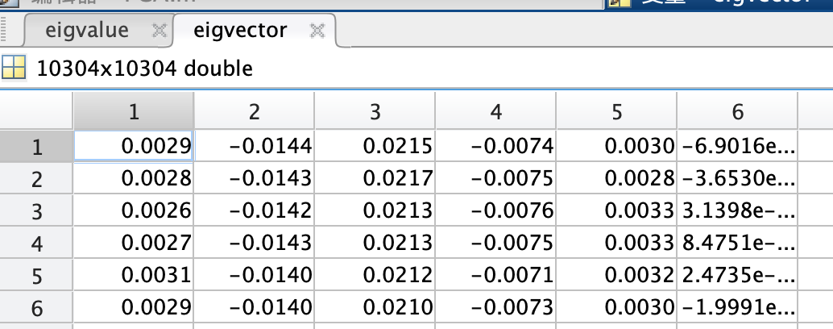
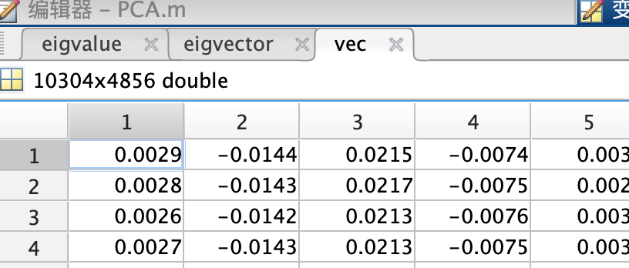
Finally, we get our eigen matrix

Slide 6
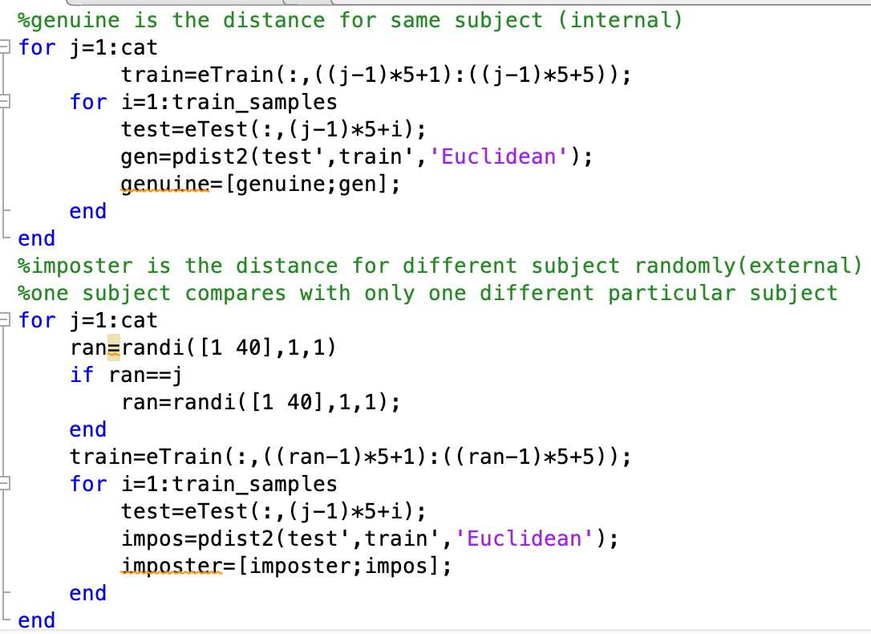
Model1
In model1 we get our genuine by compute the distance from one image with their own same subject. We have already separated into two subsets.
For instances, we only need to compute the Euclidean distance between im6 and im1-5.
And for imposters ,we select a different subjects randomly by randi(). And compute the distance between one image with the other subjects.
For instance we compute im6 with im31-35.

Slide 7
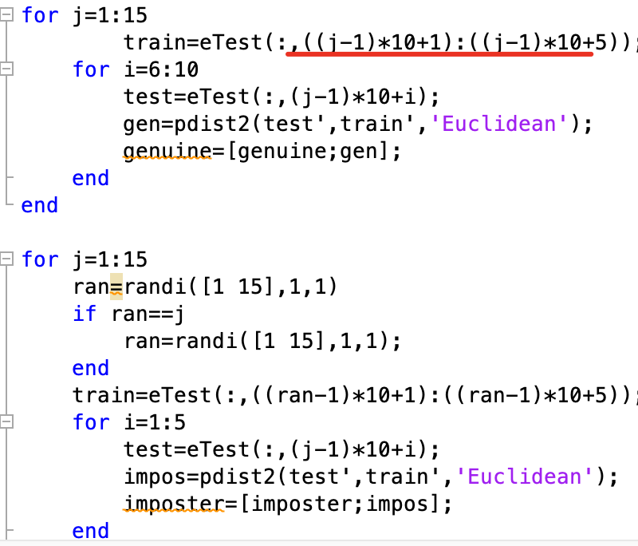
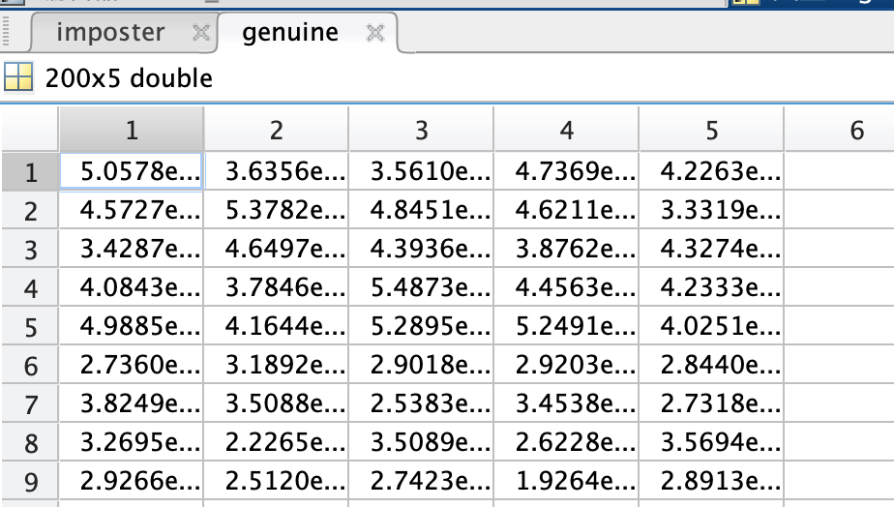
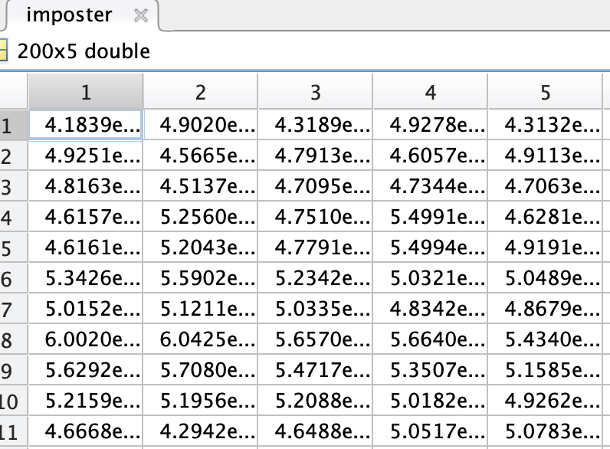
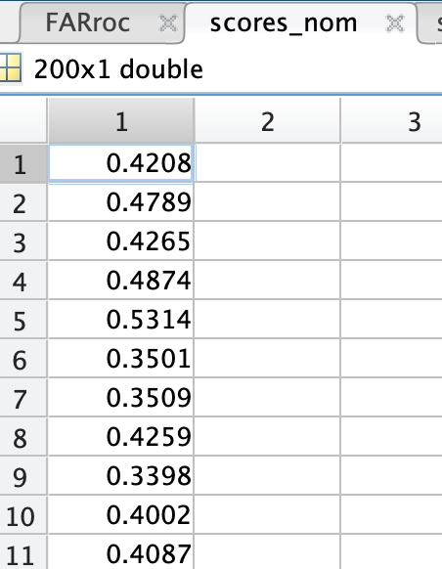
Model2
We use top 25 subjects to produce PCA subspace, we need to separate the remaining 15 datasets into test and training by 5+5.
And make same comparison as model1

Slide 8
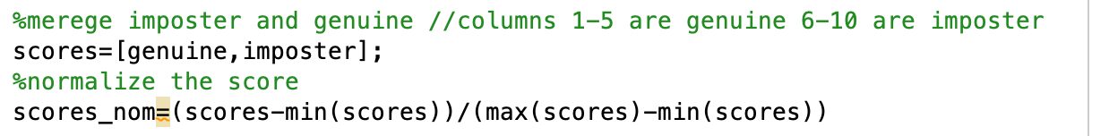
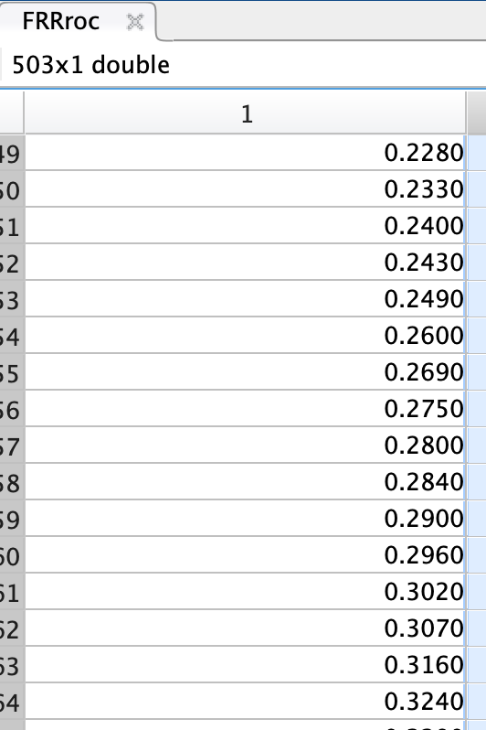
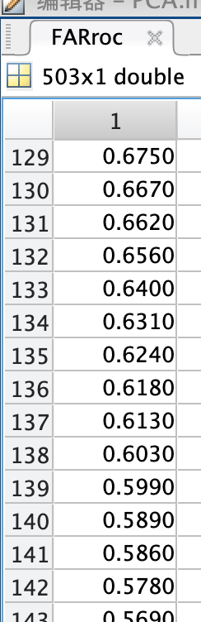
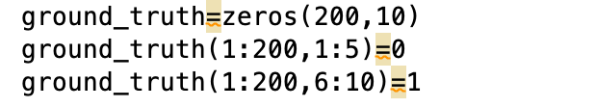
We merge the imposters and genuine into scores and normalize it.
Set up different ground truth . 1-5 columns are true ,6-10 are false for each image.
I add two return value in defined function to check the FRR and FAR conveniently .
Final step we get roc curve

Slide 9
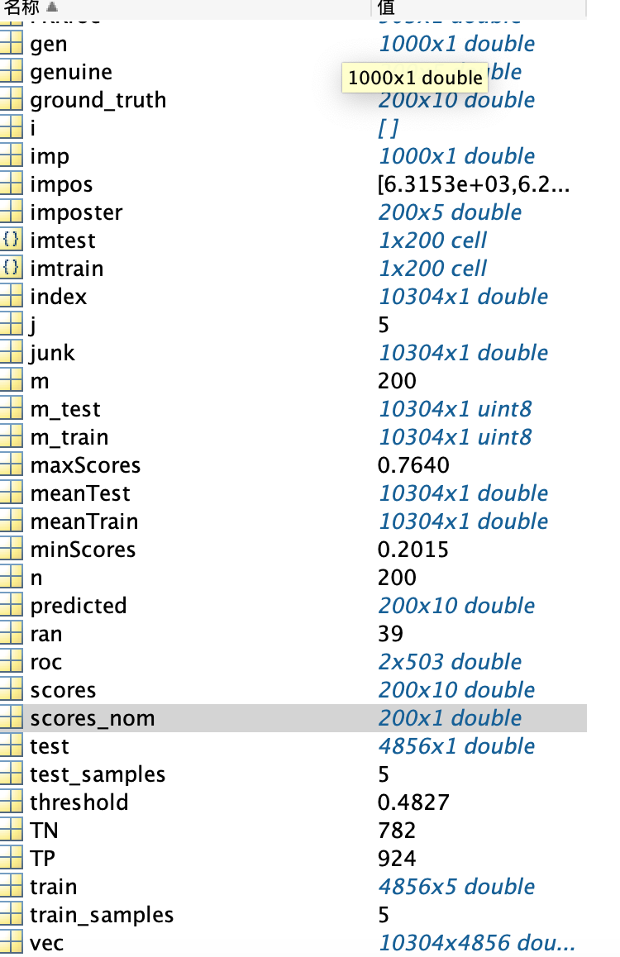
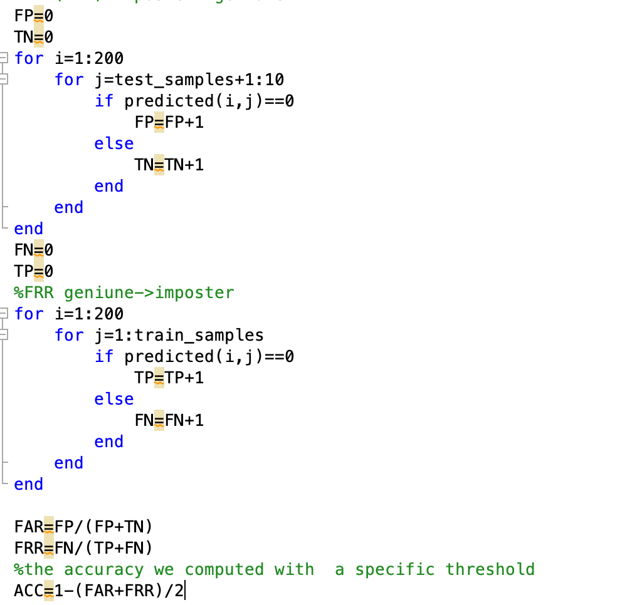
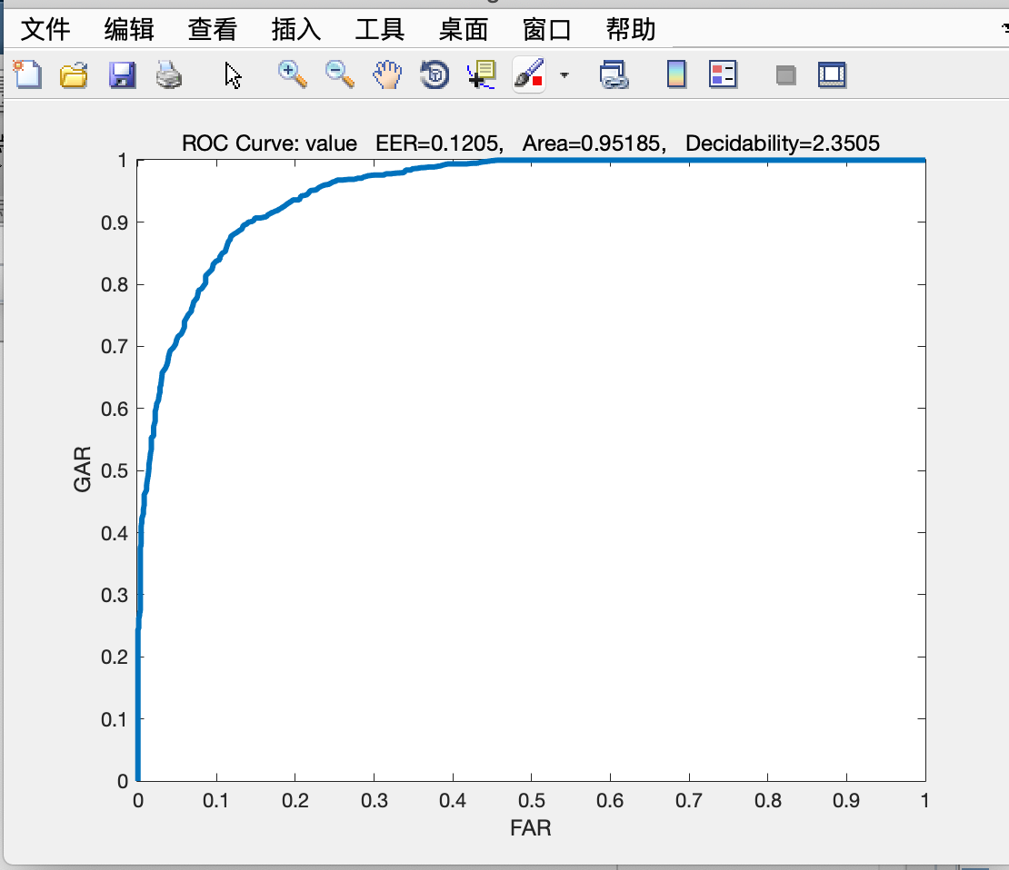
Also, I compute manually by myself to set a specific threshold rather than a continuous curve.
Work space
roc

