Slide 1
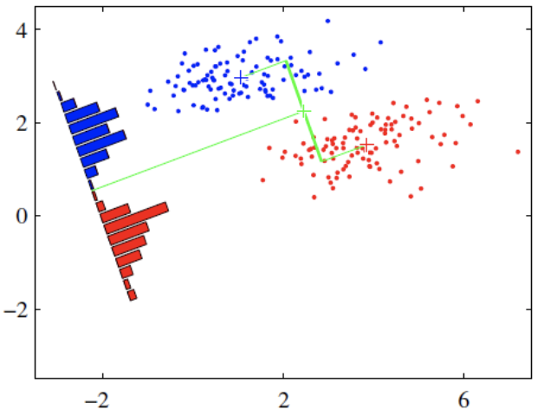
Linear discriminant analysis (LDA)
Peihao Fang
16269402
pf9bx@mail.umkc.edu

Slide 2
Project goal:
Face Recognition using Linear Discriminant Analysis (LDA)
Comparison with Principal Component Analysis (PCA) based Face Recognition
LDA : Intra-class distance is minimum
Inter-class distance is maximum
Prepare a training set of face images
Compute Within and Between Class Scatter Matrices.
Calculate the Eigenvectors and Eigenvalues of the Covariance Matrix.
Choose the Principal Components. Sort the Eigenvalues in descending order and arrange Eigenvectors accordingly.
Classify and compare with ground truth to evaluate performance
Eigen Face by PCA
Face Rrcognition by LDA

Slide 3
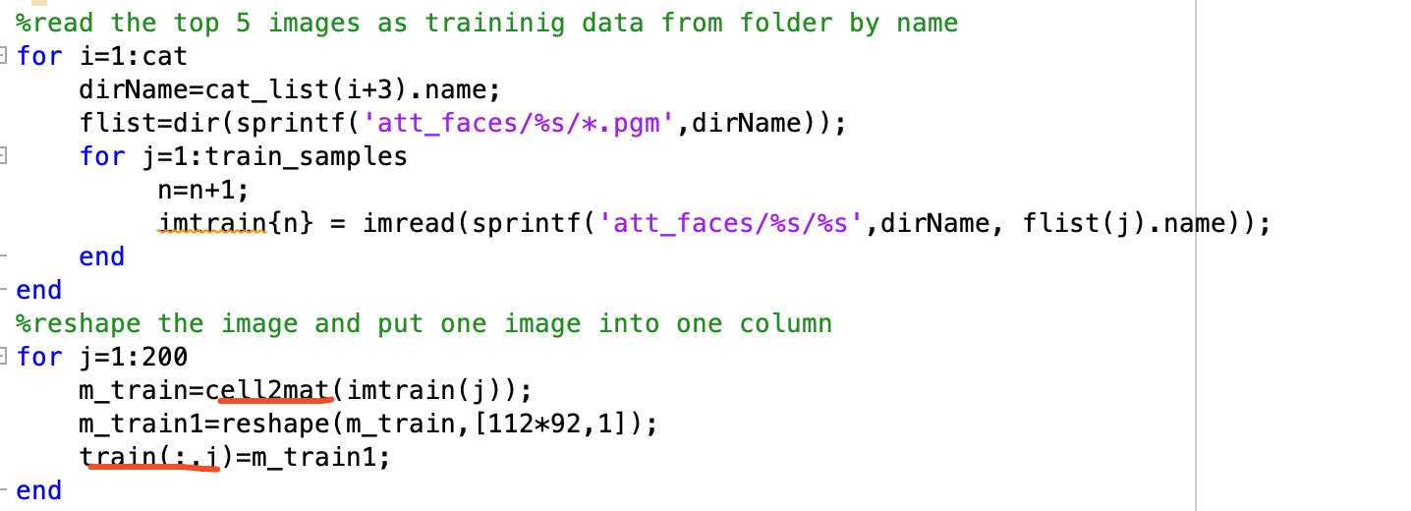
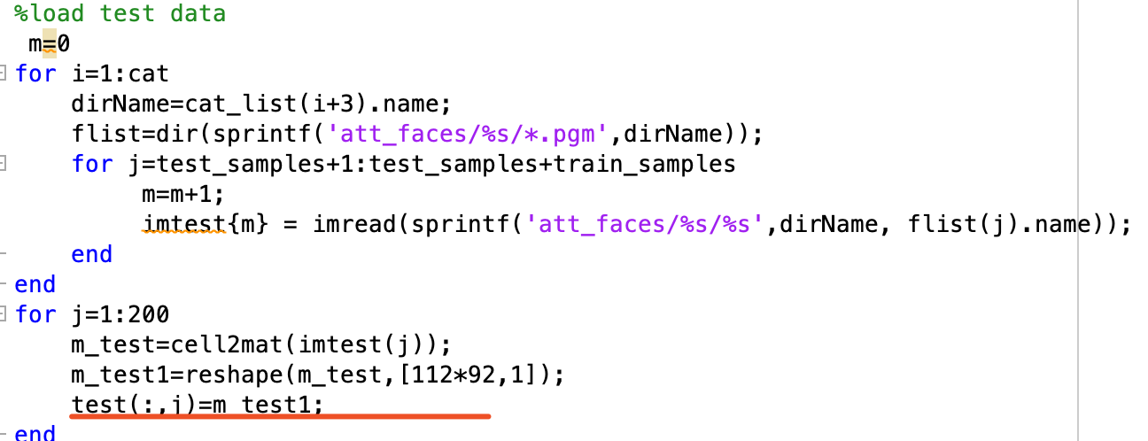
For each subject, use the first five images (1.pgm to 5.pgm) for training the subspace. Use the files 6.pgm to 10.pgm for the performance evaluation.
Training set
Test set

Slide 4
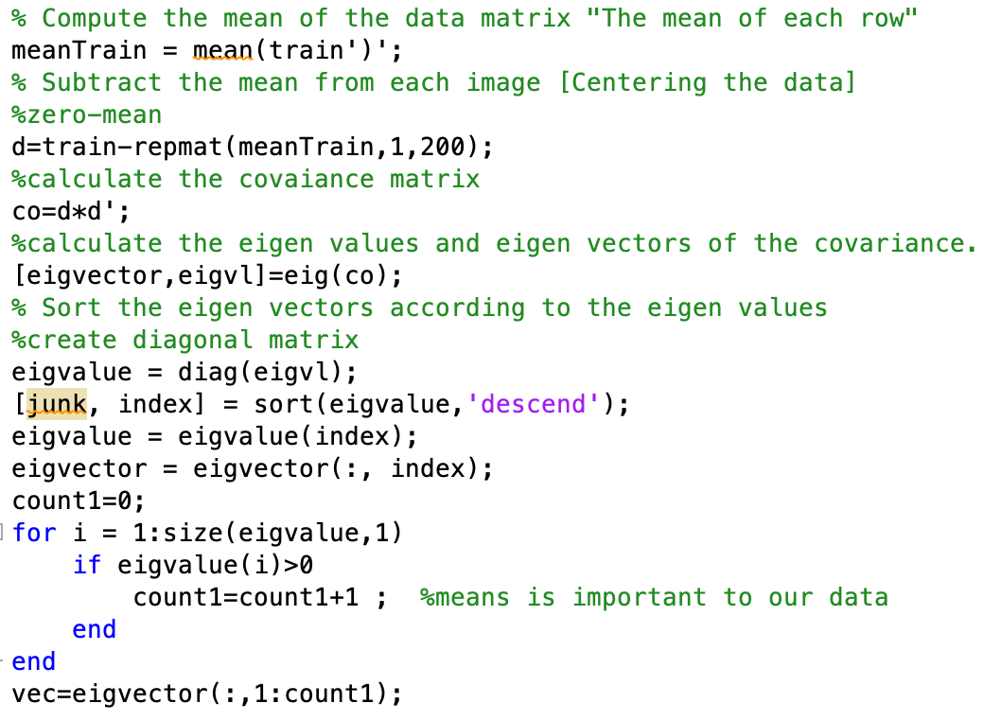
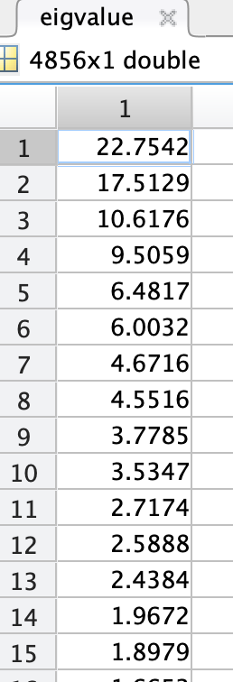
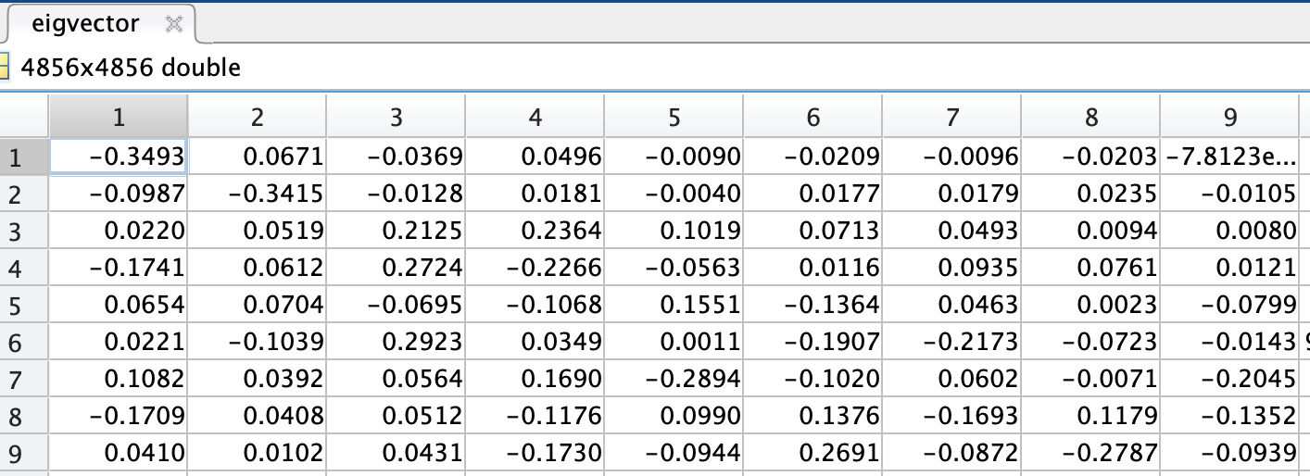
Eigen face by PCA
Zero-mean dataset and then calculate covariance to find eigen values and eigen vectors.
After we obtained the eigen value, we sort the eigen vector by descending order corresponding eigen value greater than a threshold(o)

Slide 5


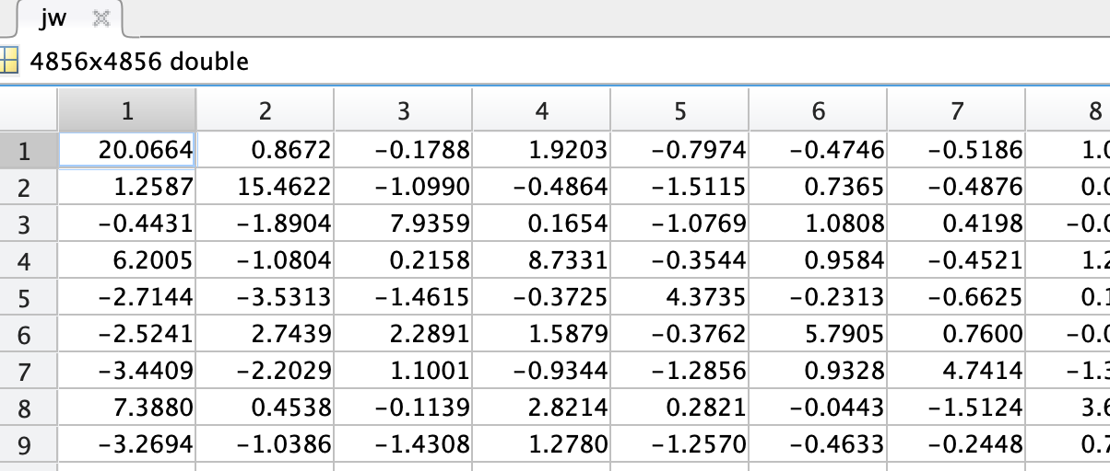
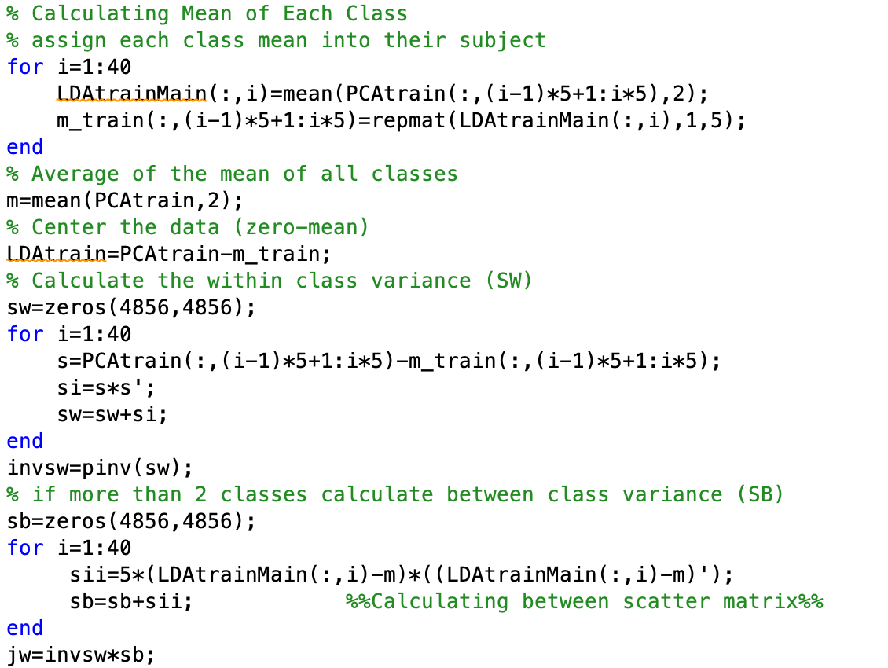
Project data into PCA subspace
We project our original dataset 10304*200 into PCA subspace 4856*200
LDA based on PCA
Preprocessing:
Due to LDA’s fundamental , we need to calculate each subject’s (five images) mean from training set by column
And then zero-mean each subject
Scatter-within:
(Each image from same subject – subject mean)*(Each image from same subject – subject mean)’
Scatter-between:
(Each mean for each subject –mean of whole dataset)* (Each mean for each subject –mean of whole dataset)’
J(w)=(Sw)-1 *Sb

Slide 6
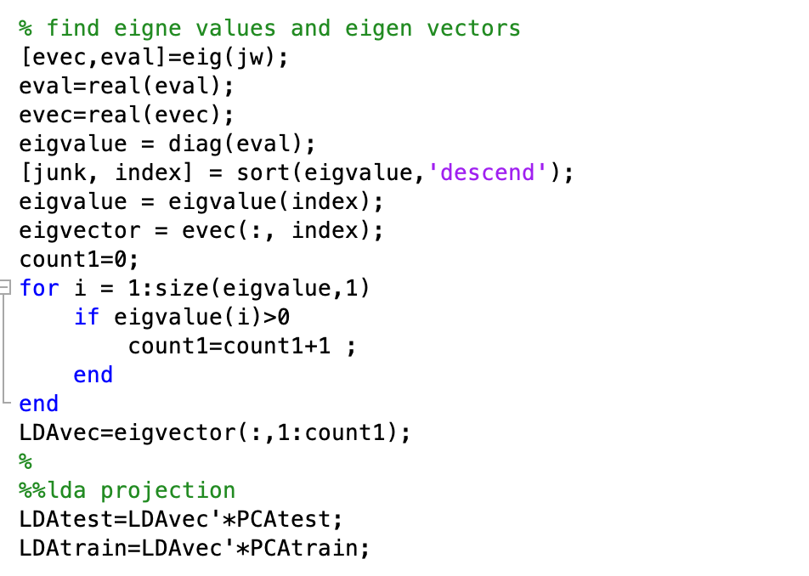
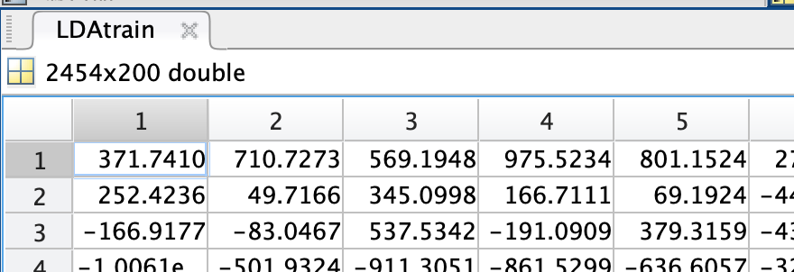
Eigen space LDA projection
Operations and workflow as same as PCA,
After LDA we can obtain 2454 eigen feature

Slide 7
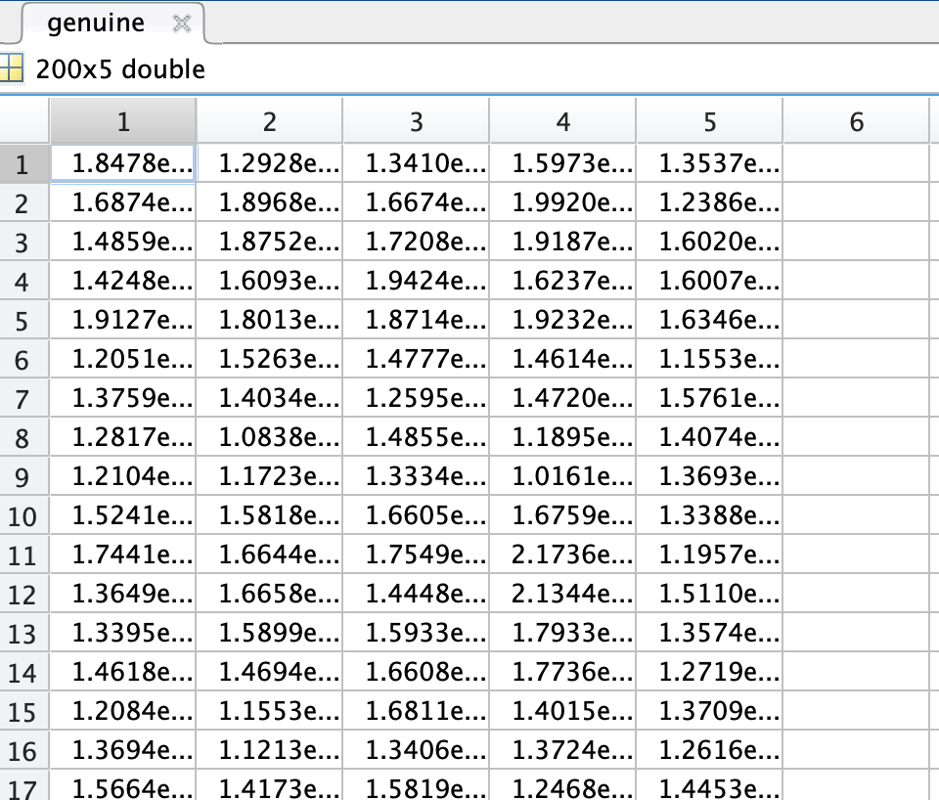
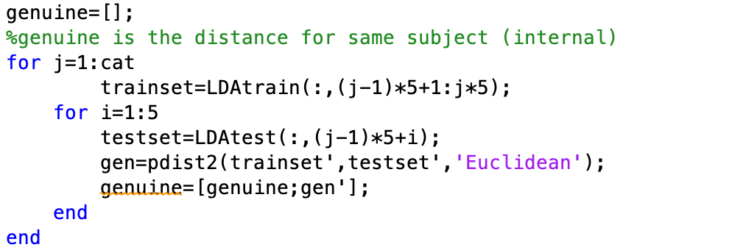
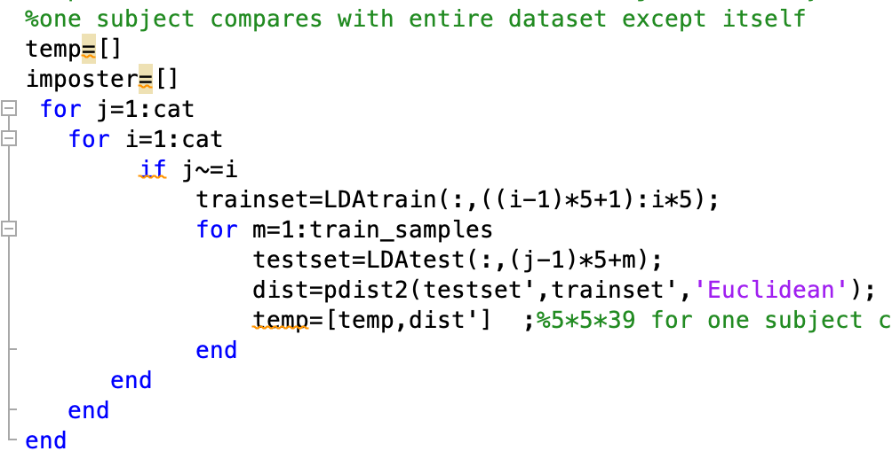
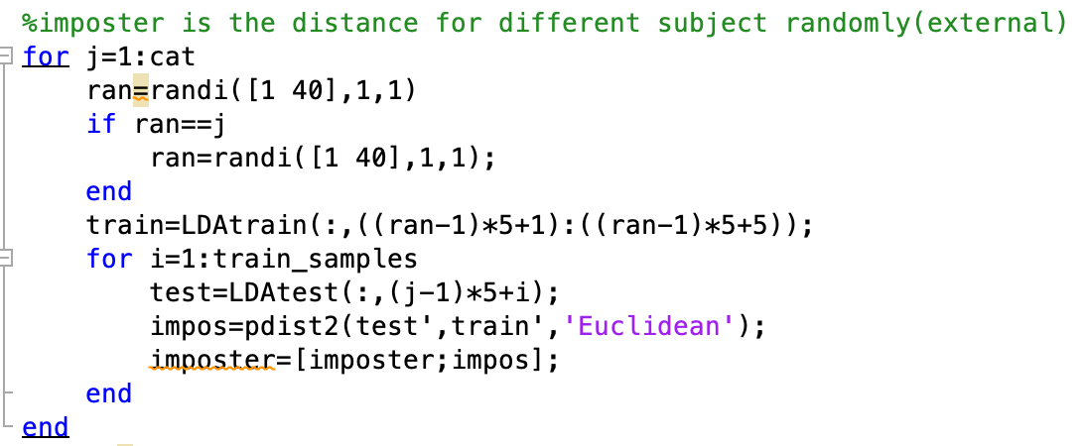
Genuine
Each image has five distance from same subject
Imposter
Model 2 compare with all different subjects
Model 1 compare with one random different subject

Slide 8
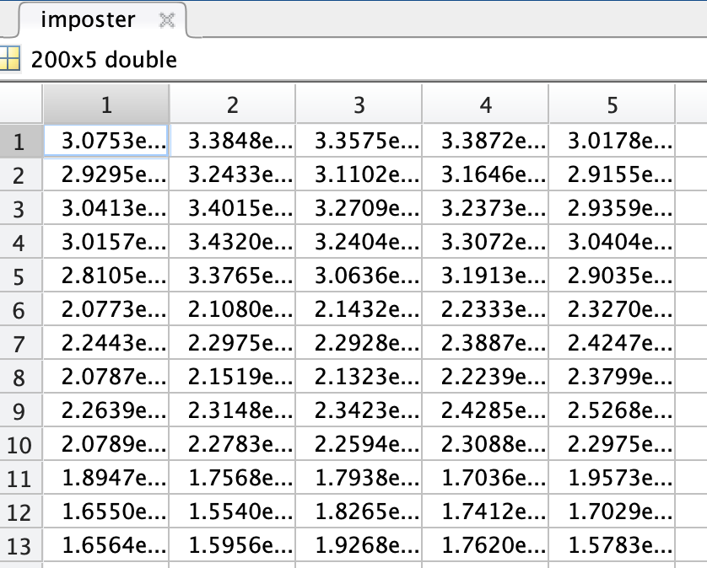
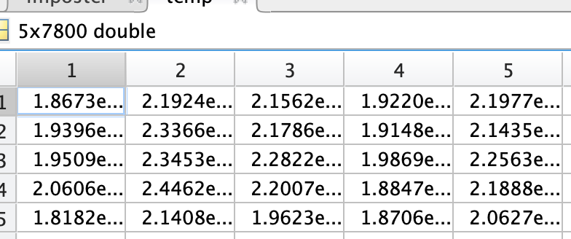
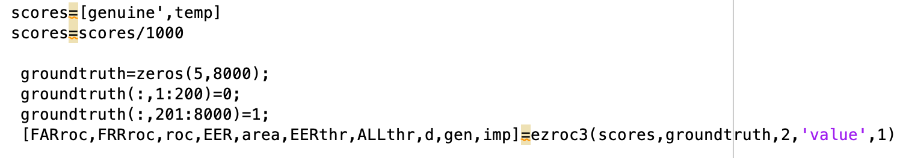
Model 1
Model 2
The size of imposter 5*5*40
The size of temp is 5*5*39*40
Each image needs to make 5*39 times comparsion and each subject has 5 images. There are total 40 subjects
Merge imposter and genuine .Based on different model , we establish different ground truth by 0 and 1. Use ezroc to get ROC curve

Slide 9
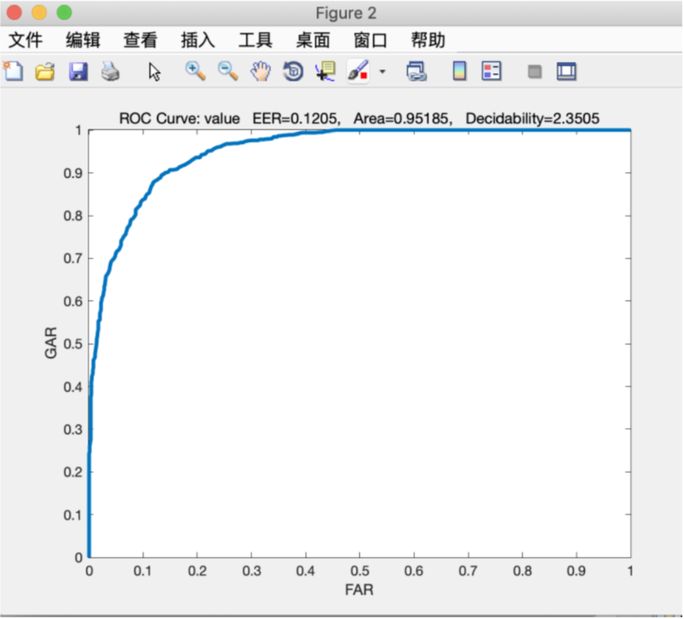
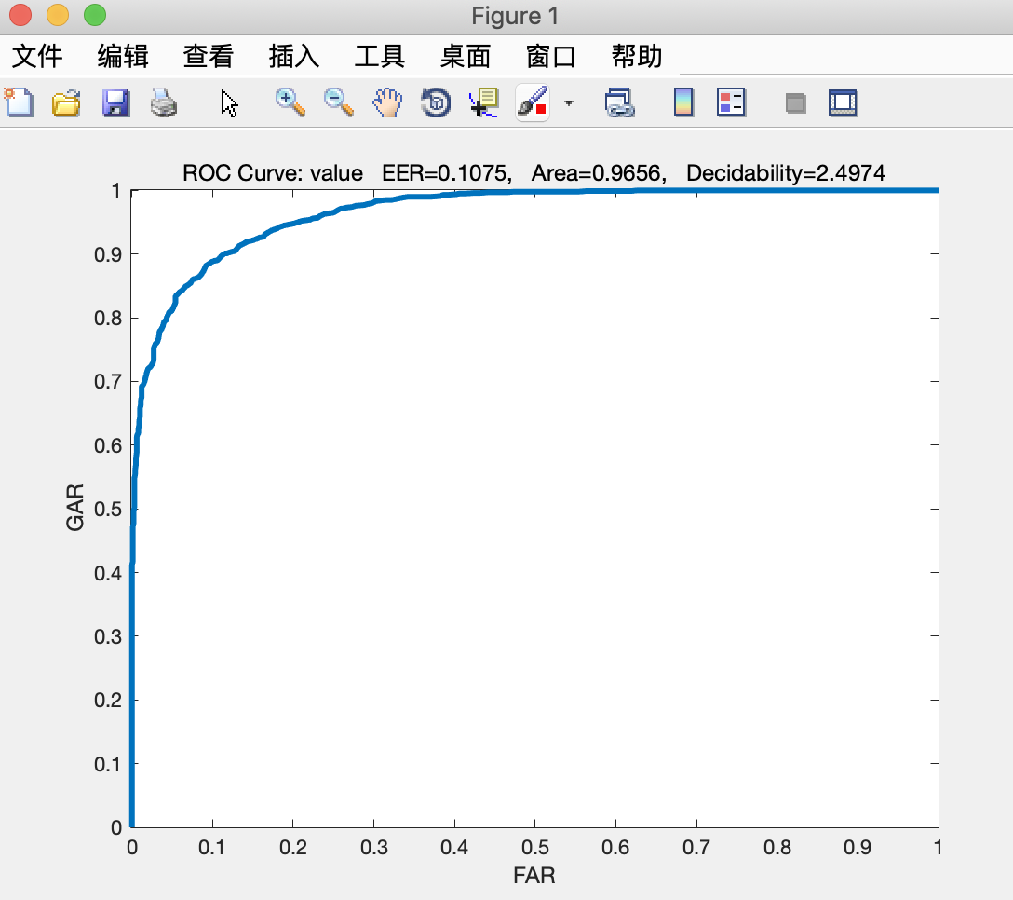
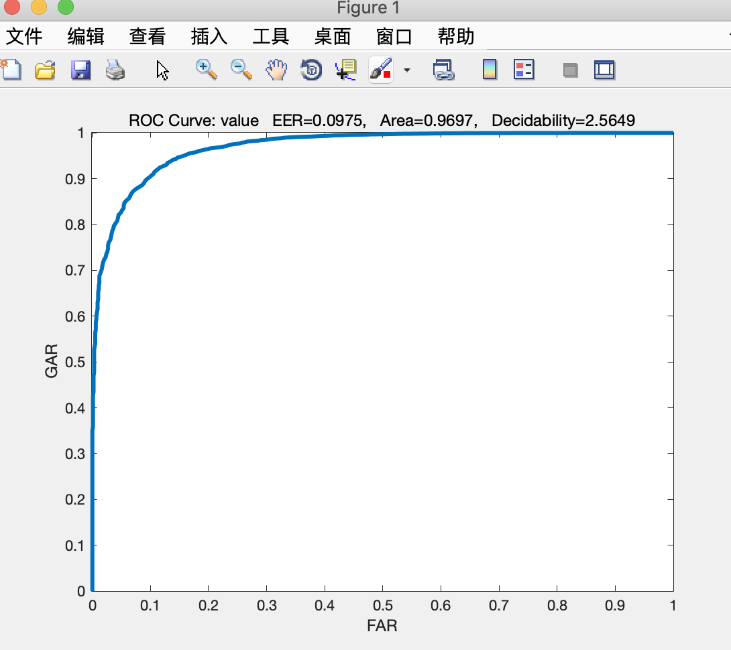
PCA
In project 1, I compute Euclidean distance between each image from test with images in their same subject from training set as genuine.
Computing Euclidean distance between each image from test set with images in different subject from training set as imposter. Due to the requirement, I only select one different subject randomly.
I get AUC=0.95185 and EER=0.1205 as a result and set it as a baseline for LDA.
Model-1
In model1, I use the result from project 1 as a baseline to evaluate my model. To control variable or also called make a unified criteria, we have to use the same dataset we used in project1. The genuine dataset is as same as project1, but for imposter the dataset we obtained by selecting randomly , so maybe brings a little bias ,but the bias is not important for the result.
I get AUC=0.9656and EER=0.1075
Model-2
According to the requirement from LDA Project Assignment, we need to compare one subject from all remainder different subjects rather than random one, so I also do this by compare with remainder 39 subjects.
I get AUC=0.9697 and EER=0.0975

Slide 10



FAR
FRR
According these three different models by same dataset, we can find out that the LDA-2 (compared with all different images as a imposter) get the largest AUC area. Compared with LDA1, it trains lots of observation to improve the accuracy.
All in all, the conclusion is that if we do PCA(model1 ) before LDA(model2，3). The performance of LDA will be better than PCA. Because we combine PCA and LDA. LDA get worse performance if dimensionality is too high. So we use PCA to reduce dimensionality, based on PCA subspace the LDA performance has been a marked improvement.

