Slide 1
Low level Policy trainging
by Zhexiong Wang
2025-12-03

Slide 2



1 Simple self-introduction
Zhexiong Wang
ROS2-Based Autonomous Wheeled Robot with Vision & Navigation
Aug 2024
frankgraen@gmail.com
Deep Learning Networks from Scratch with PyTorch
Oct 2024–Jan 2025 Personal Project
+86 13259882218
LLMs Powered Voice-Controlled Humanoid Robot
Mar – Jun 2025 at Unitree Robotics | Hangzhou, China
https://github.com/FrankGraen/DWAM_low.git
Daily Motion Design & Data Collection
Voice-to-Action Pipeline
Natural Language to Motion System for Unitree G1

Slide 3



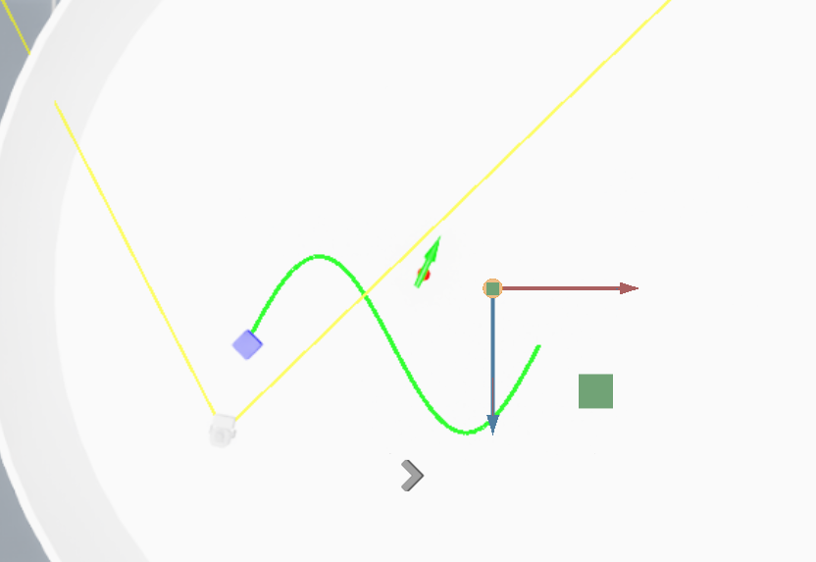
2 Task Description
Target_1 : reach box
Target_2 : tracking until completion
Push the box tracking the current trajectory
trajectory : ((x₁,y₁),(x₂,y₂), … ,(x_{N},y_{N}))
set N = 100
box
rbt
trajectory

Slide 4
2 Task Description
Observation
fov_box_observation (dis, ang)
Policy model (MLP)
goal_observation (x_local,y_local)
Action
trajectory_observation
(x_local,y_local,…)
flatten
reward
distance_decrease_reward
oscillation_penalty
out_of_bounds_penalty
fov_exploration_reward
robot_angle_to_box
trajectory_distance_reward
reached_box_reward
trajectory_progress_finish_reward
slow_down_near_finish_reward
Step1: reach box
Step2: push box tracking the trajectory

Slide 5
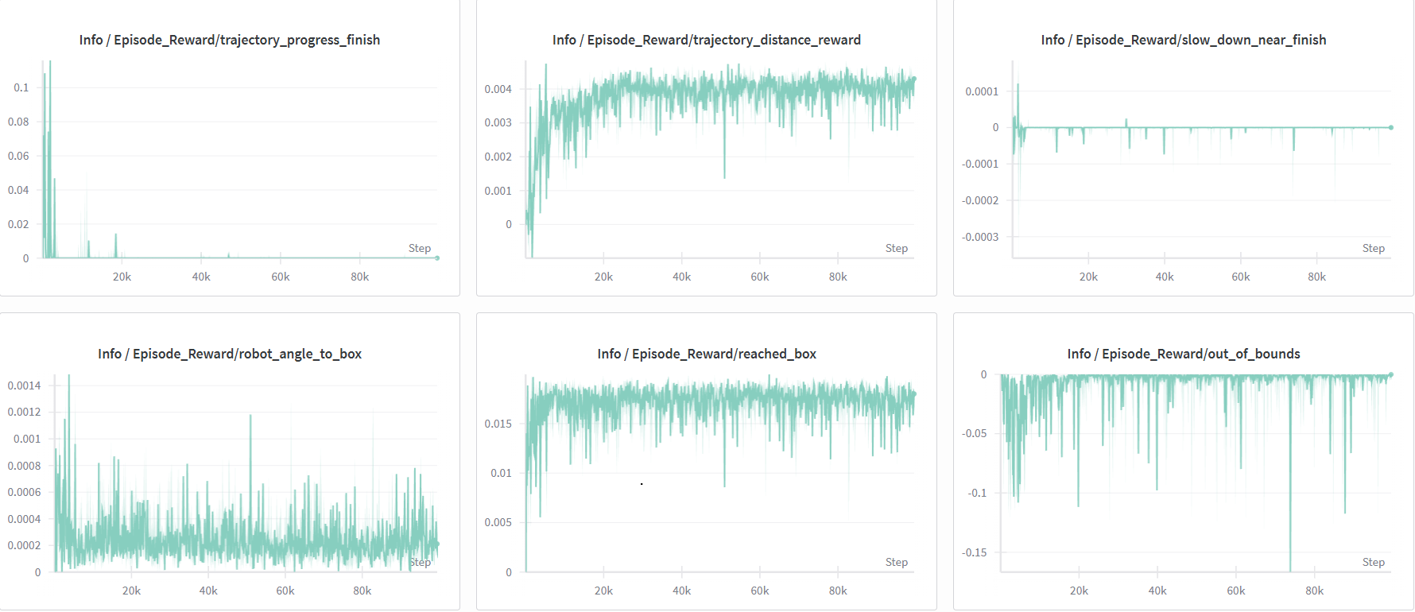
3 Difficulties Faced
reach box
tracking until completion
(perform not well like before)

Slide 6
3 Difficulties Faced
Observation
④
Use the target-box distance instead of box-trajectory distance
fov_box_observation (dis, ang)
①
Policy model (MLP)
goal_observation (x_local,y_local)
Action
trajectory_observation
(x_local,y_local,…)
flatten
②
③
Scaling of Reward Function
reward
distance_decrease_reward
oscillation_penalty
out_of_bounds_penalty
fov_exploration_reward
robot_angle_to_box
trajectory_distance_reward
reached_box_reward
trajectory_progress_finish_reward
slow_down_near_finish_reward
Step1: reach box
⑤
Step2: push box tracking the trajectory
Add other reward?

Slide 7
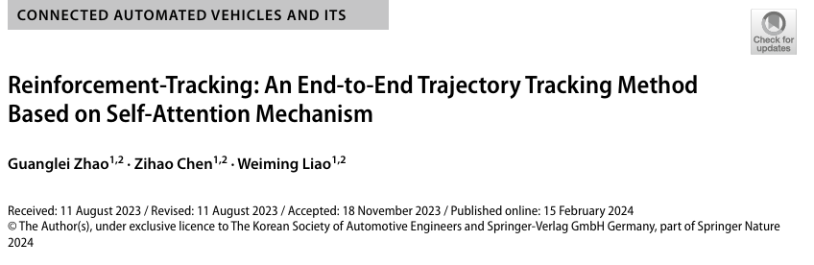
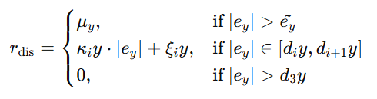
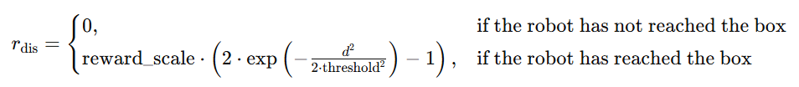

3 Difficulties Faced
⑥
Use the trajectory with (vel,t) ?
· Heading reward corrects the heading of rbt with respect to the reference trajectory
· Longitudinal reward is used to motivate rbt to move forward along the reference trajectory
$$r_{l}=k_{l}\frac{l−\hat{l}}{N}$$
· segmented linear reward function

Slide 8
2 Task Description
Observation
fov_box_observation (dis, ang)
Policy model (MLP)
fov_goal_observation (dis,ang)
Action
trajectory_observation
((xt,yt),(xt+2, yt+2))
flatten
Action
reward
distance_decrease_reward
oscillation_penalty
out_of_bounds_penalty
fov_exploration_reward
robot_angle_to_box
trajectory_distance_reward
reached_box_reward
trajectory_progress_finish_reward
slow_down_near_finish_reward
Step1: reach box
Step2: push box tracking the trajectory

