Slide 1


Slide 2
The Past
Ray Ryans‘s presentation (Google I/O 2009): „Building high performance web application“
Stateless Services
Dependency Injection
Model, View & Presenter
Event Bus (Decoupling)
History Management
After that presentation we saw implementations:
GWT Activities & Places
GWT Platform / GWTP
MVP4G

Slide 3
My Favorite: MVP4G
Navigate using events
History done by serializing events
Presenter & Handler
Filters -> cool
Easy Multi-Shell-Support
Using annotations -> very cool
Caching by default -> super cool … may be
Is MVP4G Web-like? … not really

Slide 4
Motivation
Take the cool things from MVP4G:
Filters, Annotations, Handler, Caching, Multi-Shell-Support, etc.
Add more cool stuff:
Application wide context injected in every controller, handler, filter, etc.
Application loader
Composites
Application wide event bus
History without any effort (pretty cool!)
Support GWT-based & Element-based Widgets

Slide 5
Nalukit/Nalu — Feature List
Routing based application framework for GWT 2, GWT 3 / J2CL
Route based navigation
Loader at application start
Client side context, router and event bus
Filters to intercept routing
Separation of views into a controller and a component with framework sided instantiation
A controller life-cycle using start-, mayStop- and stop- similar to GWT Activities
Caching of controllers & composites
PopUpController
BlockController
Handler-Management
Composites to support smaller visible units
Controller & component caching
Multi Shell Support
Maven multi module projects to separate an application in smaller parts (module feature)
Tracking user routing (in case a tracker is added)

Slide 6
Let‘s look at the basic concept
Added to the URL as hash (works also without ‚#‘!)
First part of the route is always the shell name
Example: #[shell]/[part_1]/:[parameter_1]/:[parameter_2]/[part_2]
shell: identifies the shell to use
part_x: a part of the route
parameter_x: a parameter

Slide 7
How do we navigate inside an application?
Use the router
Available in every controller, ghandler, etc.
Call: router.route(„hash“, „parameter1“, „parameter2“);
To force routing (route without confirmation), call: router.forceRoute(„hash“, „parameter1“, „parameter2“);

Slide 8
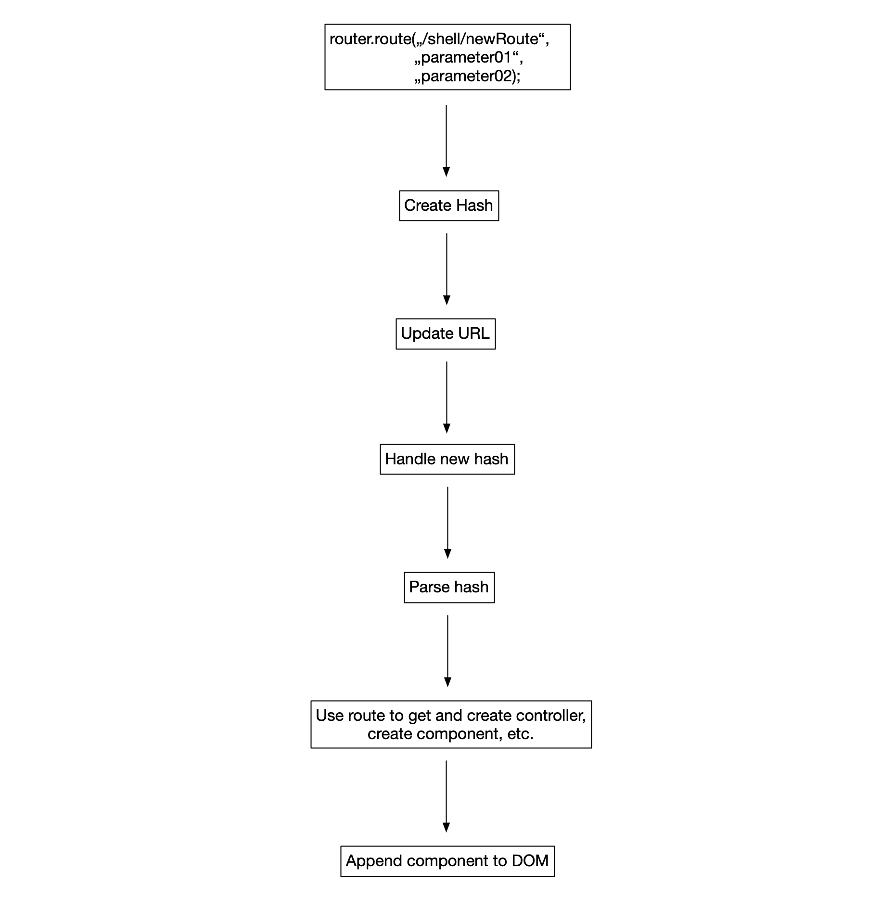
How does Nalu work?
Route to a new screen with two parameters using the router
Ask current controller for confirmation
Run filters (if present)
Create hash using route String and parameters
Update URL with hash
Handle the hash
Parse the hash
Update shell (if necessary)
Create controllers & Components
Append component to DOM

Slide 9
Let‘s start by creating an Application …
Interface must extend IsApplication
Requires @Application-Annotation
Parameter:
useColonForParametersInUrl (default is false): if true, parameters will have a ‚:‘ in URL
history (default is true): if false, the URL is not updated
useHash (default is true): if false, no hash is used
stayOnSite (default is false): you can not leave the application by pressing the back-button
alertPresenter (optional): class used, in case Nalu wants to show informations
confirmPresenter (optional): class used, in case Nalu requests a confirmation
@Application(
context = MyContext.class, startRoute = “/logon/request“, loader = MyLoader.class, useColonForParametersInUrl = true, confirmPresenter = MyDirtyDialog.class) public interface MyApplication extends IsApplication { }

Slide 10
A Nalu Context …
context-attribute is required
Context class must implement IsContext
POJO with getter- & setter-methods
Nalu will create one instance of the class and inject it in every controller, filter, handler, composite, etc.
A good place to store application wide informations
@Application(
context = MyContext.class, startRoute = “/logon/request“, loader = MyLoader.class) public interface MyApplication extends IsApplication { }
public class MyContext implements IsContext {
private String value;
// … getter & setter }

Slide 11
The startRoute-attribute
startRoute-attribute is required
Must be a valid route
Will be used in case the application is called without a hash (bookmark)
startRoute can not contain parameters!
@Application(
context = MyContext.class, startRoute = “/logon/request“, loader = MyLoader.class) public interface MyApplication extends IsApplication { }

Slide 12
Nalu Application Loader …
The Nalu Application loader is optional
Needs to extend AbstractApplicationLoader
Nalu will call the load-method right at the start of the application
To return the control to Nalu, call: command.finishLoading();
@Application(
context = MyContext.class, startRoute = “/logon/request“, loader = MyLoader.class) public interface MyApplication extends IsApplication { }
public class MyLoader
extends AbstractApplicationLoader<MyContext> {
@Override
public void load(FinishLoadCommand command) {
// do your loading stuff here ...
command.finishLoading();
}
}

Slide 13
Nalu Routing Filtering …
Filter-annotation is optional
The filter annotation accepts a single filter class or a list of filter classes
Needs to extend AbstractFilter
filter-method will be executed during a routing
Parameters:
Route
Parameters
In case the filter returns false, the redirectTo-method will be called. The method will return the new route
In case the filter returns false, the parameters-method will be called. The method will return parameters of the new route
@Application(…) @Filters(filterClasses = MyFilter.class) public interface MyApplication extends IsApplication { }
public class MyFilter
extends AbstractFilter<MyContext> {
public boolean filter(String route, String... parms) {
if (ok) return true; // everything is fine
return false; // do not execute hash
}
@Override
public String redirectTo() { return „/shell/newRouet“; }
@Override
public String[] parameters() { return new String[] {}; }
}

Slide 14
Tracker
Tracker-annotation is optional
Accepts a single class as value
Must extend AbstractTracker
The track-method will becalled in case of a successful routing
Inside the route, you have access to the current hash (route) and the parameter
Attention: Tracking a user may have legal issues!
@Application(…) @Tracker(MyTracker.class) public interface MyApplication extends IsApplication { }
public class MyTracker
extends AbstractTracker<KanaContext> {
@Override
public void track(String route, String... params) {
// do something ...
}
}

Slide 15
Debug
Debug-annotation is optional
Controlls the logging during development
Log output will be printed on the browser console
@Application(…) @Debug(logLevel = Debug.LogLevel.DETAILED) public interface MyApplication extends IsApplication { }

Slide 16
EntryPoint
The MyApplicationImpl class will be created by an APT
Create an instance
Call the run method
Tell Nalu, which plugin you will use
public class App implements EntryPoint { public void onModuleLoad() {
MyApplication application = new MyApplicationImpl();
// start the application by calling the run()-method. application.run(new NaluPluginElemental2());
} }

Slide 17
Shell
@Shell-Annotation
Parameter of @Shell-annotation is the name used inside the route
Need to extend AbstractShell<C>
attachShell-method: create your shell here and add it to the browser window
detachShell-method: add the code to remove the shell from the browser window
@Shell(“shell") public class LoginShell extends AbstractShell<MyContext> {
private Layout layout; public LoginShell() { } @Override public void attachShell() { this.layout = Layout.create("Application") .show(ColorScheme.BLUE); this.layout.getContentPanel() .appendChild(Row.create() .appendChild(Column.span12() .setId(„content“))); } @Override public void detachShell() { this.layout.remove(); } }

Slide 18
Controller-Annotation
Parameter
route: the controller is bind to (multiple shells & routes are possible)
selector: ID of a DOM element the component element is to append
component: class of the component
componentInterface: interface of the component
Keep in mind, Nalu uses an interface for the component and an interface for the controller.
@Controller(
route = “/shell/p1/:value01/:value02/p2“, selector =„content“, component = MyComponent.class, componentInterface = IMyComponent.class
)

Slide 19
Controller
Need to extend AbstractComponetController
Generics:
Name of Context-class
Name of Component-Interface
Name of Widget-class
start-method: Gets called, once the component is created and injected into the controller, etc.
@Controller(
route = “/shell/p1/:value01/:value02/p2“, selector =„content“, component = MyComponent.class, componentInterface = IMyComponent.class)
public class MyController extends AbstractComponentController <MyContext, IMyComponent, HTMLElement> implements IMyComponent.Controller { public MyController() { } @Override public void start() { } // … more magic stuff is happening here … }

Slide 20
Parameter … quite easy
Parameter are part of the route
Parameter are always of type String
Add a method for every parameter of the route
Annotate these method wich @AcceptParameter
The value of the AcceptParameter annotation is the name of the parameter from the route
The name of the method is not important
The method must accept a a String
In case a parameter has a illegal value, you can fire a RoutingInterceptionException
Route:
/shell/person/edit/:id
@AcceptParameter(“id")
public void setId (String value)
throws RoutingInterceptionException {
// handle the parameter …
}

Slide 21
Component-Interface
The interface need to extend IsComponent
Generics:
Controller-Interface
Name of the Widget-class
Controller Interface needs to extend IsComponent.Controller
Add every method that is visible for the controller of the component
Add in the Controller interface every method that is visible inside the component of the controller
public interface IMyComponent extends IsComponent <Controller, HTMLElement> {
interface Controller extends IsComponent.Controller { } }

Slide 22
Component
Needs to extend AbstractComponent
Generics
Controller Interface
Name of widget class
Requires a render-method:
Inside the render-method a initElement([rootElement])-call is required
public class MyComponent extends AbstractComponent <IMyComponent.Controller, HTMLElement> implements IMyComponent { private DivElement container;
public LoginComponent() { } @Override public void render() {
// create container here … initElement(container)
}
}

Slide 23
Slots … Element Based
Controller/Composites use the selector value to identify the slot to append the widget
Nalu will look for an ‚id‘ that matches the selector value
In case a node is found, Nalu will append the element using appendChild()
@Override public void render() { HTMLDivElement container =
Elements.div().element(); container.appendChild(Row.create() .addColumn(Column.span12() .setId("breadcrumb")) .element()); container.appendChild(Row.create() .addColumn(Column.span12() .setId("composite01")) .element()); initElement(container); }

Slide 24
Slots … GWT Widget Based
Controller/Composites use the selector value to identify the slot to append the widget
Nalu will look for a Selector-anotation that matches the selector value
In case a note is found, Nalu will append the widget using add()
@Selector("header")
public void setHeader(Widget widget) {
this.headerWidget.clear();
this.headerWidget.add(widget);
}
This code snippet was taken from a Nalu GWT example. This slot will be used, in case the selector has the value: ‚header‘

Slide 25
Some Notes on controllers …
You can have several controllers assigned to the same route (the last one wins!)
You can add several components to the same slot
In case of shell change, Nalu will look for controllers, that have the shell name as route
In case a controller is cached, the cached element will be reused
In case a controller is not cached, a new instance of the controller and the component is created
Every controller gets an instance of the context, event bus and router injected

Slide 26
Controller Life Cycle
start: will be called after the component is created. This method will be called in case a controller is not cached.
active: will be called after the start-method. This method will always be called, in case a controller is cached or not.
mayStop: will be called before a new routing occurs. In case the method return a String and not a null value, Nalu will display the String and abort the routing.
deactive: will be called before the stop-method. This method will always be called, in case a controller is cached or not.
stop: in case of a successful routing (not interrupted by a filter or the mayStop method) this method will be called. This method will be called in case a controller is not cached.

Slide 27
Composites
Divide a component into sub compoments
Better structure
Reuse
Caching
Component
Composite 1
Composite 2
Composite 3

Slide 28
PopUps
Nalu supports Dialogs
PopUps are triggered with events
PopUps have a controller and a compoment
PopUps do not have routes
Nalu uses a PopUp to display errors
@PopUpController( name = "PopUpEditor", componentInterface = IMyComponent.class, component = MyComponent.class) public class MyPopUpController extends AbstractPopUpComponentController <MyContext, IMyComponent> implements IMyComponent.Controller, IsPopUpComponentCreator<IDetailComponent> {
public MyPopUpController() { }
...
}
this.eventBus.fireEvent(
ShowPopUpEvent.show("PopUpEditor") .using("id", "4711"));

Slide 29
BlockController
Creates a always visible component
Has condition to hide block
Component
Block

Slide 30
URL-Parameter
In case the application is called with startParameter, you can easily access the URL-parameter using: router.getStartQueryParameters();
URL: www.nalukit.org/index.html?myStartParameter=cool
String startParameter = this.router.getStartQueryParameters() .get("myStartParameter");

Slide 31
Many More Features …
Handler (controller without a visual component)
Multi Module support
Multi-Module-Events
Shared Data
SEO-Support

Slide 32
More Informations …
GitHub: https://github.com/NaluKit/nalu
Documentation: https://github.com/NaluKit/nalu/wiki
Examples: https://github.com/nalukit/nalu-examples
Gitter Room: https://gitter.im/Nalukit42/Lobby
Nalu Project Creator: http://www.mvp4g.org/boot-starter-nalu/BootStarterNalu.html

