Slide 1
ITL608
Week Three Activity

Slide 2
Using Technology Tools for Differentiation
Differentiation is excellent for ALL students, but especially beneficial to meet the needs of special needs students. Some students who may benefit include advanced/gifted, ADHD, ESL, learning support, Autistic, and more.
You also probably have a few “in the middle” students. How do you meet the needs of such diverse learners?
How do you differentiate for those students that are not “in the middle?” The following technology tools provide a few options for you to consider

Slide 3
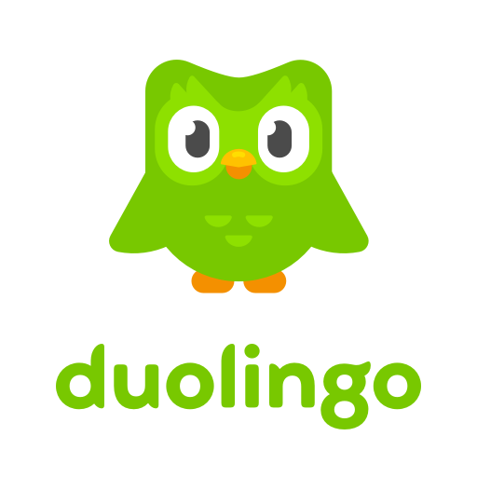
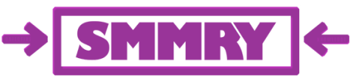
Readability test tools provide quick and easy ways to test the readability of content and improve reading skills
Smmry: Useful tool for limited readers, although all students need to understand main ideas and how to summarize. This tool provide an efficient manner of understanding text, which is done primarily by reducing the text to only the most important sentences.
Duolingo – game-like lessons keep students motivated and excited about language. Good for ELL students; it can translate words. May be used as bonus materials for gifted students. Works on any device

Slide 4


Delivers high-quality, free instructional materials to support literacy development for students in grades 5-12. It can track student progress
noredink builds stronger writers through interest-based curriculum, adaptive exercises, and actionable data. You are able to differentiate the writing program for children. noredink closes the feedback loop. It is self paced and helps students improve writing. The more students use it, the program adapts to them and learns their writing style.

Slide 5


Supplemental Curriculum
An online resources that offers a free math, language, and reading curriculum for K-8 teachers. All lessons are aligned with the Common Core Standards. Pretest are available. Offers specific fluency like 4th grade - month 2 benchmarks. Great to send kids home with it for the summer. Teachers get great feedback on levels and time children spent on the activity.
Skoobo offers help with reading and math support through gamification of math, reading, exercises. There are 28 languages in skoolbo. Started in Australia. You can share it with families, it sends reports once a week

Slide 6


Zearn is an online math curriculum. There are interactive quizzes, they have books, assessments, instructional videos.
Curriculum Pathways are interactive resources directly aligned with state and national standards. You pick the games you want students to experiences, full curriculum or tutoring available.

Slide 7

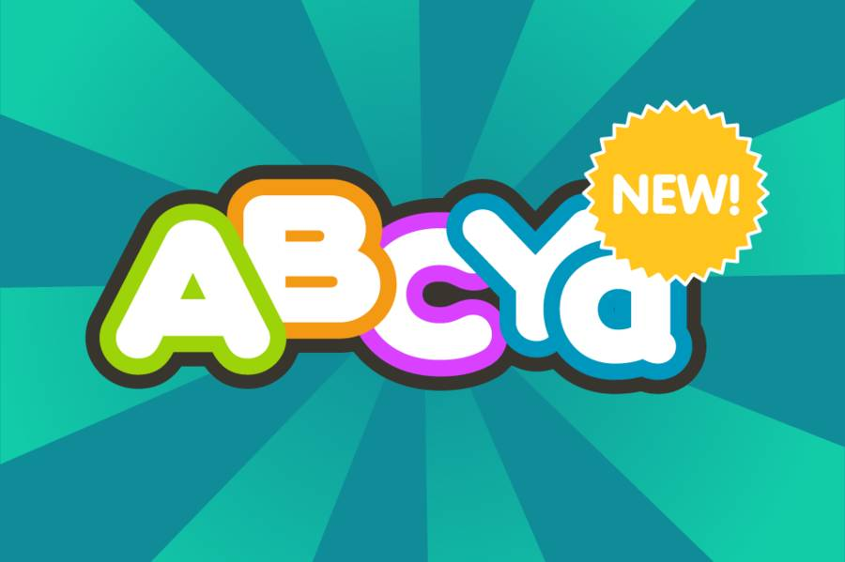
Abcya Talkify is a and easy way to make any picture talk! Good to use with children who struggle for words.
Speechnotes is a speech-enabled online notepad, designed to empower ideas by implementing a clean & efficient design, so students can focus on their thoughts.

Slide 8


Do you need to create a study set of material for practice and mastery…try Quizlet. Make flash cards and study games anywhere. It is clean looking especially for ADHD kids. It can be used on any device.
Substitution - Direct substitution for whiteboard/PowerPoint.
Augmentation - Adding voice track to provide inflection and interest.
Modification - Product link is shared among a group to bridge distance and provide a feedback loop. Flipped classroom model.
Redefinition - Can be used to globally present something conceptual in nature such as “Graffiti and Street Art.” Makes use of video, audio, still images, text, sharing, etc.

Slide 9
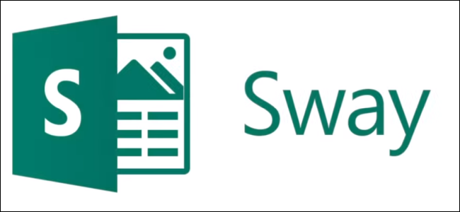

throwww is the easiest way to write something and share it. Just start writing, post it, and share the URL. Useful with children with dysgraphia.
Microsoft Sway is similar to Adobe Spark. Sway is an easy-to-use digital storytelling app for creating interactive reports, presentations, personal stories, and more.

