Slide 1

Informational Text in Mathematics
Frank Jamison
ITL522: Content Area Literacy
Professor Barbara Ray
January 21, 2024

Slide 2
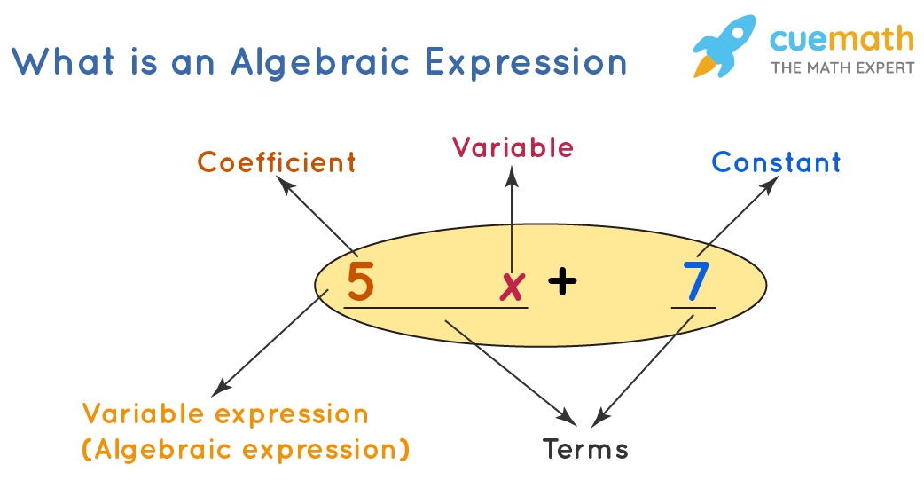
The Cuemath website: Algebraic Expressions
I choose the Cuemath (n.d.) website’s page on algebraic expressions because it provides a comprehensive overview of the topic.
The page explains key concepts such as
  variables,
  constants,
  terms,
  coefficients
and goes into detail on how to simplify algebraic expressions by combining like terms.
It also covers operations on algebraic expressions, including addition, subtraction, multiplication, and division, and provides examples of each.

Slide 3
Learning Activity Part 1: Vocabulary Comprehension
Pre-Assessment Quiz:
  Start with a brief quiz to assess the students' prior knowledge of vocabulary related to algebraic expressions (e.g., variable, coefficient, constant, term).
  This can be a mix of multiple-choice and short-answer questions.
Reading Assignment:
  Have the students read the Cuemath page on algebraic expressions, focusing specifically on sections that define key terms.
  Encourage note-taking.
Vocabulary Match-Up Exercise:
  Provide a worksheet with two columns: one with vocabulary words (variable, term, coefficient, etc.) and another with their definitions in jumbled order.
  Students will match the terms with their correct definitions.
Group Discussion:
  In small groups, students discuss the terms and their understanding of them. This peer-to-peer interaction often helps solidify comprehension.
Vocabulary in Context:
  Students will use each vocabulary word in a sentence related to algebraic expressions to demonstrate understanding.

Slide 4
Learning Activity Part 2: Accessing Text Features
Exploration Guide:
  Create a guided worksheet that asks specific questions about the layout and features of the Cuemath text, such as "Find an example of an algebraic expression in the text," or "What image is used to explain 'like terms'?"
Text Feature Presentation:
  Discuss the different features of the text such as headings, subheadings, bold words, images, and examples.
  Show how each feature helps in understanding the content better.
Scavenger Hunt:
  Organize a scavenger hunt where students have to find and note down specific information, like an example of a simplified algebraic expression, from the text.
  This activity encourages detailed reading and familiarity with navigating informational texts.
Interactive Q&A:
  Conclude with an interactive session where students ask questions about the text, and their peers try to answer by referring to specific sections of the text.

Slide 5
Writing Prompt: Exploring Algebraic Expressions
Context: Having studied the Cuemath webpage on algebraic expressions, you are now familiar with the various elements that constitute these expressions, including variables, constants, coefficients, and terms. The webpage also discusses operations such as addition, subtraction, multiplication, and division of algebraic expressions.
Prompt: "Understanding and simplifying algebraic expressions is crucial for solving complex algebra problems.“
Write a persuasive paragraph supporting this claim. In your response, include the following:
Claim: State your position clearly. Do you agree or disagree with the statement? Begin your paragraph with this claim.
Evidence: Use specific information from the Cuemath webpage to support your claim. This might include definitions, explanations, or examples of algebraic expressions and their simplification. Reference particular sections or examples from the text that illustrate why understanding and simplifying algebraic expressions is important for solving algebra problems.
Reasoning: Explain how the evidence you provided supports your claim. Link the concepts of algebraic expressions to the broader context of solving algebra problems. Make connections between the evidence and your claim to demonstrate a clear understanding of the importance of these concepts in algebra.

Slide 6
Measurement of Language and Literacy Needs
Understanding of Subject-Specific Vocabulary: The prompt requires students to use specific terminology related to algebraic expressions. Their responses will indicate their grasp of this vocabulary.
Reading Comprehension: By asking students to reference specific sections or examples from the text, their responses will reflect their ability to comprehend and recall information from the reading.
Argumentation Skills: The structure of the prompt (claim, evidence, reasoning) assesses students' ability to construct a logical argument. This includes forming a coherent claim, supporting it with relevant evidence, and articulating the connection between the two.
Writing Proficiency: The coherence, organization, grammar, and clarity of their responses will give insights into each student's writing skills.
Critical Thinking and Analysis: The reasoning part of the prompt assesses students' ability to analyze information and draw connections between the evidence and their claim, showcasing their higher-order thinking skills.

Slide 7
Actions Based on Responses
For Students Struggling with Vocabulary and Comprehension:
  Provide additional resources or exercises focused on key algebraic terms.
  Implement reading strategies, like guided reading sessions, to improve comprehension.
For Students with Weak Argumentation Skills:
  Offer mini-lessons on constructing arguments, focusing on how to make a claim, find suitable evidence, and link the two with logical reasoning.
  Organize peer review sessions where they can get feedback on their argumentation skills.
For Students with Writing Challenges:
  Conduct targeted writing workshops that address specific areas like sentence structure, grammar, and paragraph organization.
  Provide templates or graphic organizers to help structure their writing.
For Students Struggling with Critical Thinking:
  Engage them in activities that require analysis and synthesis of information, such as group discussions or problem-solving tasks.
  Offer one-on-one sessions to discuss their thought process and guide them in making connections between concepts.
For Advanced Students:
  Challenge them with more complex writing prompts or additional readings that push their comprehension and critical analysis skills.
  Encourage them to peer-tutor or lead group discussions to develop their understanding and communication skills further.

Slide 8
References
Cuemath. (n.d.). Algebraic Expressions—Formulas, Simplifying, Evaluating. Cuemath. Retrieved January 21, 2024, from https://www.cuemath.com/algebra/algebraic-expression/

