Slide 1

Enhancing Writing in Mathematics
Frank Jamison
ITL522: Content Area Literacy
Professor Barbara Ray
January 28, 2024

Slide 2
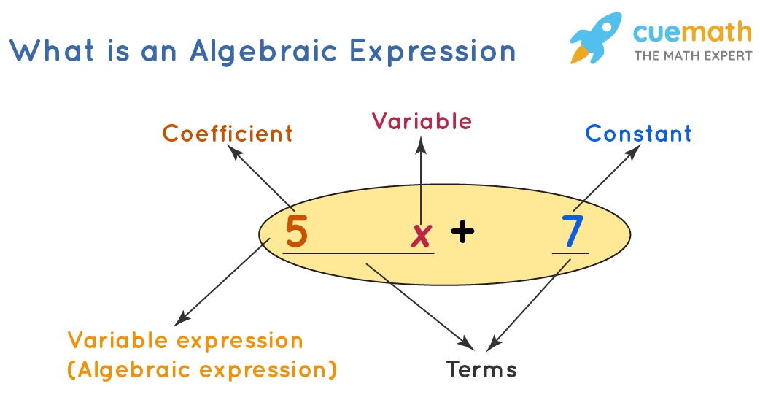
The Cuemath website: Algebraic Expressions
I choose the Cuemath (n.d.) website’s page on algebraic expressions because it provides a comprehensive overview of the topic.
The page explains key concepts such as
  variables,
  constants,
  terms,
  coefficients
and goes into detail on how to simplify algebraic expressions by combining like terms.
It also covers operations on algebraic expressions, including addition, subtraction, multiplication, and division, and provides examples of each.

Slide 3

Writing Prompt: Understanding Algebraic Expressions
After reading the Cuemath text on algebraic expressions, write a paragraph explaining how understanding algebraic expressions can be applied in real-life situations. Provide specific examples to illustrate your points.

Slide 4
Challenges and Scaffolds
Challenge 1: Difficulty in Relating Abstract Concepts to Real-Life
Challenge 2: Overwhelmed by Structuring the Response
Scaffold 1: Provide a list of real-life scenarios (like budgeting, cooking, or coding) where algebraic expressions are used. This concrete list can help students think about how to apply abstract algebraic concepts in everyday life.
Scaffold 2: Encourage students to first discuss in pairs or small groups about where they see algebra in their daily lives. Peer discussions can often help generate ideas and make connections more concrete.
Scaffold 1: Offer a graphic organizer or outline template that guides students through the structure of a paragraph – starting with an introductory sentence, followed by examples, and concluding with a summary.
Scaffold 2: Provide sentence starters or frames for each part of the paragraph. For example, “One real-life application of algebraic expressions is…” This can help students begin their thoughts and structure them coherently.

Slide 5
Writing Prompt Rubric
 | Highly Developed (4 points) | Developed (3 points) | Emerging (2 points) | Initial (1 point)
Content Relevance | Demonstrates a clear understanding of algebraic expressions and their real-life applications; provides specific, relevant examples. | Shows a basic understanding with general examples. | Understanding of algebraic expressions is somewhat clear, but real-life examples are vague or minimally relevant. | Lacks a clear understanding of algebraic expressions; real-life examples are irrelevant or not provided.
Organization and Structure | Well-structured paragraph with a clear introduction, body, and conclusion. | Generally well-structured but may lack clear transitions or a defined conclusion. | Some organization present but lacks clear structure; ideas may be disjointed. | Poor organization; difficult to follow the train of thought.
Use of Language | Uses precise language and terminology appropriately; writing is clear and concise. | Generally uses appropriate language, with minor issues in clarity or precision. | Some use of appropriate language, but often unclear or imprecise. | Inappropriate or very limited use of language and terminology.
Writing Mechanics | Free of grammatical and spelling errors. | Minor grammatical or spelling errors. | Noticeable grammatical or spelling errors that somewhat hinder comprehension | Frequent grammatical or spelling errors; significantly affects readability.

Slide 6

Activity: Feedback Carousel
Initial Reading:
    Each student reads their piece aloud to their group. This encourages active listening and prepares peers to give feedback.
Round Robin Feedback:
    After a student reads their piece, the paper is passed to the right.
    Each peer writes constructive feedback on the paper in front of them, focusing on specific aspects like content relevance, organization, language use, and mechanics, as outlined in the rubric.
    Repeat until each student has commented on every other student's work in their group.
Focused Discussion:
    Once the papers have made a full circle, allow time for a guided group discussion. Students can ask questions, clarify points, and discuss the feedback received.

Slide 7
Running the Activity
Monitoring Feedback Quality:
  Feedback Guide: Provide a feedback guide with examples of constructive comments and questions to prompt thoughtful feedback.
  Teacher Supervision: Circulate during the activity, observing group dynamics and the quality of feedback being given.
Assessing the Use of Feedback:
  Discuss the different features of the text, such as headings, subheadings, bold words, images, and examples.
  Show how each feature helps in understanding the content better.
Ensuring Productive Use of Time:
  Time Management: Set a timer for each stage of the activity to keep groups on track.
  Active Participation: Encourage all students to participate actively in giving and receiving feedback.
Expectations:
  Respectful and Constructive Feedback: Emphasize the importance of giving feedback that is respectful, specific, and helpful.
  Engagement: Expect students to engage actively with their peers' work, providing thoughtful and detailed feedback.

Slide 8
References
Cuemath. (n.d.). Algebraic Expressions—Formulas, Simplifying, Evaluating. Cuemath. Retrieved January 21, 2024, from https://www.cuemath.com/algebra/algebraic-expression/

