Slide 1
Building Positive Relationships and Community/School Support
Frank Jamison
April 21, 2024
National University

Slide 2
Strengthening Student Learning through Community Partnerships
Overview of Effective Partnerships
  Importance of integrating school with community resources to support student learning.
  Examples: Federation, YMCA, After-School All-Stars (ASAS), and Citizen Schools partnerships.
Key Strategies for Successful Partnerships (Harvard Family Research Project, 2010)
  Shared vision for learning.
  Multi-level, active relationships among partners.
  Blended staffing models and regular reciprocal data sharing.
  Strong connections with families and community resources.
Impact on Students (Caspe et al., 2015; Harvard Family Research Project, 2010)
  Improved academic achievements and emotional competencies.
  Increased family engagement and student participation in community activities.
  Examples of specific programs like ASAS at August Boeger Middle School and Citizen Schools at Bedichek Middle School demonstrating successful integration and impact.
Challenges and Solutions
  Overcoming challenges like resource allocation, sustaining engagement, and aligning goals.
  Strategies for maintaining strong partnerships and consistent communication.
Future Directions
  Encouraging broader community involvement.
  Scaling successful models across different regions and demographics.

Slide 3


Community Partnerships
Hemet Unified School District

Slide 4
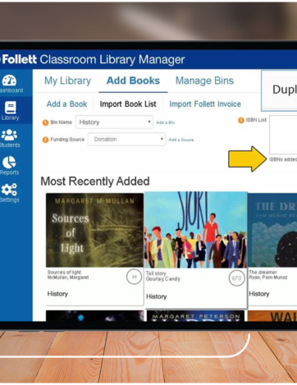
Interactive eBooks (Follett Lightbox Titles)
Service: Students have access to over 1000 interactive Pre-K-12 Follett Lightbox eBooks across science, social studies, language arts, math, and more in 10 different languages with full audio support.
Agency: Follett Software
Location: Online
Criteria: Must be students enrolled in the Hemet Unified School District
Cost to Families: Free

Slide 5
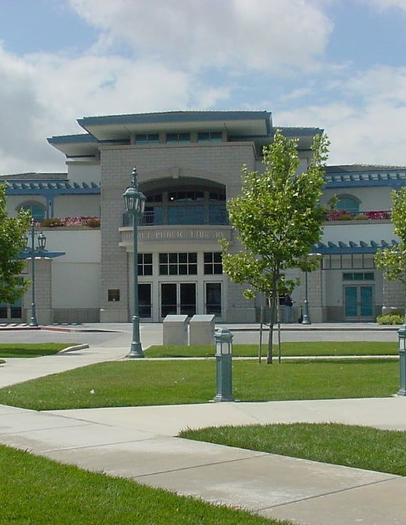
Live Online Tutoring
Service: Homework help available online 7 days a week from 10:00 am until 10:00 pm.
Agency: Hemet Public Library
Location: Online
Criteria: Must have a Hemet Public Library Card
Cost to Families: Free

Slide 6

High School/College Dual Enrollment Program
Service: Earn college credits while attending high school.
Agency: Mt. San Jacinto College
Location: Menifee, San Jacinto, and Temecula campuses.
Criteria: Students must be in high school and have the support of their parents, principal, and high school counselor.
Cost to Families: Free

Slide 7
Effective Strategies for Engaging Families in Education (Albright et al., 2011)
Two-Way School-Home Communication
  Foster regular, meaningful communication, including updates, feedback, and school activities to engage families effectively.
  Adapt communication methods to meet diverse family needs and preferences.
Family Involvement at Home
  Encourage families to create a supportive home environment that reinforces learning.
  Provide guidance on educational activities that complement schoolwork.
Family Involvement in School
  Invite families to participate in school activities, volunteer opportunities, and decision-making processes.
  Promote active involvement to enhance the educational experience and foster a sense of community.
Shared Decision-Making
  Include families in educational decisions affecting their children to reinforce partnership and mutual respect.
  Collaborate on setting educational goals and strategies that support student growth.
Parental Empowerment through Resources and Workshops
  Offer workshops and resources to equip parents with the skills to support their child’s social, emotional, and academic development.
  Provide opportunities for parents to learn and grow alongside their children.
Consistent Support and Recognition
  Regularly acknowledge and appreciate family contributions to their children’s education.
  Support families with consistent, positive feedback and recognition to foster ongoing engagement.

Slide 8

Reflecting on My School-Family Partnership Skills
Strengths:
  Communication: Skilled in clear, consistent, and empathetic communication, ensuring parents feel informed and valued.
  Enthusiasm: Eager to engage families and promote a collaborative learning environment, bringing fresh ideas and energy.
  Technology Use: Proficient in using digital tools to facilitate accessible and inclusive communication with diverse families.
Areas for Growth:
  Cultural Competency: Need to deepen understanding of diverse family structures, values, and cultural backgrounds to tailor engagement strategies.
  Conflict Resolution: Need to develop stronger skills in managing and resolving conflicts that may arise in interactions with families.
  Long-Term Engagement Strategies: Need to learn to implement sustained engagement practices that keep families involved throughout the school year.
Action Plan:
  Participate in PD: Enroll in professional development courses focused on cultural competency and family engagement.
  Mentorship: Seek mentorship from experienced teachers who excel in family engagement and conflict resolution.
  Feedback Mechanisms: Establish regular feedback mechanisms to learn from families about what works and what needs improvement.

Slide 9
Resources
Albright, M. I., Weissberg, R. P., & Dusenbury, L. A. (2011). School-Family Partnership Strategies to Enhance Children’s Social, Emotional, and Academic Growth. National Center for Mental Health Promotion and Youth Violence Prevention, Education Development Center, Inc.
Caspe, M., Lopez, M. E., & Chattrabhuti, C. (2015). Four Important Things to Know About the Transition to School.
Harvard Family Research Project. (2007). Family Involvement in Elementary School Children’s Education.
Harvard Family Research Project. (2010). Partnerships for Learning: Profiles of Three School-Community Partnership Efforts.
Redding, S., Murphy, M., & Sheley, P. (2011). Handbook on Family and Community Engagement.

