Slide 1
Used Cars Investment Analysis
A used car according to Wikipedia is a vehicle that has had one or more retail owners. There are two main categories on offer. Certified pre-owned and As-Is. Certified Pre-Owned cars are used vehicles traded by dealerships who have done some measure of refurbishment and therefore provide warranties and support. As-Is used cars can be offered by dealerships and private individuals and the cars offered are sold at the current state with no repairs and warranties provided.
According to ibisworld.com, the used car industry in the Canada is worth $14b in 2021 and has 7892 registered businesses and employing 13,778 persons. This is a reasonable chunk of the projected global size of $824b in 2019 (www.alliedmarketresearch.com). The ratio of used car sales to new cars sales in Canada is now 2:1 according www.mordorintelligence.com. With these key facts in mind, now is a wonderful time to invest in the used cars industry.
Introduction

Slide 2
Used Cars Investment Analysis
Used cars are a vital part of the automotive industry. The other part is new cars. The automotive industry in Canada began with the manufacturing of the Redpath Messenger in 1903 by Walter Redpath. A year later, Ford Motor Company started the large-scale manufacturing of Model C. By the 1920s, the Canadian automobile industry was the second largest in the world. Demand slides in the 1990s reduced market share but automobile export is still 16% of the total national exports with viable markets in Africa and South America.
The first used cars business began in the United State in 1898(Wikipedia) and the share of used cars in the automobile business has continued to grow. The Canadian used car industry earned an average revenue of 779,000 dollars in 2019 with a profitability of 66%. There are about 7800 establishments and most employ between 0-99 employees(Statistics Canada).
Recent projections by internet website www.mordorintelligence .com sees used cars selling ratio topping new cars by 2:1. Furthermore, the Covid-19 pandemic has negatively affected incomes and credit ratings making used cars a viable alternative in the market.
Background
Historical and Empirical

Slide 3
Used Cars Investment Analysis
While the industry sentiments see growth, there is the need to take a data driven approach to confirm if this are true. The problem of this research is to provide data driven information for investment decision in the used cars industry.
There is available data on used cars and we will be using the Used Cars Dataset that is available on www.kaggle.com to do the analysis. This dataset has been certified authentic by the providers and several analysis has been done using it. It is also large and comprehensive as it covers a variety of information about used cars. Such information include, maker, model, mileage, seat count and door count amongst others.
Statement of the Problem and Methodology

Slide 4
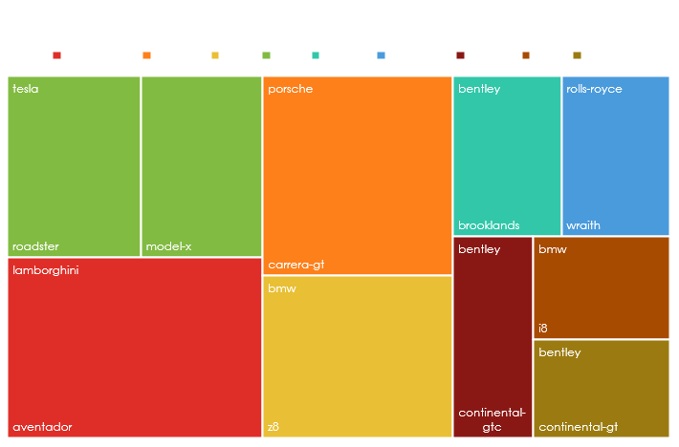
Used Cars Investment Analysis
Based on the data analysed, the following findings are outlined below:
Findings
The tree map and the legend shows the top ten cars by average highest price. Hovering over the box will show the price.

Slide 5
Used Cars Investment Analysis
Findings
This chart shows the top 10 cars with the lowest average price.

Slide 6
Used Cars Investment Analysis
Findings
This chart shows the top 5 cars in the economic category with a price range of 3,000 to just below 20,000.

Slide 7
Used Cars Investment Analysis
Findings
This chart shows the top 5 cars in the intermediate category. The price range is from 20,000 to just under 300,000.

Slide 8
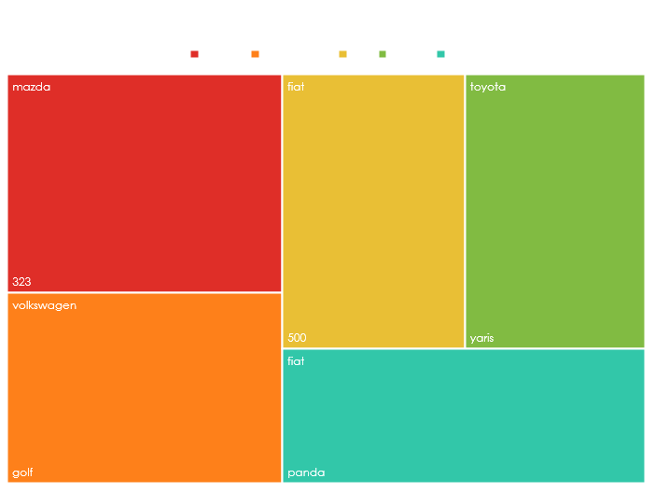
Used Cars Investment Analysis
Findings
The tree map and the legend show the top 5 cars in the luxury car category by maker and model. Hovering over the box will show the price.

Slide 9
Used Cars Investment Analysis
Based on the visual analysis of the dataset available, it is reasonable to assume that investments in the used cars under the first two segments may be rewarding. The luxury segment will need some further investigation as the brands shown there may not be the most luxurious. We recommended further investigation into that segment before investing in it.
Conclusion and recommendation

Slide 10
Used Cars Investment Analysis
Used car - Wikipedia
Automotive statistics (statcan.gc.ca)
Used Car Market Size, Trends, Forecast 2021-26 | Mordor Intelligence
Canada’s automotive industry: A history in exporting (edc.ca)
Used car prices in Canada up 12.8 per cent from last year as microchip shortage continues | CTV News
Used car dealers - 44112 - Summary - Canadian Industry Statistics - Innovation, Science and Economic Development Canada
References

Slide 11
Used Cars Investment Analysis
4. Breakdown of null value by column in dataset.
maker = 14%, model = 32%, mileage = 10%, manufacture_year = 10%, engine_displacement = 20%, engine_power = 16%, body_type = 31%, color_slug = 94%, stk_year = 48%, transmission = 21%, door_count = 17%, seat_count = 21%, fuel_type = 52%, date_created = 0%, price_eur = 0%
Remove color_slug and fuel_type
5. Outlier Check
1295.34 is a clear outlier and will be removed.
Appendix

Slide 12
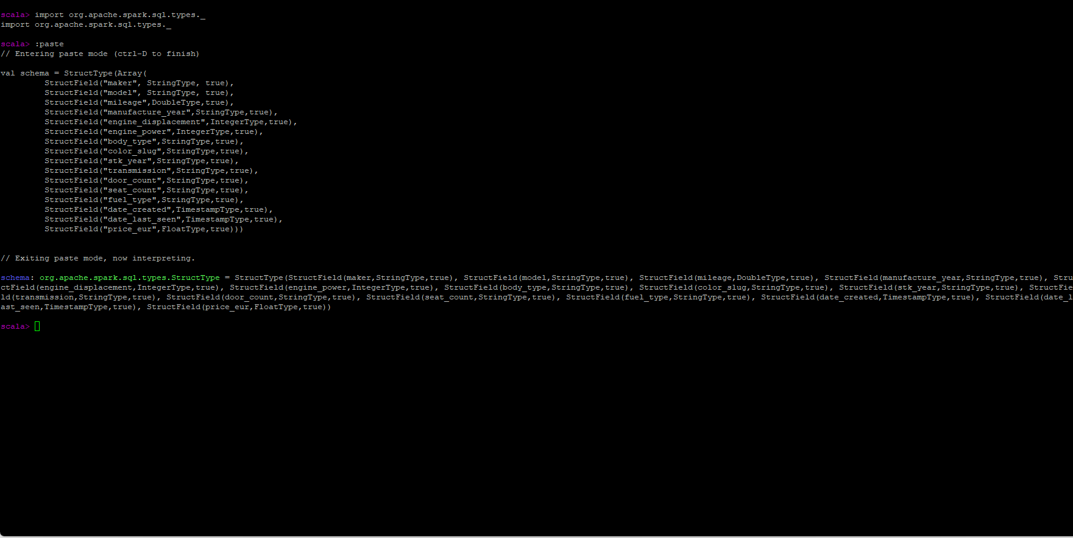
Used Cars Investment Analysis
Appendix
Screenshots

Slide 13
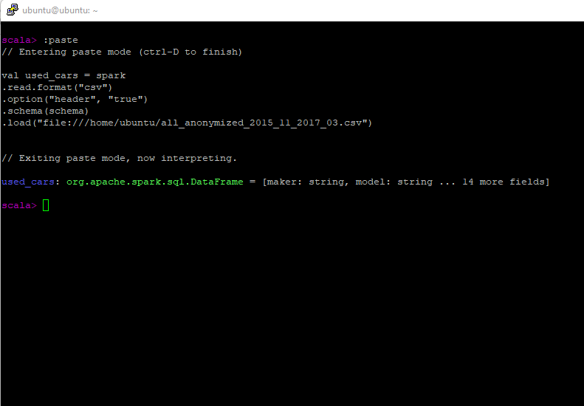
Used Cars Investment Analysis
Appendix
Screenshots

Slide 14
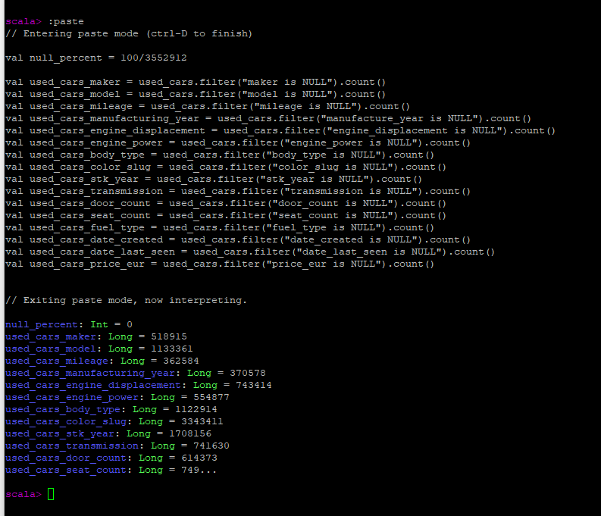
Used Cars Investment Analysis
Appendix
Screenshots

Slide 15
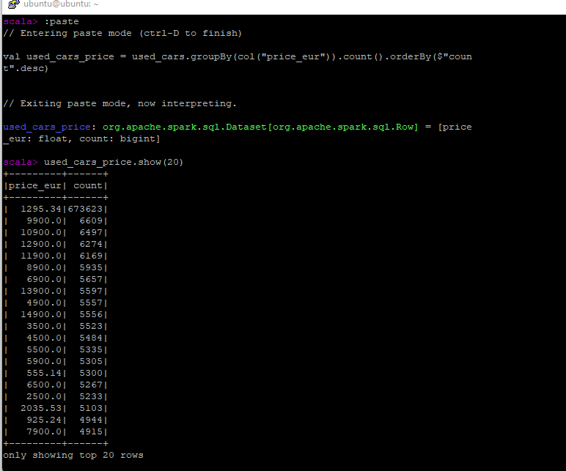
Used Cars Investment Analysis
Appendix
Screenshots

Slide 16
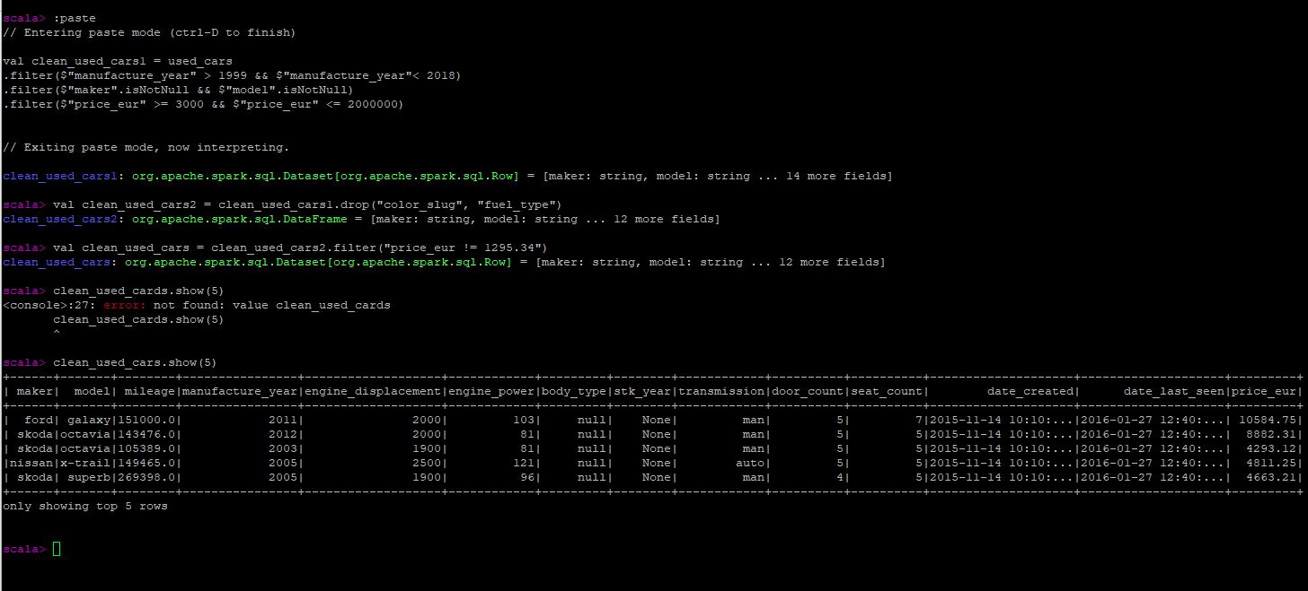
Used Cars Investment Analysis
Appendix
Screenshots

Slide 17
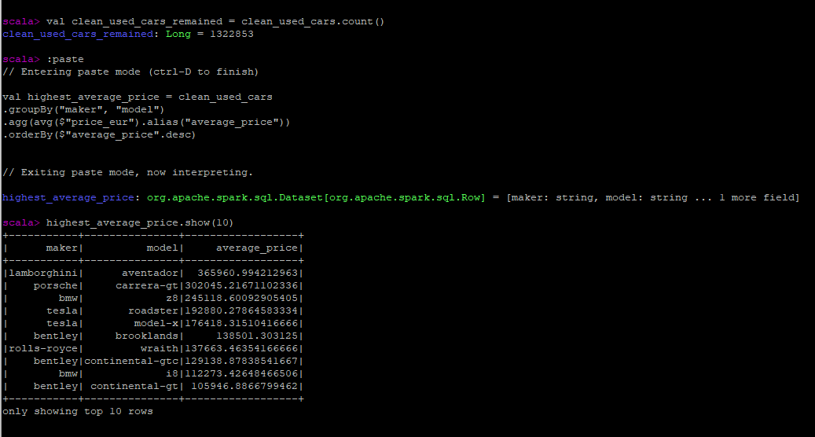
Used Cars Investment Analysis
Appendix
Screenshots

Slide 18
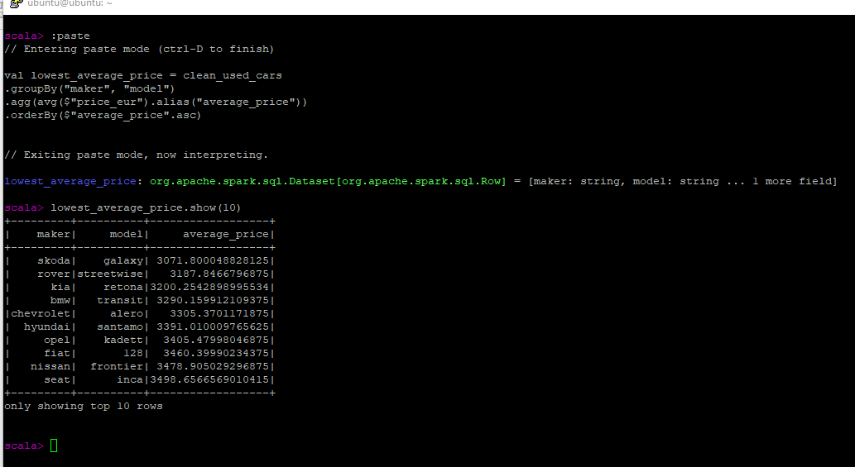
Used Cars Investment Analysis
Appendix
Screenshots

Slide 19
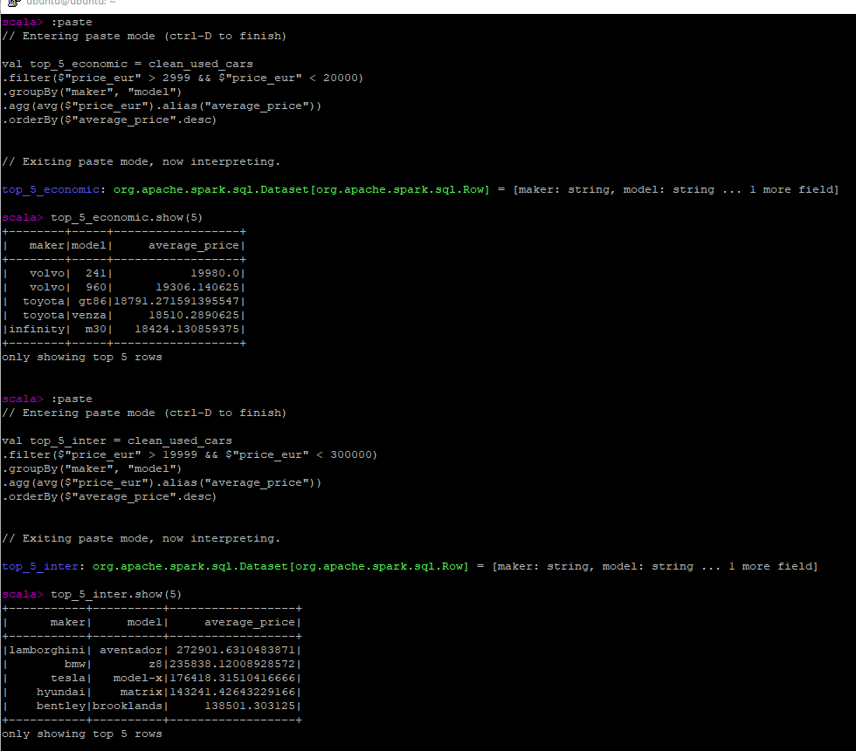
Used Cars Investment Analysis
Appendix
Screenshots

Slide 20
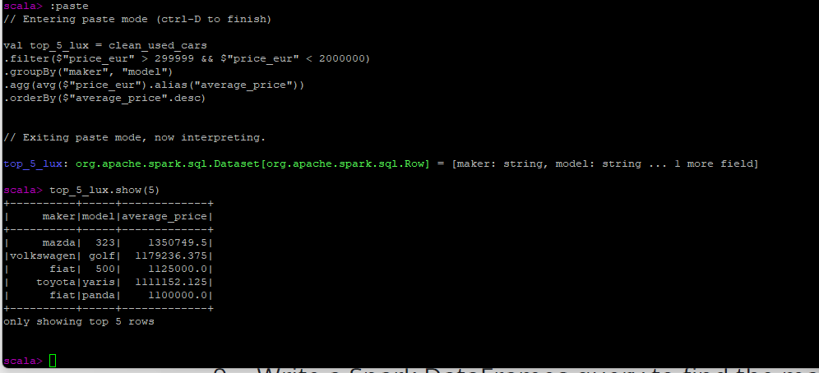
Used Cars Investment Analysis
Appendix
Screenshots

Slide 21
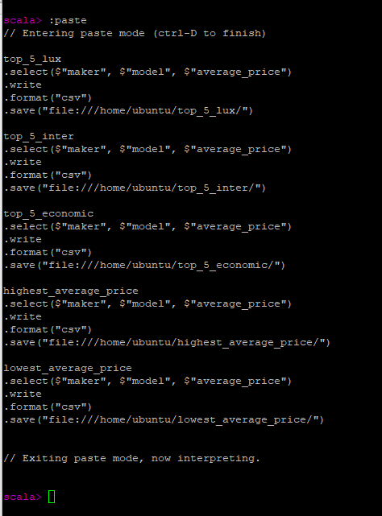
Used Cars Investment Analysis
Appendix
Screenshots

Slide 22
Used Cars Investment Analysis
Appendix
Screenshots

