Slide 1
Plagiarism,
Paraphrasing & summarizing
Week 12
Diana Yang

Slide 2
In the English-speaking academic world it is essential to use a wide range of sources for your writing, and to acknowledge these sources clearly.
This unit explains why this is vital, and introduces the techniques students need to use.

Slide 3
1. What is plagiarism?
Basically plagiarism means taking ideas or words from a source without giving credit (acknowledgement) to the author.
It is seen as a kind of theft, and is considered to be an academic crime. In academic work, ideas and words are seen as private property belonging to the person who ﬁrst thought or wrote them.
Therefore it is important for all students, including international ones, to understand the meaning of plagiarism and learn how to prevent it in their work.

Slide 4
The main difﬁculty that students face is that they are expected:
(a) to show that they have read the principal experts on a subject – by giving citations
(b) to explain these ideas in their own words and come to their own original conclusions

Slide 5
There are several reasons why students must avoid plagiarism:
• Copying the work of others will not help you develop your own understanding
• To show that you understand the rules of the academic community
• Plagiarism is easily detected by teachers and computer software
• It may lead to failing a course or even having to leave college

Slide 6
2. Acknowledging sources
If you borrow from or refer to the work of another person, you must show that you have done this by providing the correct acknowledgement. There are two ways to do this:
Summary and citation
  Smith (2009) claims that the modern state wields power in new ways.
Quotation and citation
  According to Smith: ‘The point is not that the state is in retreat but that it is developing new forms of power . . .’ (Smith, 2009: 103).

Slide 7
These in-text citations are linked to a list of references at the end of the main text, which includes the following details:
Author Date Title Place of publication Publisher
Smith, M.
(2009)
Power and the State
Basingstoke Palgrave
Macmillan

Slide 8
3. Degrees of plagiarism
Although plagiarism essentially means copying somebody else’s work, it is not always easy to deﬁne.
Practice:
Working with your partner, consider the following academic situations and decide if they are plagiarism.

Slide 9
 | Situation | Yes/No
1 | Copying a paragraph, but changing a few words and giving a citation.
2 | Cutting and pasting a short article from a website, with no citation.
3 | Taking two paragraphs from a classmate’s essay, without citation.
4 | Taking a graph from a textbook, giving the source.
5 | Taking a quotation from a source, giving a citation but not using quotation marks.
6 | Using something that you think of as general knowledge, e.g. large areas of rainforest have been cut down in recent years.
7 | Using a paragraph from an essay you wrote and had been marked the previous semester, without citation.
8 | Using the results of your own research, e.g. from a survey, without citation.
9 | Discussing an essay topic with a group of classmates and using some of their ideas in your own work.
10 | Giving a citation for some information but mis-spelling the author’s name.

Slide 10
Degree of plagiarism
(1) Y (2) Y (3) Y (4) N (5) Y (6) N (7) Y (8) N (9) Y/N (10) Y

Slide 11
Avoiding plagiarism in
Dissertation for master’s degree
（四）检测结果认定
1、检测结果中“去除本人文献”比值原则上不能超过15%；（1）文献综述、基本概念与理论基础部分文字重复率不得超过25％；（2）其它部分文字重复率分别查询，各部分均不得超过10％；作者本人在学期间发表的论文除外，但也必须正确引注；
2、论文查重结果低于15%，通过相似度检测的，进入论文抽检程序；
3、若一次检测超过15%，在规定时间内可申请二次检测，如仍超过15%，将检测报告反馈本人及导师。论文修改三个月后，可再次申请查重。
May be more strict in your own area!

Slide 12
Avoid plagiarism
Academic writing normally requires that you support your ideas and opinions with facts, statistics, quotations, and similar kinds of information.
There are four ways to use information from outside sources.
You can quote it directly or indirectly. You can also paraphrase or summarize it.
Writing paraphrases and summaries are important tools in academic writing.

Slide 13
Model Study:
Decide which kind of plagiarism each example is guilty of.
1. When you use information from an outside source without citing the source (telling where you got the information), you are guilty of plagiarism.
2. Even when you cite your source, if your paraphrase is too similar to the original, you are guilty of plagiarism.

Slide 14
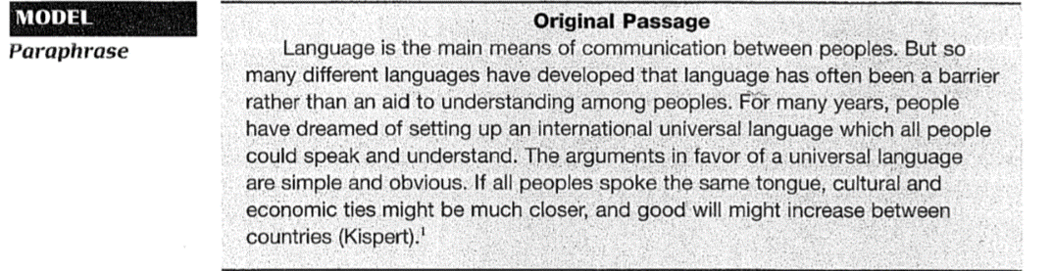

Slide 15
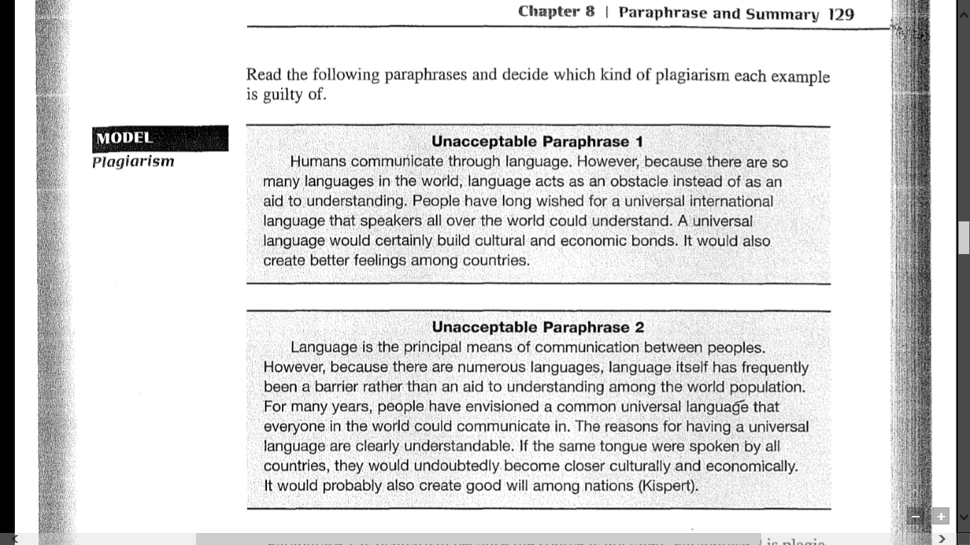

Slide 16
Analysis
Paraphrase 1 is plagiarism because the source is not cited. Paraphrase 2 is plagiarism because it is too similar to the original passage. For example, in the first sentence, only one word has been changed: main replaces principal. In the second sentence, only a few words have been changed.
You can avoid the first kind of plagiarism by always citing your sources. You can avoid the second kind of plagiarism by learning to paraphrase correctly.

Slide 17
Paraphrasing

Slide 18
Paraphrasing
When you paraphrase, you rewrite information from an outside source in your own words without changing the meaning.
Because you include in your rewriting all or nearly all of the content of the original passage, a paraphrase is almost as long as the original.
(A summary, by contrast, is much shorter than the original.)

Slide 19
How to Write a Good Paraphrase
There are three keys to writing a good paraphrase:
1. Use your own words and your own sentence structure.
2. Make your paraphrase approximately the same length as the original.
3. Do not change the meaning of the original.

Slide 20
You can write a good paraphrase if you follow these steps:
Step 1 Read the original passage several times until you understand it fully.
Look up unfamiliar words, and find synonyms for them. It may not be possible to find synonyms for every word, especially technical vocabulary. In this case, use the original word.

Slide 21
Step 2 It helps to take notes.
Write down only a few words for each idea- not complete sentences.
Here are one writer's notes on the original passage about universal language:
  Language--people use to communicate--but so many--difficult to understand one another--people wish--universal international language--reasons: cultural, economic bonds, better feelings between countries

Slide 22
It may be helpful to make a brief outline such as the following:
A. Language--people use to communicate
  1. So many languages make it difficult to understand one another.
  2. People wish for one universal international language.
B. Reasons
  1. Cultural, economic bonds
  2. Better feelings between countries

Slide 23
Step 3 Write your paraphrase from your notes.
Don't look at the original while you are writing.
Practice

Slide 24
Step 4 Check your paraphrase against the original to make sure you have not copied vocabulary or the sentence structure too closely.
Above all, make sure that you have not changed the meaning of the original or given any wrong information.
Step 5 Add an in-text citation at the end.

Slide 25
Paraphrase (63 words, about the same length as the original)
Humans communicate through language. Because there are so many different languages, however, people around the world have a difficult time understanding one another. Some people have wished for a universal international language that speakers all over the world could understand. Their reasons are straightforward and clear. A universal language would build cultural and economic bonds. It would also create better feelings among countries (Kispert).

Slide 26
Practice A:
Allen (2009) argues that the best explanation for the British location of the industrial revolution is found by studying demand factors. By the early eighteenth century high wages and cheap energy were both features of the British economy. Consequently, the mechanisation of industry through such inventions as the steam engine and mechanical spinning was proﬁtable because employers were able to economise on
labour by spending on coal. At that time, no other country had this particular combination of expensive labour and abundant fuel.

Slide 27
Note that an effective paraphrase usually:
• has a different structure to the original
• has mainly different vocabulary
• retains the same meaning
• keeps some phrases from the original that are in common use
  e.g. ‘industrial revolution’ or ‘eighteenth century’

Slide 28
Techniques for paraphrasing
(a) Changing vocabulary by using synonyms:
argues > claims/ eighteenth century > 1700s/ wages > labour costs/ economise > saving
Do not attempt to paraphrase every word, since some have no true synonym, e.g. demand, economy, energy

Slide 29
(b) Changing word class:
explanation (n.) > explain (v.) / mechanical (adj.) > mechanise (v.) / proﬁtable (adj.) > proﬁtability (n.)
(c) Changing word order:
. . . the best explanation for the British location of the industrial revolution is found by studying demand factors.
> A focus on demand may help explain the UK origin of the industrial revolution.

Slide 30
Reference Version:
The reason why Britain was the birthplace of the industrial
revolution can be understood by analysing demand in the
early 1700s, according to Allen (2009). He maintains that,
uniquely, Britain had the critical combination of cheap energy
from coal and high labour costs. This encouraged the adoption
of steam power to mechanise production, thus saving on
wages and increasing proﬁtability.

Slide 31
Practice B FOUR WHEELS GOOD
The growth of the car industry parallels the development of modern capitalism. It began in France and Germany, but took off in the United States. There Henry Ford adapted the moving production line from the Chicago meat industry to motor manufacturing, thus inventing mass production. In the 1920s Alfred Sloan’s management theories helped General Motors to become the world’s dominant car company. After the second world war the car makers focused on the styling of their products to encourage more frequent model changes. From the 1970s there was criticism of the industry due to the inefﬁciency of most vehicles, which used petrol wastefully. At the same time, trades unions became increasingly militant in defence of their members’ jobs. Today the industry owns some of the most famous brands in the world. However, many car makers are currently threatened by increased competition and saturated markets.

Slide 32
(a) Find synonyms for the words underlined.
(i) The growth of the car industry parallels the development of
modern capitalism.
Example: The rise of the automobile industry matches the
progress of contemporary capitalism.
(ii) It began in France and Germany, but took off in the United
States.
(iii) There Henry Ford adapted the moving production line from the
Chicago meat industry to motor manufacturing, thus inventing
mass production.

Slide 33
(b) Change the word class of the underlined words, and then re-write
the sentences.
(i) In the 1920s Alfred Sloan’s management theories helped General Motors to become the world’s dominant car company.
Example: In the 1920s, with help from the managerial theories
of Alfred Sloan, General Motors dominated the world’s car companies.
(ii) After the second world war the car makers focused on the styling of their products, to encourage more frequent model changes.
(iii) From the 1970s there was criticism of the industry due to the inefﬁciency of most vehicles, which used petrol wastefully.

Slide 34
(c) Change the word order of the following sentences (other changes
may be needed).
(i) At the same time, trades unions became increasingly militant in defence of their members’ jobs.
Example: At the same time increasingly militant trades unions defended their members’ jobs.
(ii) Today the industry owns some of the most famous brands in the world.
(iii) However, many car makers are currently threatened by increased competition and saturated markets.

Slide 35
(d) Combine all these techniques to paraphrase the paragraph as fully as possible.
The expansion of contemporary capitalism matches the rise of the automobile industry. After starting in Germany and France, it accelerated in the United States. There the moving assembly line was modified by Henry Ford from the Chicago meat industry to manufacturing cars; thereby inventing mass production. General Motors dominated the world’s car companies in the 1920s, with help from the managerial theories of Alfred Sloan. After the second world war the focus of car makers was on the style of their products, to encourage more frequent model changes. From the 1970s the industry was criticised for its inefficient vehicles which wasted petrol. At this time increasingly militant trades unions defended their members’ jobs. Some of the most famous brands in the world are today owned by the industry, although currently saturated markets and increased competition threaten many car makers.

Slide 36
Summarizing

Slide 37
Summarizing
Another way to use borrowed information from an outside source is to summarize it.
What is the difference between a paraphrase and a summary?
When you retell a story that someone has told you, you repeat the story in your own words. If your retelling is about the same length as the original, it is a paraphrase.
If you shorten the story-retelling only the most important points and leaving out the details-it is a summary.

Slide 38
How to Write a Good Summary
There are three keys to writing a good summary:
1. Use your own words and your own sentence structure.
2. Remember that a summary is much shorter than a paraphrase. Include only the main points and main supporting points, leaving out most details.
3. Do not change the meaning of the original.

Slide 39
The steps for writing a summary are similar to those for writing a paraphrase.
Step 1 Read the original passage several times until you understand it fully. Look up any words that you don't understand.
Step 2 Decide what the important ideas are. It helps to underline important ideas. It also helps to take notes. Write down only a few words for each idea-not complete sentences.
Step 3 Write your summary from your notes. Don't look at the original while you are writing.
Step 4 Check your summary against the original to make sure you have not changed the meaning.
Step 5 Add an in-text citation at the end of the summary.

Slide 40
MECHANICAL PICKERS
Although harvesting cereal crops such as wheat and barley has long been done by large machines known as combine harvesters, mechanising the picking of fruit crops such as tomatoes or apples has proved more difﬁcult. Farmers have generally relied on human labour to harvest these, but in wealthy countries it has become increasingly difﬁcult to ﬁnd pickers willing to work for the wages farmers are able to pay. This is partly because the demand for labour is seasonal, usually in the autumn, and also because the work is hard and demanding. As a result, in areas such as California part of the fruit harvest is often unpicked and left to rot. There are several obvious reasons why developing mechanical pickers is challenging. Fruit such as grapes or strawberries comes in a variety of shapes and does not always ripen at the same time. Outdoors, the ground conditions can vary from dry to muddy, and winds may move branches around. Clearly each crop requires its own solution: machines may be towed through orchards by tractors or move around by themselves using sensors to detect the ripest fruit. This new generation of fruit harvesters is possible due to advances in computing power and sensing ability. Such devices will inevitably be expensive, but will save farmers from the complexities of managing a labour force. In addition, the more intelligent pickers should be able to develop a database of information on the health of each individual plant, enabling the grower to provide it with fertilizer and water to maintain its maximum productivity.

Slide 41
Read the following text (3.1) and the summaries (a)–(c).
Rate them 1 (best) – 3.
(a) Fruit crops have usually been picked by hand, as it is difﬁcult to mechanise the process. But in rich countries it has become hard to ﬁnd affordable pickers at the right time so fruit is often wasted. Therefore intelligent machines have been developed that can overcome the technical problems involved, and also provide the farmer with useful data about the plants.

Slide 42
(b) Developing machines that can pick fruit such as tomatoes or apples is a challenging task, due to the complexity of locating ripe fruit in an unpredictable outdoor environment, where difﬁcult conditions can be produced by wind or water. But recent developments in computing ability mean that growers can now automate this process, which should save them money and increase their proﬁts.

Slide 43
(c) Strawberries and grapes are the kind of crops that have always
been hand-picked. But many farmers, for example in
California, now ﬁnd it increasingly difﬁcult to attract enough
pickers when the fruit is ripe. However, computing advances
have produced a solution to this problem, which will save
farmers from worrying about the pickers, and also collect vital
data.

Slide 44
1 = a (contains all key points)
2 = c (includes unnecessary examples)
3 = b (includes information not in original, e.g. increase profits and fails to describe the machines)

Slide 45
WEALTH AND FERTILITY
For most of the past century an inverse correlation between human fertility and economic development has been found. This means that as a country got richer, the average number of children born to each woman got smaller. While in the poorest countries women often have eight children, the rate fell as low as 1.3 in some European countries such as Italy, which is below the replacement rate. Such a low rate has two likely negative consequences: the population will fall in the long term, and a growing number of old people will have to be supported by a shrinking number of young. But a recent study by researchers from Pennsylvania University suggests that this pattern may be changing. They related countries’ fertility rates to their human development index (HDI), a ﬁgure with a maximum value of 1.0, which assesses life expectancy, average income and education level. Over 20 countries now have an HDI of more than 0.9, and in a majority of these the fertility rate has started to increase, and in some is approaching two children per woman. Although there are exceptions such as Japan, it appears that ever higher levels of wealth and education eventually translate into a desire for more children.

Slide 46
Complete the notes of the key points below.
(a) Falling levels of fertility have generally been found ___________
___________________________________________________________
(b) In some, number of children born ___________________________
___________________________________________________________
(c) Two results: smaller populations and ________________________
___________________________________________________________
(d) Recent research claims that _________________________________
(e) Comparison of HDI (human development index: _____________
_______________________________________) with fertility found
that in most highly rated (+0.9) countries, ___________________
__________________________________________________________

