Slide 1
Code Refractor
Compiling and Optimizing Stack-Based VMs
Student
Khlud Ciprian
Coordinator
PhD Ferucio Laurențiu Țiplea

Slide 2
Code Refractor - Content
Content
1. Stack-based VMs
2. CodeRefractor architecture
3. Front end
4. Optimization overview
5. Local optimizations
6. Use-Def optimizations
7. DataFlow optimizations
8. Inter Procedural Optimizations (IPO)
9. Purity and escape analysis
Conclusion
1. Performance vs .Net
2. Questions !?
Note: ask questions at any time
If things are not clear.
Notes:
Interruptany time
2

Slide 3
Stack-based Vms
Instruction
Instruction
23
Add
StLoc.1
34
57
23
values
values
values
values
Evaluation
Stack
Evaluation
Stack
Evaluation
Stack
Evaluation
Stack
Local_0 = 0
Local_0 = 0
Local_1 = 0
Local_1 = 23
Local_2 = 0
Local_2 = 0
Pure stack implementation
.NetCIL Hybrid implementation
Notes:
Java,.Net
Virtualinstruction set
All math operations and assignments are using an evaluation stack
They are both stack and registerVms(by means of using local variables)
3

Slide 4
Code Refractor architecture
Assembly
(.exe, .dll, or references)
CIL Instructions
Compiler
FrontEnd
Semantic IL
Compiler
Optimizations
Translated Methods
Semantic IL
Method 1
Method 2
C++ (GCC, MSVC, LLVM)
Compiler
(final binary)
C++ Code
Compiler
BackEnd
Notes:
Read IL→ Interpret → CR IL Code → Optimizations → Optimized CR IL Code → C++ code generation → C++ Code → Compile
4

Slide 5
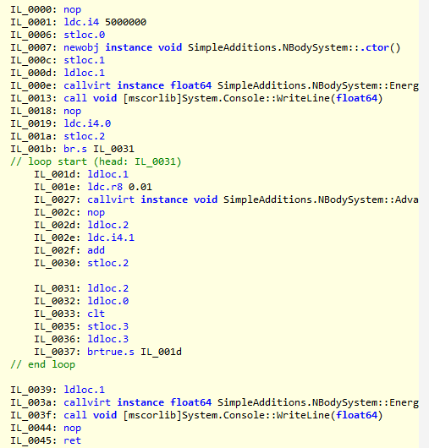
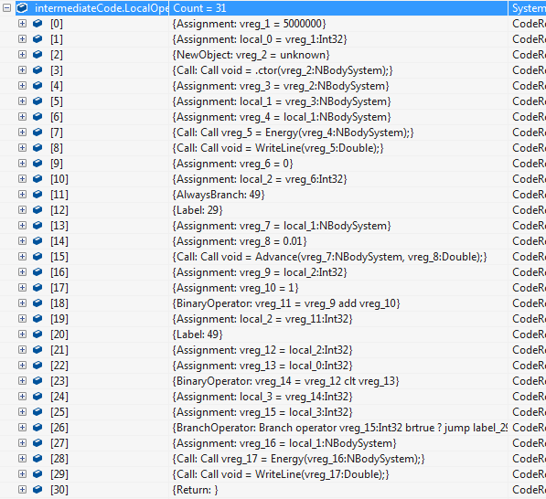
FrontEnd
Disassemble IL
Rewrite as IR
Converts CIL code into intermediate representation, builds call graph
Notes:
Looks for input assembly
UsingMono.Reflectionto get IL code
Scan for various Call instructions to fill the call-graph
Interpret instructions into CR equivalent in which instructions are grouped by semantics
5

Slide 6
Optimization overview
Block based
Constant Folding
Partial Constant Folding
Common Subexpression Elimination
Propagation of Expressions
Global optimizations
Dataflow analysis
UseDef optimizations
Program wide optimizations
Purity evaluation
Escape Analysis
Notes:
Optimizations can be defined by scope:
- one instruction range: various constant evaluations
- block based optimizations
- global (whole function)
- program wide (in C++: Link time optimizations)
6

Slide 7
Block based optimizations
Reduces the block instructions by:
- Simplifies casts with constants
- Simplifies constant expressions
- Propagates constants and variables
- Common Subexpression Elimination

Slide 8

Global Optimizations / USE-DEF optimizations
- Unused variables are deleted
- Loop invariant code motion
- Label optimizations
- remove not used
- merge consecutive
- remove next line goto labels
- Dead store eliminations (over all functions)
- One assignment with constants propagated within all body of function

Slide 9
Global Optimizations / DFA
DFA Optimizations
Methodology:
- Make some startup assumptions
- Check over all operations if they hold
- Go over all branches until assumptions stabilize
Implementations
- Reachability lines (Dead Code Elimination)
- Constant DFA propagation
Notes:
Use-Defoptimizations
DFA Optimizations:
- try to assert some assumptions
- go over whole flow of the code andrafinateassumtionsuntil stabilize the call flow
- it has states before and after instructions
9

Slide 10

Program Wide / Inter Procedural Optimizations
Inlining
Remove the cost of the call
Aggressive constant removal
- Parameters holding constants are removed
- Remove calls to empty functions

Slide 11

Purity and Escape analysis
Escape Analysis
Checks if an instance does have the
reference counting usages of other object
changing in an known way.
Resulting optimizations
- Allocations can be done on stack
- Smart pointer usages can be made as raw
pointers
Purity Analysis
Checks if a function does not have any
side effects and depend only on
parameters
Resulting optimizations
- Pure functions calls with constants are
evaluated as constants
- Better dead code elimination
- More aggressive CSE
- LICM works by moving functions too

Slide 12
Conclusions: Performance vs .Net
Bad (awful) benchmarks:
OS News 2004 benchmark
Good Benchmarks
NBodyBenchmark
- Useful math computations
- Realistic memory usage patterns
CR runs well in both cases

Slide 13

Questions?
Free Software: (GPL + MIT)
https://github.com/ciplogic/CodeRefractor/

Slide 14
T
hank you!

