Slide 1

Code Refractor
Optimizing Stack-based Vms
Student
Khlud Ciprian
Coordinator
PhD Ferucio Laurențiu Țiplea

Slide 2
Code Refractor - Content
1. – Stack-based Vms
2. – CodeRefractor architecture
3. – FrontEnd
4. - Optimization overview
5. – Local Optimizations
6. – Use-Def optimizations
7. – DataFlow optimizations
8 – Inter Procedural Optimizations (IPO)
9 – Purity and Escape analysis
Conclusion
1. Performance vs .Net
2. Questions !?
Note: ask questions at any time
If things are not clear.
Notes:
Interruptany time
2

Slide 3
1. - Stack-based Vms
Instruction
Instruction
23
Add
StLoc.1
34
57
23
values
values
values
values
Evaluation
Stack
Evaluation
Stack
Evaluation
Stack
Evaluation
Stack
Local_0 = 0
Local_0 = 0
Local_1 = 0
Local_1 = 23
Local_2 = 0
Local_2 = 0
Pure stack implementation
.NetCIL Hybrid implementation
Notes:
Java,.Net
Virtualinstruction set
All math operations and assignments are using an evaluation stack
They are both stack and registerVms(by means of using local variables)
3

Slide 4

2. - Code Refractor architecture
Assembly
(.exe, .dll, or references)
CIL Instructions
Compiler
FrontEnd
Semantic IL
Method interpreters
Method 1
Method 2
Compiler
Optimizer
Optimize operations
Method 3
Semantic IL
C++ (GCC, MSVC, LLVM)
Compiler
(final binary)
C++ Code
Compiler
BackEnd
Notes:
Read IL→ Interpret → CR IL Code → Optimizations → Optimized CR IL Code → C++ code generation → C++ Code → Compile
4

Slide 5
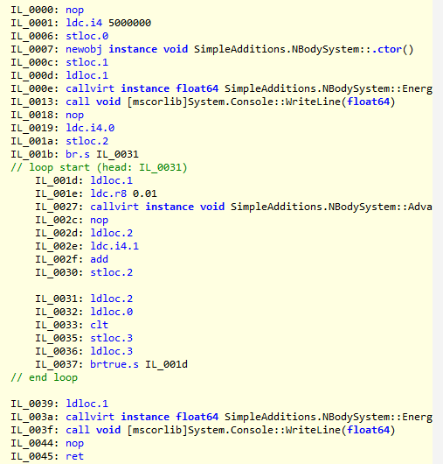
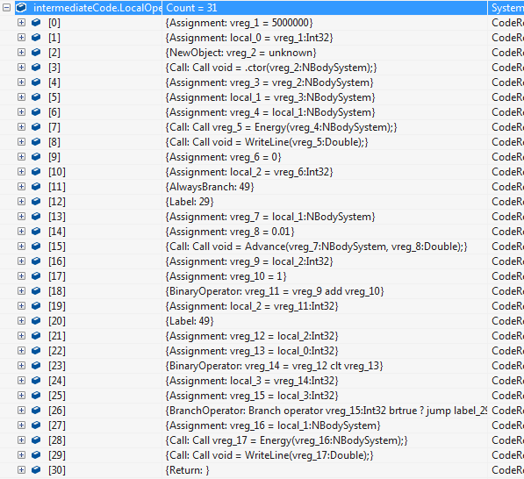
3. - FrontEnd
Disassemble IL
Rewrite as IR
Converts CIL code into intermediate representation,buidscall graph
Notes:
Looks for input assembly
UsingMono.Reflectionto get IL code
Scan for various Call instructions to fill the call-graph
Interpret instructions into CR equivalent in which instructions are grouped by semantics
5

Slide 6
4. - Optimization overview
One instruction
Code before optimizations | Code after optimization
var = constant1 (operator) identifier | var = result of the constant1 (operator) identifier
Block based
Code before optimizations | Code after optimization
Var1 = expression with no side effects (...) //code where parameters of expression are notredefined Var2= same expression | cacheVariable= expression with no side effects Var1 =cacheVariable (...) //code where parameters of expression are notredefined Var2=cacheVariable
Global optimizations
Code before optimizations | Code after optimization
Over whole body of function | (various)
Program wide optimizations
Code before optimizations | Code after optimization
Across functions | (various)
Notes:
Optimizations can be defined by scope:
- one instruction range: various constant evaluations
- block based optimizations
- global (whole function)
- program wide (in C++: Link time optimizations)
6

Slide 7
5. – Block based optimizations
Reduces the block instructions by:
- simplifies constant expressions
propagates constants and variables
Simplifies casts with constants
CSE optimizations

Slide 8

6 – USE-DEF optimizations
Not used variables are deleted
Label optimizations
remove unused,
merge consecutive,
Remove goto to labels on the next line
Dead store eliminations (over all function)
One assignment with constants propagated within all body of function

Slide 9
7.– Global optimizations
DFA Optimizations
Methodology:
Make some startup assumptions
Visit all flow of function to see if they hold
Go over all branches until assumptions stabilize
Implementations
Reachability lines (Dead Code Elimination)
Constant DFA propagation
Other function-body optimizations
Label optimizations
Loop invariant code motion
Notes:
Use-Defoptimizations
DFA Optimizations:
- try to assert some assumptions
- go over whole flow of the code andrafinateassumtionsuntil stabilize the call flow
- it has states before and after instructions
9

Slide 10

8 – Inter Procedural Optimizations
Inlining
Remove the cost of the call
Aggressive constant removal
Parameters holding constants are removed
Remove calls to empty functions

Slide 11

9 - Purityand Escape analysis
Escape Analysis
Checks if an instance does have the
reference counting usages of other object
changing in an known way.
Resulting optimizations
Allocations can be done on stack
Smart pointer usages can be made as raw
pointers
Purity Analysis
Checks if a function does not have any
Side effects and depend only from
parameters
Resulting optimizations
Pure functions calls with constants are
evaluated as constants
Better dead code elimination
More aggressive CSE
LICM works by moving functions too

Slide 12
Conclusions 1. Performance vs .Net
Bad benchmarks:
OS News 2004 benchmark
Good Benchmarks
NBodyBenchmark
Useful math computations
realistic memory usage patterns
CR runs well in both cases

Slide 13

2. Questions ?
Questions?

Slide 14
Code Refractor
THANK YOU
Optimizing Stack-based Vms
Khlud Ciprian
Coordinator
PhD Ferucio Laurențiu Țiplea

