Slide 1
Hw6 Helper

Slide 2
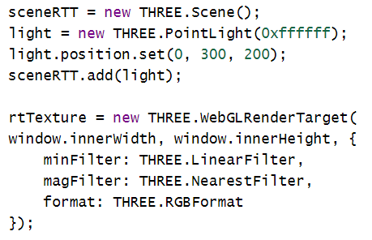
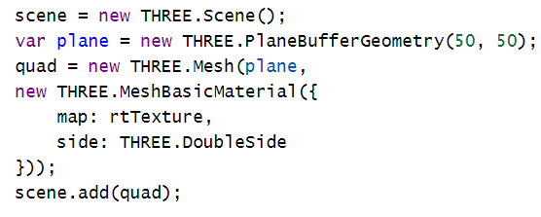


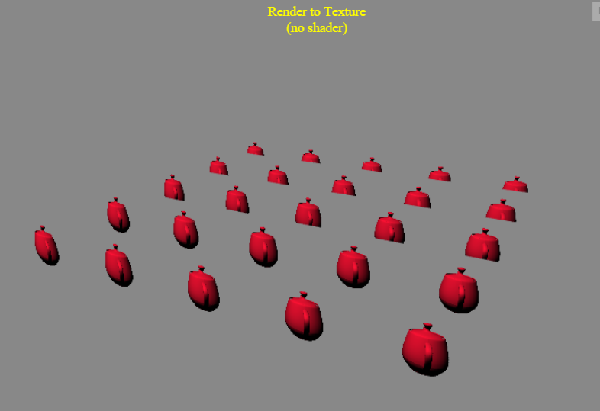
Render to texture
http://jsfiddle.net/jmchen/u3xph8wk/

Slide 3
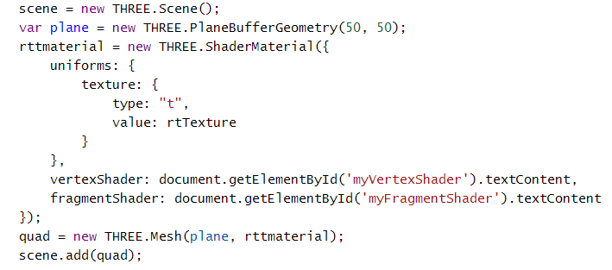
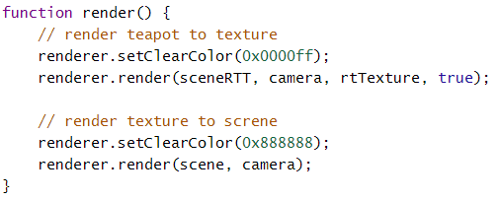
Render to texture, with cutout
http://jsfiddle.net/jmchen/62wmLLcg/

Slide 4
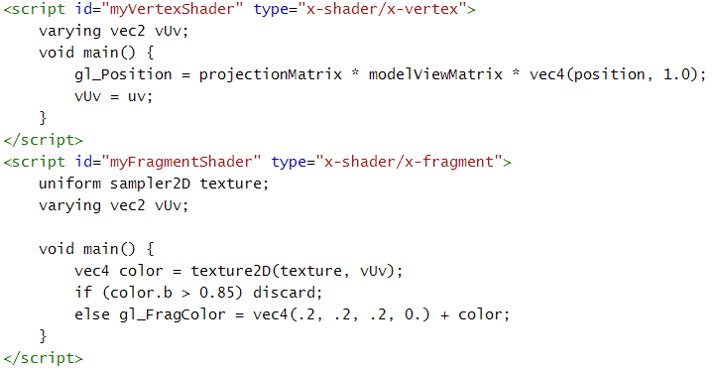
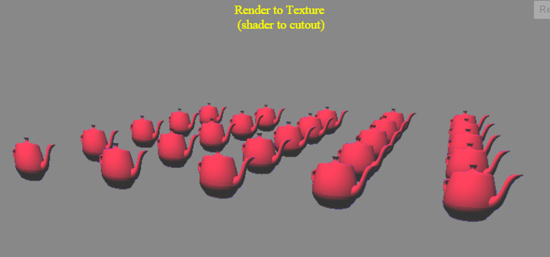

Slide 5
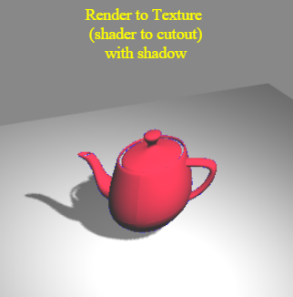
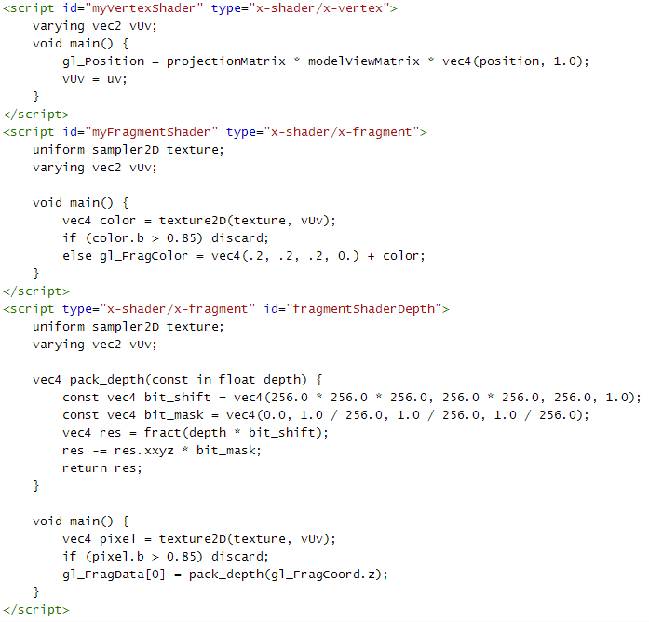
Cutout, with Shadow
http://jsfiddle.net/jmchen/vchqjf2a/

Slide 6
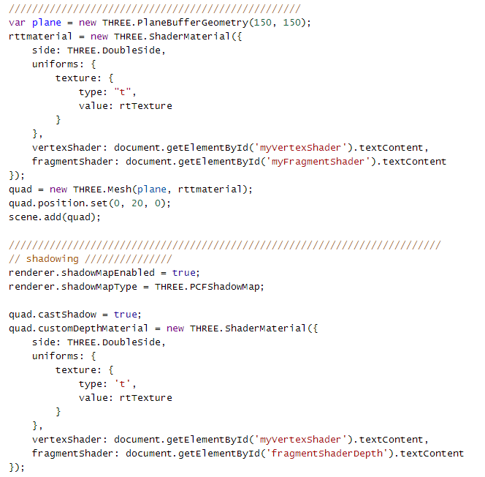

Slide 7
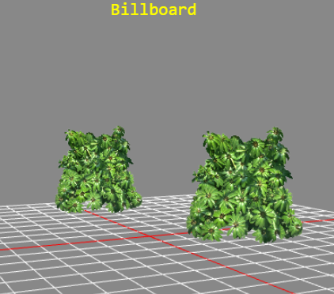
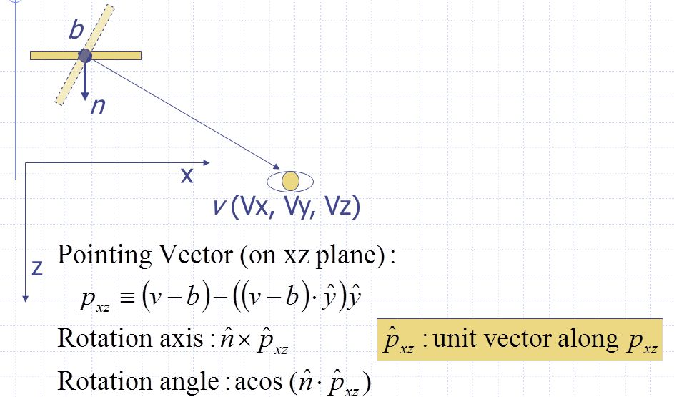
Billboard
http://jsfiddle.net/jmchen/5dqzur8q/

Slide 8
