Slide 1
深度學習系統與實現 Lab 3-2 – Model Scaling
Dept. of Computer Science and
Information Engineering
National Chiao Tung University

Slide 2
Outline
Concepts overview
Model Scaling
EfficientNet
Lab 3-2 specification
Grading
Notices & Hints

Slide 3
Model Scaling
Scaling up ConvNets is widely used to achieve better accuracy
e.g. ResNet can be scaled up from ResNet-18 to ResNet-200 by using more layers
The most common ways to scale up ConvNets:
width / depth / resolution
Is there a principled method to scale up ConvNets that can achieve better accuracy and efficiency?

Slide 4
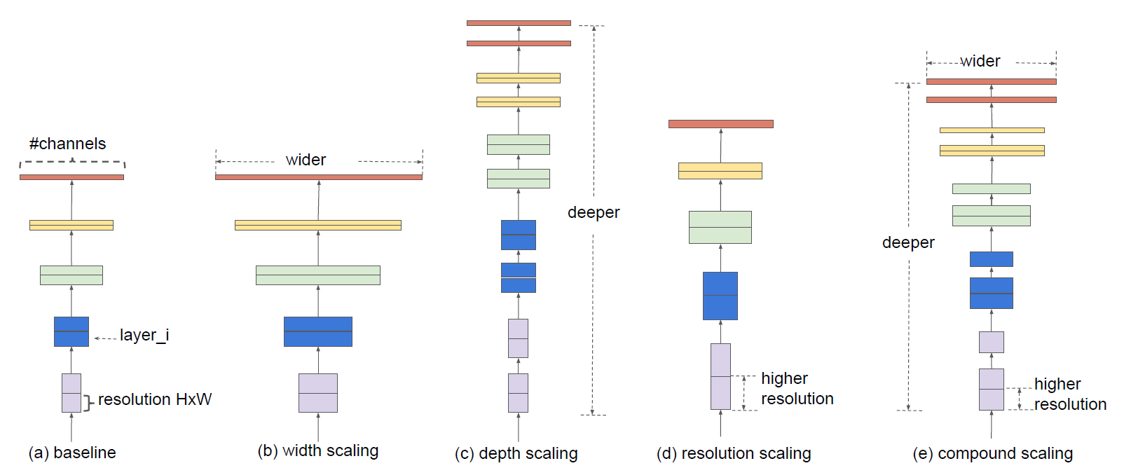
Model Scaling
Tan, Mingxing & Le, Quoc. (2019). EfficientNet: Rethinking Model Scaling for Convolutional Neural Networks.

Slide 5
Compound Model Scaling
EfficientNet
Tan, Mingxing & Le, Quoc. (2019). EfficientNet: Rethinking Model Scaling for Convolutional Neural Networks.
Observations
Scaling up any dimension of network improves accuracy, but the accuracy gain diminishes for bigger models
Different scaling dimensions are not independent
It is critical to balance all dimensions of network width, depth, and resolution during scaling

Slide 6
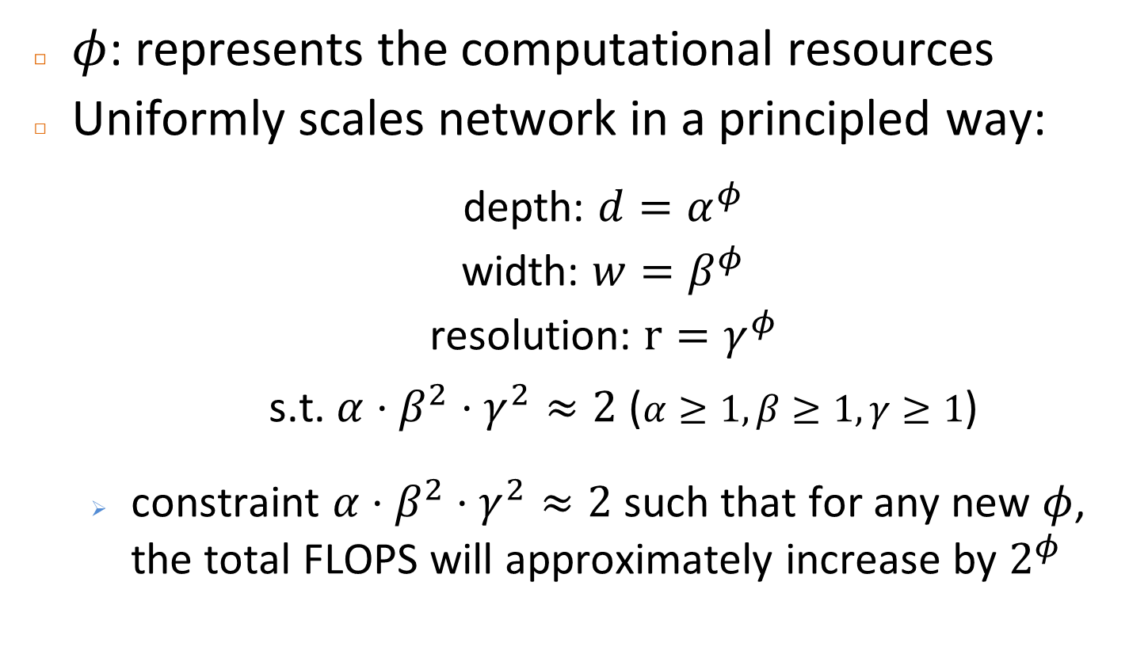
Compound Scaling Method
$φ$: represents the computational resources
Uniformly scales network in a principled way:
depth: $d=α^{φ}$
width: $w=β^{φ}$
resolution: $r=γ^{φ}$
s.t. $α⋅β^{2}⋅γ^{2}≈2$ ($α≥1,β≥1,γ≥1$)
constraint $α⋅β^{2}⋅γ^{2}≈2$ such that for any new $φ$, the total FLOPS will approximately increase by $2^{φ}$

Slide 7
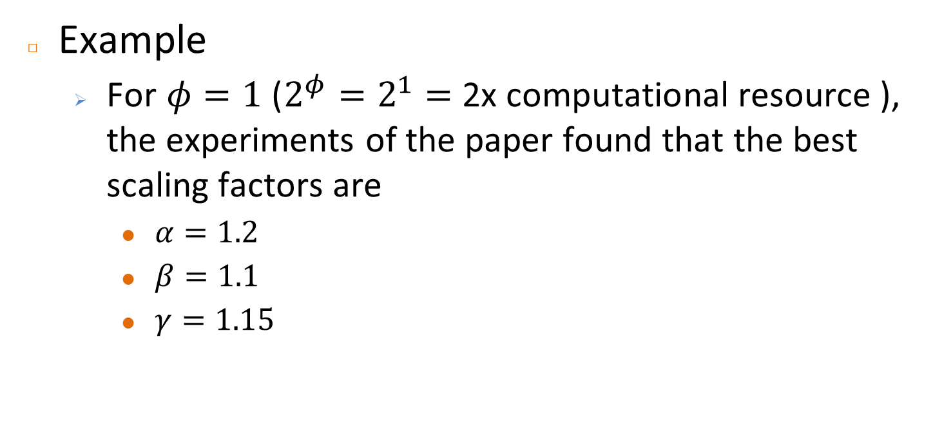
Compound Scaling Method
Example
For $φ=1$ ($2^{φ}=2^{1}=$ 2x computational resource ), the experiments of the paper found that the best scaling factors are
$α=1.2$
$β=1.1$
$γ=1.15$

Slide 8
Specification

Slide 9
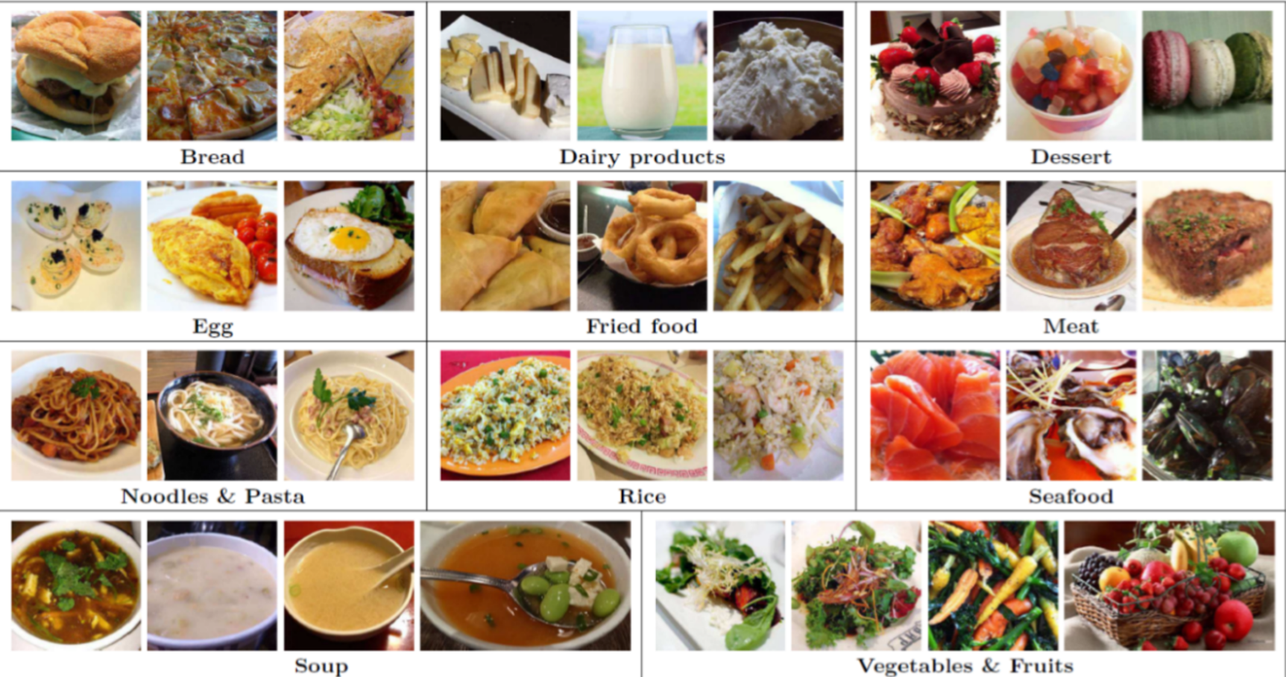
Dataset - food11
Food11 Download link - https://www.kaggle.com/tohidul/food11
Note: in lab3, full or skewed food11 are both ok
0
1
2
3
4
5
6
7
8
9
10

Slide 10
Lab 3-2 Model Scaling
In lab 3-2, we use Resnet as the backbone
[70%] Implement a scalable Resnet
The scalable Resnet should be able to configure different
depth (number of layers)
width (number of channels)
resolution (input size)
[30%] Experiments & report
Compare the different scales of your model (accuracy, execution time, memory usage, etc.)

Slide 11
Lab 3-2 Model Scaling
Questions
Do you get better results by scaling up the model?
If not, try to explain & analysis the cause
Does scaling up only 1 factor/uniformly scaling up 3 factors lead to a different result?
What should we adjust when a model is scaled up?

Slide 12
Grading
Total 100
3-2 Implementation (70%)
3-2 Experiments & report (30%)
Submission: source code + report [e3]
zip format (ex: DLSR_lab3-2_{group id}.zip)
5% penalty for the wrong submission format
Deadline : 2020/04/20, 23:59 (Mon) [3 weeks]
Demo: (TAs will announce on New-E3 later)

Slide 13
Reference
EfficientNet
https://arxiv.org/abs/1905.11946

