Slide 1

Bitonic Sort Algorithm
COMPUTER ARCHITECTURE
Salvatore Lombardi
Francesco Martoccia
A.Y. 2023/2024

Slide 2
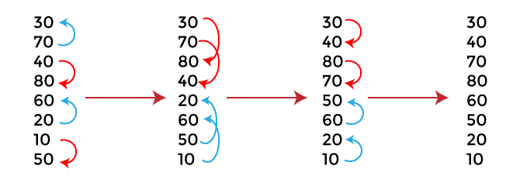
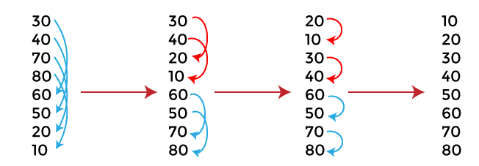
Bitonic Sort Algorithm
Comparison-based sorting algorithm that operates on elements arranged
into bitonic sequences.
They are sequences of numbers monotonically increasing and then decreasing (e.g. [2, 3, 4, 8, 6, 5]).
Input array length must be a power of 2.
The algorithm comprises 2 main phases:
Transformation of input into a bitonic sequence by repeatedly merging smaller sequences into larger bitonic sequences.
Sorting the bitonic sequence in ascending or descending order by comparing and swapping elements across the bitonic sequence at specific distances (called the ”stride”) and by repeating the process within each half, recursively narrowing the comparisons to smaller subsequence

Slide 3
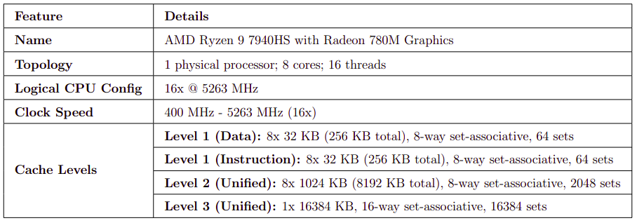
CPU Specifications

Slide 4
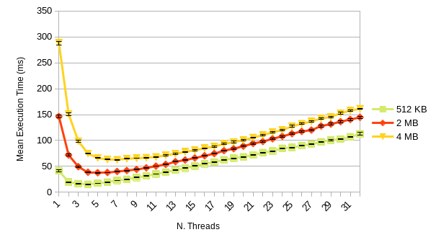
First CPU Version – Mean Execution Time
Input values generated as random 32-bit unsigned integers using a uniform distribution.
Two distinct scenarios were considered:
Small input array sizes (512 KB, 2 MB, 4 MB)
Large input array sizes (128 MB, 256 MB, 512 MB)
Number of threads was varied from 1 to 32.
The algorithm was executed 30 times for each array size and a specific number of threads (confidence interval of 95%).
Small array sizes:
computational workload is insufficient to fully leverage the advantages of parallelism.
Thread overhead causes mean execution time to increase as the number of threads grows.
Large array sizes:
greater workload allows the system to better utilize the computational resources provided by additional threads.
Thread overhead is amortized.
std::chrono library and high_resolution_clock as clock type used to measure the timing
A

Slide 5
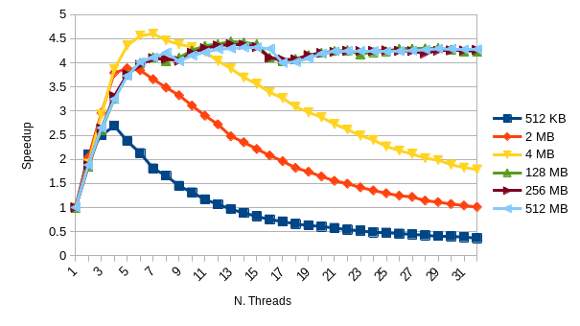
First CPU Version – Speedup
Small array sizes:
Peak speedup at low number of threads.
Drops off rapidly as the thread count increases.
Big array sizes:
Stable speedup across a higher range of thread counts.
Increased workload can better leverage the parallelism provided by additional threads.

Slide 6
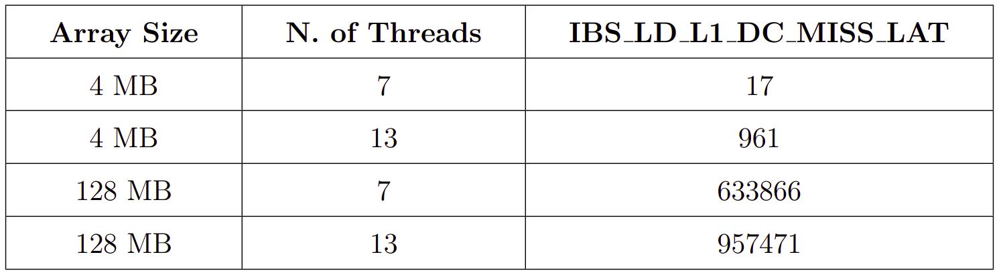
First CPU Version – Performance Analysis
Problem: peak speedup observed with 4 MB and 7 threads and not in scenarios involving larger array sizes.
Goal: Evaluation of the potential influence of inter-thread synchronization and cache behavior and subsequent code optimization.
Visual Studio's CPU Usage Tool was used to identify the function in the code with the highest CPU utilization.
About 96% CPU usage with the CompareAndSwap function, so low speedup was not due to inter-thread synchronization mechanisms.
AMD µProf profiler was leveraged to analyze the cache usage.
Significant difference in L1 cache latency results in a lower speedup when considering larger array sizes.
Increased cache misses impact on performance as the workload scales.

Slide 7
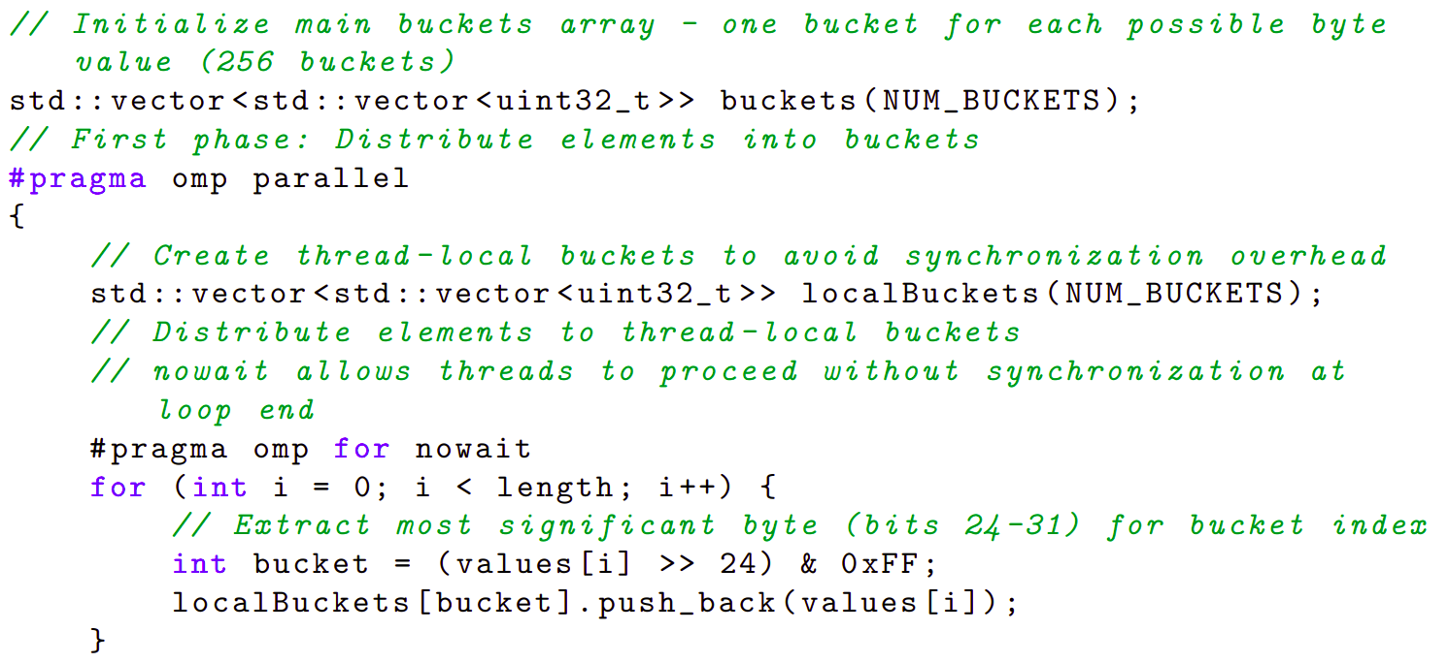
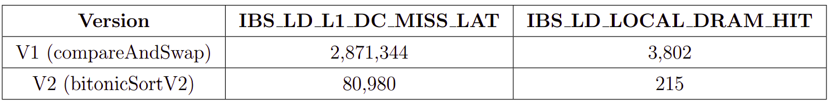
CPU Optimized Version
Goal: optimization of the code to reduce the L1 cache latency and L1 cache misses for large array sizes.
Code problems:
Each thread performs comparisons and exchanges across the entire array, without localized processing, so there is poor data locality.
Since the bitonic sequence size doubles in each iteration, these become more widespread, leading to frequent replacements and increased misses, as the entire array cannot fit within the cache.
Optimizations:
Increased data Locality and reduction of the number of accesses to shared memory locations via Bucket Sort.
SIMD optimization when Bitonic Sort works with smaller arrays by using the OpenMP API.

Slide 8
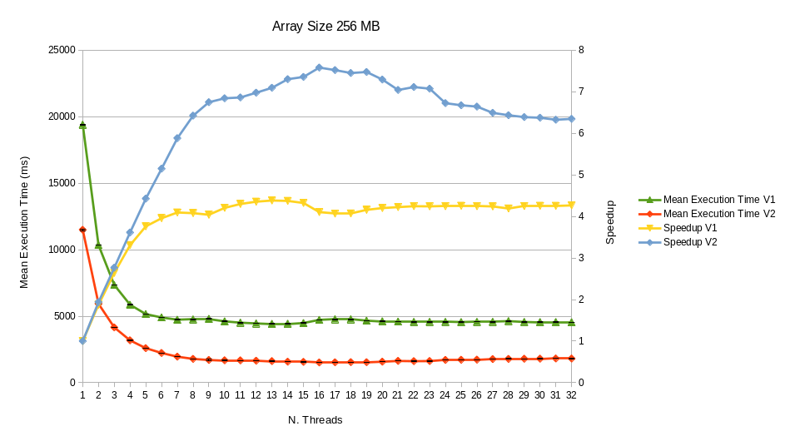
Comparison between the two versions
V2 has much lower execution times compared to Version 1 across all thread counts.
V2 outperforms the first in terms of speedup at all thread counts.
V1 maximum speedup was achieved with 13 threads (approximately 4.4x).
V2 maximum speedup was achieved with 16 threads (approximately 7.6x).

Slide 9
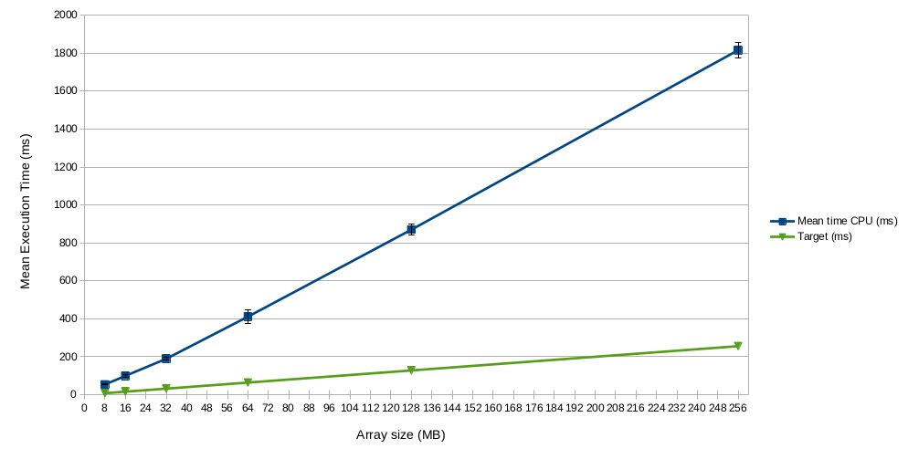
Throughput
Target: 1GB/s.
Tests performed with 16-thread configuration.
The average value achieved was around 140MB/s.
For this reason, the algorithm was implemented on the GPU.

Slide 10
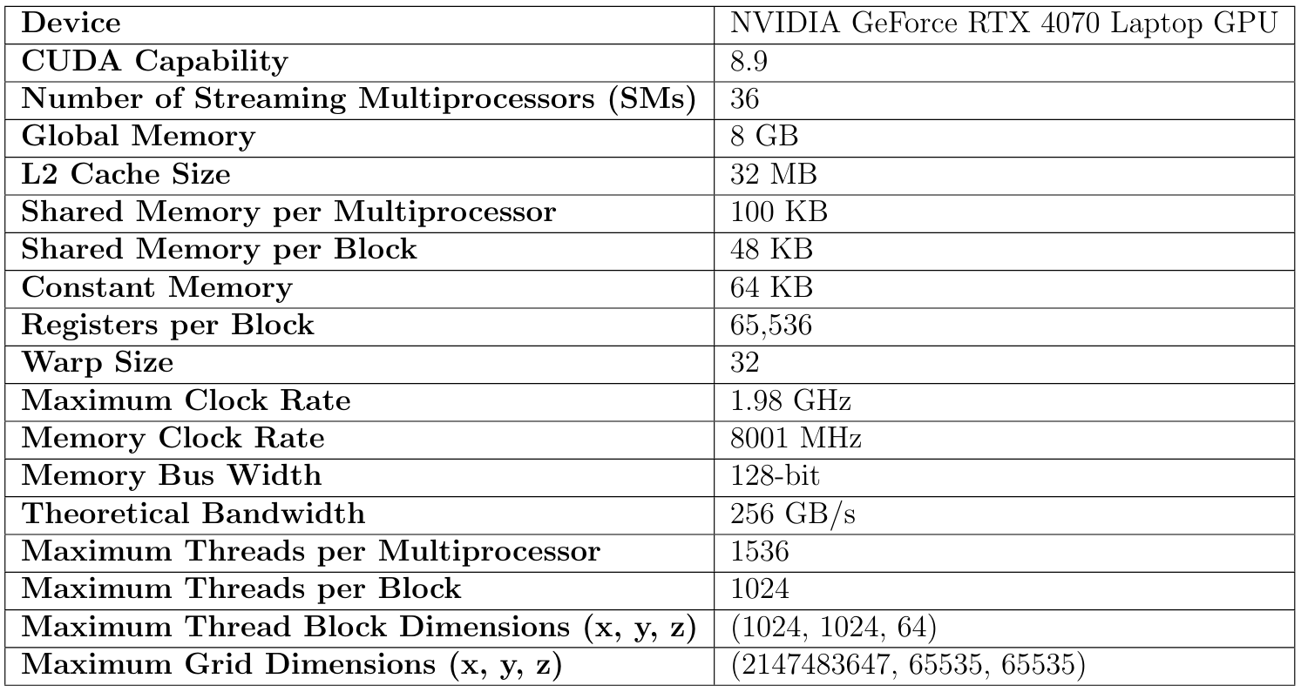
GPU Specifications

Slide 11
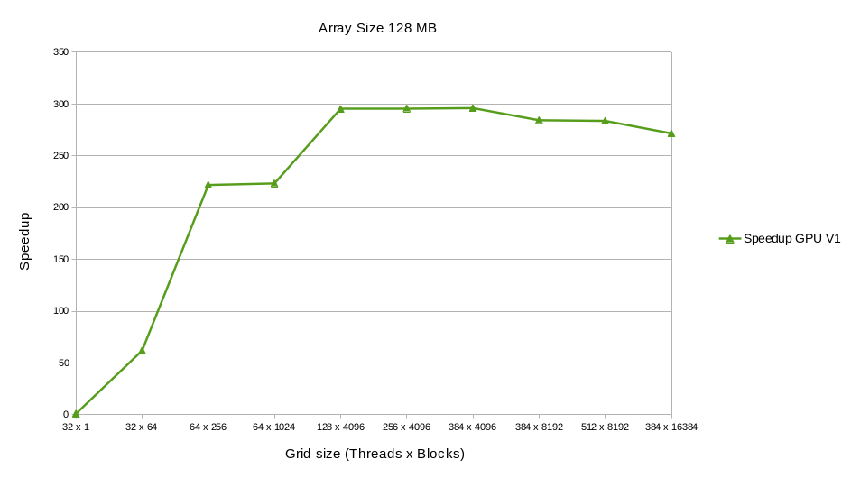
First GPU Version - Speedup
Kernels:
bitonicSort
BitonicMergeGlobal
Timings measured with cuda Events
Speedup test with different Grid sizes
The configuration with optimal results is:
384 threads x 4096 blocks
The maximum speedup is ≈ 300x w.r.t. a single warp.

Slide 12
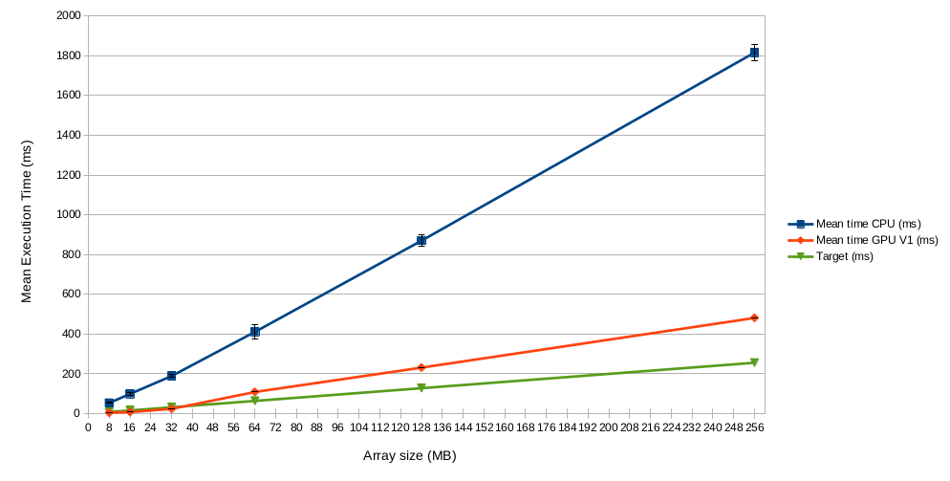
First GPU Version – Mean Execution Time
Mean Execution Time with different Array Sizes:
8, 16, 32, 64, 128, 256 (MB)
The grid size used in this case is 384 threads x 4096 blocks.
The target throughput of 1 GB/s was not reached for array sizes larger than 32 MB.
The mean throughput is 950 MB/s in this case, so further optimizations and performance analysis are required to meet the target.

Slide 13
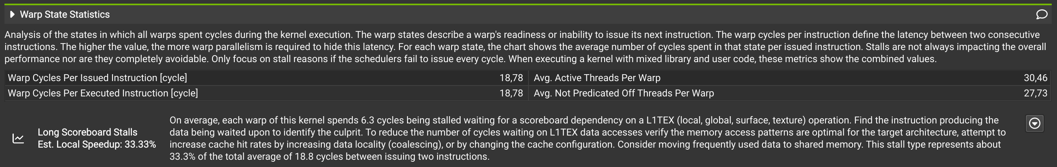
First GPU Version – Performance Analysis
The NVIDIA Nsight Compute profiler was used to analyze the execution of the 2 kernels.
The main problem found in the bitonicSort kernel is related to Long Scoreboard Stalls, which represent
approximately 33.3% of the total average of 18.8 warp cycles per instruction.
This kind of stalls occur when a warp is waiting for data from memory accesses operations, particularly those that can leave the Streaming Multiprocessor (SM).

Slide 14
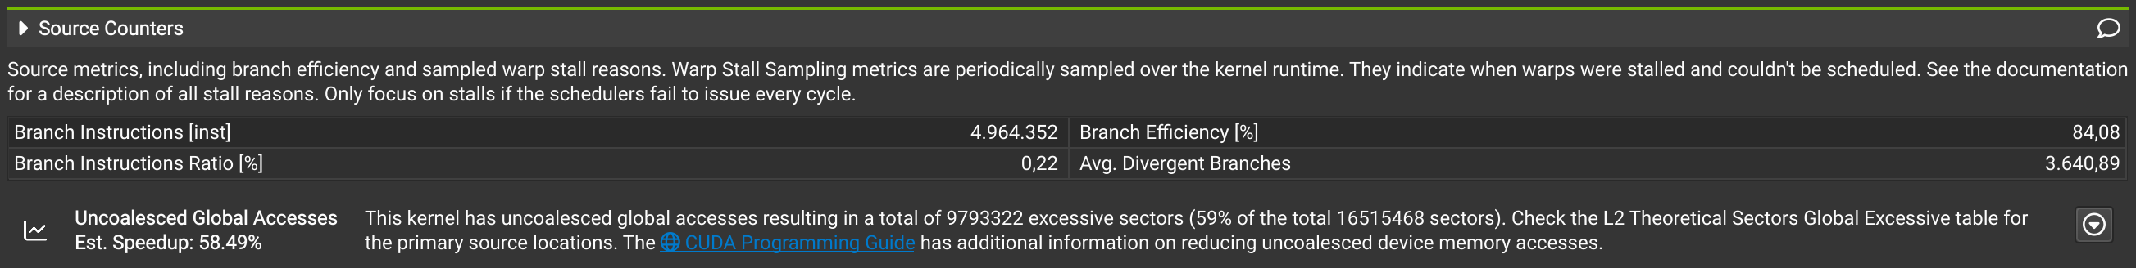
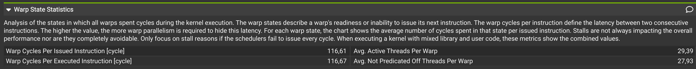
First GPU Version – Performance Analysis
The main problem in the bitonicMerge kernel was instead due to Uncoalesced Global Accesses.
The tool estimates a potential speedup of 58.49% if this issue is addressed.
Furthermore, the results indicate that on average each warp spends 100.3 cycles stalled
waiting for a scoreboard dependency .
This accounts for approximately 86.0% of the total warp cycles per issued instruction (116.6).

Slide 15
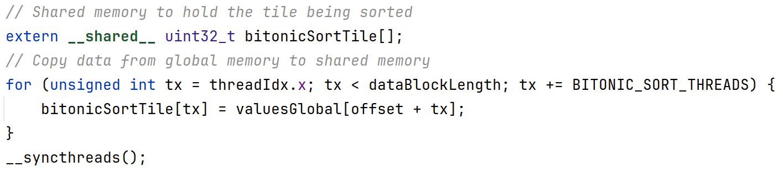
Optimized GPU Version
The optimized version (Version 2) aimed at improving the first one in terms of memory access latency and data locality.
This was accomplished by exploiting shared memory.
Version 2 can be used only when the required shared memory per thread block does not exceed the device’s MAX_SHARED_MEMORY_SIZE. This occurs if there are enough blocks in the grid.
The bitonicSort kernel was optimized by loading a tile of data from global memory to shared memory.
The sorting is performed locally to the block and the sorted values are copied back to global memory at the end.

Slide 16
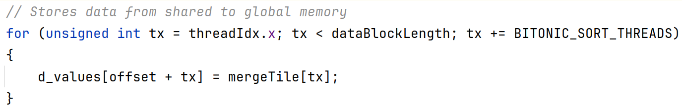
Optimized GPU Version
Version 2 introduces a distinction between global merges (for larger blocks) and local merges (for smaller blocks that fit in shared memory).
The bitonicMergeLocal kernel was added. It performs local merges in shared memory, allowing threads within a block to collaborate more efficiently.
The process of copying data from global to shared memory and viceversa is performed in a coalesced manner.
Once the data is in shared memory, the bitonicMergeStep function is called directly on the local data.
Finally, after all the merge steps have been performed, the data is copied back to global memory.

Slide 17
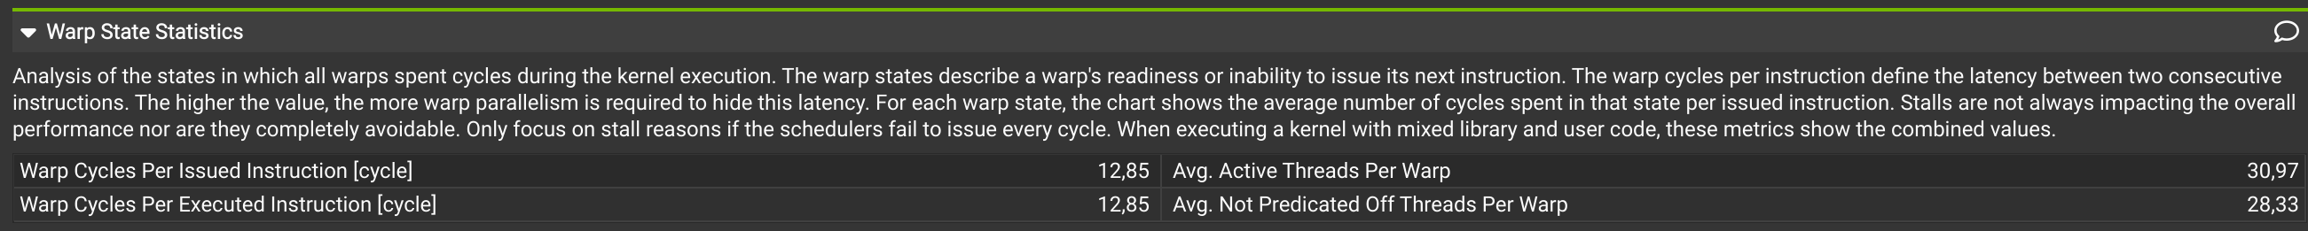
Optimized GPU Version - Performance Analysis
In the bitonicSort kernel the number of warp cycles per issued instruction decreased significantly, from 18.78 in the first version to 12.45 in the optimized version. This improvement is primarily due to the absence of Long Scoreboard Stalls.
In bitonicMergeGlobal the branch efficiency increased from 84.08% in the first version to 99.93% in the optimized version. In this case the uncoalesced global accesses problem was solved.
The bitonicMergeLocal kernel has significantly lower latency between consecutive instructions in a warp (12.85 vs 116.6 in the previous version).

Slide 18
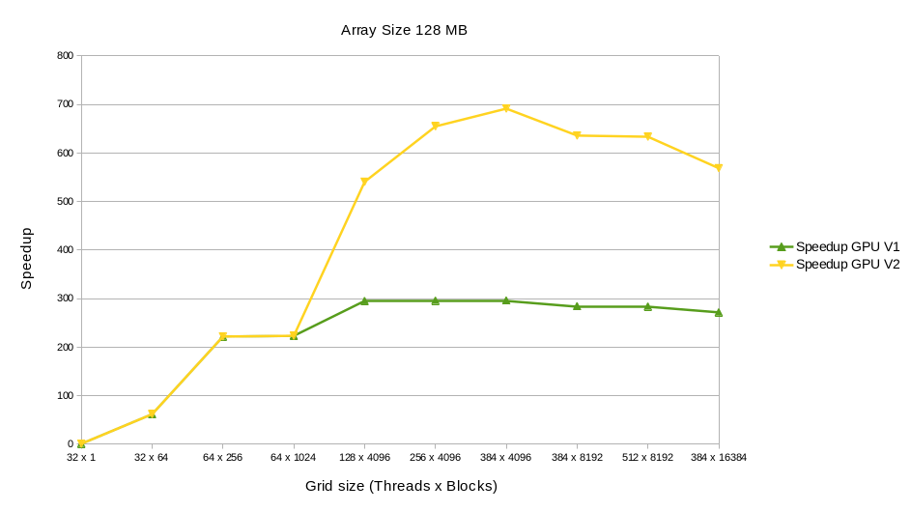
Optimized GPU Version - Speedup
GPU Version 2 achieves significantly higher speedup, peaking at 700x compared to 300x in the first version.
The 5th configuration is the first that allows the optimization to be applied (there are enough blocks in the grid to exploit the shared memory).
The optimal configuration for GPU Version 2 occurs at 384 threads and 4096 blocks, as it was in GPU Version 1.

Slide 19
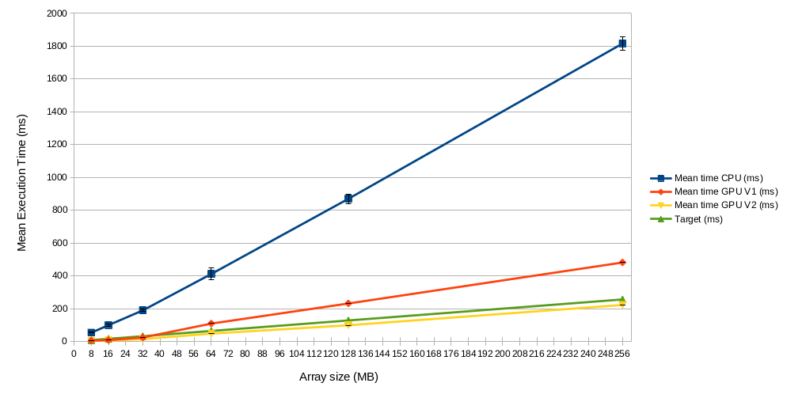
Optimized GPU Version - Mean Execution Time
The target throughput of 1 GB/s was reached also for array sizes larger than 32 MB, unlike the GPU Version 1.
These results demonstrate that the optimizations applied reduce execution time, ensure better scaling behavior compared to the first version and allow to meet the target.
The mean throughput obtained by the optimized version is
1.4 GB/s.

