Slide 1
Fundamentals and applications of WEB SERVICES

Slide 2
AGENDA
Web Service Architecture
Service Oriented Architecture (SOA)
Walkthrough WCF Service Implementation
Walkthrough WCF Client Proxy Generation
WCF in WSCC Project
Sample console application – CISCOServerWCF
WSCC – CISCO APP DEMO
Q&A

Slide 3
Web service architecture
A web service is a network accessible interface to application functionality, built using standard Internet technologies.
Clients of web services do NOT need to know how it is implemented.
Network
Web
Service
Application
client
Application
code

Slide 4
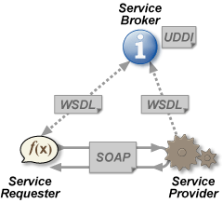
Web service architecture
UDDI – Universal Directory Discovery Integration
WSDL – Web Service Description Language
SOAP – Simple Object Access Protocol

Slide 5
WHAT IS SERVICE ORIENTED ARCHITECTURE
Service-Oriented Architecture (SOA) is a set of principles and methodologies for designing and developing software in the form of interoperable services. These services are well-defined business functionalities that are built as software components (discrete pieces of code and/or data structures) that can be reused for different purposes. SOA design principles are used during the phases of systems development and integration.

Slide 6
SOA DESIGN PRINCIPLES
Explicit Boundaries
Share Contract and Schema, not Classes
Autonomous
Interoperable

Slide 7
WHAT IS WCF
Windows Communication Foundation (WCF) is a framework for building service-oriented applications.
It is a runtime and a set of APIs for creating systems that send messages between services and clients.

Slide 8
WALKTHROUGH WCF DEVELOPMENT

Slide 9
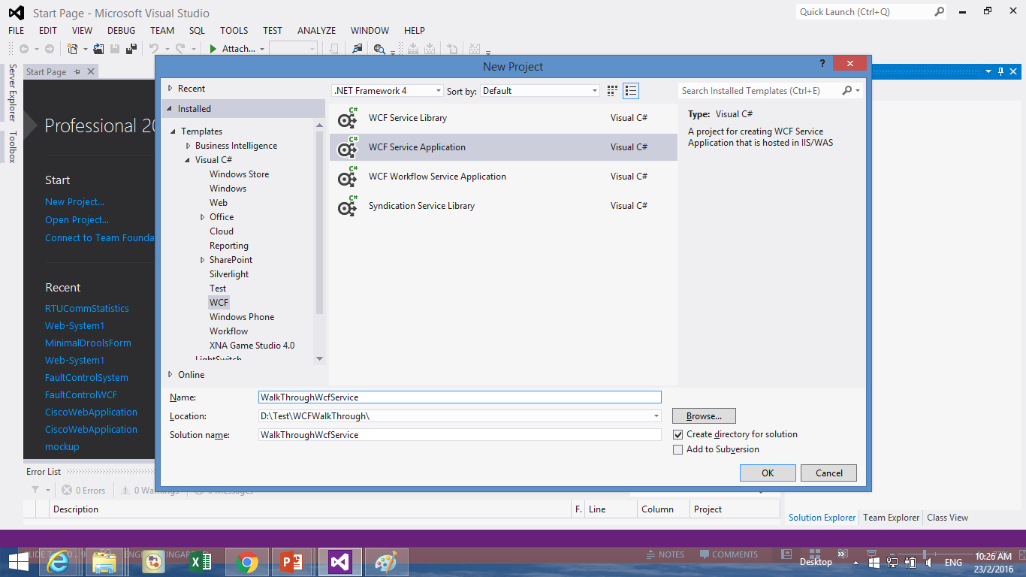
Create Project Solution

Slide 10
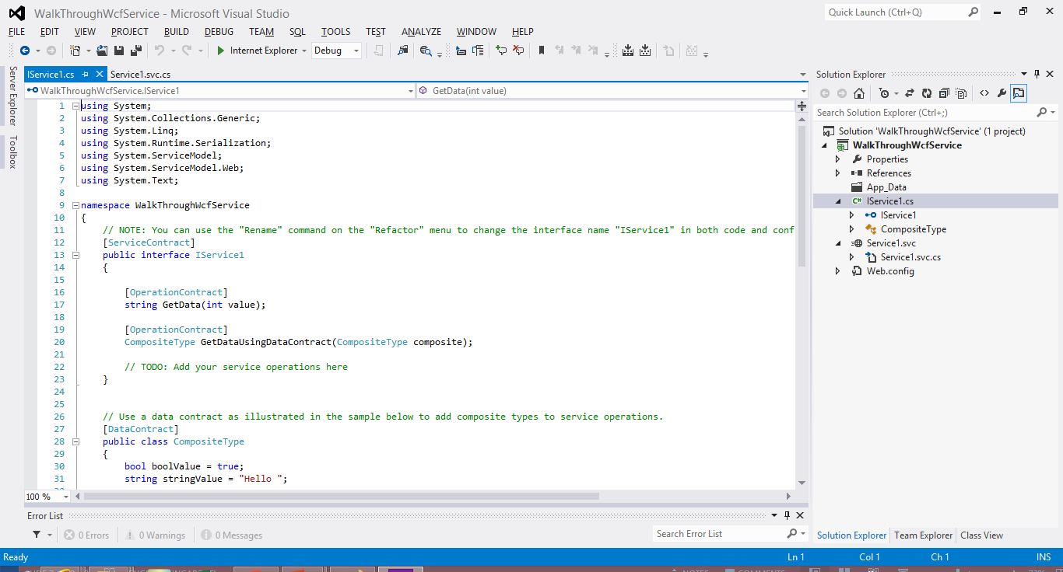
GENERATED Service and DATA CONTRACT

Slide 11
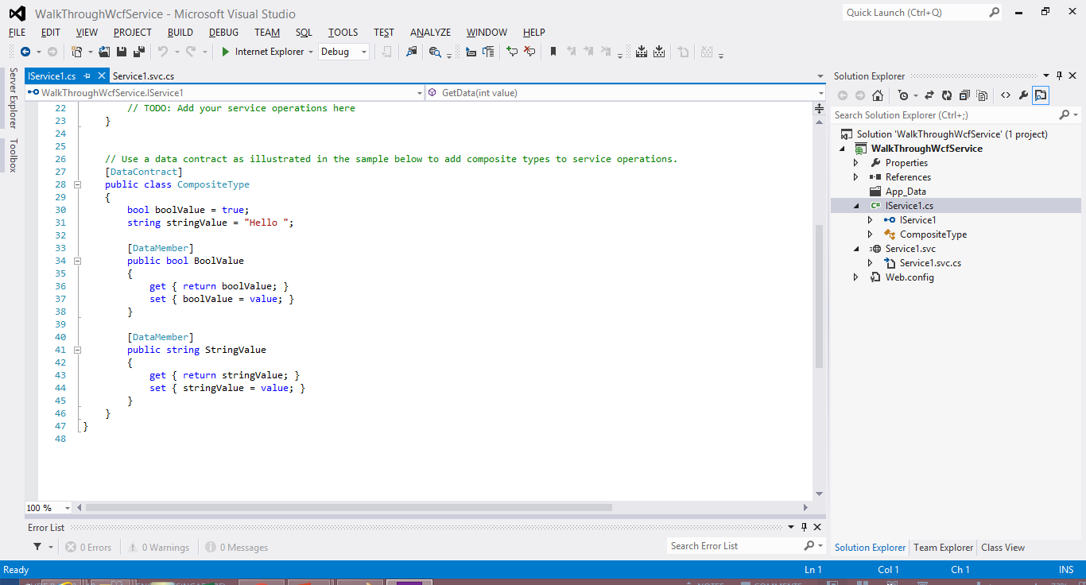
GENERATED Service and DATA CONTRACT

Slide 12
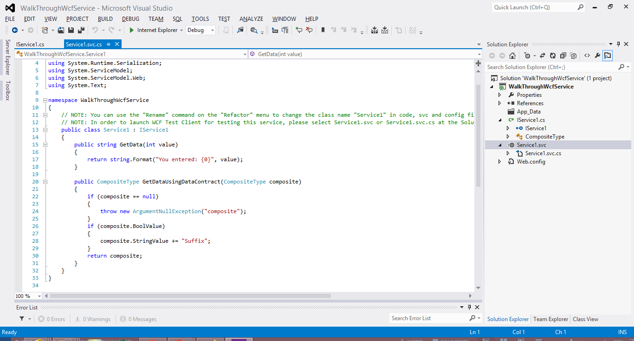
GENERATED SERVICE IMPLEMENTATION

Slide 13
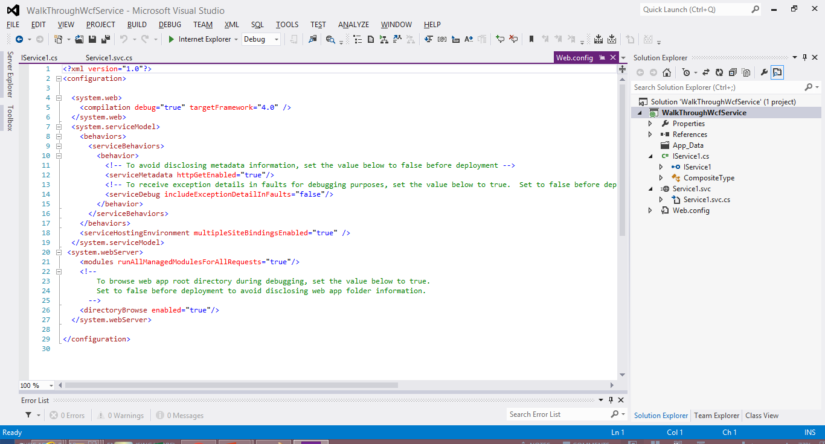
GENERATED CONFIGURATION FILE

Slide 14
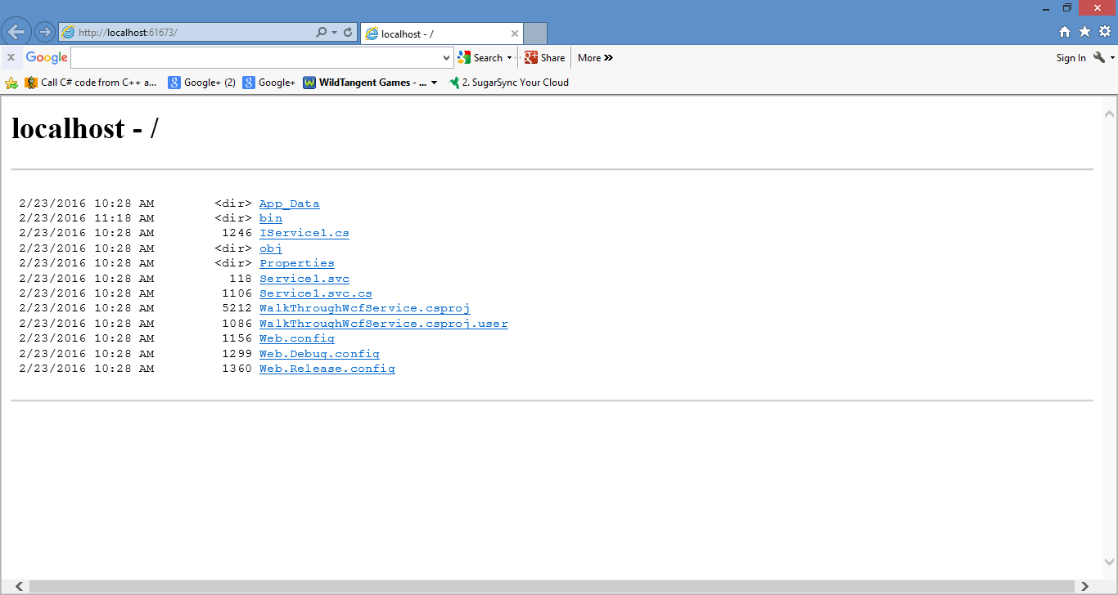
RUNNING WCF SERVICE

Slide 15
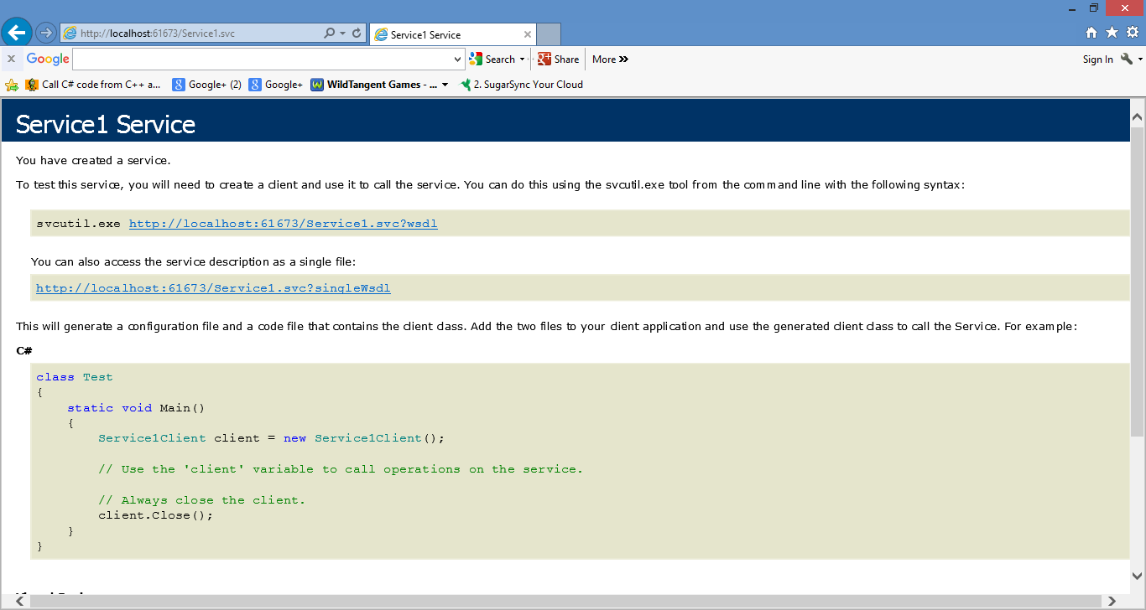
SAMPLE WCF CLIENT

Slide 16
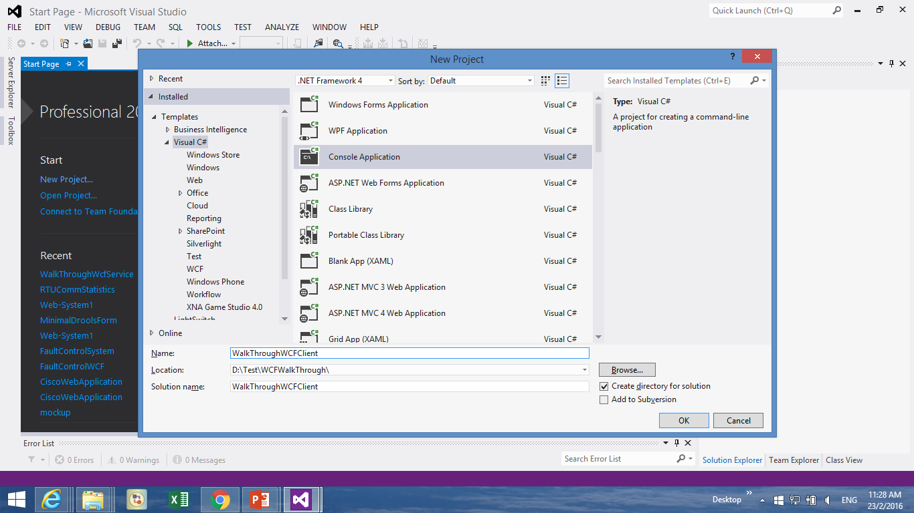
CREATE WCF CLIENT

Slide 17
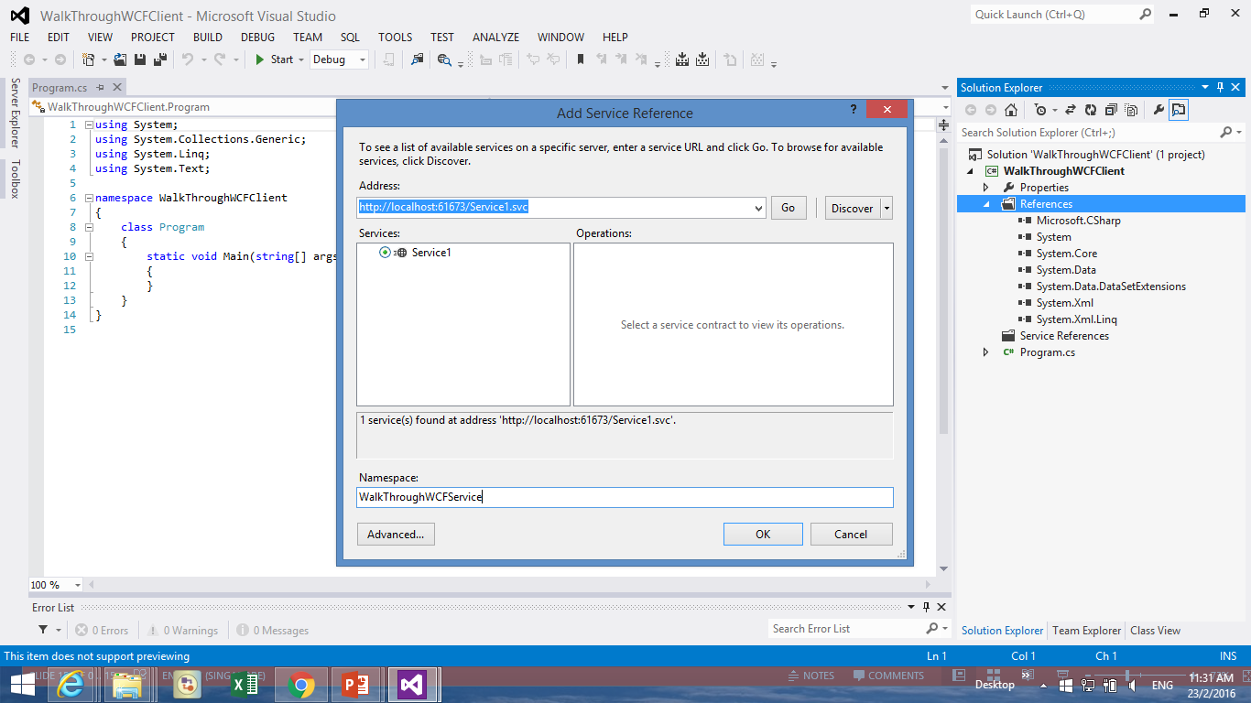
GENERATE WCF SERVIce PROXY

Slide 18
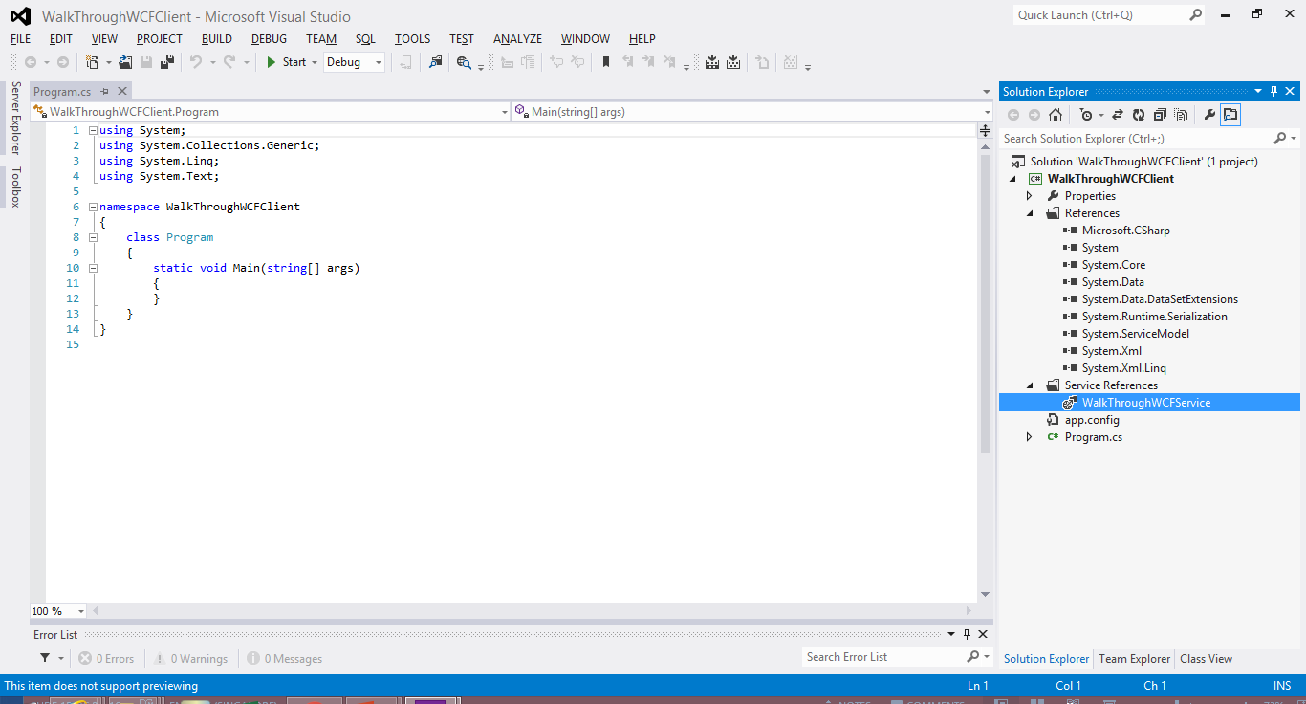
GENERATE WCF SERVIce PROXY

Slide 19
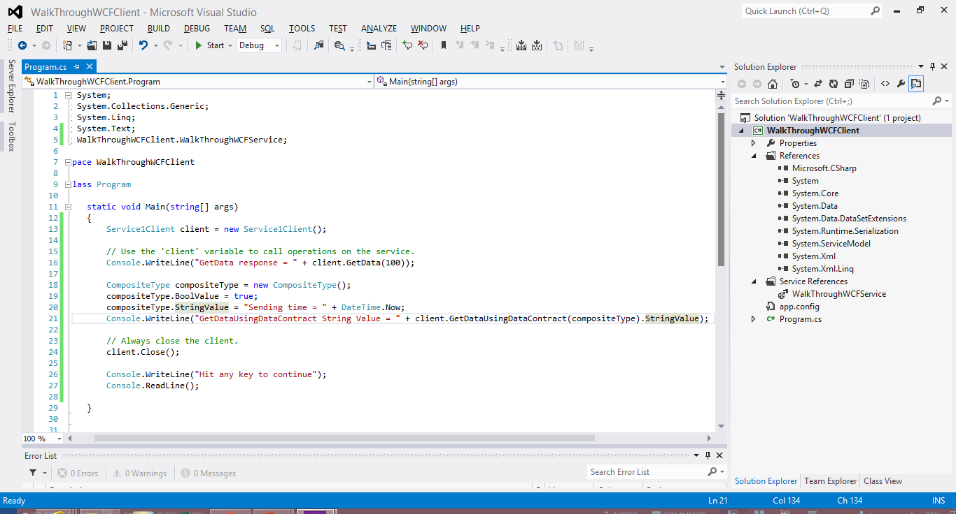
IMPLEMENT WCF CLIENT

Slide 20
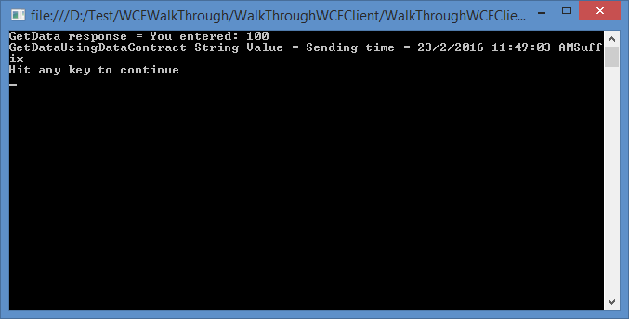
RUNNING WCF CLIENT

Slide 21
TuTORIAL – Develop A Web SERVICE and Client

Slide 22
WCF aPPLICATIoN IN WSCC

Slide 23
WCF APPLICATION IN WSCC
CISCO Application
CISCO Desktop Service
CISCO Server Service
Service Reservoir Stock Estimation

Slide 24
CISCOSErverwcf – Source location
SVN url: http://192.3.70.200:18080/svn/PROJ_WSCC_APPLS/branches/IntelligenceModule/CISCO/CISCOWCF

Slide 25
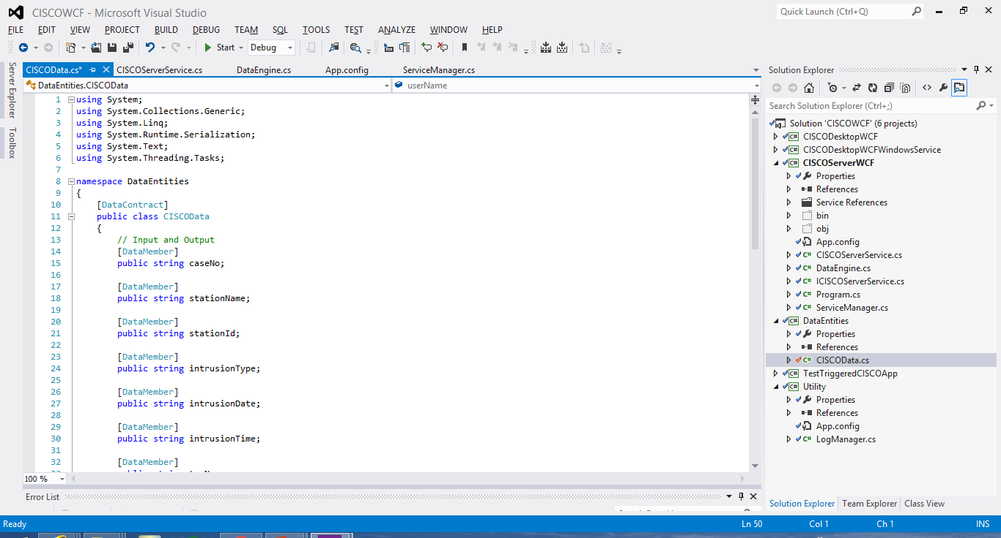
CISCOSErverwcf – data contract

Slide 26
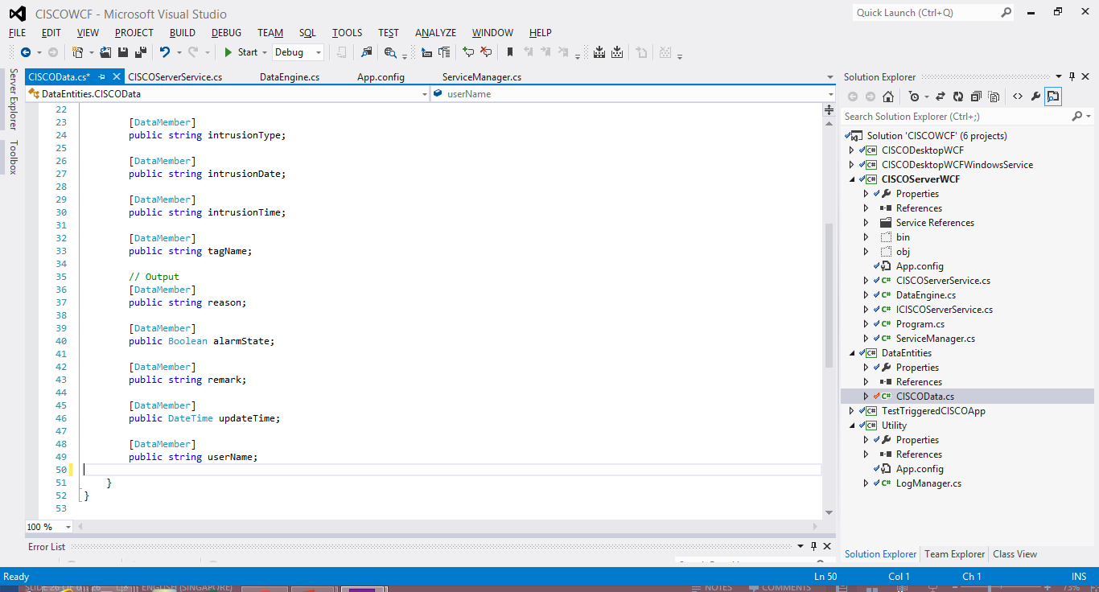
CISCOSErverwcf – Data contract

Slide 27
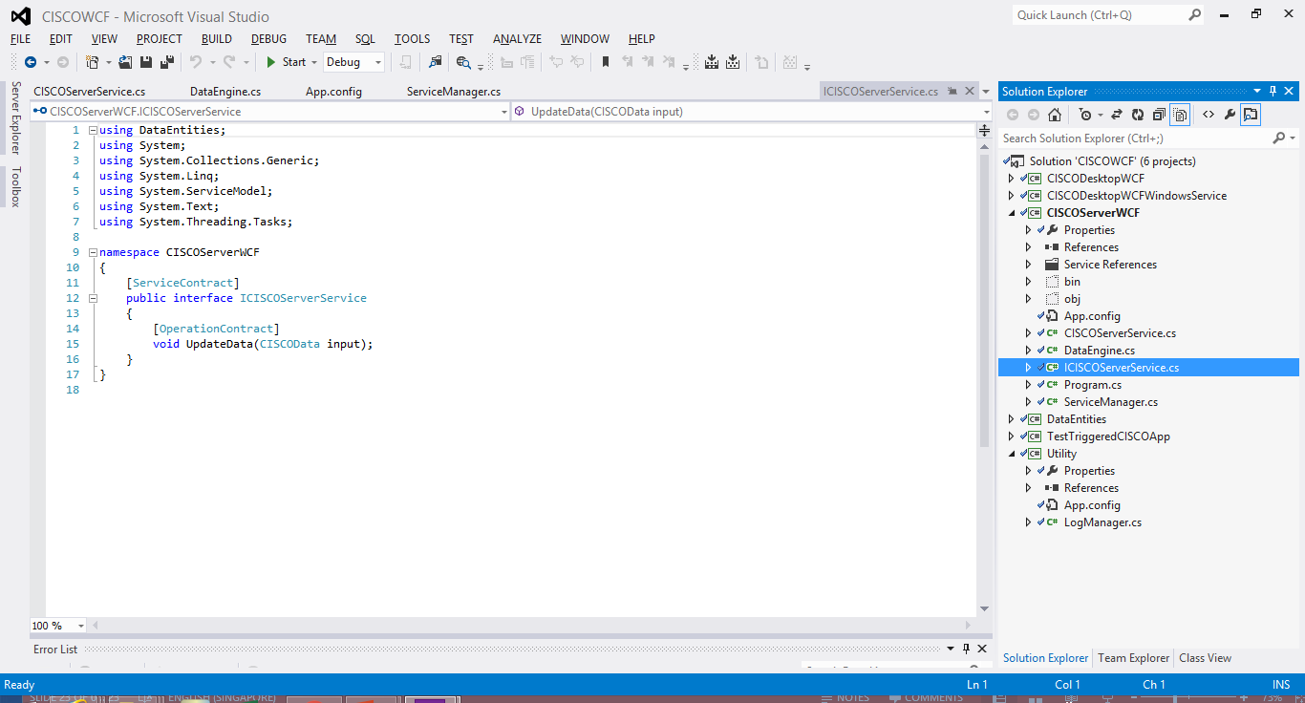
CISCOSErverwcf – service contract

Slide 28
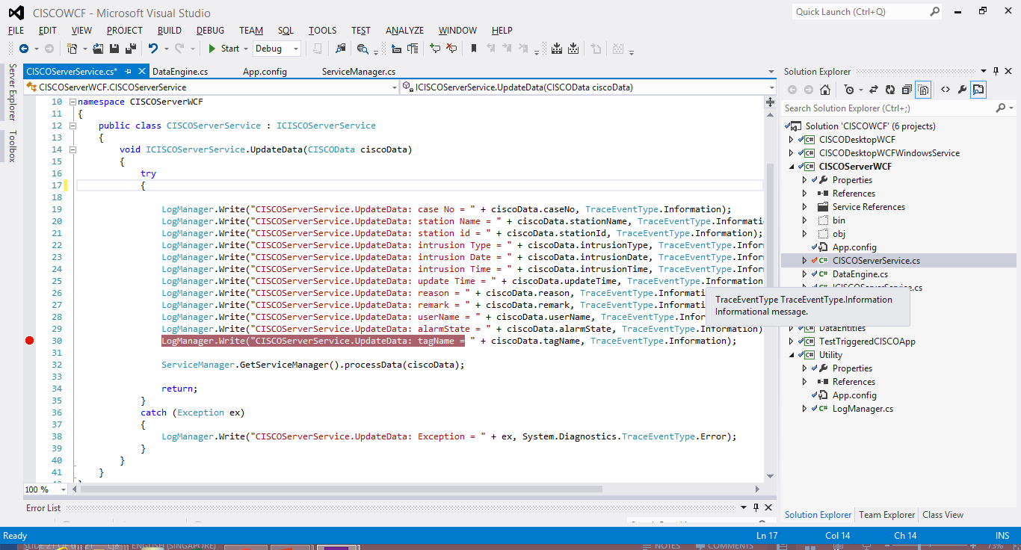
CISCOSErverwcf – service implementation

Slide 29
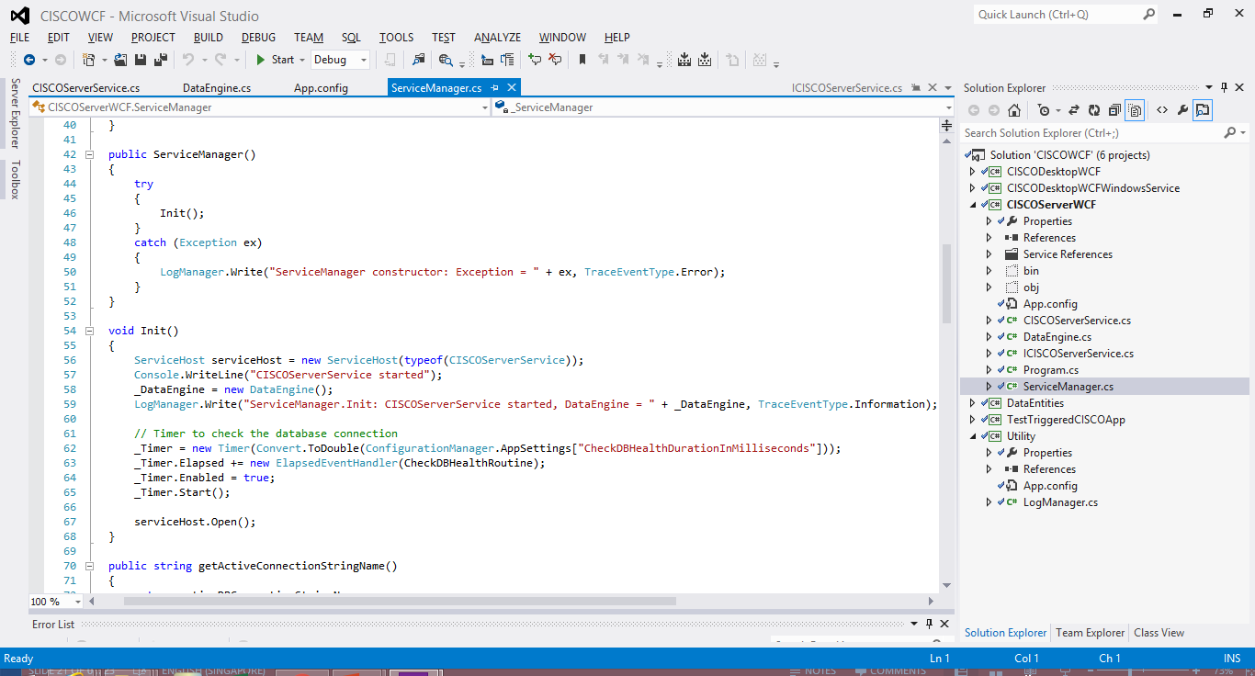
CISCOSErverwcf – Start WCF Service

Slide 30
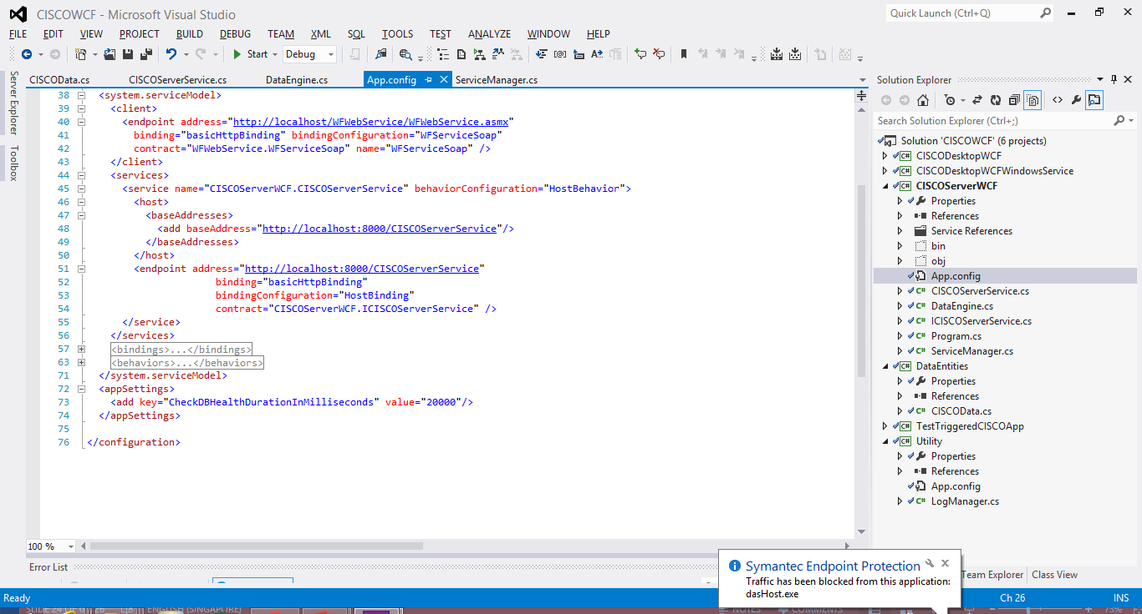
CISCOSErverwcf – Config file

Slide 31
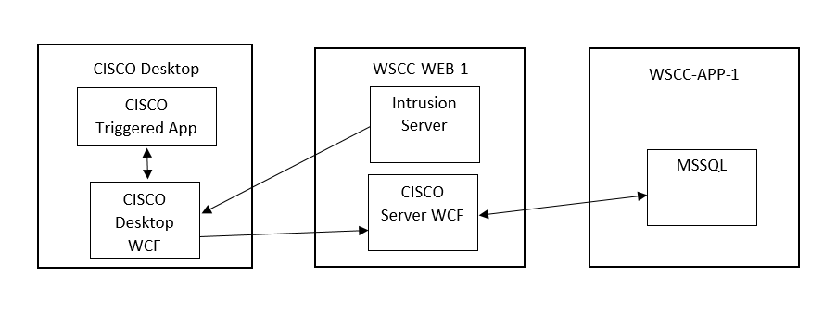
WSCC – CISCO Application DEMO

Slide 32
ANY QUESTIONS?

Slide 33
THANK YOU

