Slide 1
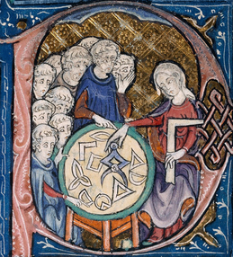

Fisher-Rao distance and pullback Hilbert distance between multivariate normal distributions
Frank Nielsen
Sony Computer Science Laboratories Inc
GSI'23
arXiv:2307.10644
August 2023

Slide 2

References for this talk
NB: Paper is not included in the GSI proceedings
A Simple Approximation Method for the Fisher–Rao Distance between Multivariate Normal Distributions, Entropy (2023)
Fisher-Rao and pullback Hilbert cone distances on the multivariate Gaussian manifold with applications to simplification and quantization of mixtures, ICML TAG-ML workshop (2023)

Slide 3
Overview and main contributions
Give details of method [Kobayashi 2023] to calculate the Fisher-Rao geodesics
between multivariate normal distributions with boundary conditions
Report a guaranteed (1+ε)-approximation for the Fisher-Rao MVN distance
Define a fast metric distance between d-variate MVNs based on Hilbert
projective metric on the SPD cone of dimension d+1: pullback Hilbert distance

Slide 4

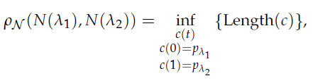
Rao distance and Fisher-Rao Riemannian geometry
Consider a regular statistical parametric model: {p_{λ:} λ∈Λ}, dim(Λ)=m
regular = smooth partial derivatives, {∂₁p_{λ},...,∂_{m}p_{λ}} linearly independent
or score functions {∂₁log p_{λ},...,∂_{m}logp_{λ}} defining the tangent plane
Let the Fisher information matrix (FIM) defines the Riemannian metric g
FIM well-defined, finite, and positive-definite → Fisher metric tensor
Define the geodesic length as the Rao distance
By construction, Rao's distance is invariant to reparameterization
[Atkinson & Mitchell 1981]
[Rao 1945]
[Hotelling 1930]
Notes:
https://arxiv.org/abs/2302.08175

Slide 5
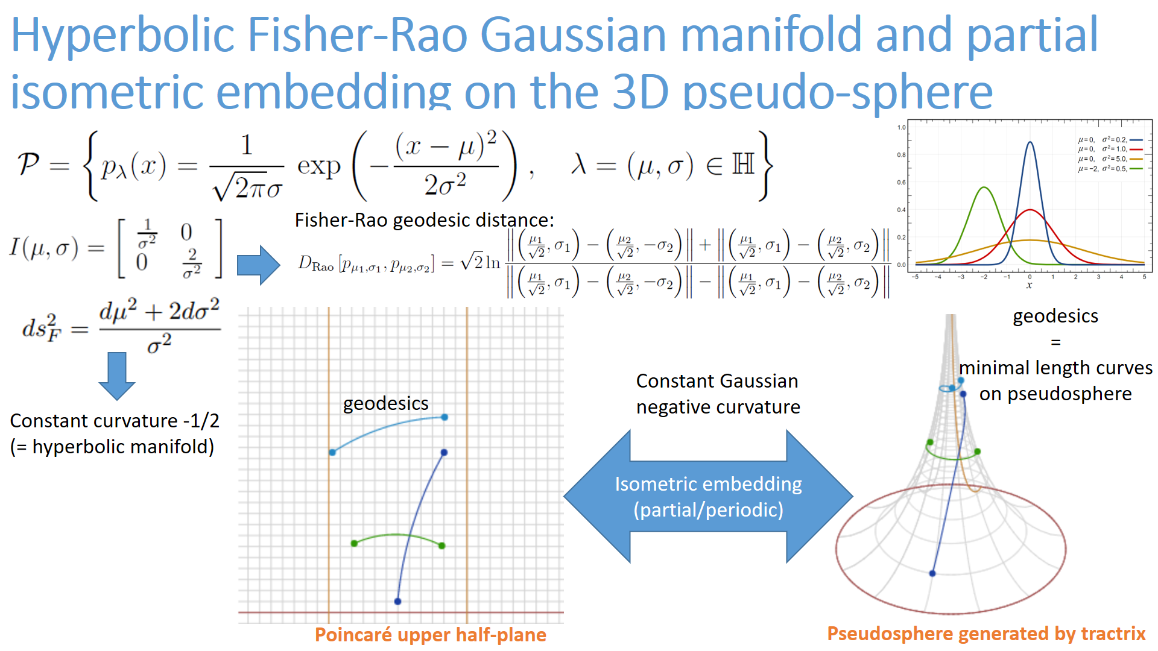

Slide 6
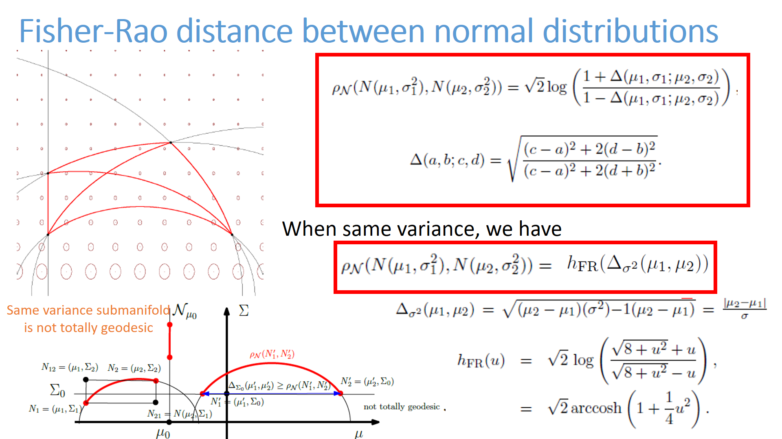
Upper plane
[Yoshizawa 1971]

Slide 7
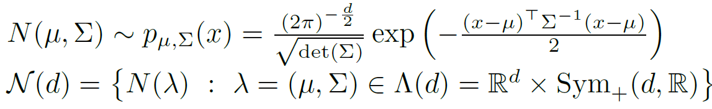
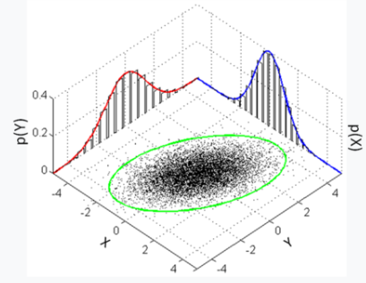

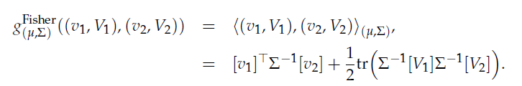
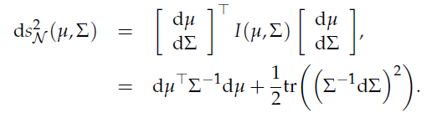
Fisher-Rao geometry: multivariate normals
Fisher information matrix (vector, matrix):
Fisher metric tensor:
v= vector space R^{d}
V=Symmetric matrix
vector space
Length element:
[Skovgaard 1984]
Non-constant sectional curvatures which can also be positive, not NPC space (d>1)

Slide 8


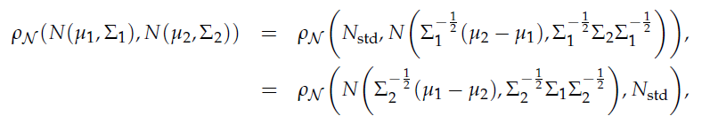
Invariance under action of the positive affine group
Length element/Rao distance is invariant under the action of the positive affine group (a,A):
Thus we may always consider one normal distribution is the standard normal distribution N_{std}
Matrix group:

Slide 9


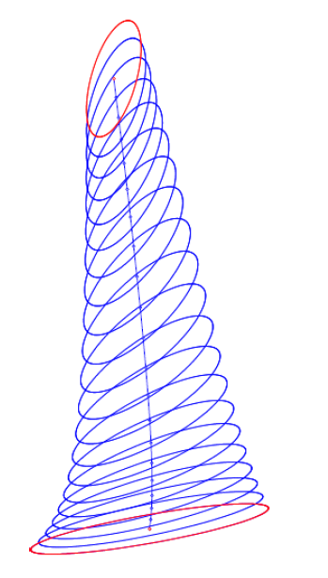
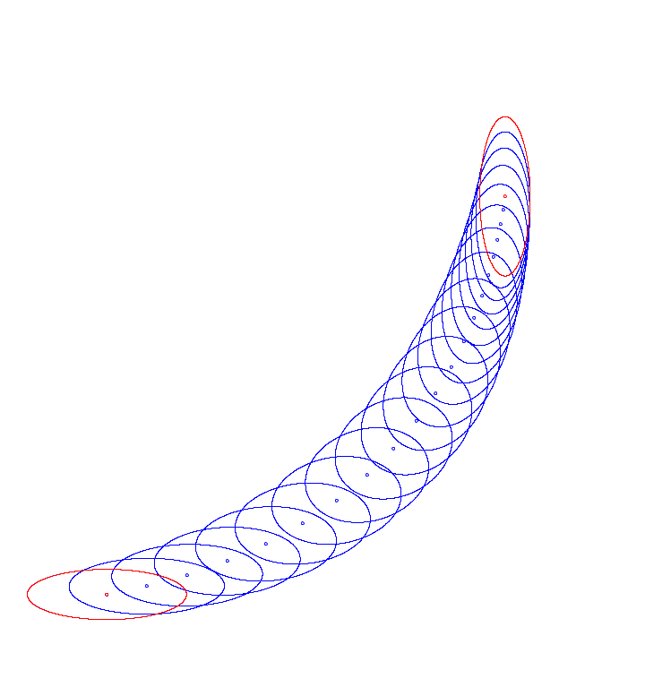
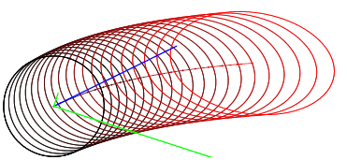
Geodesic equation
In general, geodesic wrt Levi-Civita connection
using (vector, Matrix) parameterization:
Second-order ODE:
Consider either initial value conditions or boundary value conditions of ODE
Once the geodesics are known, integrate length elements to get Rao distance
[Initial values]
[Boundary values]

Slide 10


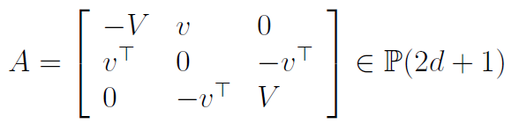



Geodesic solution: Initial value condition (N₀=N_{std}) indirect solution
Manipulate geodesic equation algebraically
natural parameterization of the exponential family of MVNs:
Consider the matrix exponential (a la "symmetric homogeneous space") of (2d+1)x(2d+1) matrices to solve geodesics with initial values
[Eriksen 1987]
Compute matrix exponential:
retrieve natural parameters
+ convert to ordinary parameterization
Notes:
$$
(v,V)\in T_{(\mu,\Sigma)}\in\bbR^d\times\Sym(d,\bbR)
$$
$$
A=\matrixthreethree{-V}{v}{0}{v^\top}{0}{-v^\top}{0}{-v^\top}{V}\in\mathbb{P}(2d+1)
$$
$$
\exp(tA)
$$
$$
\Xi(t)=[\exp(tA)]_{1:d,1:d}, \quad \xi(t)=[\exp(tA)]_{1:d,d+1}
$$
$$
\Sigma(t)=\Xi^{-1}(t),\quad \mu(t)=\Sigma(t)\xi(t)
$$

Slide 11


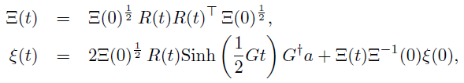


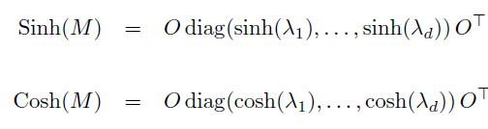
Fisher-Rao geodesics from multivariate normals with initial value conditions (direct solution)
Geodesic equation:
When initial value conditions are given, the geodesics are
known in closed-form using the natural parameters :
[Calvo & Oller 1991]
with
and matrix pseudo-inverse
and matrix hyperbolic functions
for M=
Notes:
The Fisher-Rao geodesic N(ξ(t),Ξ(t)) starting from the standard multivariate normal N(0,I) with initial value condition (a,B) can be expressed using the natural parameters and matrix hyperbolic functions Cosh and Sinh
👉https://www.mdpi.com/1099-4300/25/4/654
This is a result of Calvo and Oller from their beautiful paper:
Calvo, Miquel, and Josep Maria Oller. "An explicit solution of information geodesic equations for the multivariate normal model." Statistics & Risk Modeling 9.1-2 (1991): 119-138.

Slide 12



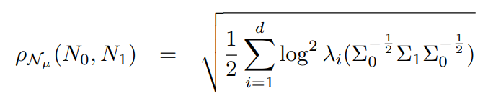
Special case: Centered multivariate normals Closed form geodesics and Fisher-Rao distances
Submanifold of MVNs with constant mean is totally geodesic
[James 1973]
Rao geodesics:
Rao distance:
Require to compute all eigenvalues (costly)
Because of sum of log² , ρ(P₁,P₂)=ρ(P₁⁻¹,P₂⁻¹) : invariant to matrix inversion

Slide 13






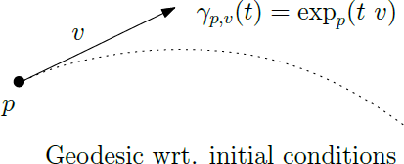



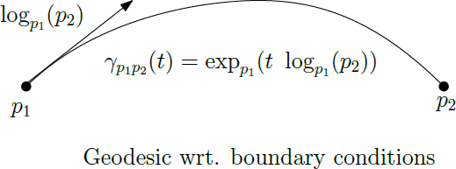
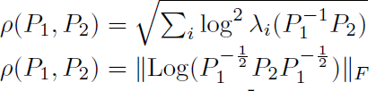
Riemanian geometry of the SPD cone (trace metric)
Trace metric:
related to Fisher information of centered normal/Wishart
Length element:
Geodesic equation:
Initial value
conditions:
Boundary value
conditions:
Rao's distance:

Slide 14
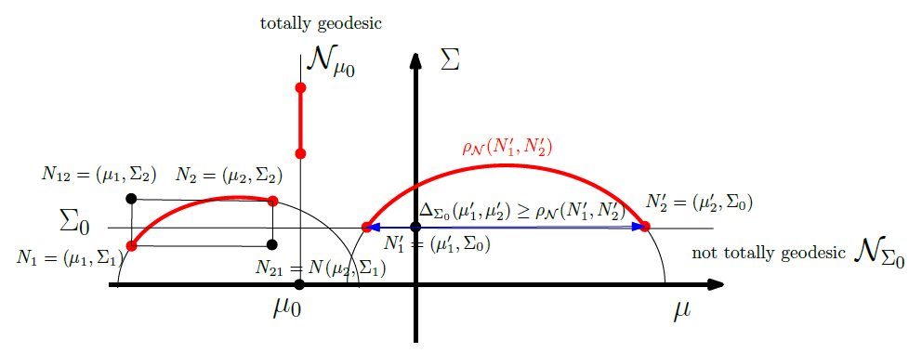
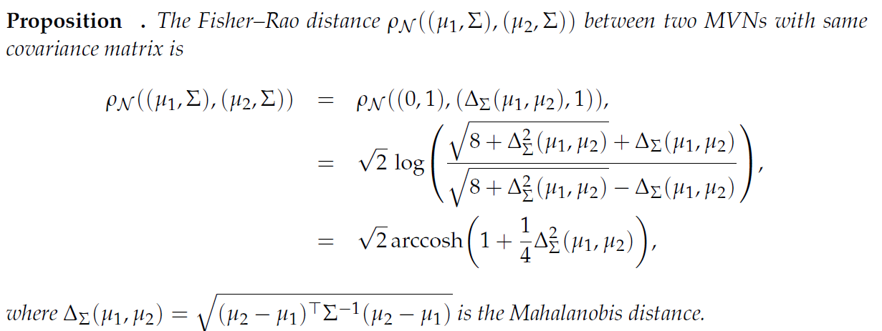
Submanifolds of constant covariance matrices
totally geodesics Nμ0
not totally geodesics N_{Σ0}

Slide 15
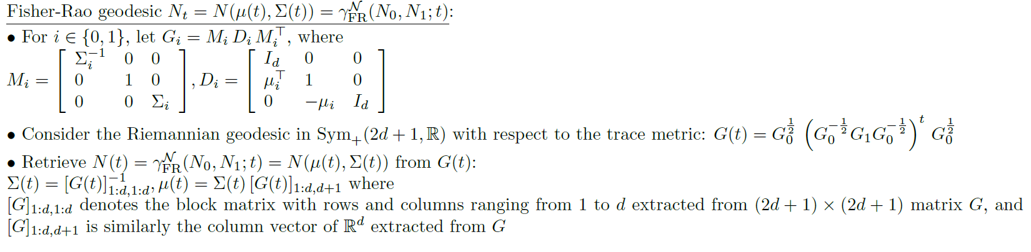
Fisher-Rao geodesics from multivariate normals with boundary value conditions in closed form
[Kobayashi 2023]
Ingredient: Riemannian submersion and MVN geodesics from horizontal geodesics
Get closed-form geodesics with boundary values
However, no closed-form Rao distance because of the integration of length element problem

Slide 16
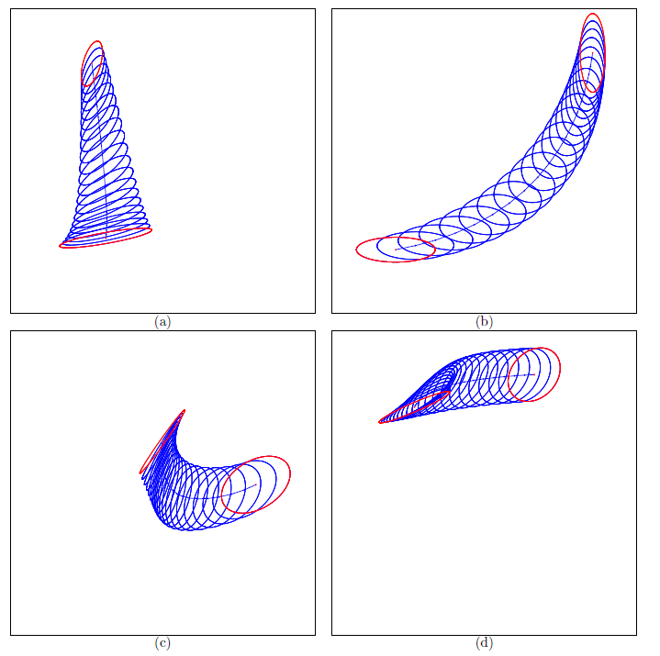

Slide 17



Fisher-Rao MVN distance: An upper bound
Geodesics with boundary conditions form 1d totally geodesic submanifolds
Cut the geodesics in many small parts using T+1 geodesic points
Upper bound for nearby points Rao distance by the square root of Jeffreys divergence (or any other f-divergence)
Infinitesimal Fisher-Rao distance:
[N. 2023]

Slide 18
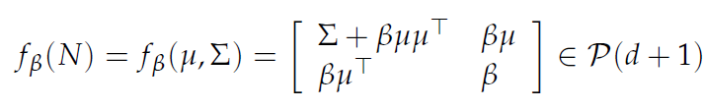
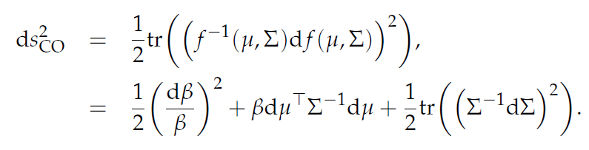

Diffeomorphic embeddings of MVN(d) onto SPD(d+1)
The diffeomorphisms {f_{β}} foliates the SPD cone P(d+1)
[Calvo & Oller 1990]
Using half trace metric in P(d+1), we get the following metrics on MVN(d):
β=1
When β=1 (constant), we thus get a Fisher isometric embedding of MVN(d) into SPD(d+1):

Slide 19
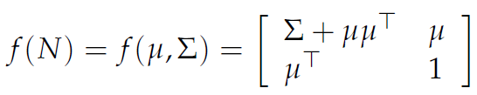
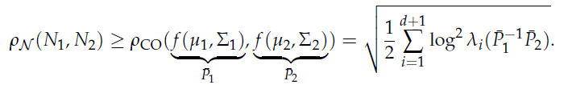
Fisher-Rao MVN distance: A lower bound
Embed isometrically the Gaussian manifold N(d) into a submanifold
of codimension 1 into the SPD cone of dimension d+1 (non-totally geodesic):
Use SPD geodesic in the (d+1)-dimensional cone:
SPD path is of length necessarily smaller than the MVN geodesic
in submanifold f(N). Thus get a lower bound on Rao distance:
[Calvo & Oller 1990]
Cut MVN geodesics into and apply lower bound piecewisely : Fine lower bound

Slide 20
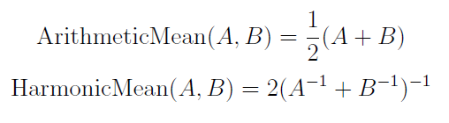

Fisher-Rao MVN geodesic: Numerical midpoint geodesic with quadratic convergence
Computing SPD geodesics points require all eigenvalues/eigenvectors:
For t=1/2, we can compute Σ_{1/2} with quadratic convergence (thus bypassing
eigendecomposition) as follows:
Matrix AHM mean:
A_{t+1}=ArithmeticMean(A_{t},B_{t})
B_{t+1}=HarmonicMean(A_{t},B_{t})
initialized with A₀=Σ₀ and B₀=Σ₁
Converge to the matrix geometric mean
[Nakamura 2012]

Slide 21
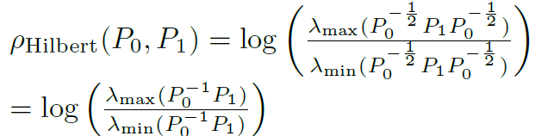
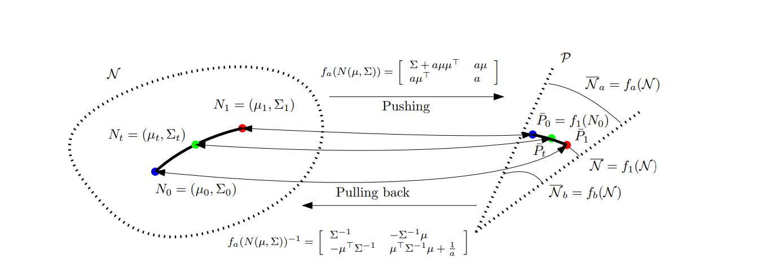
New fast distances between multivariate normals
Gaussian(d) manifold
SPD(d+1) cone

Slide 22
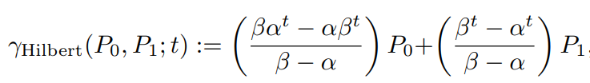
New fast distances between multivariate normals
Use Calvo & Oller isometric cone embedding f(μ,Σ)
In the cone, use Hilbert projective metric distance and LERP pregeodesics
Pullback the geodesics and distance into the Gaussian manifold
Projective metric on SPD
But proper metric on f(N)

Slide 23
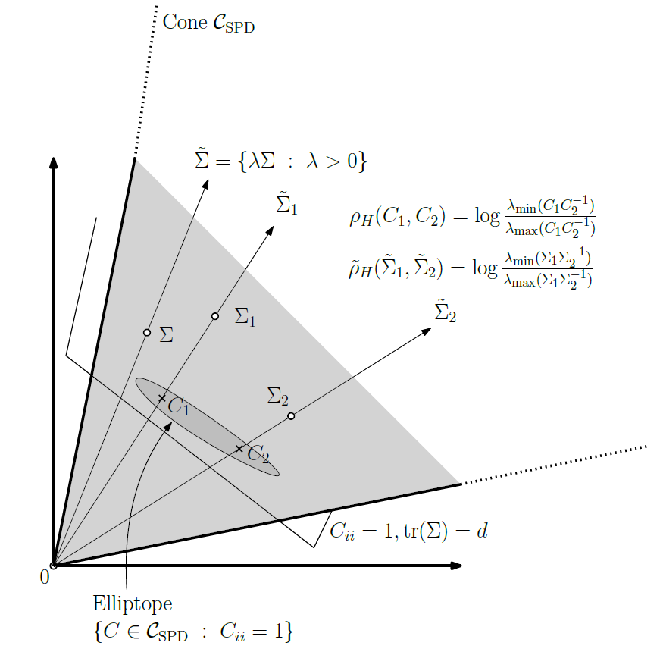
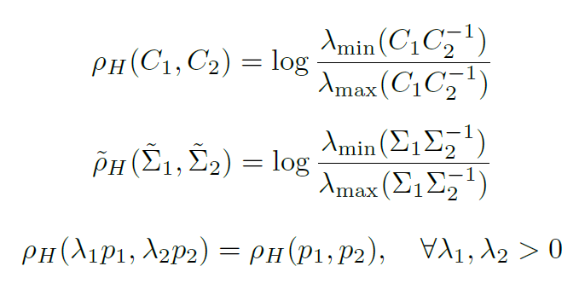
Hilbert projective metric distance in the SPD cone
Metric distance in the elliptope of correlation matrices
N. and Sun. "Clustering in Hilbert’s projective geometry:
The case studies of the probability simplex and the elliptope of correlation matrices."
Geometric structures of information (2019): 297-331.

Slide 24


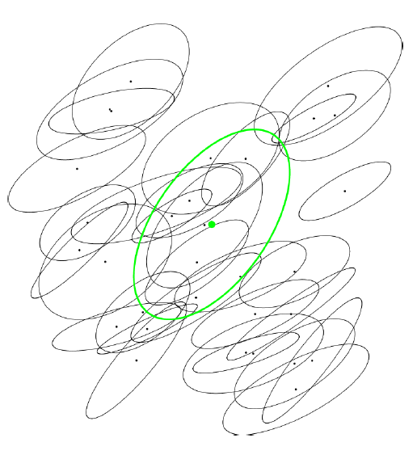
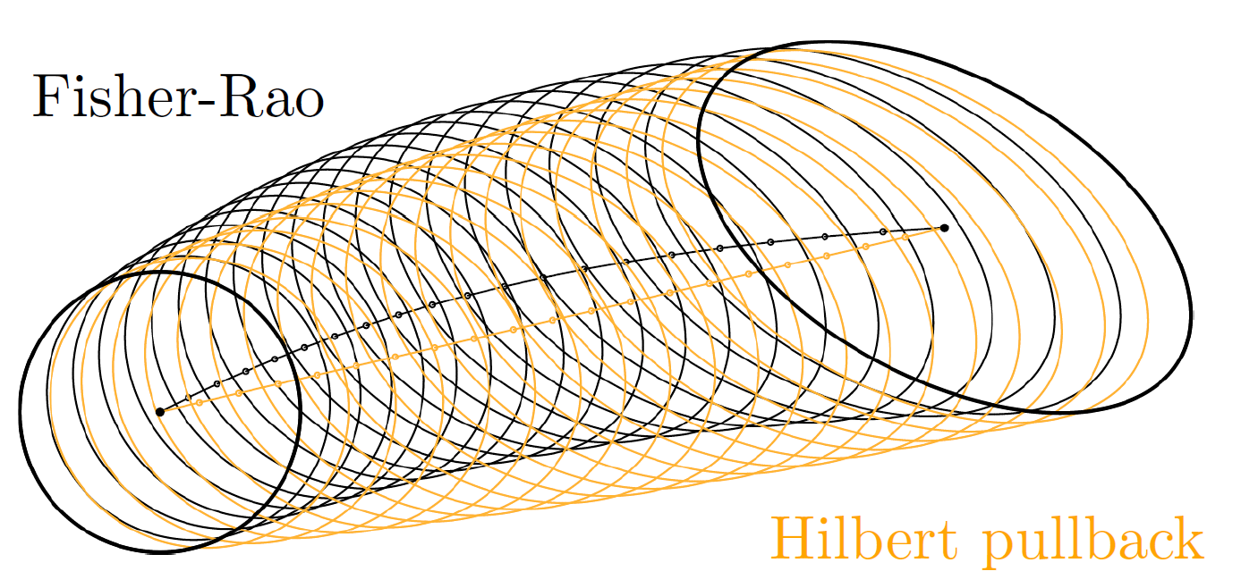
Pullback Hilbert distance/geodesics between MVNs
Only require to calculate extreme eigenvalues (eg., power method iteration)
Applications: Approximation of the smallest enclosing ball (SEB)
of a set of multivariate normals (quantization/clustering of Gaussian mixtures)

Slide 25
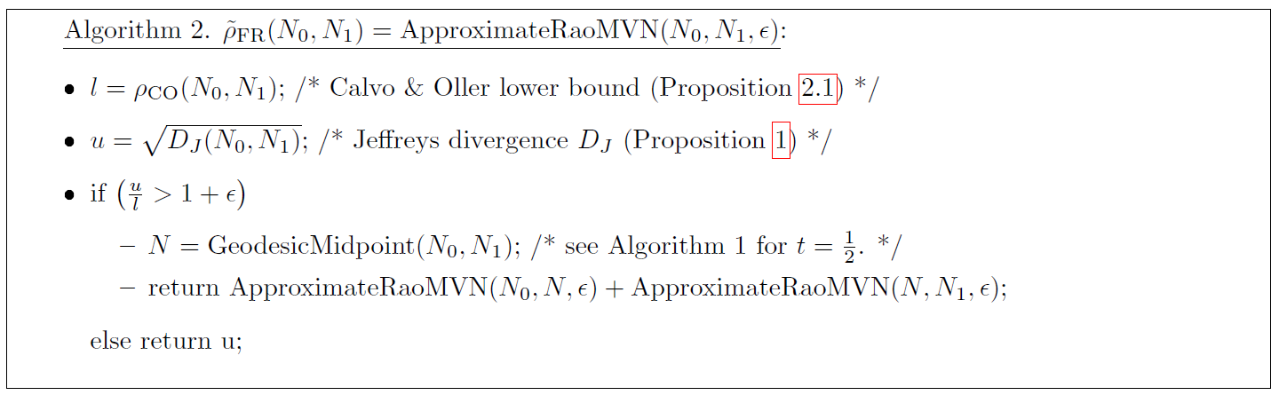
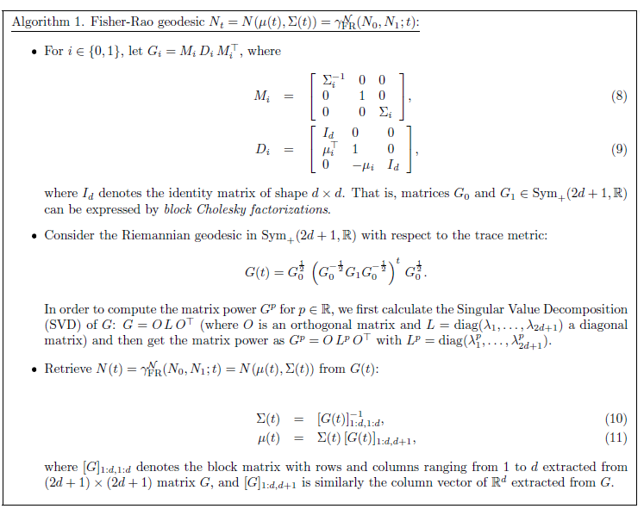



Summary: A (1+ε)-approximation of Rao's distance between multivariate normal distributions
A recursive algorithm

Slide 26
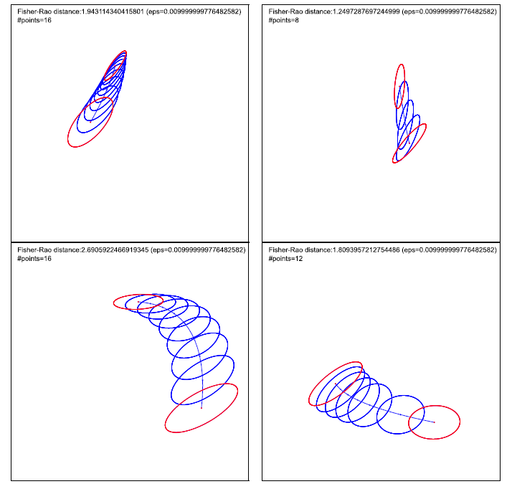

Slide 27
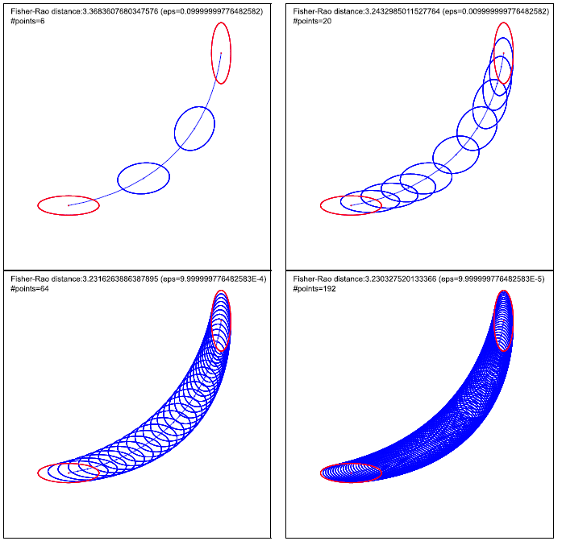

Slide 28
Summary and concluding remarks
Geodesics with initial values or boundary values are known in closed-form
Rao distance's lower bound using isometric embedding into SPD(d+1).
Thus get arbitrarily fine lower bounds using piecewise MVN Rao geodesics
Arbitrarily fine upper bound using square root of Jeffreys divergence
on piecewise MVN Rao geodesics
Pullback of SPD cone distance via Calvo & Oller isometric embedding:
Fast distance & geodesic requiring only extremal eigenvalues
Gaussian/MVN manifold is not NPC/Hadamard/CAT(0) because there
are some positive sectional curvatures. SPD cone is NPC.
Siegel considered a complex matrix metric which yields a NPC space
[Cabanes N, 2021]

Slide 29
References
James: The variance information manifold and the functions on it, Multivariate Analysis–III. Academic Press (1973)
Skovgaard: A Riemannian geometry of the multivariate normal model, Scandinavian journal of statistics (1984)
Eriksen: Geodesics connected with the Fisher metric on the multivariate normal manifold, Proceedings of the GST Workshop, Lancaster (1987)
Calvo and Oller: A distance between multivariate normal distributions based in an embedding into the Siegel group, Journal of multivariate analysis (1990)
Calvo and Oller: "An explicit solution of information geodesic equations for the multivariate normal model", Statistics & Risk Modeling (1991)
Kobayashi: Geodesics of multivariate normal distributions and a Toda lattice type Lax pair, arXiv:2304.12575 (2023)
Nielsen: A Simple Approximation Method for the Fisher–Rao Distance between Multivariate Normal Distributions, Entropy (2023)
Nielsen: Fisher-Rao and pullback Hilbert cone distances on the multivariate Gaussian manifold with applications to simplification and quantization of mixtures, ICML TAG-ML (2023)
Siegel: Symplectic geometry (1964)
Cabanes and Nielsen: Classification in the Siegel Space for Vectorial Autoregressive Data, GSI (2021)

Slide 30
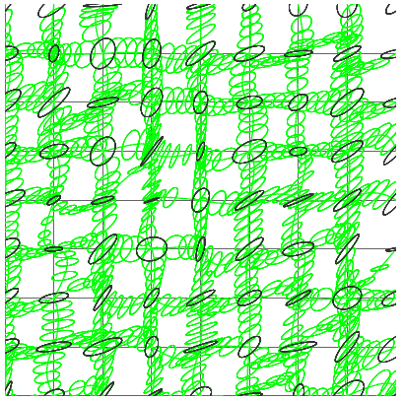
Thank you!
Open problem:
Closed-form formula for MVN Rao distance?

Slide 31
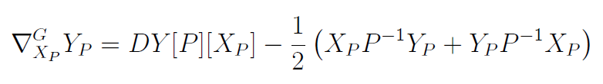


SPD Riemannian geometry wrt trace metric
Levi-Civita metric connection
Fréchet derivative
Geodesic arclength parameterization:
Notes:
https://en.wikipedia.org/wiki/Fr%C3%A9chet_derivative
functional derivative used widely in the calculus of variations.

Slide 32





Matrix Karcher centers as matrix means
Arithmetic weighted mean matrix
yields a ∇^{A-}geodesic with respect to metric (Euclidean)
Harmonic weighted mean matrix
yields a geodesic ∇^{H} with respect to metric
(isometric to g, Euclidean)
Geometric weighted mean matrix
yields a geodesic wrt metric (Non-positively curved)
(SPD, g^{G}, ∇^{A}, ∇^{H}) is a dually flat space, is ∇^{G} Levi-Civita connection
Notes:
"Classification of affine matrix means": arXiv:1208.5603
----
$$
A_\alpha(P,Q)=(1-\alpha)P+\alpha Q
$$
$$
g_P^A(X,Y)=\tr(X^\top Y)
$$
$$
H_\alpha(P,Q)=\left((1-\alpha)P^{-1}+\alpha Q^{-1}\right)^{-1}
$$
$$
g_P^H(X,Y)=\tr(P^{-2}XP^{-2}Y)
$$
$$
G_\alpha(P,Q)=P^{\frac{1}{2}} \,\left(P^{-\frac{1}{2}}\, Q\, P^{-\frac{1}{2}} \right)^\alpha\, P^{\frac{1}{2}}
$$
$$
g_P^G(X,Y)=\tr(P^{-1}XP^{-1}Y)
$$

Slide 33
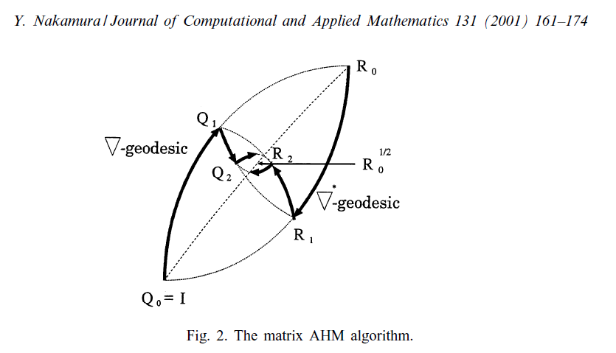

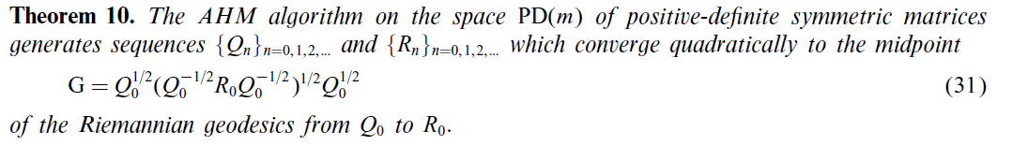
Notes:
Algorithms associated with arithmetic, geometric and harmonic means and integrable systems
Symmetrized Bregman centroid from AGH or Riemannian centroid?

Slide 34


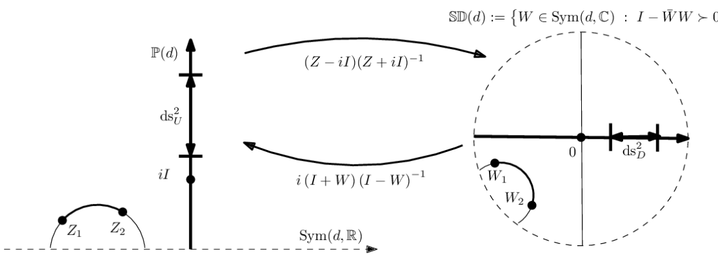
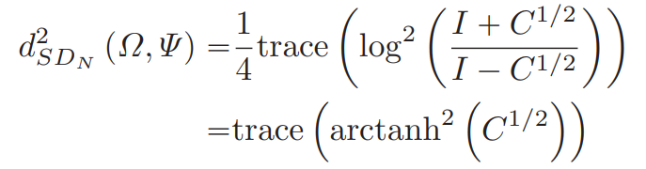


Siegel upper/disk space: Non-Positive Curvature (NPC)
Siegel disk:
Siegel metric/line element:
Siegel disk distance:
Siegel geodesic:
:

Slide 35
Summary: A (1+ε)-approximation of Rao's distance between multivariate normal distributions
ApproxRaoDistMVN(N0,N1,ε>0):
LB=CalvoOllerLowerBound(N0,N1);
UB=SqrtJeffreysUpperBound(N0,N1);
if (UB/LB>1+ε)
{/* N is midpoint geodesic */
N=GeodesicMidpoint(N0,N1);
return ApproxRaoDistMVN(N0,N,ε)+ApproxRaoDistMVN(N,N1,ε);}
else
return UB;
Instead of exact midpoint, may use the matrix arithmetic-harmonic mean (quadratic convergence)

